Slide 1
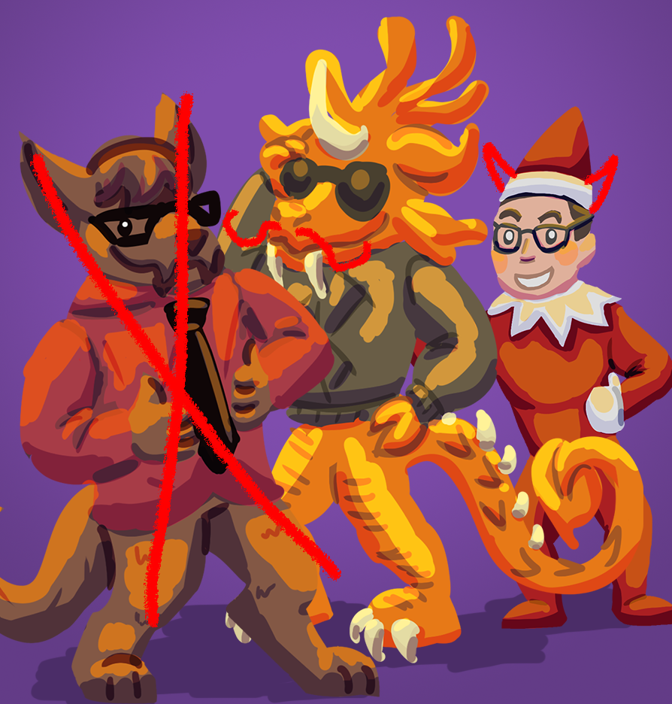
Just Wungus & Jimmy
Jordan Cattelona
Leo Bunyea
Casual Game Treatment

Slide 2
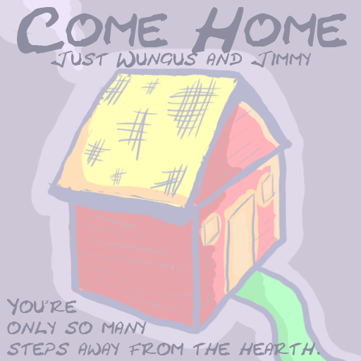

Slide 3
Key Features
Sliding block puzzle mechanics with a twist
Instead of unjumbling an image, you’re connecting a path between two beads
Different bead colors have different behaviors
Diagonal
Jumping
Soothing, pastel color palette
Satisfying level completion animations
Sparse, ambient music and sound effects
Thirteen levels
Notes:
Jordan

Slide 4

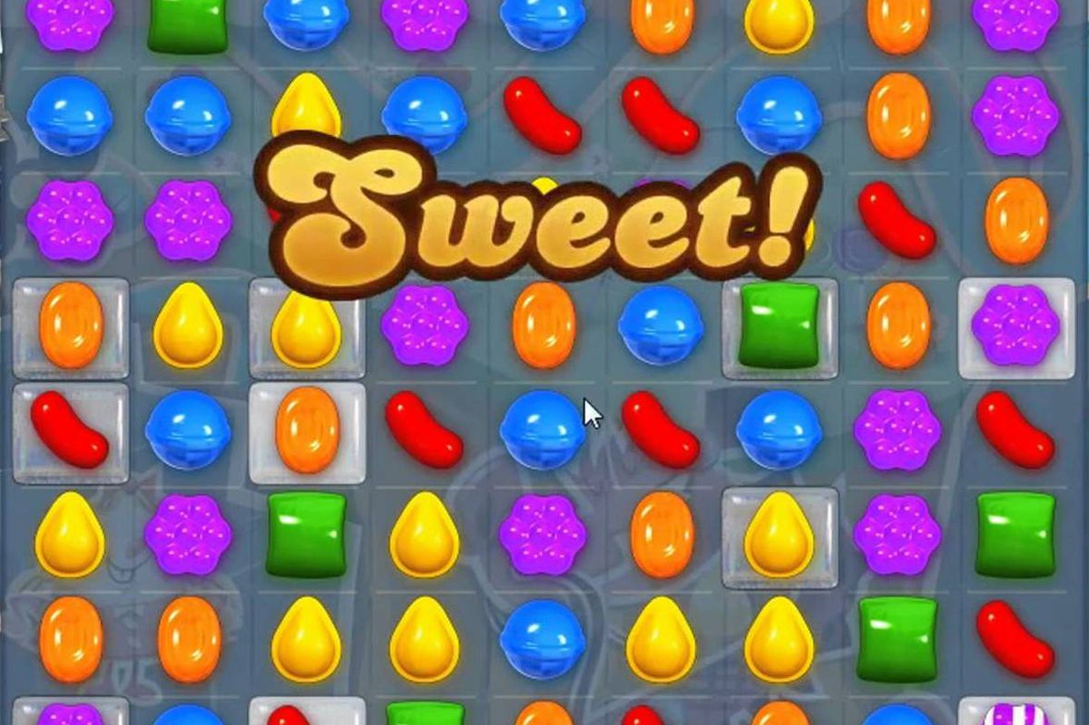
Target Audience
Women between the ages of 35 and 50
Notes:
Leo

Slide 5
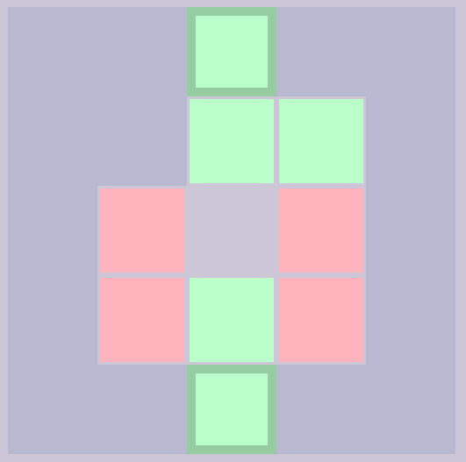
Play Description
When players begin a level, they’re met with a grid of beads. There is a start and end bead, wall beads, and then a collection of colored beads. This collection includes a “hole” bead which signifies the space available for sliding. The colors of the start and end beads indicate what color the path created by the player must be.
Notes:
Leo

Slide 6
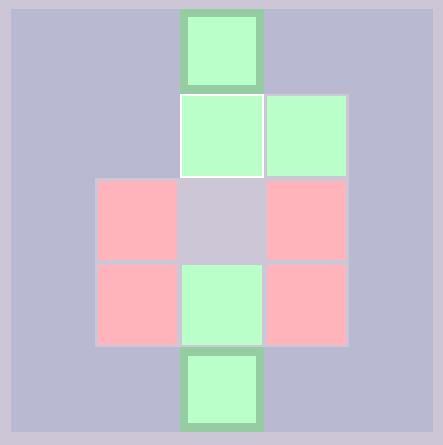
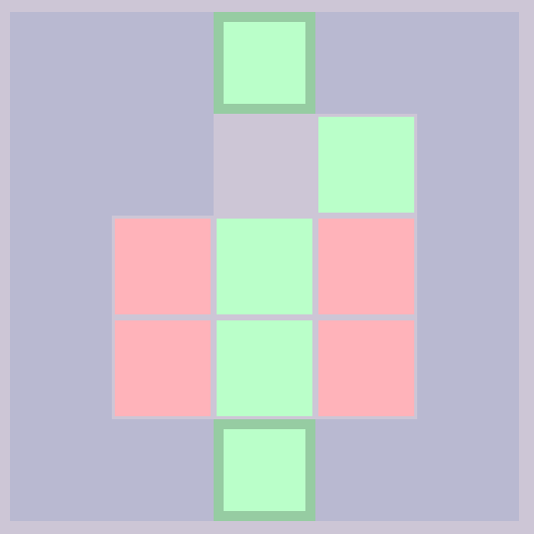
Play Description
Players tap a bead around the “hole bead” to indicate that’s the bead they want to slide. They then tap the “hole” bead to actually move it.
Notes:
Leo

Slide 7
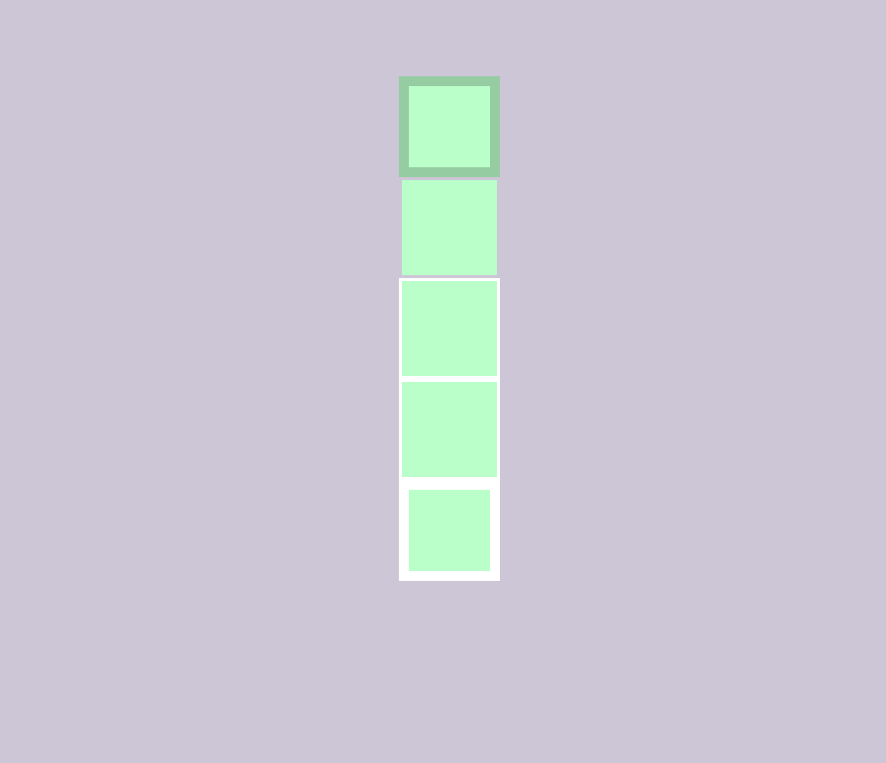
Play Description
When players successfully create path of the same colored beads from the start to the finish bead, a cascading animation plays of the beads being sequentially highlighted, mimicking a traveled path.
Notes:
Leo

Slide 8


General Experience Goals
For players to feel clever and have a sense of accomplishment upon completing a puzzle
For players to feel soothed, relaxed, and centered
Notes:
Jordan

Slide 9
Measurable Experience Goals
For at least 80% of players to complete all levels
For players to spend no more than three minutes on any level
For players to solve levels in a certain number of moves
This varies depending on the level
Notes:
Leo

Slide 10
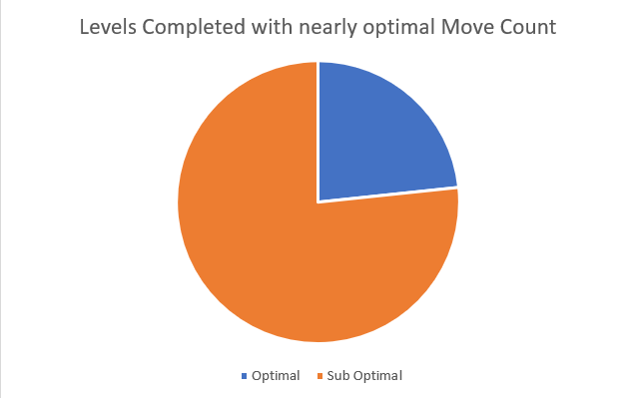
Analytics Data
Notes:
Analytics Data
1st Optimal: 1
2nd Optimal: 2
3rd Optimal: 5
4th Optimal: 10
5th Optimal: 19
Measured two different patterns of behavior when playing the first level
Either people picked understood what they had to do right away, or it took them a long time to figure out the mechanic of the game and make their first move. Once the first move was made however, the player completed the level almost right away in most cases
Leo

Slide 11
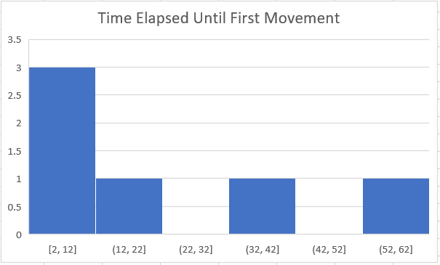
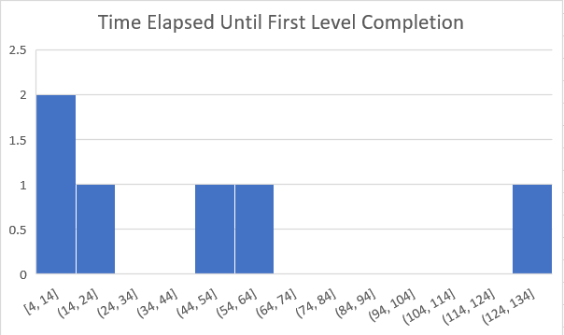
Analytics Data
Notes:
Analytics Data
1st Optimal: 1
2nd Optimal: 2
3rd Optimal: 5
4th Optimal: 10
5th Optimal: 19
Measured two different patterns of behavior when playing the first level
Either people picked understood what they had to do right away, or it took them a long time to figure out the mechanic of the game and make their first move. Once the first move was made however, the player completed the level almost right away in most cases

Slide 12
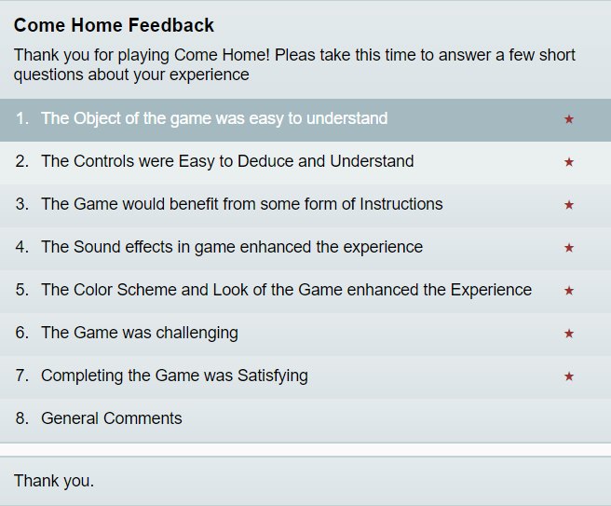
Playtesting & Survey Feedback
Notes:
Jordan
Animation Tutorials
Different colored beads,

Slide 13
Critique Feedback
Positive feedback about color scheme and sound design
“Charming,” “cute,” “relaxing”
Would benefit from background ambience/music
Would benefit from thicker start/end bead borders
Theme of “going home” was not understood
Notes:
Leo

Slide 14
Any questions?

