Slide 1
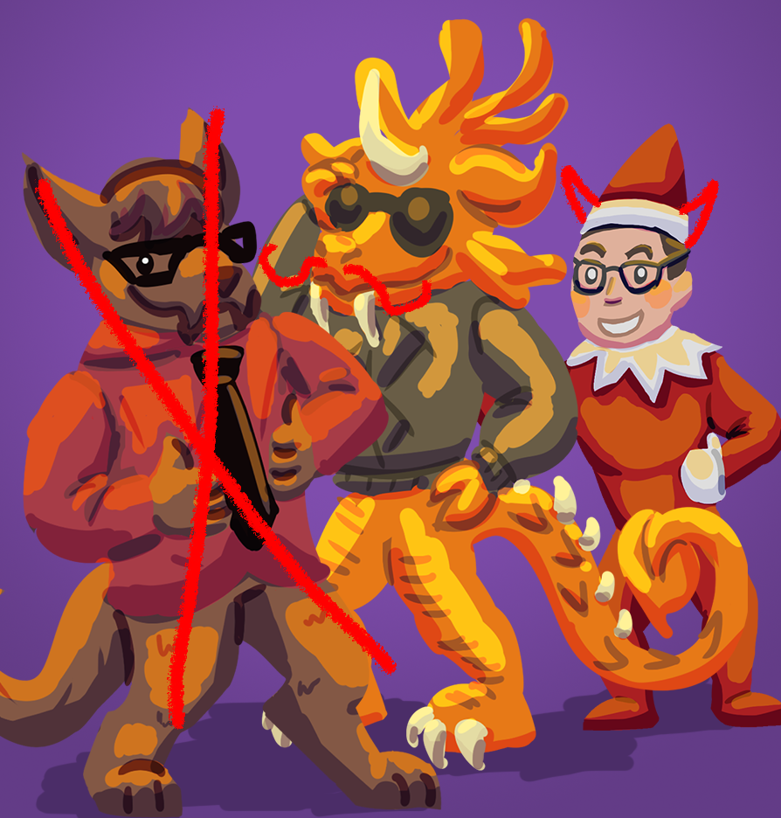
Just Wungus & Jimmy
Jordan Cattelona
Leo Bunyea
Casual Game Treatment

Slide 2
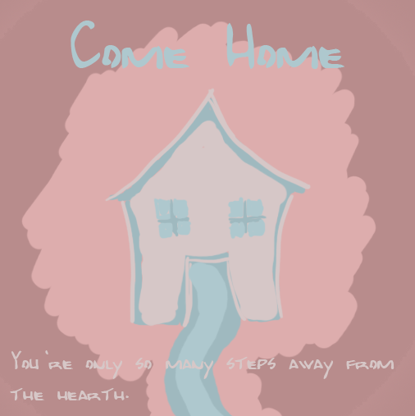
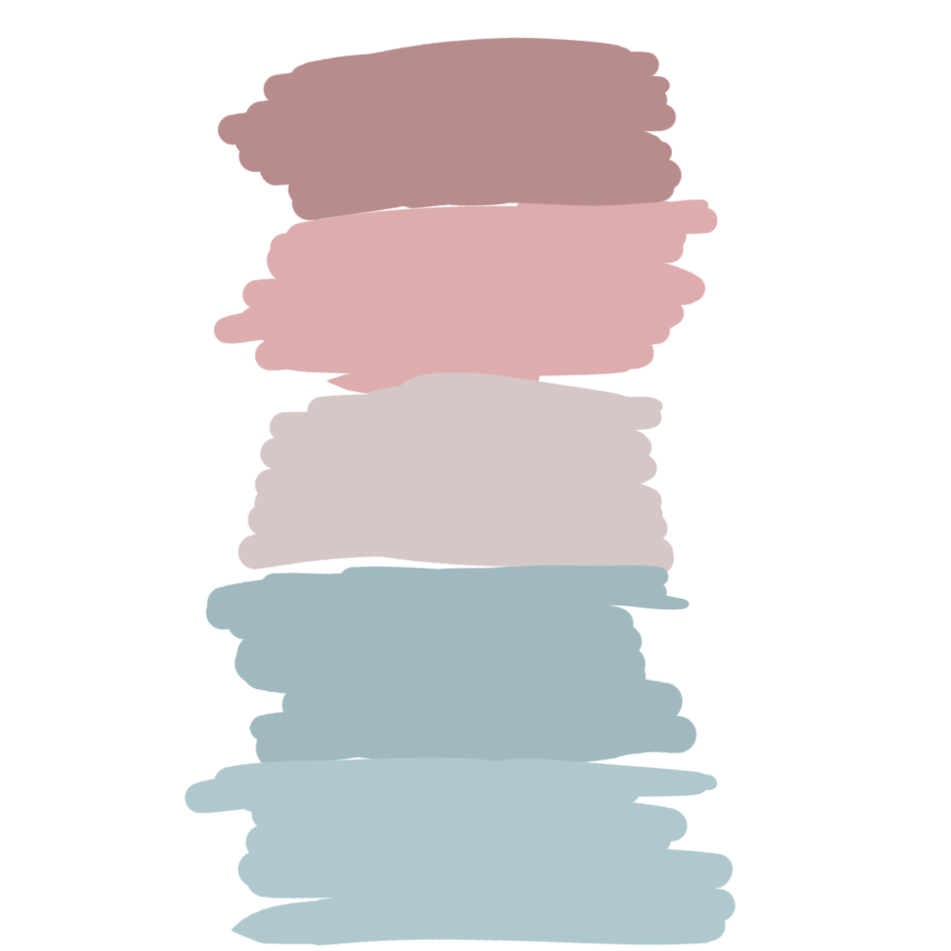

Slide 3
Key Features
Sliding block puzzle mechanics with a twist
Instead of unjumbling an image, you’re connecting a path between two beads
Soothing, pastel color palette
Satisfying level completion animations
Sparse, ambient music and sound effects which are suggestive of environment
Five levels

Slide 4

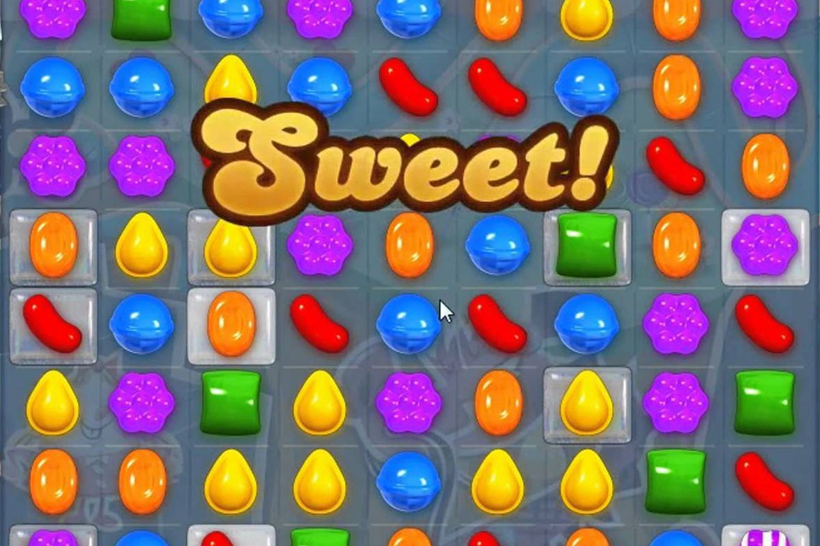
Target Audience
Women between the ages of 35 and 50

Slide 5


General Experience Goals
For players to feel clever and have a sense of accomplishment upon completing a puzzle
For players to feel soothed, relaxed, and centered

Slide 6
Measurable Experience Goals
For at least 80% of players to complete all levels
For players to spend no more than three minutes on any level
For players to solve levels in a certain number of moves
This varies depending on the level

Slide 7
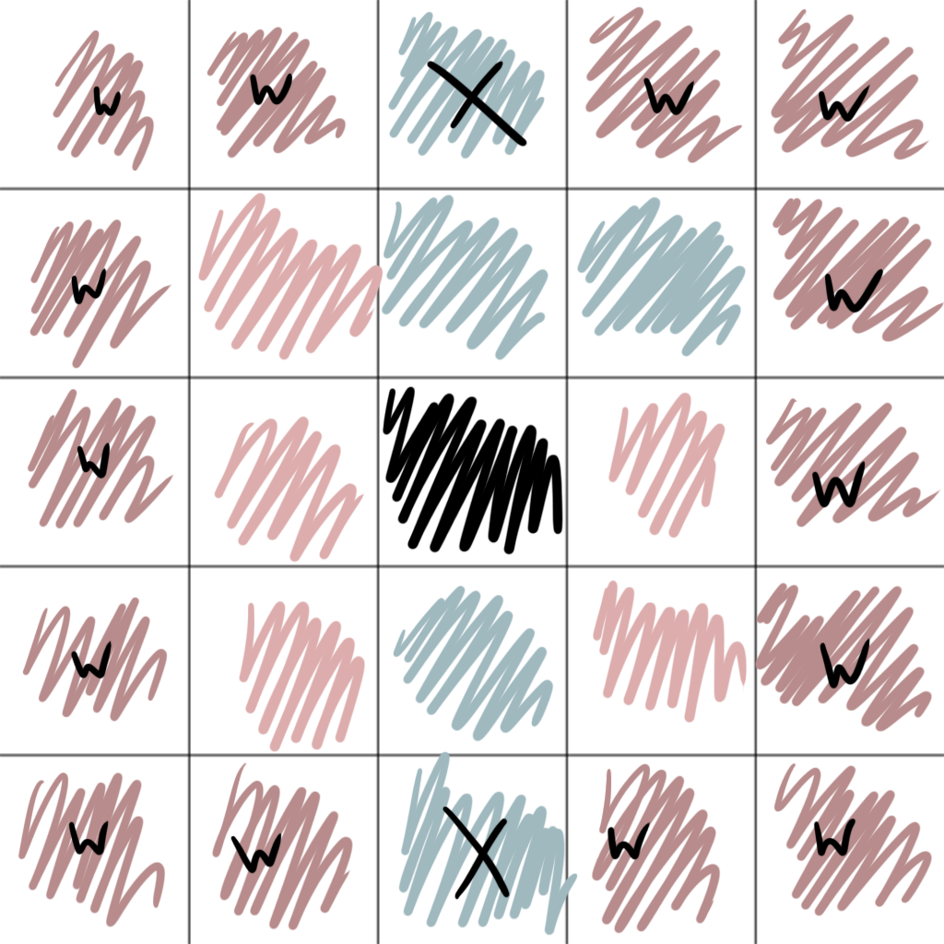
Play Description
When players begin a level, they’re met with a grid of beads. There is a start and end bead, wall beads, and then a collection of colored beads. This collection includes a “hole” bead which signifies the space available for sliding. The colors of the start and end beads indicate what color the path created by the player must be.

Slide 8
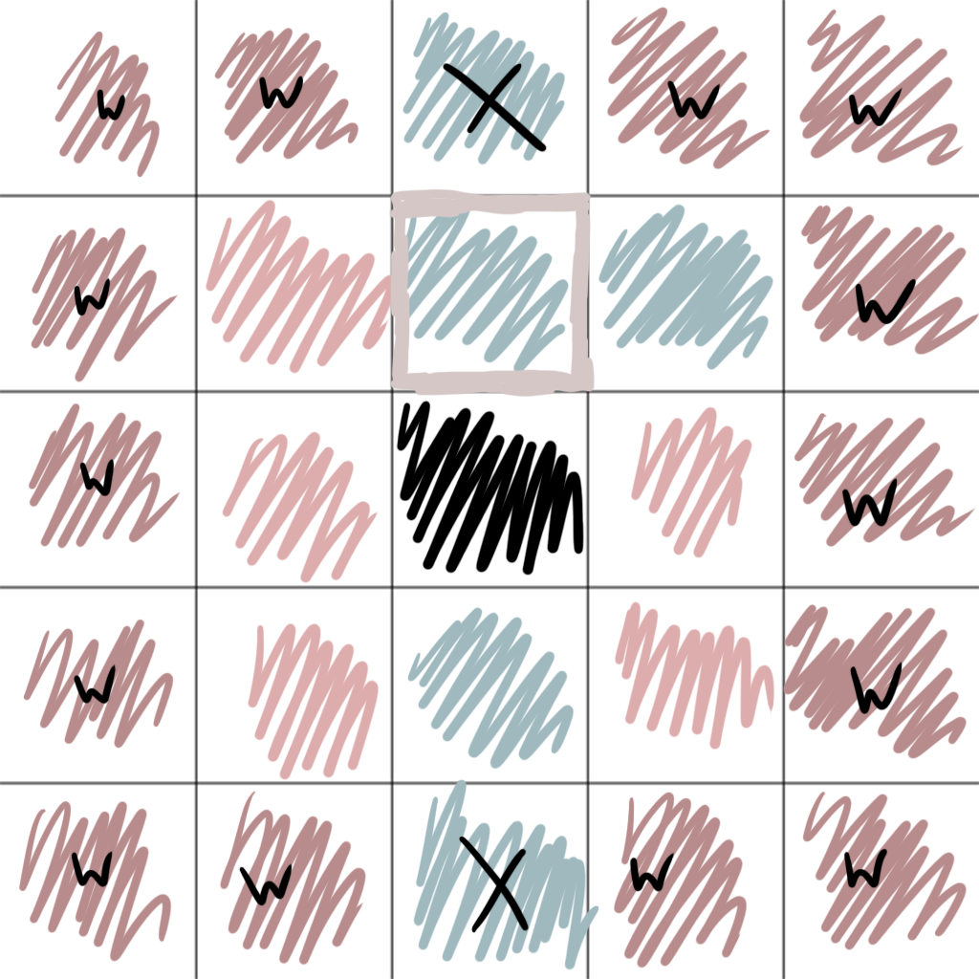
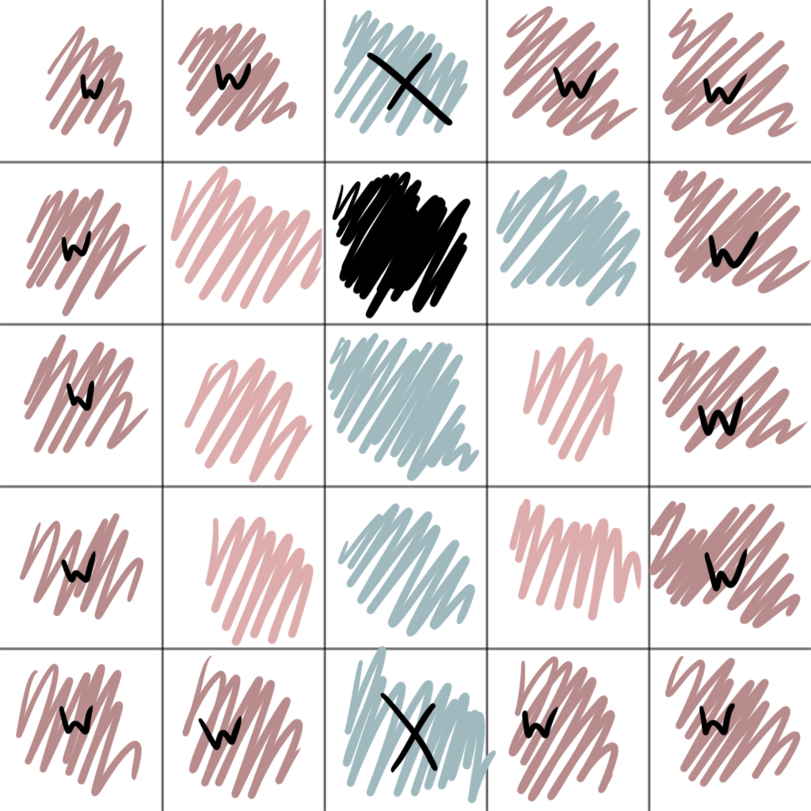
Play Description
Players tap a bead around the “hole bead” to indicate that’s the bead they want to slide. They then tap the “hole” bead to actually move it.

Slide 9
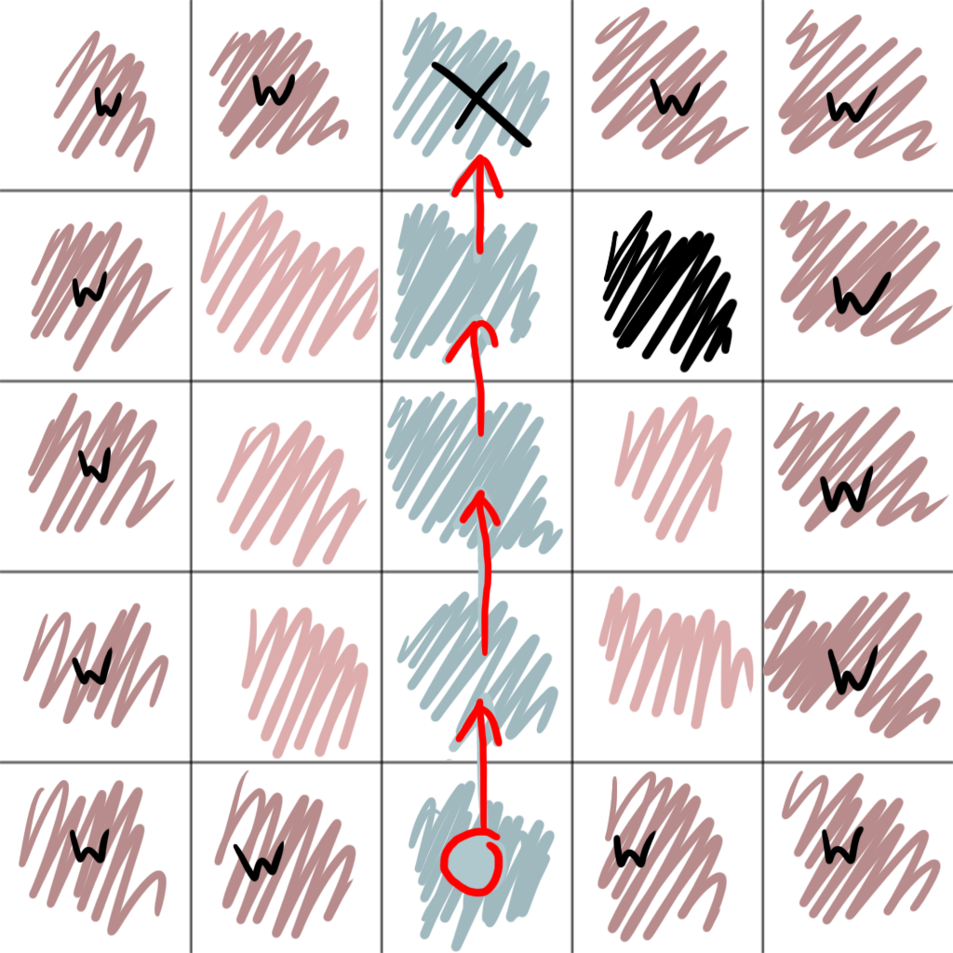
Play Description
When players successfully create path of the same colored beads from the start to the finish bead, a cascading animation plays of an entity/person traveling along it.

Slide 10
Any questions?

