Slide 1
EOS AI Trainer
Enhancing Inclusivity in Manufacturing
Notes:
This presentation was automatically generated by PowerPoint Copilot based on content found in this document: https://1drv.ms/w/c/58d20147a645d1c1/Ed3FZcrrtDRJlx-kyBYry_wBlrh6EbjhPccXVJ4Zai-56g?e=a7VzlK AI-generated content may be incorrect.

Slide 2
Agenda
Introduction
Goals
Project Description
Trainer Administration Portal
Used Tools
Cloud Architecture
Demo
Trainer Station
Conclusion
Notes:
Agenda * Introduction * Overview of EOS AI Trainer * Importance of Inclusivity and Accessibility in Manufacturing * Goals * Innovation in Assistive Technology * Inclusion and Equality * Project Description * Enhanced Assembly Workspace * Training Process and Interaction * Training Station Diagram * Trainer Administration Portal * Web Application for Managing Workouts * Workout Selection and Management * Filtering Workouts * Configuration and Administration * Used Tools * Cloud Architecture * Demo * Authentication and Dashboard * Current Workout Management * Trainer Administration Portal Overview * Trainer Station * 3D Printed Pieces for Assembly Simulation * Guidance and Safety Recommendations * Step-by-Step Training and Validation * Graphical User Interface for Feedback * Integration with Large Language Model (LLM) * Conclusion

Slide 3

Overview of EOS AI Trainer
AI Enhanced Space for Supported Employment Coaches
Provides interactive trainings
Offers information for visually impaired individuals
Powered by Microsoft Azure AI Services
Utilizes advanced AI technology
Ensures reliable cloud infrastructure
Notes:
Eos is an AI-enhanced space designed to assist supported employment coaches. It offers interactive training and information for visually impaired individuals, powered by Microsoft Azure AI Services and reliable cloud infrastructure. Original Content: 🤖 Eos - Enhanced Orienting Space - AI enhanced space to help supported employment coaches to provide interactive trainings and information for visually impared individuals, enhanced by Microsoft Azure AI Services and cloud infraestructure.

Slide 4

Importance of Inclusivity and Accessibility in Manufacturing
The manufacturing industry plays a crucial role in the field of supported employment, offering a variety of job opportunities that are instrumental in fostering inclusivity. By actively helping visually impaired individuals integrate into the workforce, manufacturing companies not only enhance their own diversity but also contribute to broader economic growth.
This inclusive approach ensures that all individuals, regardless of their disabilities, can participate in meaningful and productive work. As a result, companies benefit from a diverse talent pool, while visually impaired workers gain independence and a sense of accomplishment. Moreover, this inclusivity drives innovation and productivity, promoting a more resilient and dynamic economy.
Notes:
Our software is revolutionizing manufacturing by focusing on inclusivity and accessibility for visually impaired individuals. By integrating LLM, voice recognition, and custom vision technologies, we are creating a more inclusive and efficient work environment. Original Content: In the ever-evolving landscape of manufacturing, inclusivity and accessibility and Supported employment are paramount. Our software is at the forefront of this movement, designed specifically to revolutionize the way visually impaired individuals work at manufacturing assembly sites. By integrating LLM, advanced voice recognition and custom vision technologies, we are breaking new ground in creating a more inclusive and efficient work environment.

Slide 5

Inclusion and Equality
Our Goals:
Creating an Inclusive Workplace
Focus on visually impaired individuals
Ensuring equal opportunities
Opportunities to Contribute
Encouraging participation in manufacturing roles
Supporting career growth and excellence
Notes:
Our main objective is to foster an inclusive environment where visually impaired individuals can thrive and have equal opportunities in manufacturing roles. Original Content: 🟢 Inclusion and Equality: Our primary goal is to create a more inclusive workplace where visually impaired individuals have equal opportunities to contribute and excel in manufacturing roles.

Slide 6
Enhanced Assembly Workspace
Purpose of the Workspace
Guides individuals in receiving appropriate training
Focuses on assembling manufactured products
Demonstration Scenario
Simulates an automotive manufacturing assembly site
User Setup
User sits in front of a desk with necessary pieces
Physical action button in front of the individual
Camera System
Camera system at the top of the desktop
Points to the workspace covering the overhead plane
Notes:
The enhanced assembly workspace guides individuals in training for assembling manufactured products. It simulates an automotive manufacturing site. Users sit at a desk with necessary pieces and a physical action button. A camera system covers the workspace overhead. Original Content: Enhanced Assembly Workspace: This area will help and guide the individual to receive the appropriate training on how to assemble a manufactured product. (For this demonstration we will simulate an automotive manufacturing assembly site.) The user sits in front of a desk with the necessary pieces to complete the assembly, in front of the individual there is a physical action button. At the top of the desktop there is a camera system pointing to the workspace covering the overhead plane.

Slide 7
Training Process and Interaction
Natural Conversation Techniques
EOS provides descriptions of each piece
Utilizes text to speech services
Step-by-Step Assembly Guidance
Guides user through precise assembly steps
User places piece on validation space after each step
Interaction through action button triggers Vision Validation
Interactive Agent with LLMs
Provides information on current training
Explains end goal of manufactured pieces
Tracks current progress
Notes:
EOS guides users through assembly with natural conversation and text to speech. Users validate each step using Vision Validation. EOS also provides training information and tracks progress. Original Content: Once the training starts EOS will provide the description of each piece to the user by implementing natural conversation techniques and text to speech services. EOS will guide the user through the precise steps on the assembly, after each step on the assembly user will be required to place the piece on the validation space and interact with the system through the action button, this will trigger the Vision Validation, which will validate the correct progress of the assembly and enable the next step description and guidance. Additionally, EOS will function as an interactive agent enhanced with LLM’s to provide the user with information regarding the current training, the end goal of manufactured pieces, the industry, tracking current progress, among other utilities.

Slide 8
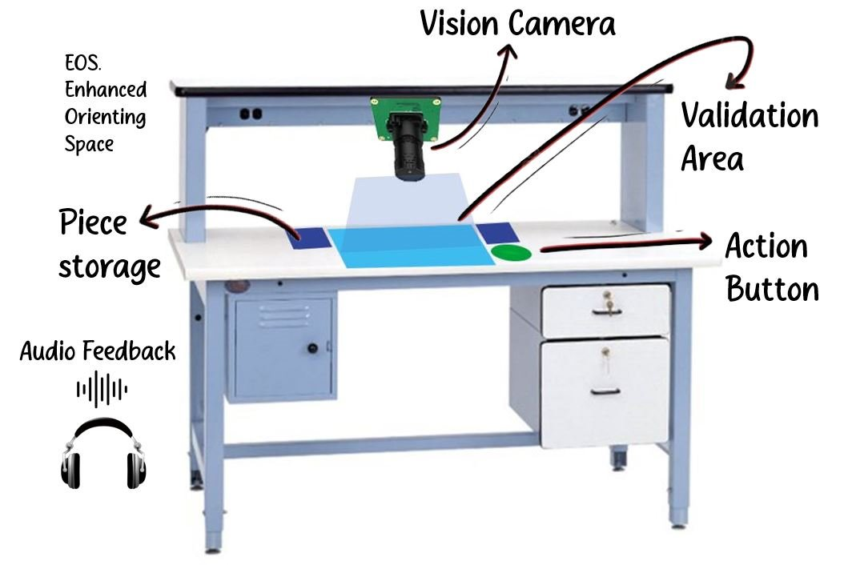
Training Station Diagram
To illustrate this concept is the following diagram, which describes the key elements of the training station, it’s important to highlight that the user will be receiving audio feedback at all moments through the usage of headphones or speakers.
Key Components:
Vision Camera: Enables custom vision validation of the assembly
Piece Storage: Fixed site where the user can locate the assembly individual parts
Action Button: Single Action button to interact with the system
Validation Area: Fixed space where the user locates the assembly for validation.
Notes:
The web application includes a login for authentication, leading to a dashboard. The dashboard displays created workouts, their progress, and execution status. Users can start new workouts and view the current one running. Original Content: The web application for managing workouts consists of a login and a dashboard, which displays the workouts that have been created, their progress, and execution status. You can also start a new workout and view the one currently running. First you must authenticate with a login, which will take you to the administration dashboard:

Slide 9
Trainer Administration Portal Overview
Trainer administration portal
Notes:
The Trainer Administration Portal is designed for trainers to manage their administrative tasks efficiently. Original Content: Trainer administration portal

Slide 10
Web Application for Managing Workouts
Login Authentication
Access to administration dashboard
Dashboard Features
Displays created workouts
Shows progress and execution status
Starting New Workouts
Option to initiate a new workout
Viewing Current Workouts
View the workout currently running
Notes:
Our software is transforming manufacturing by prioritizing inclusivity and accessibility for visually impaired workers. By integrating LLM, advanced voice recognition, and custom vision technologies, we are creating a more efficient and inclusive work environment. Original Content: In the ever-evolving landscape of manufacturing, inclusivity and accessibility and Supported employment are paramount. Our software is at the forefront of this movement, designed specifically to revolutionize the way visually impaired individuals work at manufacturing assembly sites. By integrating LLM, advanced voice recognition and custom vision technologies, we are breaking new ground in creating a more inclusive and efficient work environment.

Slide 11
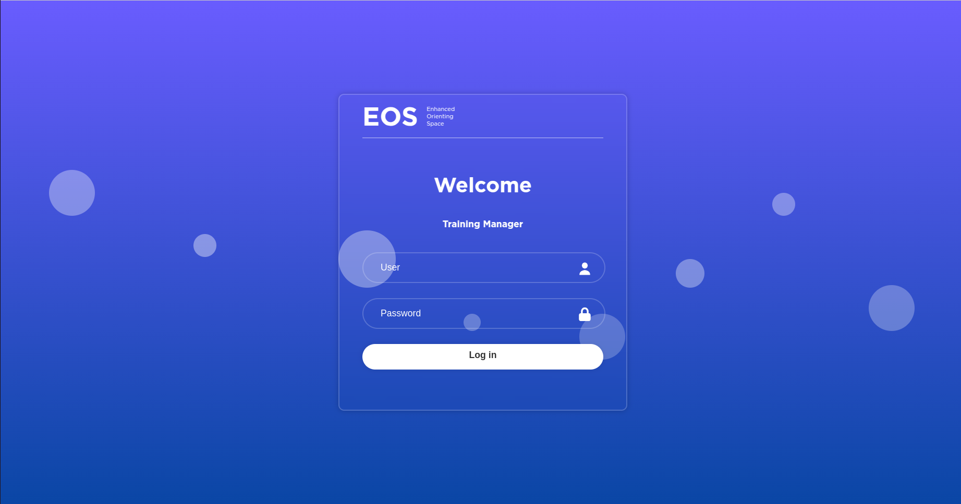
Authentication and Dashboard
Notes:
To access the administration dashboard, you must first authenticate with a login. Original Content: First you must authenticate with a login, which will take you to the administration dashboard:

Slide 12
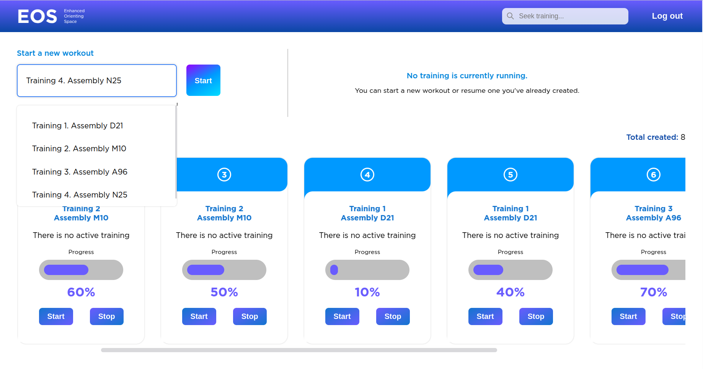
Workout Selection and Management
Selecting a New Workout
Only start if no other workout is running
Viewing Current Workout
Check the status of the ongoing workout
Option to stop the current workout
Managing Created Workouts
View information of each workout
Start or stop any workout from the list
Notes:
You can select a new workout if no other workout is running. View and stop the current workout. Manage created workouts by viewing their information and starting or stopping them. Original Content: You can select a new workout, which should only be started if no other workout is currently running. You can view the current workout and stop it. In the list of created workouts, you can view their information and start or stop them.

Slide 13
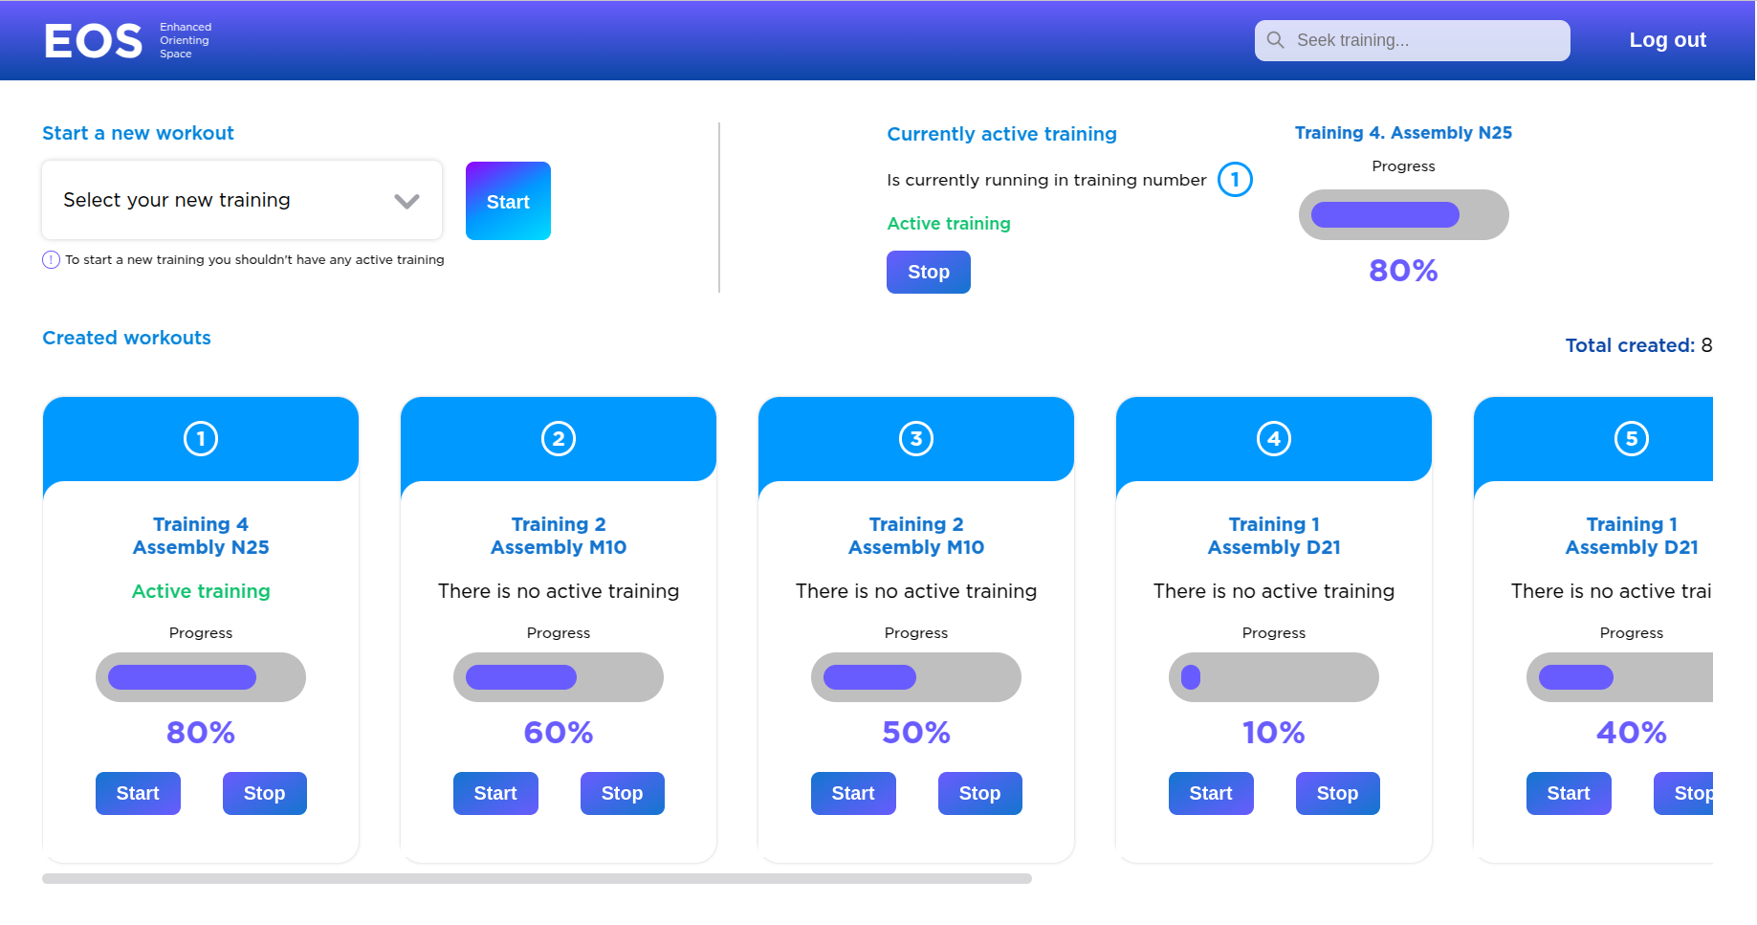
Current Workout Management
Current Workout
View the current workout
Stop the current workout
Created Workouts
View information of created workouts
Start or stop created workouts
Notes:
You can manage your workouts by viewing and stopping the current workout. Additionally, you can view information and start or stop any of the created workouts. Original Content: You can view the current workout and stop it. In the list of created workouts, you can view their information and start or stop them.

Slide 14
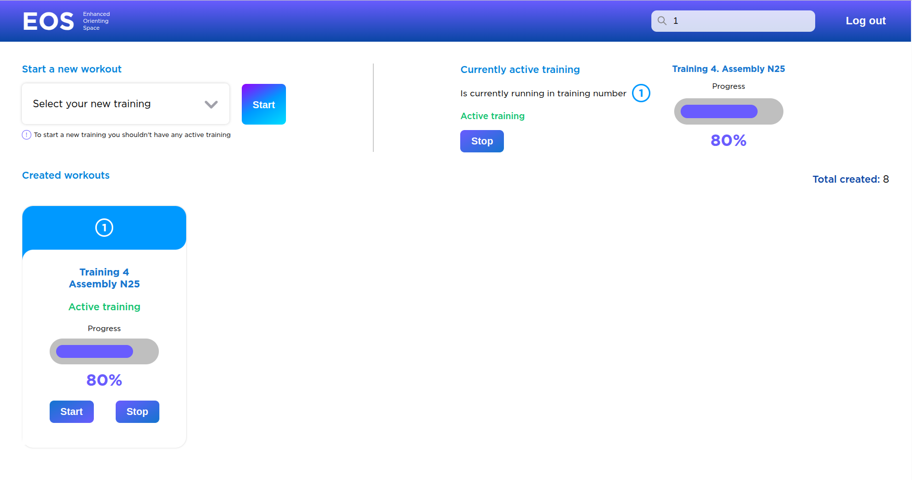
Filtering Workouts
Filter by Workout Number
Example: 1
Filter by Workout Sequence
Example: train 2
Filter by Workout Name
Example: Assembly A96
Notes:
You can filter the workout list by the workout number, sequence, or name. For instance, you can filter by number like '1', by sequence like 'train 2', or by name like 'Assembly A96'. Original Content: In the following three images you can see that the list of workouts can be filtered by: The number of the workout created (example: 1). The number of the workout (example: "train 2"). The name of the workout (example: Assembly A96).

Slide 15
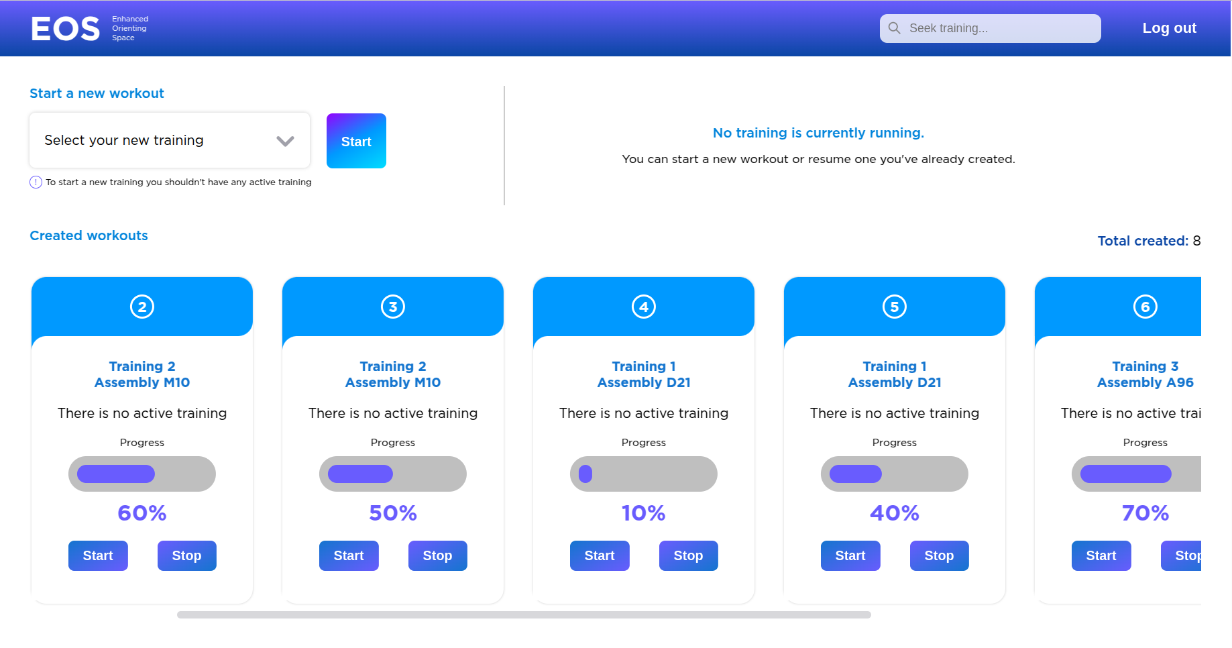
Configuration and Administration
Configuration and Administration
Helps employment coaches to launch and configure trainings
Tracks the progress of users
Allows tweaking of system behavior
Notes:
This element helps employment coaches to configure trainings, track user progress, and tweak system behavior. Original Content: This will be the configuration and administration element of the solution, developed to help supported employment coaches to launch and configure the different trainings, track the progress of users and tweak the system behavior. Below are images of the dashboard:

Slide 16
Used Tools
Tool | Description
Azure AI Foundry | Azure AI Foundry is a platform for building, managing, and deploying AI applications. It provides a unified interface for AI developers and data scientists. This project implement LLM functionality, Speech services, Custom Vision from Azure AI Foundry services.
React.js | It is open-source JavaScript library that allows you to create user interfaces for web and mobile applications. React.js with CSS was used to create the web application to manage the training.
Python | Python is used in this project to create the edge scripts at the enhanced workspace station.
GitHub | Is a code hosting platform for version control and collaboration.

Slide 17
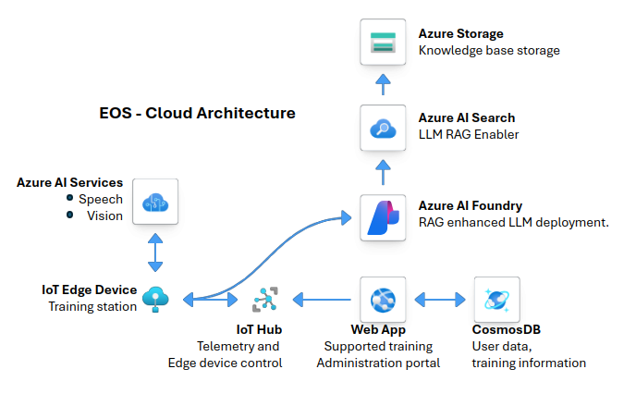
Cloud Architecture
Notes:
This slide presents the end-goal architecture of the project, focusing on scalability and reliability. Original Content: The following diagram describes the end-goal architecture of this project which will allow scalability and reliability

Slide 18
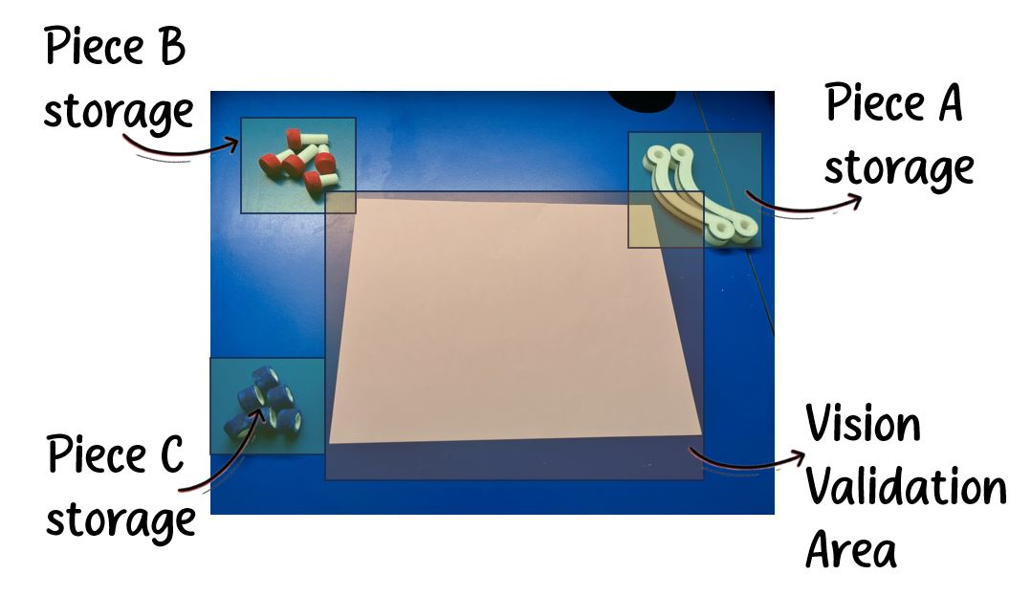
3D Printed Pieces for Assembly Simulation
Simulation of Automotive Piece Assembly
Designed and 3D printed a small set of pieces
Included core piece, millimetric bolt, and matching nut
Innovation in Assistive Technology
Pushing boundaries of assistive technologies
Enhancing software to meet evolving user needs
Notes:
We designed and 3D printed pieces for automotive assembly, including a core piece, bolt, and nut. Our goal is to innovate in assistive technology, continually improving our software to meet user needs. Original Content: To simulate the assembly of an automotive piece we designed, and 3D printed a small set of pieces, the core piece, a millimetric bolt and the matching nut. 🟢 Innovation in Assistive Technology: We aim to push the boundaries of what is possible with assistive technologies, continually enhancing our software to meet the evolving needs of users.

Slide 19
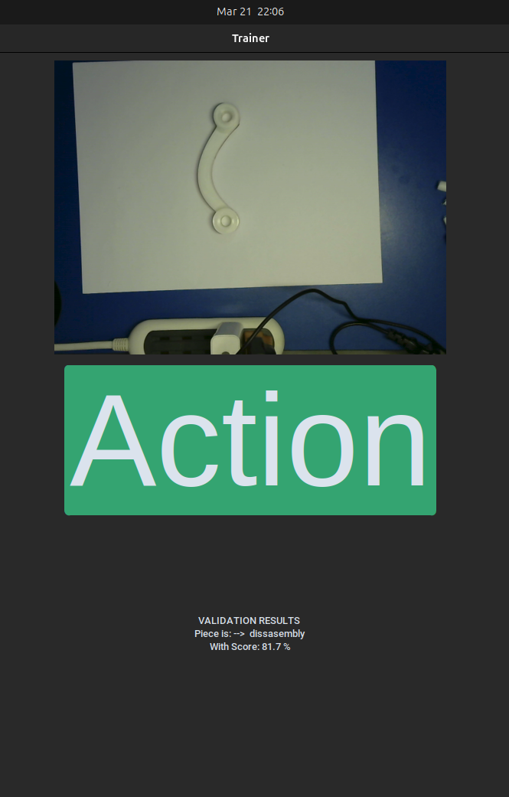
Guidance and Safety Recommendations
Comprehensive User Guidance
EOS provides detailed instructions to users
Industrial Safety Recommendations
EOS ensures user safety by presenting safety guidelines
Introduction to Training Session
EOS helps users familiarize with each assembly piece
Notes:
Our Enhanced Orienting Space (EOS) offers comprehensive guidance, starting with industrial safety recommendations for user safety. It then introduces the training session, helping users familiarize themselves with each assembly piece. Original Content: Our Enhanced Orienting Space will provide comprehensive guidance to the user. Initially, EOS will speak to the user, first by presenting industrial safety recommendations to ensure user safety. Following this, EOS will introduce the training session, starting by helping the user to familiarize themselves with each assembly piece.

Slide 20
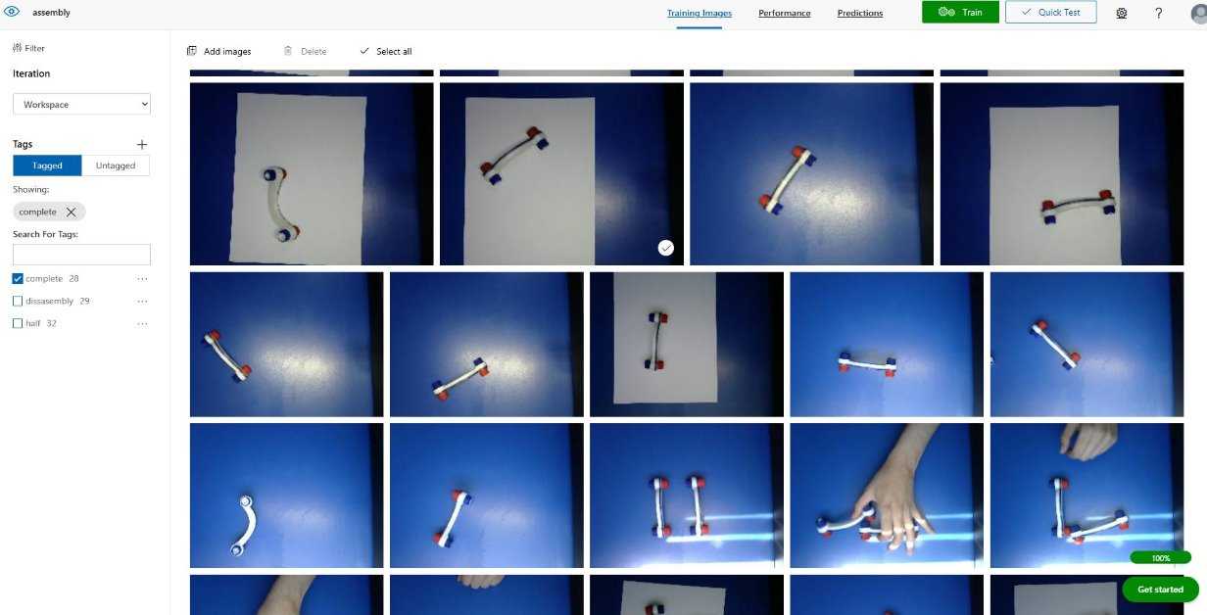
Step-by-Step Training and Validation
Step-by-Step Guidance
EOS offers detailed instructions for assembly tasks
Ensures user familiarity with various pieces
Advanced Computer Vision Technology
Verifies correct assembly of pieces
Provides substantial assistance to visually impaired individuals
Enhancing Software
Continuously improving to meet evolving user needs
Pushing boundaries of assistive technologies
Notes:
The system uses a Large Language Model to provide real-time insights and detailed explanations, enhancing user understanding and efficiency during assembly tasks. Original Content: Furthermore, the system is potentiated with a Large Language Model (LLM) that provides users with useful information regarding the current process. This integration ensures that users receive real-time insights and detailed explanations, enhancing their understanding and efficiency during the assembly tasks.

Slide 21

Graphical User Interface for Feedback
Graphical User Interface Creation
Simulates a physical action button
Allows user feedback via mouse click
Future Improvements
Replace with physical button
Include haptic feedback
Notes:
We developed a graphical user interface to simulate a physical action button. Users can provide feedback by clicking the mouse. Ideally, this would be replaced with a physical button featuring haptic feedback. Original Content: For demonstration purposes, and to simulate a physical action button, we created a graphical user interface that enables the user to provide feedback to the system by clicking the mouse. Ideally, this would be replaced with a physical button featuring haptic feedback.

Slide 22
Integration with Large Language Model (LLM)
Real-Time Insights
LLM provides users with useful information during the process
Ensures users receive up-to-date data
Enhanced Understanding
Detailed explanations are provided by the LLM
Improves user comprehension of assembly tasks
Increased Efficiency
Users can perform tasks more efficiently
LLM aids in streamlining the assembly process
Notes:
EOS provides step-by-step guidance for assembly tasks, utilizing advanced computer vision technology to verify correct assembly. This innovation significantly aids visually impaired individuals. We aim to continually enhance our software to meet evolving user needs and push the boundaries of assistive technologies. Original Content: Once the user confirms their familiarity with the various pieces, EOS will start the training by offering step-by-step guidance. Utilizing advanced computer vision technology, EOS will verify if the user correctly assembles the piece.This technology offers substantial assistance to visually impaired individuals in performing assembly tasks within manufacturing environments. 🟢 Innovation in Assistive Technology: We aim to push the boundaries of what is possible with assistive technologies, continually enhancing our software to meet the evolving needs of users.

Slide 23
Thank you
EOS - Enhanced Orienting Space
Listen to see
Tanji Software
Nancy Vázquez
Ricardo Zamudio
Notes:
This slide provides an overview of the EOS AI Trainer documentation available on GitHub. Original Content: eos-ai-trainer/README.md at main · JustZeus/eos-

