Slide 1

Is the model any good? Objective Validation of Computational Neuroscience Models
Justas Birgiolas, MBA
Rick Gerkin, PhD
Sharon Crook, PhD
Notes:
Hi Everyone, my name is Justas, and I work with Dr. Crook and Dr. Gerkin, at Arizona State University.
I want to talk about an important problem in the computational neuroscience field…. The problem of Model Validation.

Slide 2
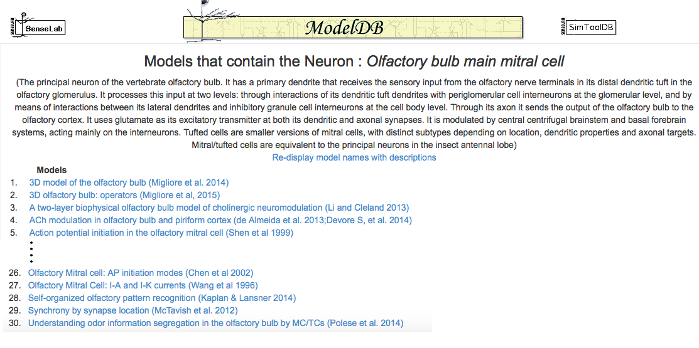
The Model Validation Problem
30 OB Mitral Cell Models
NC L23 Pyramidal: 58
HP CA1 Pyramidal: 103!
Notes:
To illustrate the problem. Suppose you wanted to use a model of your favorite cell. Suppose it’s the OB MC. Now if you searched on ModelDB, you’d find 30 of them.
You’d find 58 models of Neucortical L23 Pyramidal cells. Even worse in the hippocampus – there are 103 models of the CA1 pyramidal cell.
If you want to use one of these models. How do you decide which one to pick? Which models will work for your goal?
What if there was a way to objectively test each model, compare them, and find the one that works best for you?
Furthermore, if you create such models, how do you communicate your model’s fitness for particular purpose to others?

Slide 3
The Broader Model Validation Problem
Creators need:
Clear way to outline model scope
Rigorous way to demonstrate fitness
Defend the above two to users
Users need:
Clear way to know what was modeled
How the fitness was tested and the results
Understand the justification
Notes:
Do parallel appearance of the list

Slide 4



Solution: Unit Testing
 | Test 1 | Test 2 | Test 3 | Test 4 | Overall
App
Model
Prediction
Experimental
Observation
Model Test =
 | Test 1 | Test 2 | Test 3 | Test 4 | Overall
Model 1 | 0.1 | -0.1 | 2.0 | -0.3 | 0.6
Model 2 | 0.7 | 1.0 | -0.1 | -0.3 | 0.5
Model 3 | 0.3 | 0.3 | -0.4 | -0.3 | 0.3
Model 4 | 0.0 | 0.1 | -0.1 | -0.3 | 0.1
Model 5 | -1.5 | 2.9 | -2.4 | -0.2 | 1.8
Overall | 0.5 | 0.9 | 1.0 | 0.3

Slide 5
From SciUnit to NeuronUnit
SciUnit Framework
Python framework for scientific model validation
Take a scientific model as input
Create a suite of tests
Compare test results to expected values
NeuronUnit Library
Provides support for CompNeuro models
Passive membrane property tests
Action potential property tests

Slide 6
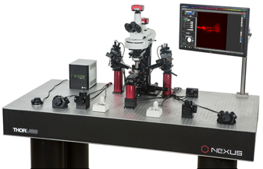



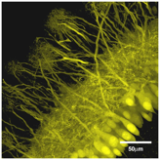



BioPhysically Realistic Models
?
Notes:
That brings to aquestion. Are our models any good? How do we know this? Do the models running on the computer behave the same way as the real cells?
Images:
http://www.yalescientific.org/wp-content/uploads/2011/05/fulllengths-olfaction-5.jpg
https://raw.githubusercontent.com/OpenSourceBrain/MiglioreEtAl14_OlfactoryBulb3D/master/images/30cells.jpg
http://www.thorlabs.us/images/gallery/Cerna/Cerna4.jpg
https://upload.wikimedia.org/wikipedia/commons/d/d3/IBM_Blue_Gene_P_supercomputer.jpg

Slide 7
ModelDB
ModelDB
Repository for published CompNeuro models
Models
8 NEURON Models
Mitral Cells (Olfactory Bulb)
Deterministic
Produce APs
Single and Multi-Compartment

Slide 8
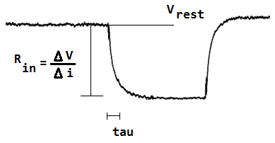
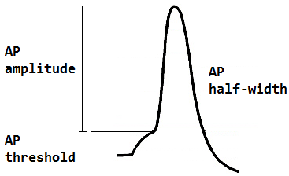
Tests: Deviations from Experimental Property Values
Passive
Active

Slide 9
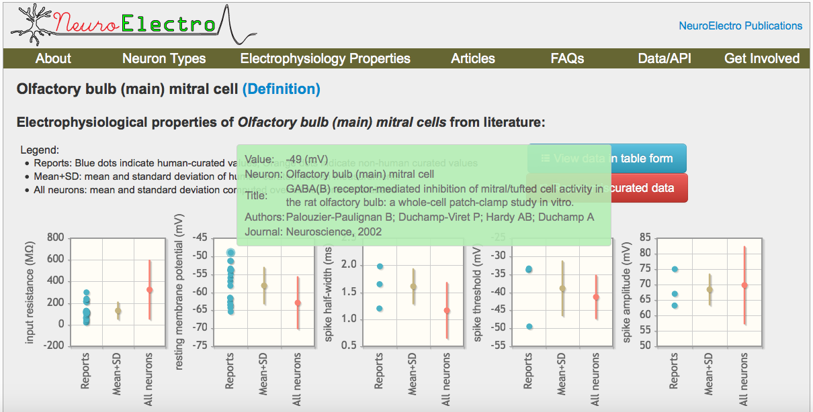

Slide 10
NeuronUnit
Tests
Model soma sections subjected to current injections
6 property values computed by NeuronUnit
Expected Values
Article data is retrieved from NeuroElectro
Article Values Pooled
Article mean and SD
Each as independent, random Gaussian variable
N-Weighted
=> Aggregate distribution, mean, and SD

Slide 11
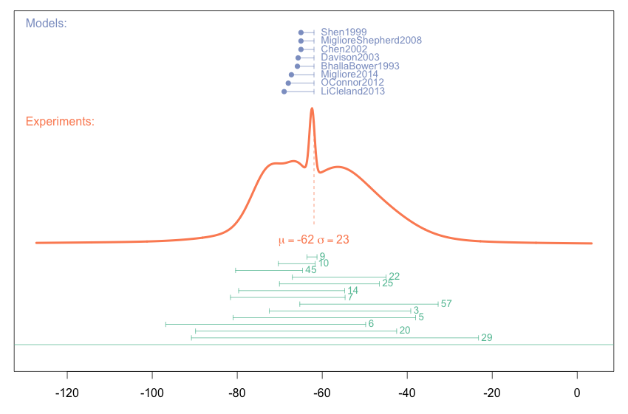

Computational
model values
Pooled
experimental distribution
Experimental
literature
values
Literature mean + SD
Resting Membrane Potential (mV)
Notes:
Y AXIS not important – for visual clarity only.

Slide 12
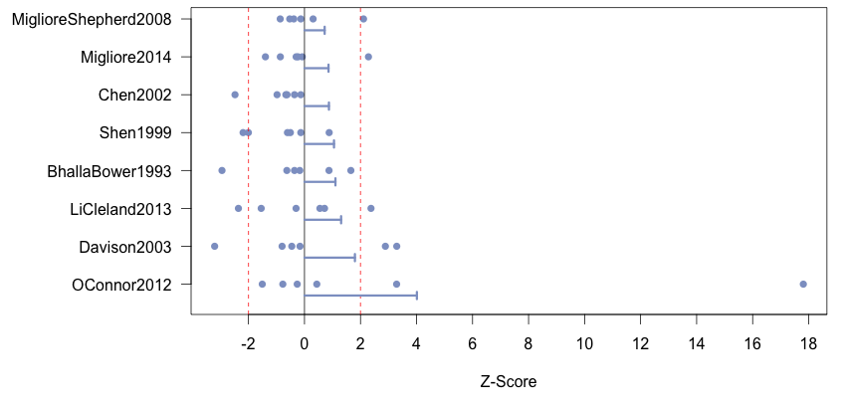
Overall Model Deviations
Expected >2 SD: 2.4
Actual: 12
p < 0.001 **
Notes:
Blue dots are the properties, lines are average model deviations (absolute). Y axis is sorted by average model deviation. Most properties of all models are within 2SDs from experimental means. All models have at least one property outside the 2SD window.
!!! Not neccesarily biophyz realistic models !!!

Slide 13
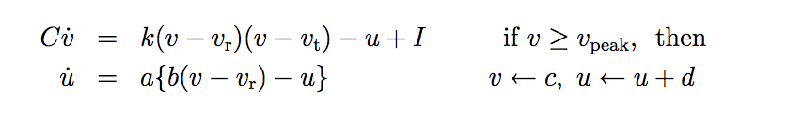
NeuronUnit for Parameter Search: Test Scores as the Cost Function
Izhikevich, Dynamical Systems in Neuroscience, 2007.

Slide 14
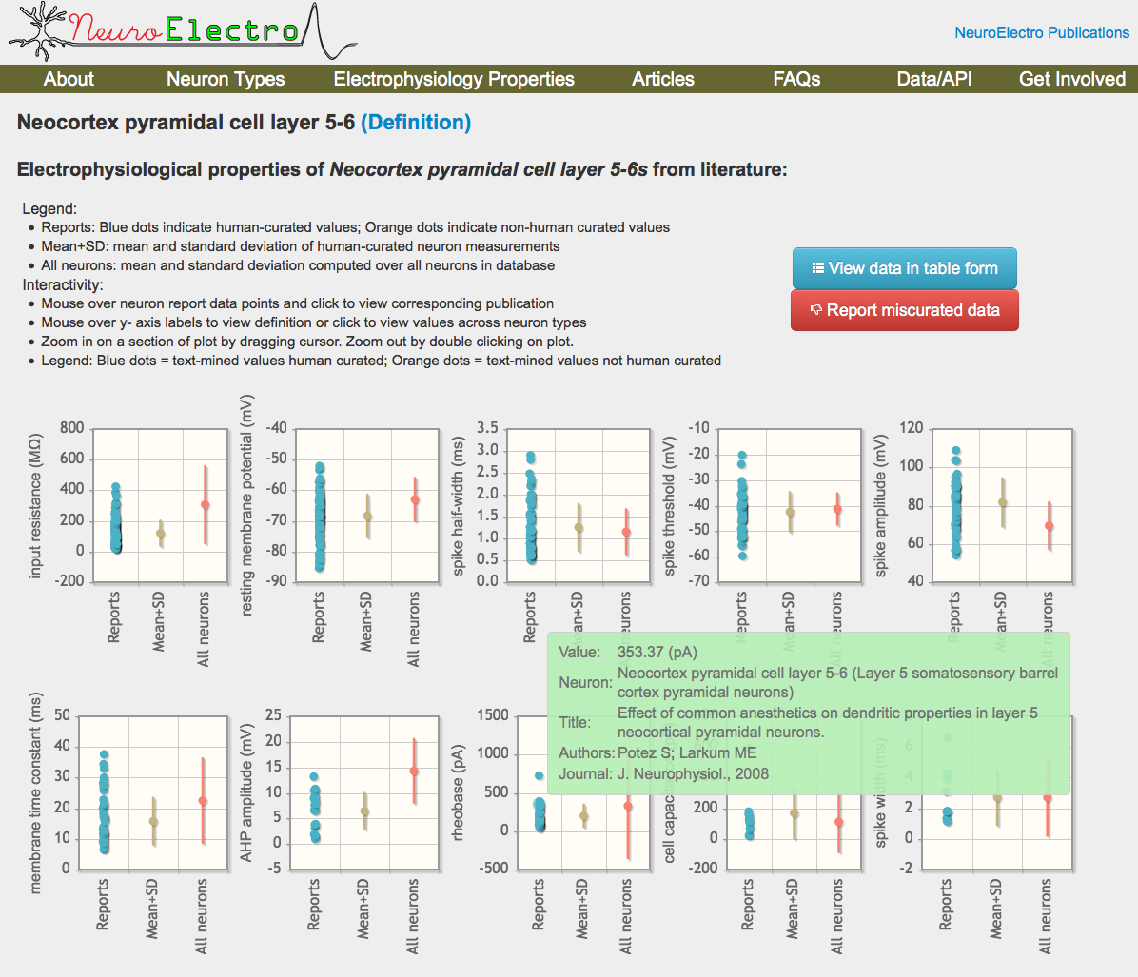
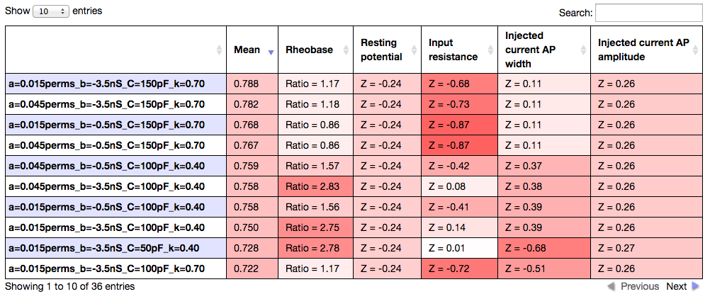

Slide 15
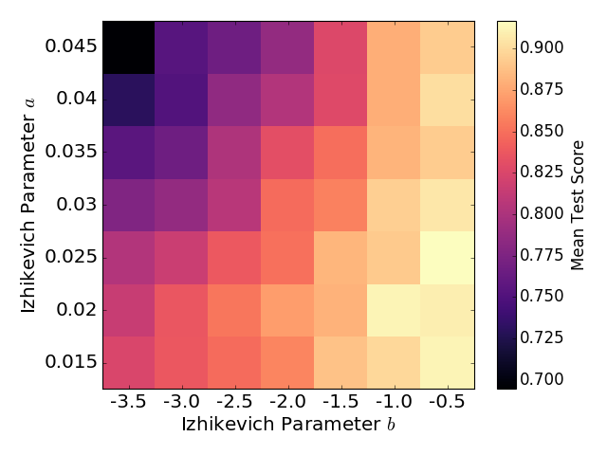
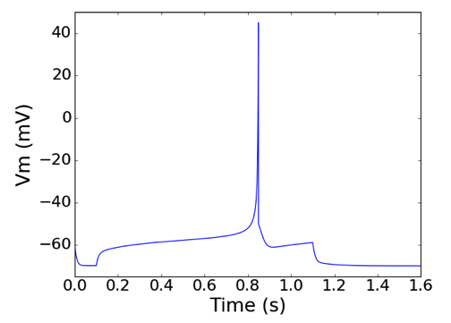
Parameter Search
Results
Best Cell Response

Slide 16
Conclusions
ModelDB + NeuronUnit + NeuroElectro can be used to:
Objectively validate a set of models vs. a set of experimental properties
Fine-tune models via parameter search
Mitral Cell Model Evaluation
Majority of properties of every model were in agreement with experimental data
Every model had at least one property that disagreed
Experimental value reporting can be improved by:
Reporting junction potential correction
Standardizing AP property computation methods
Making individual, paired cell data available

Slide 17

Thank You
Acknowledgments
Shreejoy Tripathy, Ph.D.: NeuroElectro.org API
National Institutes of Health: R01MH1006674
Code, Slides, Data Available Online
github.com/JustasB/MitralSuite
NeuronUnit framework:
github.com/scidash/neuronunit

Slide 18
Future Directions
Other properties:
Bursting properties
I-F properties
Other Models:
Stochastic models
Network models
Model Complexity vs. Fitness
Ultimate Goal: Behavioral Validation

Slide 19
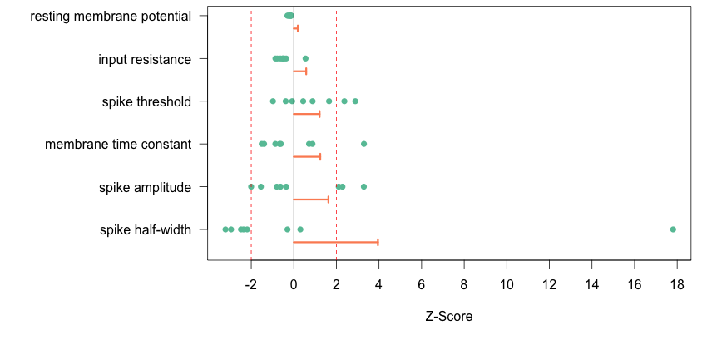
Overall Property Deviations
Notes:
The grey dots are the model values. The x-axis is model deviation from experimental mean in SDs. Orange lines are the average absolute deviations. Using absolute values to avoid negative cancelation affects. The y axis is sorted by average property deviation.

Slide 20
Pooled Property Estimates
Property | Pooled Estimates ± SD (N)
Resting Potential | -62 ± 23 mV (295)
Input Resistance | 150 ± 150 MΩ (386)
Time Constant | 31 ± 14 ms (66)
AP Threshold | -47 ± 4.2 mV (8)
AP Amplitude | 74 ± 7.3 mV (52)
AP Half-Width | 1.7 ± 0.41 ms (64)
Notes:
Because of pooling we get these

