Slide 1
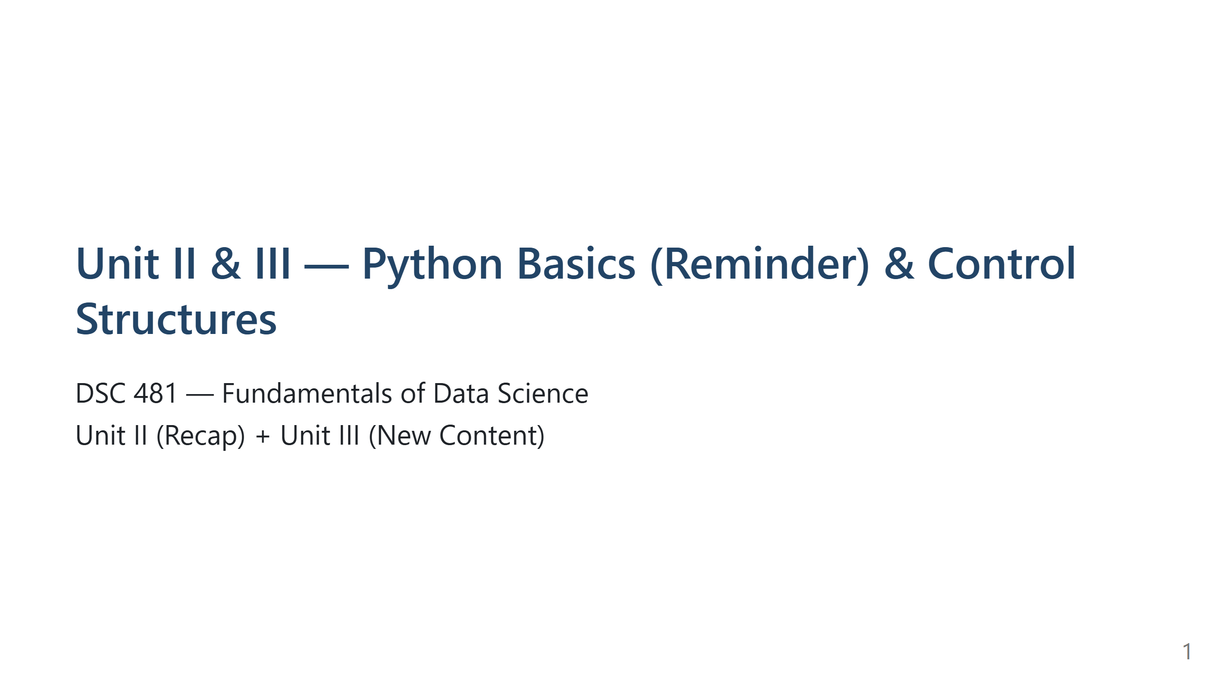
Notes:
Speaker Notes:
Efficient summary of Unit II, then focused coverage of Unit III (new content). For lecture and lab in Colab/Jupyter.

Slide 2
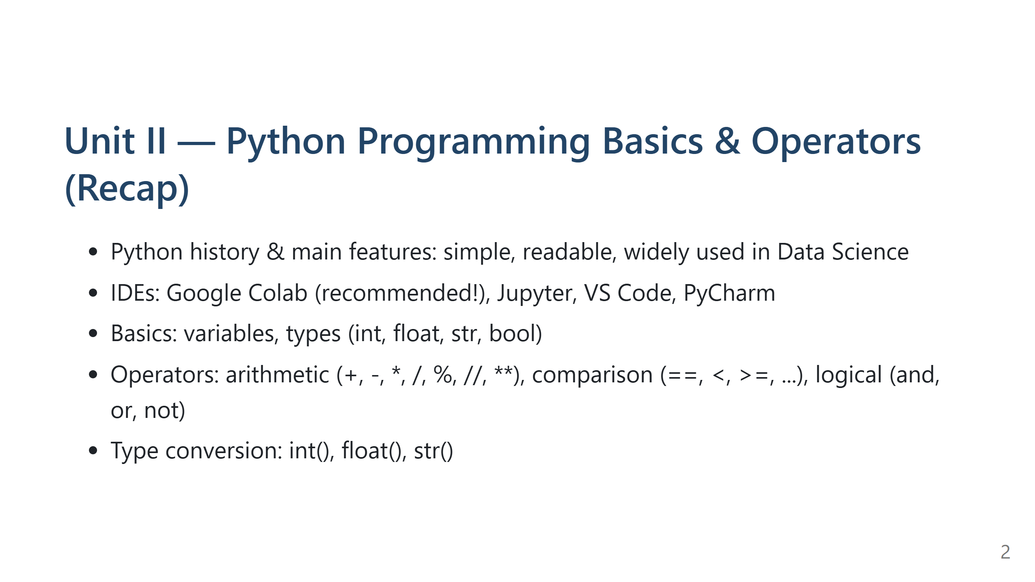
Notes:
Speaker Notes:
Quick review — these should now be familiar! Ask warm-up questions (variable, print, assignment vs comparison).

Slide 3
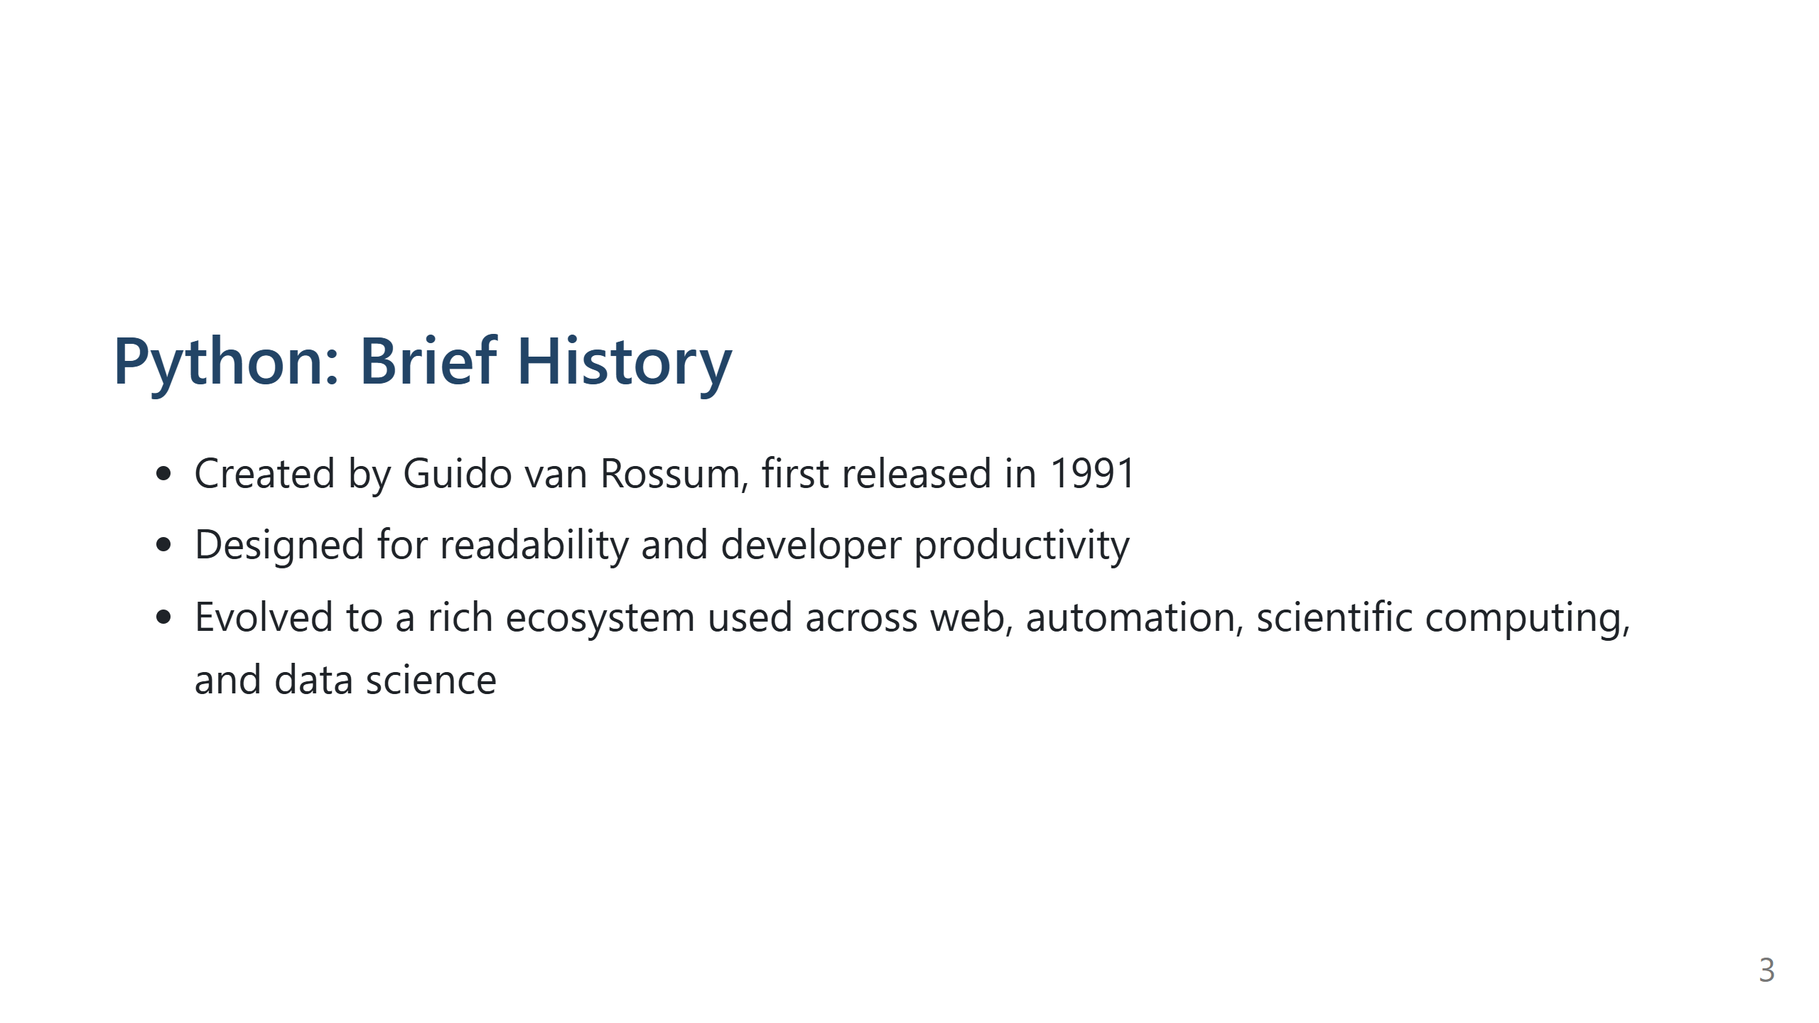
Notes:
Speaker Notes:
Discuss the importance of clear syntax and Python's widespread use. Mention Zen of Python (import this) — fun for students to see.

Slide 4
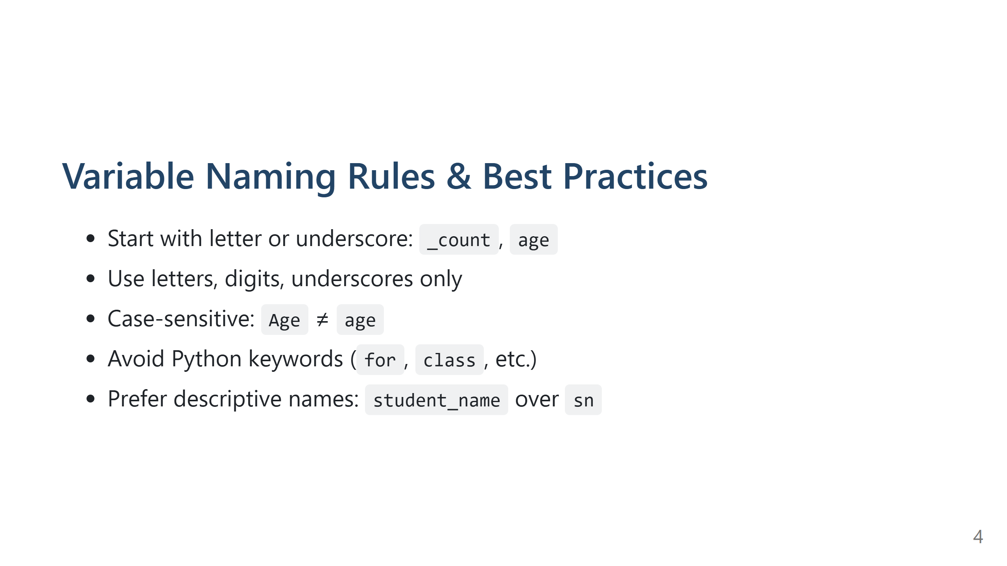
Notes:
Speaker Notes:
Live demo: try naming a variable `class` or `2nd`, show SyntaxError.
Encourage descriptive, readable names — makes code and teamwork easier.

Slide 5
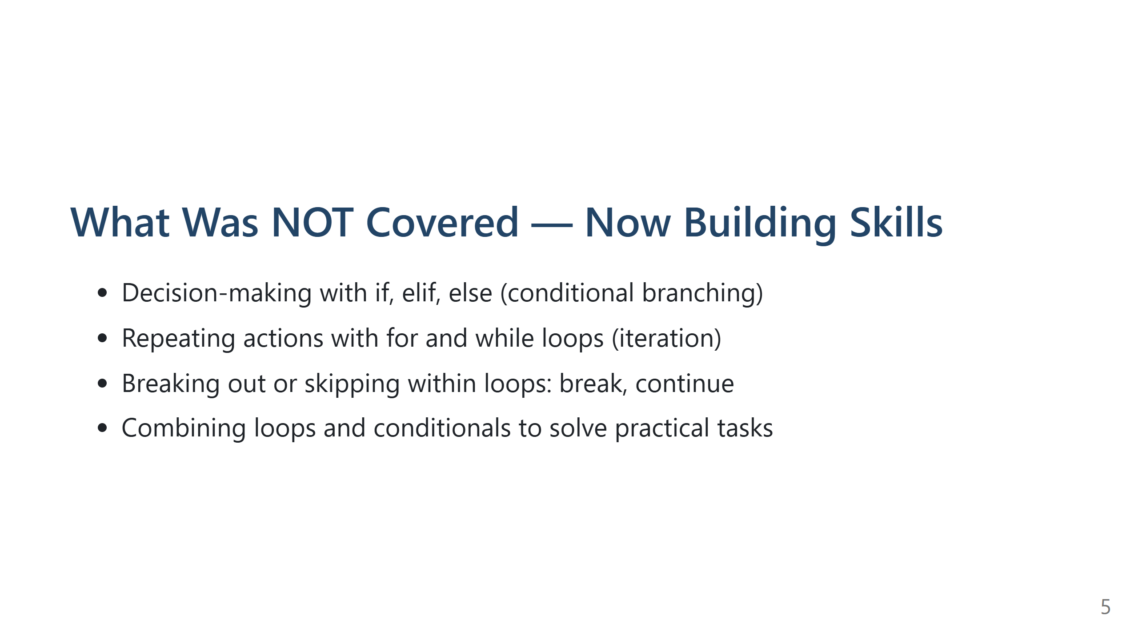
Notes:
Speaker Notes:
Unit III begins: Control Structures. Time to learn how programs "think" and "repeat"!

Slide 6
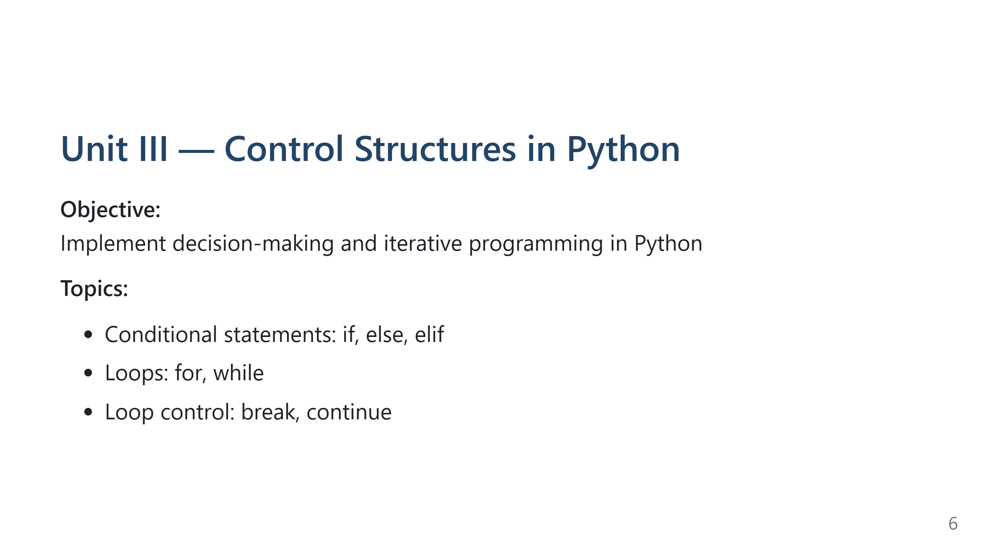
Notes:
Speaker Notes:
Announce new unit. Control structures allow Python to make decisions and repeat (core to programming!).

Slide 7
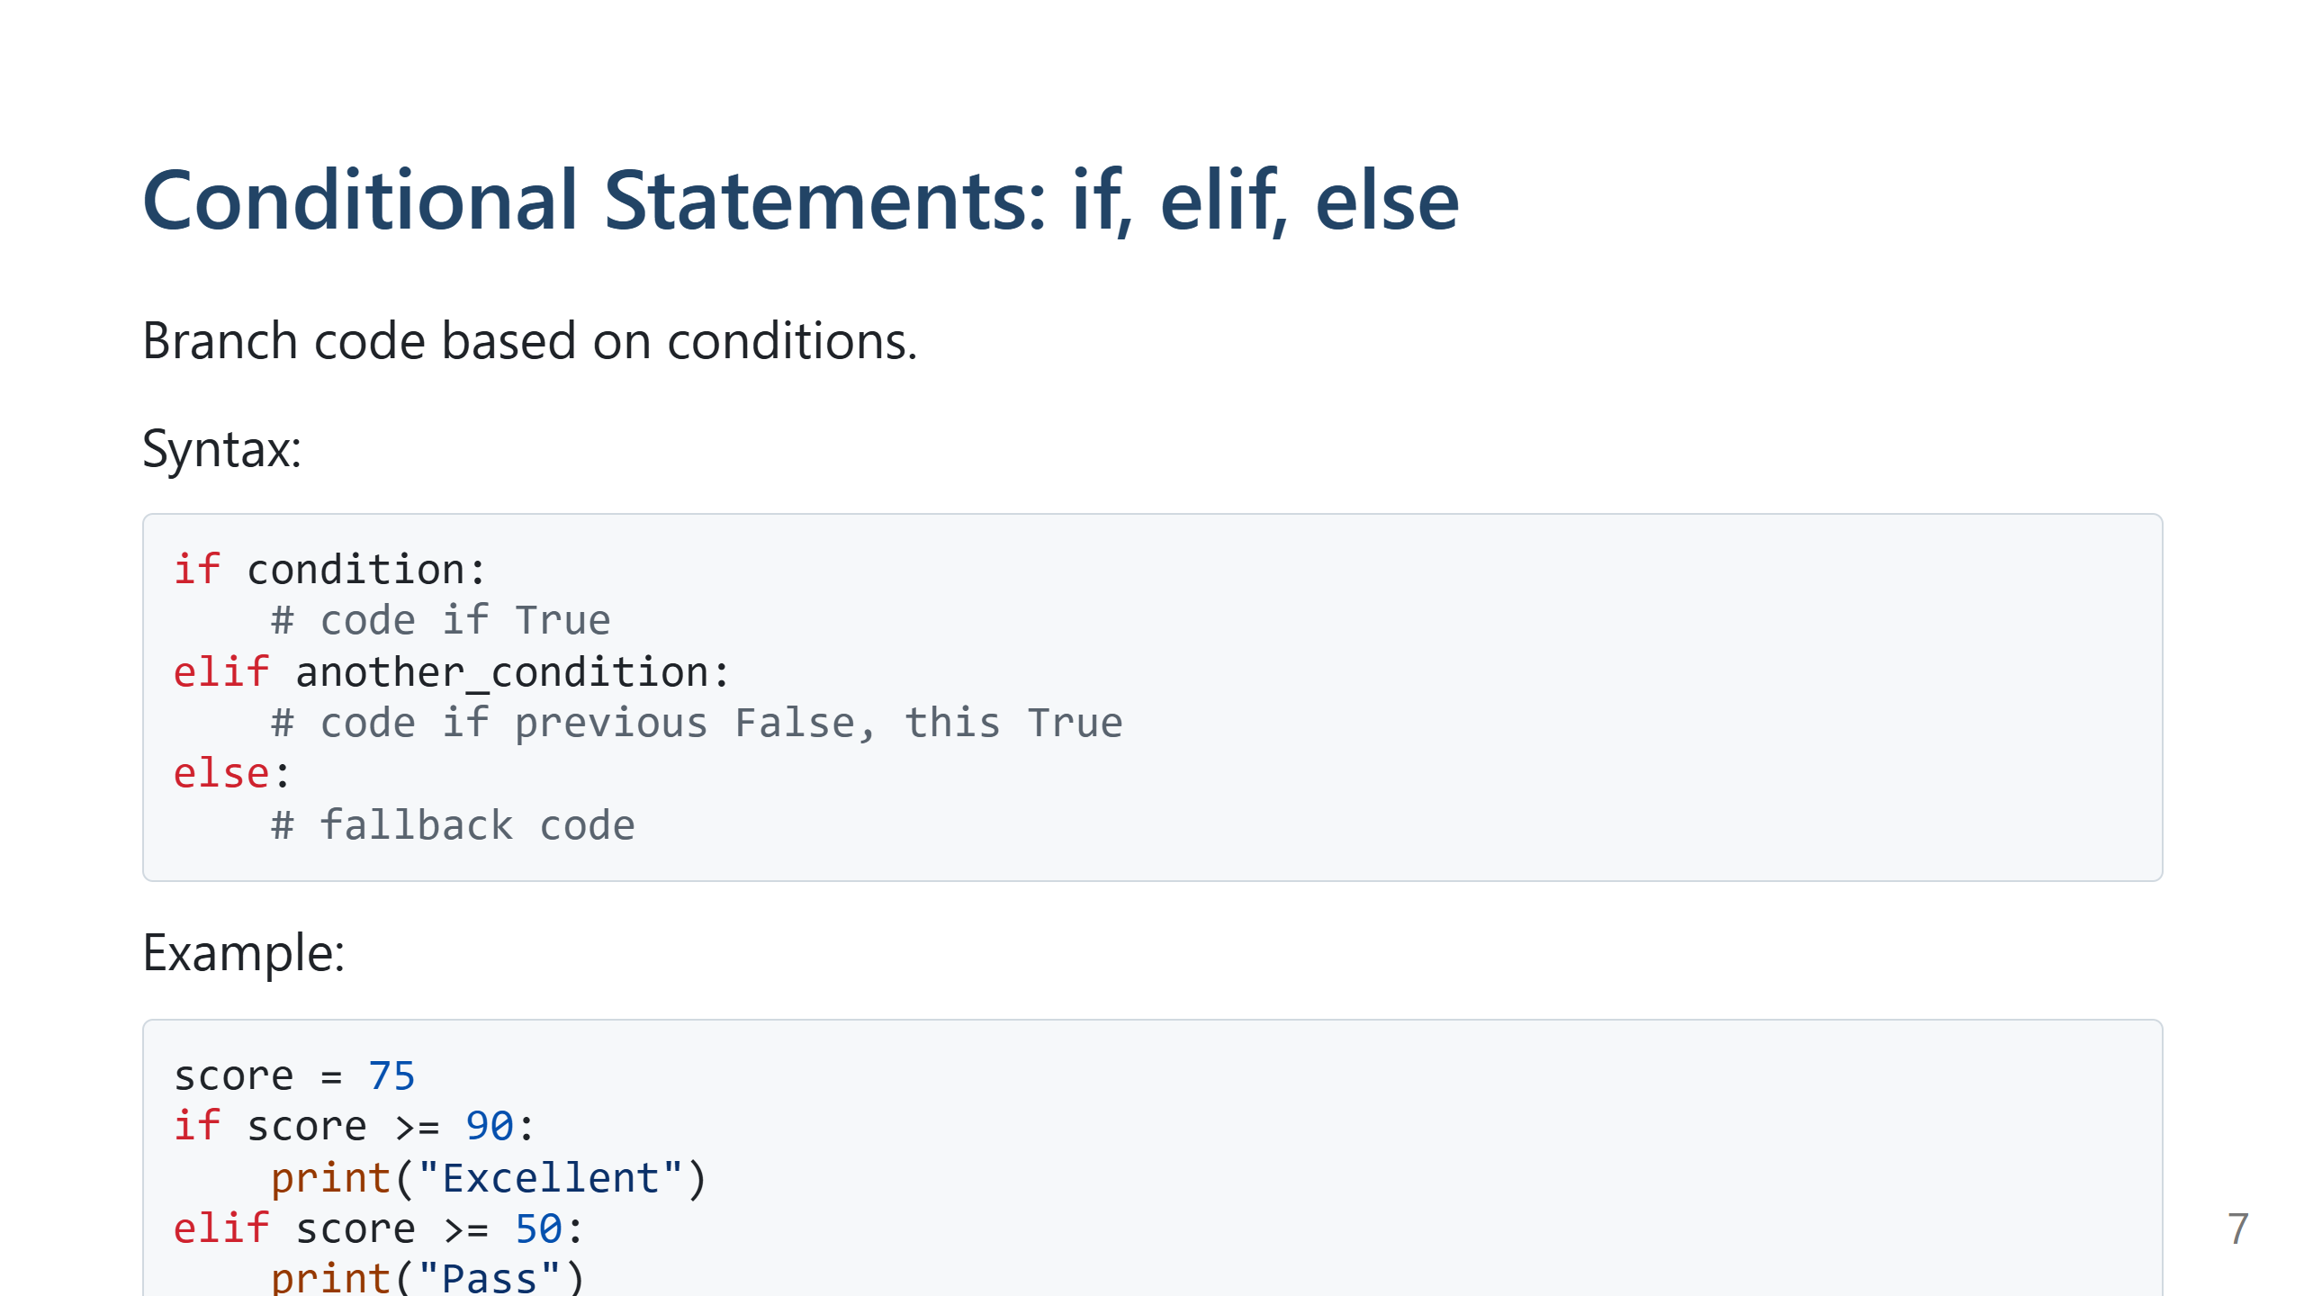
Notes:
Speaker Notes:
Change score in the demo. Indentation is essential — show a block error if spaces are missing!

Slide 8
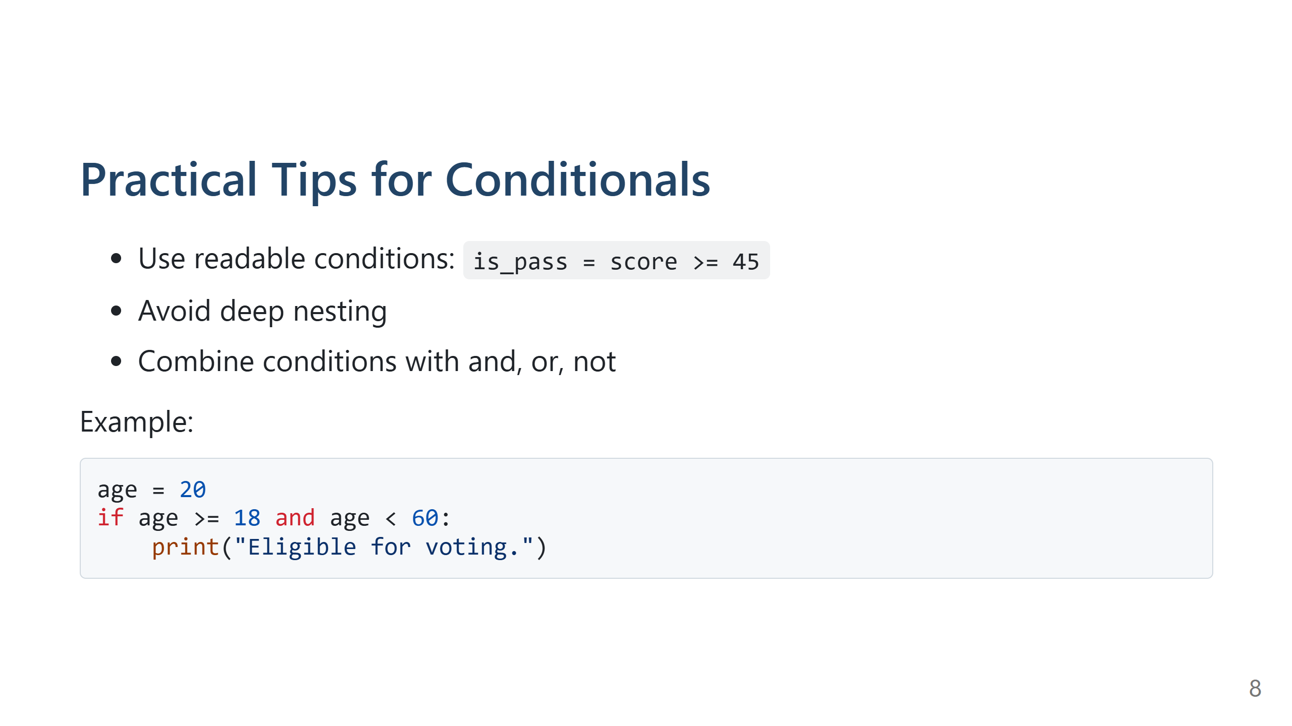
Notes:
Speaker Notes:
Demo: several age values. Encourage students to predict output before running.

Slide 9
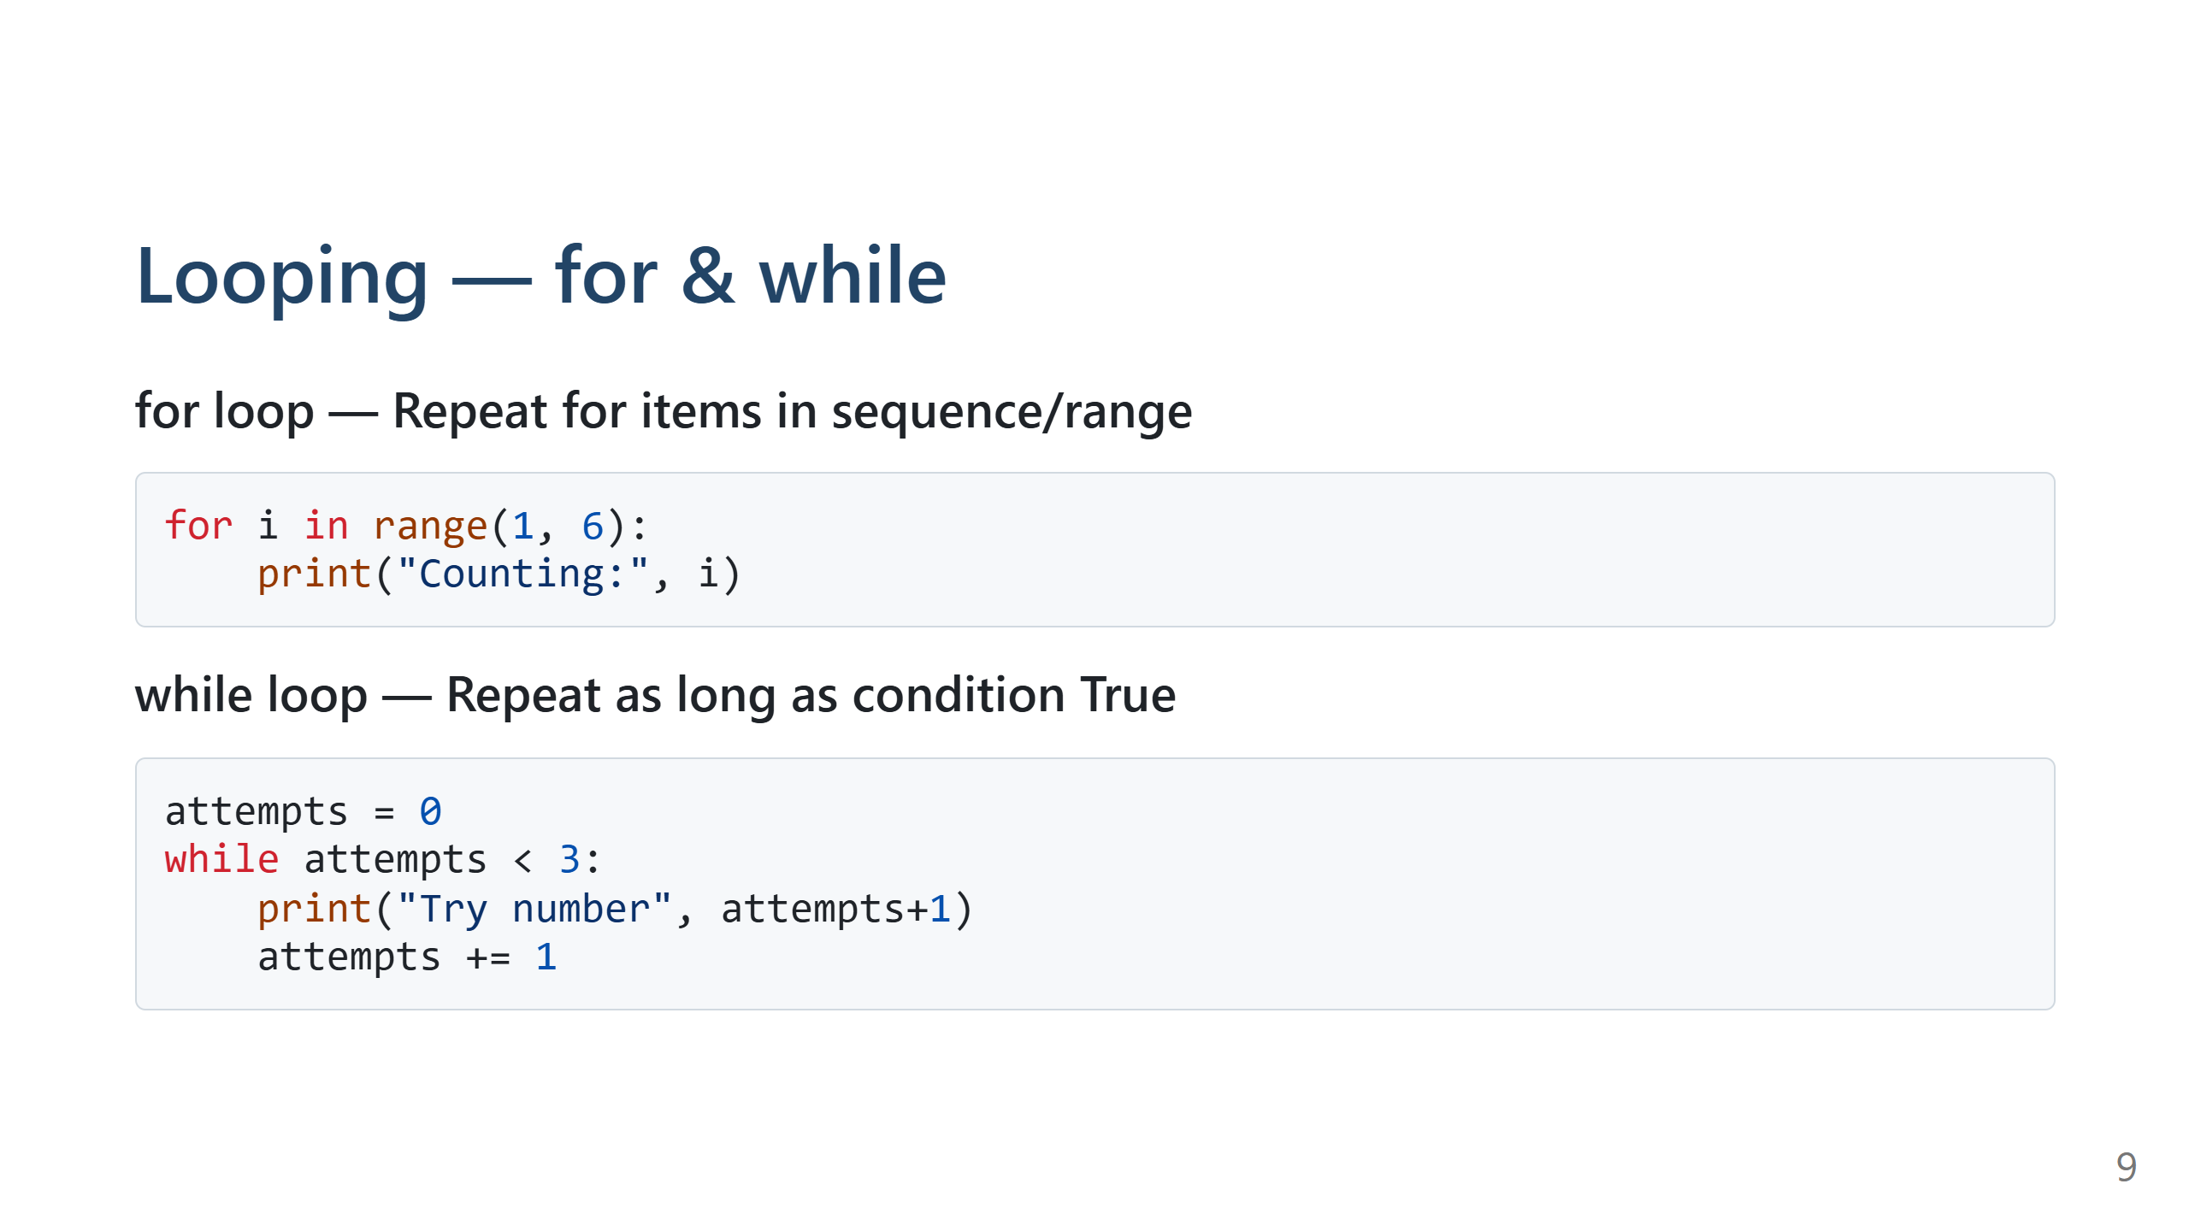
Notes:
Speaker Notes:
Demo: for-loop for simple counting, while-loop for repeated prompts.

Slide 10
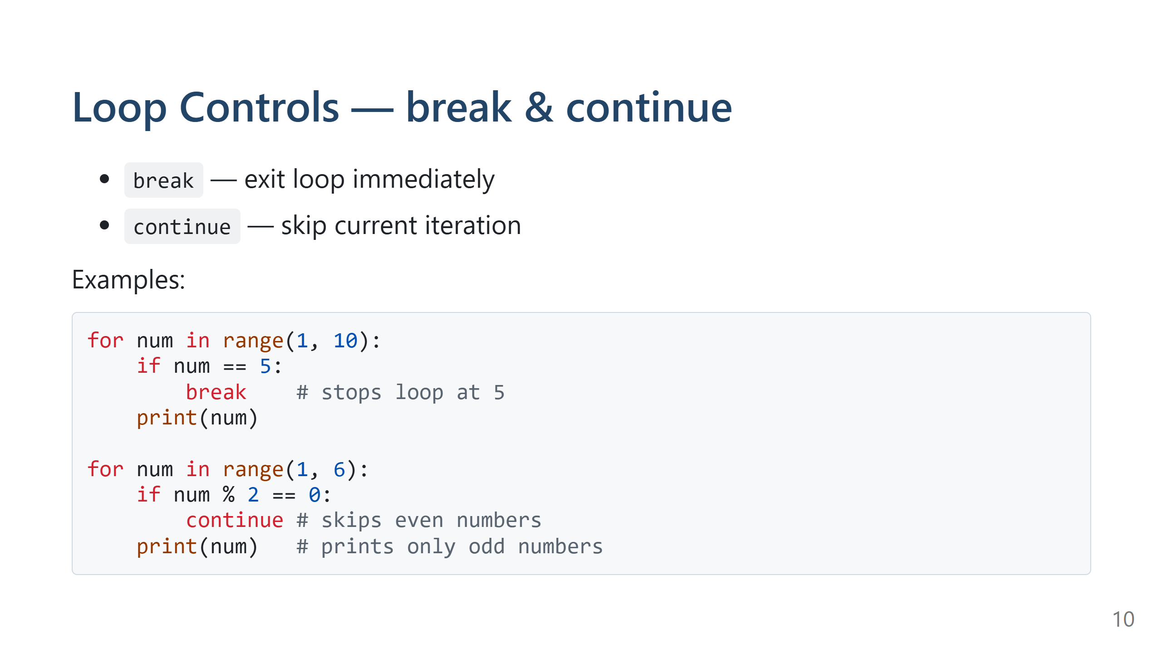
Notes:
Speaker Notes:
Useful for filtering, early exit, skipping! Demo live, ask students what the printout will be.

Slide 11
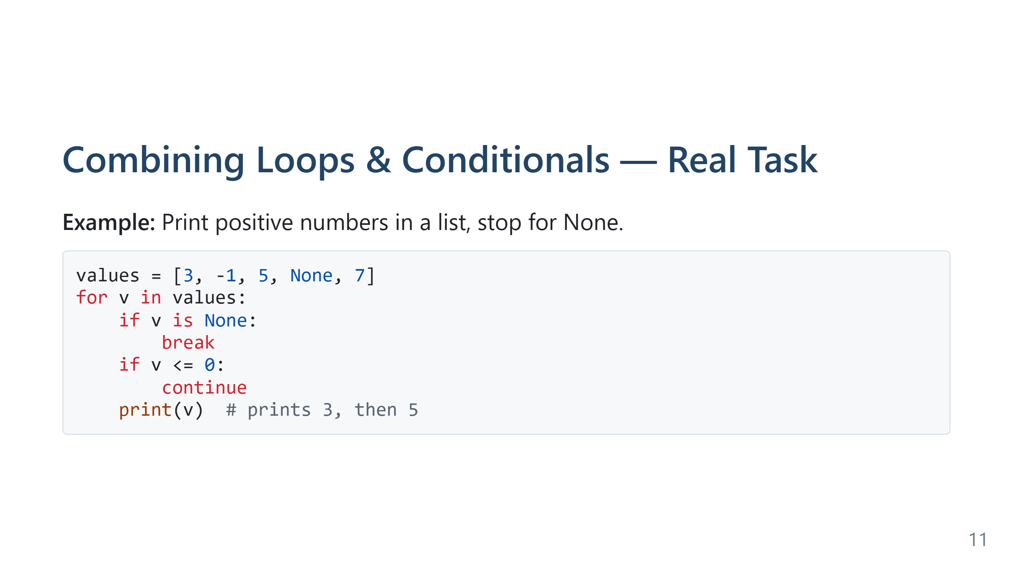
Notes:
Speaker Notes:
Trace through the example step-by-step, asking students to follow logic.

Slide 12
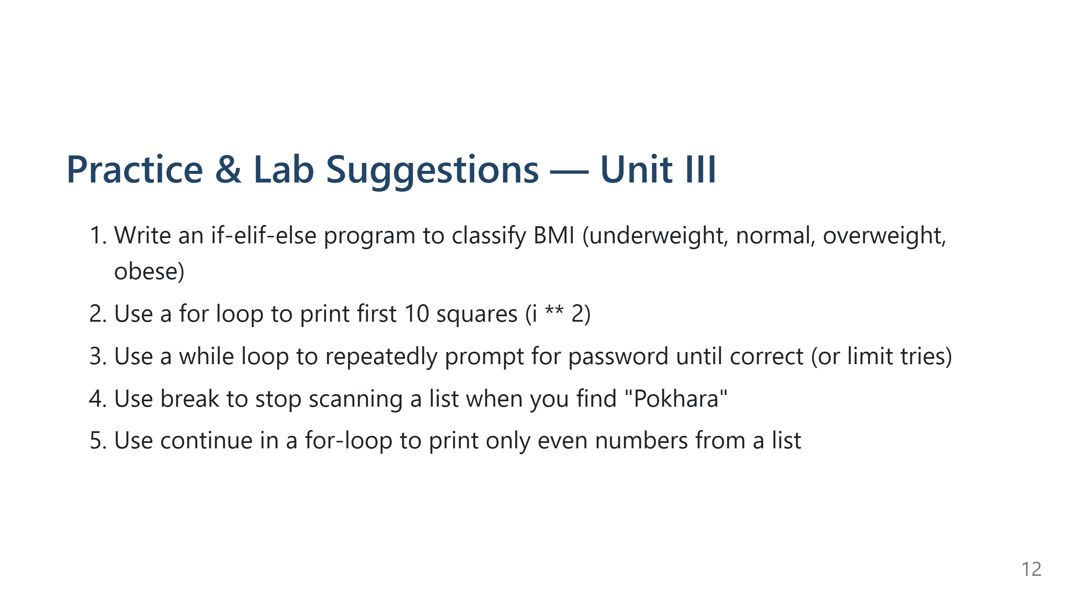
Notes:
Speaker Notes:
Assign these for hands-on work. Encourage students to tinker, try new conditions and loops!

Slide 13
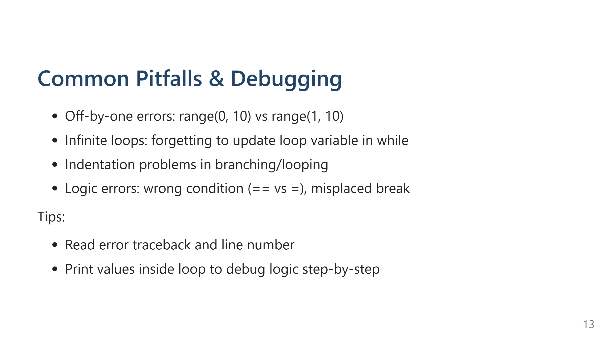
Notes:
Speaker Notes:
Demo a bug and fix it live. Encourage students to ask about confusing error messages.

Slide 14
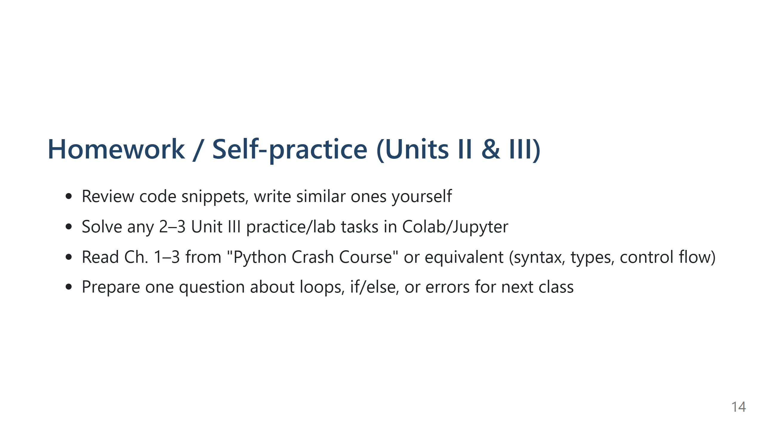
Notes:
Speaker Notes:
Emphasize regular practice and coming with questions!

Slide 15
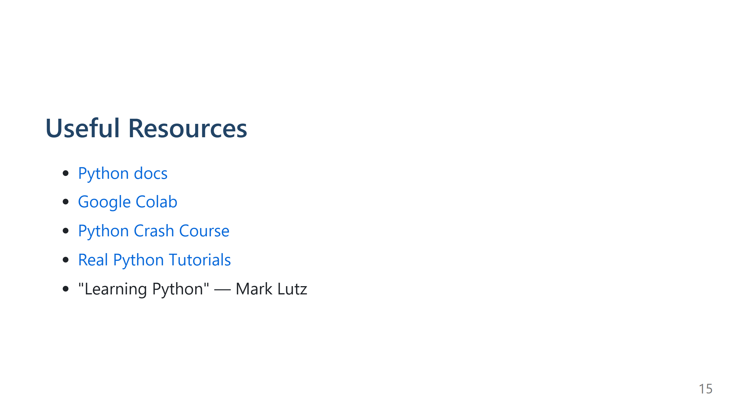
Notes:
Speaker Notes:
All links also posted to LMS or class Drive. Invite students to explore and test code samples.

Slide 16
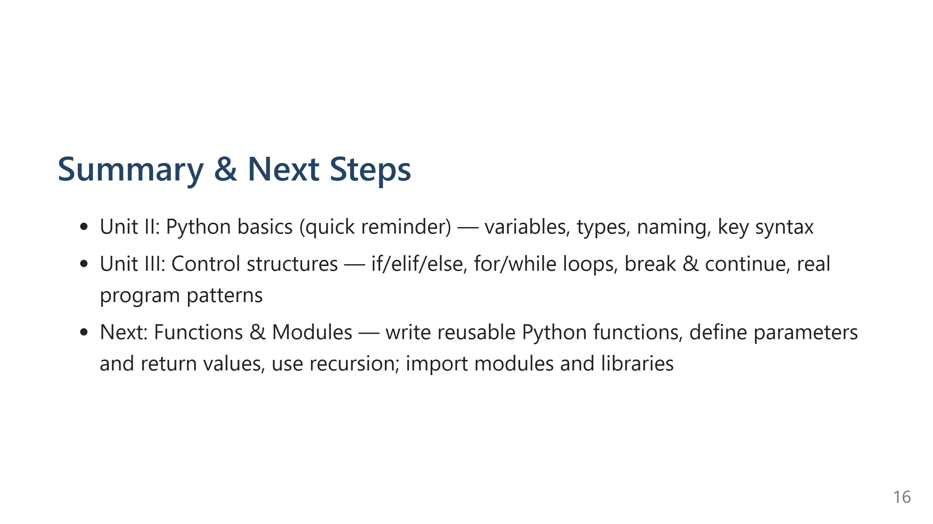
Notes:
Speaker Notes:
Wrap up, take any final questions, and preview next session (functions & modules).

