Slide 1
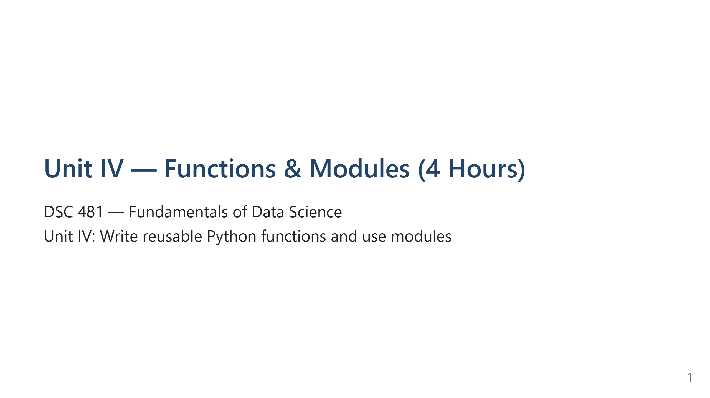
Notes:
Expanded Speaker Notes (≈30s)
Intro (what to say first)
- Welcome students and state the learning goal for this unit: write reusable Python functions and organize them into modules so code can be reused across scripts and sessions.
- Motivation: emphasize maintenance, readability, testability and collaboration benefits. Real-world example: one correctly written BMI function can be reused for thousands of records without duplicating logic.
Planned flow & timing
- Quick lecture (30–40s overview) then hands-on examples and exercises throughout the class. Tell students you expect them to experiment with small code snippets and to use the provided exercises to practice.
Interaction prompts
- Ask: "Who has reused code before? How did you share it?" Use answers to highlight benefits of modular code.
Transition
- Move to the learning objectives slide next.

Slide 2
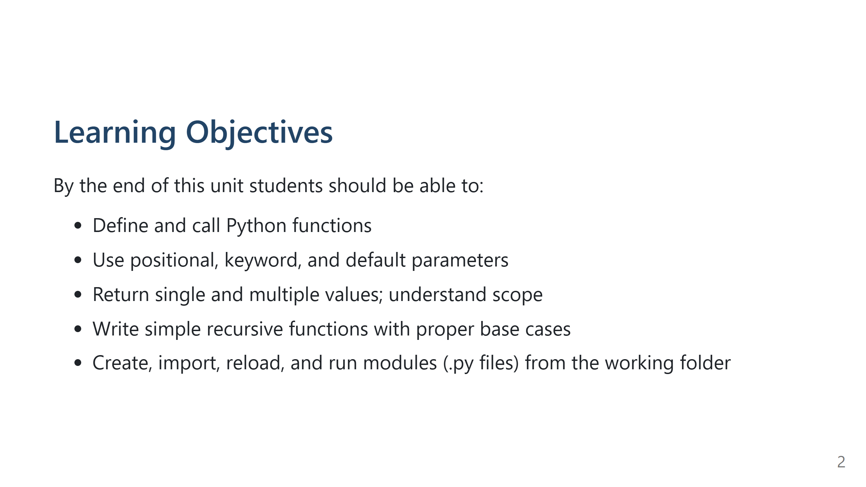
Notes:
Expanded Speaker Notes (≈30s)
What to emphasize
- Read each objective aloud and briefly explain why it matters.
- Example: positional vs keyword args matter for readability and avoiding bugs.
- Returning multiple values matters when a function computes several related quantities.
Teaching plan link
- Explain the link between objectives and exercises: each objective maps to a short hands-on task students will perform during the lab portion.
Assessment note
- Tell students how they will demonstrate competency: small scripts, a module file, and a short README describing how to run the demo.

Slide 3
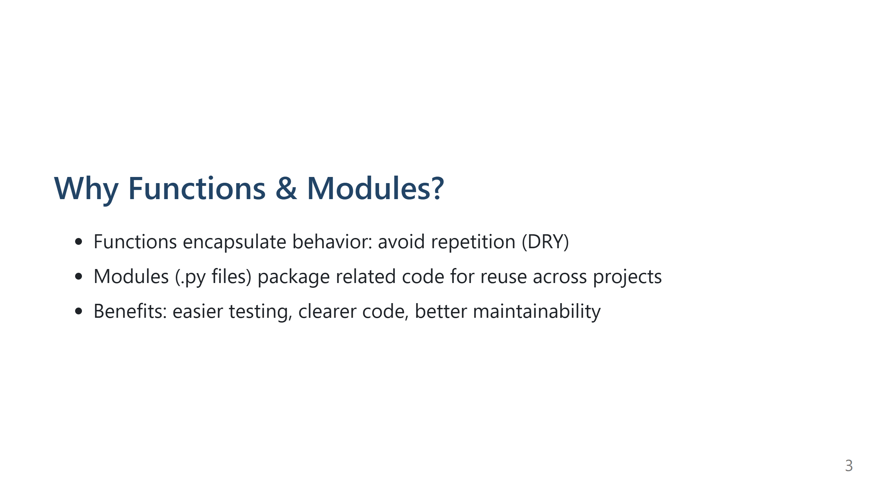
Notes:
Expanded Speaker Notes (≈45s)
Concrete illustration
- Demonstrate a simple before/after:
- Before: copy/paste BMI logic in three places — highlight problems (duplication, inconsistency).
- After: one function bmi_info(weight, height) used everywhere — easier to fix and test.
Testing angle
- Explain unit testing: small functions are easy to test with simple assertions.
Maintainability & team work
- When working in teams, modules provide agreed APIs. Show how import boundaries clarify responsibilities.
Class activity suggestion
- Ask students quick question: name one function they can imagine pulling out of their current code into a module.

Slide 4
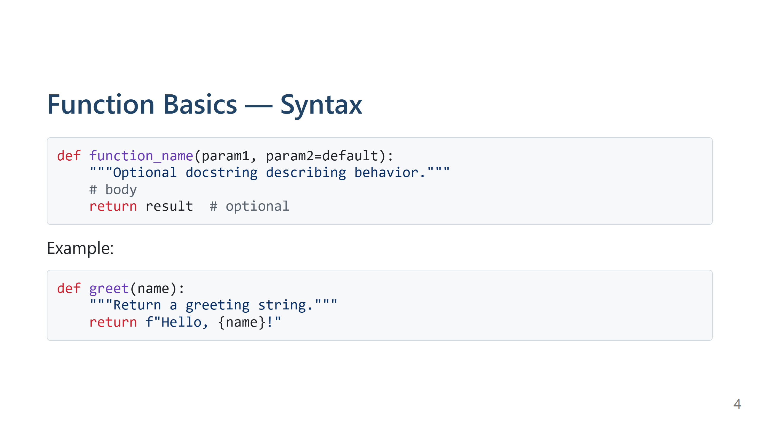
Notes:
Expanded Speaker Notes (≈1 min)
Explain each part
- def: defines a function
- function_name: naming convention (snake_case), should be descriptive
- params: required and optional, defaults after required ones
- docstring: briefly show where to write purpose, parameter descriptions, and return info
- body: indentation is critical in Python — remind students about consistent indentation (4 spaces)
- return: optional; if omitted, function returns None
Style tips
- Encourage short functions, descriptive names, and docstrings (one-line summary + optional longer explanation).
- Show example docstring format:
"""Return a greeting string.
Args:
name (str): Name to greet.
Returns:
str: Greeting message.
"""
Quick live demo suggestion
- Ask a volunteer to suggest a function name and parameter and type a one-line function in a shared environment (or instructor types it).

Slide 5
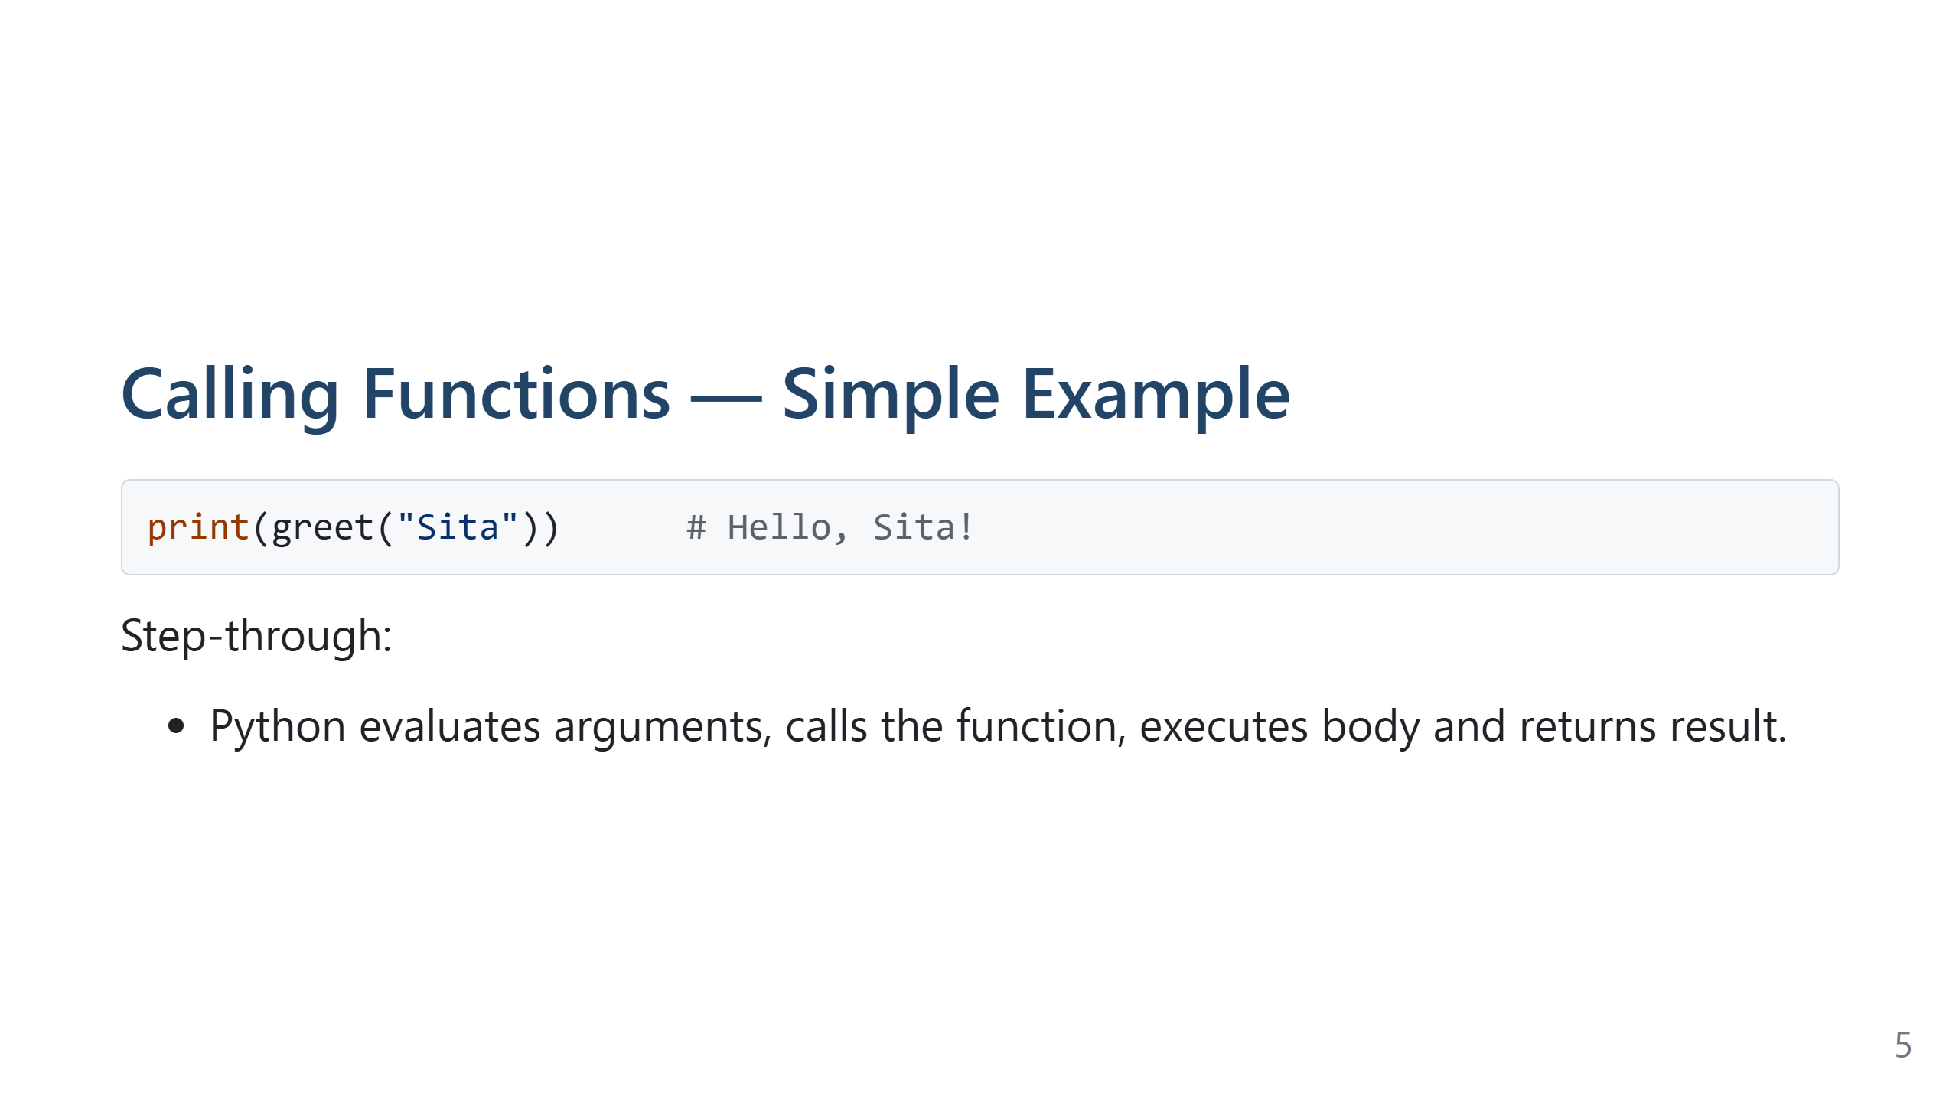
Notes:
Expanded Speaker Notes (≈30s)
Walkthrough
- Show the call -> execution -> return sequence step by step:
1. Evaluate arguments ("Sita")
2. Bind parameters inside function (name = "Sita")
3. Execute function body
4. Return value to caller and print it
Common mistakes to highlight
- Forgetting parentheses when calling a function (e.g., print(greet) vs print(greet()))
- Passing wrong number/type of arguments — demonstrate TypeError by calling greet() with no argument
Quick interactive check
- Ask students: "What happens if you call greet(123)?" — discuss that Python will accept it at runtime unless you validate types; recommend docstrings or type hints for clarity.

Slide 6
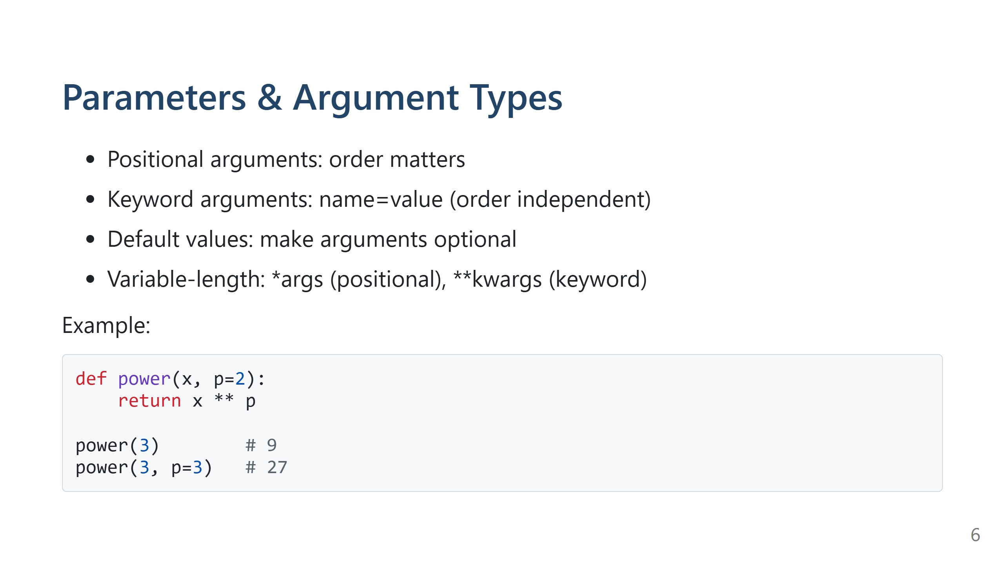
Notes:
Expanded Speaker Notes (≈1 min)
Explain each form with pros/cons
- Positional: concise but less explicit
- Keyword: self-documenting and safer when calling functions with many parameters
- Default values: good for common cases; warn about mutable defaults
Show *args and **kwargs
- Example:
def concat(*parts): ...
def configure(**options): ...
- Explain patterns: *args for flexible positional lists; **kwargs when you want named options
Mutable default caveat
- Show bad example:
def f(lst=[]): lst.append(1); return lst
- Explain the shared list across calls and how that causes bugs
- Show fix: use None and initialize inside the function
Small hands-on idea
- Ask students to rewrite a function with many optional params to use keywords and defaults for clarity.

Slide 7
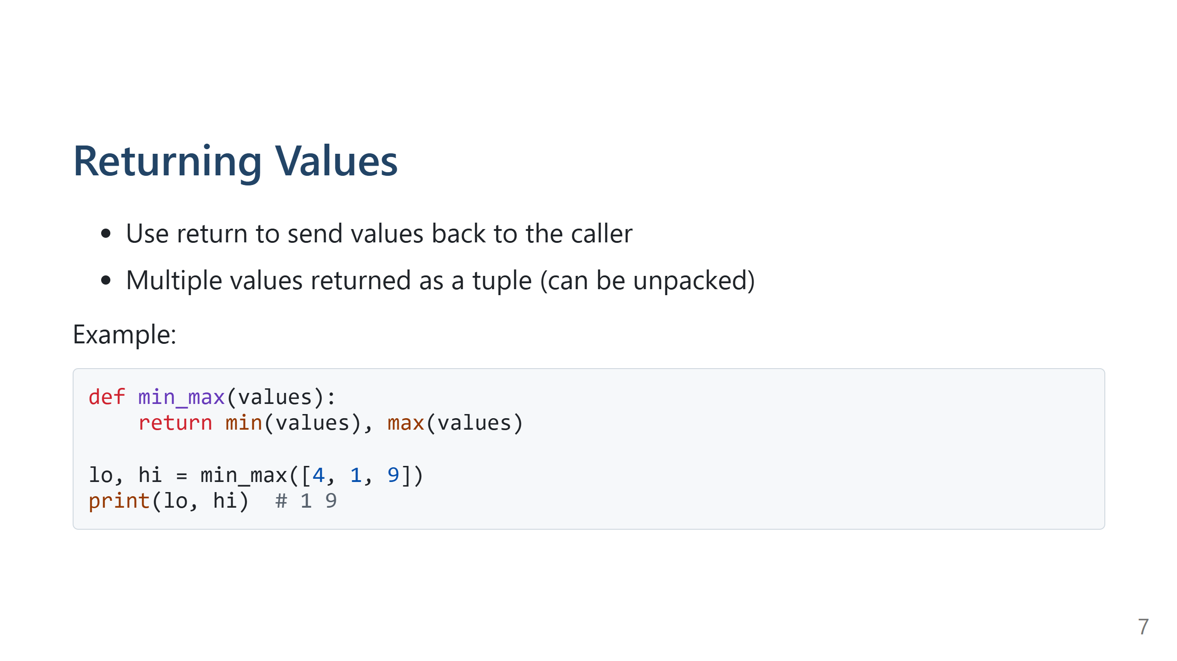
Notes:
Expanded Speaker Notes (≈45s)
Explain tuple return semantics
- Returning a, b is returning a tuple (a, b). Show that the caller can unpack or treat it as a tuple.
Design guidance
- When to return multiple values: when they are logically linked (min & max) — otherwise consider returning a namedtuple/dataclass or dict to improve readability.
Introduce small namedtuple/dataclass idea
- For clarity use:
from collections import namedtuple
Stats = namedtuple("Stats", ["min", "max"])
return Stats(min_val, max_val)
Testing idea
- Suggest adding small asserts inside development or write unit tests that unpack the tuple and check fields.

Slide 8
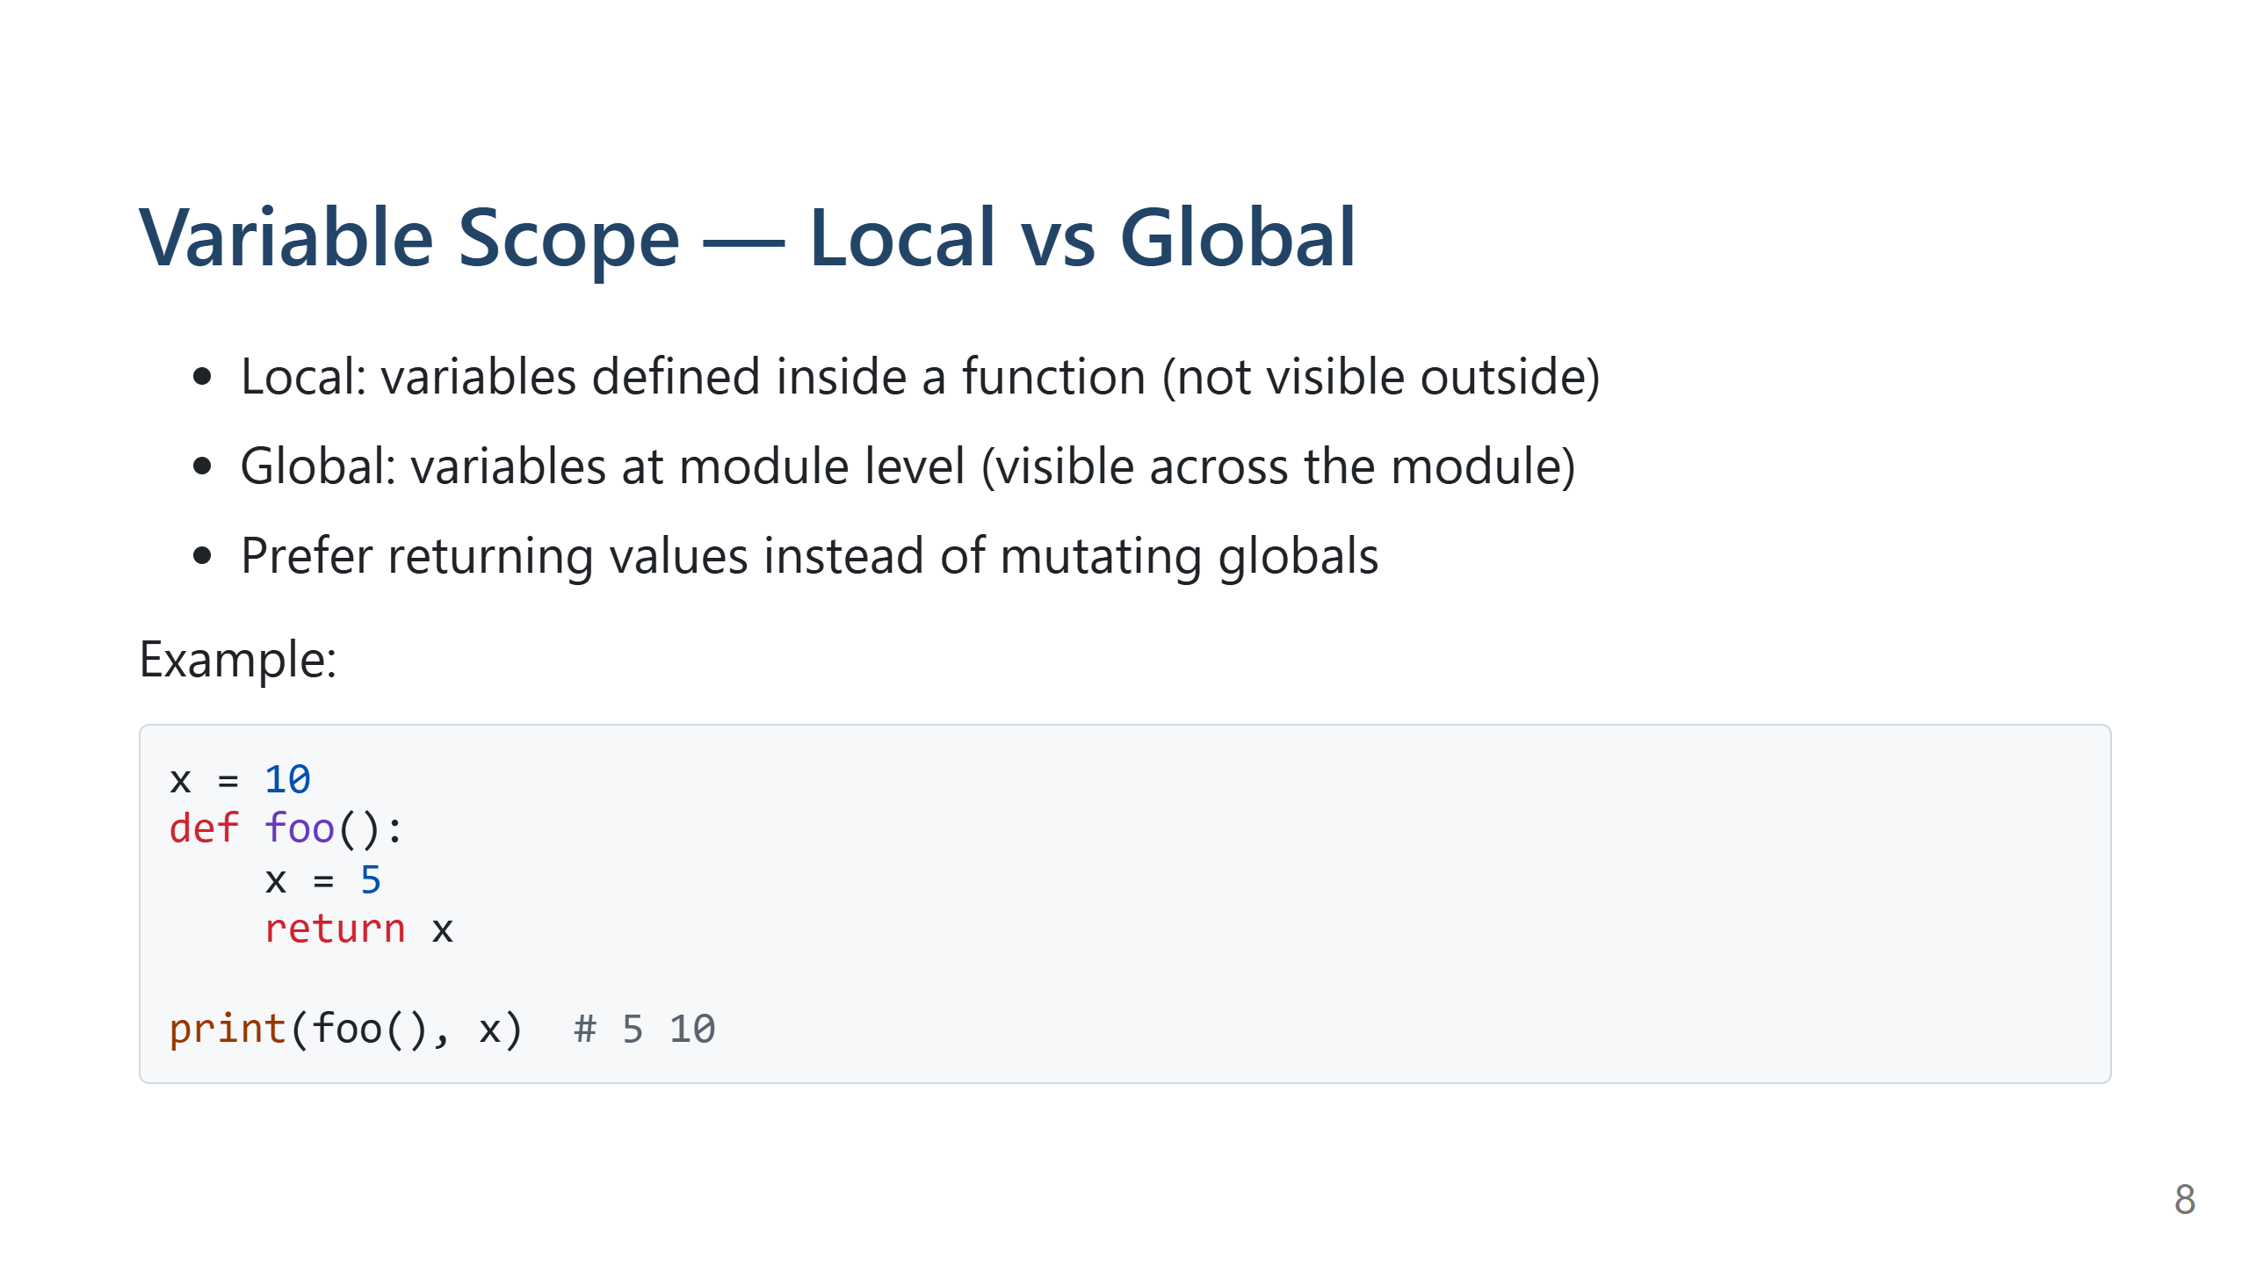
Notes:
Expanded Speaker Notes (≈45s)
Explain exact behavior
- Show that assigning to a name inside a function creates or rebinds a local name by default.
- To modify a module-level name, you can use `global name` — demonstrate the syntax but stress it is discouraged.
Why avoid `global` (talking points)
- Hidden side effects (function signature does not show dependency)
- Harder to test (tests must set/reset global state)
- Coupling across modules leads to brittle code and bugs
- Concurrency hazards if code runs concurrently
Alternatives to `global`
- Pass the value in and return the new value
- Use an object (class) to hold mutable state and methods to manipulate it
- Use a module-level read-only constant for config (OK), but avoid runtime reassignments
Small demo/refactor
- Show bad example with a global counter, then refactor to:
def increment(counter): return counter+1
or use a Counter class.
Class exercise prompt
- Ask students to identify any global variables in their current code and suggest a refactor.

Slide 9
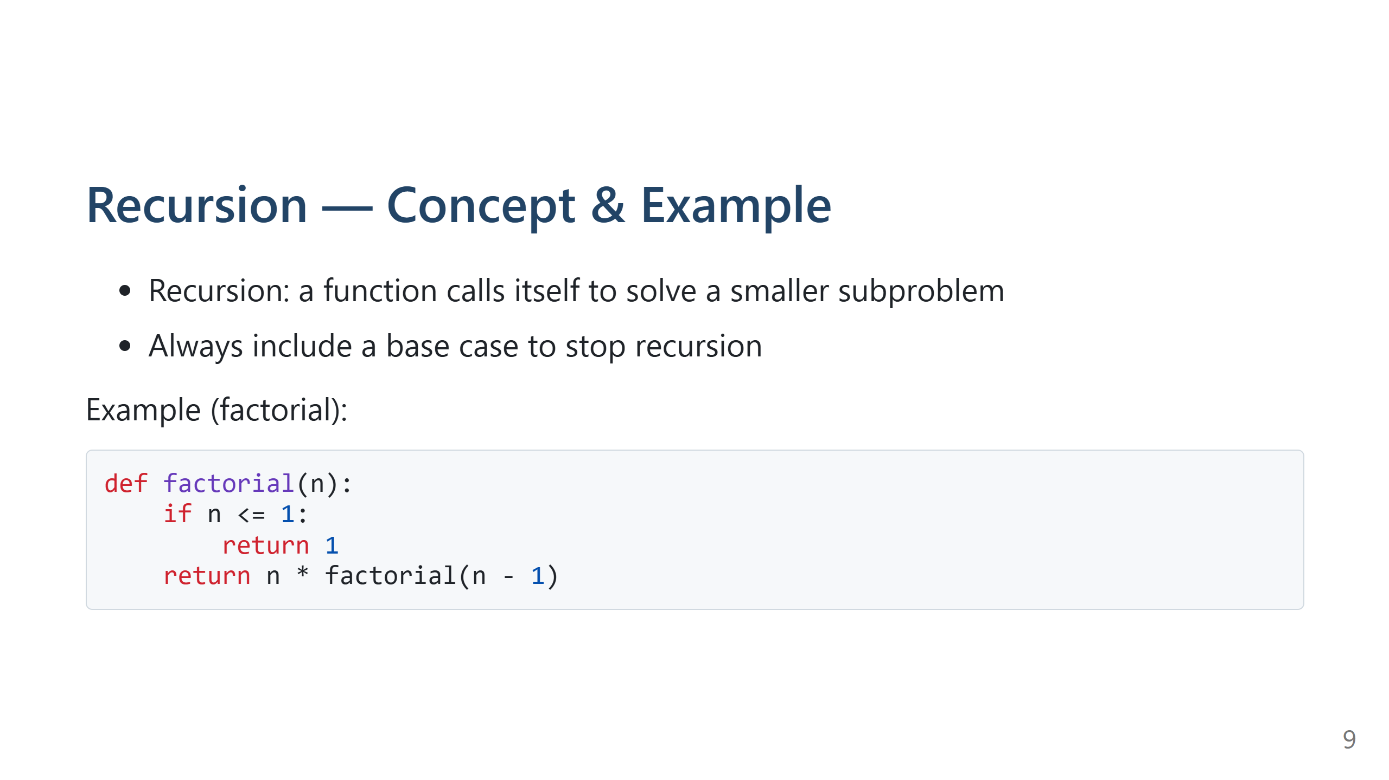
Notes:
Expanded Speaker Notes (≈1 min)
Trace example step-by-step
- Draw or verbally show the call stack for factorial(4)
- Emphasize the base case and how it prevents infinite recursion
Performance considerations
- Recursion can be elegant but sometimes slower and memory-intensive — discuss stack depth limits and RecursionError
- For large n, prefer iterative solutions or memoization (show a simple memoized fib example with a cache dict)
When recursion is appropriate
- Recursive solutions are natural for tree traversal, divide-and-conquer algorithms (merge sort), and some mathematical definitions.
- For simple sequences, iterative may be simpler and safer.
Quick classroom task
- Ask students to implement both recursive and iterative factorial and compare readability and performance for small n.

Slide 10
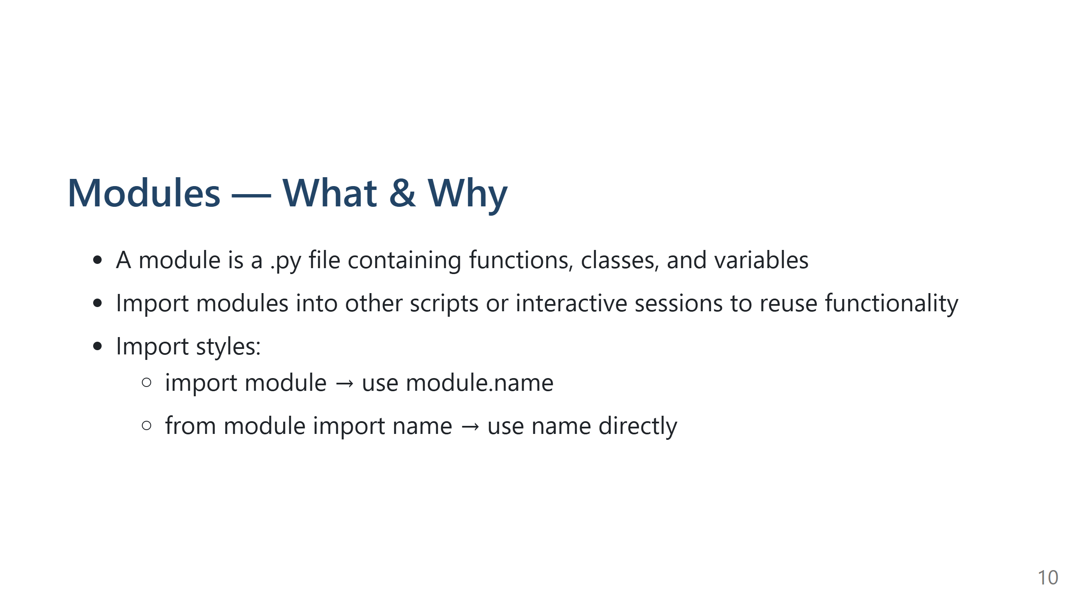
Notes:
Expanded Speaker Notes (≈30s)
Clarify terminology
- Module: a single .py file
- Package: a directory with __init__.py (optional in newer Python) that groups modules
Import rules & namespace
- Explain how imports create a namespace and why module.name is explicit and easy to read
- Show that from module import name brings the name into the current namespace and can shadow local names (possible source of bugs)
Practical example
- Mention that modules are the unit of code sharing and organization: e.g., math, random, pandas are modules you import.

Slide 11
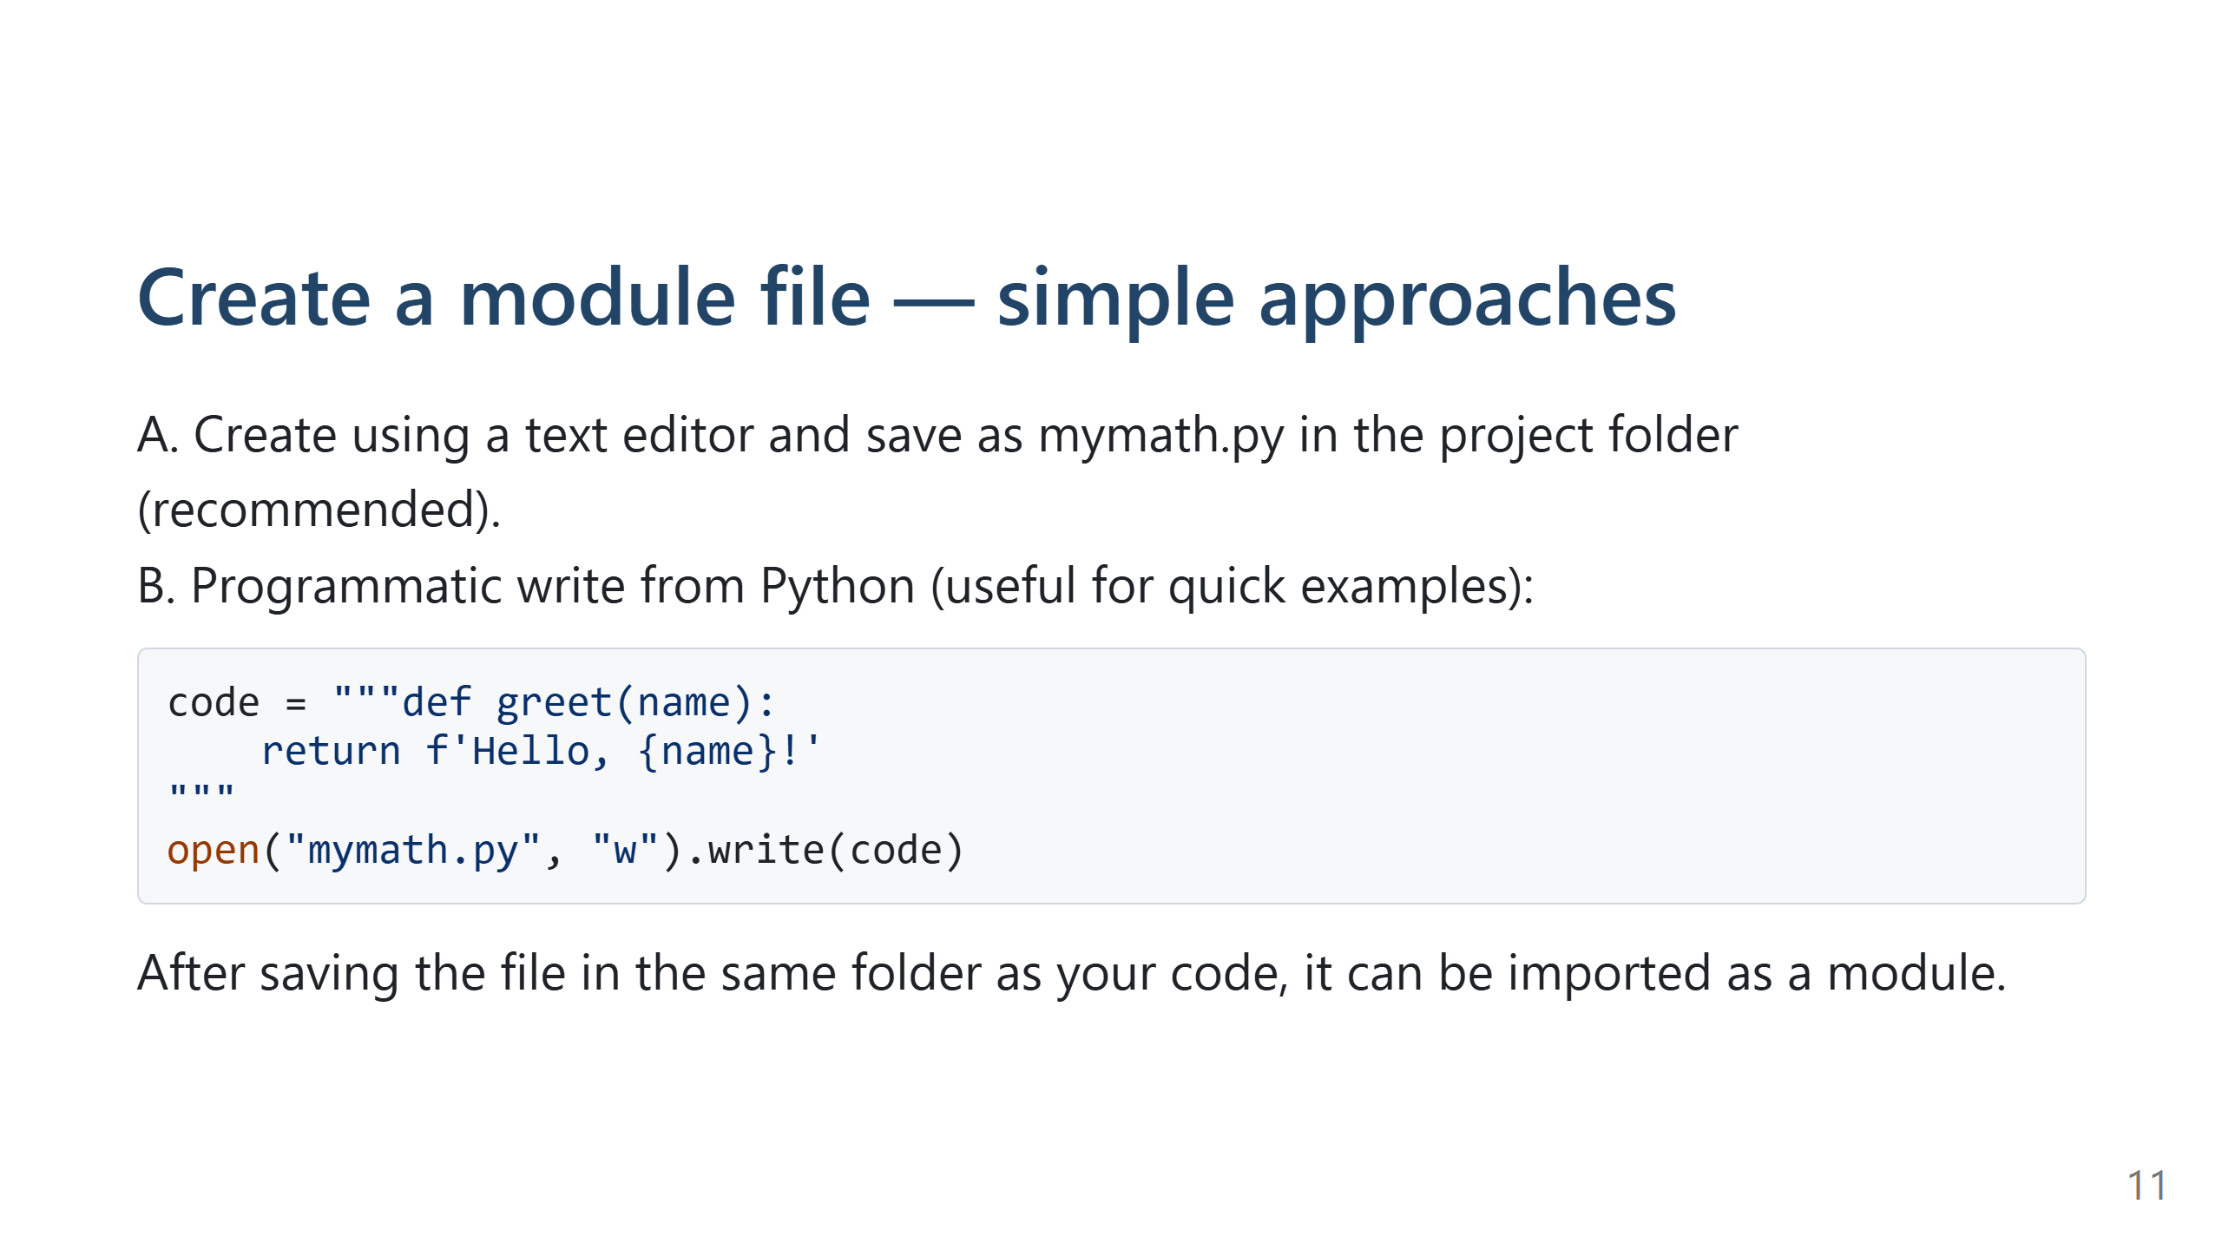
Notes:
Expanded Speaker Notes (≈45s)
Practical tips for students
- Save modules in the same folder as the script that will import them or place them somewhere on sys.path.
- Use meaningful file/module names (no hyphens or spaces).
- Recommend editors that show project folders (VS Code) for clarity.
Demonstrate step-by-step
- Create mymath.py with functions, save it, then open a new REPL or script and import it.
- If editing a module while the REPL is open, show how to reload it using importlib.reload(module).
Mention simple debugging hints
- If ImportError occurs, check current working directory and sys.path.
- Avoid naming modules the same as standard library modules (e.g., random.py) to prevent shadowing.

Slide 12
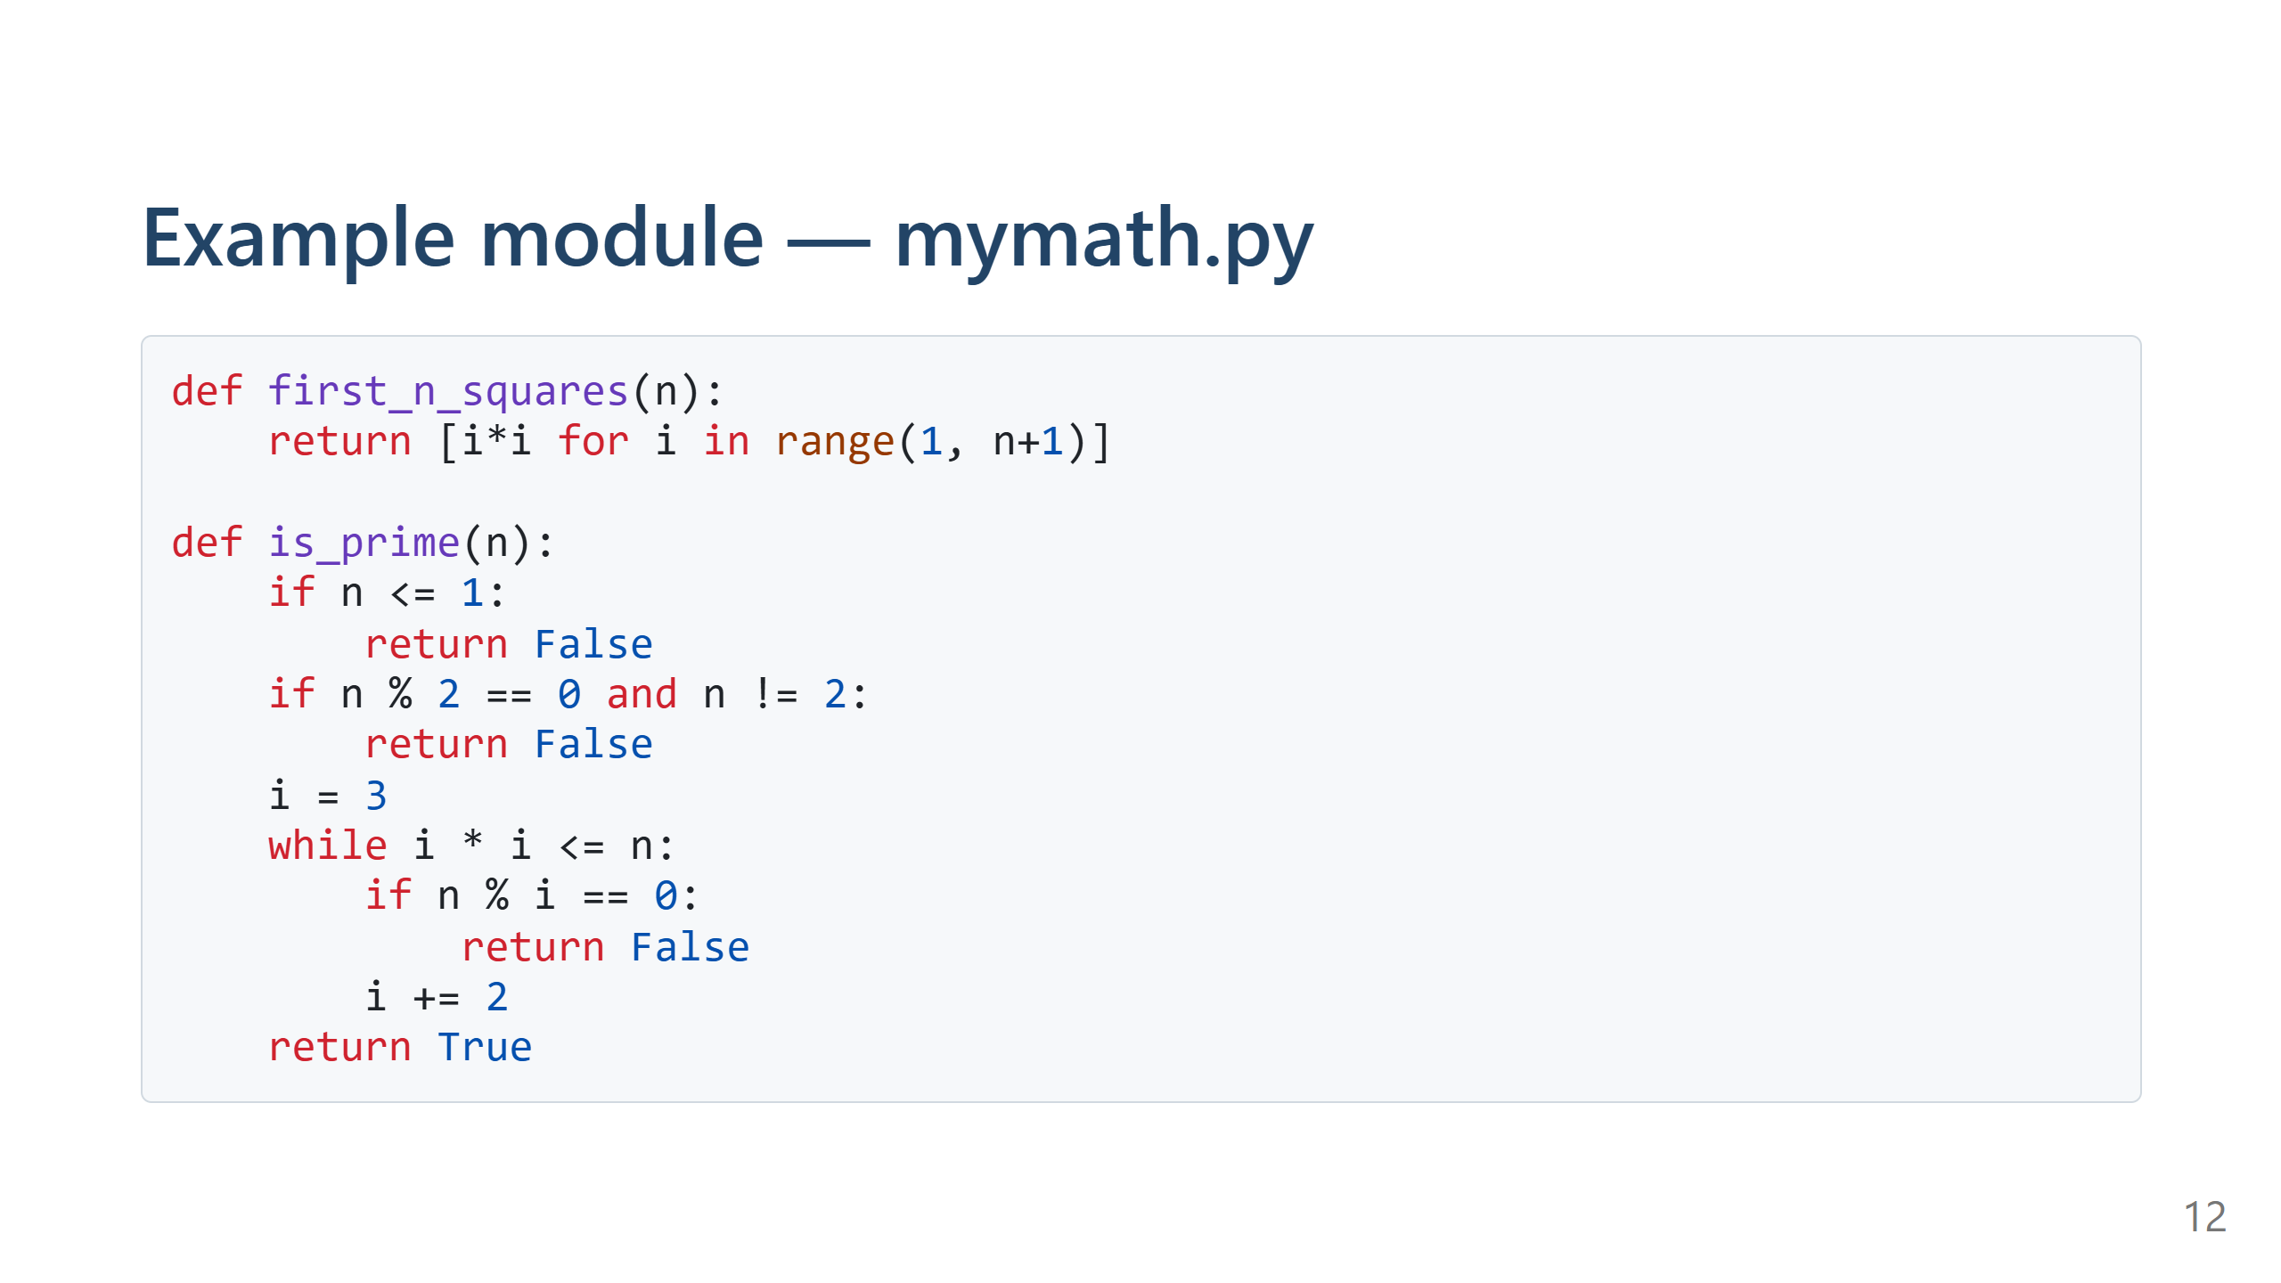

Slide 13
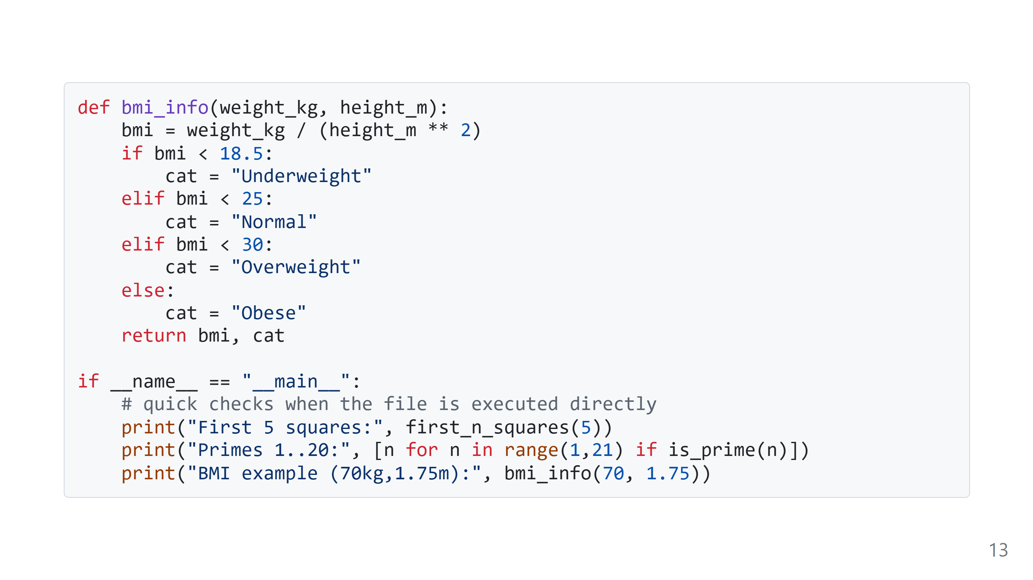
Notes:
Expanded Speaker Notes (≈1 min)
Walkthrough function-by-function
- first_n_squares: show list comprehension and ask about its complexity O(n)
- is_prime: explain improved checks (even numbers and odd divisors only) and mention limitations for very large numbers — fine for class exercises
- bmi_info: discuss units (kg/m) and why docstrings should specify units
Explain __main__ block
- Purpose: run quick demos or simple tests when the file is executed directly; these do not execute when module is imported
- Encourage adding a few asserts or small tests inside the block for quick manual verification
Class activity
- Ask students to extend mymath.py with a function that returns top-n primes and test it in the demo block.

Slide 14
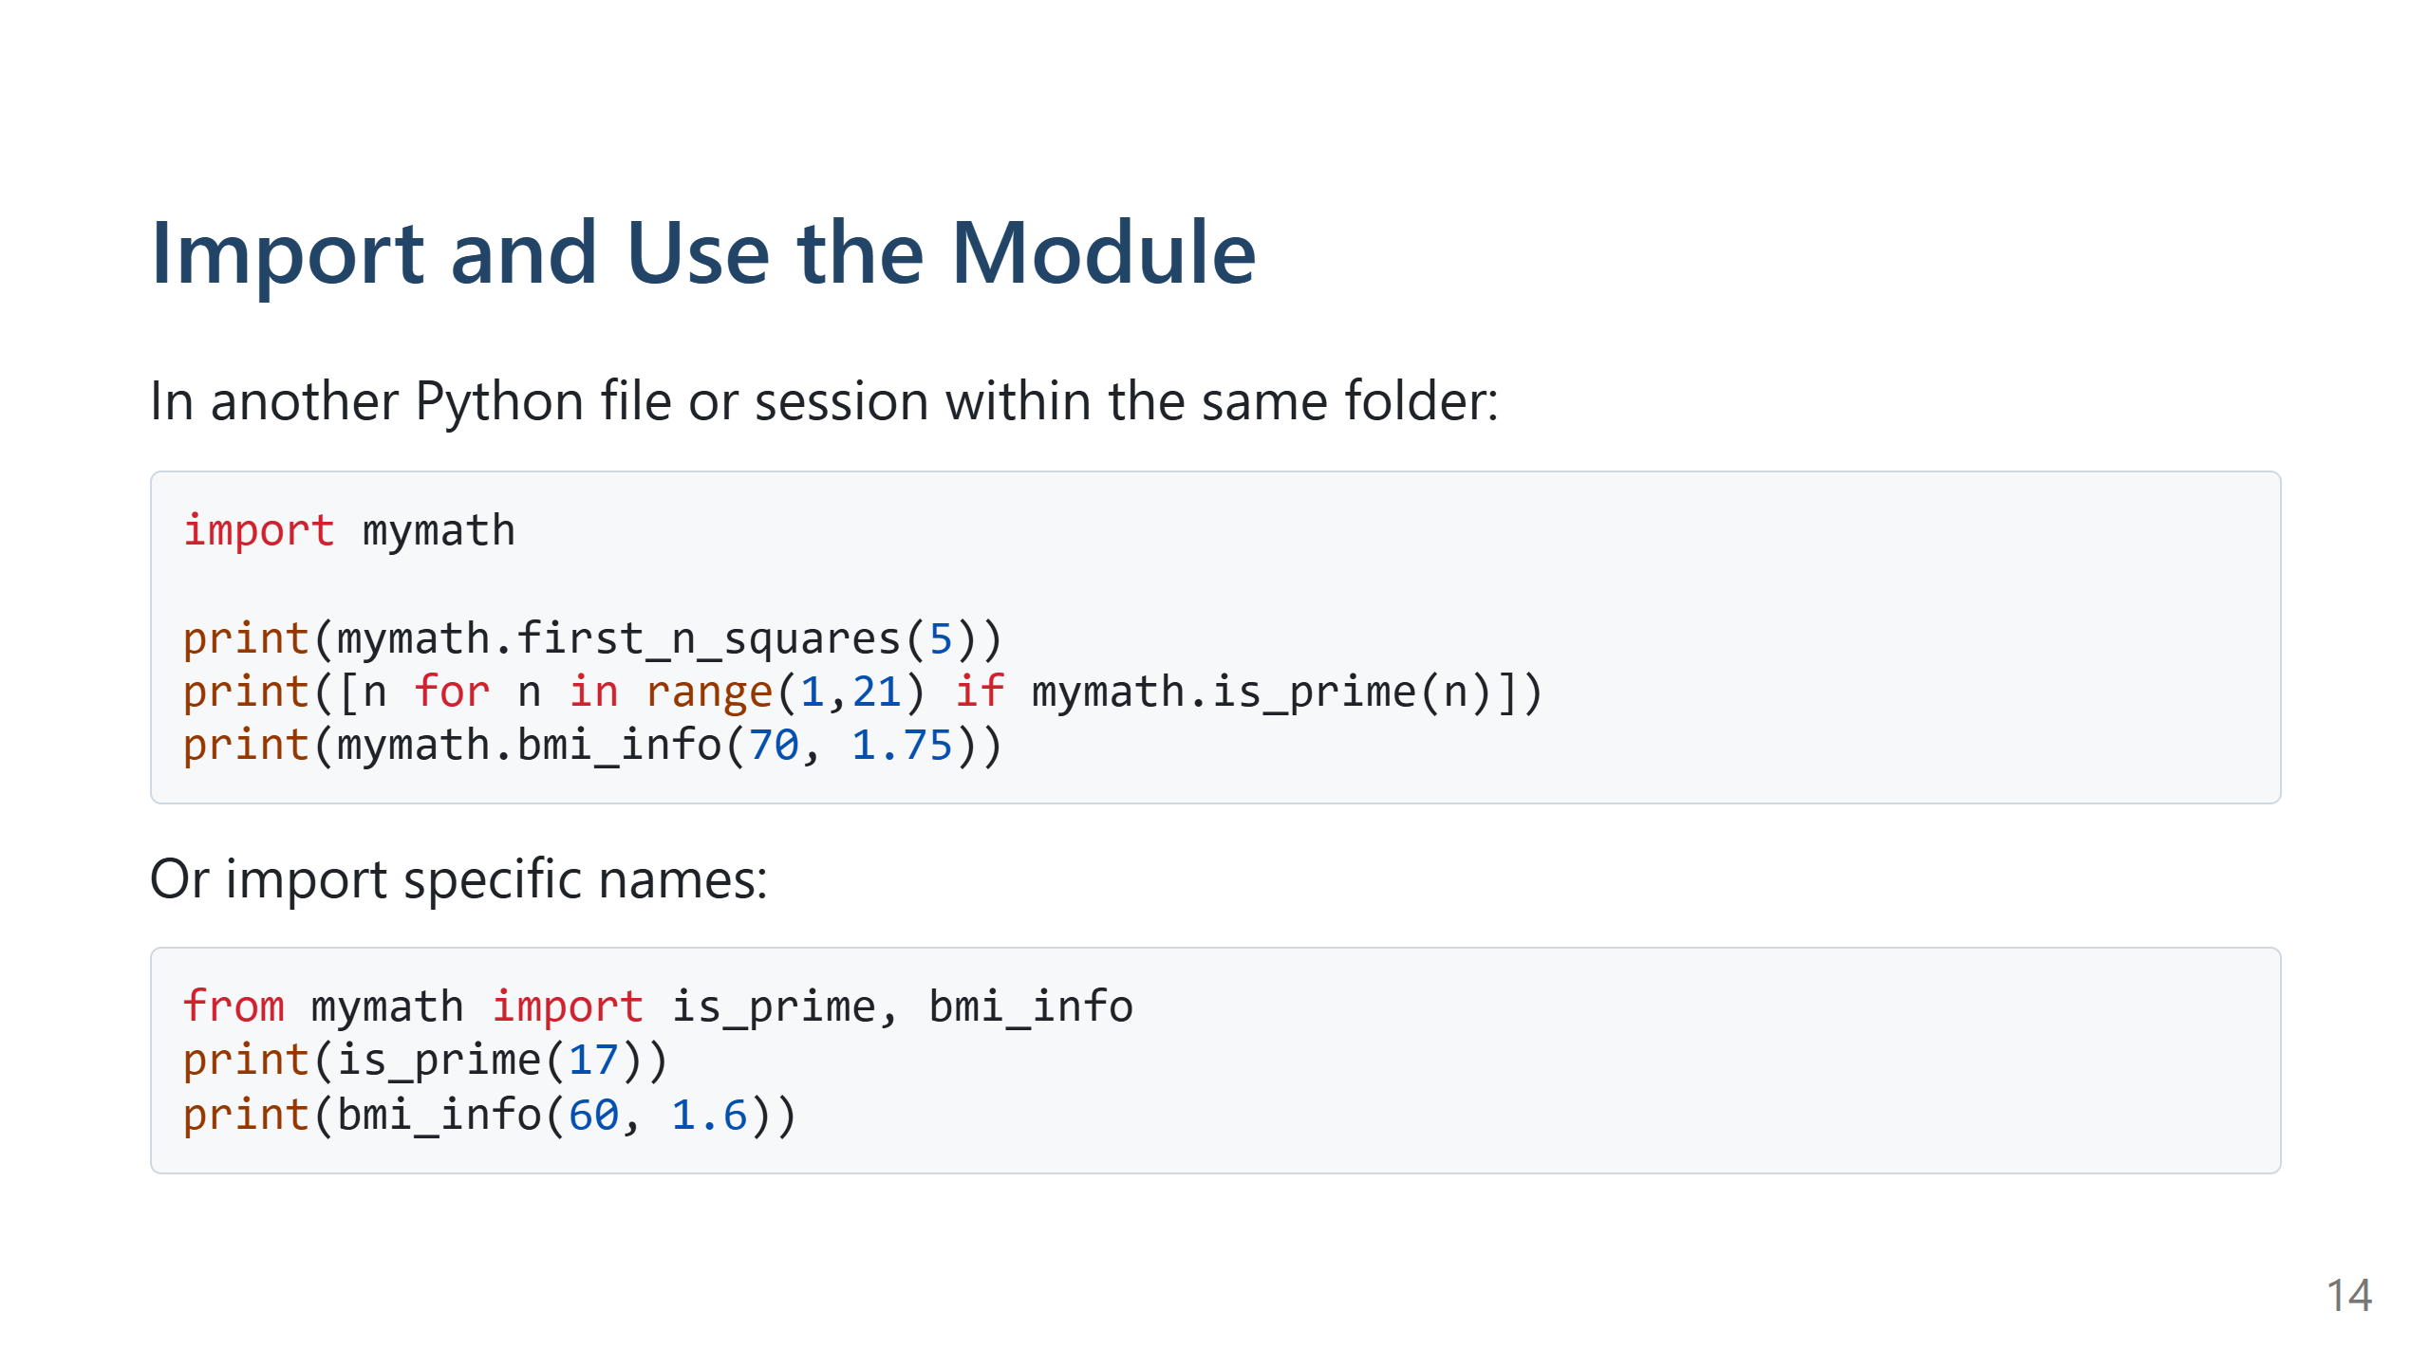
Notes:
Expanded Speaker Notes (≈45s)
Explain behavior differences
- import mymath: module is loaded and you use qualified names (mymath.function). This makes it clear where functions come from.
- from mymath import name: imports name into current namespace directly — useful for convenience but can hide origins and cause name clashes.
Best practice recommendation
- For classroom code and small scripts, explicit import (import module) is safer and clearer. In short throwaway scripts, selective imports are fine.
Troubleshooting tips
- If import fails, check file is saved and working directory is correct.
- If you change the module and the running session does not reflect changes, show importlib.reload(mymath).

Slide 15
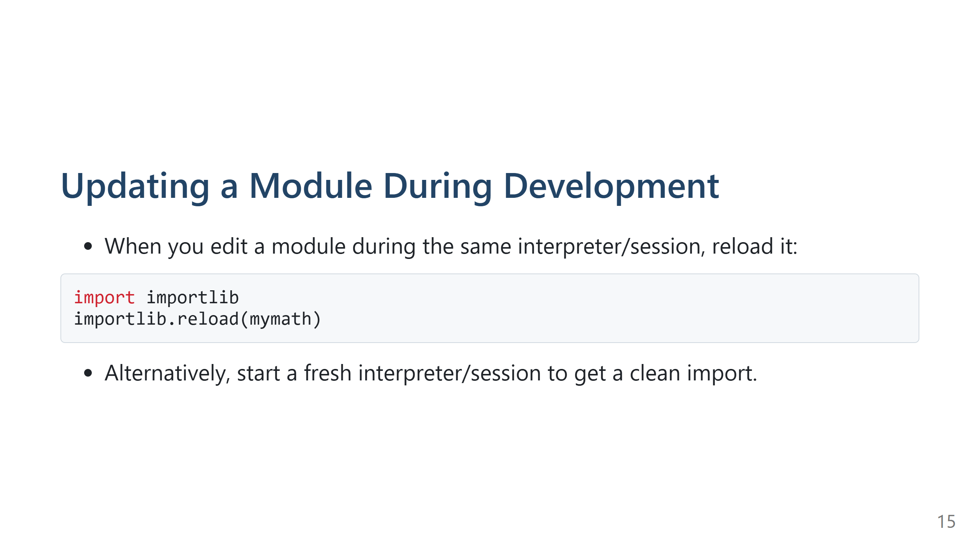
Notes:
Expanded Speaker Notes (≈30s)
Why reload is needed
- Python caches modules in sys.modules — subsequent imports return the cached module. importlib.reload forces Python to re-execute the module code and update the module object.
Limitations & caveats
- reload will update the module object but any names previously imported via `from module import name` will still refer to the old object. Recommend using `import module` when iterating and reloading, or re-import names explicitly after reload.
Practical workflow for students
- Edit module file, run importlib.reload(mymath) in the running session, then re-run the test calls. If things get confused, restart the interpreter for a clean state.

Slide 16
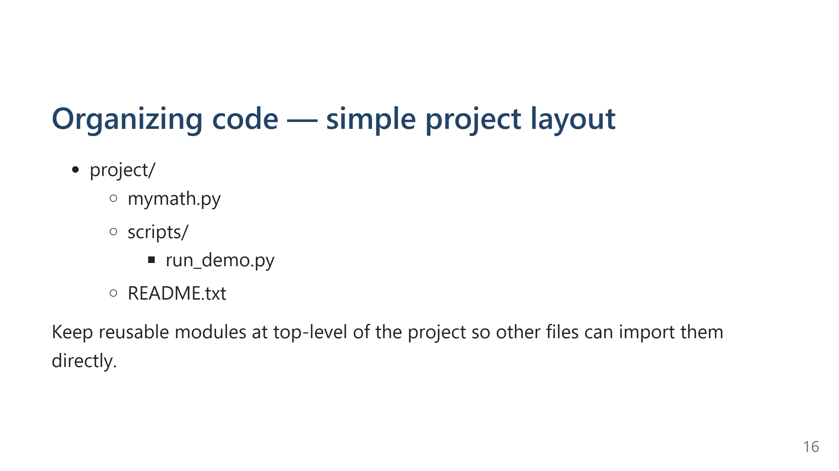
Notes:
Expanded Speaker Notes (≈30s)
Explain reasoning behind layout
- Top-level modules are easy to import without messing with sys.path.
- scripts/ holds runnable scripts that orchestrate modules — keeps responsibilities separate.
- README should include exact run steps and any environment notes.
Class suggestion
- Encourage students to create their project folder and save mymath.py and a small runner script there for the assignment.

Slide 17
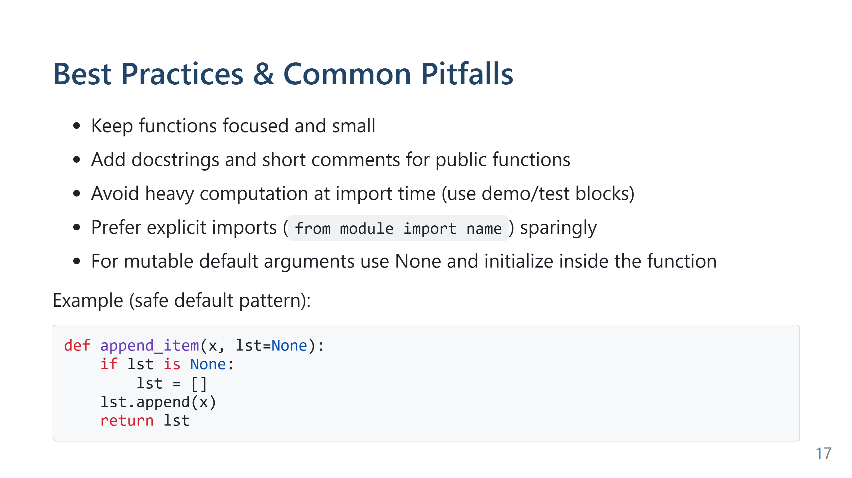
Notes:
Expanded Speaker Notes (≈1 min)
Explain each practice with concrete examples
- Small focused functions: easier to read, test, and reuse
- Docstrings: show how to quickly document args/returns and include short examples in the docstring for future readers
- Heavy work at import: explain that modules imported by many other modules should avoid expensive setup (e.g., large data loads) at import time — perform those inside functions or in the __main__ block
- Mutable default pitfalls: repeat the bad example and fix; show how surprising behavior can persist across calls
Testing & verification
- Encourage students to include simple assertion tests or a small tests/ folder with scripts that import modules and assert expected outputs.

Slide 18
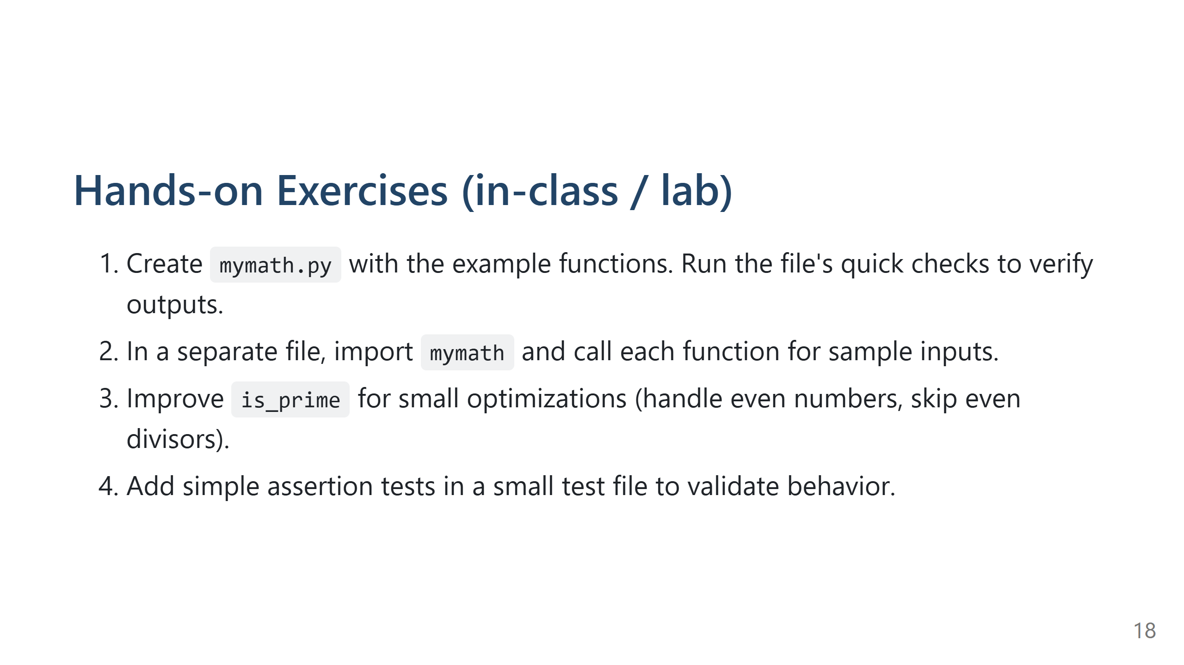
Notes:
Expanded Speaker Notes (≈5–12 min)
Lab facilitation guidance
- Walk students through the tasks step-by-step if time permits.
- Suggested pacing:
- 0–2 min: create mymath.py with first_n_squares and bmi_info
- 2–6 min: test in a separate file or REPL and debug simple mistakes
- 6–10 min: implement/improve is_prime and test it for 1..50
- 10–15 min: add a small test file with a few assertions (e.g., assert is_prime(17) is True)
Debugging tips to offer
- If an import fails, print os.getcwd() to check the current folder and ensure mymath.py is present.
- If changes don't appear, explain importlib.reload and re-import patterns.
Encourage collaboration
- Let students compare implementations and discuss edge cases (e.g., is_prime for negative numbers).

Slide 19
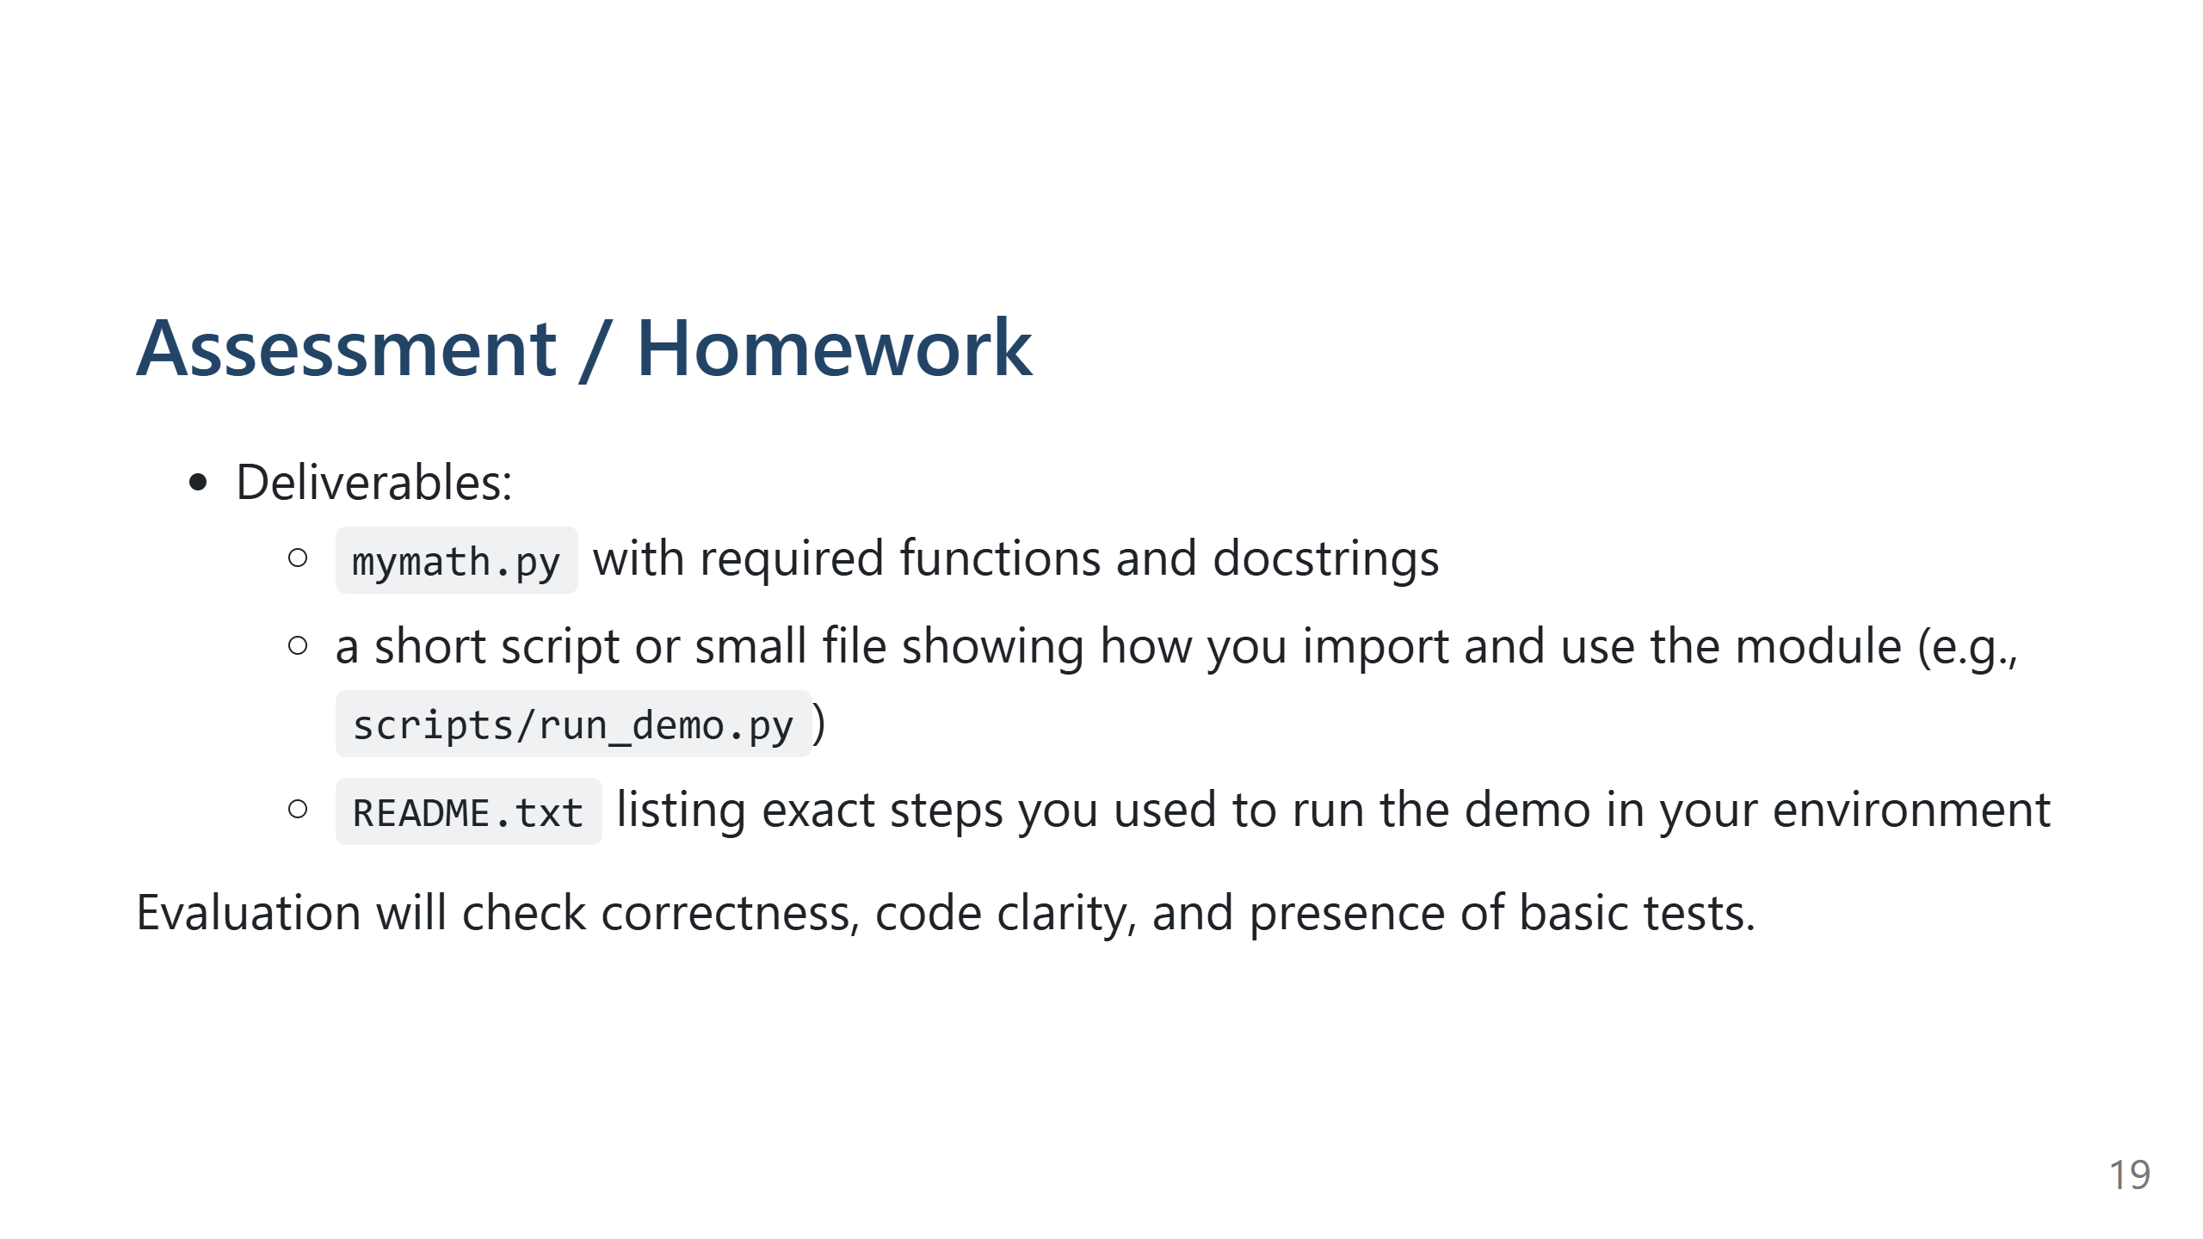
Notes:
Expanded Speaker Notes (≈30s)
Grading rubric guidance (tell students)
- Correctness: functions produce expected outputs for normal inputs (60%)
- Code clarity & documentation: readable names and docstrings (20%)
- Tests & reproducibility: included simple tests and clear README with run steps (20%)
Submission advice
- Encourage students to include exact commands and file locations in README and to attach a short note about any special environment or Python version used.

Slide 20
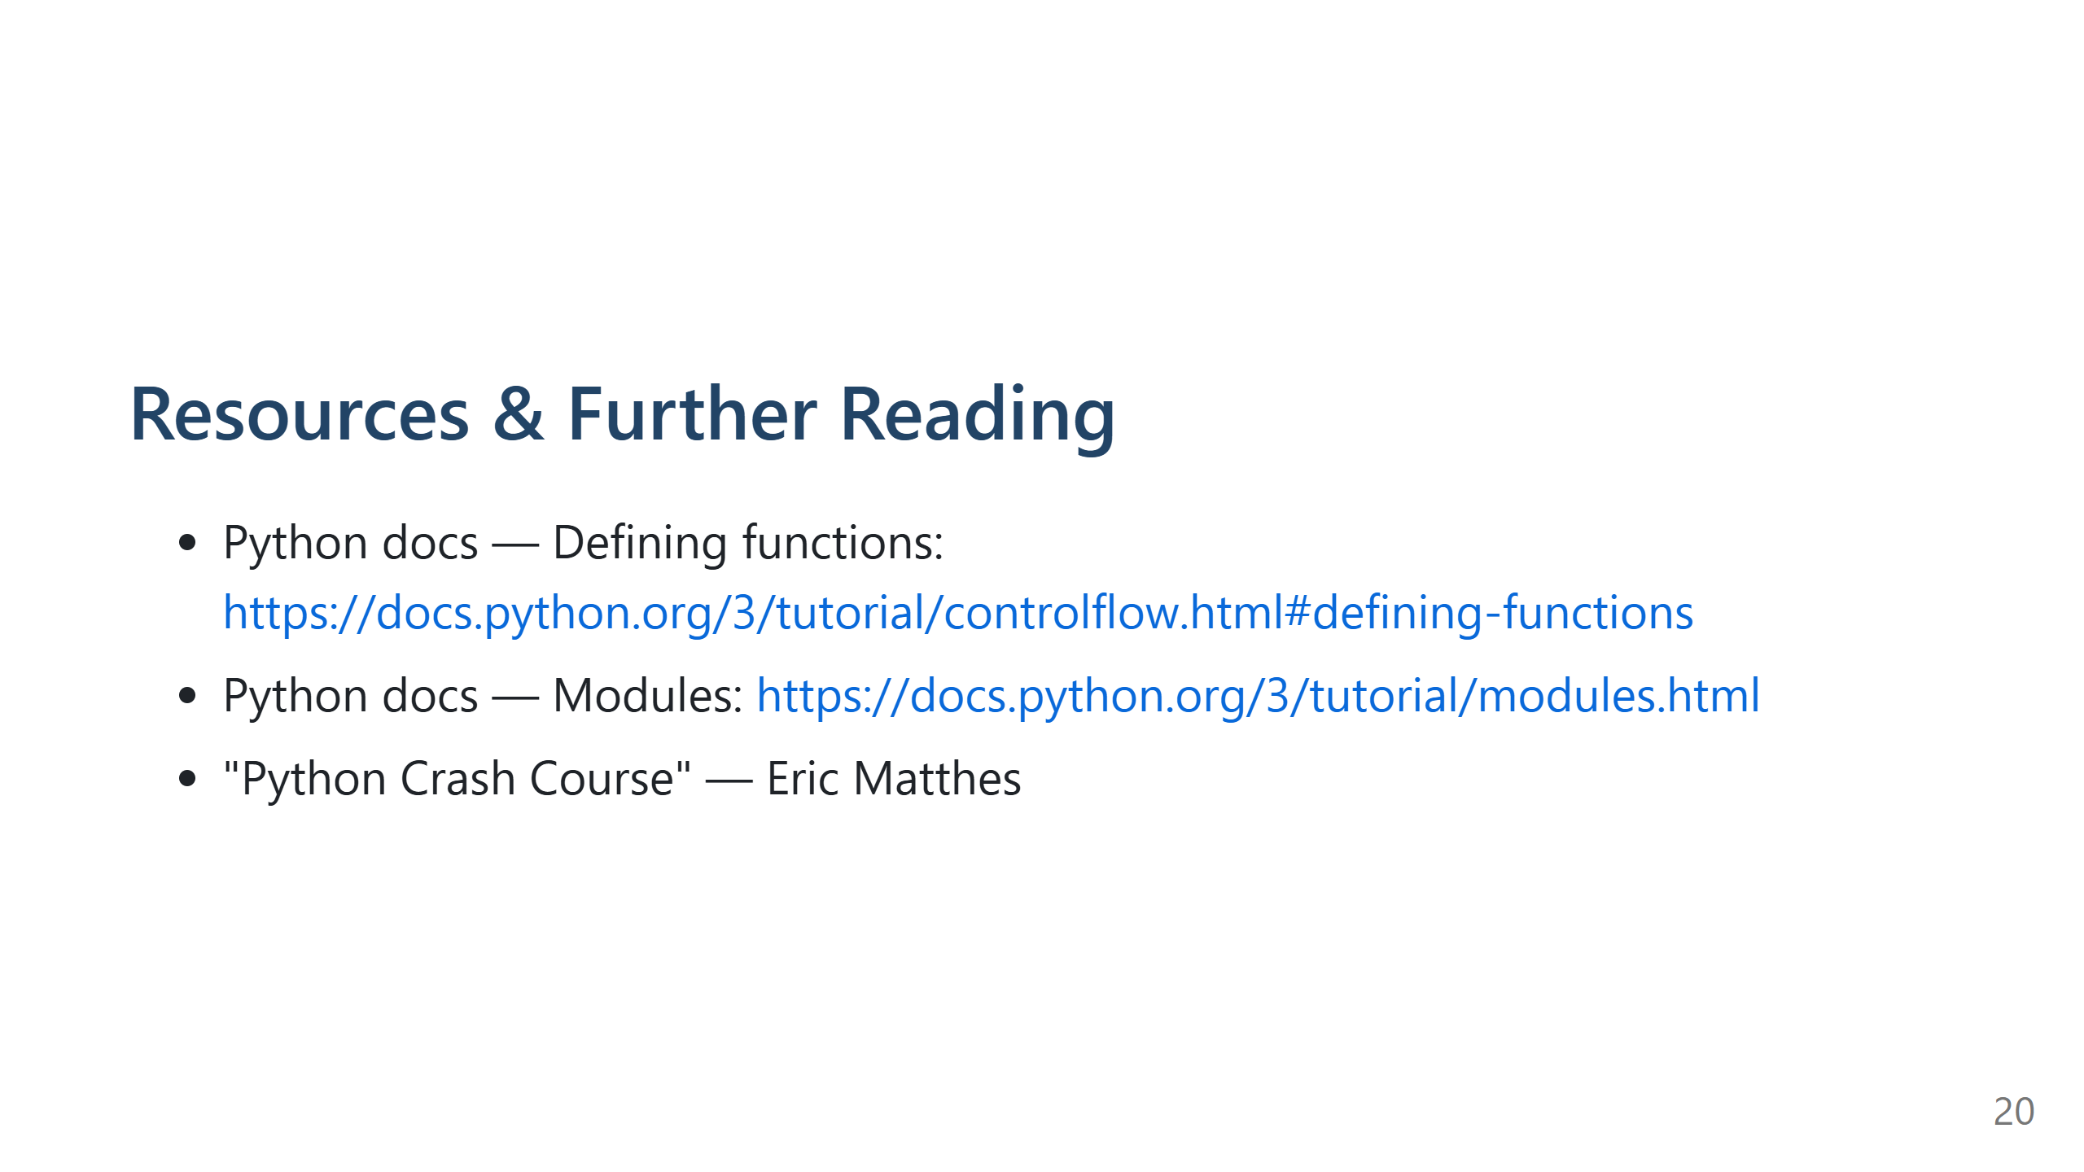
Notes:
Expanded Speaker Notes (≈15s)
Encourage further reading
- Mention recommended chapters for deeper reading and quick lookup.
- Recommend practice: re-implement a small utility and turn it into a module for the next class.

Slide 21
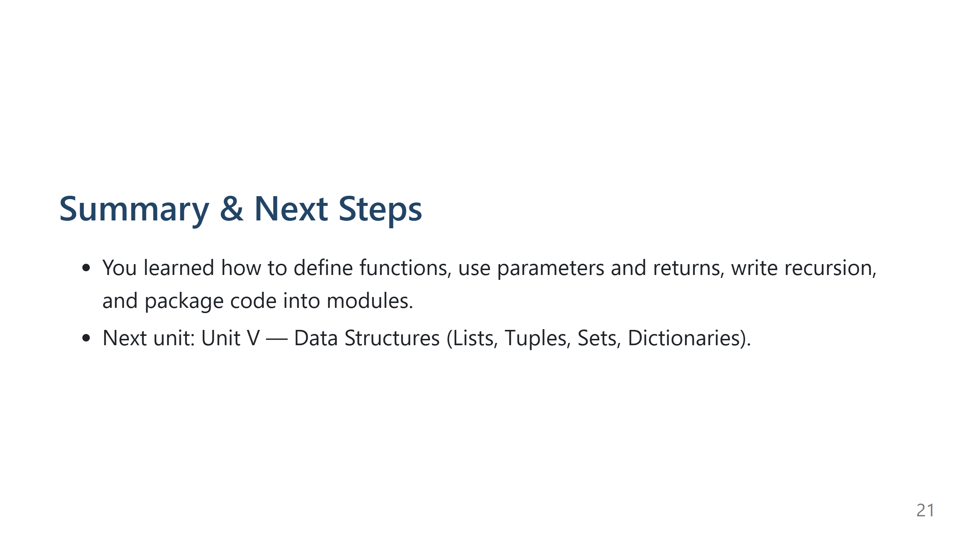
Notes:
Expanded Speaker Notes (≈1 min)
Wrap-up
- Reiterate key takeaways: explicit inputs/outputs; prefer returning values over mutating global state; keep functions small and documented.
- Remind students of homework deliverable and where to submit it.
Q&A
- Leave 2–3 minutes for questions. Ask students to state one concept they found confusing or would like to revisit in the next class.

