Slide 1
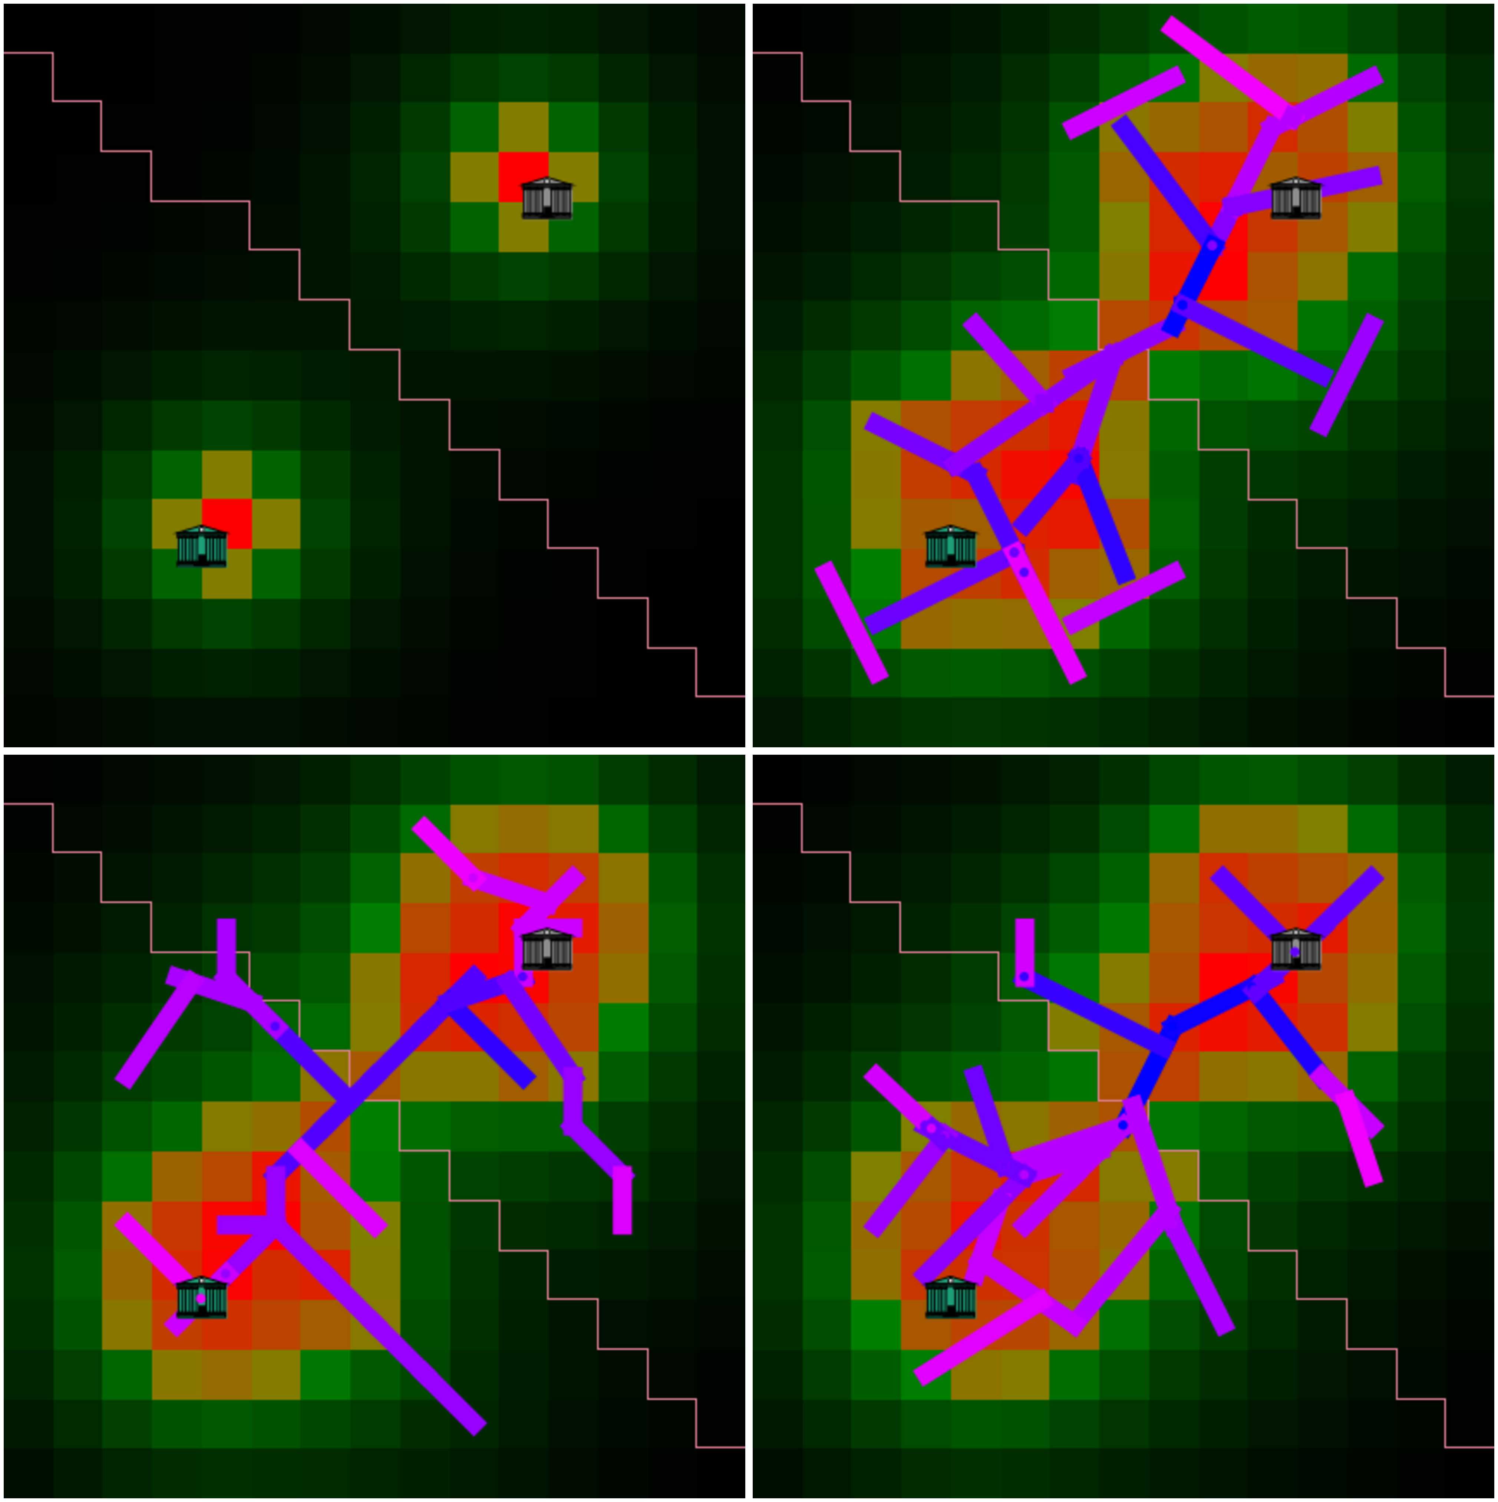
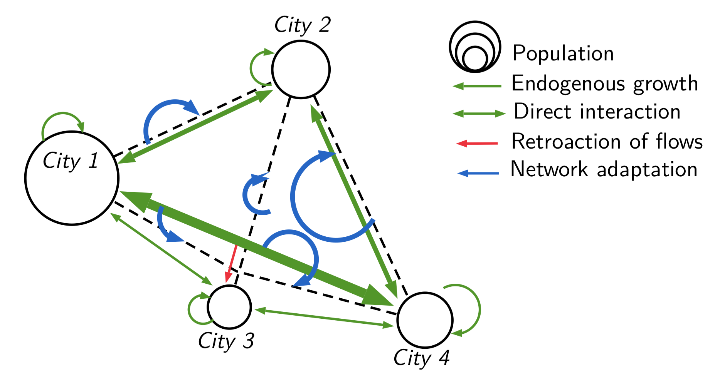
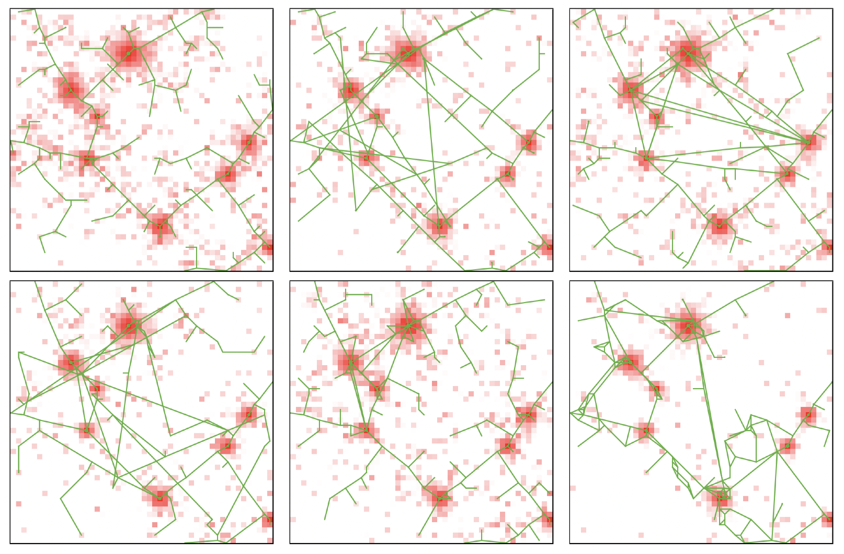
Land-use transport interactions, urban morphogenesis and systems of cities
Raimbault, J. (2020). Indirect evidence of network effects in a system of cities. Environment and Planning B: Urban Analytics and City Science, 47(1), 138-155.
Raimbault, J., & Le Néchet, F. (2021). Introducing endogenous transport provision in a LUTI model to explore polycentric governance systems. Journal of Transport Geography, 94, 103115.
Raimbault, J. (2018). Calibration of a density-based model of urban morphogenesis. PloS one, 13(9), e0203516.

