Slide 1
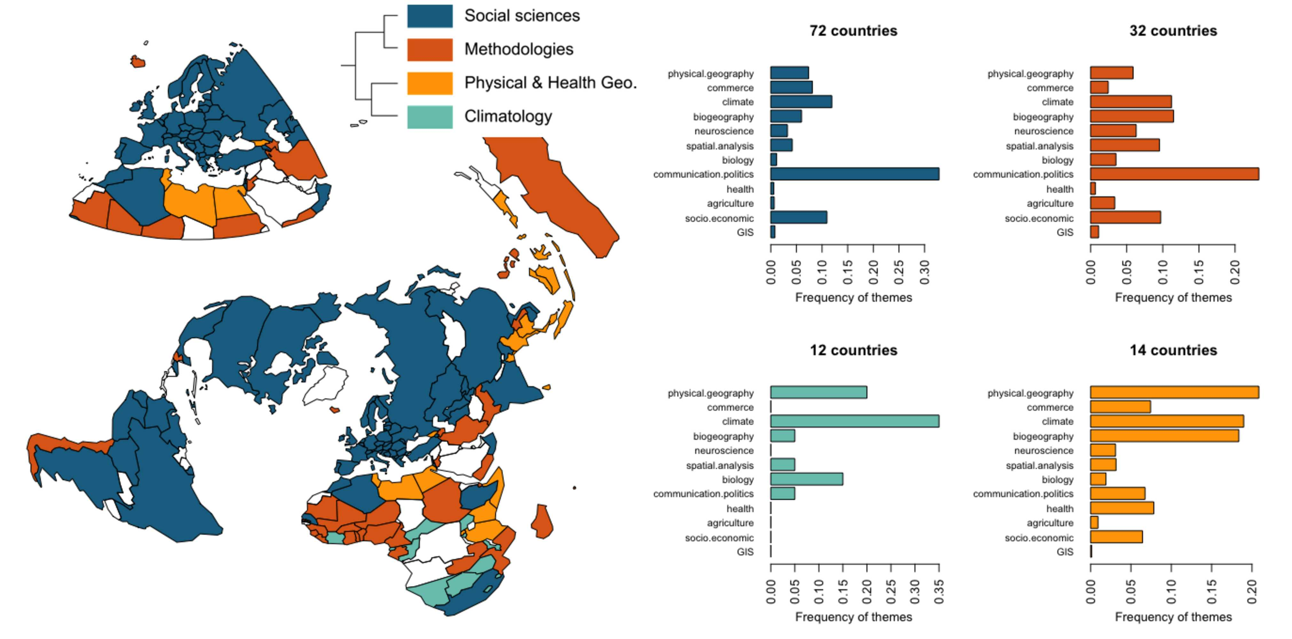
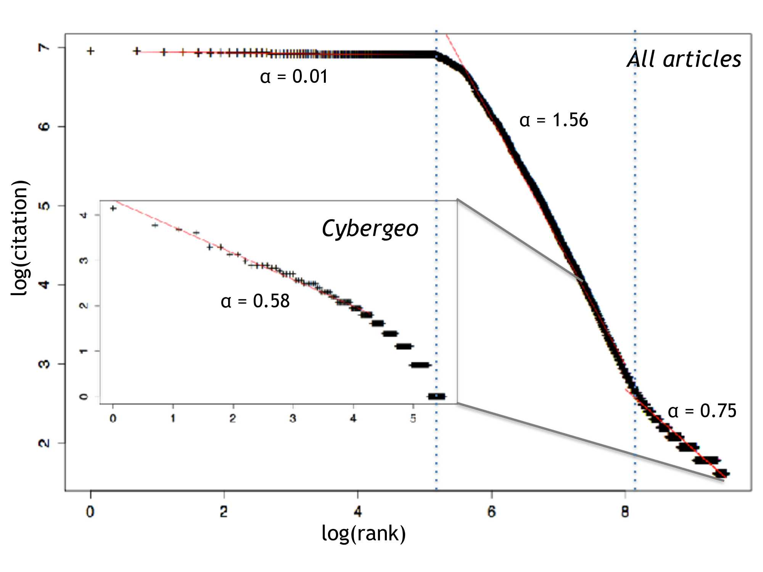
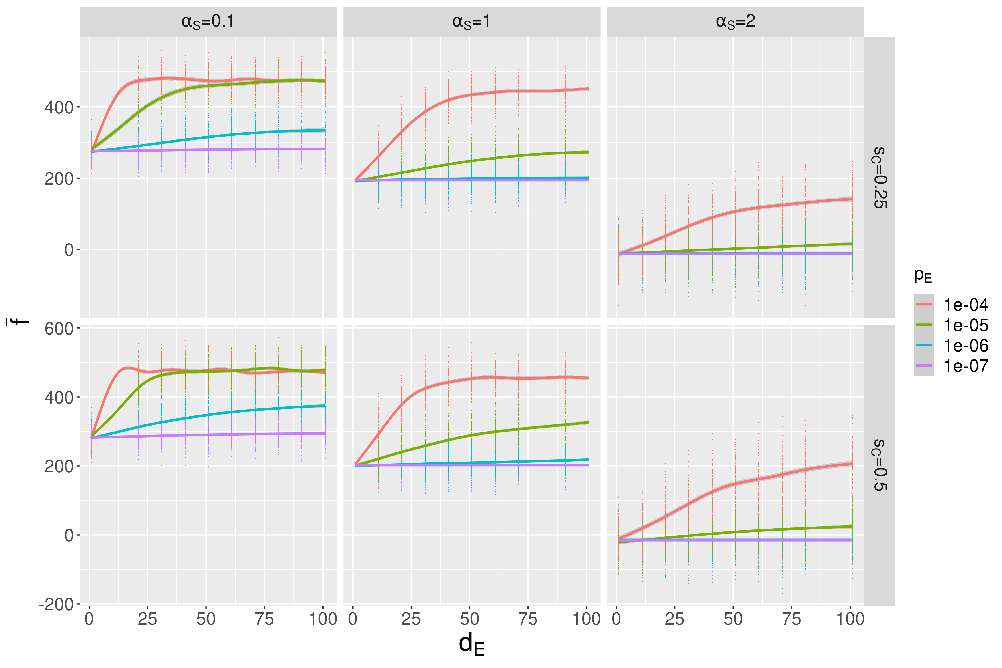
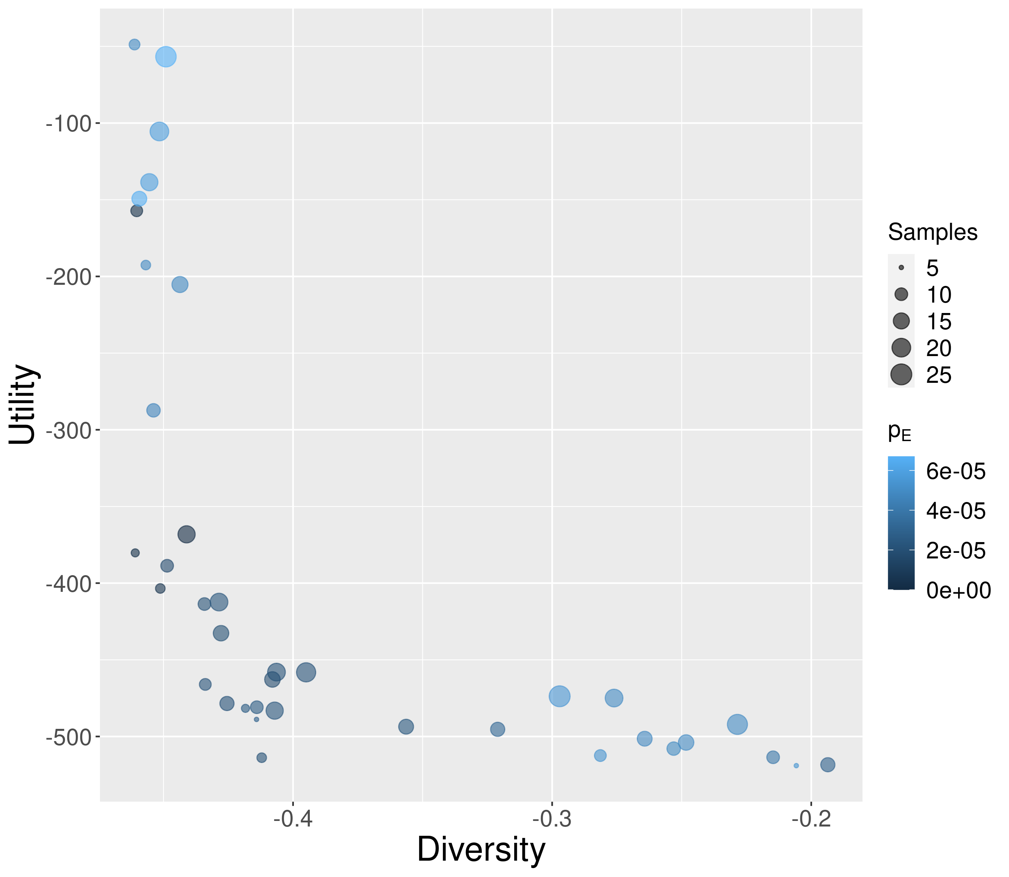
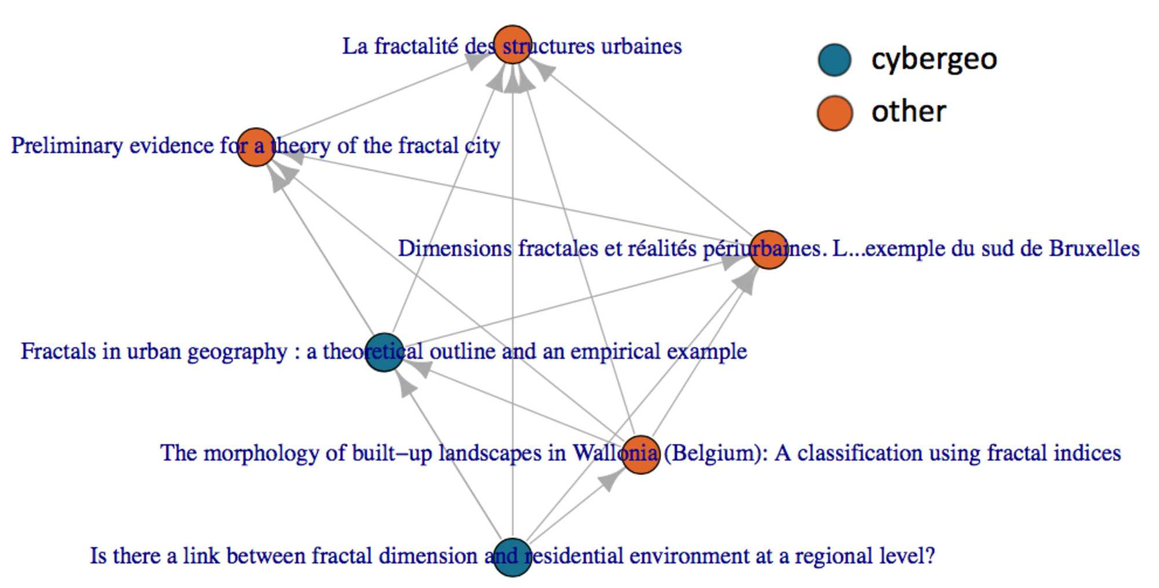
Scientometrics and
quantitative epistemology
Raimbault et al. (2021). Empowering open science with reflexive and spatialised indicators. Environment and Planning B: Urban Analytics and City Science, 48(2), 298-313.
Raimbault, J. (2022). Innovation and informal knowledge exchanges between firms. In ALIFE 2022: The 2022 Conference on Artificial Life. MIT Press.
Raimbault, J. (2019). Exploration of an interdisciplinary scientific landscape. Scientometrics, 119(2), 617-641.

