Slide 1
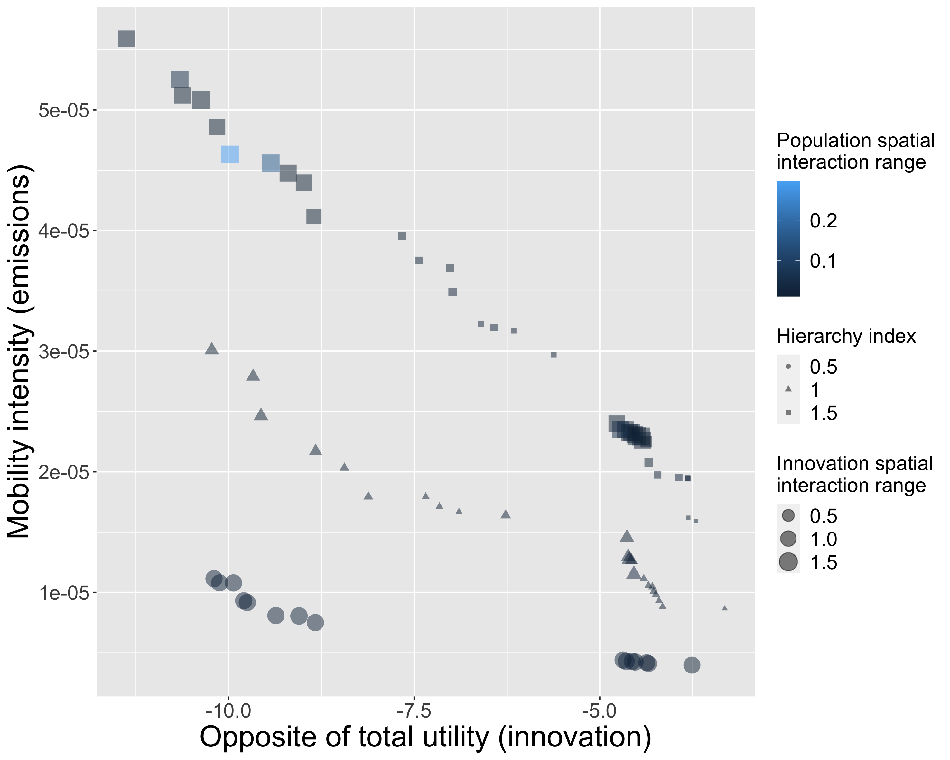
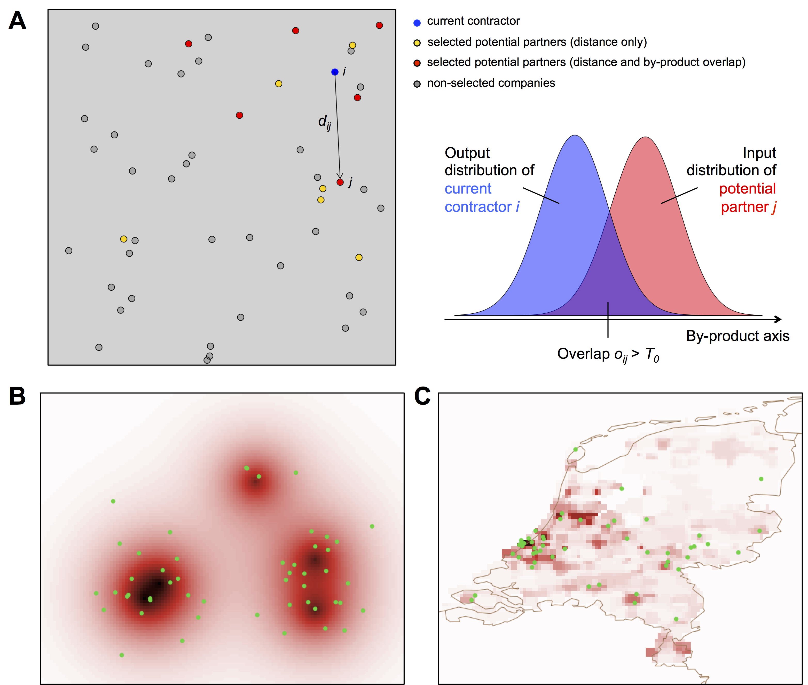
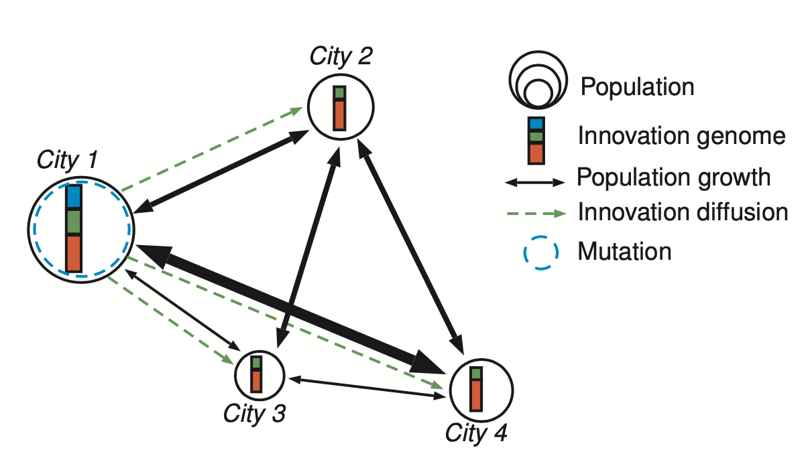
Agent-based modeling for sustainability
Raimbault et al. (2020). A spatial agent based model for simulating and optimizing networked eco-industrial systems. Resources, Conservation and Recycling, 155, 104538.
Raimbault, J., & Pumain, D. (2022). Trade-offs between sustainable development goals in systems of cities. Journal of Urban Management.

