Slide 1
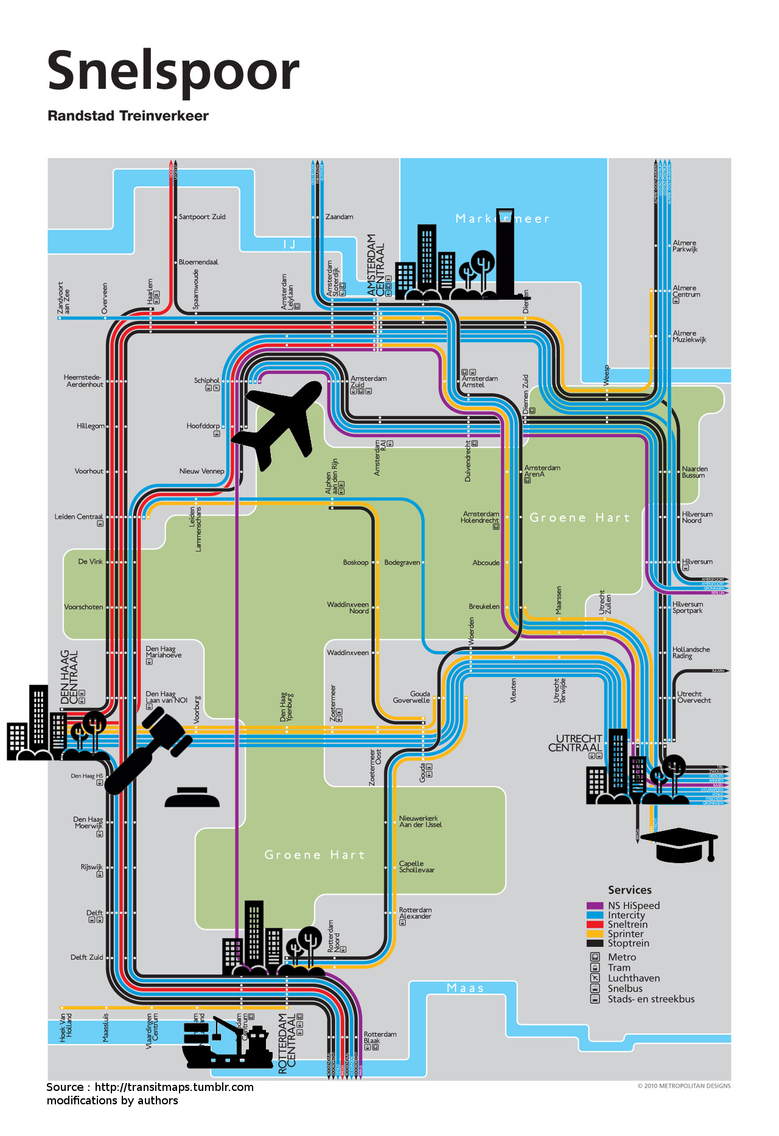


Modeling the emergence of metropolitan transport autorithy in a polycentric urban region – the model LUTECIA
ECTQG 2015, Bari, 4th of September, 2015
Le Néchet Florent, Université Paris-Est, Laboratoire Ville Mobilité Transport
Raimbault Juste, Université Paris VII, Géographie-Cités
florent.lenechet@u-pem.fr

Slide 2
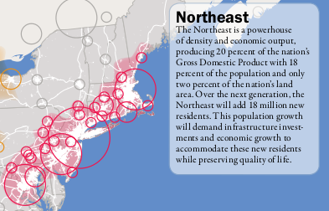
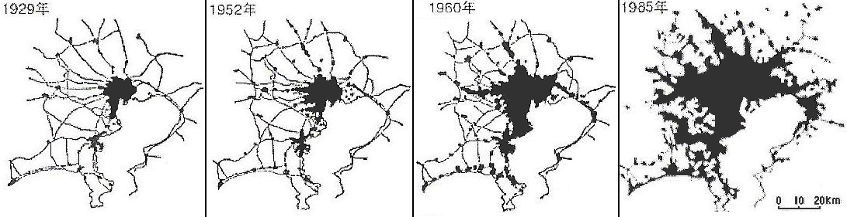
Context
From 50's emergence of Mega City Regions (Gottmann, 1957 ; Hall & Pain, 2006).
New problems to be faced
at larger spatial scales
Towards new form of
governance ?
Source : IAURIF, 2005

Slide 3
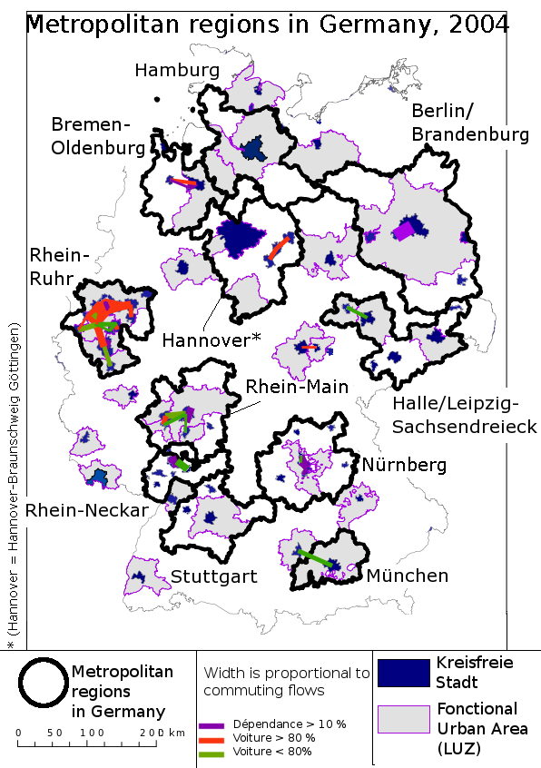
Cities, states and mega city regions
Tenfold increase in mobility
Impact at all
spatial scales :
- intra urban
- inter urban, within
Mega City Regions
- inter urbain, world
wide
 | 1960 | 1990 | 2020 | 2050
World population | 3 | 5 | 7,5 | 9,5
Total distance (x10^12 km) | 5 | 25 | 55 | 105
Distance per person per year (km) | 1700 | 5000 | 7300 | 11000
Source Schaefer & Victor, 2000 + UN + own computation
Polycentric network of cities
Source : EEA (2002)
and Urban Audit.
Boundaries of « Larger
Urban Zones »

Slide 4
Outline
Emergence of Mega City Regions
Caracteristics of a Mega City Region
Modelling framework
LUTECIA model
Discussion

Slide 5
Emergence of Mega City Regions
Champion : emergence of polycentric urban area
  Fusion
  Diffusion
  Absorbtion
Paasi : formation of centralized governance
  Identity (e.g. culture)
  Name (formalization)
  Institution (public or not)
  Capacity to sustain
e.g. Ruhr
area
e.g. Atlanta
area (Edge Cities)
e.g. Paris
area
‘most metropolitan regions in the past were focused mainly on one or perhaps two clearly defined central cities, the city-regions of today are becoming increasingly polycentric or multiclustered agglomerations’ (Scott et al., 2001, p. 18; emphasis added by Hoyler & Kloosterman).

Slide 6
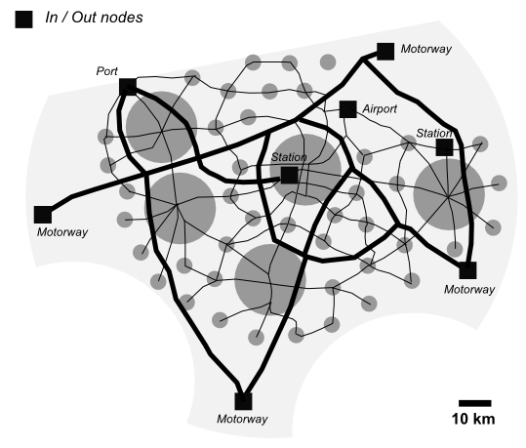
Caracteristics of MCR
Made of several urban regions
With economic and social integration
Typically served by few major international transport nodes > importance of accessibility at continental level
Has a few major metropolitan facilities (e.g. CBD, university...) > importance of accessibility at the MCR level
Transport networks play great role in creation of accessibility at MCR
No harmonized definition (Polynet network in Europe, America 2050 in US, and others...)
Flows are typically used to
define « self-sufficient »
urban region envelops
Examples : Randstad Holland (8 M inh.),
Flemish Diamond (5 M), BowWash (50 M),
Pearl River Delta (60 M)

Slide 7
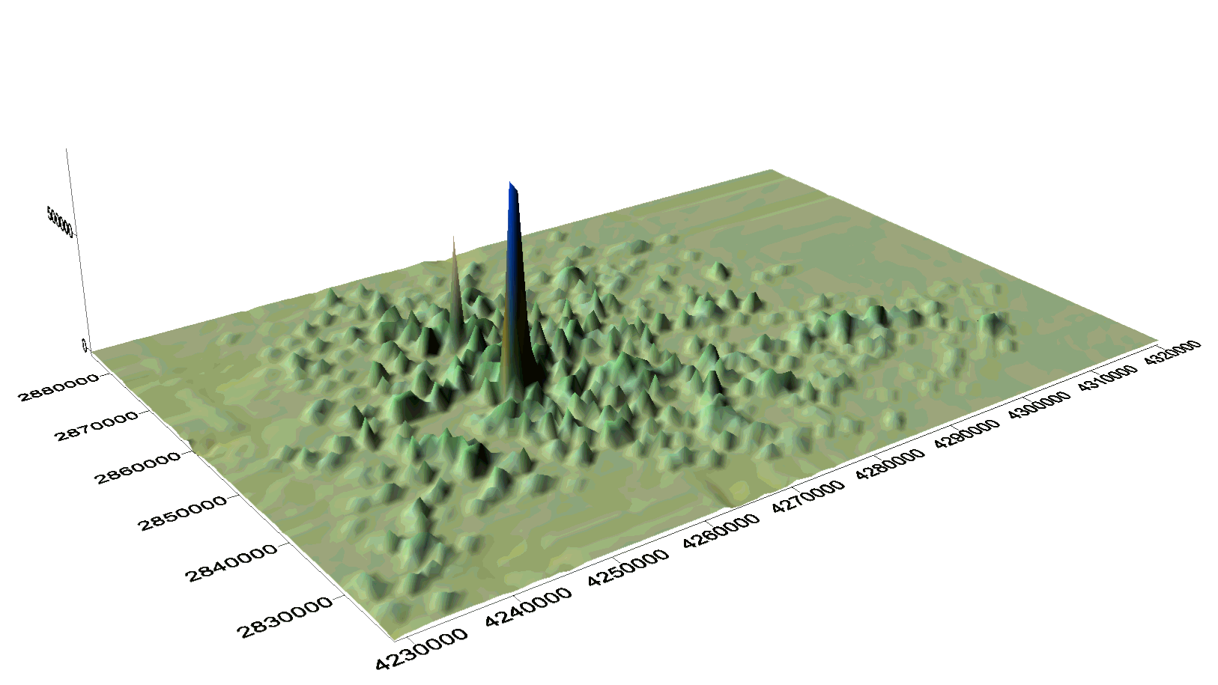
Gouvernance in Mega City Regions
"Globalisation has increased the significance of regions - as autonomous actors and not only as objects of analysis" ("Region Stuttgart Aktuell")
"Stuttgart metropolitan region"
Regionalverband Stuttgart tackled
- increase in traffic
- consumption of open space
- increasing ecological problems
- social segregation
Centralisation forces | Non-centralisation forces
Mutualisation of ressources (Meijers & Romein, 2003) Reach a critical mass (Stuttgart) changed perception of problems (Haag, 2003) Fostering spillover between agglomeration economies (Sassen, 2007) Response to intensitified economic competition (Muller, 1994 ; Heeg, 2003) | Lack of financial competencies of the new entity Continued role of central state Negative impact on environment (Manchester) Continued localism (Davoudi, 2007) Lack of economic / cultural integration Distance between main cities Costs of cooperation
Stuttgart area urban form

Slide 8
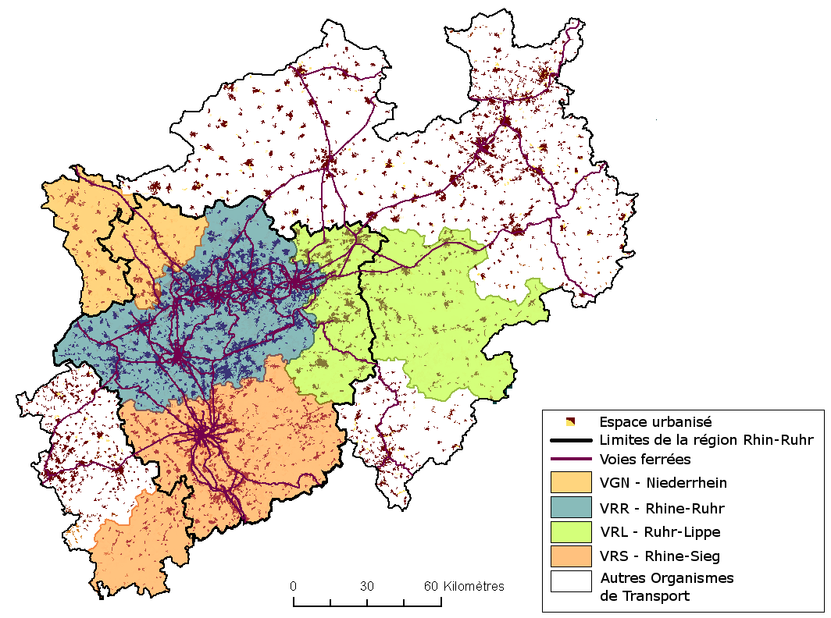
Rhine-Ruhr area
12 M inhabitants
Local cities has important planning power (Knapp & Schmitt)
Historical cultural differences (Blotevogel)
4 transport autorithy with fare integration

Slide 9
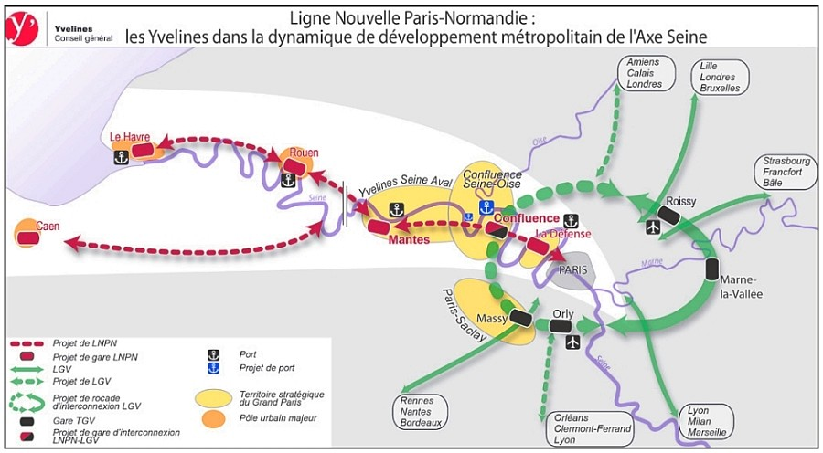
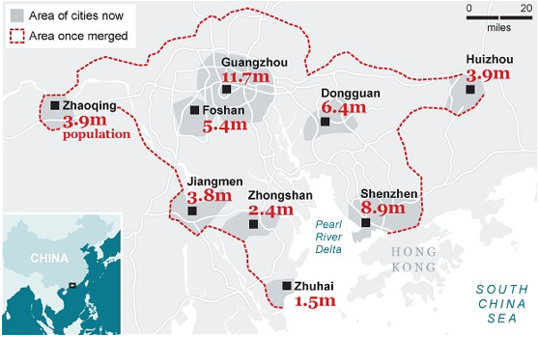
Paris area : possible better linkeage between Normandy and Roissy airport
Some exemples of planning
transport at MCR scale
Pearl river delta : planned High Speed
Rail system linking Guangzhou to Shenzhen

Slide 10
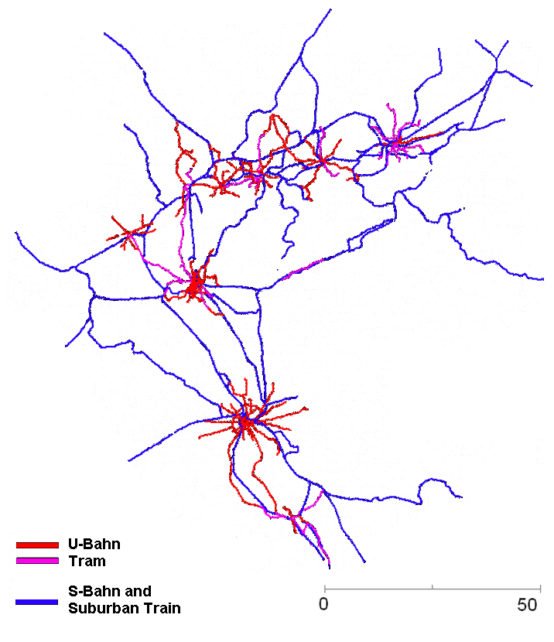
Thematical questions
What factors explain the
emergence of centralized
decision within a set of
towns ?
What consequences
does it have on urban
dynamic ?

Slide 11
Tool
A LUTI + infrastructure provision model (LUTECIA)
  Coevolution transport / urbanism (LUTI model
  with endogeneous transport infrastructure provision)
  Concentration / dispersion forces (Krugman)
  Game theory framework to predict emergence of centralized decision within a polycentric region
Competition for external ressource
  Importance of accessibility at MCR scale

Slide 12
Overview of model LUTECIA
Activities
Centralization
EC module
A module
EC module
I module
Geography
of mega
city region
T module
Accessibility
LU module
T module
T module
Mobility
Transport
network
Very simplistic assumptions about geography
> only workers
> only one type of job
> only one type of transport infrastructure
« Open » model : total ressources is not fixed
a new infrastructure is created at each timestep
LU : Land Use module
T : Transport module
EC : Evaluation of Cooperation decision module
I : Infrastructure provision module
A : Agglomeration economies module

Slide 13
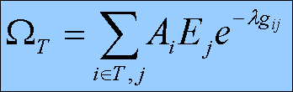
Planning submodel
At each timestep, a new infrastructure is built (Le Néchet, 2011)
Choice is made by actor T, which is endogeneously chosen by the model
Simplistic hypothesis : governor agents seek to maximize the accessibility for inhabitants within territory T

Slide 14
Scenario « central amenity»
Reformulation of the
thematic question
in the « model world » :
- what factors can
favour emergence
of centralized
provision of transport
infrastructure ?
- what impact does it
have on employment
of a « central super
amenity » ?
Ea(t) / Ea(t-1) = k * Aa(t)

Slide 15
Game Theory framework

Slide 16
juste
 | B Cooperate | B Defect
A Cooperate | UA = ΔXA(ZC) – I – J | UA = ΔXA(ZA U ZB ) – J
 | UB = ΔXB(ZC) – J | UB = ΔXB(ZA U ZB)
A Defect | UA = ΔXA(ZA U ZB ) | UA = ΔXA(ZA U ZB )
 | UB = ΔXB(ZA U ZB) – J | UB = ΔXB(ZA U ZB)
Where J is the cost of cooperation and...

Slide 17
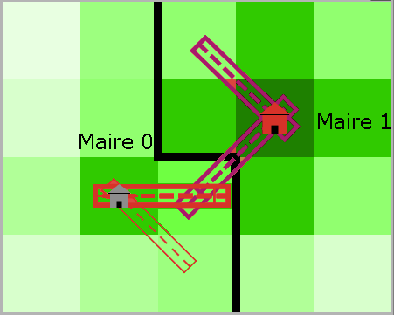
Validation of the model
Dire quels faits stylisés sont à reproduire (variation au fil du temps)
  Dynamique générale d'étalement
  Distances de déplacement augmentent
  Proba de collaborer ne décroît jamais

Slide 18
Experimental design
Capture écran grille + conditions initiales
Ce qu'on fait varier / non
Design without ext
Design with ext

Slide 19
Indicators

Slide 20
Results without ext
« validation » de quelques influences de paramètres « évidentes »

Slide 21
Results without ext
Cost of construction ?
  More collaboration in DC game
  No effect for Nash game

Slide 22
Results without ext
Collaboration cost
  Pb sorties ? Pourquoi ne change pas proba collab.

Slide 23
Results without ext
Cost of energy
  Increase probability to collaborate ?

Slide 24
Results with ext
Vitesse > décripitude
Cout énergie > décripitude
K / AO > décripitude
K / AO > proba collaborer

Slide 25
Results with ext

Slide 26
Discussion
Path dependancy

