Slide 1
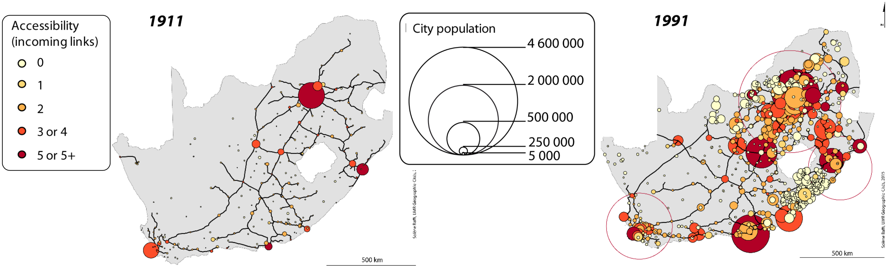
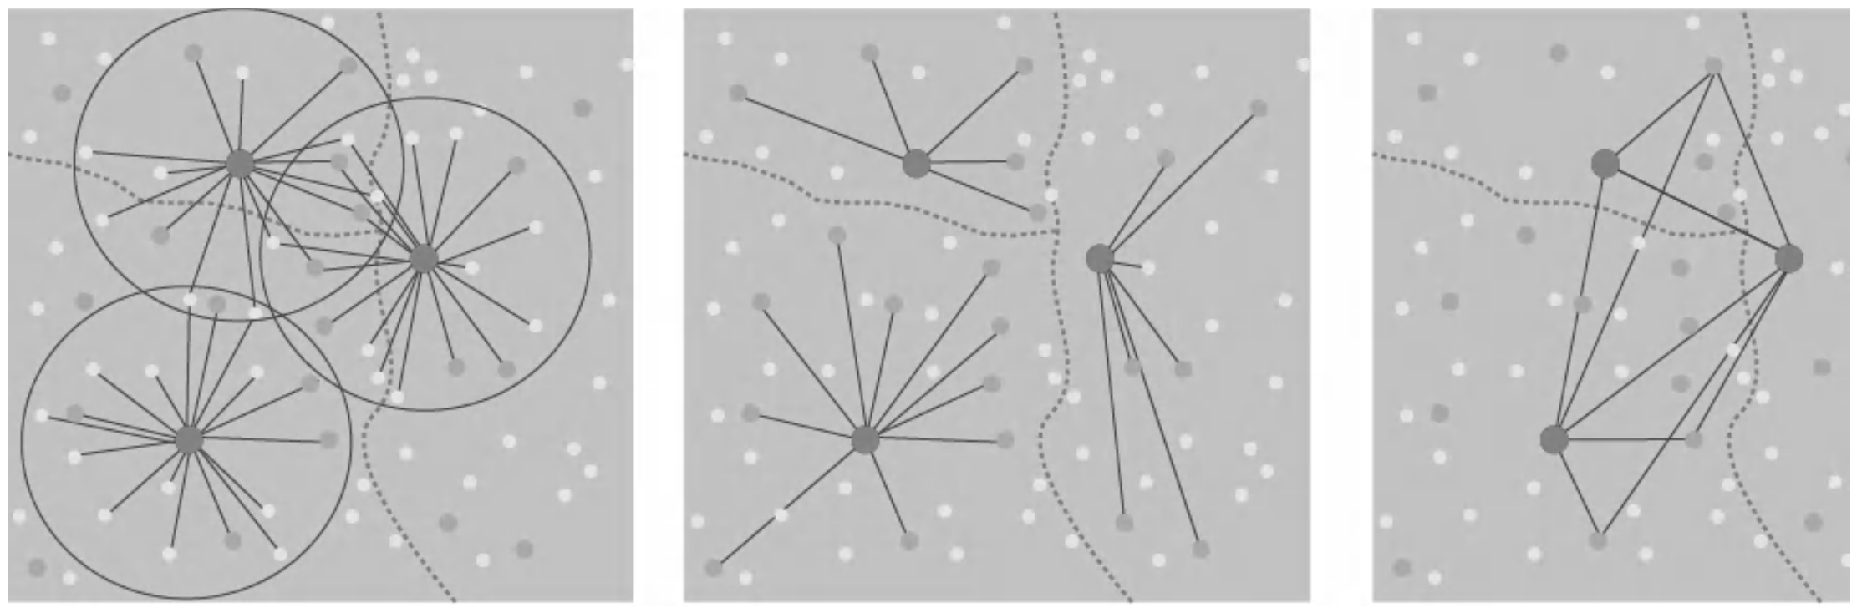

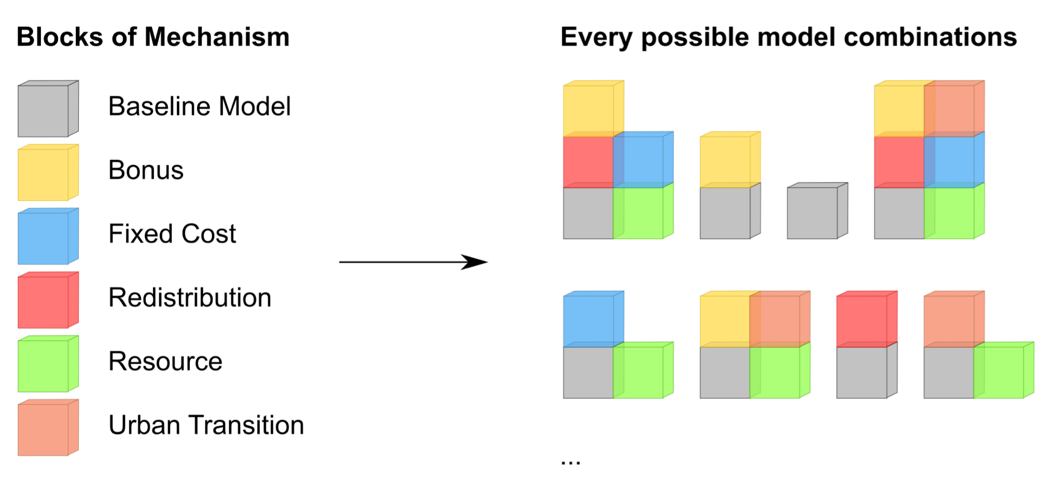
Empirical studies (ex. [Baffi, 2016])
Databases
(ex. [Swerts, 2017])
Models (ex. [Pumain, 2008])
Tools (ex. [Reuillon et al., 2013])
Theory
[Pumain, 1997]
[Pumain, 2010]
Methods (ex. [Cottineau et al., 2015])

