Slide 1
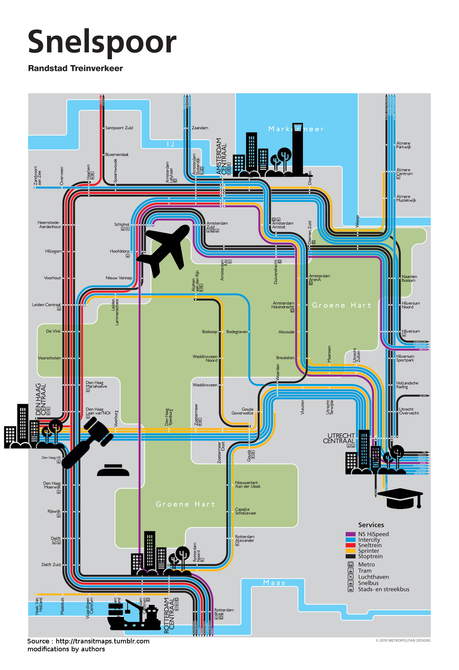


Modeling the emergence of metropolitan transport autorithy in a polycentric urban region – the model LUTECIA
ECTQG 2015, Bari, 4th of September, 2015
Le Néchet Florent, Université Paris-Est, Laboratoire Ville Mobilité Transport
Raimbault Juste, Université Paris VII, Géographie-Cités
florent.lenechet@u-pem.fr

Slide 2
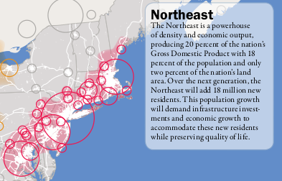
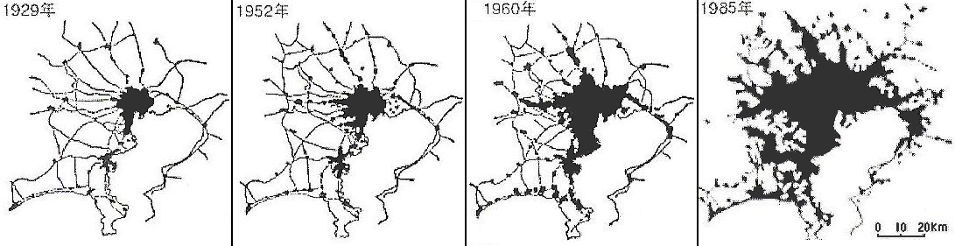
Context
From 50's emergence of Mega City Regions (Gottmann, 1957 ; Hall & Pain, 2006).
New problems to be faced
at larger spatial scales
Towards new form of
governance ?
Source : IAURIF, 2005

Slide 3
Outline
Emergence of Mega City Regions
Caracteristics of MCR
Modelling framework
MetropolSim model
Discussion

Slide 4
Emergence of Mega City Regions
Champion : emergence of polycentric urban area
  Fusion
  Diffusion
  Absorbtion
Paasi
  Identity
  Name
  Institution
  Capacity to perdue
‘most metropolitan regions in the past were focused mainly on one or perhaps two clearly defined central cities, the city-regions of today are becoming increasingly polycentric or multiclustered agglomerations’ (SCOTT et al., 2001, p. 18; emphasis added by Hoyler & Kloosterman).

Slide 5
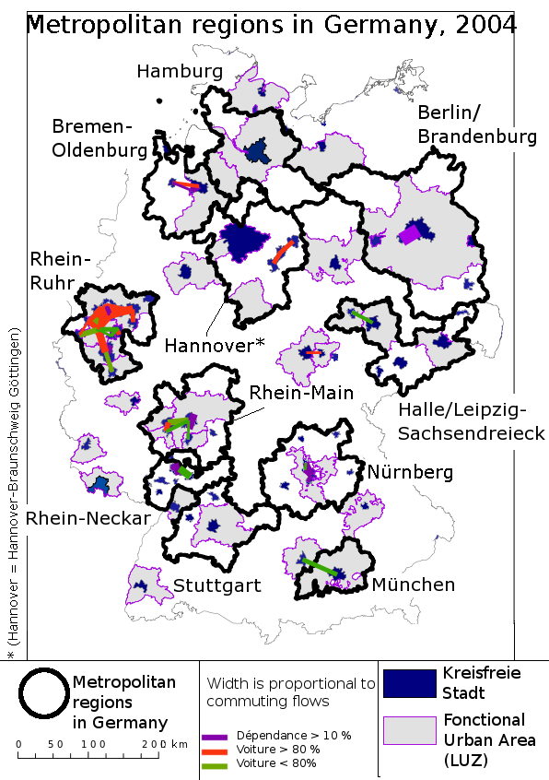
Cities, states and mega city regions
 | 1960 | 1990 | 2020 | 2050
Population mondiale (milliard) | 3 | 5 | 7,5 | 9,5
Total distance parcourue (x1000 milliards de km) | 5 | 25 | 55 | 105
Distance par personne et par an | 1700 | 5000 | 7300 | 11000
Source Schaefer & Victor, 2000 + ONU ? + calculs de l’auteur

Slide 6
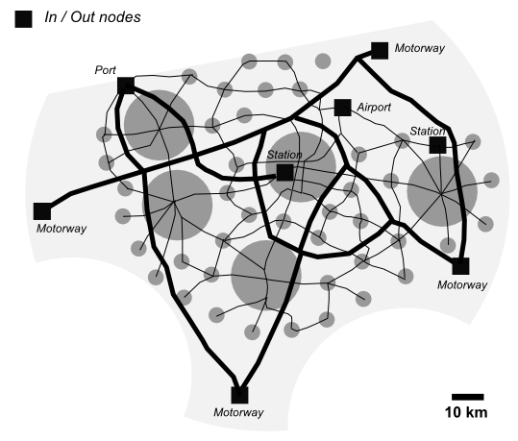
Caracteristics of MCR
At the same time, a new type of urban form, first anticipated by GOTTMANN (1961), seems to be emerging across the globe (SIMMONDS and HACK, 2000).
"Due to their polycentric structure, these regions tend to display criss-cross
commuting patterns, which often result in severe traffic congestion"
Made of several urban regions
With economic and social integration
Typically served by few major international transport nodes

Slide 7
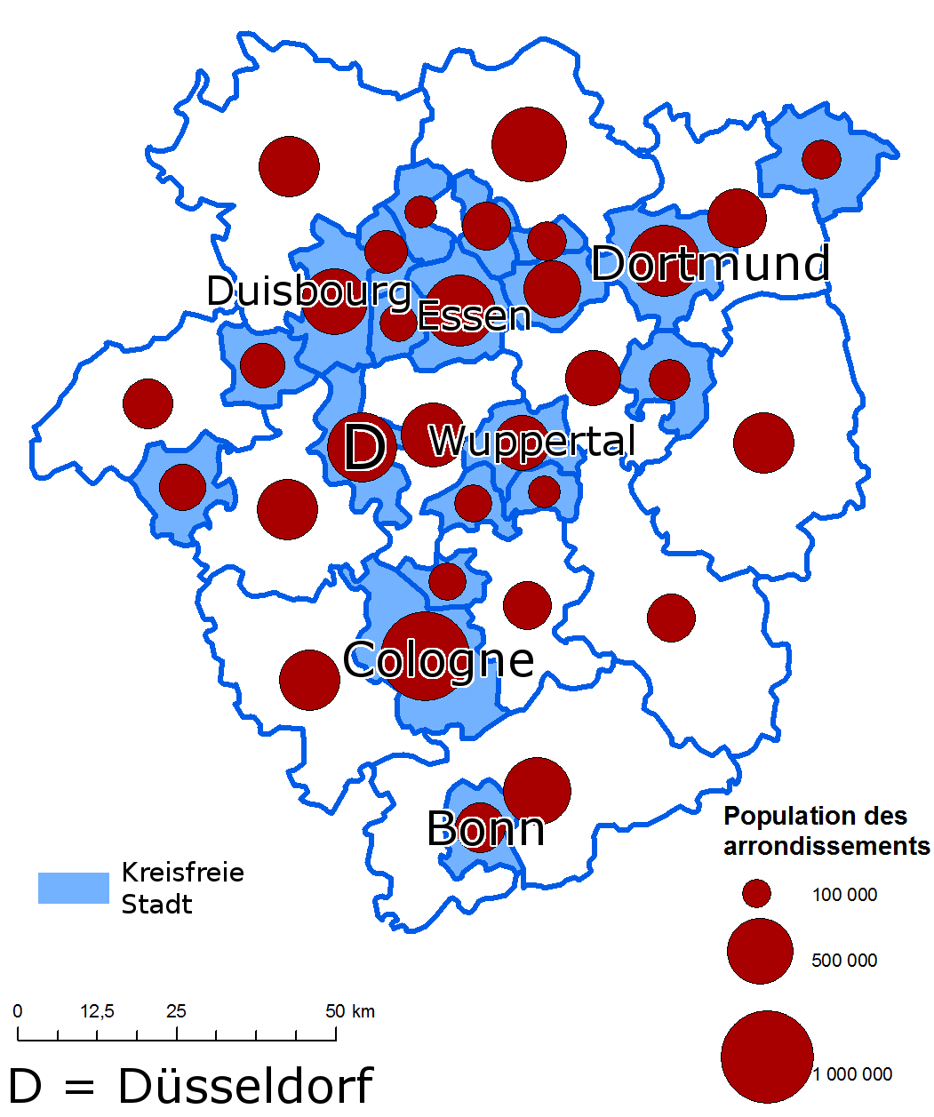
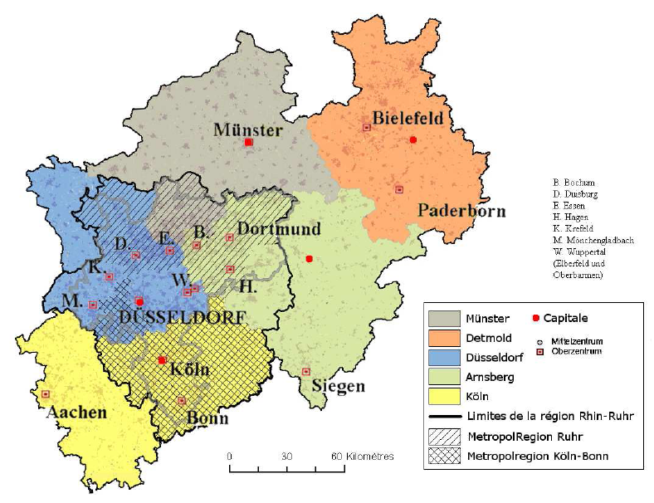
Rhine-Ruhr area
Caractéristiques de base
Quelques villes & culture

Slide 8
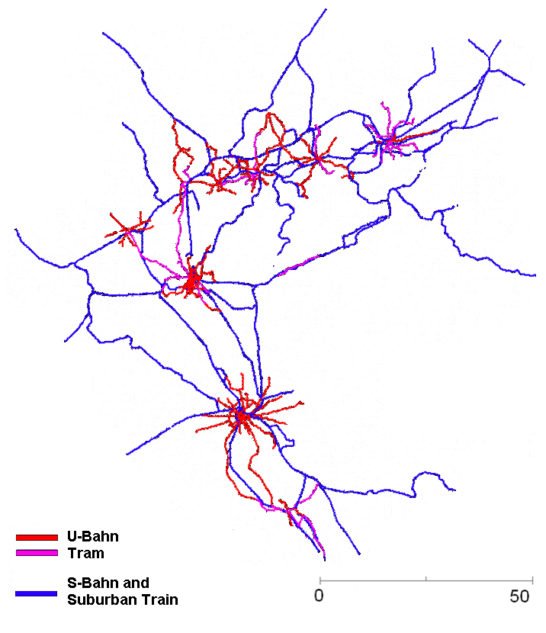
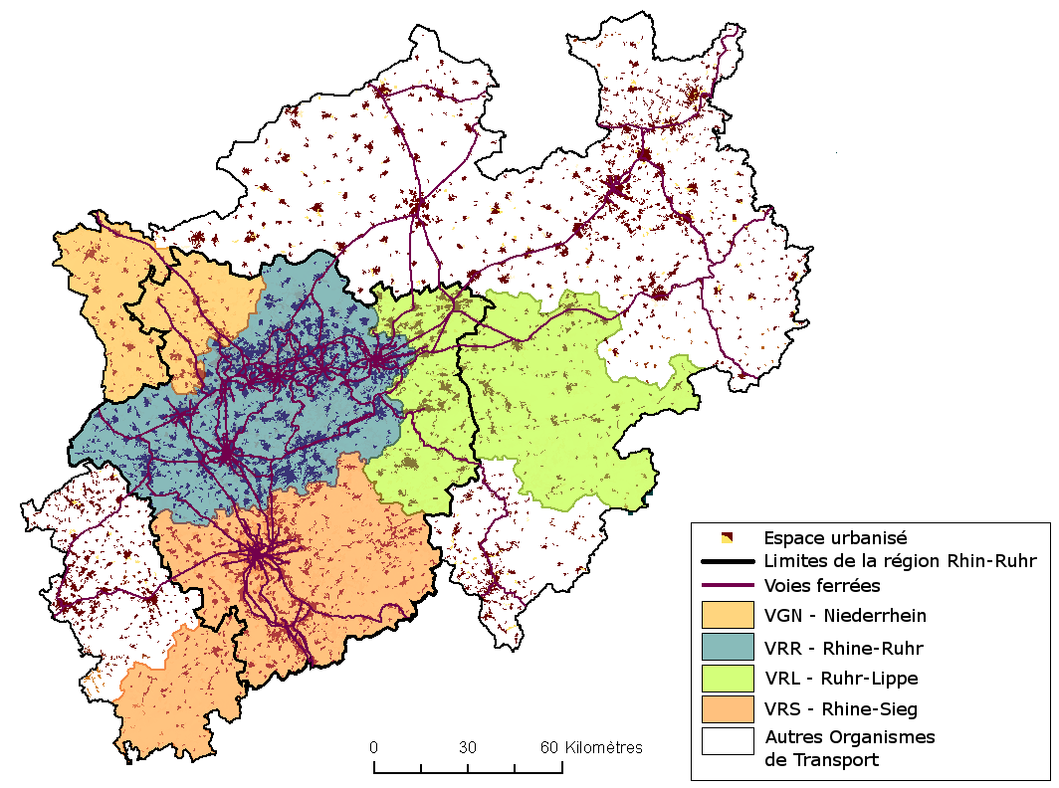
Rhine-Ruhr area
Network > shift transport

Slide 9
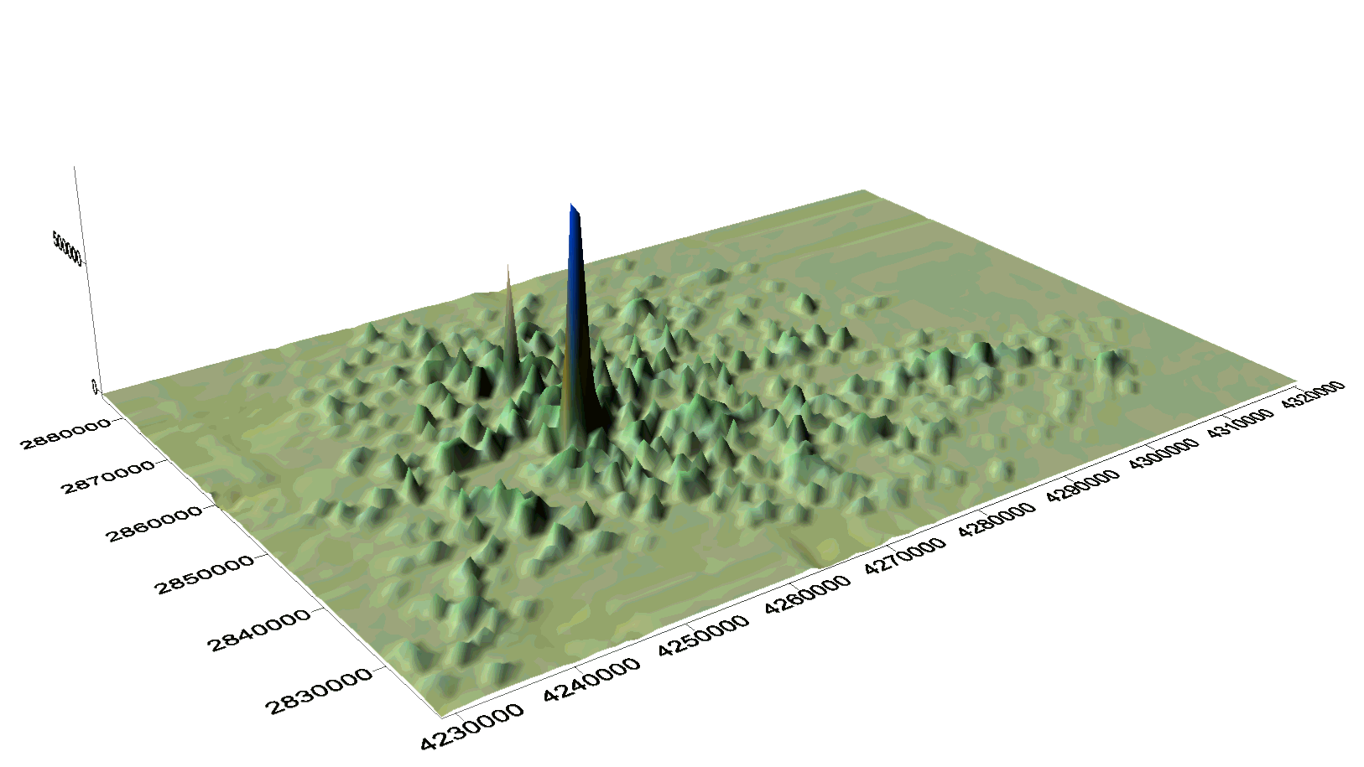
Stuttgart area
"Stuttgart metropolitan region"
Verbund Region Stuttgart, VRS -> Regionalverband Stuttgart
Stuttgart city center : HH with lower incomes and lower qualifications
problèmes qu'ils se sont proposé de résoudre :
- increase in traffic
- consumption of open space
- increasing ecological problems
- social segregation
"political actors in Baden Wurttemberg and the metropolitan region understood the economic problems of the metropoltain region as in fact being the central problems of Baden Wurtembert, since the Stuttgart metropolitan region has been the motor of Baden Wurttemberg's spatial economy"
From "Region Stuttgart Aktuell" : "However, globalisation has increased the significance of regions - as autonomous actors and not only as objects of analysis"

Slide 10
Concentration / Centralisation forces
Typology from Krugman
Concentration forces | Dispersion forces
Site configuration Access to market Access to products Job market Face to face communication | Transport costs Housing costs Type of ressources (e.g. Agriculture) Pollution
Centralisation forces | Non-centralisation forces
Mutualisation of ressources (Meijers & Romein, 2003) Reach a critical mass (Stuttgart) changed perception of problems (Haag, 2003) Fostering spillover between agglomeration economies Response to intensitified economic competition (Muller, 1994 ; Heeg, 2003) | Lack of financial competencies of the new entity Continued role of central state Negative impact on environment (Manchester) Continued localism (Davoudi, 2007) Lack of economic / cultural integration Distance between main cities Costs of cooperation
SASSEN (2007, p. 60) has argued that ‘the specific advantages of the megaregional scale consist of and arise from the coexistence within one regional space of multiple types of agglomeration economies’. According to this argument, the underlying spatial logic is not just based on urbanization economies (advantages of scale and spatial concentration) but also on localization economies.

Slide 11
Modelling framework
Faire le point sur les forces pour / contre fusion et intégrer dans article
Facteurs explicatifs de cette transition Facteurs exogènes : démographie et exode rural ; baisse coûts de transport ; tissu urbain historique
Facteurs endogènes : interactions sociales -> objet de cette recherche.

Slide 12
Tool
A LUTI + infrastructure provision model (LUTECIA)
  Coevolution transport / urbanism
  Game theory framework to predict emergence of centralized decision within a polycentric region
Competition for external resources

Slide 13
Thematical questions

Slide 14
Overview of model LUTECIA
Activities
Centralization
EC module
A module
EC module
I module
Mobility
Geography
of mega
city region
T module
T module
LU module
Accessibility
T module
Transport
network
LU : Land Use module
T : Transport module
EC : Evaluation of Centralized decision module
I : Infrastructure provision module
A : Agglomeration economies module

Slide 15
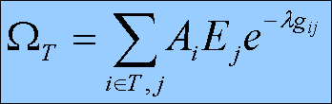
Planning submodel
At each timestep, a new infrastructure is built (Le Néchet, 2011)
Choice is made by actor T, which is endogeneously chosen by the model
Simplistic hypothesis : governor agents seek to maximize the accessibility for inhabitants within territory T

Slide 16
Scenario « central opportunity »
Illustration with
Randstad area
Endogeneous evolution
of the amenity :
E(t+1) = kE(t) * A(t) / A0

Slide 17
Game Theory framework
Infrastructure planning module

Slide 18
Governance Game
Matrix of actors utilities, depending on respective choices
 | B Cooperate | B Defect
A Cooperate | UA = ΔXA(ZC) – I – J | UA = ΔXA(ZA U ZB ) – J
 | UB = ΔXB(ZC) – J | UB = ΔXB(ZA U ZB)
A Defect | UA = ΔXA(ZA U ZB ) | UA = ΔXA(ZA U ZB )
 | UB = ΔXB(ZA U ZB) – J | UB = ΔXB(ZA U ZB)
Where J is the cost of cooperation and...

Slide 19
Implementation
Implemented in NetLogo (Wilenski, 2004) : practical for ABM/visualization but difficult to have a modular architecture (no object-agent hydrid language, (Rey, 2015) )
Available under CC licence for reproducibility at https://github.com/JusteRaimbault/MetropolSim
Specific dynamic programming implementation for network/effective shortest paths (planning module demands recomputation for each potential infrastructure)
Model explored using OpenMole (Reuillon & al., 2013), allowing extensive exploration through parallel computing

Slide 20
Validation of the model
External Validation : reproduction of stylized facts for endogeneous dynamics
  Dynamique générale d'étalement
  Distances de déplacement augmentent
  Proba de collaborer ne décroît jamais
Internal Validation : consistence regarding stochasticity

Slide 21
Experimental design
Capture écran grille + conditions initiales
Ce qu'on fait varier / non
Design without ext
Design with ext

Slide 22
Indicators
Outputs to quantify behavior of the model and to compare different configurations :
Actives/Employments final entropy (~ city sprawl)
Mean Accessibility and travel distance (infra performance)
Expected probability of collaboration
Facility evolution : Ef(tf)/Ef(t0)
Cumulated stability of actives and employments

Slide 23
Results without ext
« validation » de quelques influences de paramètres « évidentes »

Slide 24
Results without ext
Cost of construction ?
  More collaboration in DC game
  No effect for Nash game

Slide 25
Results without ext
Collaboration cost
  Pb sorties ? Pourquoi ne change pas proba collab.

Slide 26
Results without ext
Cost of energy
  Increase probability to collaborate ?

Slide 27
Results with ext
Vitesse > décripitude
Cout énergie > décripitude
K / AO > décripitude
K / AO > proba collaborer

Slide 28
Results with ext

Slide 29
Discussion
Path dependancy

