Slide 1
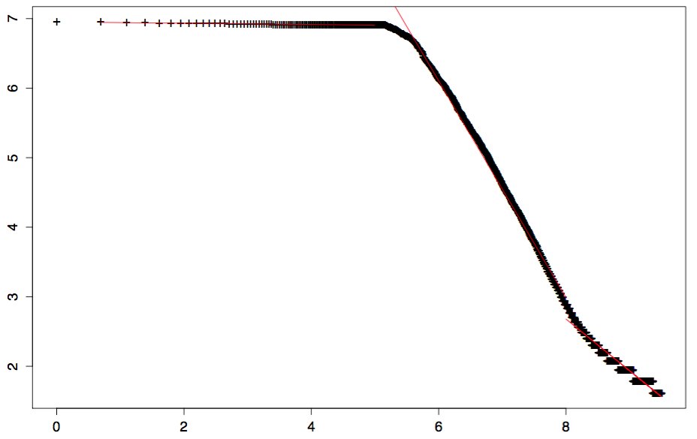
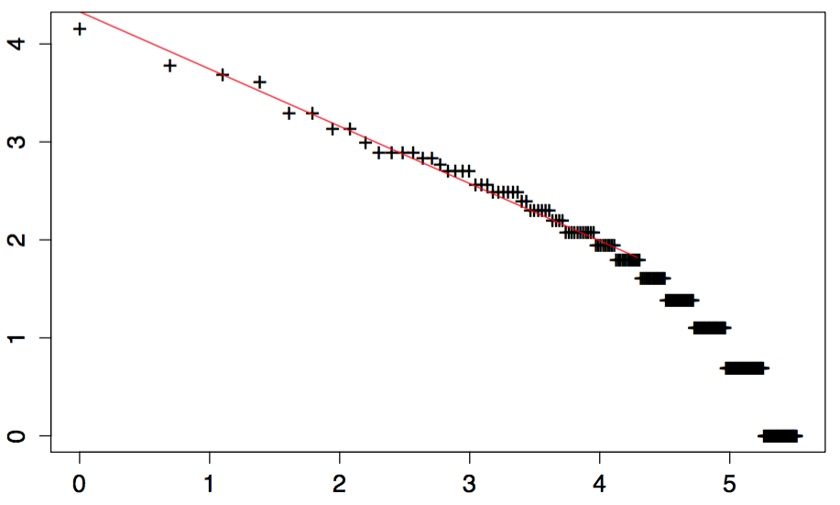
All articles
α = 0.01
α = 1.56
log(citation)
Cybergeo
α = 0.58
α = 0.75
log(rang)

