Slide 1
An evolutionary theory for the spatial dynamics of urban systems worldwide Juste Raimbault, Eric Denis et Denise Pumain UMR Géographie-cités, Paris, France ECTQG 2019, Mondorf, Luxembourg, September 5-9

Slide 2
How to explain urban growth?
Apparent direct causes : intentions/actions from urban actors (policies, locational strategies from firms, residential migrations…)
But statistical observation (thousands of cities, over centuries) : each city has a probability of growing similar to other cities belonging to the same territorial system
= « distributed growth » on the long run with many local and temporal fluctuations

Slide 3
Gibrat’s model
(« proportional » growth = growth rates are equiprobable ∀ city size and not correlated with previous rate)
Good fit ➔ double explanatory gain:
Persistancy of urban spatial patterns and hierarchies
The statistical shape of urban sizes distribution (Zipf’s law or lognormal ≈ H. Simon ≠ P. Krugman) as generated from growth process
(Gibrat, 1931, Robson, 1973, Pumain, 1982)

Slide 4
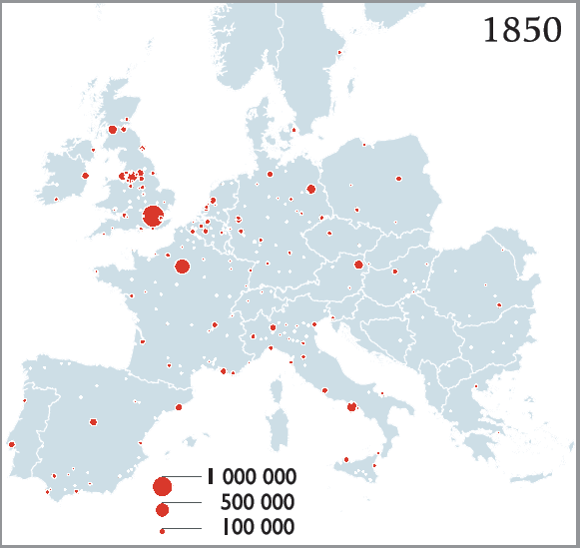
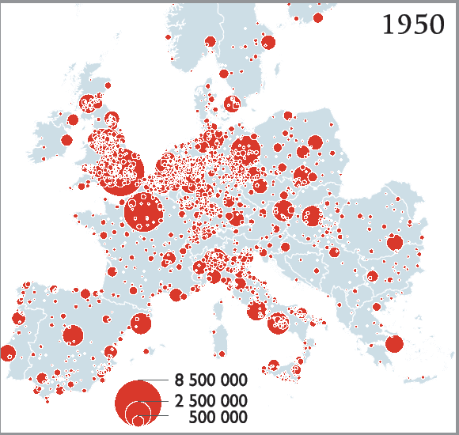
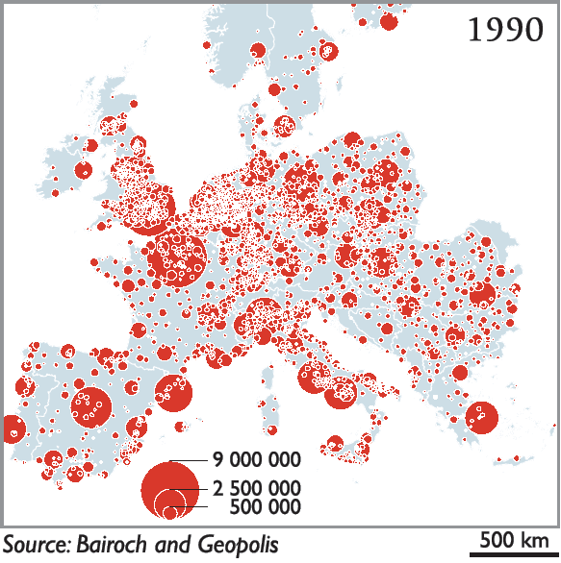
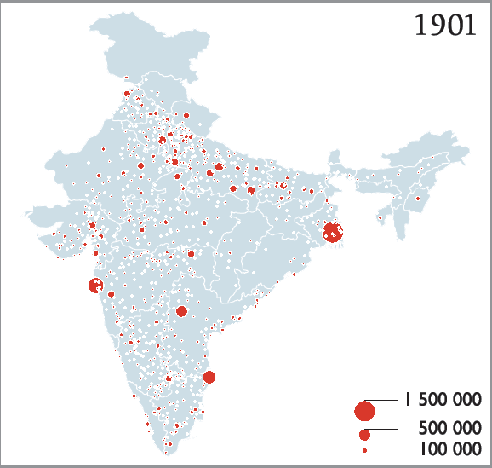
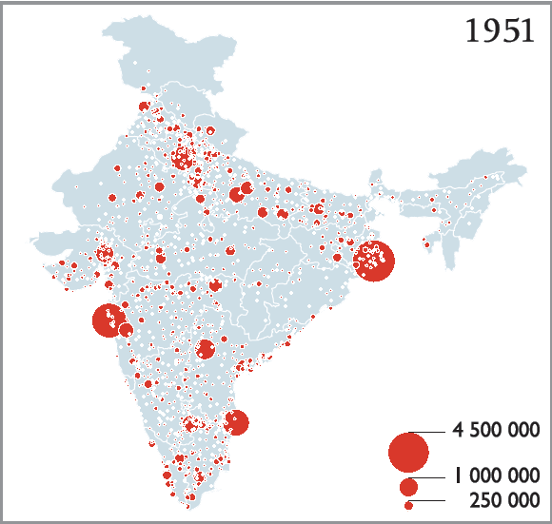
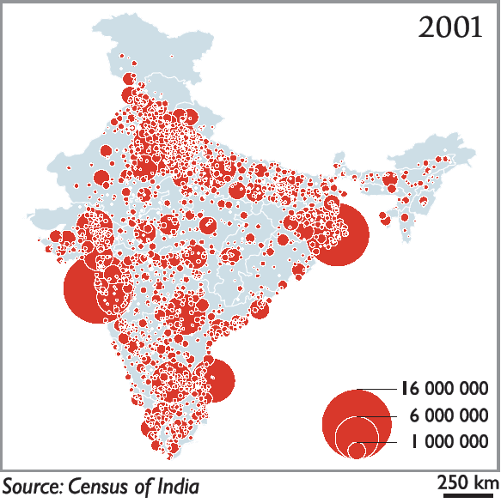
Urban systems Europe and India
Bretagnolle et al., Cybergeo, 2002
Notes:
<number>

Slide 5
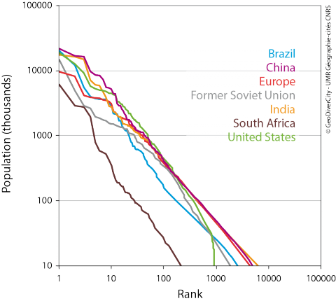
Zipf’s law for 7 systems of cities
Zipf’s law:
Urban sizes
continuum
over more than
4 orders of
magnitude
(10³ à 10⁷ inhab.)
GeoDiverCity, Pumain et al, Cybergeo 2015, 706

Slide 6
Gibrat’s model: a satisfying proxy but some empirical contradiction
1 The observed distributions of city sizes (actually: settlement sizes including hamlets, villages, towns and SMAs) are lognormal (evidence from Robson, 1973, Pumain, 1982, Eeckhout, 2004, Decker et al, 2007)
2 Gibrat’s growth model leads to a lognormal distribution of city sizes
3 but Gibrat’s growth model hypothesis are rejected (correlation between growth rates and city size, correlation between successive growth rates)

Slide 7
A geographical model for simulating urban growth
We develop a geographical model of urban growth including:
A recurring emergence of clustered new innovations that create growth cycles (Schumpeter)
➔The diffusion of innovations occurs through a dynamic spatial interaction model (Wilson).
The diffusion of innovation is a hierarchical process (Hägerstrand) The growth of a city depends on its share of labour force in each innovation cycle = scaling parameter >1
Source: Favaro, 2007

Slide 8
The geographical growth model
Analytically, the model can be expressed in a form that is very close to Gibrat’s model:
log P_{it} = α + log P_{it-1} + G_{i} + u_{it}
where G_{i} holds for the « bias » noticed in estimating Gibrat’s model by MCO (linked with spatial interaction processes)
Favaro, Pumain, Geographical Analysis, 2011

Slide 9
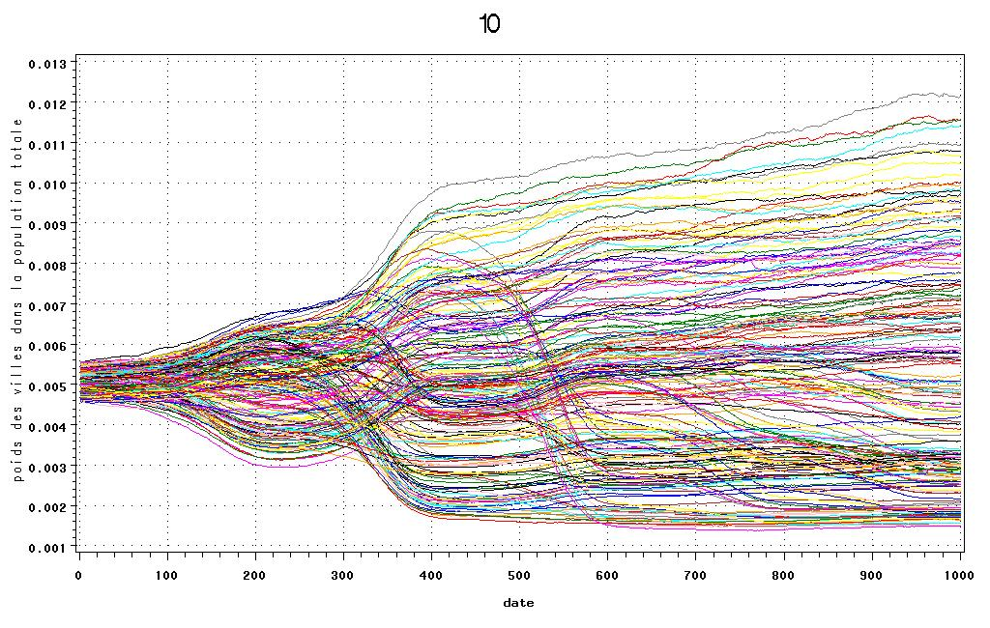
Simulated trajectories of individual cities (relative weight in the system’s of cities total pop)
J.M. Favaro, D. Pumain, 2011

Slide 10
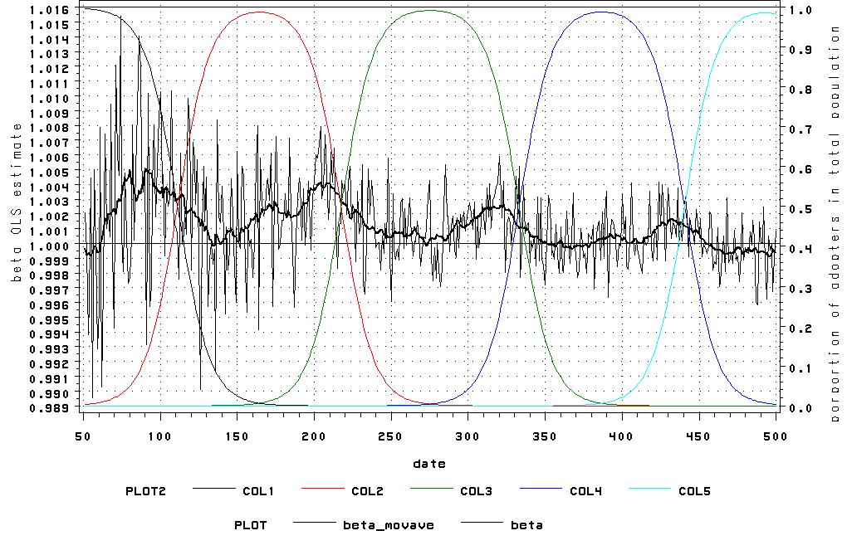
Evolution of beta (size effect, allometric growth) according to innovation cycles
J.M. Favaro, D. Pumain, 2011

Slide 11
Matching classes of urban growth trajectories and Kondratiev cycles (France)
Freeman & Louça, 2001, Favaro, 2007

Slide 12
Linking scaling laws to a geographical model of urban growth with spatial interaction and innovation cycles
We suggest to replace a generic statistical model of growing independent entities (Gibrat’s urban growth model) by a model of spatially and temporally interdependent entities (i.e. the geographical concept of « system of cities » or « settlement system »)
It reproduces the observations on differential scaling parameters for urban activities according to their age in innovation cycles (Favaro, Pumain, Geographical Analysis, 2011)
It also makes explicit the multilevel dynamics of interurban competition for capturing innovation, which may itself generate new innovation through interurban emulation, within an evolutionary perspective

Slide 13
Urban evolution in Europe and India

Slide 14
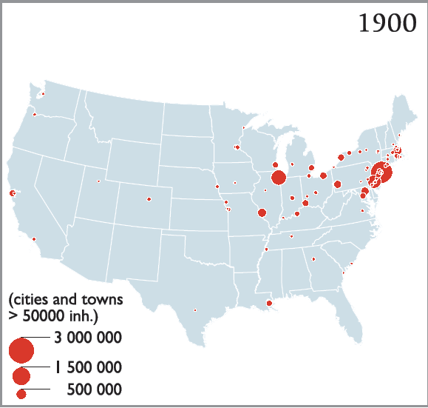
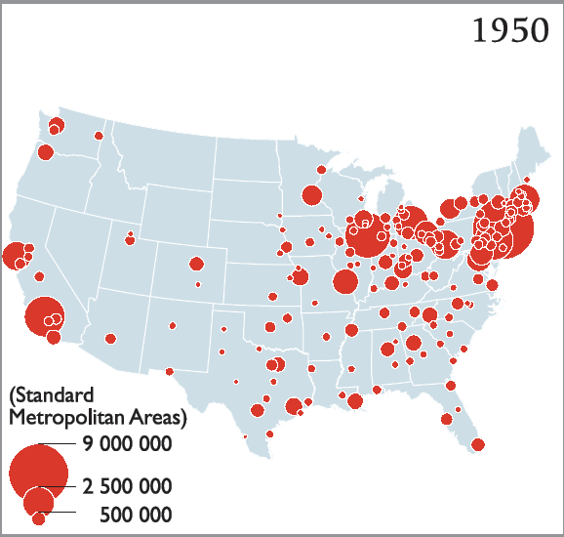
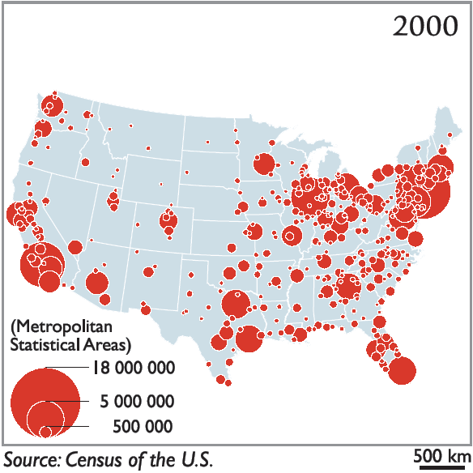
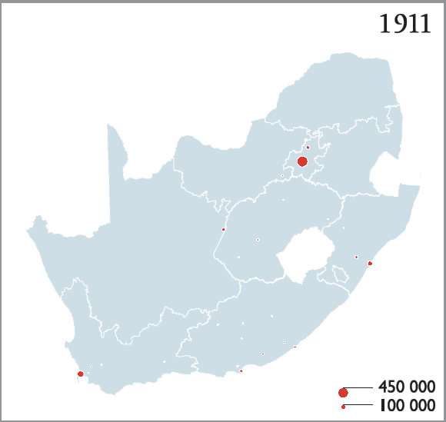
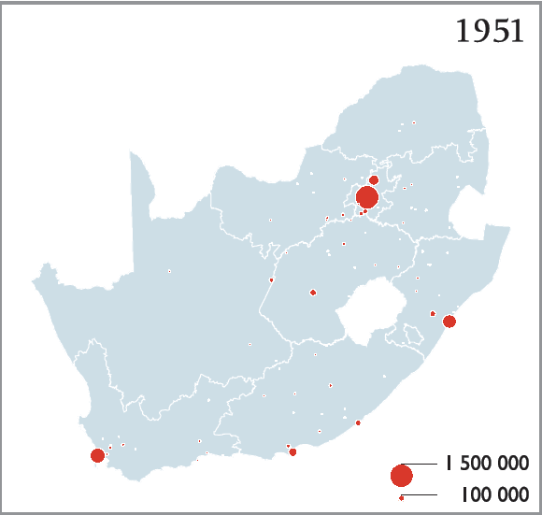
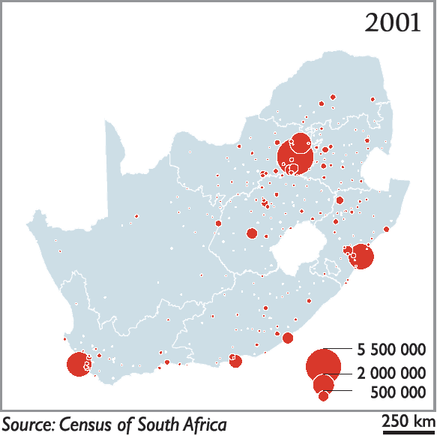
Urban evolution in United States and South Africa
Anne Bretagnolle et Céline Vacchiani-Marcuzzo, 2006

Slide 15
Innovation diffusion and spatial integration of urban systems
In new urban systems, as in USA, there is a spatial filling process that occur through waves of urban growth (urban Frontier) corresponding to the diffusion of economic cycles
In mature urban systems, like in France, the innovations diffusion reaches cities that are not spatially regularly arranged but already experienced other growth periods according to distinct cycles of urban specialisation

Slide 16
Des transitions urbaines décalées
Sources : Paul Bairoch, De Jéricho à Mexico, 1985
et François Moriconi-Ebrard, Geopolis, 1994.

Slide 17
A new source of data on global urbanization
GHSL (Global Human Settlement Layer) : GEO Human Planet Initiative (European Commission)
Built up area from satellite images 40 m + population data 250 m ➔ 1 km² grid
13 000 urban areas > 50 000 inhab.
Surface, population in 1975, 1990, 2000, 2015
GDP, Green surfaces Pollutants 1990-2015

Slide 18
Scaling relationship area/population
Exponents from 1975 to 2015

Slide 19
Applicable knowledge
Statistical predictibility of city growth and size on short time periods
Largest metropolises are not « monstruopolises »
Complexity ➔ proactive adaptive strategies are necessary (imitation, or anticipation and risk), emulation (co-opetition)
Robustness, variation and sustainability of urban systems (neither norm nor optimum)

Slide 20
Urban trajectories/specialisation
X =Pi_{t}/PU_{t}
(Pit = population
city i time t
PU = Urban system’s
total population
time t)
Y=Pi_{t+1}/PU_{t+1}
Bretagnolle,
Vacchiani-
Marcuzzo,
Pumain
2007

Slide 21
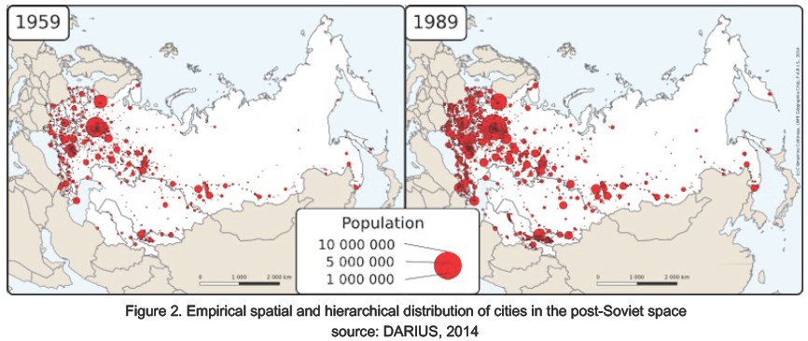
Urban trajectories to reconstruct
Cottineau et al., 2015, JASS

Slide 22
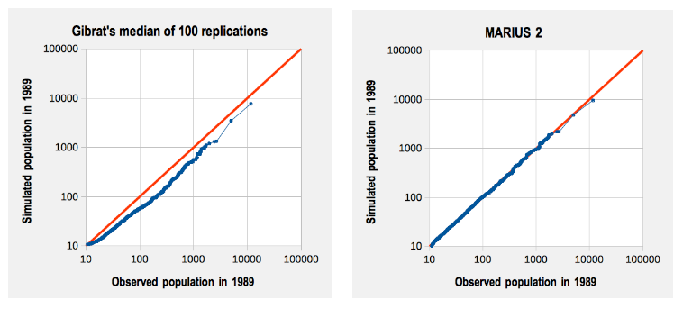
Networking boosts urban growth: model with interaction fits better than random growth
Gibrat’s model
model with interactions
Cottineau, 2014

