Slide 1
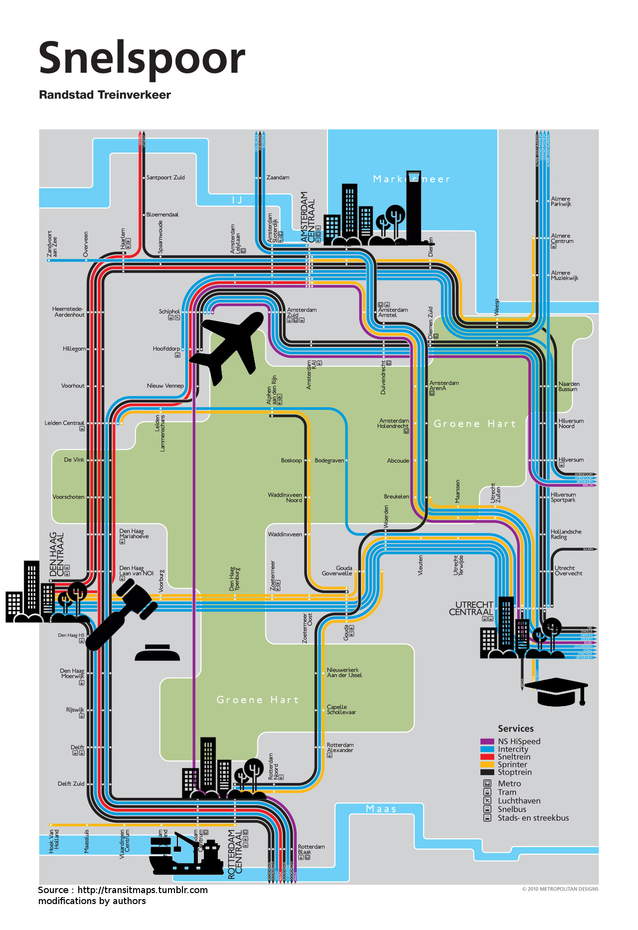


Modeling the emergence of metropolitan transport autorithy in a polycentric urban region – the model LUTECIA
ECTQG 2015, Bari, 4th of September, 2015
Le Néchet Florent, Université Paris-Est, Laboratoire Ville Mobilité Transport
Raimbault Juste, CNRS, ISC-PIF
florent.lenechet@u-pem.fr

Slide 2
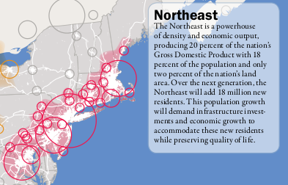
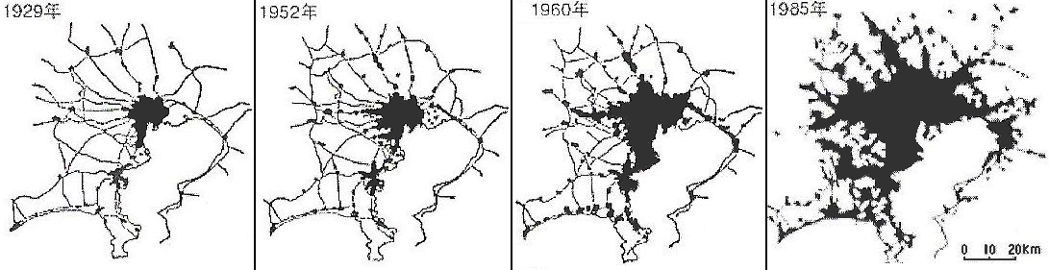
Context
From 50's emergence of Mega City Regions (Gottmann, 1957 ; Hall & Pain, 2006).
New problems to be faced
at larger spatial scales
Towards new form of
governance ?
Source : IAURIF, 2005

Slide 3
Outline
Emergence of Mega City Regions
Caracteristics of a Mega City Region
Modelling framework
LUTECIA model
Discussion

Slide 4
Emergence of Mega City Regions
Champion : emergence of polycentric urban area
  Fusion
  Diffusion
  Absorbtion
Paasi : formation of centralized governance
  Identity (e.g. culture)
  Name (formalization)
  Institution (public or not)
  Capacity to sustain
e.g. Ruhr
area
e.g. Atlanta
area (Edge Cities)
e.g. Paris
area
‘most metropolitan regions in the past were focused mainly on one or perhaps two clearly defined central cities, the city-regions of today are becoming increasingly polycentric or multiclustered agglomerations’ (Scott et al., 2001, p. 18; emphasis added by Hoyler & Kloosterman).

Slide 5
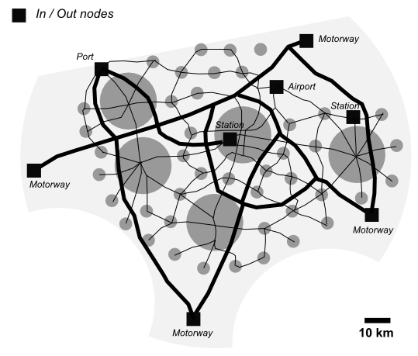
Caracteristics of MCR
Made of several urban regions
With economic and social integration
Typically served by few major international transport nodes > importance of accessibility at continental level
Has a few major metropolitan facilities (e.g. CBD, university...) > importance of accessibility at the MCR level
Transport networks play great role in provision of accessibility at MCR
No harmonized definition (Polynet network in Europe, America 2050 in US, and others...)
Flows are typically used to
define « self-sufficient »
urban region envelops
Examples : Randstad Holland (8 M inh.),
Flemish Diamond (5 M), BowWash (50 M),
Pearl River Delta (60 M)...

Slide 6
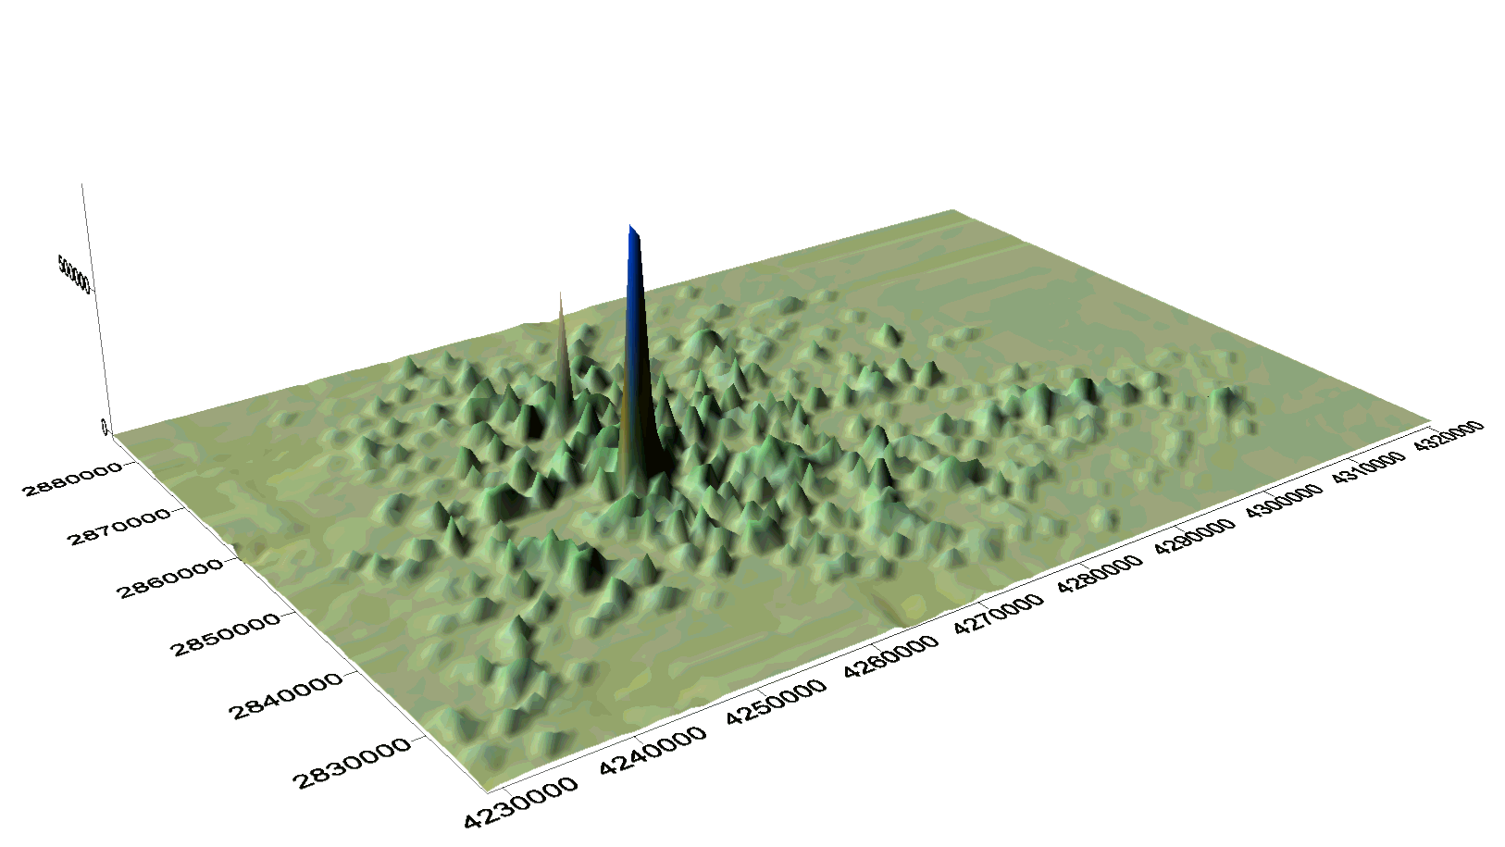
Gouvernance in Mega City Regions
"Stuttgart metropolitan region"
Regionalverband Stuttgart tackled
- increase in traffic
- consumption of open space
- increasing ecological problems
- social segregation
"Globalisation has increased the significance of regions - as autonomous actors and not only as objects of analysis" ("Region Stuttgart Aktuell")
Centralisation forces | Non-centralisation forces
Mutualisation of ressources (Meijers & Romein, 2003) Reach a critical mass (Stuttgart) changed perception of problems (Haag, 2003) Fostering spillover between agglomeration economies (Sassen, 2007) Response to intensitified economic competition (Muller, 1994 ; Heeg, 2003) | Lack of financial competencies of the new entity Continued role of central state Negative impact on environment (Manchester) Continued localism (Davoudi, 2007) Lack of economic / cultural integration Distance between main cities Costs of cooperation
Stuttgart area urban form

Slide 7
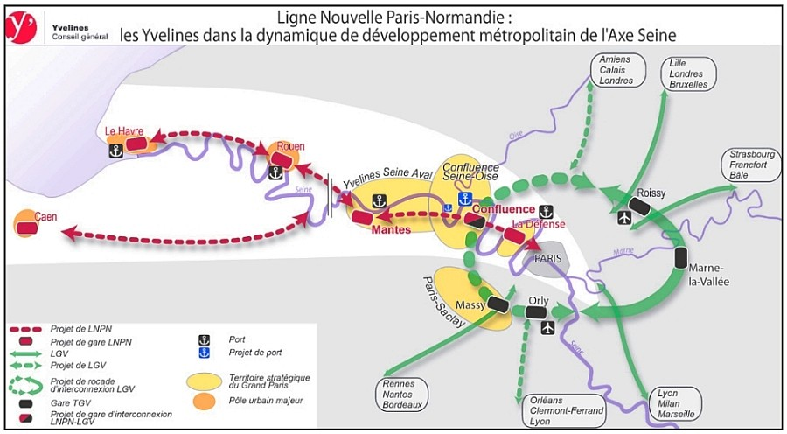
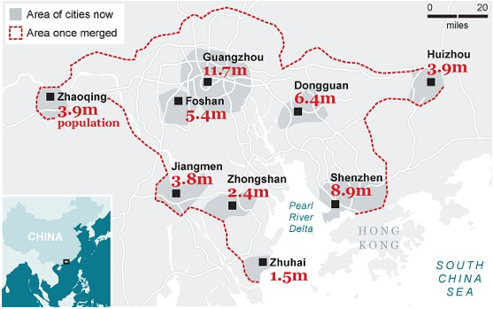
Paris area : possible better linkeage between Normandy and Roissy airport
Some exemples of planning
transport at MCR scale
Pearl river delta : planned High Speed
Rail system linking Guangzhou to Shenzhen

Slide 8
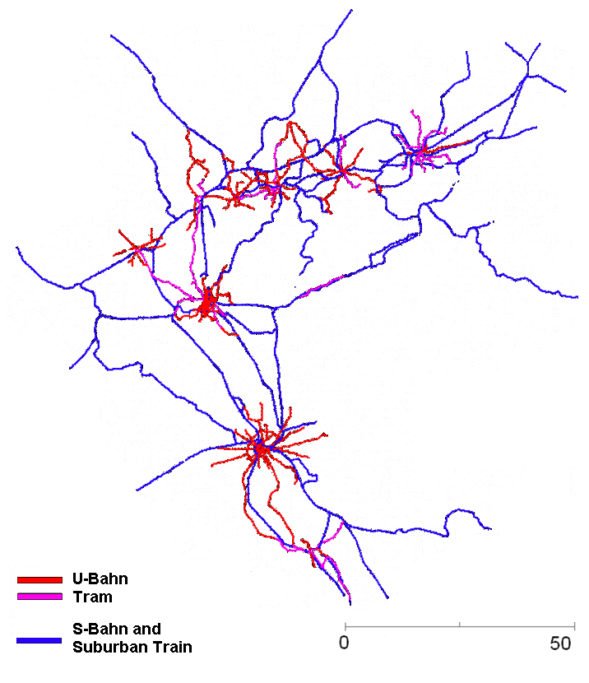
Thematical questions
What factors explain the
emergence of centralized
decision within a set of
towns ?
What consequences
does it have on urban
dynamic ?
Transport network in Rhine-Ruhr region (Germany)

Slide 9
Modelling framework
A LUTI + infrastructure provision model (LUTECIA)
  Coevolution transport / urbanism (LUTI model
  with endogeneous transport infrastructure provision)
  Concentration / dispersion forces (Krugman)
  Game theory framework to predict emergence of centralized decision within a polycentric region
Competition for external ressource
  Importance of accessibility at MCR scale

Slide 10
Overview of model LUTECIA
Activities
Centralization
EC module
A module
EC module
I module
Geography
of mega
city region
T module
Accessibility
LU module
T module
T module
Mobility
Transport
network
Very simplistic assumptions about geography
> only workers
> only one type of job
> only one type of transport infrastructure
« Open » model : total ressources is not fixed
a new infrastructure is created at each timestep
LU : Land Use module
T : Transport module
EC : Evaluation of Centralized decision module
I : Infrastructure provision module
A : Agglomeration economies module

Slide 11
Empirical evidence of co-evolution
Exemple of Paris wider region (Bassin Parisien)
Travel times
0-30 minutes (road based)
Transport provision
Data from INSEE
and IGN

Slide 12
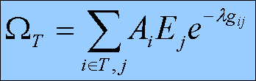
Infrastructure provision submodel
At each timestep, a new infrastructure is built (Le Néchet, 2011)
Choice is made by actor T, which is endogeneously chosen by the model
Simplistic hypothesis : governor agents seek to maximize the accessibility for inhabitants within territory T
- Urban form (Ai and Ej)
- Travel times (road network)
- Cost of energy (λ)

Slide 13
Game Theory framework
Infrastructure planning module implements a game between actors to simulate their choices in the frame of Game Theory (Ordeshook, 1986), already widely used to tackle transportation problems (Roumboutsos and Kapros, 2008).
Decisions are first attributed to global level (centralized decision, global optimization) or local level (game between actors), uniformaly following a parameter p_reg.
In the case of a local game, probabilities of collaborative / non-collaborative behaviors are determined as described later, and infrastructures are optimized and constructed locally.

Slide 14
Governance Game
Matrix of actors utilities, depending on respective choices
 | B Cooperate | B Defect
A Cooperate | UA = ΔXA(ZC) – I – J | UA = ΔXA(ZA U ZB ) – I – J
 | UB = ΔXB(ZC) – I – J | UB = ΔXB(ZA U ZB) – I
A Defect | UA = ΔXA(ZA U ZB ) – I | UA = ΔXA(ZA U ZB ) – I
 | UB = ΔXB(ZA U ZB) – I – J | UB = ΔXB(ZA U ZB) – I
Where J is the cost of cooperation, I the cost of construction,
ΔX(Z) accessibility differences for the corresponding infrastructure and area.
Two types of games are implemented, with different thematic meanings :
One mixed Nash equilibrium, where actors compete and « try to win »
One Rational Discrete Choice equilibrium, where players choose to collaborate or not
depending on the value of the difference of utilities.

Slide 15
Indicators
Outputs to quantify behavior of the model and to compare different configurations :
Actives/Employments final entropy (~ city sprawl)
Mean Accessibility and travel distance (infra performance)
Expected probability of collaboration
Cumulated stability of actives and employments

Slide 16
Implementation
Implemented in NetLogo (Wilenski, 2004) : practical for ABM/visualization but difficult to have a modular architecture (no object-agent hydrid language, (Rey, 2015) ).
Available under CC licence for reproducibility at https://github.com/JusteRaimbault/MetropolSim
Specific dynamic programming implementation for network/effective shortest paths (planning module demands recomputation for each potential infrastructure).
Model explored using OpenMole (Reuillon & al., 2013), allowing extensive exploration through parallel computing.

Slide 17
Exploring models of simulation
OpenMOLE slides

Slide 18
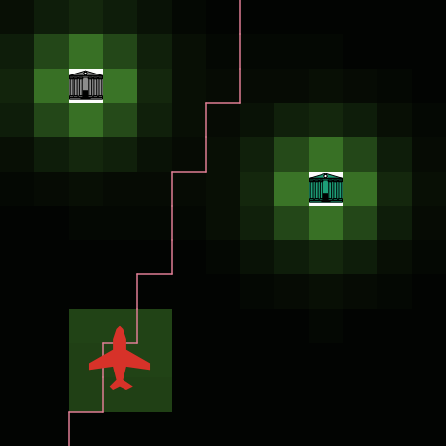
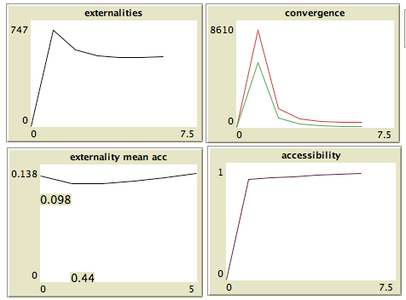
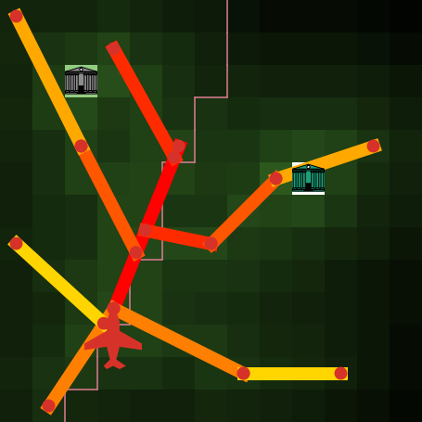
Run Example

Slide 19
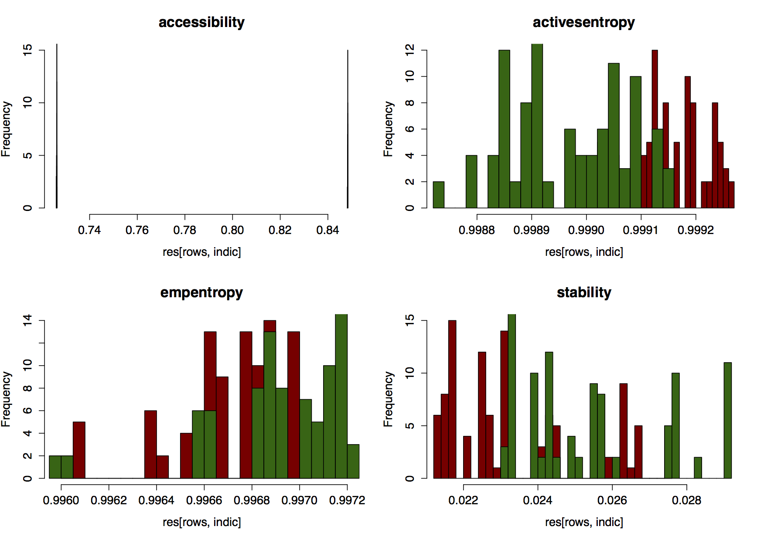
Validation of the model
External Validation : reproduction of stylized facts for endogeneous dynamics
  General dynamic of Urban Sprawl over time
  Travel distances increase (vs ~ stability of travel times)
  Probability to collaborate increases
Internal Validation : consistence regarding stochasticity

Slide 20
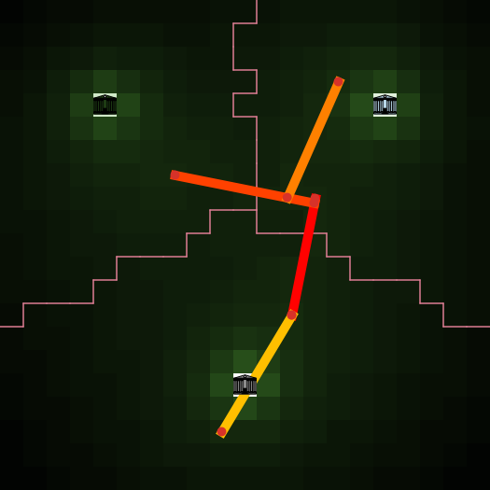
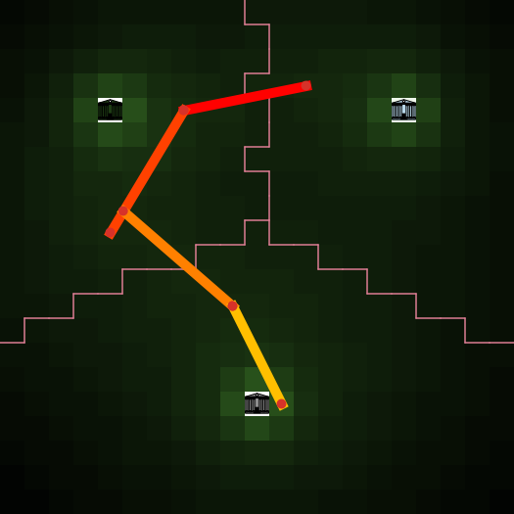
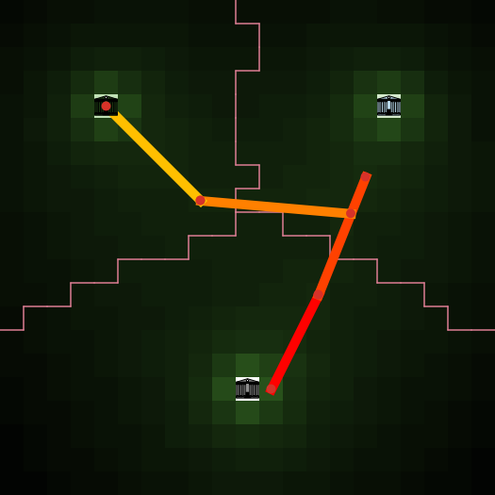
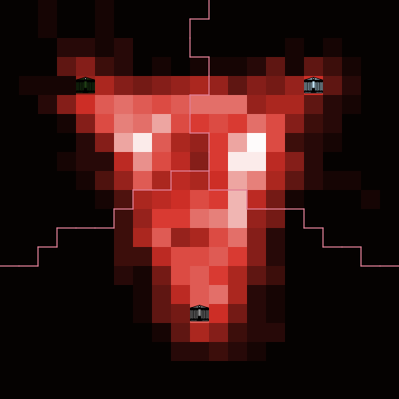
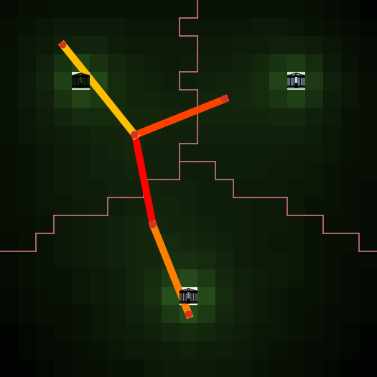
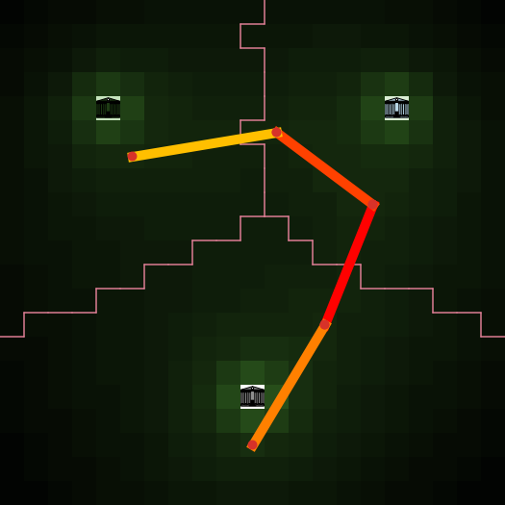
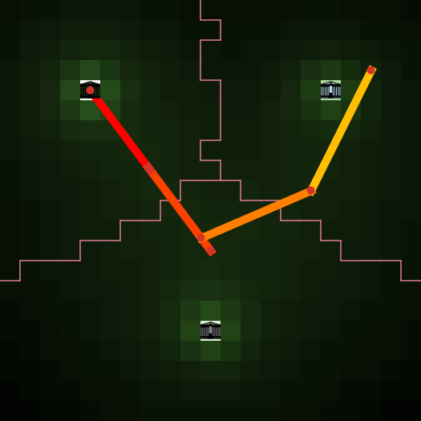
Validation of the model
Internal Validation : Infrastructure exploration heuristic. Repetitions on a fixed initial configuration

Slide 21
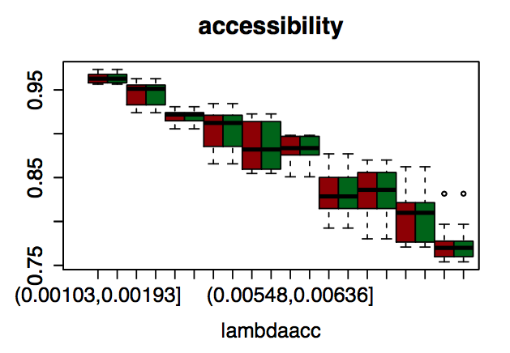
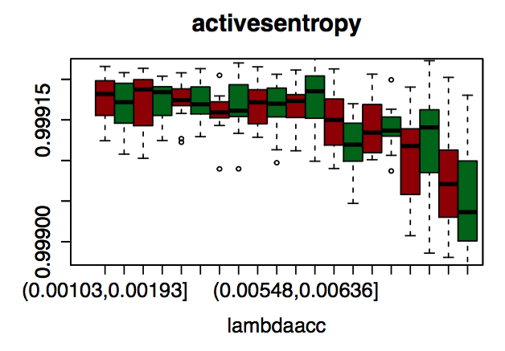
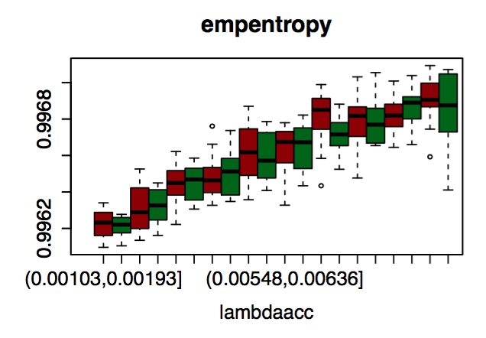
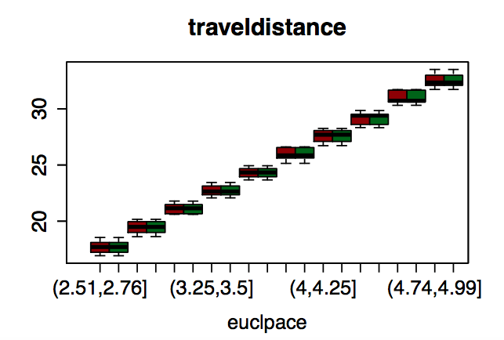
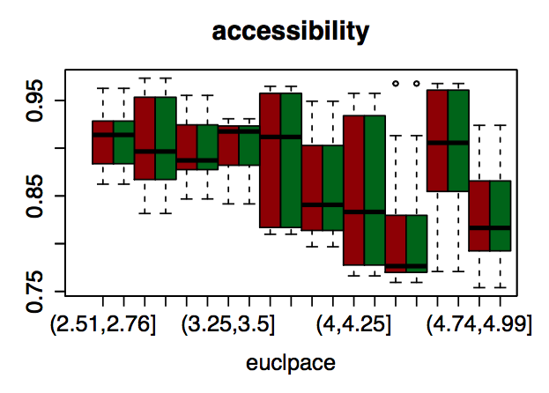
Validation
Control parameters such as cost of energy or euclidian pace have expected effect
Lambda Accessibility
Lambda Accessibility
Lambda Accessibility
Network speed
Network speed

Slide 22
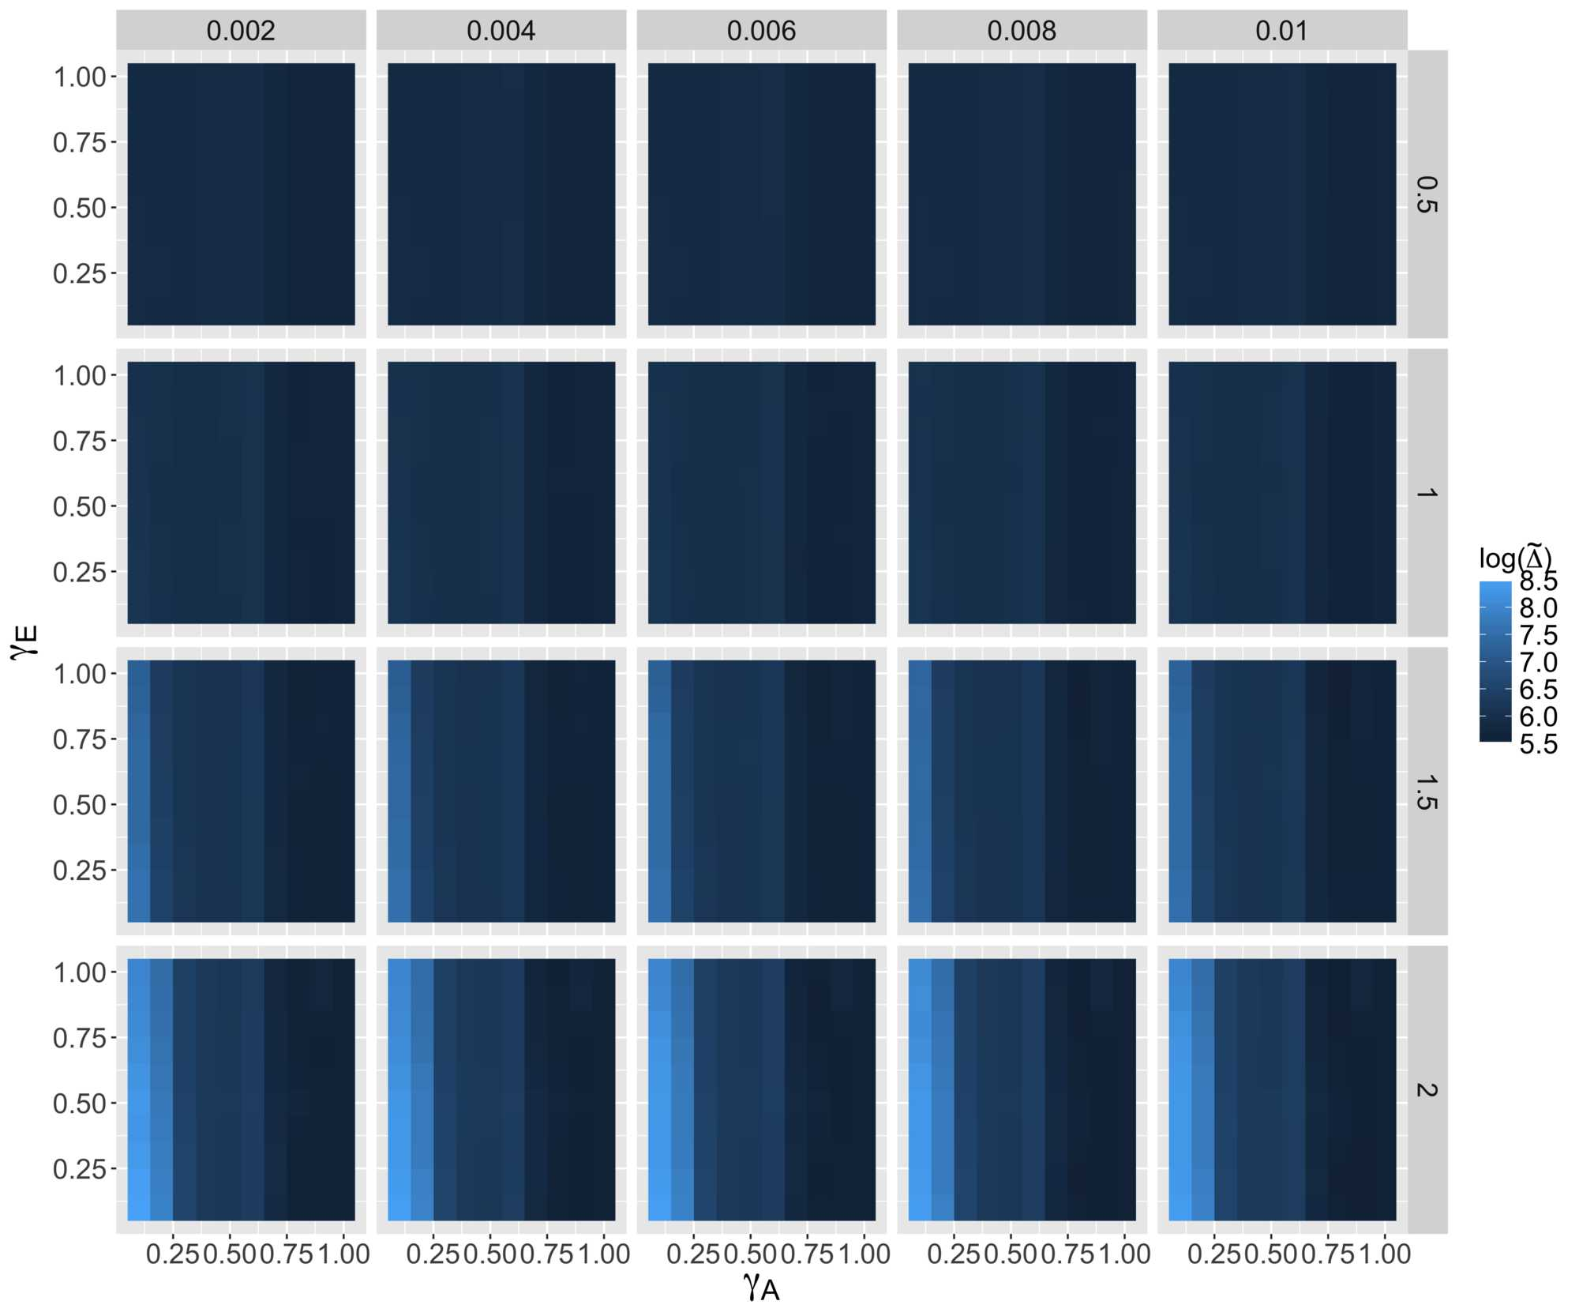
Validation : Luti module (relocations)

Slide 23
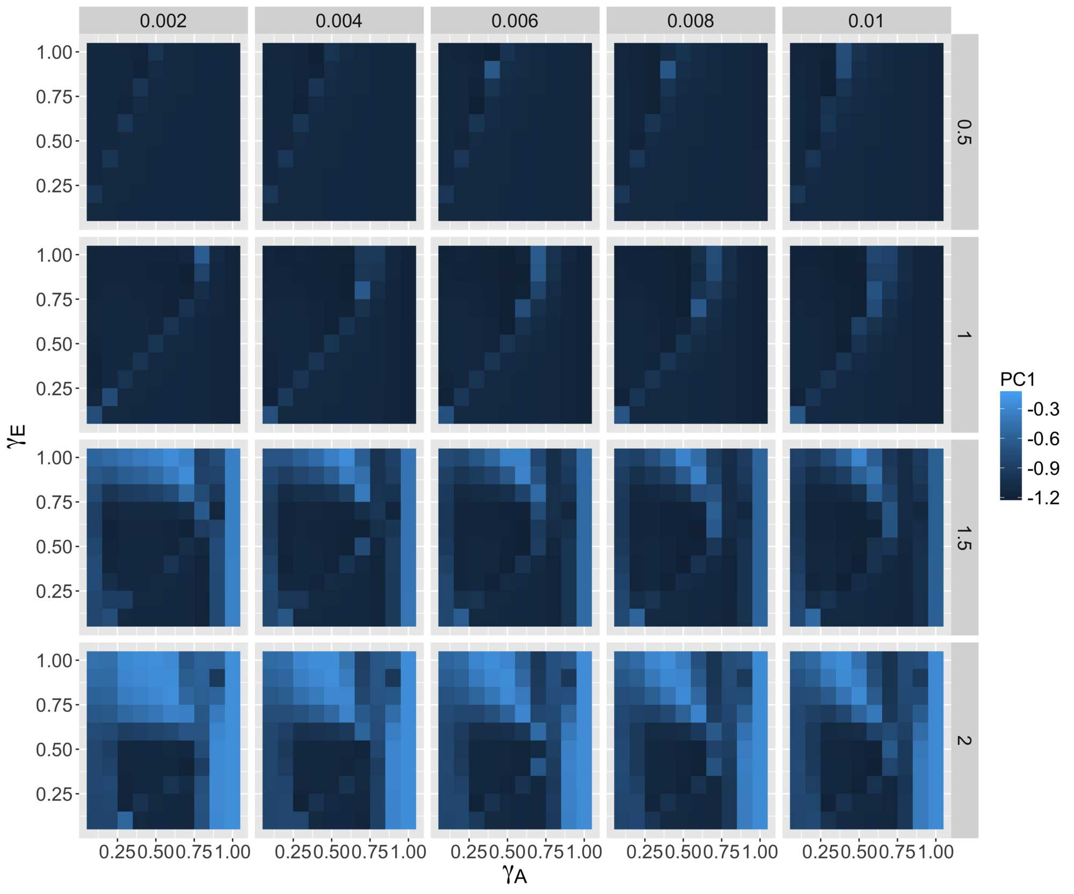
Validation : Luti module (morphology)

Slide 24
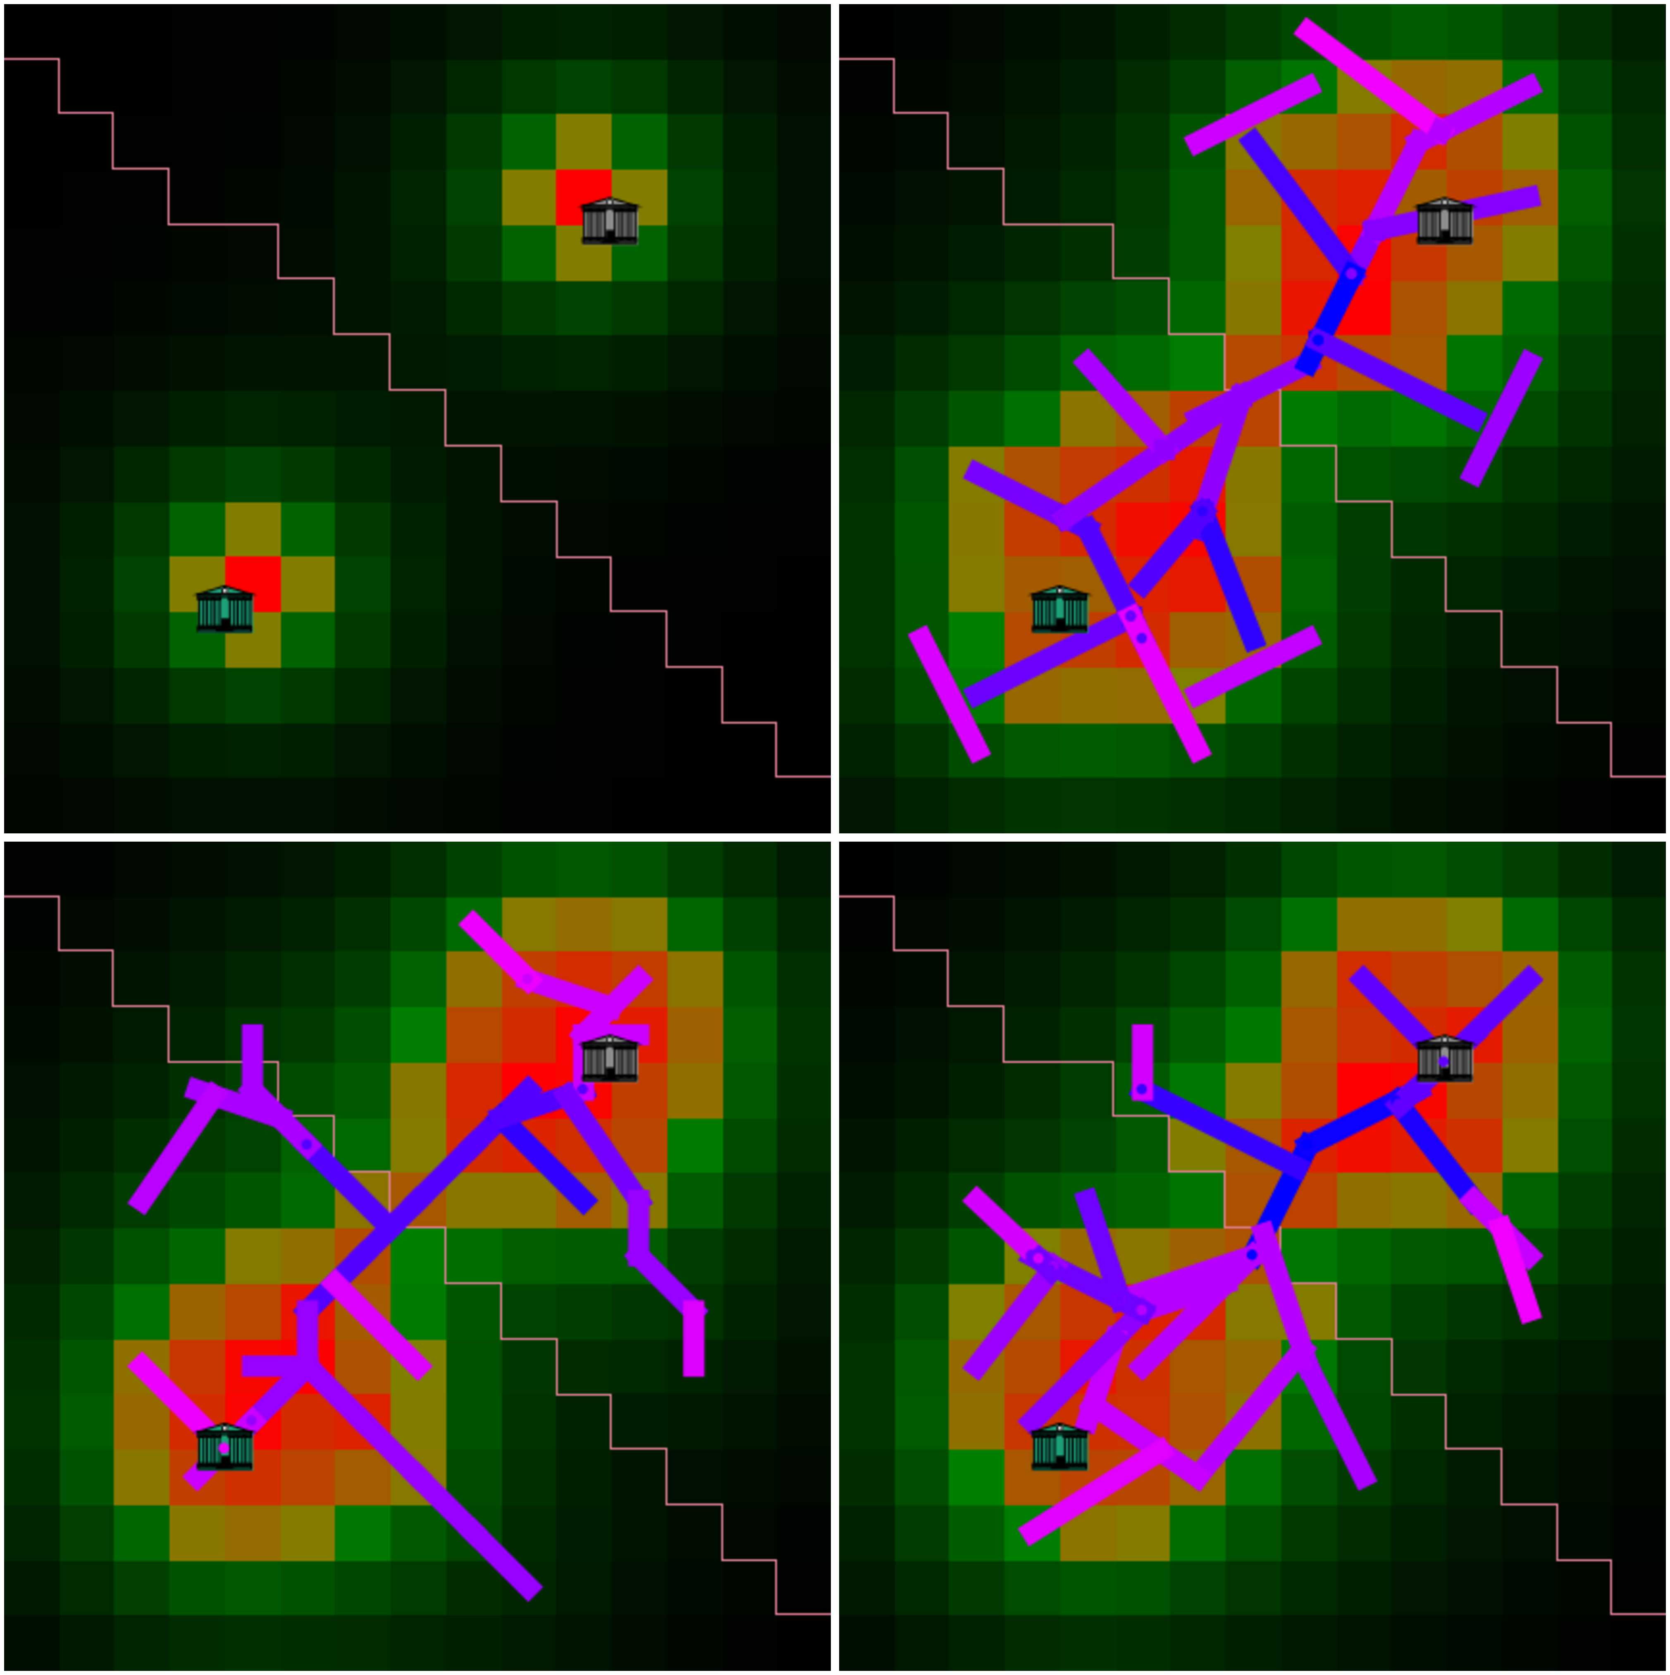
Influence of governance parameters

Slide 25
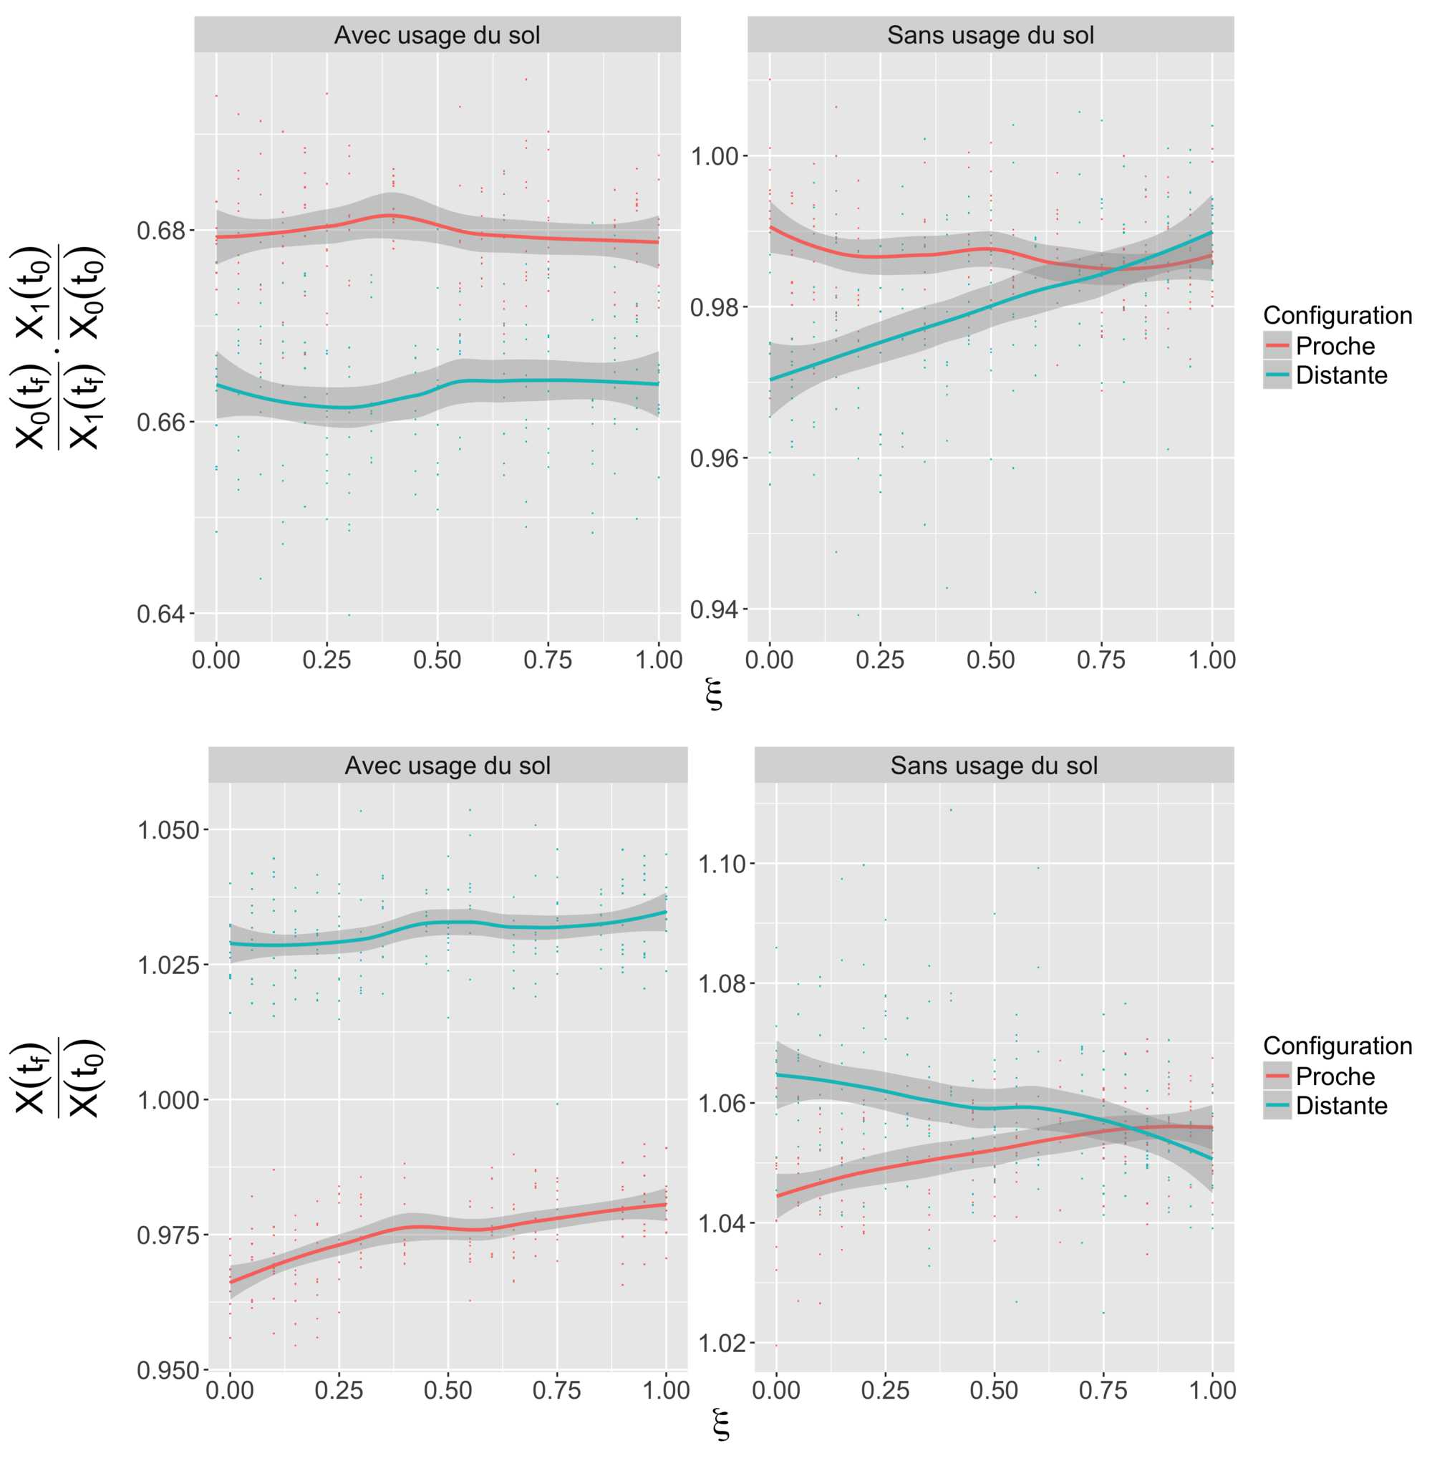
Effect of co-evolution

Slide 26
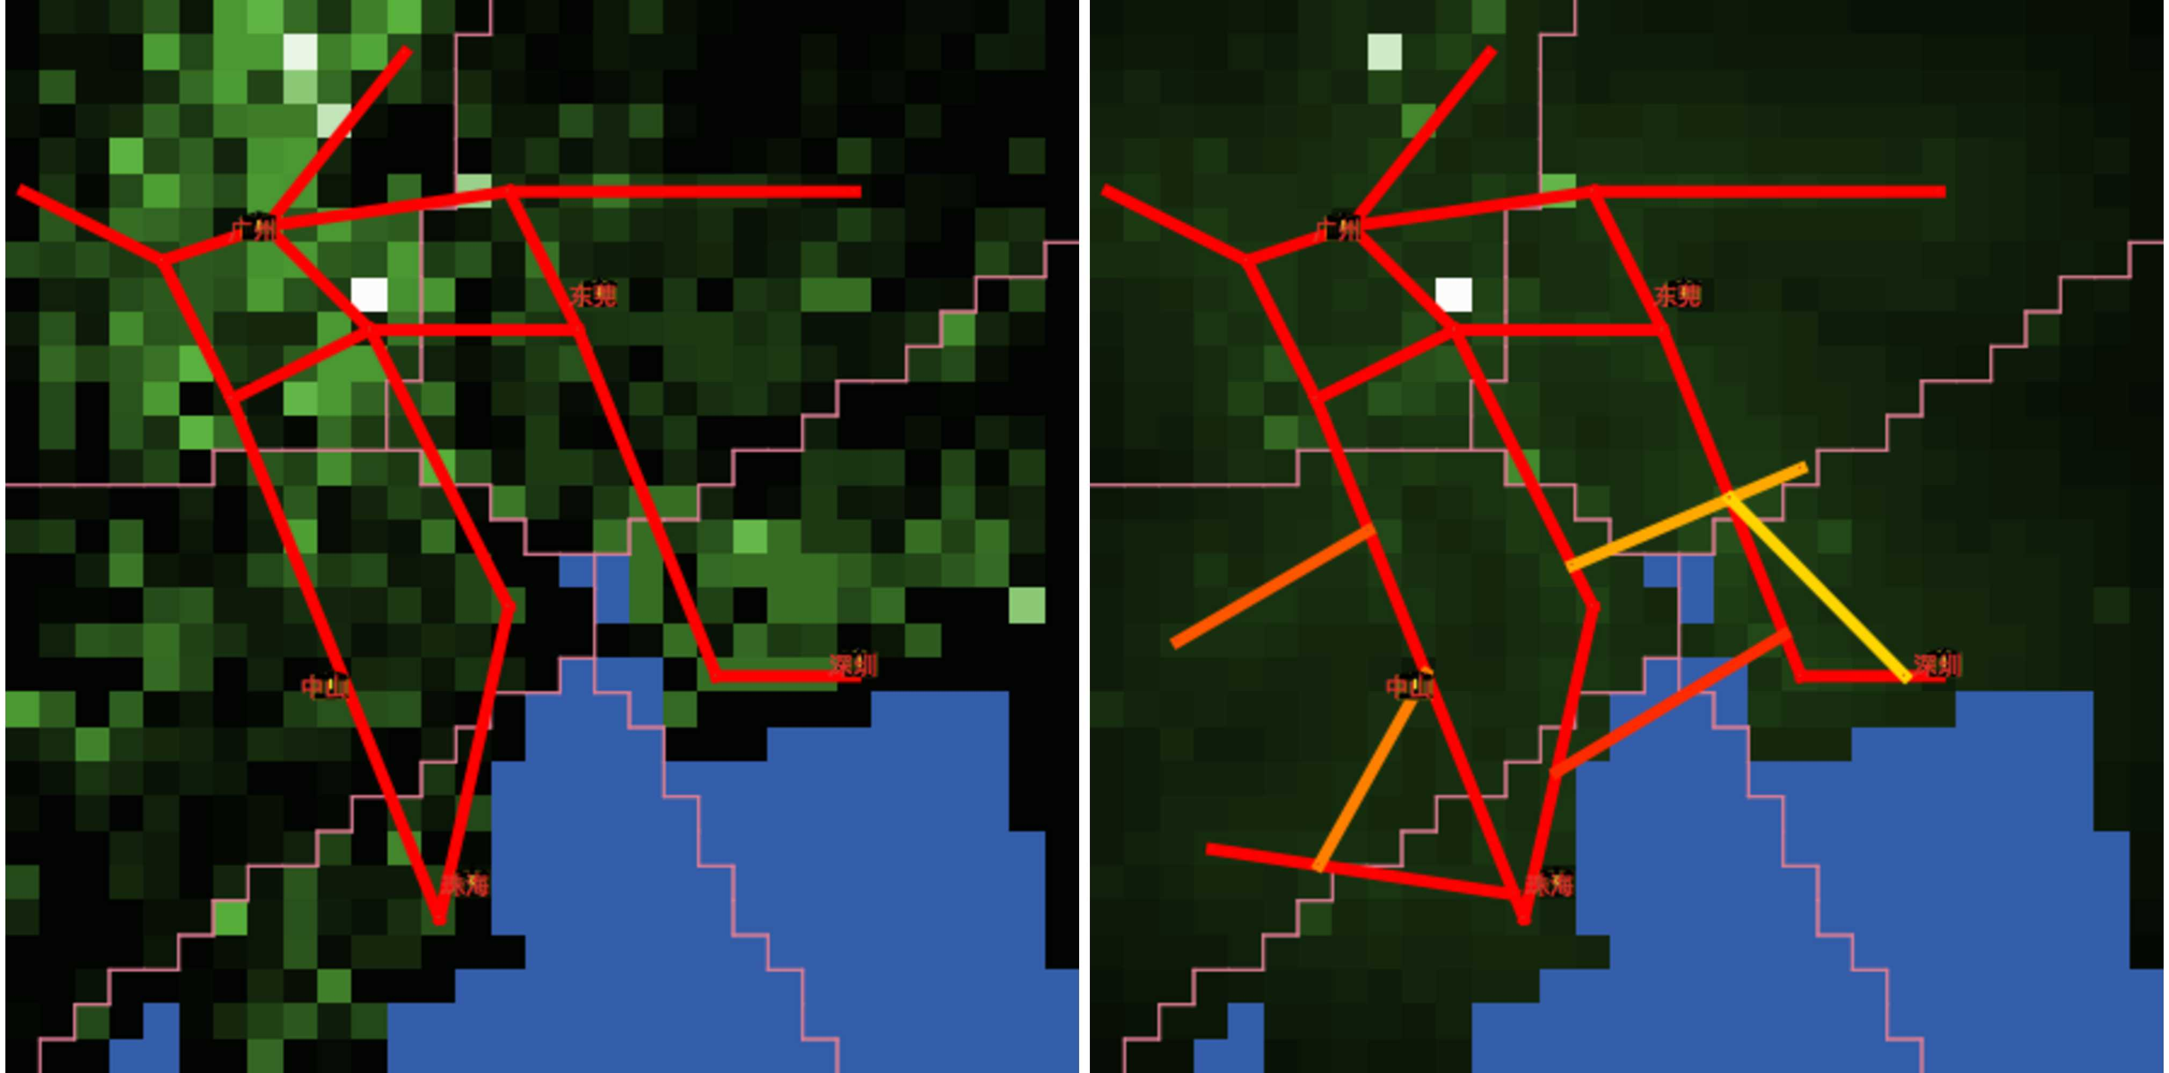
Application on Pearl River Delta

Slide 27
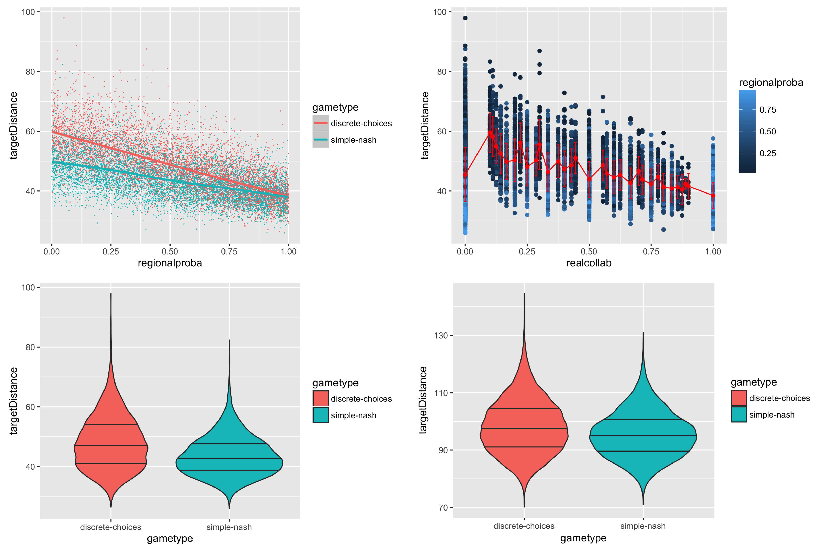
Calibration on Pearl River Delta

Slide 28
Concluding discussion
Path dependancy in infrastructure construction : final result does not globally optimize, since it is built step by step.
Question of applicability : possibility of going further than a toy model (Banos, 2013) ?
  More realistic urban forms ?
  More detailed LUTI module structure.
Step towards the integration of endogeneous governance in models coupling network growth with city growth (models which are quite rare (Raimbault, 2015) )

Slide 29
Reserve Slides

Slide 30
Scenario « central amenity»
Reformulation of the
thematic question
in the « model world » :
- what factors can
favour emergence
of centralized
provision of transport
infrastructure ?
- what impact does it
have on employment
of a « central super
amenity » ?
Ea(t) / Ea(t-1) = k * Aa(t)

Slide 31
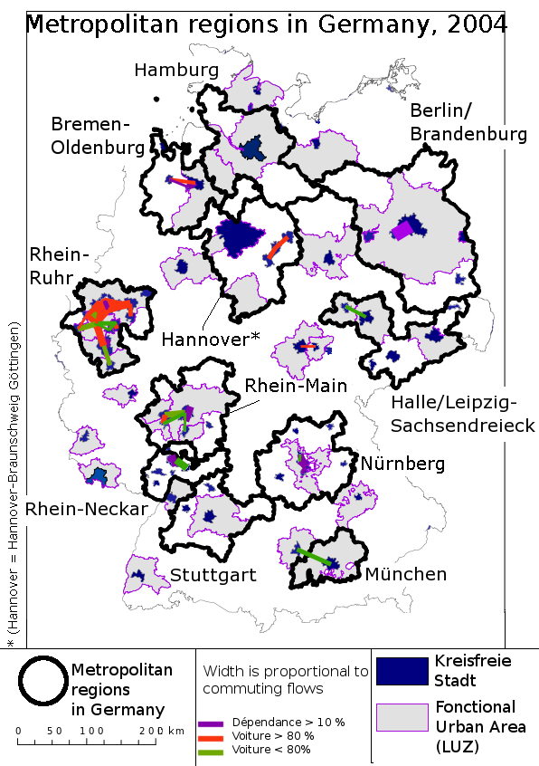
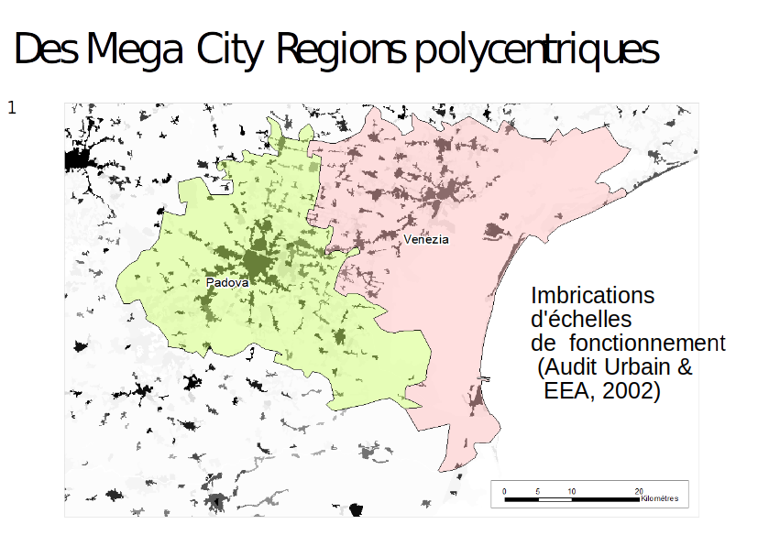
Cities, states and mega city regions
Tenfold increase in mobility
Impact at all
spatial scales :
- intra urban
- inter urban, within
Mega City Regions
- inter urbain, world
wide
 | 1960 | 1990 | 2020 | 2050
World population | 3 | 5 | 7,5 | 9,5
Total distance (x10^12 km) | 5 | 25 | 55 | 105
Distance per person per year (km) | 1700 | 5000 | 7300 | 11000
Source Schaefer & Victor, 2000 + UN + own computation
Polycentric network of cities
Source : EEA (2002)
and Urban Audit.
Boundaries of « Larger
Urban Zones »

Slide 32
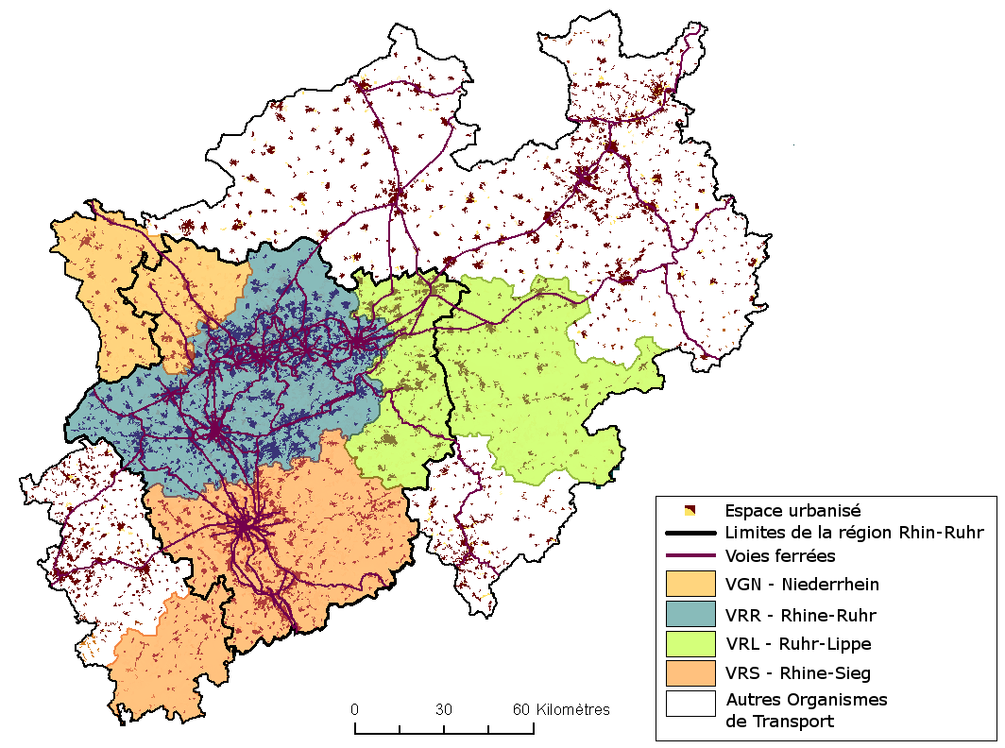
Rhine-Ruhr area
12 M inhabitants
Local cities has important planning power (Knapp & Schmitt)
Historical cultural differences (Blotevogel)
4 transport autorithy with fare integration

Slide 33
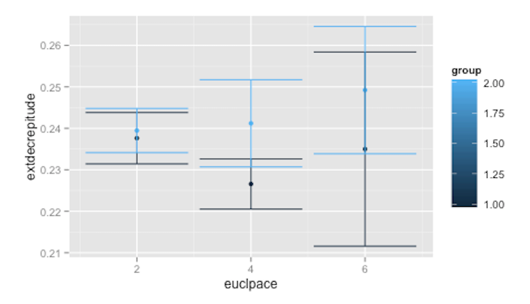
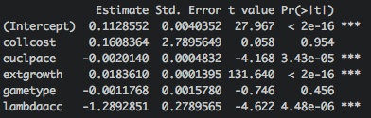
Results (with central amenity)
Euclidian Pace : inverse effect for two games, but not significant
Final Amenity Growth
Euclidian Pace

Slide 34
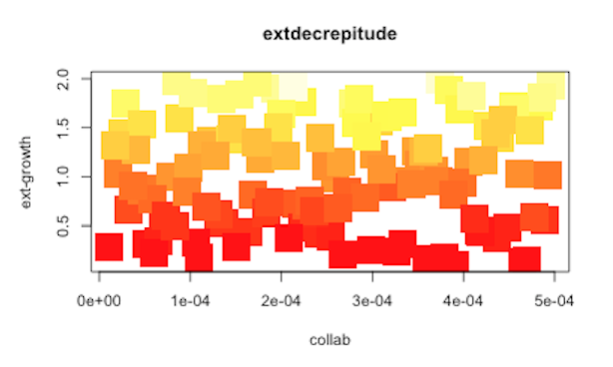
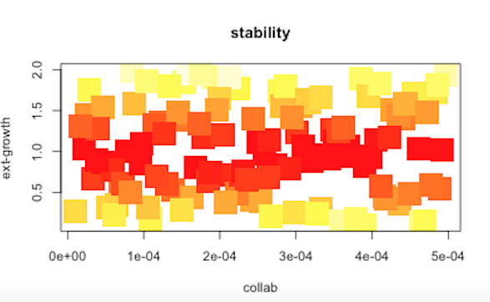
Results (without central amenity)
Collaboration cost vs growth parameter : independance of their influence on stability and facility growth for these settings
→ Need of more computations to regress statistical models and achieve control.
Final Amenity Growth
Cumulated relocations
Amenity Growth
Parameter
Amenity Growth
Parameter
Collaboration Cost
Collaboration Cost

Slide 35
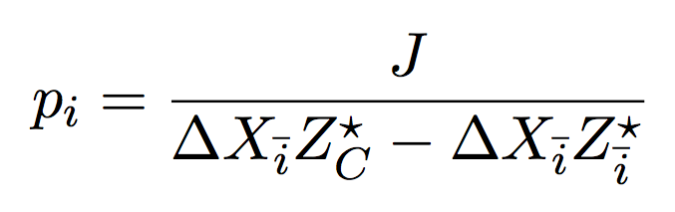
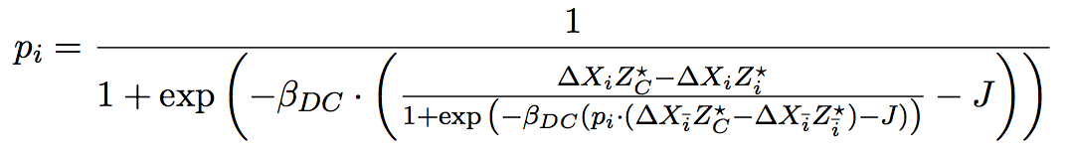
Equations for Games
Probability of collaboration in mixed Nash case :
Difference of utilities in DC game yields the corresponding equation to solve to obtain
probability to cooperate :

Slide 36


Slide 37
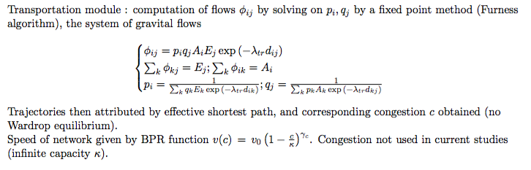

Slide 38
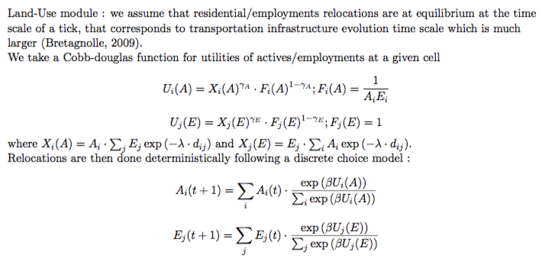

Slide 39
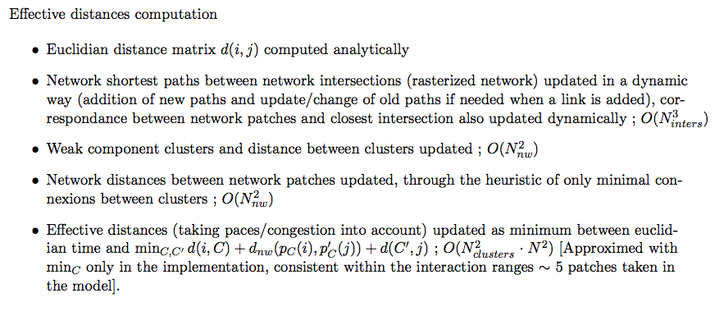

Slide 40
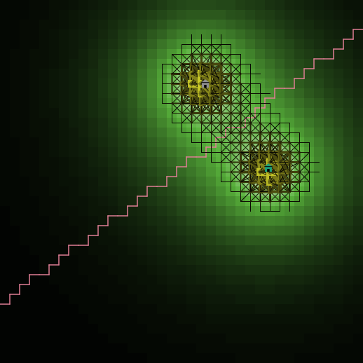
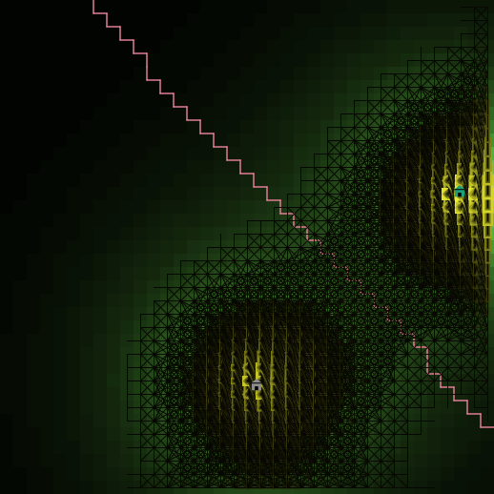
Flows Visualization Example

Slide 41
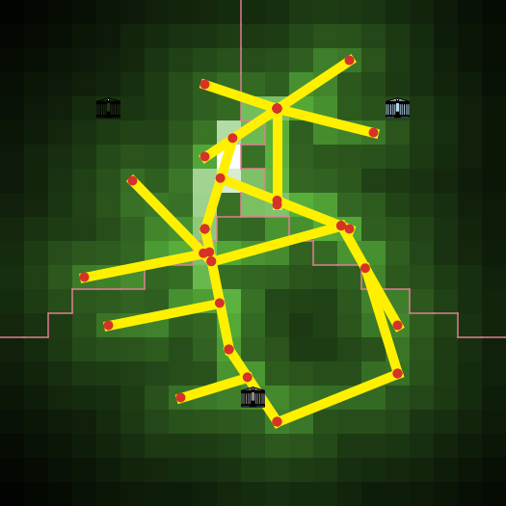
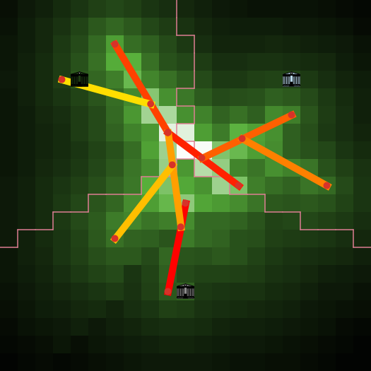
Long-time Limits for Network Examples

Slide 42
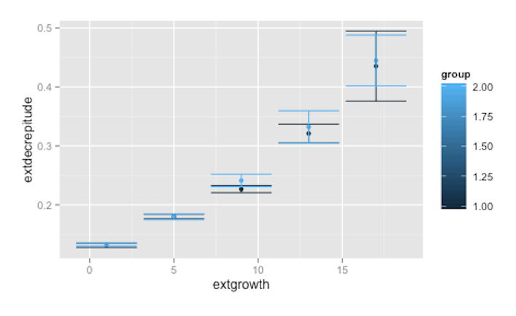
Results (with central amenity)
Growth parameter controls facility growth, but has an influence on its volatility
Final Amenity Growth
Amenity Growth Parameter
→ preferential attachment scheme for volatility ?

Slide 43
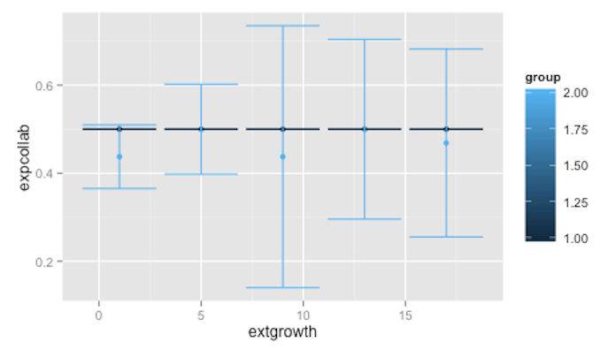
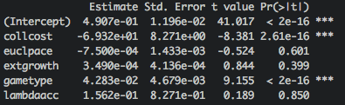
Results (with central amenity)
No significant influence of facility growth on collaboration for both games
Probability of collaboration
Amenity Growth Parameter
→ further study needed to confirm or find bias origin (exploration heuristic, too few repetitions, wrong value for controlling parameter ?)

Slide 44

Results (with central amenity)
Does cost of energy sligthly decrease facility growth ?
Final Amenity Growth
Lambda Accessibility
→ feedback of accessibility on relocation ?

Slide 45

Results (with central amenity)
Influence of collaboration cost
→ Nash game is chaotic, we do not converge towards E[1/(∆Xc-∆Xi)]. (why?)
Probability of collaboration
Collaboration Cost

Slide 46
Main Conclusions of Experiments
Optimized operational implementation.
Expected influence of « main » parameters and expected behavior of the extended Luti model.
Difficult to extract the role of secondary parameters, that must be hidden in noise at this level of statistical significance → only a large scale exploration (order of 10^7 simulations ~ 10^9s CPU time) will allow to obtain exploitable thematic conclusion through robust model behavior knowledge, see (Schmitt & al., 2015).
Further themetical experiment to be conducted :
  Influence of initial urban form ?
  Influence of continued National planning ?

Slide 47




Accessibility
Actives Entropy
Employment Entropy
Collaboration
Amenity Growth
Stability
Travel Distance

Slide 48


Slide 49


Slide 50


Slide 51


