Slide 1
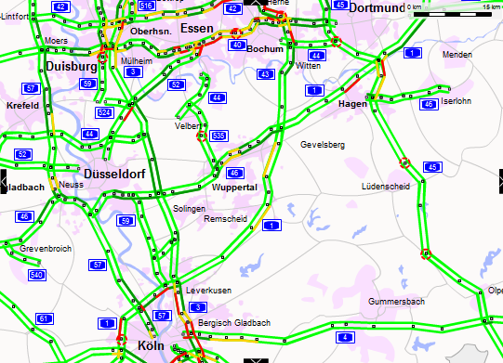
URBAN DYNAMICS MODELLING WITH ENDOGENEOUS TRANSPORT INFRASTRUCTURES IN A POLYCENTRIC REGION
ecQTG 2011
September, 5, 2011
Florent Le Néchet
LVMT (Université Paris Est)
UMR Géographie-Cités

Slide 2
Urban growth and mobility
Context : sprawl of cities
- Urban transition : walking city / rail city / road city (Newman & Kenworthy, 1999) ; decrease of density
> Suburbanisation : households ; jobs ; Edge Cities (Garreau, 1991)
> « Metropolisation » (Lacour, 1999)
Concentric growth
(Edge Cities)
Local diffusion
(ex. Paris)
- Towards polycentricity ?
- Sustainable mobility ?
Typology of Champion (2001)
Fusion
(ex. Aix-Marseille)

Slide 3
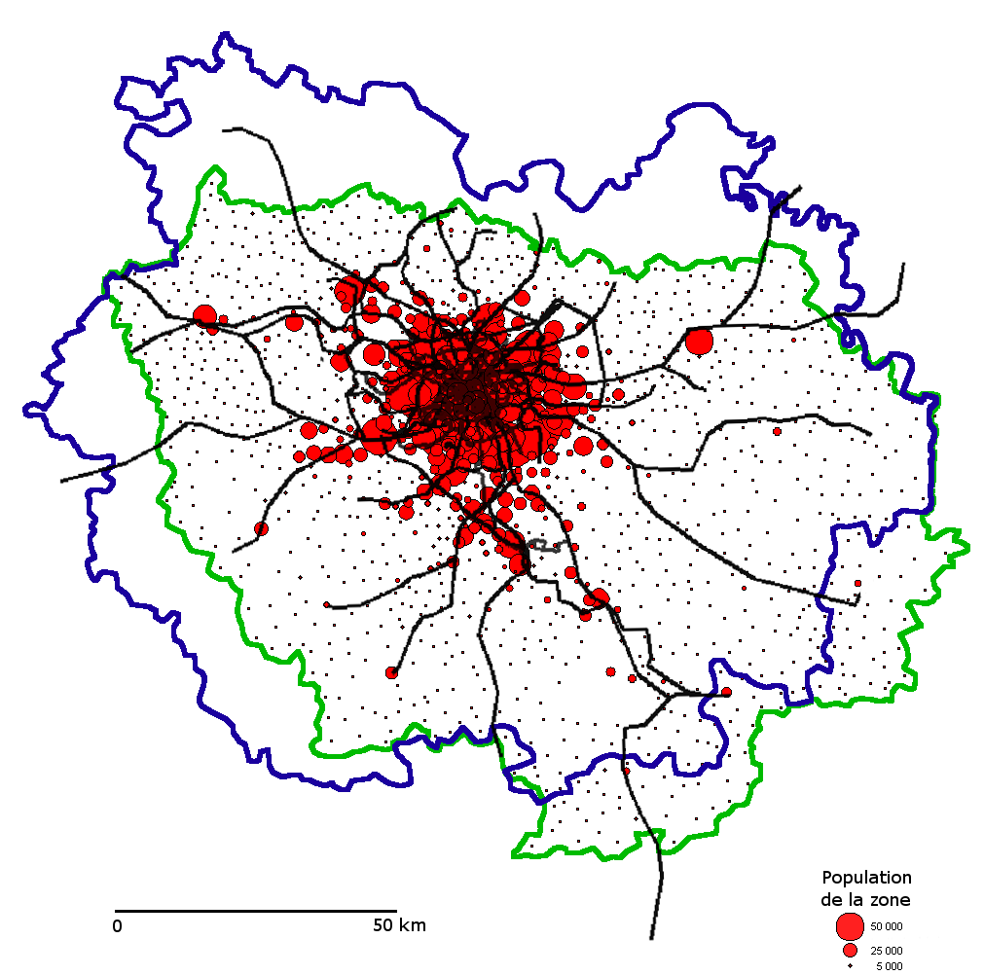
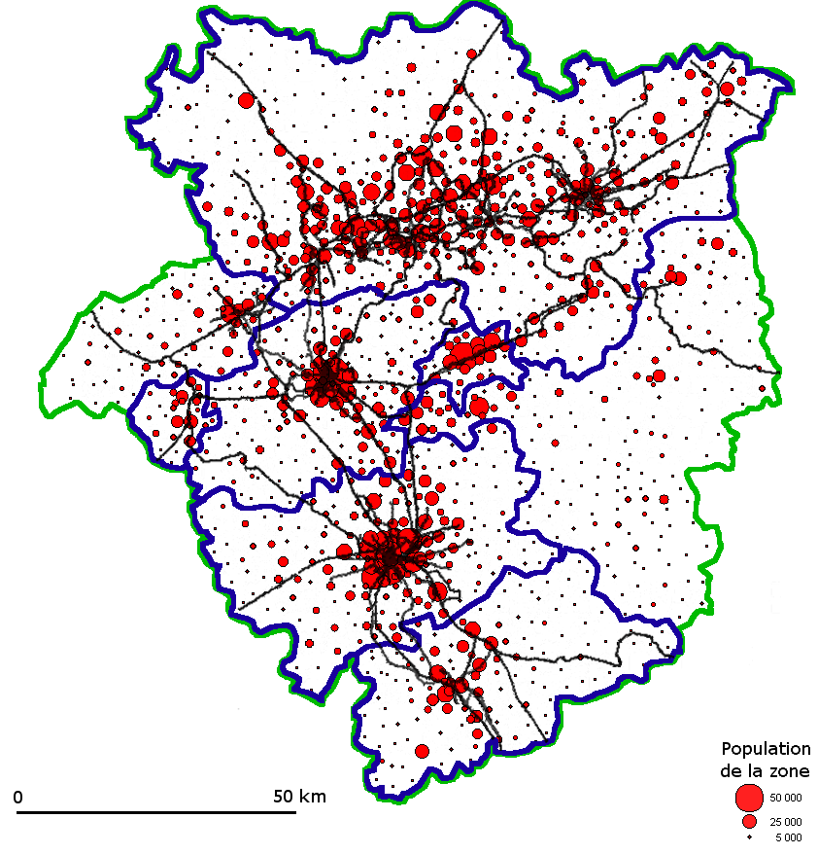

Emergence of polycentric regions
Bassin de la Ruhr
Aire urbaine de Paris
Düsseldorf
Cologne
Bonn
Ile-de-France
Rhine-Ruhr
→ « Inertia » within governance systems (Paasi, 1986).
Polycentric metropolis (Cowell, 2010) ; multi-scale planning (Knapp, 2003).

Slide 4
Urban change modelling
Traditional monocentric model (Alonso, Muth)
Entity based models
- Cellular automata (spatial units)
- Agent-based
(individual units)
Land-Use Transport
Interaction models (LUTI)
  Dominant paradigm :
  individual utility
  Pseudo-dynamic models
  (TRANUS, UrbanSIM)
  Static models (Pirandello)
Land use change : MOLAND project (White & Engelen)
Polycentric modelling (Lemoy & Raux, 2011) : agents used for convergence of rent prices.
SIMPOP familiy models : cities as agents.
Transport network and land use exogeneous

Slide 5
Specifications of the model
Two levels of « agents » are represented
→ Individuals (microeconomic utility)
→ Planners (simple rule of decision)
Discrete time : « open » system,
out of equilibrium
  Transport infrastructure
  provision
Transport
Planning
Endogeneous growth of the
transport system.
Land Use

Slide 6
Planning submodel
Simplistic hypothesis of development : urban planner seeks improvement of global or local accessibility
- Urban form (Ai and Ej)
- Travel times (road network)
- Cost of energy (λ)
Exemple of Paris wider region (Bassin Parisien).
Transport provision
Travel times
0-30 minutes (road based)
Sprawling
Data from INSEE
and IGN

Slide 7
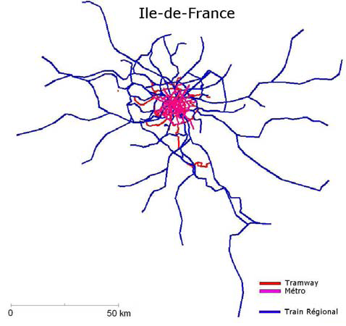
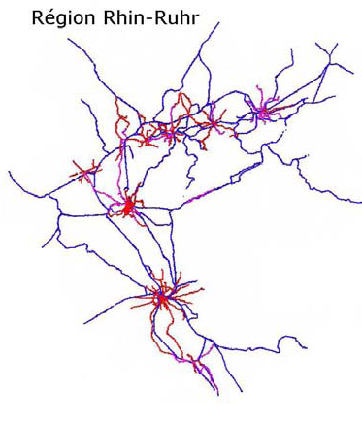
Transition rules
1) Random choice between metropolitan and local decision ; exogeneous parameter ξ.
2) If local decision, random choice between local bodies (pro-rata of number of jobs).
3) Once territory is fixed, tests of all new infrastructures of exogeneous length, and building of the locally optimum one.

Slide 8
Tests on polycentric cities
London
Stuttgart
Centralized
Monocentric
Polycentric
Decentralized
Even more complex reality : 3 or 4 scales
Marseille
Rhine-Ruhr

Slide 9
Tests on polycentric cities
Zahavi's law (1976) is respected (λ is constant).
Better accessibility in polycentric city if centralized planning.
No impact for monocentric city.

Slide 10
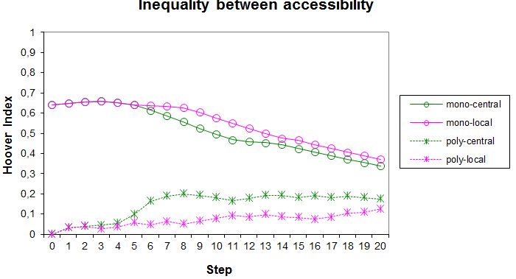
Tests on polycentric cities
Bigger sprawl for monocentric cities if centralized planning.
Slight impact of planning on urban form in case of polycentric cities.
More inequality between local accessibilities if central planning (reinforcement of biggest polarity).

Slide 11
Perspectives
Calibration of the model
What does represent a time step (~5 years ?) and size of the city (~ 50 km * 50 km )
Various economic agents and planning policies ; impact of urban form on residential choice.
Use of the model
Stylized version of a real city – reproduction of key indicators : speed of growth, urban form, network shape.
Shift from decentralized to centralized planning.
Mode choice, energy use change when energy costs vary (with adaptation of land-use).

Slide 12
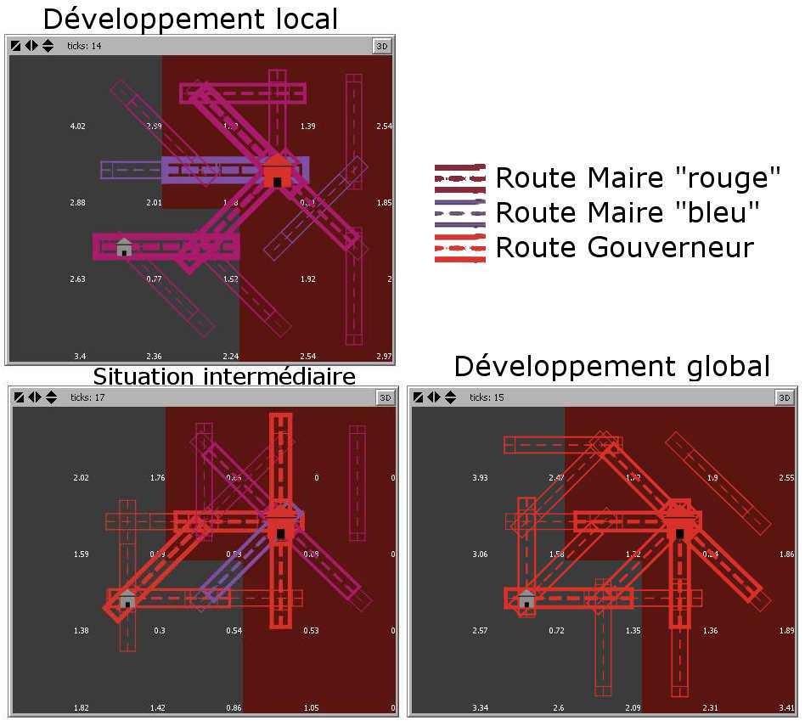
Thank you !

Slide 14
Tests on theoretical cities
1) Monocentric
city sprawl
2) Planning and urban form for polycentric configurations

Slide 15
Sprawl of monocentric city
Impact of speed and capacity of roads
Sprawl index : average distance between two individuals (Bertaud, 2003).

Slide 16
Imbrication of scales within a complex system
Retroaction Transport /
Land Use (Wegener &
Fürst, 1996)
Three susbsystems
(Bonnafous, 1996)
  Activity
  Transport
  Localisation
Imbrication of scales, even
for the same trip purpose
(path dependancy)
Intra-urban
mobility
Suburban train,
motorway
High-speed
rail

Slide 17
Transport / Land Use
→ Travel is modelled by classical 4 stage model. Only commuting is represented.
→ Every cell is urbanized ; a proportion μ of households and jobs change place between two steps ; total population is constant.
Localisation of individuals depend on metropolitan accessibility and local urban form.

Slide 18
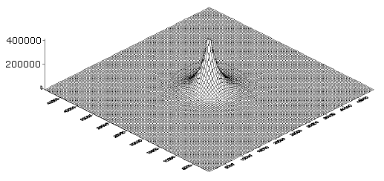
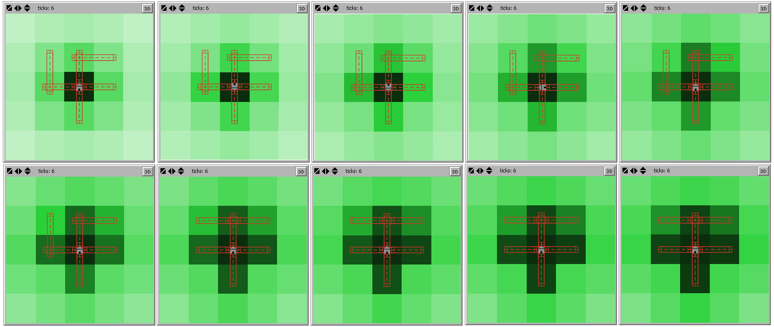
Sprawl of monocentric city
Calibration of submodels, via macroscopic observation.
μ, proportion of agents moving in space between two steps.
No reaction
Overreactive

