Slide 1
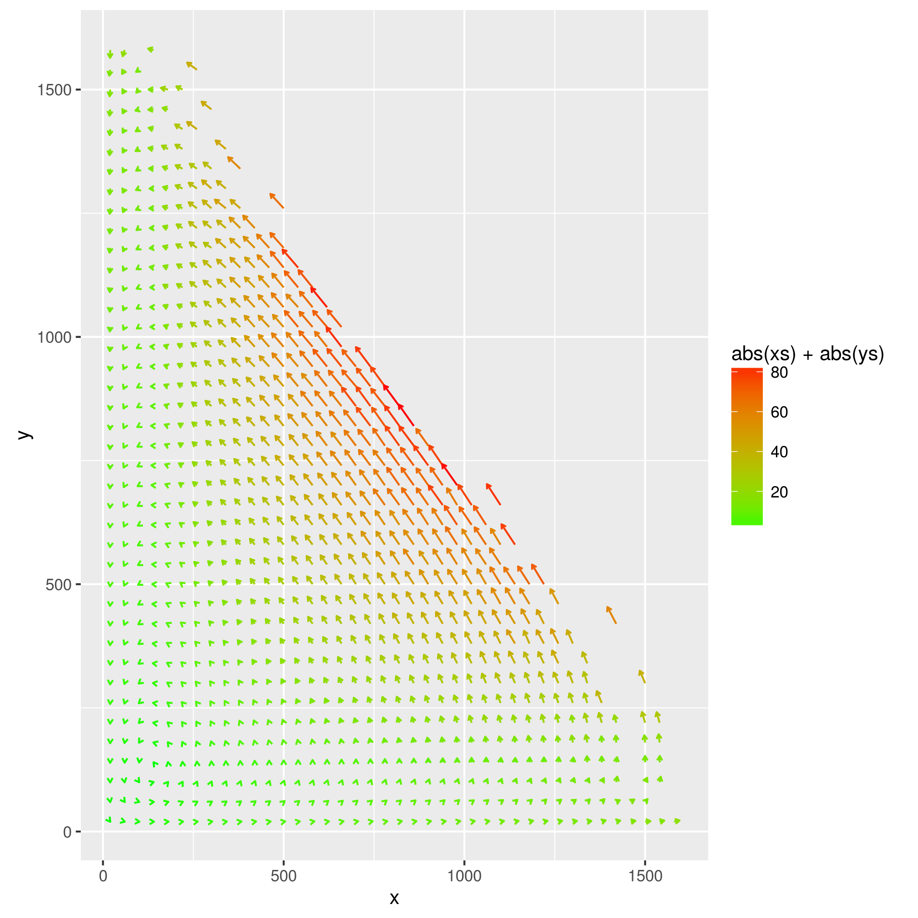
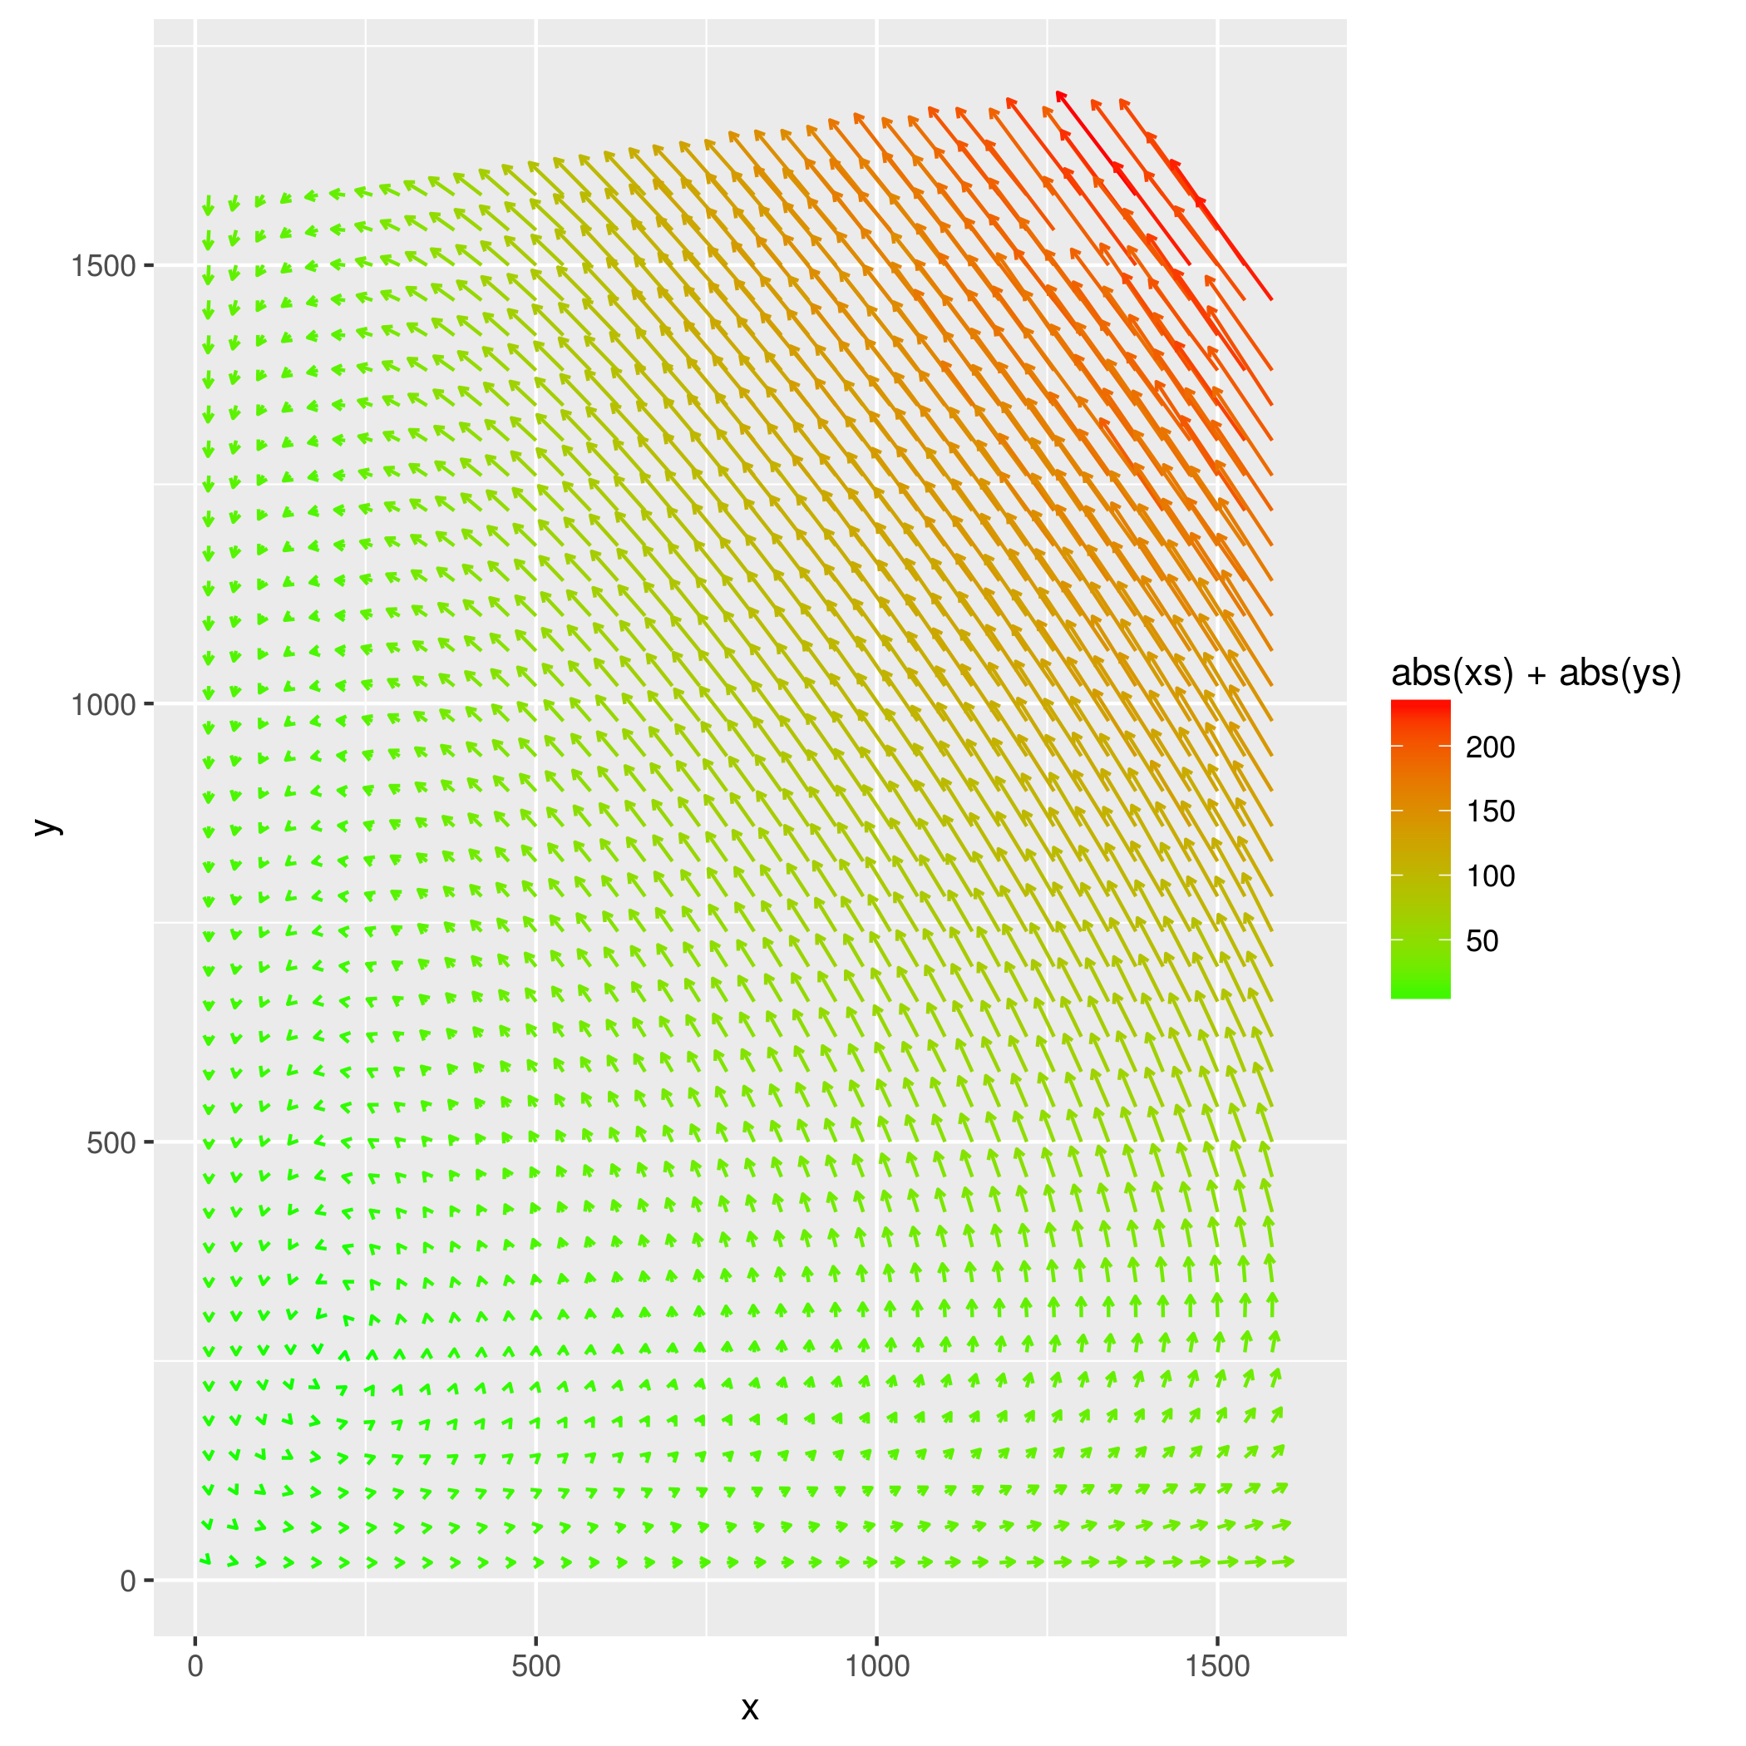
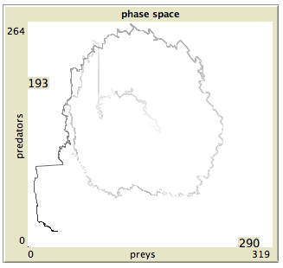
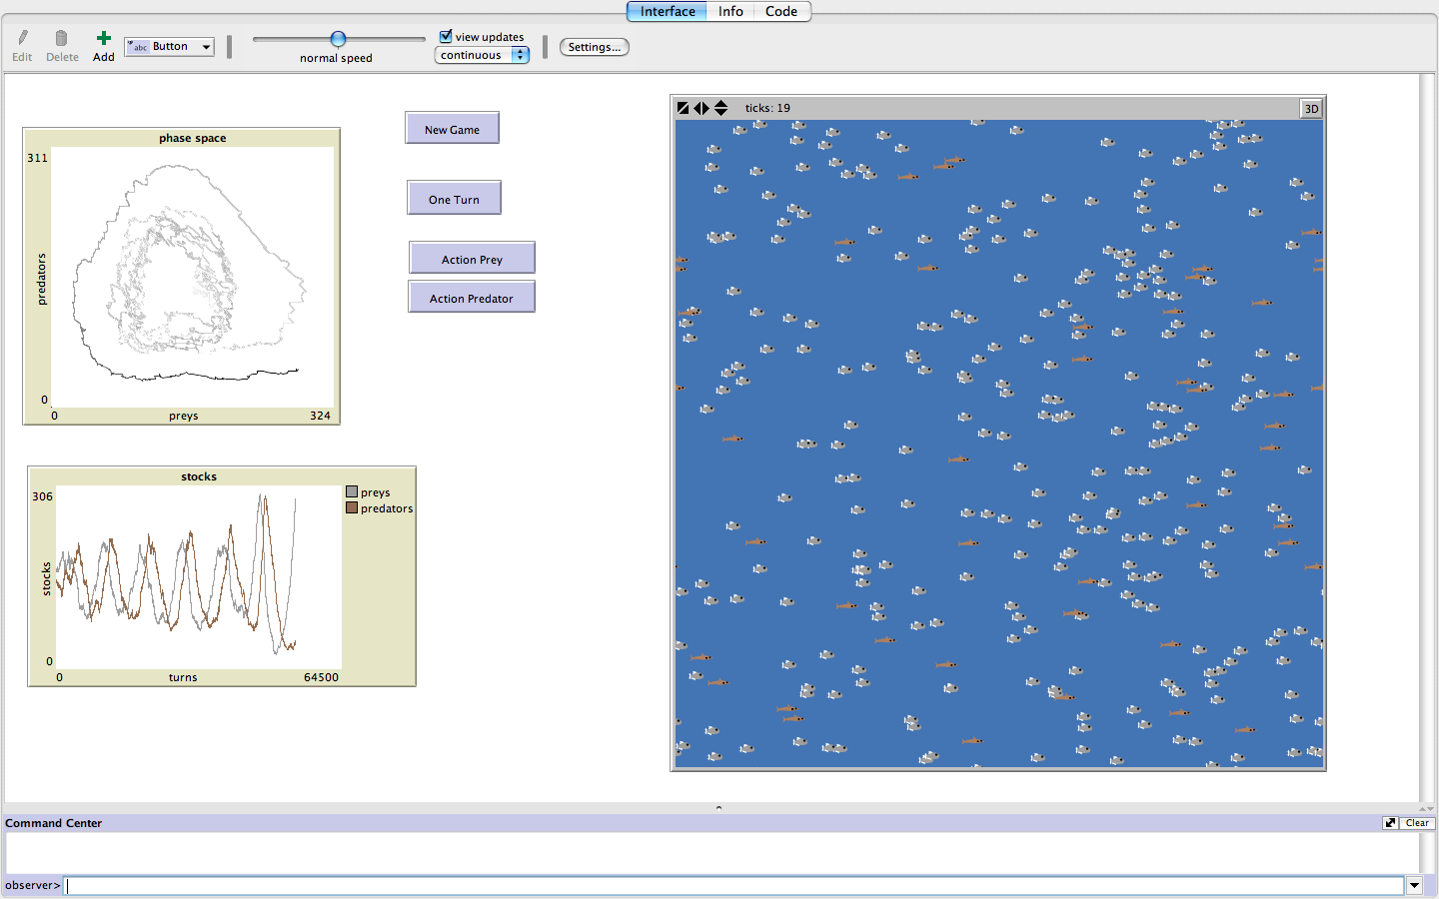
Game-based tools to transmit freshwater ecology concepts
SERRA, Hélène¹ , RAIMBAULT, Juste² *corresponding author: helene.serra@ineris.fr
¹ University of Bordeaux/UMR CNRS 5805 EPOC/LPTC, France
² CNRS/polytechnique
INTRODUCTION and OBJECTIVES
METHODOLOGY
STEP 1
DEFINITION OF THE MAIN IDEAS
Aim of the game
Aquatic species and ecological concepts
Inclusion of time and chance
STEP 2
CONSTRUCTION OF THE PROTOTYPS
Design of the games (players , token, board)
Size and layout of the board
Coding and calibration of the model
STEP 3
TESTING AND EVALUATION
Gather feedbacks from specific audiences:
- Board game association
- Netlogo users
- Scientific community
STEP 5
DIFFUSION OF THE GAMES
Search for funding and diffusion network
Open online access of the computer based game
BOARD GAME: individual-based approach
COMPUTER GAME: population dynamics
MAIN IDEAS
The aim of the game is to reach a stable population of fish
The player is a fish either the roach (rutilus rutilus) or the pumpkinseed (???!!)
The game should illustrate different feeding and reproduction strategies, predation and competition
MAIN IDEAS
The aim of the game is to maintain the ecosystem at the equilibrium between preys and predators
The player(s) controls the behavior of population of roach (pray) and pumpkinseed (predators)
The game should illustrate population dynamics and stability in a simple ecosystem
STEP 1
CONSTRUCTION OF A PROTOTYPE
An agent-based model for a simple prey-predator system is proposed as a basis for the computer game.
Parameters : prey reproduction rate, predator survival rate and prey prelevement probability.
Sochasticity is included with spatialized interactions (smoothed brownian motions)
CONSTRUCTION OF A PROTOTYPE
General rules
The board represents the edge of a lake with cases corresponding to ressources.
Each species has feeeding preferences:
Roach = plants and crustaceans (dessins)
Pumpinkseed= juveniles roach (predation) and crustaceans (dessin)
At each turn, the player throws dices and moves on the board his tokens (male and female fish) to cases with ressources.
To reproduce both fish should be on the same case and provide an given amount of energy. Roach should be on « plant » and the pumkinseed at the bottom of the lake and the male should constructs a nest
Incorporation of chance: external events
Disturbation affecting:
→ ressources
→ players
→ the ecosystems
STEP 2
2. Model exploration : systematic exploration of parameter space (OpenMole software for intensive grid computation) to verify theoretical average
trajectories in phase space, analytical and numerical determination of initial position (attractor)
3. The player(s) can influence parameters at each turn (50 time steps) to correct the trajectory. Events randomly perturbate the position in phase space, endangering the ecosystem.
Ex. Of average phase space obtained by model exploration
Game turn workflow
Predator death event
Initial condition
System evolution
Player action
Event
Prey death event
Effective stochastic phase space
Prey action
Predator action
Screenshot of game interface (NetLogo software)

