Slide 1
Agent-based Modeling of Migrant Workers Residential Dynamics within a Mega-city Region: the Case of Pearl River Delta, China Cinzia Losavio¹ and Juste Raimbault^{1,2} (1) UMR CNRS 8504 Géographie-cités and (2) UMR-T IFSTTAR 9403 LVMT
Medium Project Seminar, 4th December 2016

Slide 2
Mega-city regions
Mega-city regions (MCRs) are integrated sets of cities and their surrounding suburban hinterlands across which labour and capital can be reallocated at very low cost (Florida, Gulden & Mellander, 2008).
Main characteristics:
symbiosis between urban and rural areas
migration flows
density of connections
regional migration patterns
Notes:
This presentation focuses on a Collaborative research projects between Juste Raimbault and I, and it is the result of a transfer of knowledge between researchers with very different backgrounds and methods.
Combining qualitative and quantitative research We use an agent-based model to simulate residential dynamics of migrants in the Pearl River Delta (PRD) mega city region. Even though the model doesn't use statistical data but synthetic data, we identified a need for qualitative research in order to further investigate relevant contextual factors.
Mega-city regions (MCRs) are integrated sets of cities and their surrounding suburban hinterlands across which labour and capital can be reallocated at very low cost (Florida, Gulden, & Mellander, 2008). It was first coined by Gottmann (1961) using the term megalopolis—that he defines as “urban area of several tens of millions of people, including several cities and major urban centers, and extending continuously over several 100 km”.
It represents the new economic unit that emerges as metropolitan regions not only grow upward and become denser but also grow outward and into one another (Florida et al., 2008) These spaces result of the networking of a group of metropolitan areas deployed around very large cities and it is characterized by the “symbiosis between urban and rural areas”. Other characteristic are migration flows, density of connections, and regional migration patterns.

Slide 3
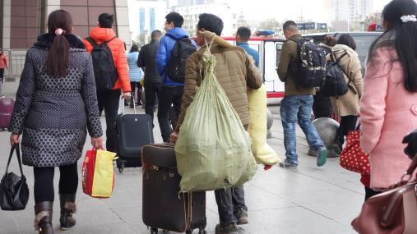
Pearl River Delta (PRD) represent the most prosperous and dynamic mega-city region in term of migration waves
Notes:
Since the gradual decentralization of the state power which occurred in the beginning of 1990 Mega-city regions have become a new scale of Chinese State regulation, and in particular the pearl River Delta, represent the most prosperous and dynamic one in term of migration waves. That’s why we choose PRD as our unit of study.
Since the Open Door Policy was implemented in 1978 the PRD launch a process of rapid economic and social transformation, becoming a global manufacturing region attracting an increasing number of migrant-workers from all over China. In fact, PRD was designed as an open economic zone in 1984, and was granted many ‘one step ahead’ policies to attract foreign capital, becoming the most important exporter center since economic reform.

Slide 4
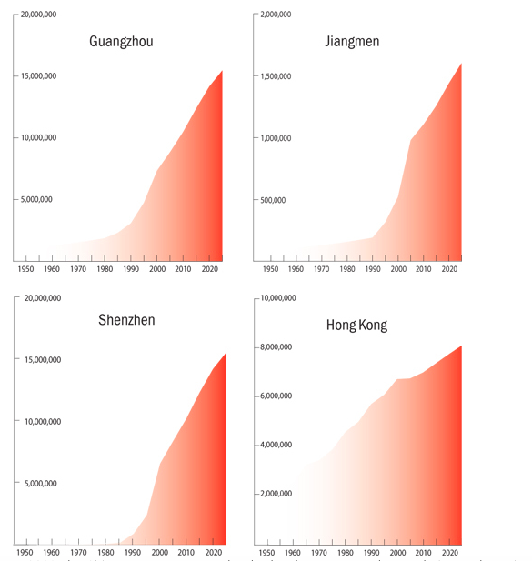
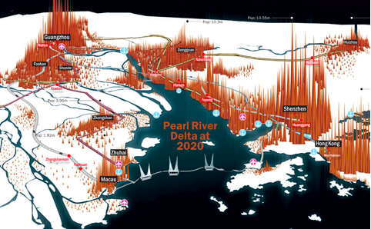
PRD Mega-city regions characteristics
Exponential rise of population
Polycentrism
Source: Time Out HK
Source: Time Out HK
Notes:
That results in an astonishing rise of population in the area. That today count more than 50 million people. If during the first year of the opening-up reforms the barycenter of the region was Guangzhou, over the last decade PRD has become increasing polycentric.
Taking PRD as the unit of our model we try to reproduce migrants residential patterns taking into account the full range of migrants’ socio-economical status and their evolution.

Slide 5
This agent-based model simulates migrants residential patterns taking into account the full range of migrants’ socio-economical status and their evolution
3 dimension to discern migrant-workers diversity:
PROFESSIONAL: industry, construction, private sector, services
RESIDENTIAL:
TEMPORARY: migrants working in the construction sector, seasonal migrants workers
PERMANENT: migrants living in the urban area for more than 6 months and renting a room or an apartment depending on their:
Economic situation
Social network
Proximity to the work place
GENERATIONAL:
The "first generation" is the set of individuals born in rural areas and having lived there for a long period. They carried out agricultural or non-agricultural activities and chose to immigrate to the city on a temporary basis.
The "second generation" refers to all individuals originating from rural areas but not necessarily engaged in agricultural work, and who migrate to the city in order to remain there more permanently.
The "third generation", the children of migrant-workers who were born in the village or in the city and who grew up in urban areas (and who are effectively urban but with a rural hukou, they are more likely to stay in the city and probably move less then their parents)
Notes:
Even though migrants workers are generally considered and treated as a uniform category, my previous research showed how considering their economical, cultural and human capital migrants workers are a very diversified social category. Especially 3 dimension are fundamental to understand migrant workers:
ROFESSIONAL DIMENSION : industry, construction, private sector, services (will change not only their economical situation but which influence migrants’ trajectory and the staying duration in the city and their residential choice.
RESIDENTAIL DIMENSION
We could recognize two under-categories, with different socio-economic situation:
TEMPORARY
- migrants working in the construction sector, who are really mobile, changing city or province according to the labour demand;
- seasonal migrants workers, most of the time are peasants working as farmer and cultivating their land who come to the urban area to sell their product at the city price but without paying the running costs
temporary migrants’ trajectory are more difficult to detect since they move in a discretional way
PERMANENT
Who are living in the city for more than 6 months and are renting a room or apartment depending on their:
Economic situation: revenues
Social network
Proximity to the work place
GENERATIONAL …
All these sub-categories have different mobility patterns, that we try to simulate in our model.
Considering this diversity and translating it in qualitative stylized facts that correspond to precise patterns of synthetic data, this model aims at establishing a new perspective for understanding China’s urban and regional mobility employing a more qualitative approach, specifying the mechanisms trhough which Party-State shape the parameters of migrants’ choices.
I will give the floor to my collegue Juste Raimault, that will present the model and how it works.

Slide 6
Hybrid Agent-based Modeling
Agent-based Modeling : from toy to fully parametrized models, to infer indirect knowledge on processes in Complex Systems.
Recent trends : Pattern-oriented Modeling (Grimm et al., 2005) as a way to externally validate models ; return of Multi-Modeling (Cottineau et al., 2015) to discriminate alternative explanations ; High Performance Computing calibration bringing “proofs” in Social Sciences (Schmitt et al., 2014).

Slide 7
Model Structure

Slide 8
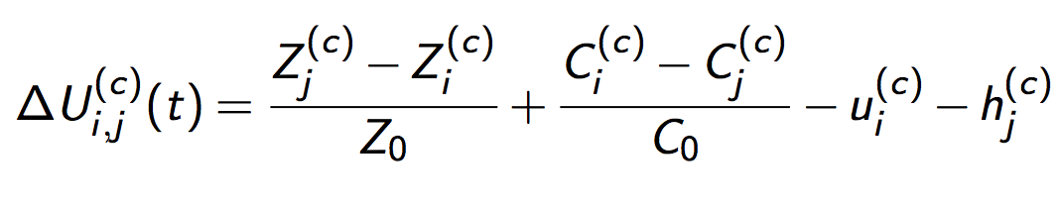
Residential Dynamics
Variety of economic profiles : migrants wealth w ~ g(w)
Corresponding Economic categories
State regulates dynamics with control term h_{j} ^{(c)}
Discrete Choice utilities include accessibilities, cost of life and risk aversion :

Slide 9
Temporal Evolution
At each time step :
Cities mesoscopic evolution (Gibrat’s laws and Scaling laws) ; patch level distribution through preferential attachment scheme
New migrants enter the city, settle given their social network (关系）
Discrete choice migrations (randomly drawn for each migrant)
Update migrants wealths and economic categories
Update accessibilities

Slide 10
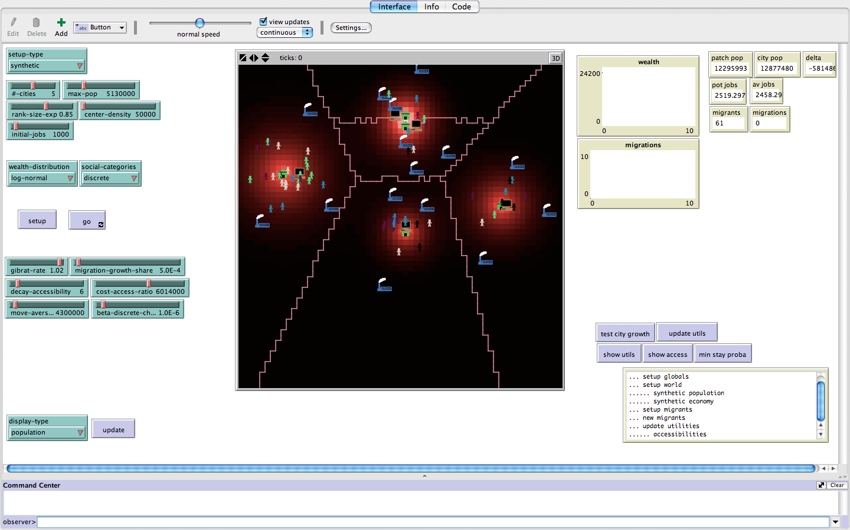
Model Implementation
Implementation in NetLogo (Wilenski, 1999) ; High Performance Computing exploration with OpenMole (Reuillon et al., 2013)
Synthetic Data : Synthetic city system

Slide 11
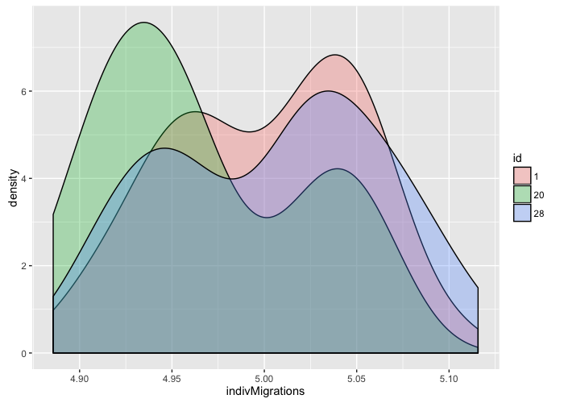
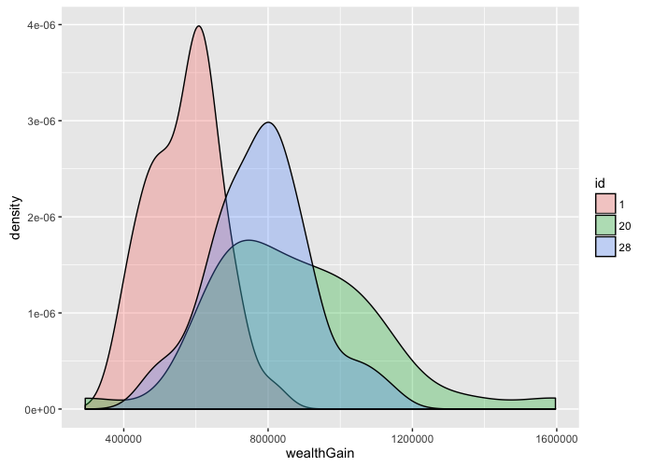
First Results : Convergence
Internal validation by checking statistical convergence and establish number of repetitions needed

Slide 12
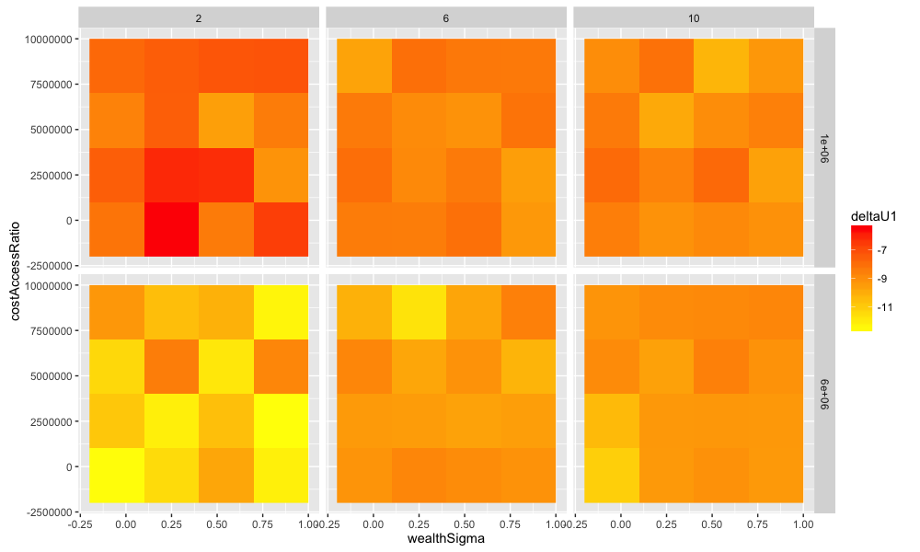
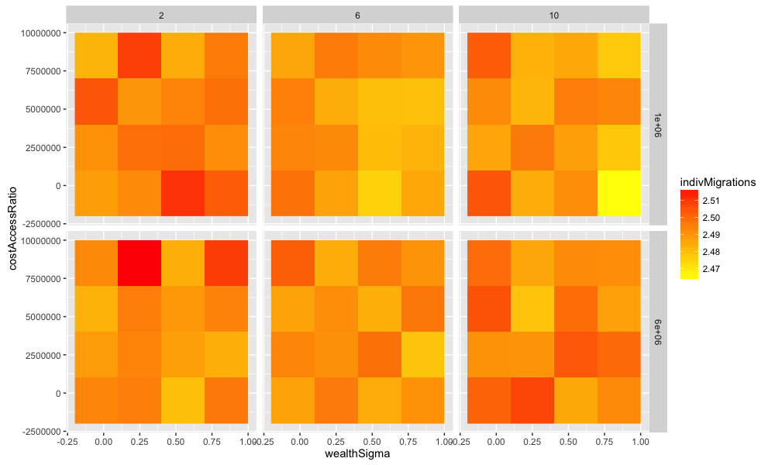
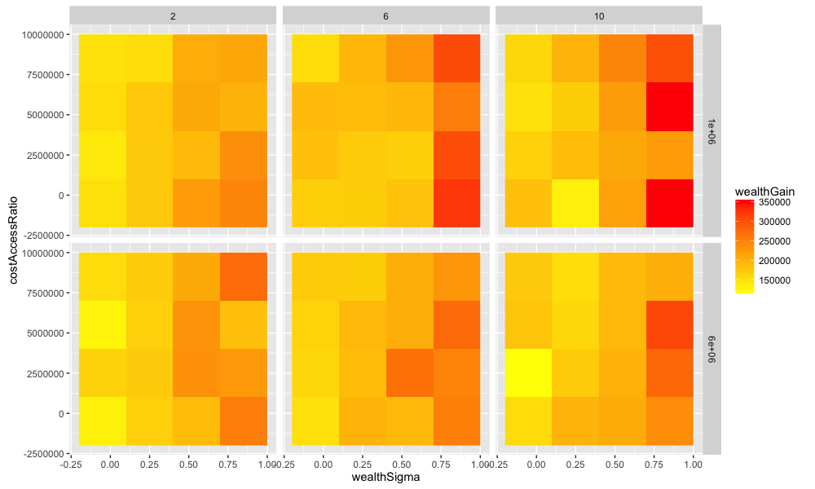
First Results : Phase Diagrams
Grid Exploration of the parameter space

Slide 13
Perspectives
Next steps :
Full exploration on synthetic data : model behavior
Stylization and scenarization of real DPR configuration, model behavior on real and hybrid configurations
Targeted experience plans (e.g. : role of economic diversity, influence of state regulation)
Iterative further construction/multi-modeling (e.g. generations)
Expected Results :
Impact of processes linked to migrants diversities on emergent dynamics
Explore or unveil state strategies (through regulations or companies control)

Slide 14
Conclusion
A first insight into an inter-disciplinary complex approach on Meso-scale migration dynamics
Cruciality of both qualitative empirical knowledge and quantitative theoretical knowledge
Complementarity with « classical » approaches, in particular quantitative contributions (statistics, equilibrium economics)
All code and data available for reproducibility at
https://github.com/JusteRaimbault/MigrationDynamics

Slide 15
Reserve Slides
Reserve Slides

Slide 16
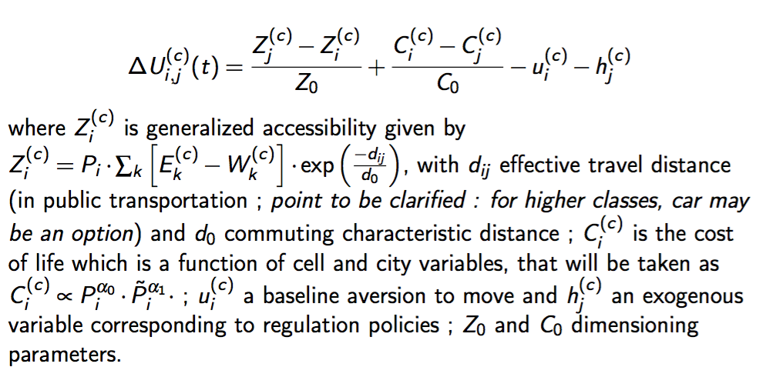
Discrete Choice Utilities

Slide 17
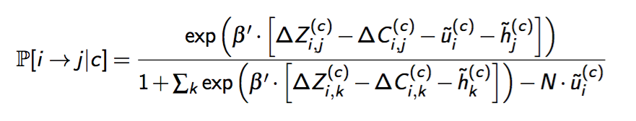
Discrete Choice Probabilities

Slide 18
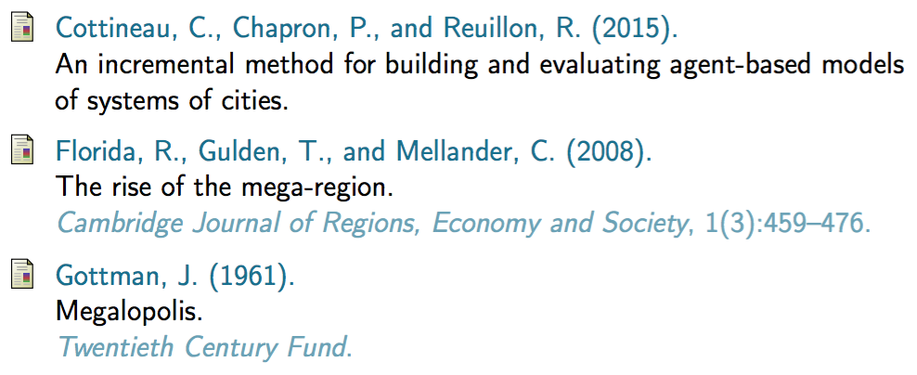
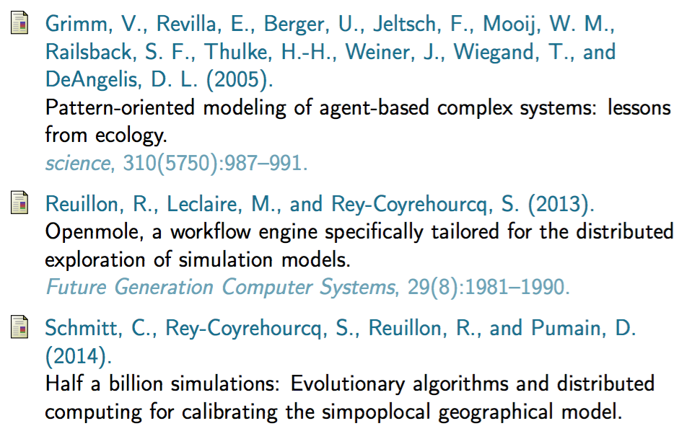

References

