Slide 1
Agent-based Modeling of Migrant Workers Residential Dynamics within a Mega-city Region: the Case of the Pearl River Delta, China
Cinzia Losavio¹ and Juste Raimbault^{1,2} (1) UMR CNRS 8504 Géographie-cités and (2) UMR-T IFSTTAR 9403 LVMT
2017 International Conference on China Urban Development
5–6 May 2017 LONDON
(Session 6D Migrant settlement decisions)
Notes:
This presentation focuses on a Collaborative research projects between Juste Raimbault and I, and it is the result of a transfer of knowledge between researchers with very different backgrounds and methods.
We start to think about this model and to work on it in Zhuhai, a medium-sized city located in the Pearl river Delta where we are conducting some research in the framework of the Medium project.

Slide 2

MEDIUM is led by CNRS, hosted by Géographie-cités and co-financed by the European Union.
Scientific coordinator: Pr. Natacha AVELINE-DUBACH
PARTNERS :
COORDINATOR INSTITUTION: CNRS (France);
4 CO-APPLICANTS : Hangzhou Normal University in China, Science Po Aix in France, Ca’ Foscari University in Italy, Spatial Foresight GmbH in Luxembourg;
2 ASSOCIATES IN SWITZERLAND: the universities of Lausanne and Neuchatel
THREE MEDIUM-SIZED CITIES: Hangzhou, Zhuhai and Datong
OBJECTIVE: to study the socio-economic and urban development dynamics
INTERESTS: urban governance, strategic planning, urban mobility, inclusion of migrants, ICT or networks of multinational corporations.
Notes:
The MEDIUM project brings together European and Chinese institutions and researchers with very different backgrounds and interests. Focusing on three medium-sized cities, including, Zhuhai in the PRD, the project aims to study urban development from different perspectives.
In the framework of medium project, we realize the increasing importance of medium-sized cities, which are a key element in the PRD megacity region and his polycentric structure.

Slide 3
Mega-city regions
«Mega-city regions (MCRs) are integrated sets of cities and their surrounding suburban hinterlands across which labor and capital can be reallocated at very low cost» (Florida, Gulden & Mellander, 2008).
Main characteristics:
Globally connected (Hall and Pain, 2006)
Symbiosis between urban and rural areas
Migration flows
Density of connections
Regional migration patterns (Mu and Yeh, 2016)
Notes:
Combining qualitative and quantitative research Juste and I use an agent-based model to simulate residential dynamics of migrants in the Pearl River Delta (PRD) mega city region. Even though the model doesn't use statistical data but synthetic data, we identified a need for qualitative research in order to further investigate relevant contextual factors.
Mega-city regions (MCRs) as defined by Florida & all are integrated sets of cities and their surrounding suburban hinterlands across which labour and capital can be reallocated at very low cost. This Urban configuration is similar to what Gottmann (1961) called megalopolis
As Florida & all as well explained MEGA CITY REGIONS share the same functions megalopolises perform in the past but “ON A LARGER SCALE”. Economic growth and the urban development are no longer defined by the border of a single city but encompass nearby areas and urban regions. That’s why one of the the distinctive characteristics of a MCR is the “symbiosis between urban and rural areas”.
Furthermore the MCR become more and more connected performing not only regionally but globally : INTERNATIONAL CONNECTIVITY (Hall and Pain, 2006) → globally connected
Other characteristic of these new economic unit are migration flows, density of connections, and regional migration patterns (that are at the center of our model).

Slide 4
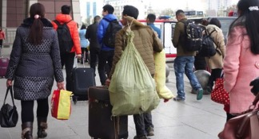
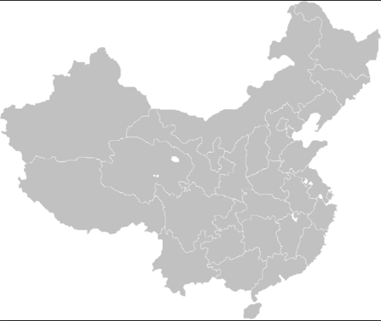
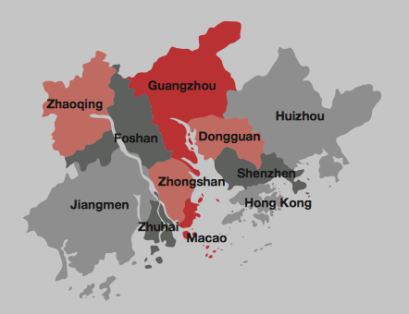
Pearl River Delta (PRD) : the most prosperous and dynamic mega-city region in terms of migration waves
Picture by Cinzia Losavio, 2016
The Pearl River Delta Region in China
Source: Invest HK, 2010
Notes:
In China, Since the gradual decentralization of the state power which occurred in the beginning of 1990 Mega-city regions have become a new scale of Chinese State regulation, and in particular the pearl River Delta, represent the most prosperous and dynamic one in term of migration waves. That’s why we choose PRD as our unit of study.
Since the Open Door Policy was implemented the has become a global manufacturing region attracting an increasing number of migrant-workers from all over China.

Slide 5
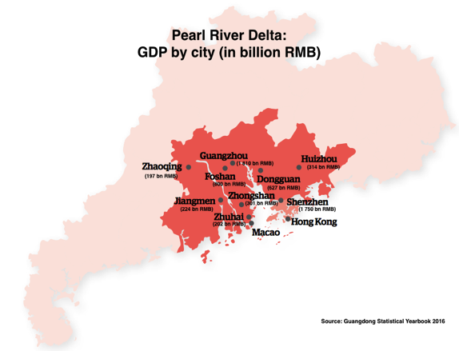
PRD Mega-city region characteristics
Polycentrism
In 2015, the PRD accounted for:
4.3% of China’s total population
9.1% of China’s GDP
26.8% of China’s total export
Notes:
The zone which consists of 9 cities, in 1988 was designed as a “comprehensive economic reform area, and was granted many ‘one step ahead’ policies to attract foreign capital, becoming the most important exporter center since economic reform.
That results in an astonishing rise of population in the area, that today counts around 60 million people and in a dramatic increase of the Gross Domestic Product that reached 7 billions RMB in 2015.
Large scale infrastructure projects have been carried out to improve regional connectivity, in particular cross-boundary transportation facilities are currently under construction, re-defining the spatial layout of the PRD and encouraging regional integration.
If during the first year of the opening-up reforms the barycenter of the region was Guangzhou (the provincial capital), over the last decade PRD has become increasingly polycentric, as shown in the map.

Slide 6
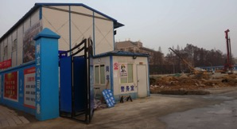
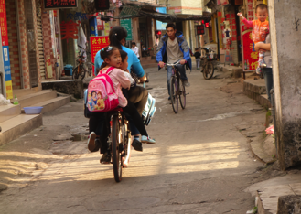
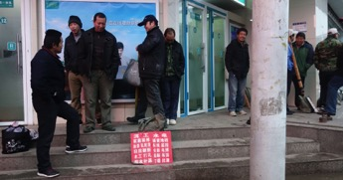
This agent-based model simulates migrants residential patterns taking into account the full range of migrants’ socio-economical status
3 dimensions to discern migrant workers diversity
RESIDENTIAL
GENERATIONAL
PROFESSIONAL
Picture by Cinzia Losavio, 2016
Picture by Cinzia Losavio, 2017
Picture by Cinzia Losavio, 2016
Notes:
Taking PRD as the unit of our model we try to reproduce migrants residential patterns taking into account the full range of migrants’ socio-economical status and their evolution.
Even though migrants workers are generally considered and treated as a uniform category, recent research showed how considering their economical, cultural and human capital migrants workers are a very diversified social category. Especially 3 dimension are fundamental to understand migrant workers, namely:
ROFESSIONAL DIMENSION : which determines not only their economical situation but also migrants’ trajectory and the duration of their stay in the city as well as their residential choice.
RESIDENTAIL DIMENSION which influence all aspects of migrants’ lives in the city – patterns of urban settlement, housing choices, residential conditions, relation with the city, neighbourhood activities
THE GENERATIONAL DIMENSION
All these sub-categories have different mobility patterns, that we try to simulate in our model. However, we are just taking in consideration, the first two dimensions I have mentioned (PREOFESSIONAL AND RESIDENTIAL) and not the generational because the time frame is too short to identify aging patterns; even though we believe that add this generational component to complexify the model will be quite interesting.

Slide 7
Main qualitative lessons from baseline model exploration: qualitative interpretation
The model shows that in real situation the regime of job congestion dominates
The importance of accessibility relative to the cost of life does not influence much dynamics at a macro level
The importance of the external factor relative to the cost of life and the accessibility has a “U-shaped” influence on the role of time
Notes:
Considering this diversity and translating it in qualitative stylized facts that correspond to precise patterns of synthetic data, this model aims at establishing a new perspective for understanding China’s urban and regional mobility employing a more qualitative approach, specifying in a second time the mechanisms through which Party-State shape the parameters of migrants’ choices.
Before giving the floor to my collegue Juste Raimbault, I will presents briefly some of the results emerging from our model:
The model shows that when migrants have a high propensity to move , for an intermediate values of the level of randomness, the regime of job congestion dominates. In the real situation this scenario of job congestion will imply a sub-sequential mobility of migrants which will move to another city in search for another job.
Some qualitative interviews I’ve conducted in Zhuhai show this pattern of congestion.
For example Mr. Lin a migrant workers from Guanxi who is working as a taxi driver in Zhuhai said that he worked for several years in a smartphones factory in Dongguan, but when it shut down because it was hard to find well paid jobs he decided to leave the city and to move to Zhuhai, where It’s not hard to find a job ( better-paid jobs, employers offer better terms and conditions).
Another results shown by our agent-based model is that changing the importance of accessibility* relative to the cost of life does not influence much dynamics at a macro level. This outcome could be useful for urban planners, in the sense that for ex policies having an impact on mobility (as i.e. transportations subsides**) will have no effect on migrations patterns
*WE USE GENERALIZED HANSEN ACCESSIBILITY, WHICH CAN BE UNDERSTOOD IN A SIMPLIFIED WAY NUMBER OF JOBS AVAILABLE TO THE POPULATION WITHIN A SPATIAL RANGE
**A SUBSIDY IS LIKELY TO REDUCE PUBLIC TRANSPORT CHARGES. THIS WILL LEAD TO AN EXTENSION OF DEMAND, AS MORE PEOPLE ARE ENCOURAGED TO USE THIS FORM OF TRANSPORT.
A third result emerging from the model take in consideration an external factor (that can be for example linked to the family choice or environmental choice) and that is relative to the cost of life and the accessibility. Intermediate situations, where the importance of this external factor is neither high neither low, correspond to a negative effect of time on number of migrations; on the contrary an high level of importance of the external factor means a positive effect of time on migrations. The qualitative interpretation of the effect of this ”external factor” on migrants’ lives is complex: indeed on the one hand, changing location could improve the quality of their life (finding a new job, improving their economical situation etc), and on the other hand it could have a negative impact on their life (moving too much can mean less stability for migrants: less rights, less interest in settling down)
I will give the floor to my Juste Raimault, that will present the model and how it works.

Slide 8
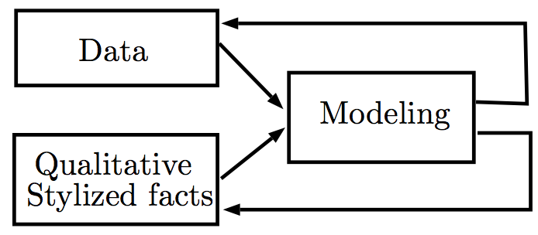
Hybrid Agent-based Modeling
Agent-based Modeling : from toy to fully parametrized models, to infer indirect knowledge on processes in Complex Systems.
Recent trends :
Pattern-oriented Modeling (Grimm et al., 2005)
Multi-Modeling (Cottineau et al., 2015)
High Performance Computing calibration (Schmitt et al., 2014).
Notes:
Pattern-oriented Modeling (Grimm et al., 2005) as a way to externally validate models ; return of Multi-Modeling (Cottineau et al., 2015) to discriminate alternative explanations ; High Performance Computing calibration bringing “proofs” in Social Sciences (Schmitt et al., 2014).

Slide 9
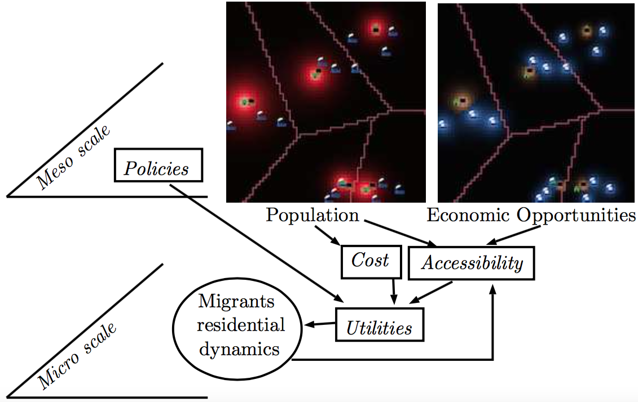
Model Structure and Ontology

Slide 10
Residential Dynamics
Variety of economic profiles : migrants wealth w ~ g(w)
Corresponding Economic categories
State regulates dynamics with control term h_{j} ^{(c)}
Discrete Choice utilities include accessibilities, cost of life and risk aversion :

Slide 11
Temporal Evolution
At each time step :
Cities mesoscopic evolution (Gibrat’s laws and Scaling laws) ; patch level distribution through preferential attachment scheme
New migrants enter the city, settle given their social network (关系）
Discrete choice migrations (randomly drawn for each migrant)
Update migrants wealths and economic categories
Update accessibilities

Slide 12
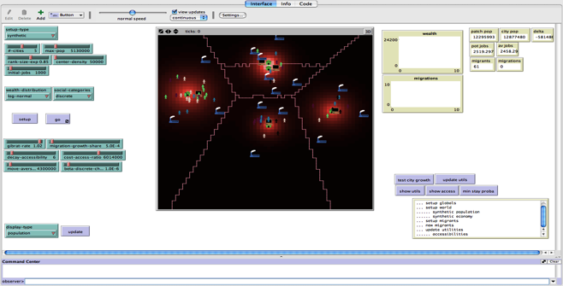
Model Implementation
Implementation in NetLogo (Wilenski, 1999) ; High Performance Computing exploration with OpenMole (Reuillon et al., 2013)
Synthetic Data : Synthetic city system

Slide 13
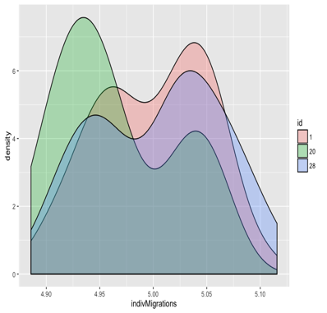
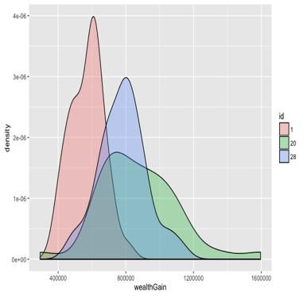
First Results : Convergence
Internal validation by checking statistical convergence and establish number of repetitions needed

Slide 14
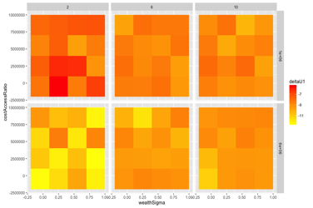
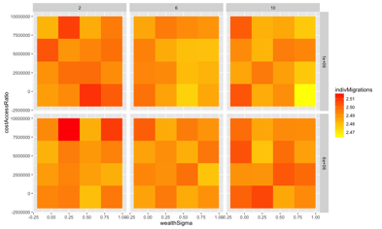
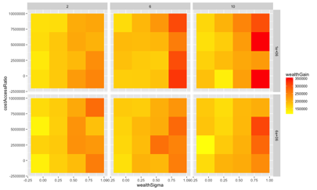
First Results : Phase Diagrams
Grid Exploration of the parameter space

Slide 15
Perspectives
Next steps :
Full exploration on synthetic data : model behavior
Stylization and scenarization of real DPR configuration, model behavior on real and hybrid configurations
Targeted experience plans (e.g. : role of economic diversity, influence of state regulation)
Iterative further construction/multi-modeling (e.g. generations)
Expected Results :
Impact of processes linked to migrants diversities on emergent dynamics
Explore or unveil state strategies (through regulations or companies control)

Slide 16
Conclusion
A first insight into an inter-disciplinary complex approach on Meso-scale migration dynamics
Cruciality of both qualitative empirical knowledge and quantitative theoretical knowledge
Complementarity with « classical » approaches, in particular quantitative contributions (statistics, equilibrium economics)
All code and data available for reproducibility at
https://github.com/JusteRaimbault/MigrationDynamics

Slide 17
Reserve Slides
Reserve Slides

Slide 18
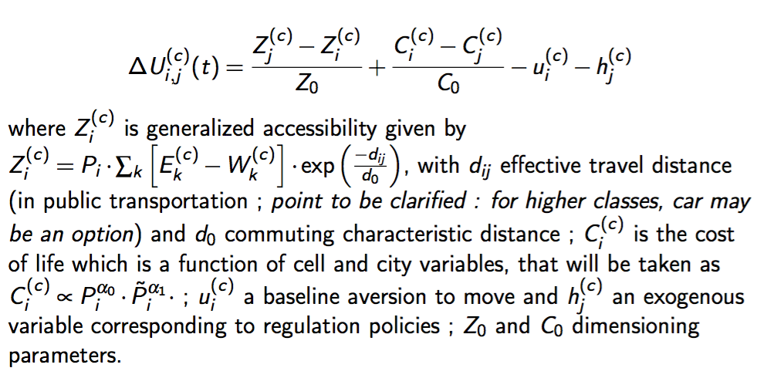
Discrete Choice Utilities

Slide 19
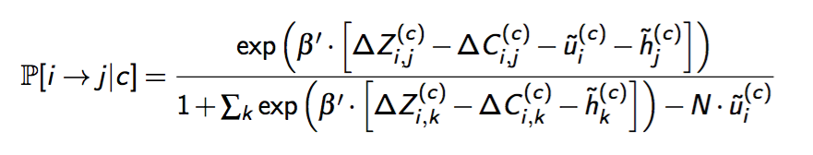
Discrete Choice Probabilities

Slide 20
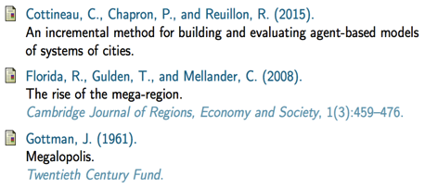
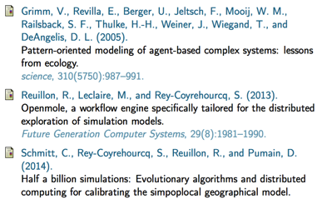

References

