Slide 1
How validation through model exploration empowers theories of spatial complexity: example of urban systems
Juste Raimbault and Denise Pumain
UMR Géographie-cités, Paris, France
ECTQG 2021, Manchester, UK, November 3-5th

Slide 2
Urban theories and models
Plea for sound theories and models:
“Cities not simply as places but systems of networks and flows” (Batty, 2013)
Consistent ontology and data (Rozenblat 2020)
“Integrated theory” (complexity sciences and social sciences, Lobo et al. 2020): which fundamental principles still in discussion
Inclusive of previous knowledge: spatial interaction and evolutionary path dependence (Pumain, Raimbault 2020)
Explicit ontology in terms of time and space

Slide 3
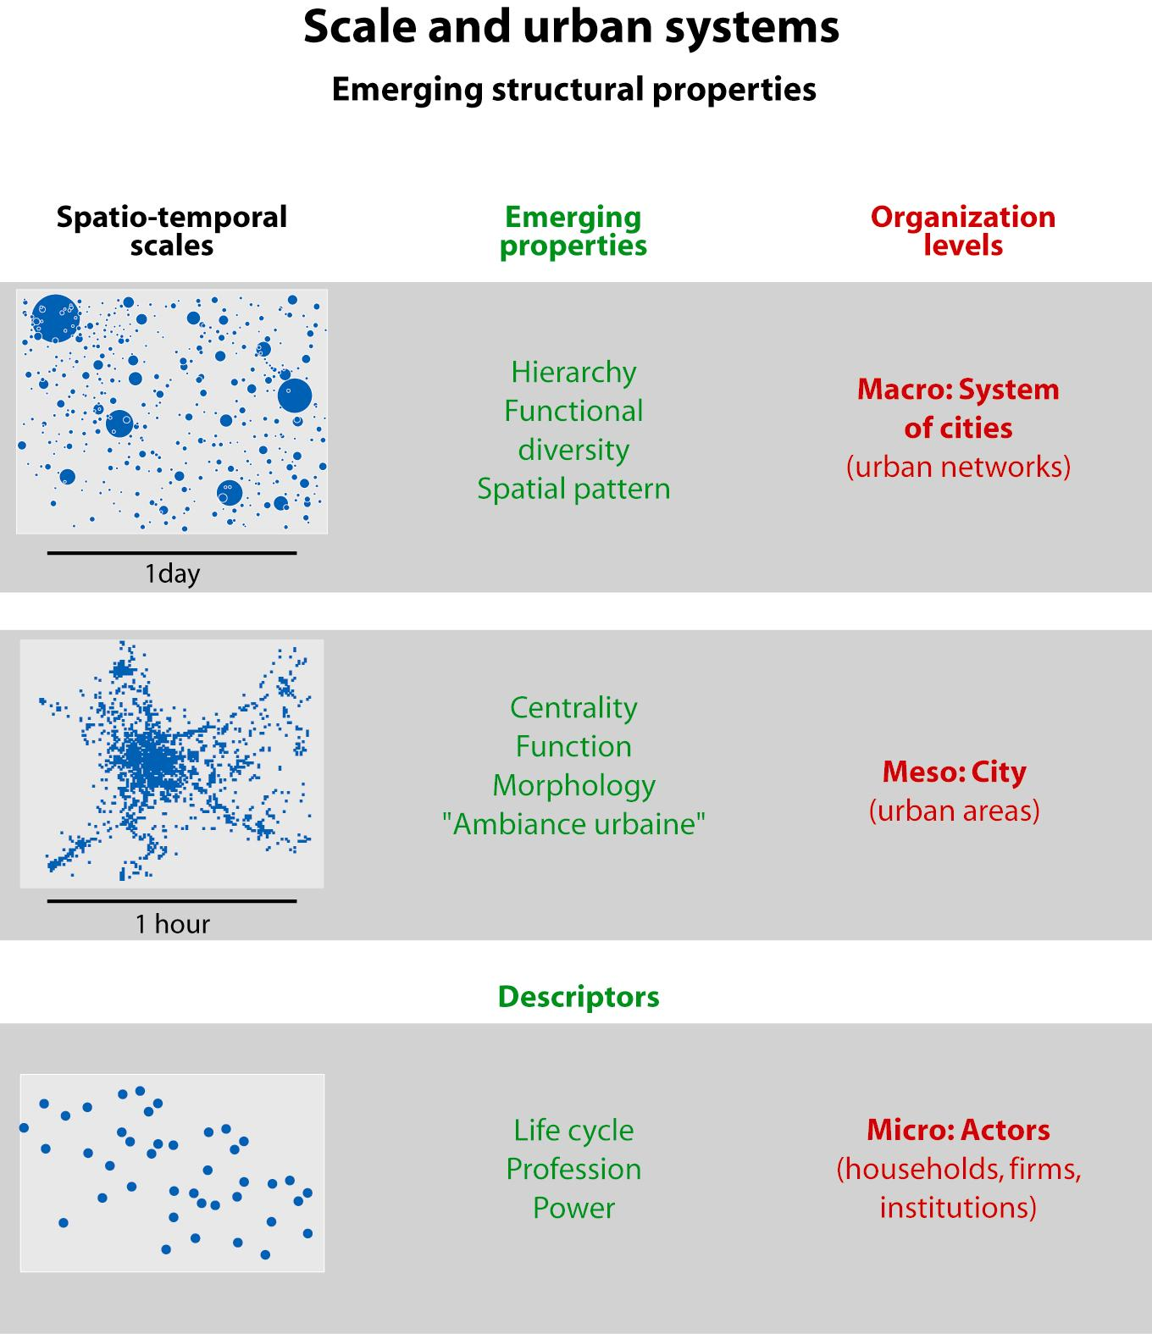
Geographical ontology for urban systems
Two levels:
Cities and
Systems of
cities
Pumain D.
Hierarchy in
natural and
social sciences,
Springer, 2006

Slide 4
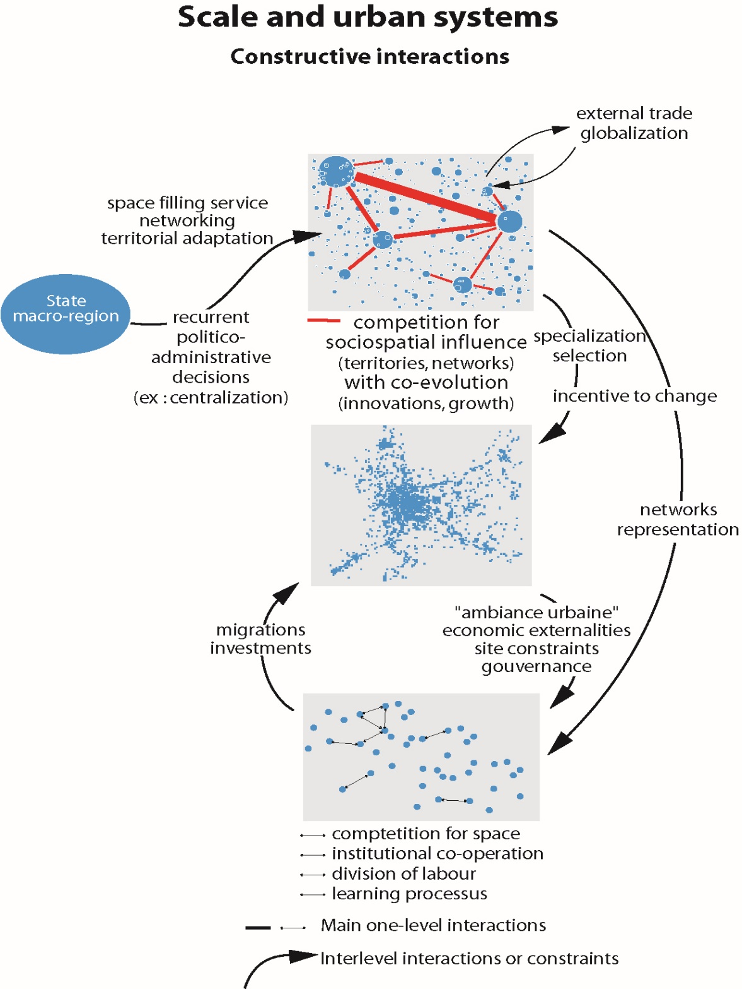
Constructive
multi-levels
interactions
Pumain (ed), 2006
Hierarchy in
Natural and
Social Sciences,
Springer

Slide 5
Evolutionary urban theory frame
Urban systems are complex adaptive systems
Their evolution combines:
a specific history of settlement in a territory
and a generic dynamics that is proper to settlement systems : stylised facts at macro-level generated by spatial interactions between individual settlements differentiated by size and functions
Exploring this complex systems dynamics with the help of multi-agent models, partly driven by harmonised historical urban data bases and validated by multiscale processing of simulations

Slide 6
Stylised facts from evolutionary theory
Hierarchical differentiation of city sizes emerging from interurban interaction (competition >cooperation)
Persistance of urban hierarchies (long term) and specialisation (medium term) despite many local and temporal fluctuations in cities profiles and individual trajectories (firms, households)
Functional geodiversity from innovation cycles generated by interurban competition and emulation
Systemic (proactive) partial diffusion of innovations:
Hierarchical selection (top down and bottom up)
Emergence of specialised cities
Each innovation wave trigger a growth impulse to large cities and specialised ones

Slide 7
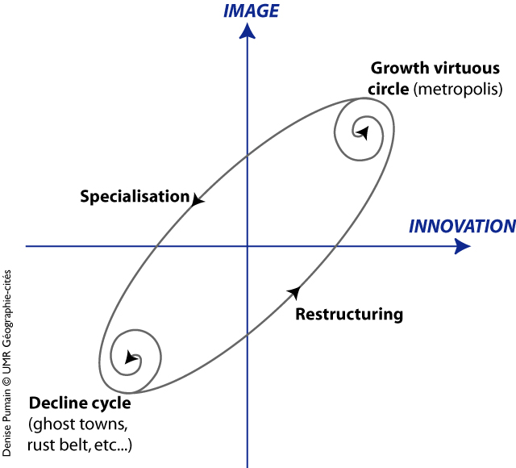
Innovation as key factor of urban adaptive process
D. Pumain
Th. Saint-Julien
F. Paulus

Slide 8
Reconstructing urban trajectories with multi-agents systems
Reconstructing past urban trajectories within their historical and geographical context is a first necessary step for testing the relevance of our theoretical explanation
It is also a condition for ensuring the quality of projections estimating future relative positions of cities within inter-urban competition, thus for adjusting intelligent urban policies.

Slide 9
SIMPOP: a multi-agents system
First application of MAS in geography !
Bura, Guérin-Pace, Mathian, Pumain, Sanders, Multi-agent systems and the dynamics of a settlement system. Geographical Analysis, 1996, 2, 161-178
Main results:
No emergence if no spatial interactions
Emergence of a polycentric hierarchised system of cities even if homogeneous initial conditions
A renewed innovation flow is necessary for maintaining structural properties of the system of cities
Pending questions: which validity of estimated parameters?
Conditions are sufficient , are they necessary?

Slide 10
Originality of SIMPOP Models
Scale: national or continental integrated urban systems, long term
Cities are agents : collective, immobile, heterogenous, evolving entities
Main attributes: location, resources (labour force, capital), functions (10 types)
Three levels: individual (firm or mayor, for scenarios), cities (local governance), national or multinational (global governance)
Rules : stylised facts from comparative study of the observed evolution of integrated urban systems

Slide 11
Further advances in explanation
No counter-urbanisation (≠ Berry, 1976), increasing hierarchisation / Gibrat’ model prediction
(Bretagnolle, Pumain, Rozenblat, 1997, Cybergeo, 61, Bretagnolle, Mathian, Pumain, Rozenblat 2000, Cybergeo 131, Bretagnolle, Paulus, Pumain 2002, Cybergeo, 219)
« metropolisation » and « simplification from below of urban hierarchies (cf. « shrinking cities »)
« Global cities since Middle Age » (Bretagnolle, Pumain, 2010, Urban Studies)

Slide 12
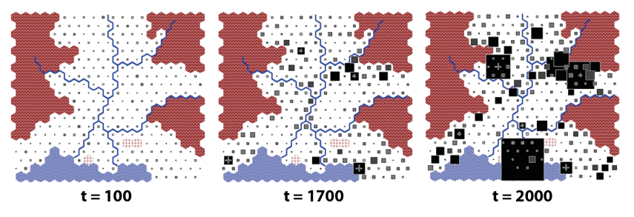
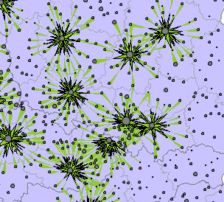
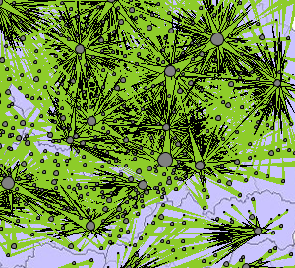
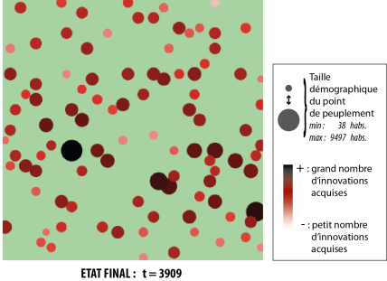
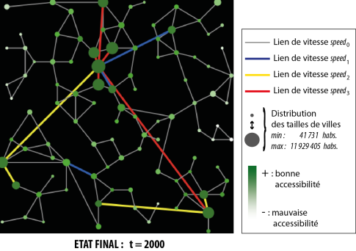
The Simpop family of simulation models
Urban Evolutionary Theory
SIMPOP (1996)
First
generation
SIMPOP 2 (2006)
SimpopLocal
(2012)
Second
generation
& SimpopNet
(2012)
MARIUS
(2014)

Slide 13
Two types of modelling teams
1995-2010 : 3 PhD students in computing from 3 different labs Ferber, Drogoul, Giavitto/Hutzler help geographers ( S. Bura, B. Glisse, T. Louail)
Three models each in a different langage (Smalltalk, Swarm, C++…), not reusable
Institutionnal event : ERC adv. grant GeoDiverCity
2010-2015: real daily team work between 4 computer scientists (Reuillon, Leclaire, Chapron, Cherel) and PhD in geography and geomatics (C. Schmitt, C. Cottineau, S. Rey-Coyrehourcq, E. Swerts, A. Ignazzi, S. Baffi, O. Finance)
Models on systems of cities in Europe, USA, BRICS with OpenMOLE platform (evolutionary algorithms and distributed computing)

Slide 14
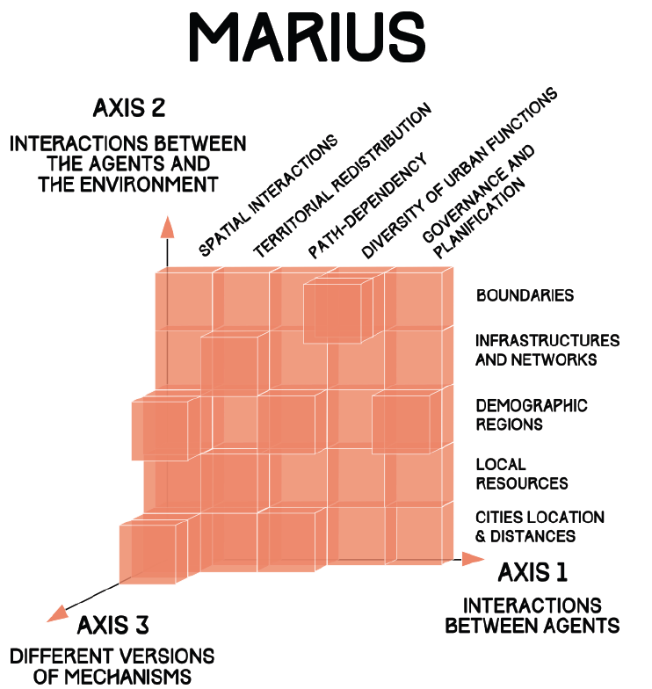
New modelling method: building multi-models
Cottineau, Chapron, 2015

Slide 15
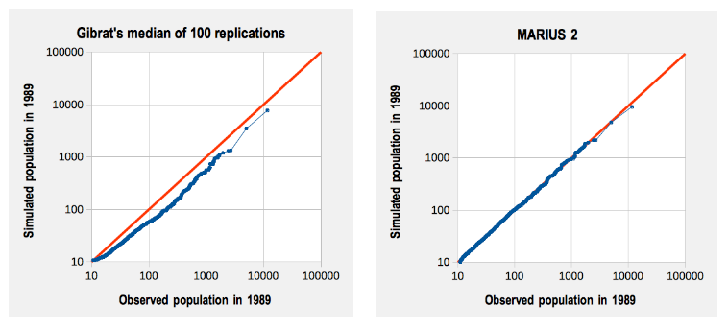
Networking boosts urban growth: model with interaction fits better than random growth
Gibrat’s model
model with interactions
Cottineau, 2014

Slide 16
Toward providing proofs in social sciences
With SimpopLocal model (Clara Schmitt & Sébastien Rey-Coyrehourcq) and simulation platform OpenMole (Romain Reuillon, Mathieu Leclaire)
➔ Proof: hypotheses are sufficient…and necessary!
➔ Schmitt C., Rey-Coyrehourcq S., Reuillon R., Pumain D., 2015, Half a billion simulations, Evolutionary algorithms and distributed computing for calibrating the SimpopLocal geographical model, Environment and Planning B, 42, 2,300-315.
Calibration profile: Romain Reuillon

Slide 17
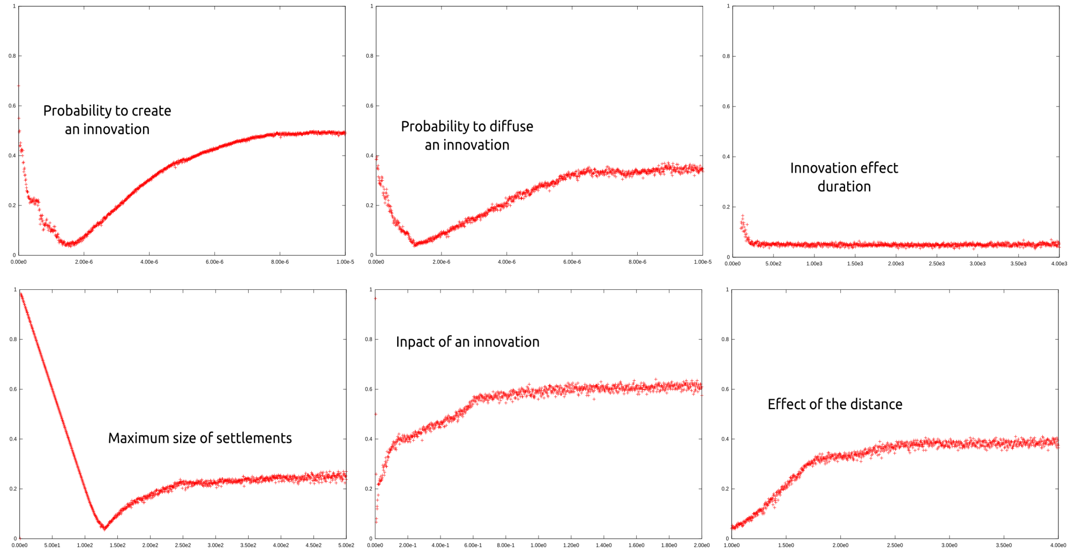
Best solutions in parameter space (SimpopLocal model)
[Schmitt, Reuillon, 2014: Calibration profile method]

Slide 18
A new source of data on global urbanization
GHSL (Global Human Settlement Layer) : GEO Human Planet Initiative (European Commission)
Built up area from satellite images 40 m + population data 250 m ➔ 1 km² grid
13 000 urban areas > 50 000 inhab.
Surface, population in 1975, 1990, 2000, 2015
GDP, Green surfaces Pollutants 1990-2015

Slide 19
Dynamic models of urban growth
Testing and comparing interaction-based dynamical models for urban growth
The Favaro-Pumain model for the diffusion of innovation [Favaro and Pumain, 2011]
The Marius model family based on economic exchanges [Cottineau, 2014]
An interaction model including physical transportation networks [Raimbault, 2020]

Slide 20
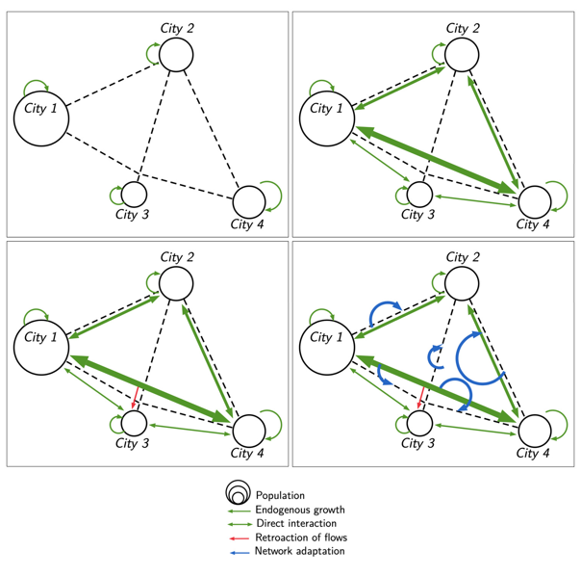
A co-evolution model developing urban hierarchy with transportation network
Processes:
Gibrat growth
Spatial interactions
Centrality
Network investments
[Raimbault, 2021]

Slide 21
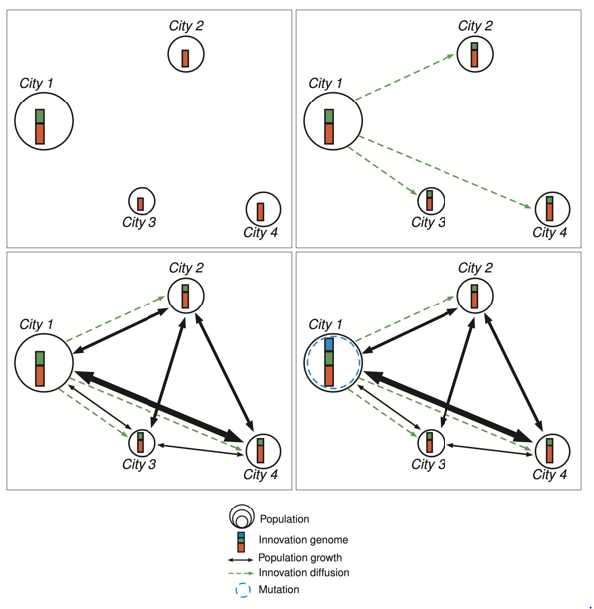
Explicit model of urban evolution
Processes:
Innovation diffusion: evolution crossover
Spatial interactions
Mutation: emergence of new innovations
[Raimbault, 2021]

Slide 22
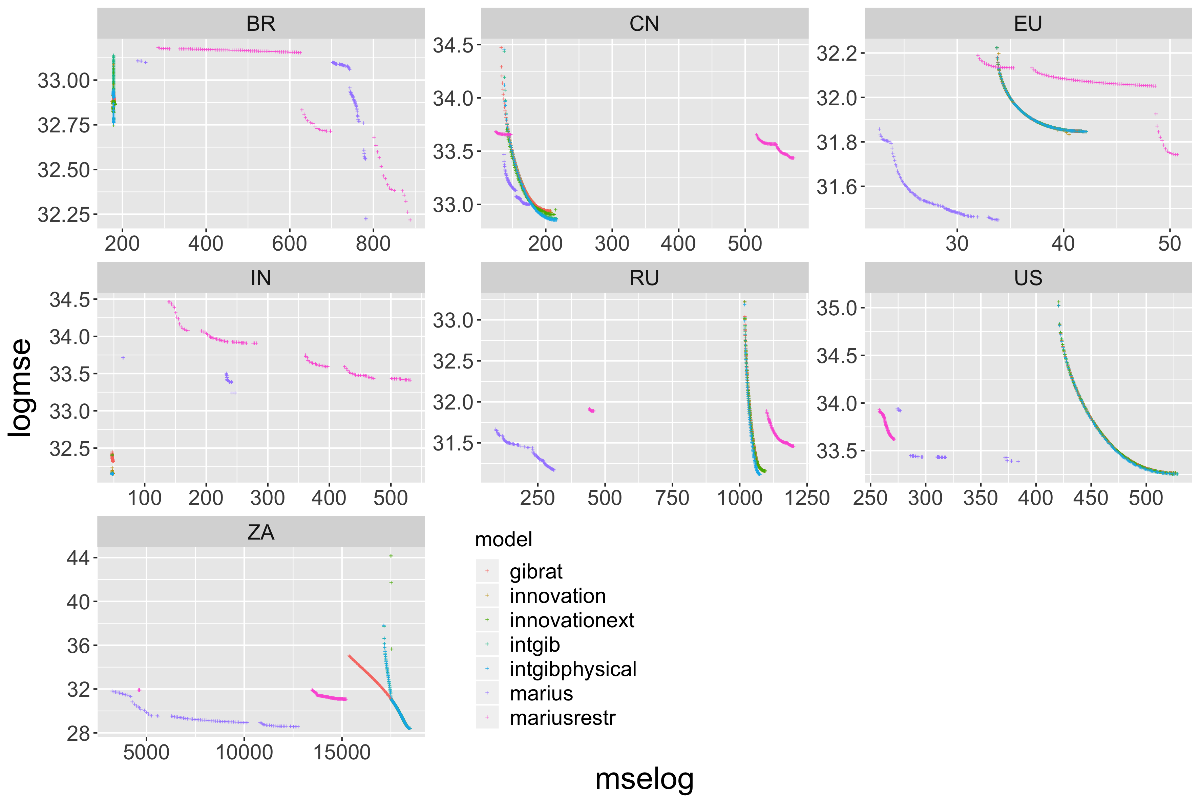
Calibrating dynamic models on regional systems
[Raimbault, Denis, Pumain 2020]

Slide 23
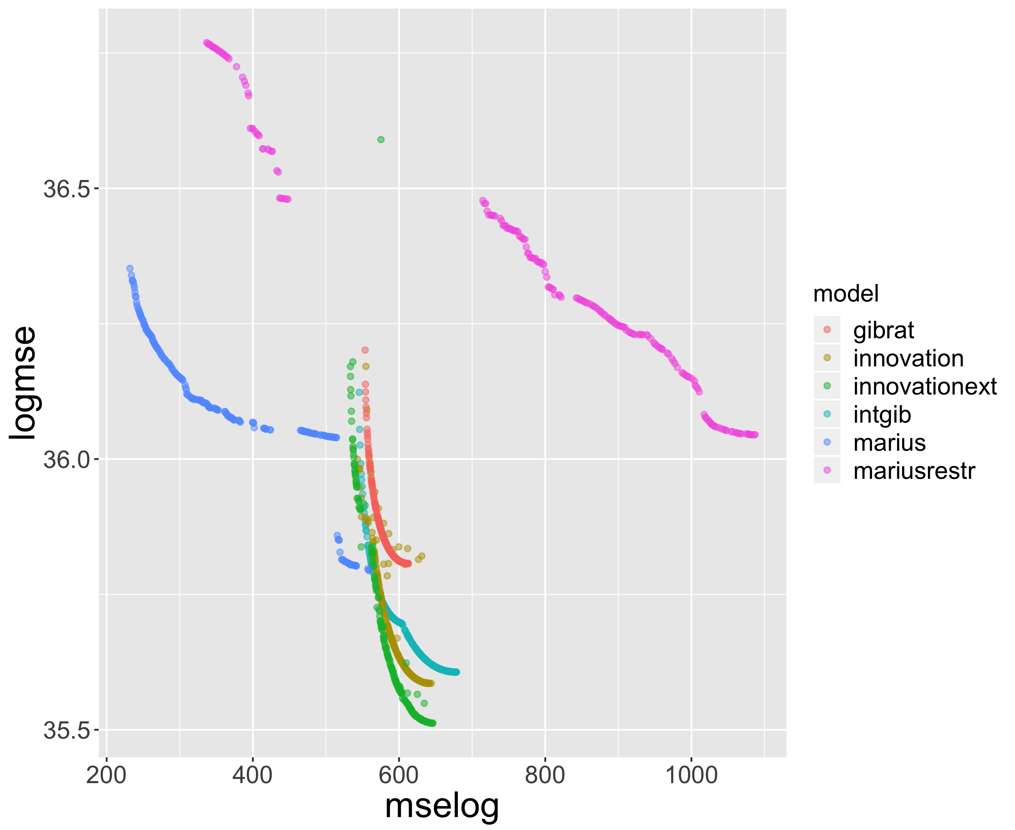
Worldwide calibration of models

Slide 24
Discussion
A step forward assessing the level of generality of urban theories vs their ability to identify regional specificities :
Multimodelling (incremental modelling with generic computing and distributed computing tool) produces a population of optimal solutions and compares their contribution to model fit i.e. the explanatory power of different mechanisms at reconstructing urban trajectories
For non-compatible models: comparing respective performances of bi-objective Pareto fronts
Open questions
How to compare the explanatory power of models with different structures?
Observations or synthetic data for simulations?

Slide 25
Discussion
Open questions for the validation of spatial simulation models
Methods for model benchmarking, integration and coupling
Spatial sensitivity analysis [Raimbault et al., 2019]
Generation of synthetic data at different scales [Raimbault, Perret and Reuillon, 2020]
-> Most recent developments continuously integrated into the OpenMOLE platform

Slide 26
Conclusion
Robustness of results regarding data sources, multiple models. Need for more systematic model exploration and sensitivity analysis.
Model complementarity. Need for more integrated and multi-scale models.
Multiple perspectives on urban systems? Need for more interdisciplinarity.
Open repository at https://github.com/JusteRaimbault/UrbanGrowth
Acknowledgments: thanks to the European Grid Infrastructure for access to the infrastructure.

