Slide 1



DAFNI Champion update – 10/12/2020
Champion update
Juste Raimbault
CASA, UCL
Notes:
1

Slide 2
Current work update
Running on DAFNI
OpenMOLE embedding: sensitivity analysis, calibration
Road network preprocessing for MATSim on Functional Urban Areas
SPENSER model for synthetic population generation
Synthetic population preprocessing for MATSim on Functional Urban Areas
One-mode MATSim model coupled with road network and synthetic population processors
Current work:
Fixing population preprocessing and coupling with MATSim
Four-stage model for travel demand
SPENSER and MATSim visualisations
Multimodal data
Future work:
Health indicators downstream MATSim
Sensitivity analysis, calibration and validation using OpenMOLE
Notes:
2

Slide 3
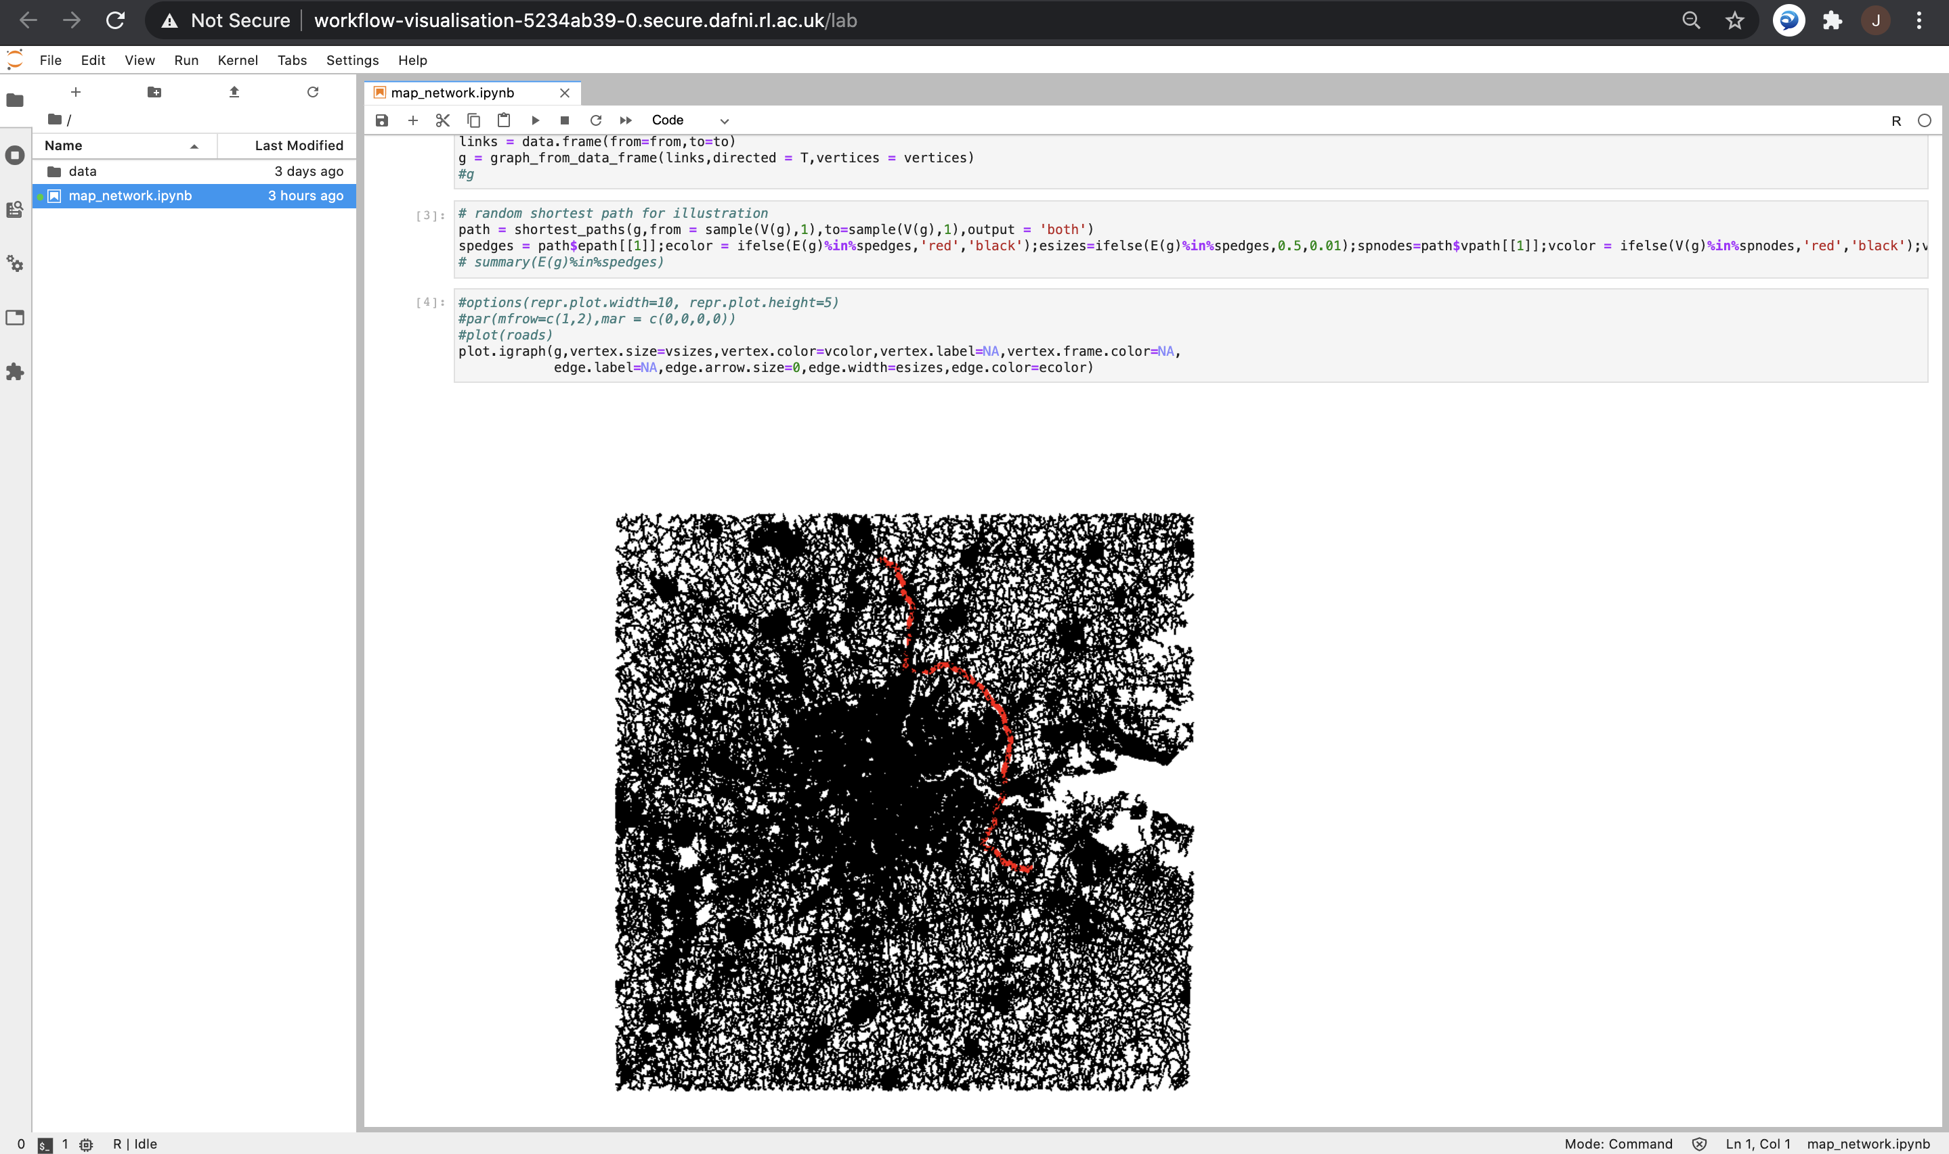
Visualisation of road network processing
Notes:
3

Slide 4
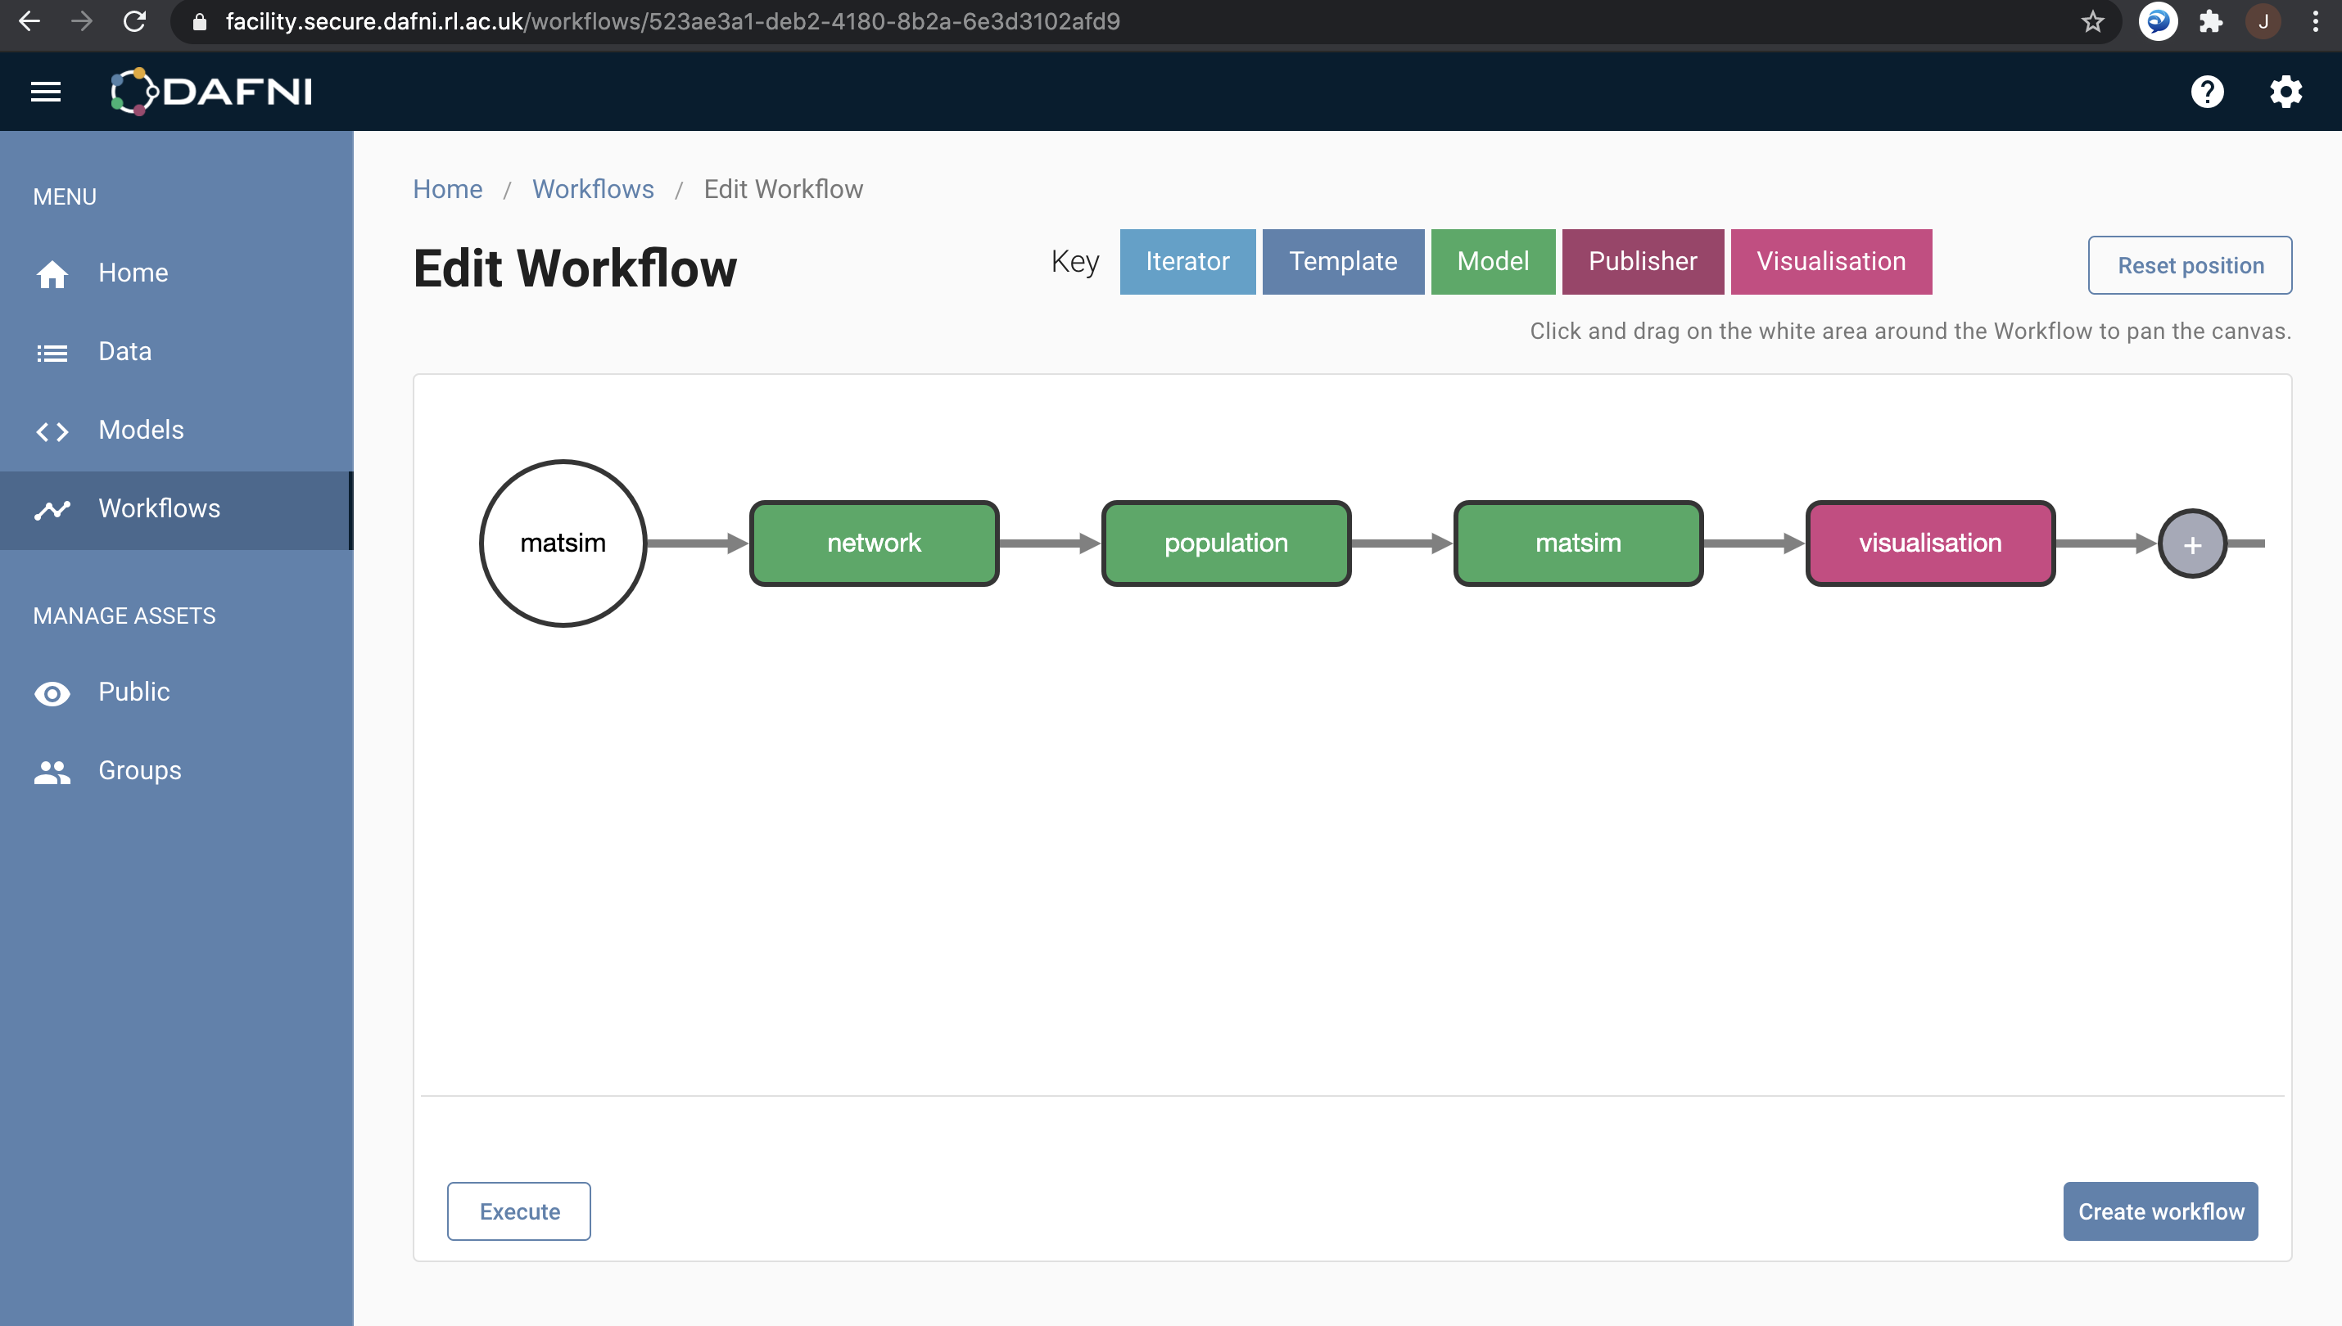
Full MATSim workflow on DAFNI
Notes:
4

Slide 5
SPENSER synthetic population microscopic distribution
Synthetic individuals and households at the OA level in 2020 for all UK, integrated in the NID
Implemented in spatialdata: distribute uniformly within the OA on network nodes; attribute jobs randomly within the FUAs given the OA employment distribution; basic home-work plans with uniform start/end times – Failing on DAFNI, currently being fixed
In progress (design): “Four stage model”
Distribute households within OAs according to population density grid (100m Eurostat or 1km GHSL) and buildings (OpenStreetMap; OSM pbf implemented in spatialdata) – individuals already matched in SPENSER data
Use QUANT calibrated parameters to estimate potential home-work flows
Sample workplace given these flows, accessibility patterns and car ownership
Notes:
5

Slide 6
MATSim visualisation
Test of the OTFVis tool: conversion of MATSim output events into movie files
Online/interactive visualisation not possible within DAFNI (for now?)
Integration into Jupyter notebook with python
Multimodal data
Java library to convert GTFS data into matsim schedule files
Multimodal network?
Notes:
6

Slide 7
Next steps planning
Communication
Event on DAFNI and transportation?
Abstract for Applied Urban Modeling conference
Next steps:
Operational MATSim for mid-January
Coupling with health indicators for end of January (AUM Conference)
Validation and sensitivity analysis in February
Notes:
7

