Slide 1



DAFNI Executive board – 17/02/2021
Champion update
Juste Raimbault
CASA, UCL
Notes:
1

Slide 2
Current work update
Since last update:
Sensitivity analysis (stochasticity) of one-mode MATSim
MATSim visualisations and output indicators
Current work:
Four-stage model for travel demand: gravity model for O-D flows
Multimodal data
Dissemination
Future work:
Health indicators downstream MATSim
Calibration and validation using OpenMOLE
Notes:
2

Slide 3
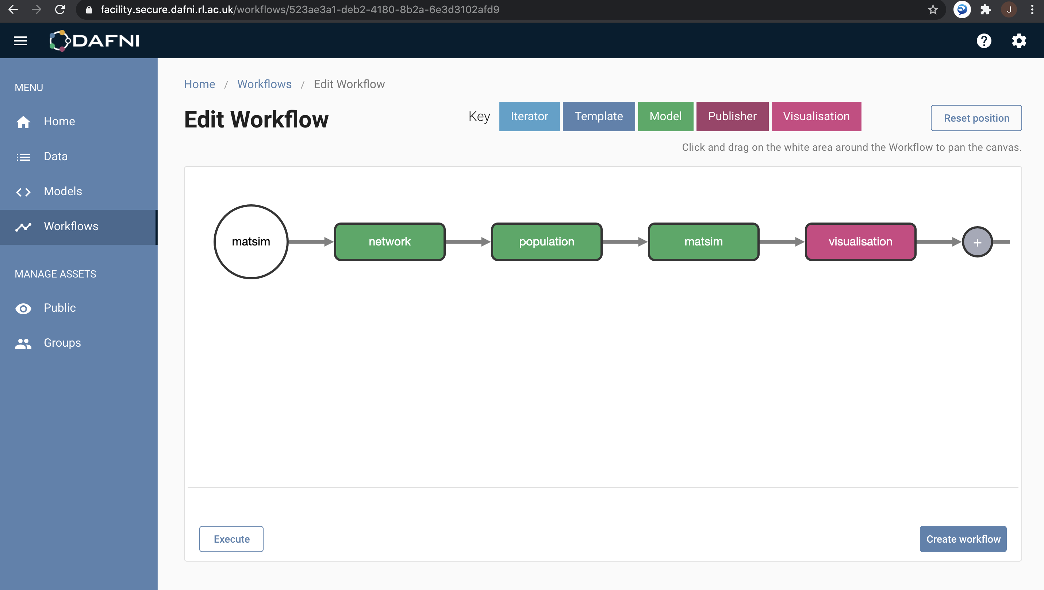
Full MATSim workflow on DAFNI
Notes:
3

Slide 4
SPENSER synthetic population microscopic distribution
Synthetic individuals and households at the OA level in 2020 for all UK, integrated in the NID
Implemented in spatialdata: distribute uniformly within the OA on network nodes; attribute jobs randomly within the FUAs given the OA employment distribution; basic home-work plans with uniform start/end times
In progress (code): Four-stage transportation model
Distribute households within OAs according to population density grid (100m Eurostat or 1km GHSL) and buildings (OpenStreetMap; OSM pbf implemented in spatialdata) – individuals already matched in SPENSER data
Use QUANT calibrated parameters to estimate potential home-work flows
Sample workplace given these flows, accessibility patterns and car ownership
Notes:
4

Slide 5
MATSim visualisation and outputs
Test of the OTFVis tool: conversion of MATSim output events into movie files -> integration into DAFNI Jupyter notebook with python
Relevant output indicators (mode shares, trip statistics, congestion)
Multimodal data
Test of the MATsim extension to convert GTFS data into MATsim schedule files
Test of eqasim pipeline (python) and library (java) for OSM/GTFS data preparation (implemented for Paris)
Package UK2GTFS (developed at Leeds) to collect and harmonize data
Notes:
5

Slide 6
Dissemination
Conferences
Presentation at the Applied Urban Modelling conference (28/01/2021): “Building and validating modular urban transportation models using scientific workflow systems” -> Recording at https://youtu.be/jTxsr--scJk?t=4376
Submitted extended abstract to the EWGT2021 conference (full paper due in May): ”Scientific workflow systems as platforms to integrate modular urban transportation models”
Submitted extended abstract to GISRUK 2021 conference: “Estimating public transport congestion in UK urban areas with open transport models”
Roadshow event: wait for results with public transport – aim for April/May
Notes:
6

