Slide 1



DAFNI Governance Board – 27/05/2021
Champion update
Juste Raimbault
CASA, UCL
Notes:
1

Slide 2
The MATSim (Multi-agent Transport Simulation) framework
Flexible open-source library for transport microsimulation:
Finest granularity (time, space, agents), scalable (country-level, millions of agents)
Multimodal (includes public transportation with schedules)
Activity-based (generalized adaptive scoring for agents daily plans)
Potential policy applications for the COVID crisis:
Impact of changes in commuting patterns on transportation
Indicators on physical contacts within transportation (basis of the EpiSIM epidemiological model)
Test of policies to limit these (flatten peak hour, higher level of service, alternative modes)
Notes:
2

Slide 3
Current work update
Running on DAFNI
OpenMOLE embedding: sensitivity analysis, calibration
Road network preprocessing for MATSim on Functional Urban Areas
SPENSER model for synthetic population generation
Synthetic population preprocessing for MATSim on Functional Urban Areas
One-mode MATSim model coupled with road network and synthetic population processors
Current work:
SPENSER and MATSim visualisations
Four-stage model for travel demand
Future work:
Multimodal data processing and MATSim model
Health indicators downstream MATSim
Sensitivity analysis, calibration and validation using OpenMOLE
Notes:
3

Slide 4
Current work update
Running on DAFNI
OpenMOLE embedding: sensitivity analysis, calibration
Road network preprocessing for MATSim on Functional Urban Areas
SPENSER model for synthetic population generation
Synthetic population preprocessing for MATSim on Functional Urban Areas
One-mode MATSim model coupled with road network and synthetic population processors
Current work:
SPENSER and MATSim visualisations
Four-stage model for travel demand
Future work:
Multimodal data processing and MATSim model
Health indicators downstream MATSim
Sensitivity analysis, calibration and validation using OpenMOLE
Notes:
4

Slide 5
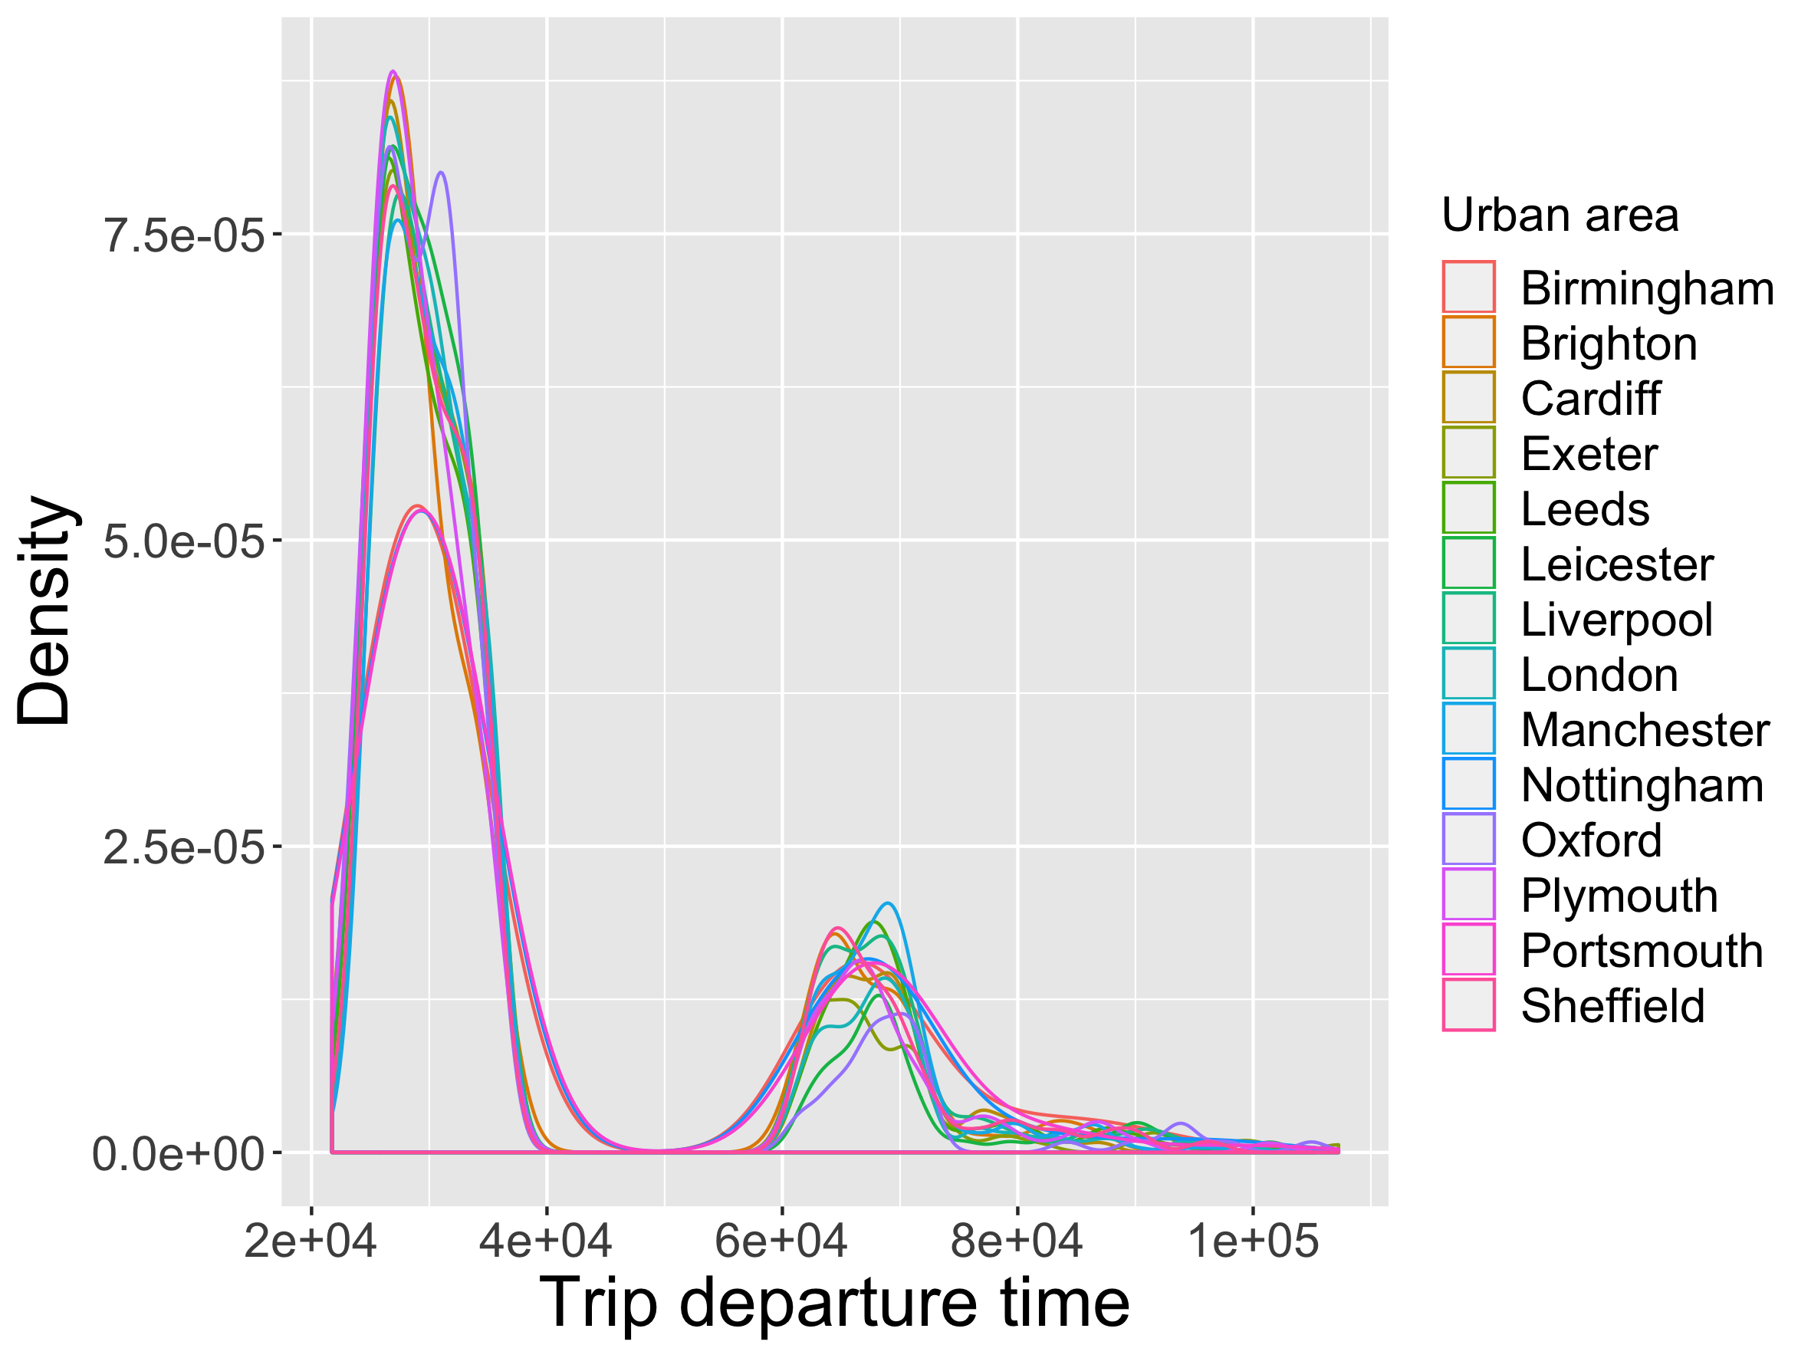
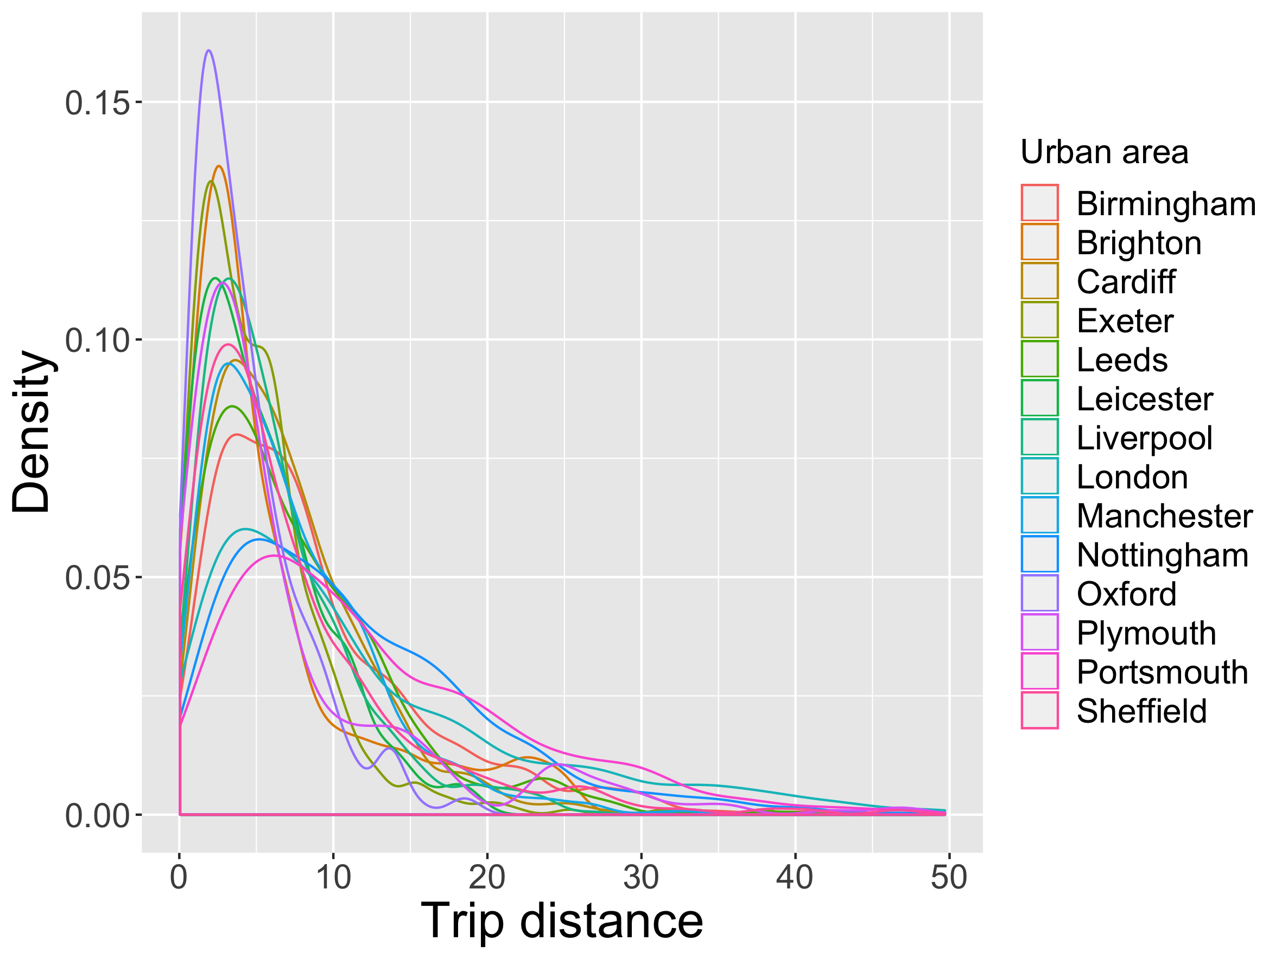
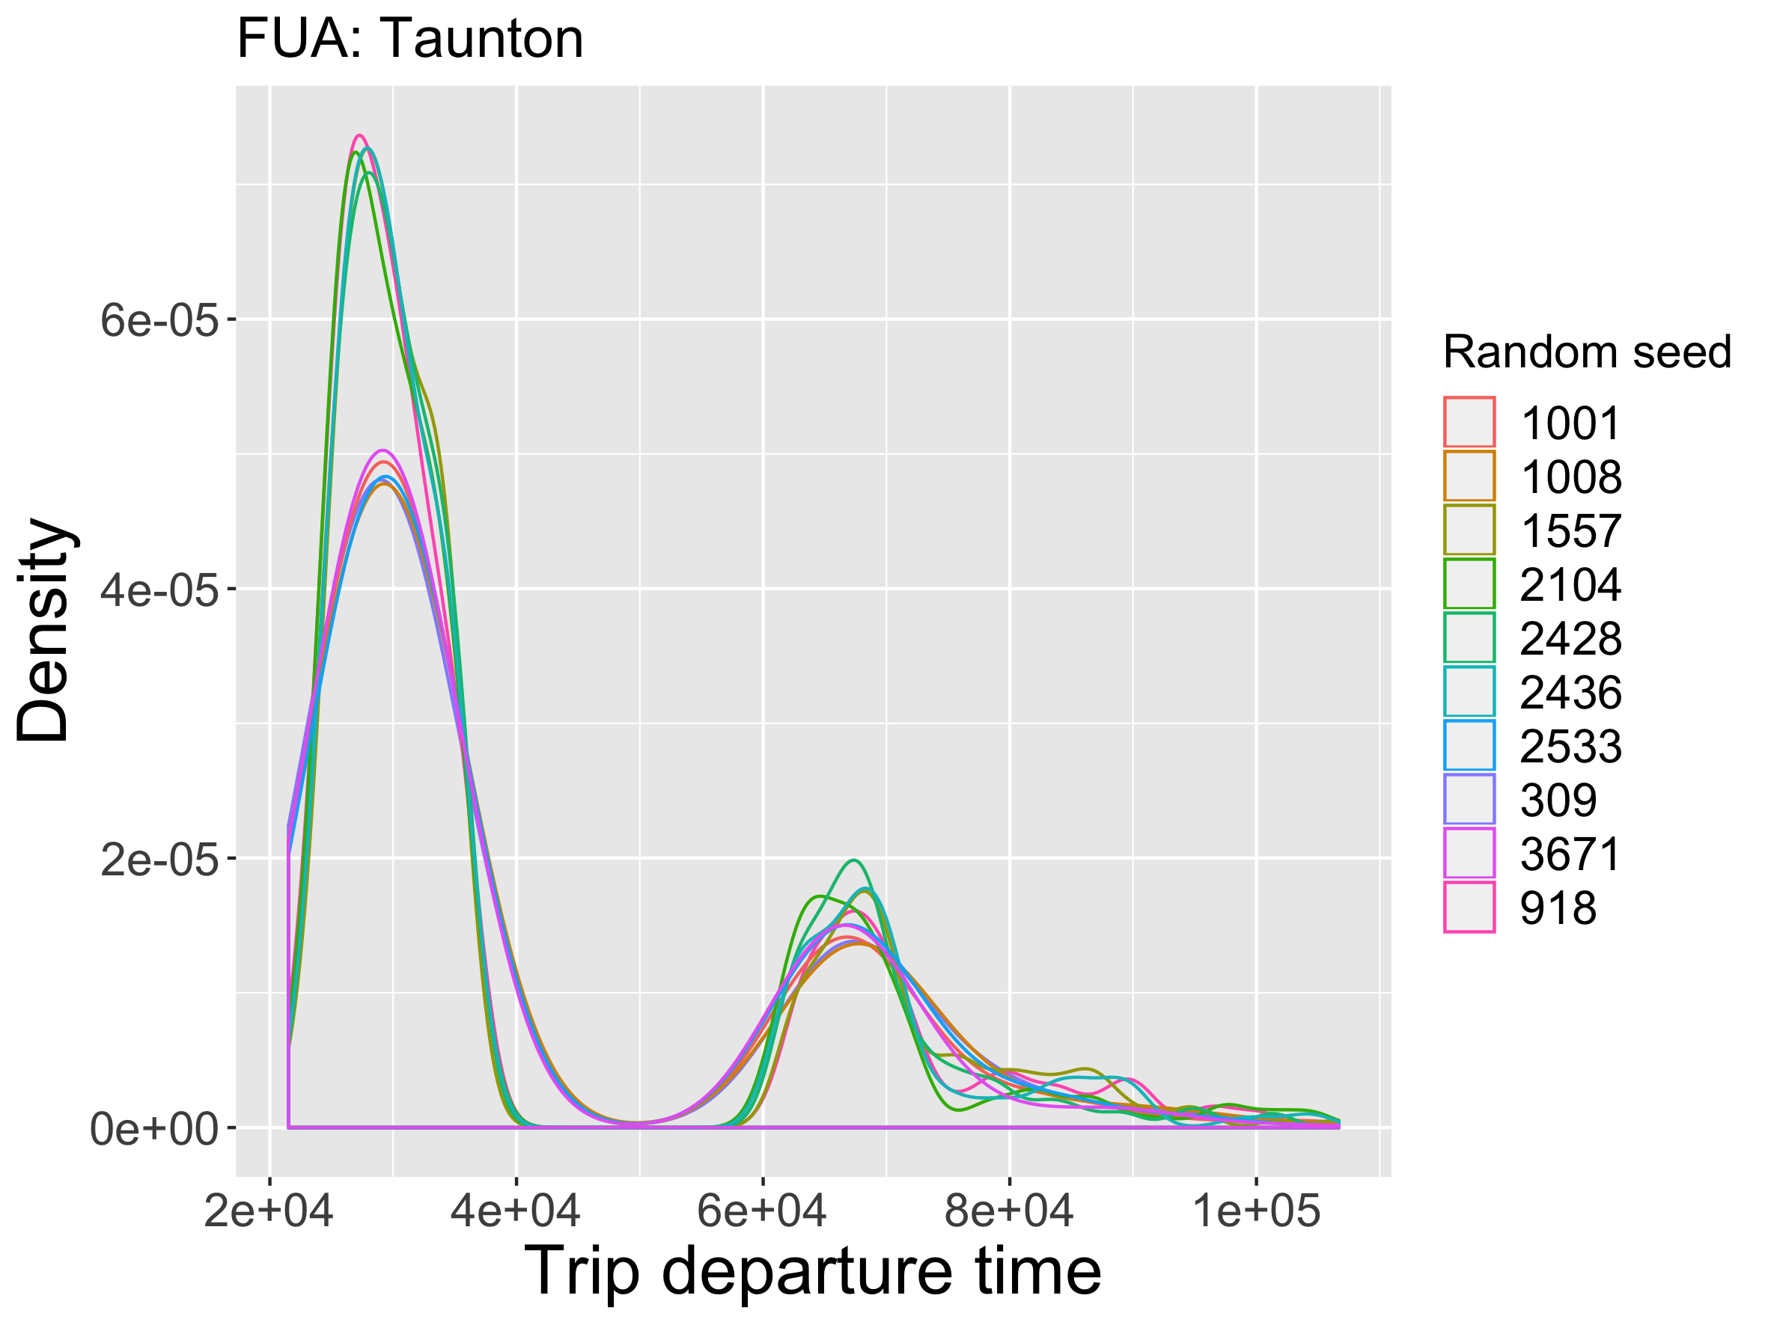
Simulation results: model runs on largest FUAs
Distributions of trip departure times and distances for the largest urban areas
Sensitivity analysis to stochasticity
Notes:
5

Slide 6
Synthesis of model integration
Assets of using DAFNI
Computation memory: can run very large experiments (London: tested with 1% sampling : ~ 0.5M agents)
Integration of many datasets
Difficulties
Model runtime: need to increase number of cores in parallelisation
Visualisation
Notes:
6

