Slide 1



DAFNI Executive Board – 14/10/2020
Champion report
Juste Raimbault
CASA, UCL
Notes:
1

Slide 2
Current work
Getting familiar with the platform, run dummy models
Report issues (model upload, output subdirectories, etc.)
Suggest new features (navigate container, run info, workflow editing, etc.)
Embed the OpenMOLE model exploration software within a DAFNI workflow
Road network data preprocessing for the MATSim model
SPENSER model integration for synthetic population generation
Notes:
2

Slide 3
OpenMOLE model exploration software
Aim: to provide OpenMOLE methods (Design of Experiments, Sensitivity Analysis, Genetic Algorithm Calibration, Diversity Search, Spatial Sensitivity Analysis) to DAFNI users
Achieved: running workflow with OpenMOLE + visualization (dummy example of a Saltelli Global Sensitivity Analysis)
Need to embed model inside the OpenMOLE docker with experiment scripts
No interactive access to workflow system (future possibility as a visualization step?)
Work in progress: test workflow with a NSGA2 calibration for a real model (urban network model)
Notes:
3

Slide 4
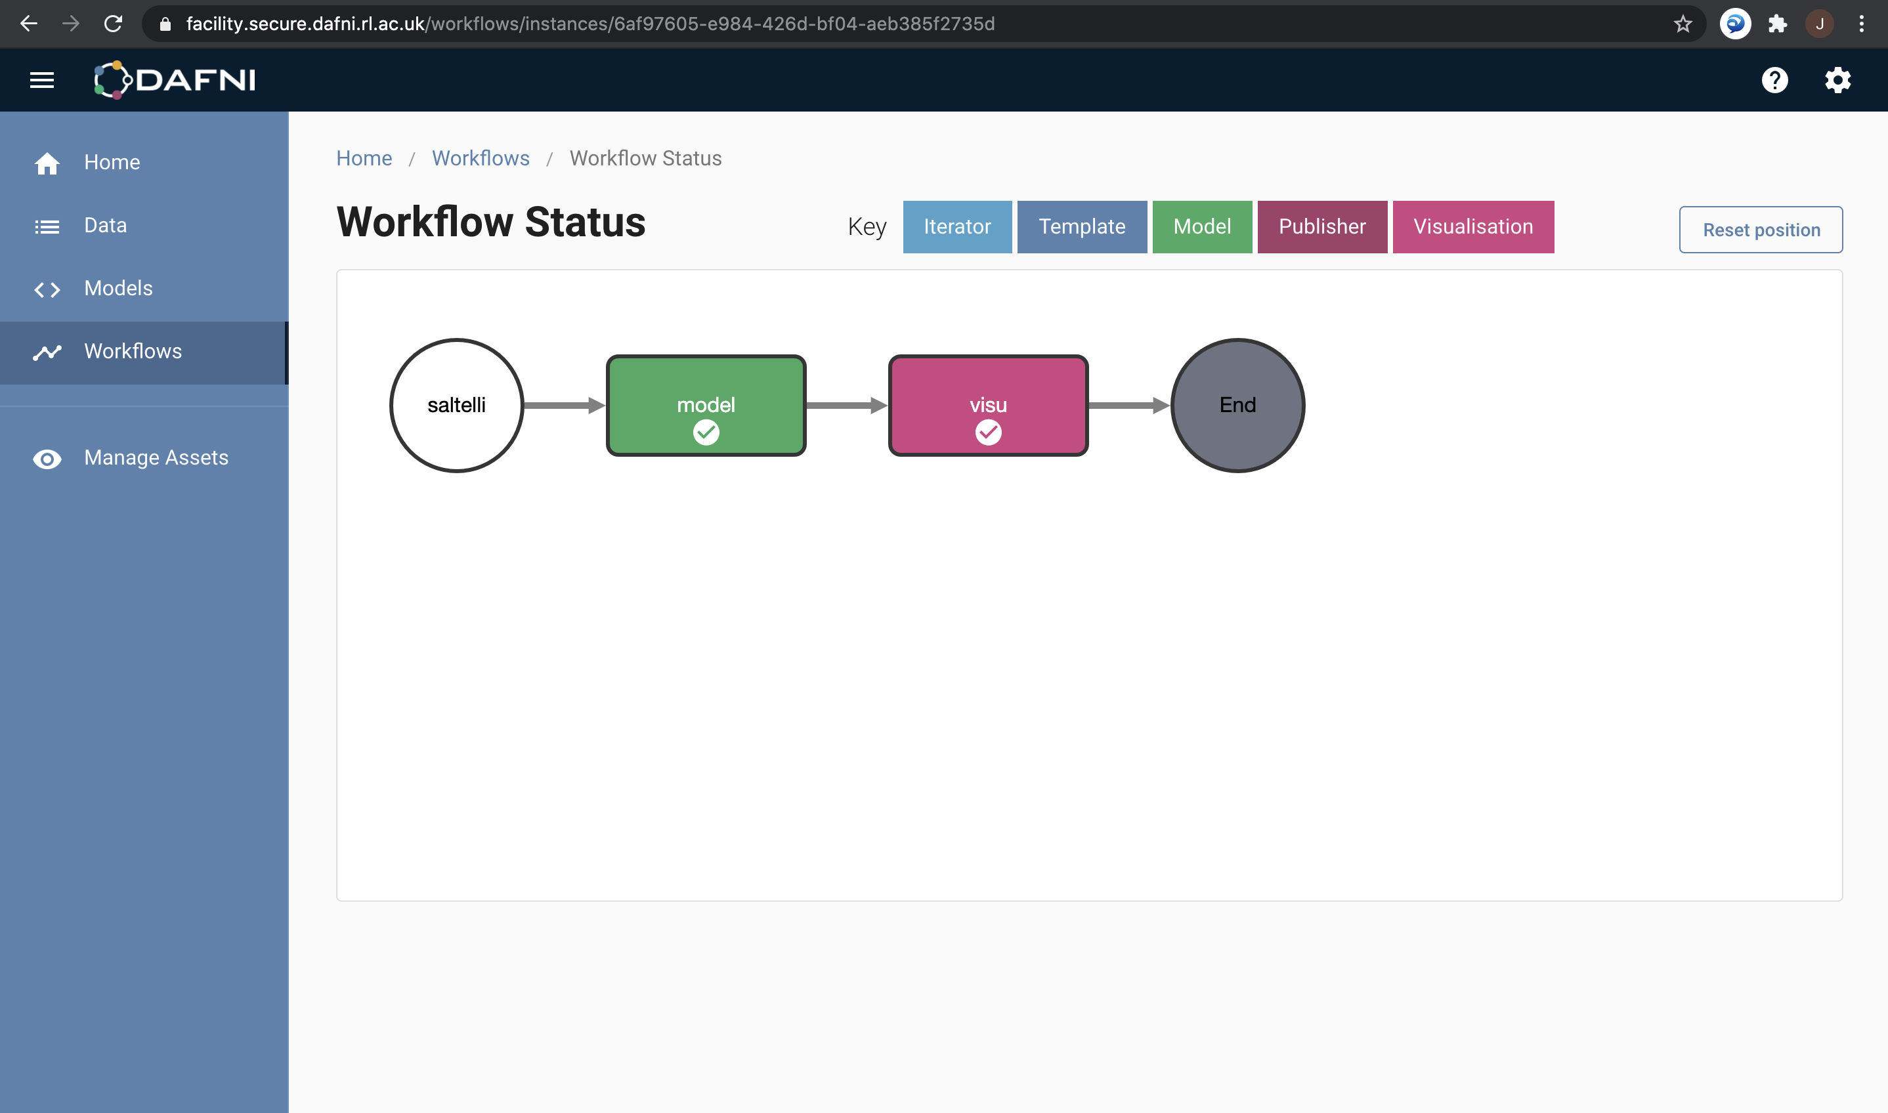

Embedding OpenMOLE experiments in DAFNI
Visualization in R
Docker image
Model code - tested: JVM
- R, python, C, etc.
Experiment
Script (.oms)
Notes:
4

Slide 5
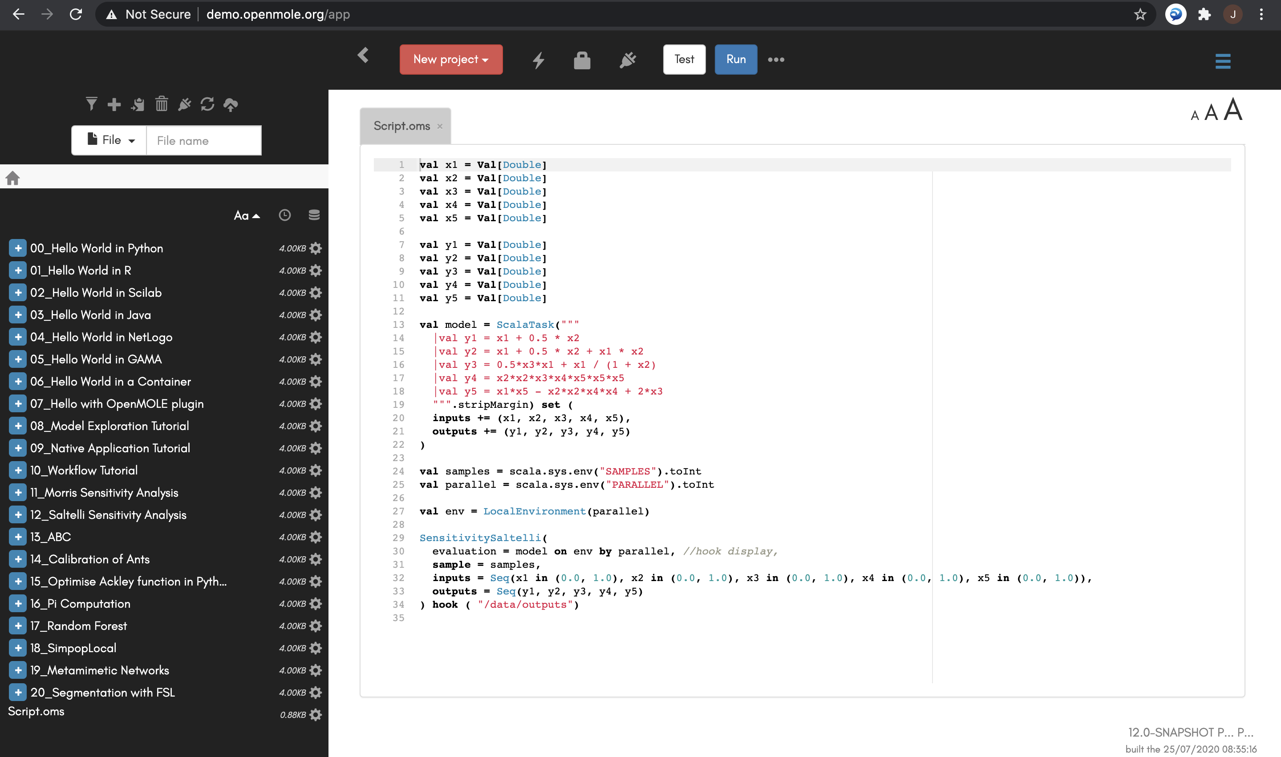
Script for model and global sensitivity analysis
Notes:
5

Slide 6
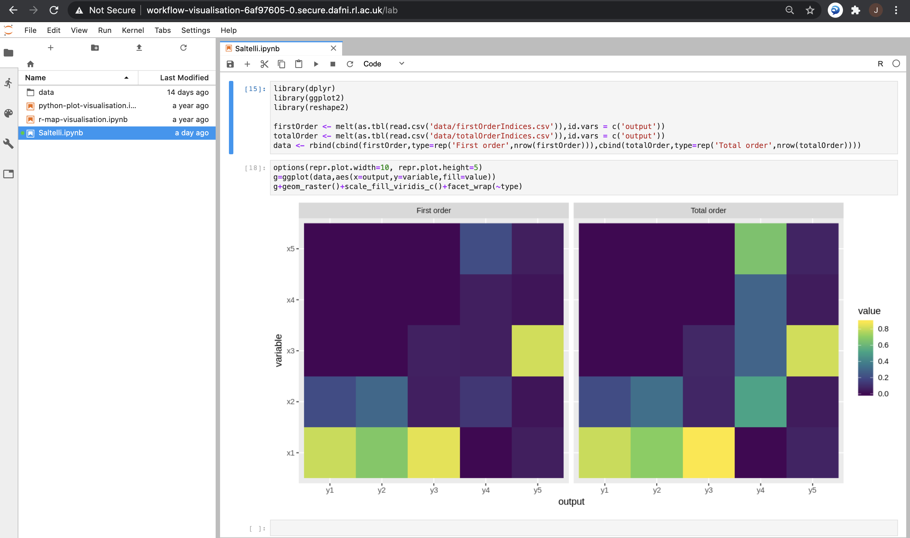
Visualisation of results
Notes:
6

Slide 7
Road network data preprocessing for MATSim
Conversion of GIS road network data to a topological network, export into MATSim xml network file: spatial snapping algorithm
Implemented in the spatialdata scala library (includes coarse graining algorithms, spatial interaction models, urban dynamics models, spatial synthetic data generators, etc. – see https://github.com/openmole/spatialdata)
Working DAFNI workflow using scala-sbt docker, with Ordnance Survey dataset and visualization
Next steps:
Implement multi-modal network (which data source for public transport? QUANT data already processed, would need MATSim conversion)
Couple with a minimal MATSim
Notes:
7

Slide 8
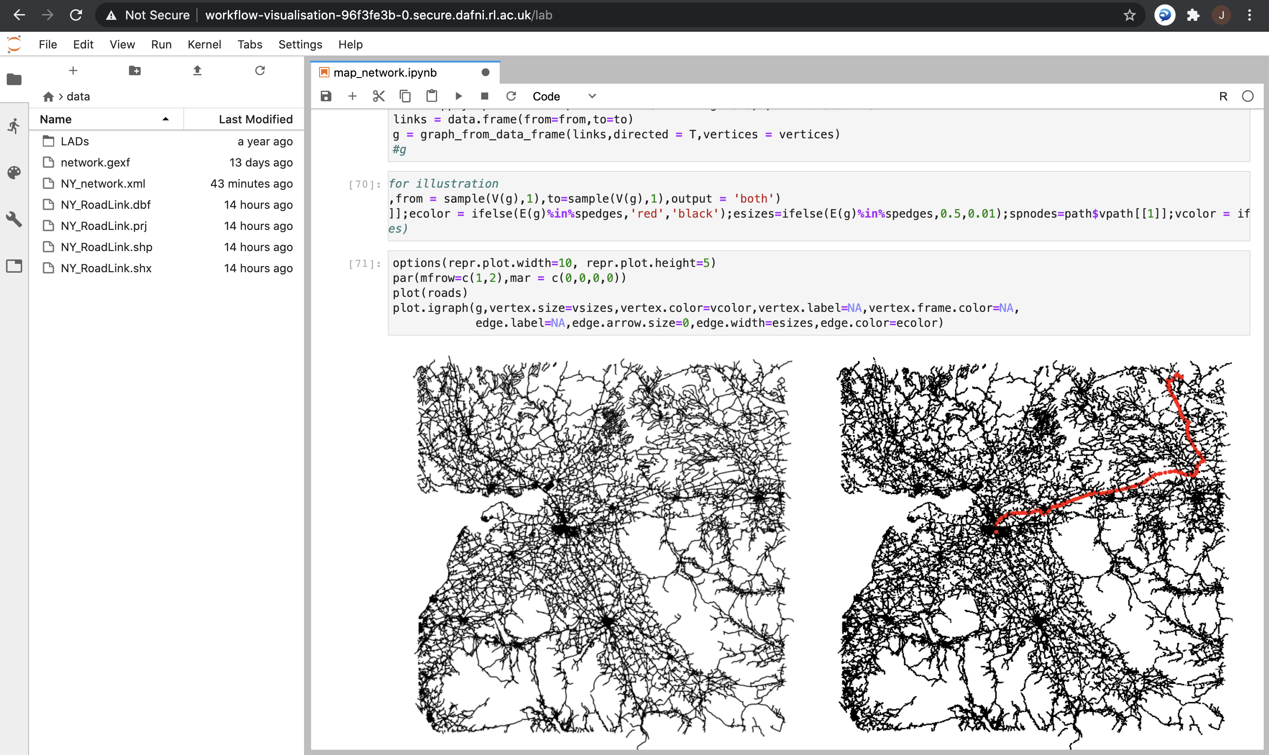
Visualisation of road network processing
Notes:
8

Slide 9
SPENSER model for synthetic population
Synthetic population generation (individuals or households) module of the SPENSER microsimulation framework developed by N. Lomaks at Leeds
Provided as a docker on dockerhub (version 1.4): running DAFNI workflow producing synthetic population csv files for given Local Authorities, at MSOA level and in time as a projection (2011-2050)
Next steps:
Implement some visualization
Conversion SPENSER output → Matsim xml format (within SPENSER docker or as a separate coupled model?)
Notes:
9

Slide 10
Next steps
More suggestions to add in issue tracker (webdav API, Domain Specific Language, OpenMOLE as visualisation)
More OpenMOLE tests (calibration, spatial sensitivity analysis)
Minimal MATSim model running on DAFNI (on processed sample network with a uniform population)
MATSim data processing:
Multi-modal network construction, public transport timetables
Synthetic population data conversion
MATSim outputs: first output processing model, prospective work for health indicators
Notes:
10

