Slide 1
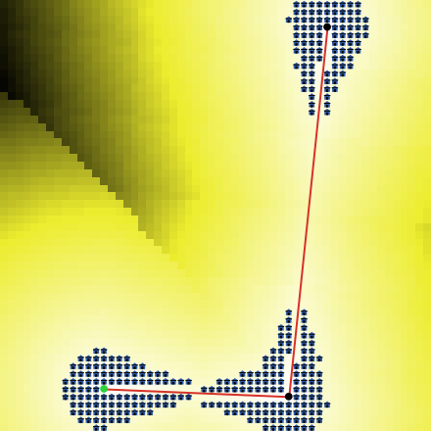
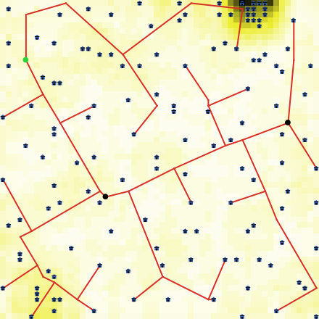
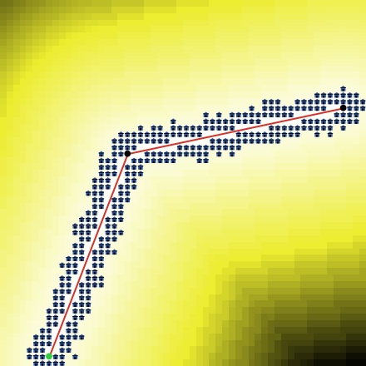
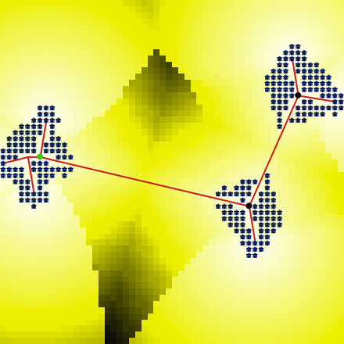
Roads and Centers
D=0.58, m=0.13
Density only
D=0.9, m=0.49
Roads only
D=0.45, m=0.08
Centers only
D=0.48, m=0.07
“Not achivied” sprawls

