Slide 1
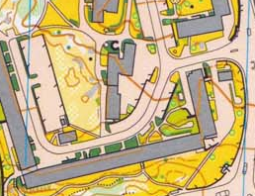
Axial lines
extraction
Abstract topological
graph
Original map

