Slide 1







Trends in the IT industry
By: John Justin Verendia
May 05, 2024

Slide 2



OUTLINE
Executive Summary
Introduction
Methodology
Results
Visualization – Charts
Dashboard
Discussion
Findings & Implications
Conclusion
Appendix

Slide 3

EXECUTIVE SUMMARY
Languages that focuses on Web Development and Data Analytics/Science, specifically HTML/CSS, Javascript, Python, and SQL seems to be the preference by the demographics of the survey at the present and the coming years.
SQL still seems to be the preference in Databases, but with the growing number of unstructured data coming day-by-day MongoDB seems to be on the rise in the coming years.
There seems to be little change in-terms of the platform preference, but a huge shift in the Web Frames preference in the coming years
There seems to be a huge gender discrepancy in the IT industry

Slide 4

INTRODUCTION
The IT industry is generally regarded as a fast-paced industry, with the constant improvement and evolution of technology, people tend to secure themselves and learn skills that are in demand and considered “future proof”. This study aims to answer the following questions:
What are the top languages in the industry?
What are the top databases that are being used?
What are some of the most popular platforms?
What is the demographics of the industry?
The goal of this analysis is to analyze the trends and patters in the IT industry by today’s standards specifically, the:
Current usage in technology.
Future preference in technology.
Demographics of the users.

Slide 5

METHODOLOGY
Data Sources:
Stack overflow developer survey from 2019
Github Job Posting
Programming Languages Annual Salary
Data analysis:
Language used:
Python
Data Wrangling
Exploratory Data Analysis
Data Visualization and Presentation:
IBM Cognos
Microsoft Excel

Slide 6
RESULTS

Slide 7
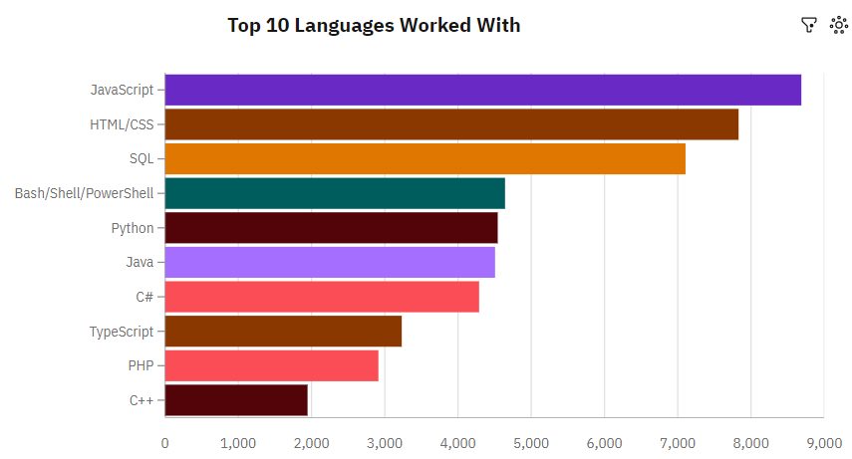
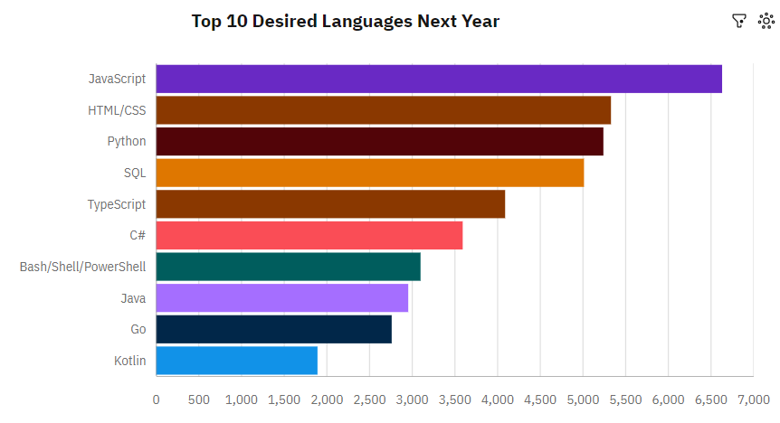
PROGRAMMING LANGUAGE TRENDS
Current Year
Next Year

Slide 8
PROGRAMMING LANGUAGE TRENDS - FINDINGS & IMPLICATIONS
Findings
JavaScript and HTML/CSS are the most popular language.
Python and TypeScript are languages on the rise.
Though surpassed by Python, SQL is still one of the most popular language.
Implications
With the popularity of JavaScript and HTML and rise of TypeScript, shows that Web Development will be in demand in the coming years.
With versatility of Python, it might surpass JavaScript and HTML/CSS in popularity in the future.
With the rise in popularity of Python and SQL, Data analytics may also grow demand in the coming years.

Slide 9
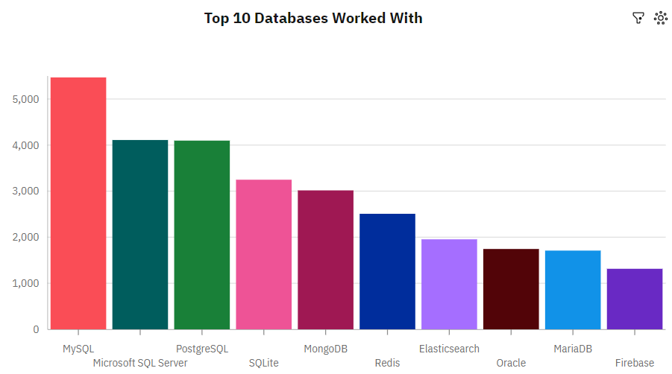
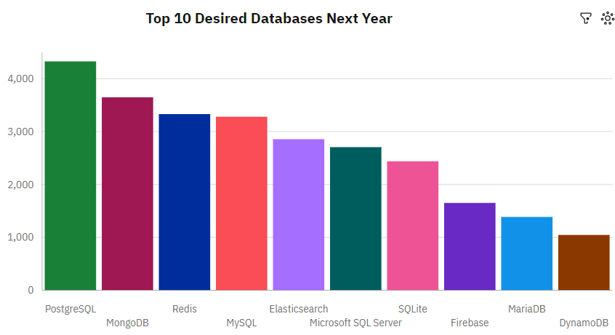
DATABASE TRENDS
Current Year
Next Year

Slide 10
DATABASE TRENDS - FINDINGS & IMPLICATIONS
Findings
SQL is and still will be the most popular Database next year. Though with different SQL dialect
A huge spike in the popularity of MongoDB and Redis in the coming years.
NoSQL database are on the rise in the coming years.
Implications
PostgreSQL might have better usability than MySQL.
With the continuous growth of unstructured data, NoSQL databases will also continue to grow.
SQL might be overtaken in-terms of popularity by NoSQL in the coming years.

Slide 11

DASHBOARD
Click here to visit the Dashboard in Cognos Analytics.

Slide 12
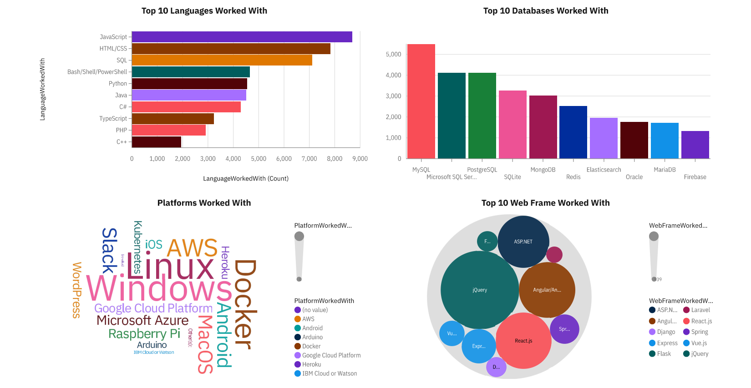
DASHBOARD TAB 1

Slide 13
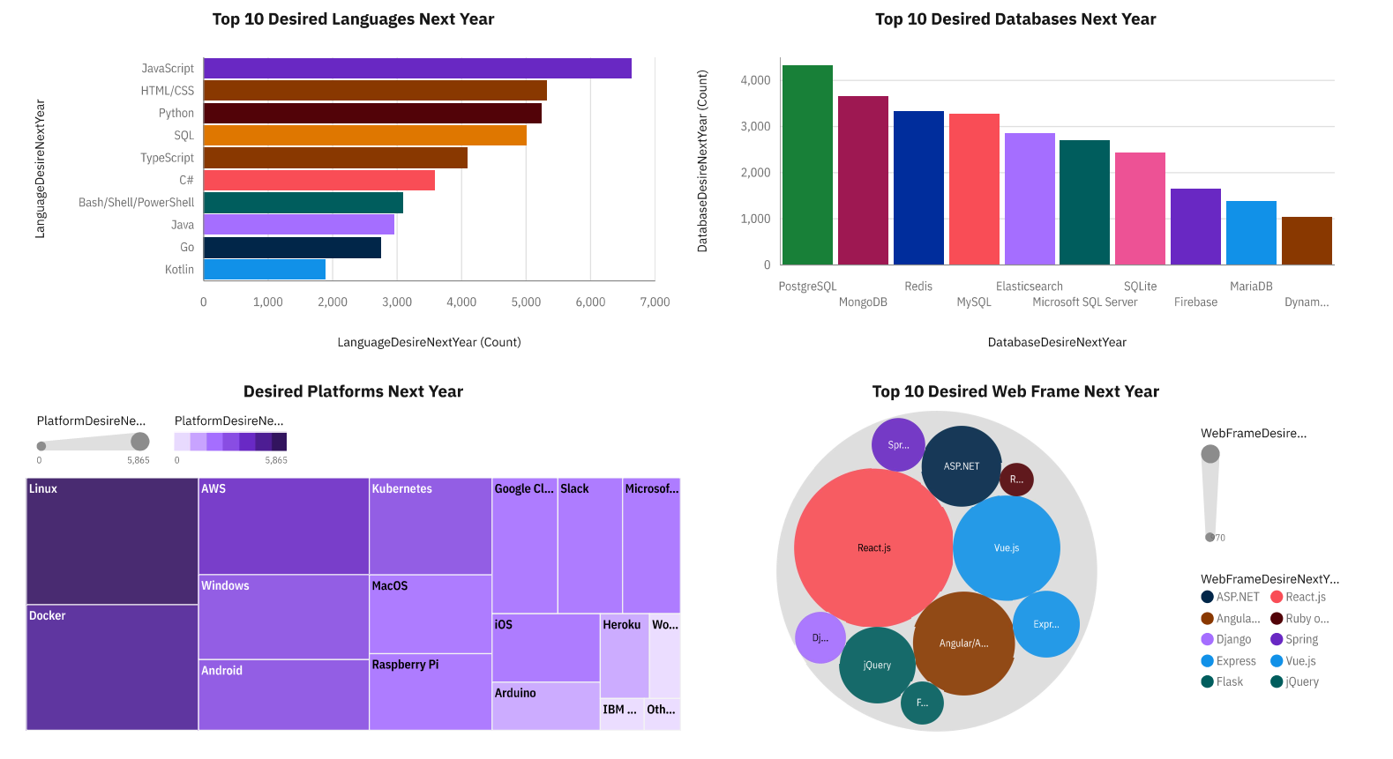
DASHBOARD TAB 2

Slide 14
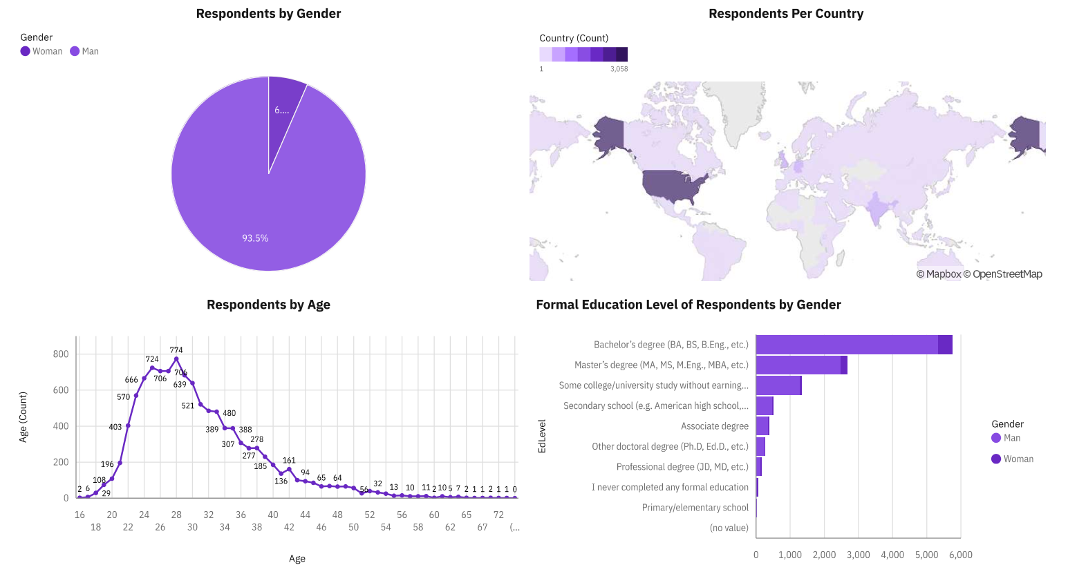
DASHBOARD TAB 3

Slide 15
DISCUSSION
The instability of the IT industry, and the future proof-ability of a certain skill, language, database, or platform.
The Huge discrepancy of Gender in the industry.
The rise of new jobs with the rise of new and bigger data.

Slide 16
OVERALL FINDINGS & IMPLICATIONS
Findings
The IT industry is very unstable, demands and trends may significantly vary within a short time.
Web Development will not go anywhere for a while.
The rise of other versatile languages like python.
Implications
People within the industry must be aware of these changes and be ready to learn new skills in-order to stay in the industry.
Web Development will still be in demand in the coming years.
With the rise of python, applications like AI, Machine learning, Data analytics and Science will also be on the rise in the coming years.

Slide 17

CONCLUSION
Trends and popularity in IT industry may vary significantly from what is considered popular the year before.
Languages for Web Development seems to be the most popular programming language.
NoSQL databases seems to be on the way to dethrone SQL databases as the most popular databases in the future.
Not so much changes in the Platforms but the opposite can be said with the shifts in Web Frames.

Slide 18

APPENDIX
Tables of information from other Sources
Location | Total Number of Jobs
Austin | 434
San Francisco | 435
Los Angeles | 640
New York | 3226
Seattle | 3375
Detroit | 3945
Washington DC | 5316
Grand Total | 17371
Language | Estimated Average Annual Salary
PHP | 84727
SQL | 84793
C# | 88726
R | 92037
Go | 94082
Java | 101013
Javascript | 110981
C++ | 113865
Python | 114383
Swift | 130801
Grand Total | 1015408

Slide 19
JOB POSTINGS

Slide 20
POPULAR LANGUAGES

