Slide 1


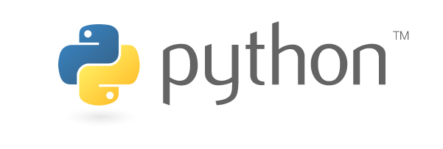
Python-based Paraview postprocessing
Oztoprak, Oguz
Droll, Darwin
Technische Universität München
Department of Civil, Geo and Environmental Engineering
Chair of Computation in Engineering
Munich, 25. May 2018
Notes:
1

Slide 2
Outline
Postprocessing
Paraview
Task
Features
Timeline
Oztoprak, Oguz (TUM) | Droll, Darwin (TUM) | Python-based Paraview postprocessing
2

Slide 3
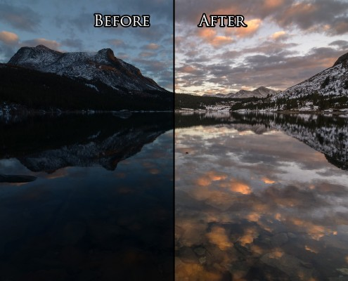
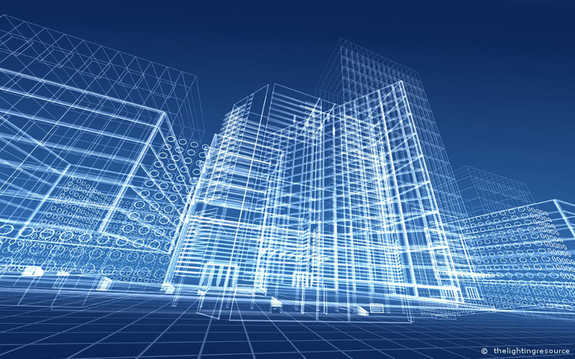
Postprocessing
Post (lat.) – after
Further calculation
May be “expensive”
Source: https://www.joshuacripps.com/category/photography-tutorials/post-processing-photoshop-lightroom/page/3/
Source: https://www.aproplan.com/layout/uploads/2017/09/resource-bim-the-importance-of-bim-in-the-lighting-industry.jpg
Oztoprak, Oguz (TUM) | Droll, Darwin (TUM) | Python-based Paraview postprocessing
3

Slide 4
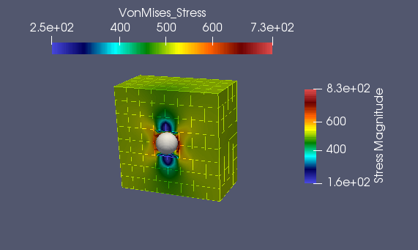
Paraview
Kitware
Open Source
Visualization
Python Shell
Paraview simple module
VTK-Files
(Visualization Toolkit)
XML-structure
Source: Screenshot from Paraview
Oztoprak, Oguz (TUM) | Droll, Darwin (TUM) | Python-based Paraview postprocessing
4

Slide 5
Task
3D Object (vtk-File)
Selection
Distribution to postprocessing
3
1
Creating 3D Object
4
Paraview
Python plugin
AdhoC++
6
2
User selection of cells
Result
display
5
processing
Oztoprak, Oguz (TUM) | Droll, Darwin (TUM) | Python-based Paraview postprocessing
5

Slide 6
Features
Selecting of cells by the User
Distribution to AdhoC++ of the selection
Creating a new display in Paraview out of the selected cells
Make it work by pressing one button
Oztoprak, Oguz (TUM) | Droll, Darwin (TUM) | Python-based Paraview postprocessing
6

Slide 7
Timeline
What we have done till now
Getting to know the tools
Ubuntu
Paraview
Python
GIT
Making a selection and getting the Cell IDs of the selection by calling a function
Oztoprak, Oguz (TUM) | Droll, Darwin (TUM) | Python-based Paraview postprocessing
7

Slide 8
Timeline
Next steps & tasks
Creating a new display in paraview out of the selected cells
Make it work by pressing a button in the GUI of paraview
Distribution to AdhoC++
Importing the data from AdhoC++
Display the results
Oztoprak, Oguz (TUM) | Droll, Darwin (TUM) | Python-based Paraview postprocessing
8

Slide 9
Thank you for your attention.
Oztoprak, Oguz (TUM) | Droll, Darwin (TUM) | Python-based Paraview postprocessing
9

Slide 10
Sources
Oztoprak, Oguz (TUM) | Droll, Darwin (TUM) | Python-based Paraview postprocessing
10

