Slide 1


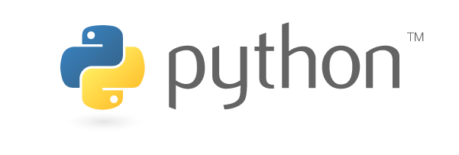
Python-based Paraview postprocessing
Oztoprak, Oguz
Droll, Darwin
Technische Universität München
Department of Civil, Geo and Environmental Engineering
Chair of Computation in Engineering
Munich, 25. May 2018
Notes:
1

Slide 2
Outline
Introduction
Postprocessing
Paraview
Features
Timeline
Oztoprak, Oguz (TUM) | Droll, Darwin (TUM) | Python-based Paraview postprocessing
2

Slide 3
Introduction
Postprocessing for Paraview
Distribution to an existing Program, called Adhoc
Plugin written in python
Working OS Ubuntu (Linux)
Usage of GIT
Oztoprak, Oguz (TUM) | Droll, Darwin (TUM) | Python-based Paraview postprocessing
3

Slide 4
Postprocessing
Post (lat.) – after
Further calculating may be necessary
Processing takes too long to do all calculations every time
Selecting a specific part for postprocessing
Example: Building
Oztoprak, Oguz (TUM) | Droll, Darwin (TUM) | Python-based Paraview postprocessing
4

Slide 5
Paraview
What is paraview?
How does it work?
How it can help us
Oztoprak, Oguz (TUM) | Droll, Darwin (TUM) | Python-based Paraview postprocessing
5

Slide 6
Features
Selecting of cells by the User
Distribution to Adhoc of the selection
Creating a new display in paraview out of the selected cells
Make it work by pressing one button
Oztoprak, Oguz (TUM) | Droll, Darwin (TUM) | Python-based Paraview postprocessing
6

Slide 7
Timeline
What we have done till now
Getting to know the tools
Ubuntu
Paraview
Python
GIT
Making a selection and getting the Cell IDs of the selection by calling a function
Oztoprak, Oguz (TUM) | Droll, Darwin (TUM) | Python-based Paraview postprocessing
7

Slide 8
Timeline
Next steps & tasks
Creating a new display in paraview out of the selected cells
Make it work by pressing a button in the GUI of paraview
Distribution to Adhoc
Importing the data from Adhoc
Display the results
Oztoprak, Oguz (TUM) | Droll, Darwin (TUM) | Python-based Paraview postprocessing
8

Slide 9
Thank you for your attention.
Oztoprak, Oguz (TUM) | Droll, Darwin (TUM) | Python-based Paraview postprocessing
9

Slide 10
Sources
Oztoprak, Oguz (TUM) | Droll, Darwin (TUM) | Python-based Paraview postprocessing
10

