Slide 1



Python-based Paraview Postprocessing
Oztoprak, Oguz
Droll, Darwin
Technische Universität München
Department of Civil, Geo and Environmental Engineering
Chair of Computation in Engineering
Munich, 25. May 2018
Notes:
1

Slide 2
Outline
Postprocessing
Paraview
Task
Features
Timeline
Oztoprak, Oguz (TUM) | Droll, Darwin (TUM) | Python-based Paraview postprocessing
2

Slide 3
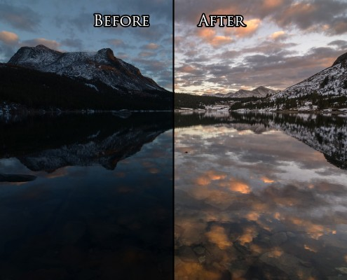
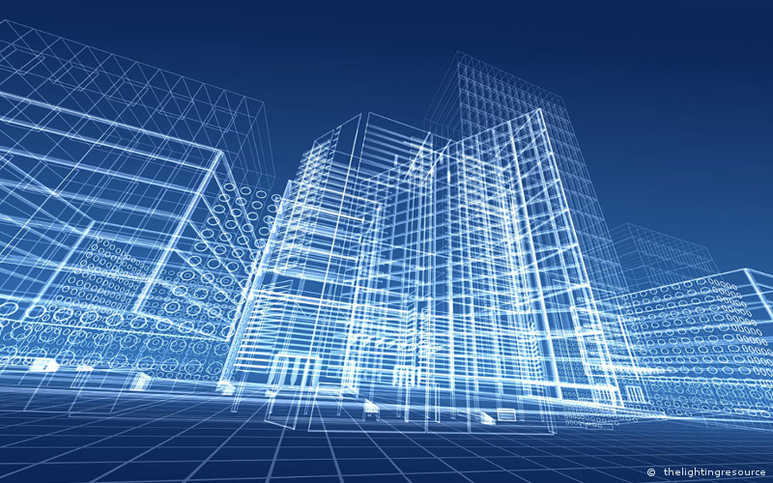
Maybe sth. like:
Visualization and interpretation of the results
Postprocessing
Post (lat.) – after
Further calculation
May be “expensive”
Visualization and Interpretation
Source: https://www.joshuacripps.com/category/photography-tutorials/post-processing-photoshop-lightroom/page/3/
Source: https://www.aproplan.com/layout/uploads/2017/09/resource-bim-the-importance-of-bim-in-the-lighting-industry.jpg
Oztoprak, Oguz (TUM) | Droll, Darwin (TUM) | Python-based Paraview postprocessing
3

Slide 4
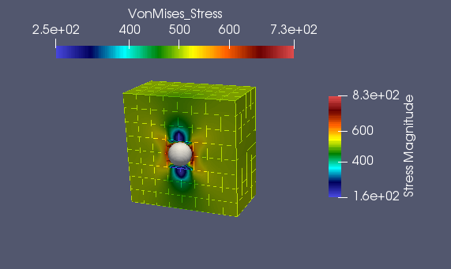
Paraview
Kitware
Open Source
Visualization
Python Shell
Paraview simple module
VTK-Files
(Visualization Toolkit)
XML-structure
Source: Screenshot from Paraview
Oztoprak, Oguz (TUM) | Droll, Darwin (TUM) | Python-based Paraview postprocessing
4

Slide 5
Task
3D Object (vtk-File)
Selection
Distribution to postprocessing
3
1
Creating 3D Object
4
Paraview
Python plugin
AdhoC++
6
2
User selection of cells
Result
display
5
processing
Oztoprak, Oguz (TUM) | Droll, Darwin (TUM) | Python-based Paraview postprocessing
5

Slide 6
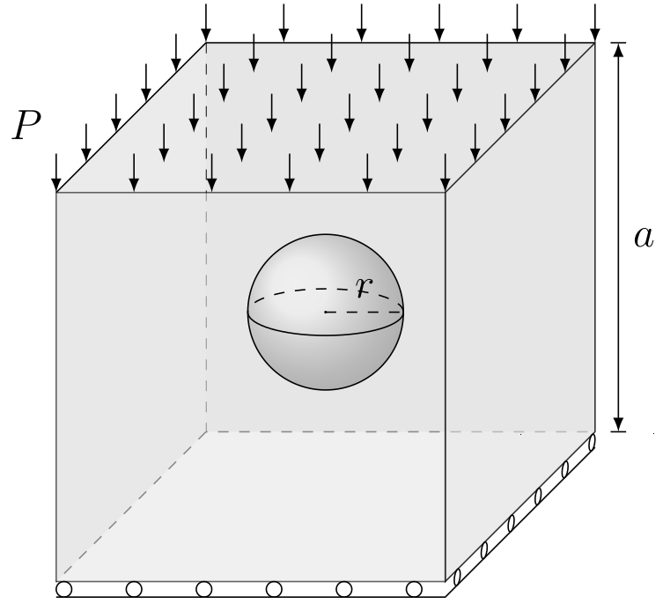
Features
Example Problem
Cube with a Hole
Oztoprak, Oguz (TUM) | Droll, Darwin (TUM) | Python-based Paraview postprocessing
6

Slide 7
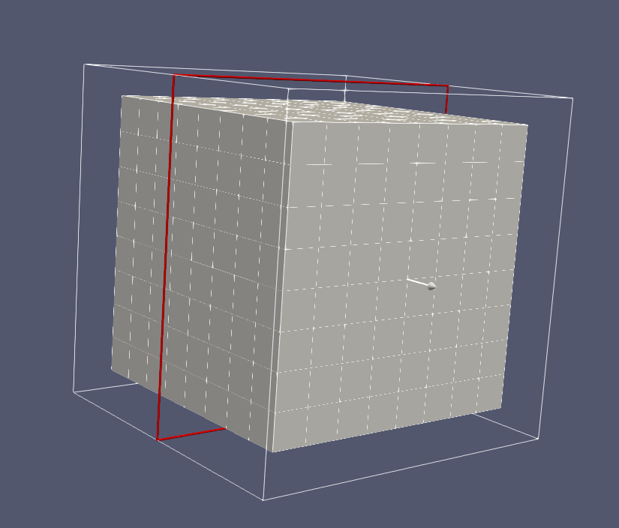
Features
Starting Point: Cell Selection and Extraction
Oztoprak, Oguz (TUM) | Droll, Darwin (TUM) | Python-based Paraview postprocessing
7

Slide 8
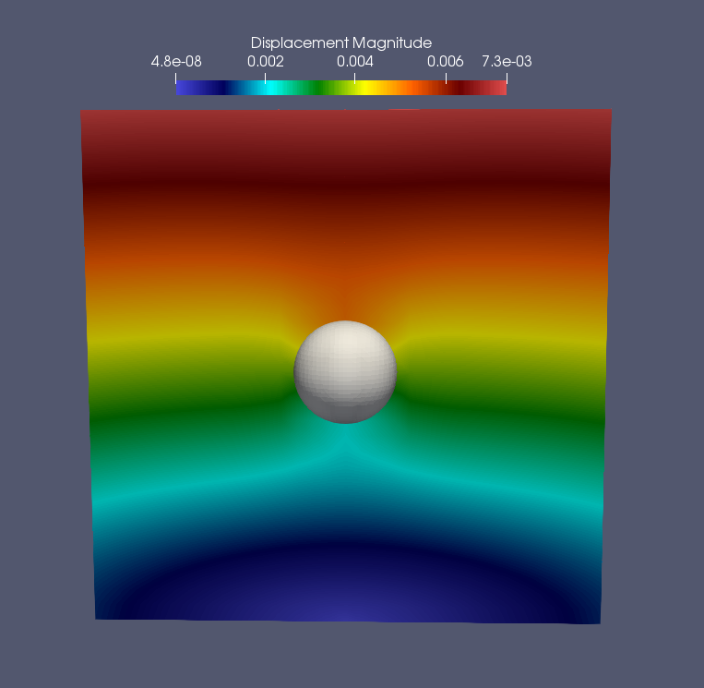
Features
Where could we use a finer mesh?
Oztoprak, Oguz (TUM) | Droll, Darwin (TUM) | Python-based Paraview postprocessing
8

Slide 9
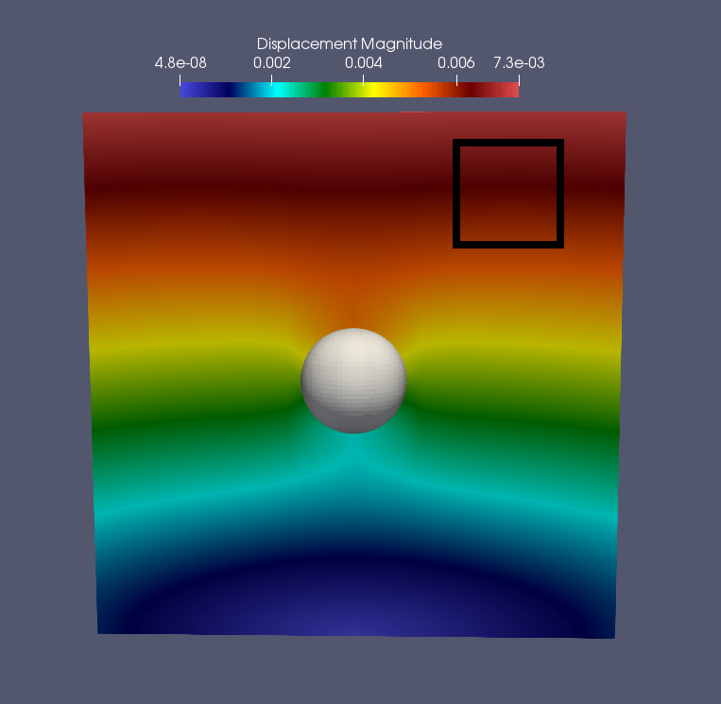
Features
Where could we use a finer mesh?
Oztoprak, Oguz (TUM) | Droll, Darwin (TUM) | Python-based Paraview postprocessing
9

Slide 10
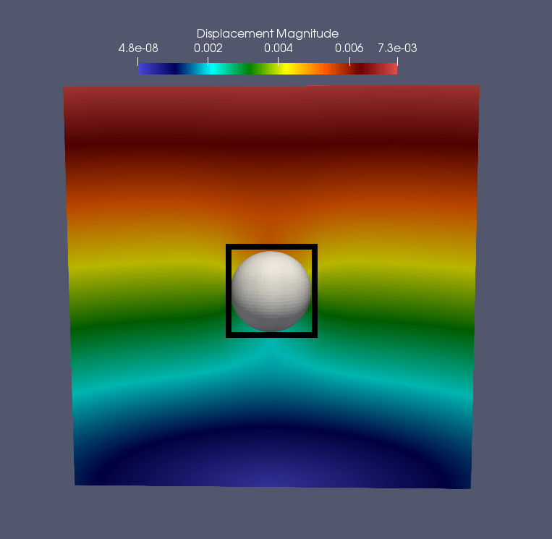
Features
Where could we use a finer mesh?
Oztoprak, Oguz (TUM) | Droll, Darwin (TUM) | Python-based Paraview postprocessing
10

Slide 11
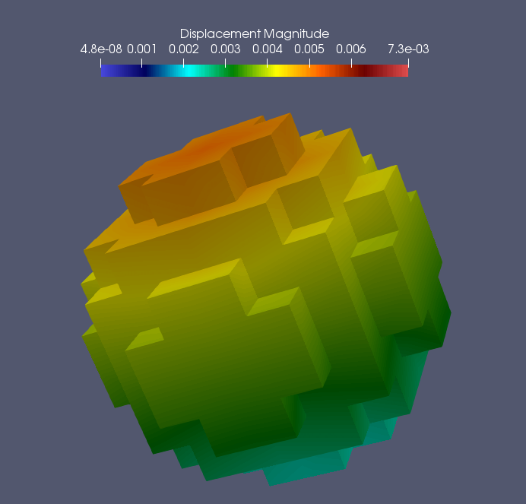
Features
Select and Extract Cells around the Hole
Oztoprak, Oguz (TUM) | Droll, Darwin (TUM) | Python-based Paraview postprocessing
11

Slide 12
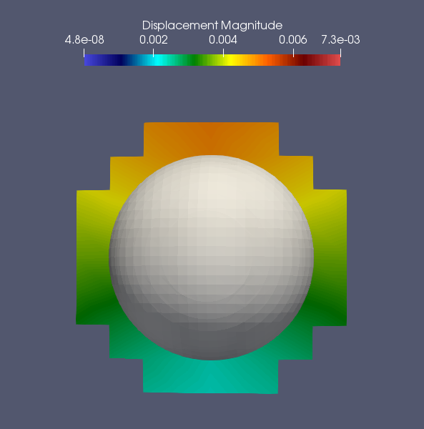
Features
Select and Extract Cells around the Hole
Oztoprak, Oguz (TUM) | Droll, Darwin (TUM) | Python-based Paraview postprocessing
12

Slide 13
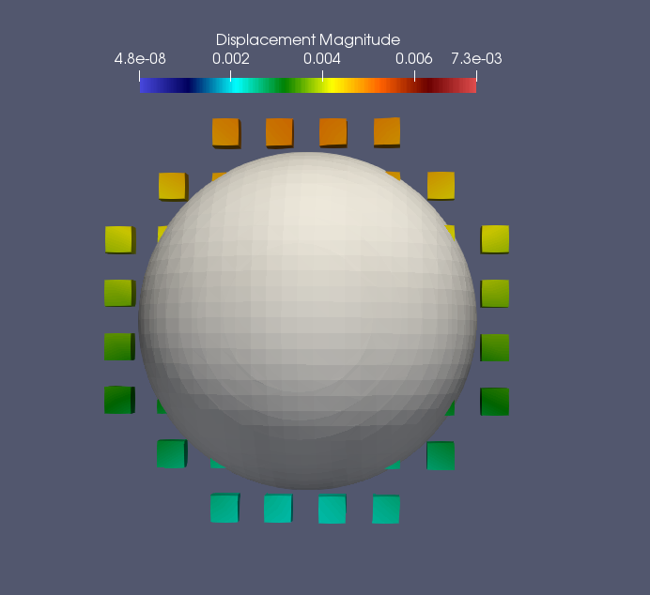
Features
Select and Extract Cells around the Hole
Oztoprak, Oguz (TUM) | Droll, Darwin (TUM) | Python-based Paraview postprocessing
13

Slide 14
Timeline
What we have done till now
Getting to know the tools
Ubuntu
Paraview
Python
GIT
Introduction to .vtu format
Scripting in PVPython
Oztoprak, Oguz (TUM) | Droll, Darwin (TUM) | Python-based Paraview postprocessing
14

Slide 15
Timeline
Next Steps:
Standardizing existing scripts
Further Experiments with Extraction methods
Is there a better way?
Adding New Functionalities
Oztoprak, Oguz (TUM) | Droll, Darwin (TUM) | Python-based Paraview postprocessing
15

Slide 16
Thank you for your attention.
Oztoprak, Oguz (TUM) | Droll, Darwin (TUM) | Python-based Paraview postprocessing
16

Slide 17
Sources
ParaView, Kitware, www.paraview.org/Wiki/ParaView
“Paraview Home - MarkMail - Community Libraries.” Paraview Home - MarkMail - Community Libraries, paraview.markmail.org/
Oztoprak, Oguz (TUM) | Droll, Darwin (TUM) | Python-based Paraview postprocessing
17

