Slide 1
Sec. 2.7: Applications to Computer Graphics

Slide 2
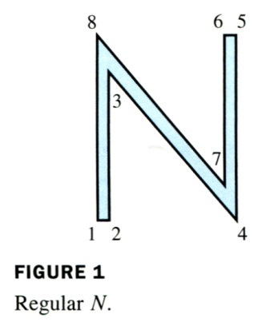
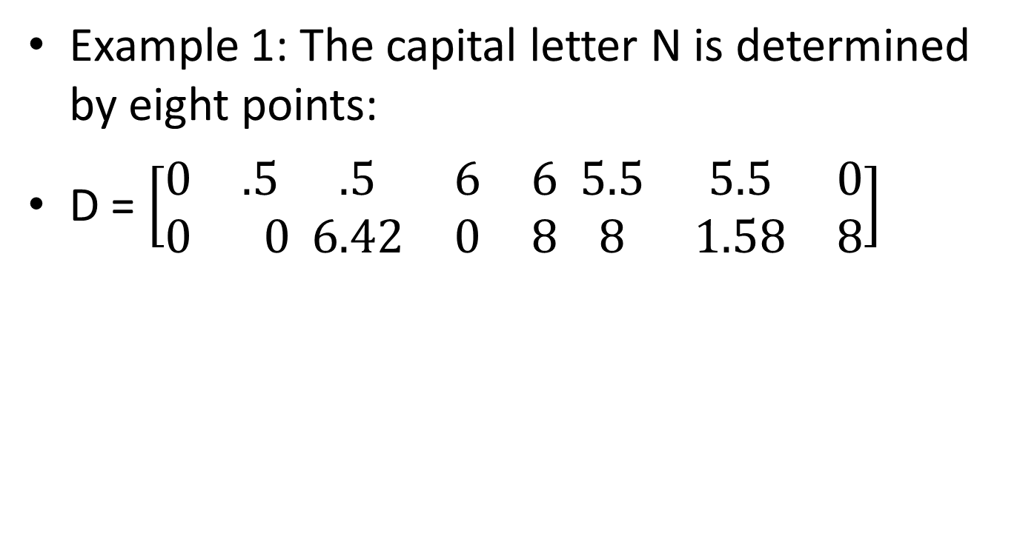
Example 1: The capital letter N is determined by eight points:
D = $\left[\begin{matrix}0 & .5 \\ 0 & 0\end{matrix}\begin{matrix}.5 & 6 & 6 \\ 6.42 & 0 & 8\end{matrix} \begin{matrix}5.5 & 5.5 & 0 \\ 8 & 1.58 & 8\end{matrix}\right]$

Slide 3
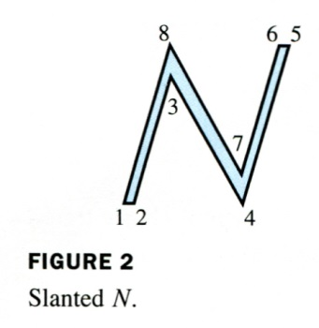
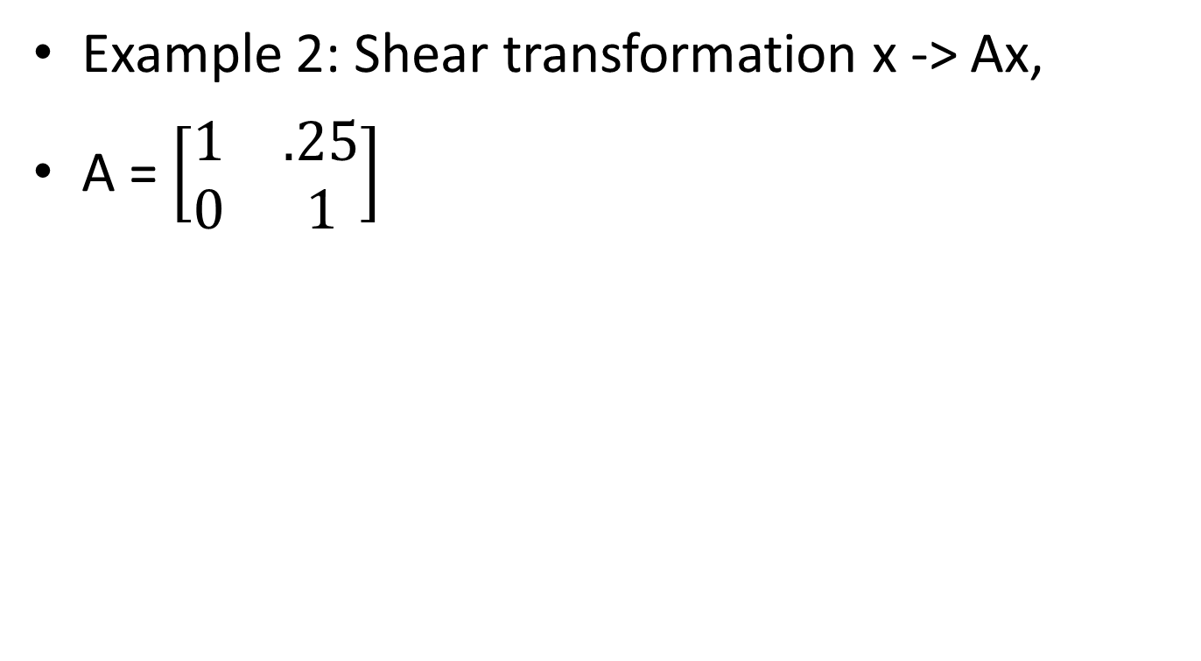
Example 2: Shear transformation x -> Ax,
A = $\left[\begin{matrix}1 & .25 \\ 0 & 1\end{matrix}\right]$

Slide 4
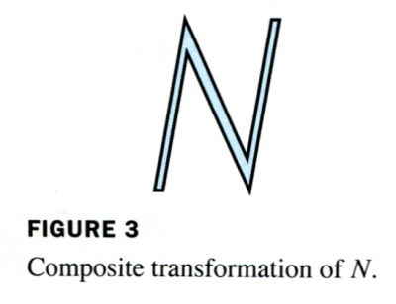
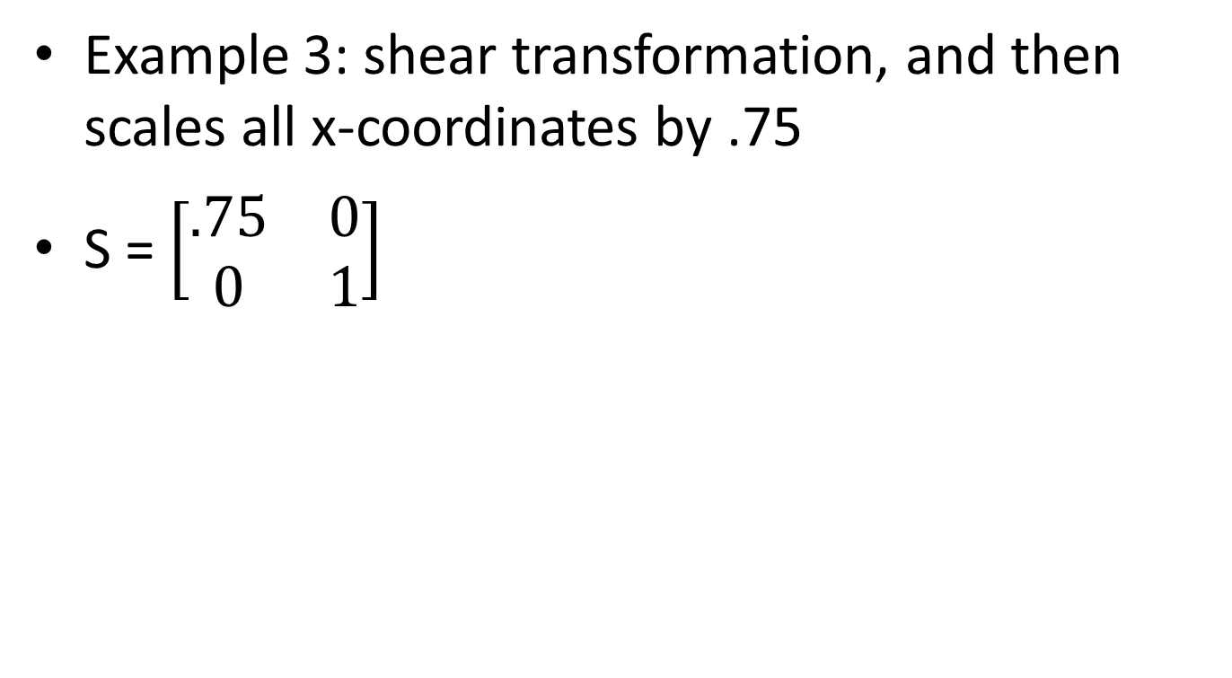
Example 3: shear transformation, and then scales all x-coordinates by .75
S = $\left[\begin{matrix}.75 & 0 \\ 0 & 1\end{matrix}\right]$

Slide 5
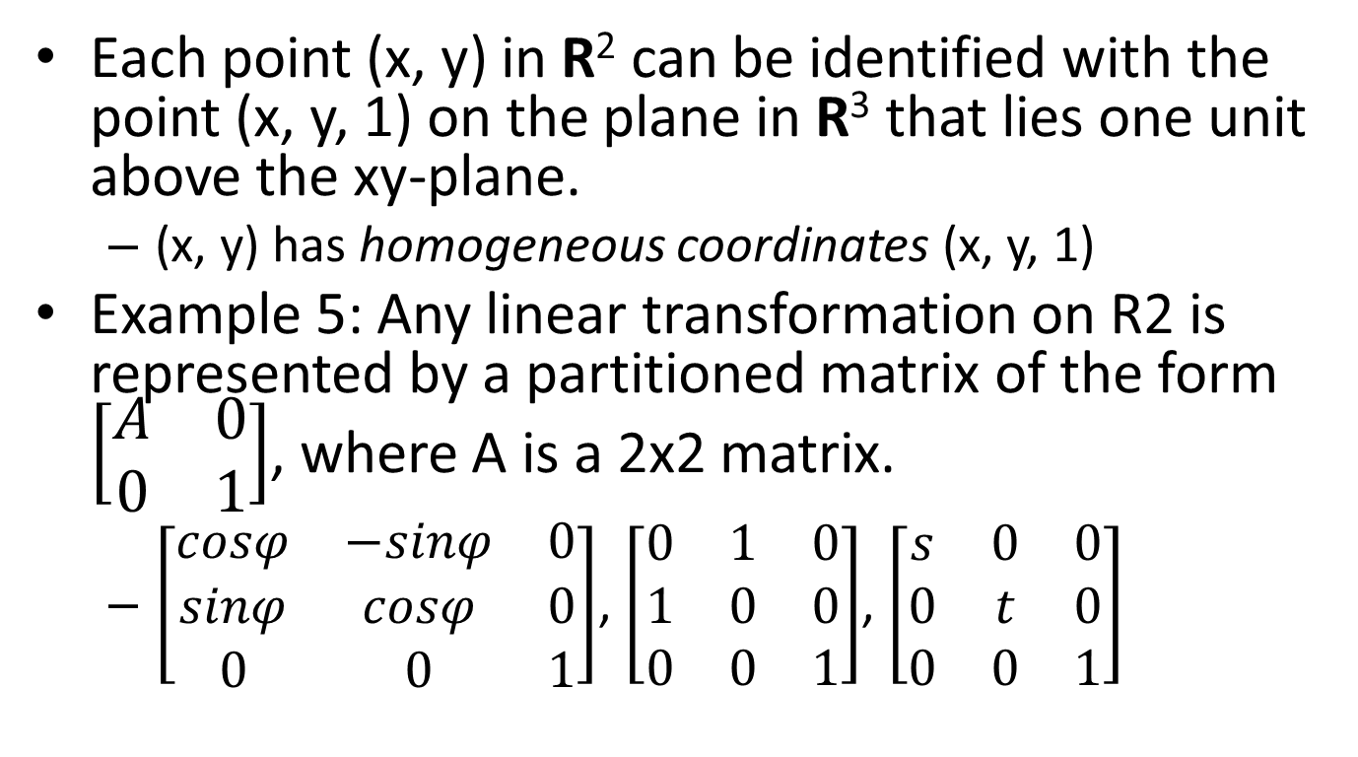
Homogeneous Coordinates
Each point (x, y) in R² can be identified with the point (x, y, 1) on the plane in R³ that lies one unit above the xy-plane.
  (x, y) has homogeneous coordinates (x, y, 1)
Example 5: Any linear transformation on R2 is represented by a partitioned matrix of the form $\left[\begin{matrix}A & 0 \\ 0 & 1\end{matrix}\right]$, where A is a 2x2 matrix.
  $\left[\begin{matrix}cosφ & −sinφ & 0 \\ sinφ & cosφ & 0 \\ 0 & 0 & 1\end{matrix}\right]$, $\left[\begin{matrix}0 & 1 & 0 \\ 1 & 0 & 0 \\ 0 & 0 & 1\end{matrix}\right]$, $\left[\begin{matrix}s & 0 & 0 \\ 0 & t & 0 \\ 0 & 0 & 1\end{matrix}\right]$

Slide 6
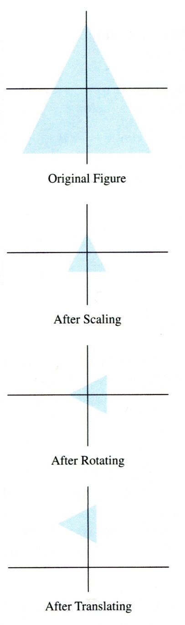
Composite Transformations
The composite of transformations corresponds to matrix multiplication when homogeneous coordinates are used
Example 6: Find the 3x3 matrix that corresponds to the composite transformation of a scaling by .3, a rotation of 90 about the origin, and finally a translation of (-.5, 2).

Slide 7
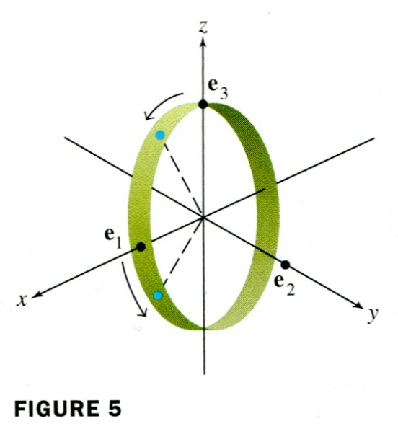
Homogeneous 3D Coordinates
In general, (X, Y, Z, H) are homogeneous coordinates for (x, y, z) if H≠0 and
x = X/H, y = Y/H, and z = Z/H.

Slide 8
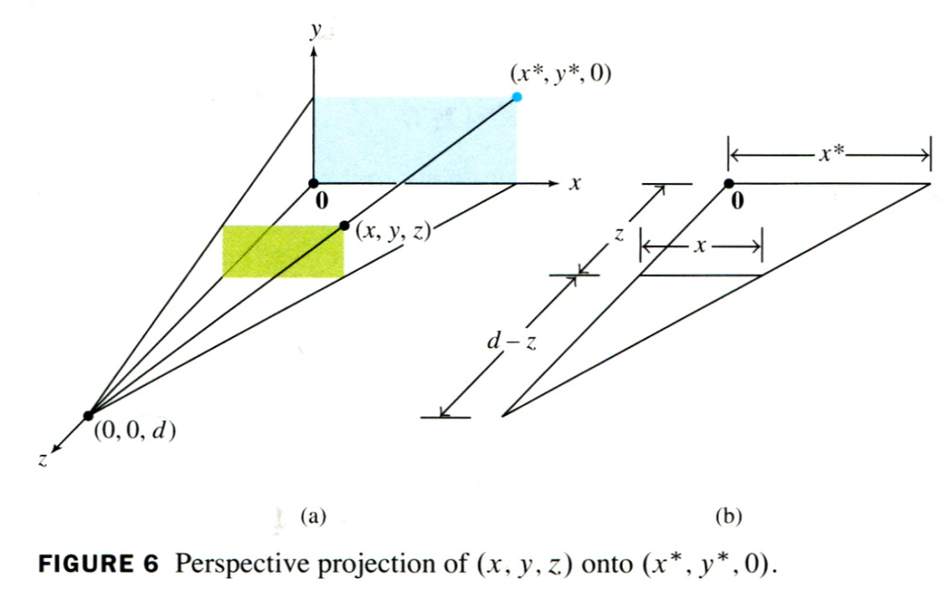
Perspective Projections
A perspective projection maps each point (x, y, z) onto an image point (x*, y*, 0) so that the two points and the eye position, called the center of projection, are on a line.

Slide 9
x*/d = x/(d-z), x* = x/(1-z/d)
y* = y / (1-z/d)
Using homogeneous coordinates, we can represent the perspective projection by a matrix P
  We want (x, y, z, 1) to map into (x, y, 0, 1-z/d)
  P=?

