Slide 1
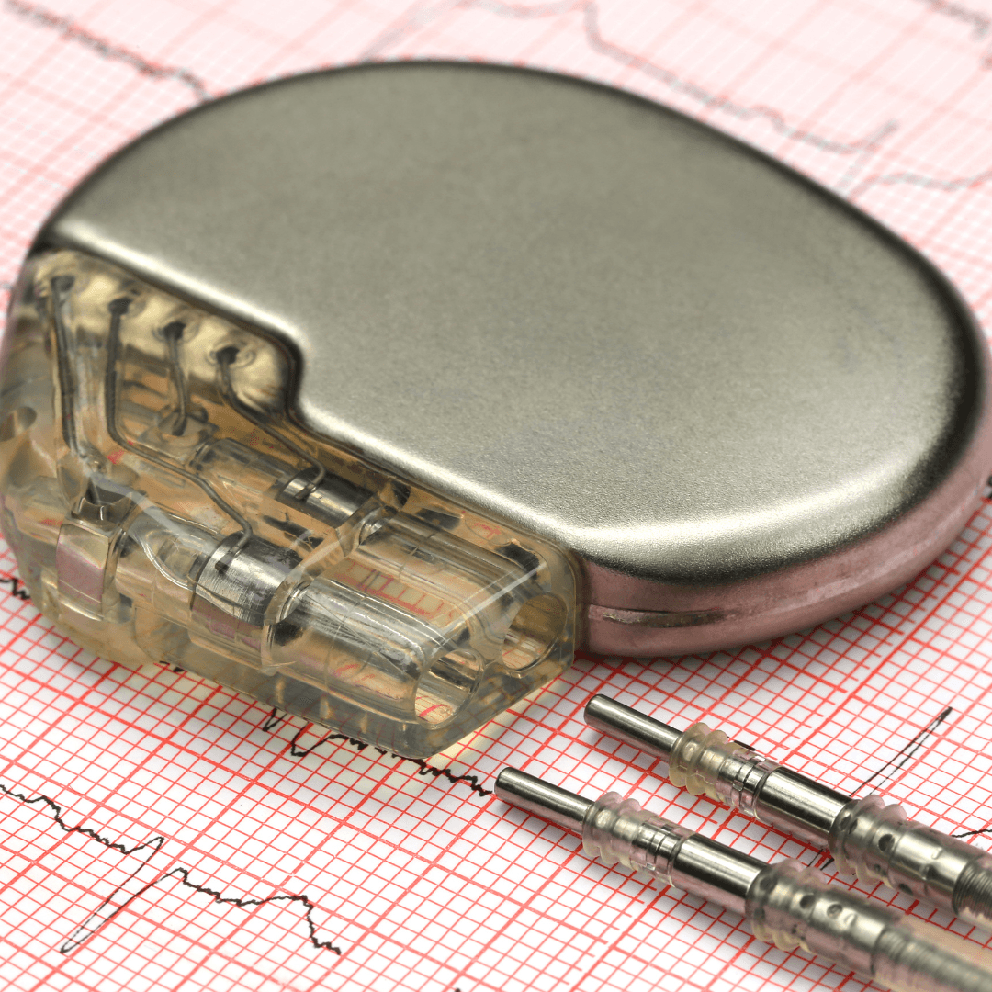
Digital Pacemaker Rhythm Generator
By: Justice Rebrovich

Slide 2
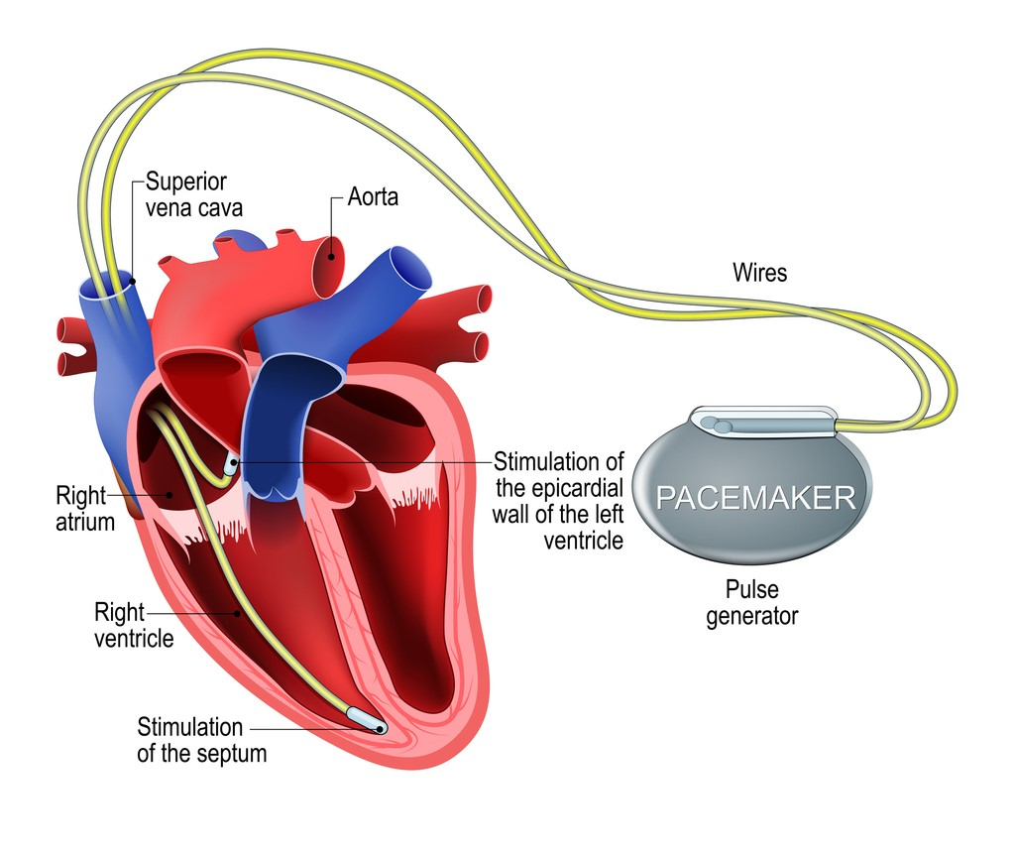
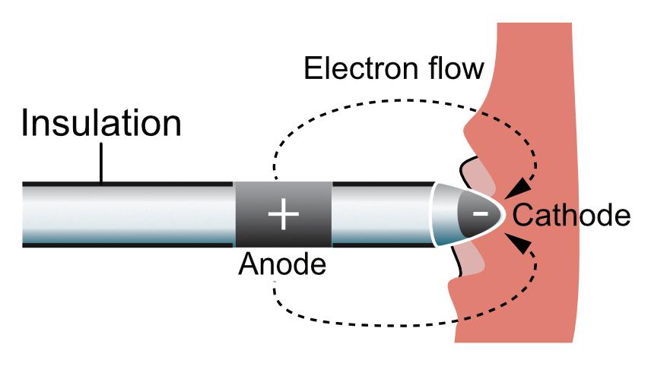
What is a Pacemaker?
It is a small medical device that helps regulate abnormal heart rhythms
Sends tiny electrical pulses(millivolts) to the heart when it beats too slowly or stops to simulate a heartbeat
Built in sensors using electrodes placed in the right atrium and ventricle

Slide 3
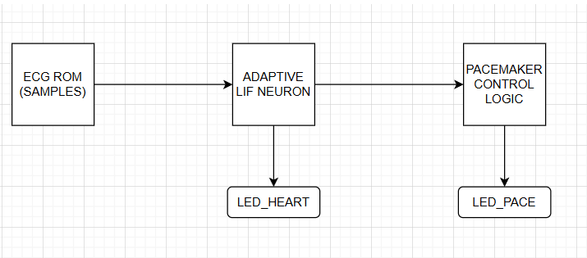
Architecture of Design
3 Stage Pipeline
ECG ROM (Electrocardiogram Read Only Memory)
Mimic a heartbeat for simulation
Flatline value (2048)
Beat spike (4095)
LIF (Leaky Integrate and Fire Neuron)
Heartbeat Detector
Detects input samples over time
Ignores noise
Outputs a spike(1) if fire threshold is crossed
Pacemaker Control Logic
Decision maker
Starts a timer after each spike, if timer exceeds threshold (>1000ms for 60 bpm) it fires a pulse
Uses blanking and refractory periods to avoid false spikes.

Slide 4
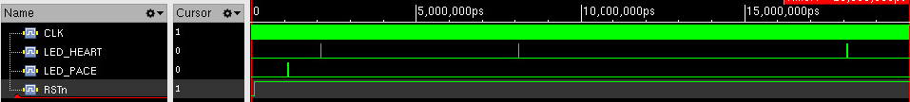
Output Waveforms
Output waveform when heart stops beating for a longer time (Pace triggers during bradycardia)
Output wave form when beat is normal

Slide 5
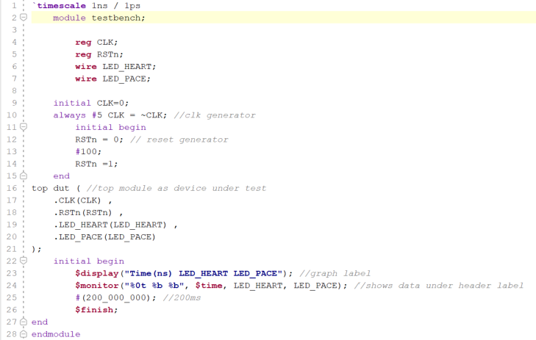
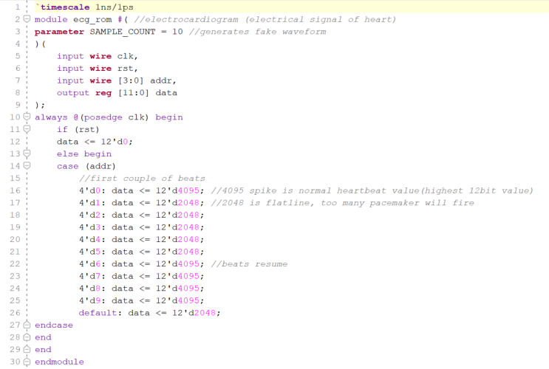
Key Code Blocks
Testbench
Create a 100MHz CLK
Applies Reset for 100ns
Instantiates the top model (device under test)
Prints LED outputs
Stops sim after 200ms
Address assigning for heartbeat simulation

Slide 6
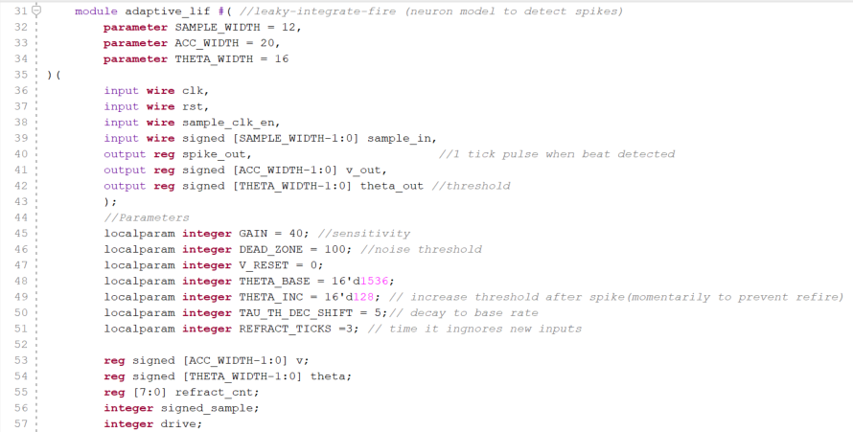
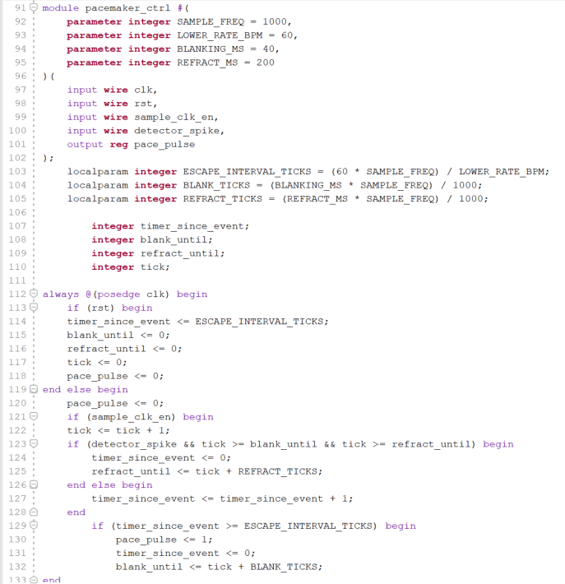
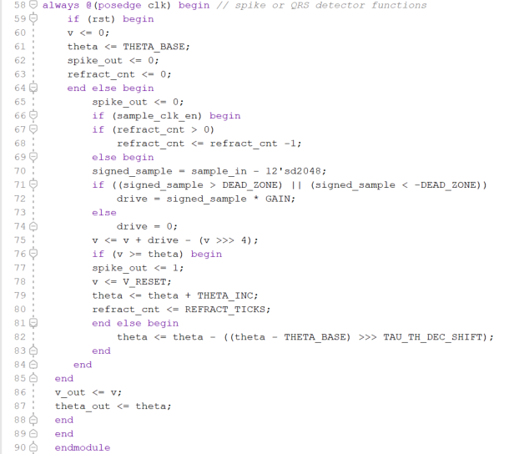
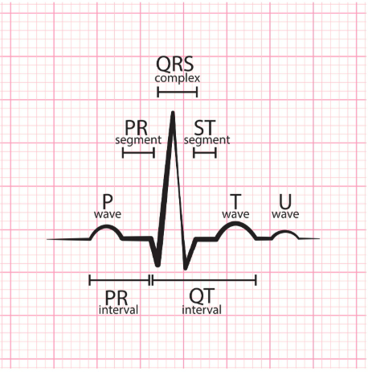
Adaptive LIF Function & Parameters
Timing Control
QRS (Q, R, S Wave) Detector
Uses Blanking and Refractory Period
After a beat, the heart follows up with a T-wave or other noise
Blocks them from being treated as new beats and resetting clock

