Slide 1
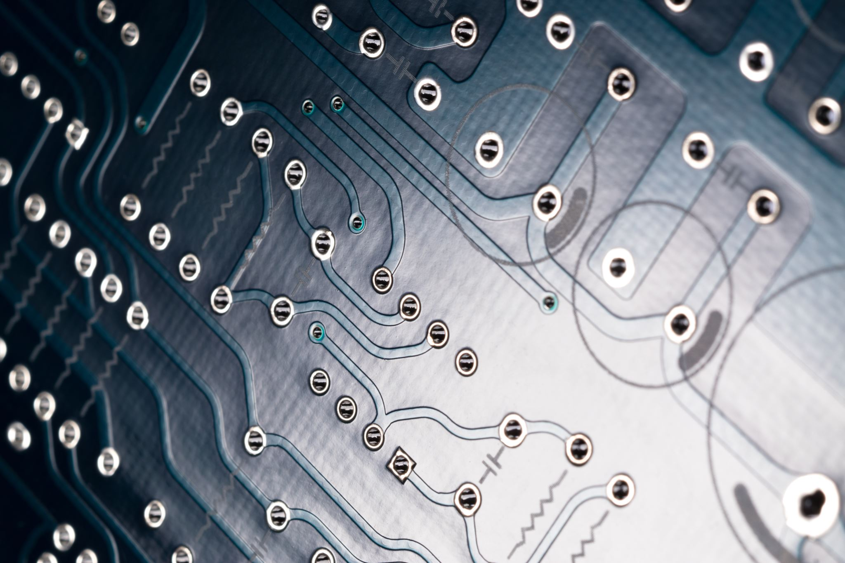
EMBEDDED SYSTEMS
FPGA Based Digital
Pacemaker
Embedded System Design
Justice Rebrovich & Tyler Olsen
Nexys A7-100T · Verilog · PCB Integration · ~70 BPM Output

Slide 2
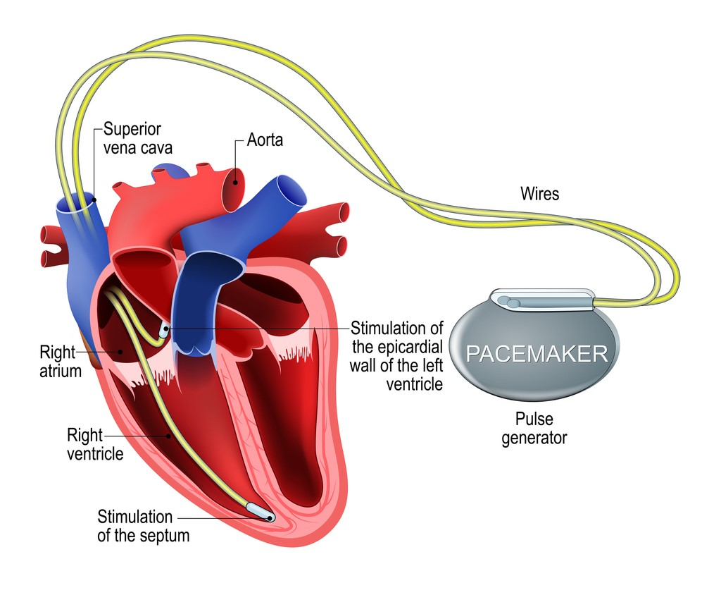
WHAT IS A PACEMAKER?
🫀
Medical Device
Regulates abnormal heart rhythms like Bradycardia — when the heart beats too slowly.
⚡
Electrical Pulses
Sends tiny millivolt pulses to the heart when it beats too slowly or stops, stimulating a heartbeat.
📡
Built-in Sensors
Electrodes placed in the right atrium and ventricle sense and respond to the heart's natural rhythm.

Slide 3
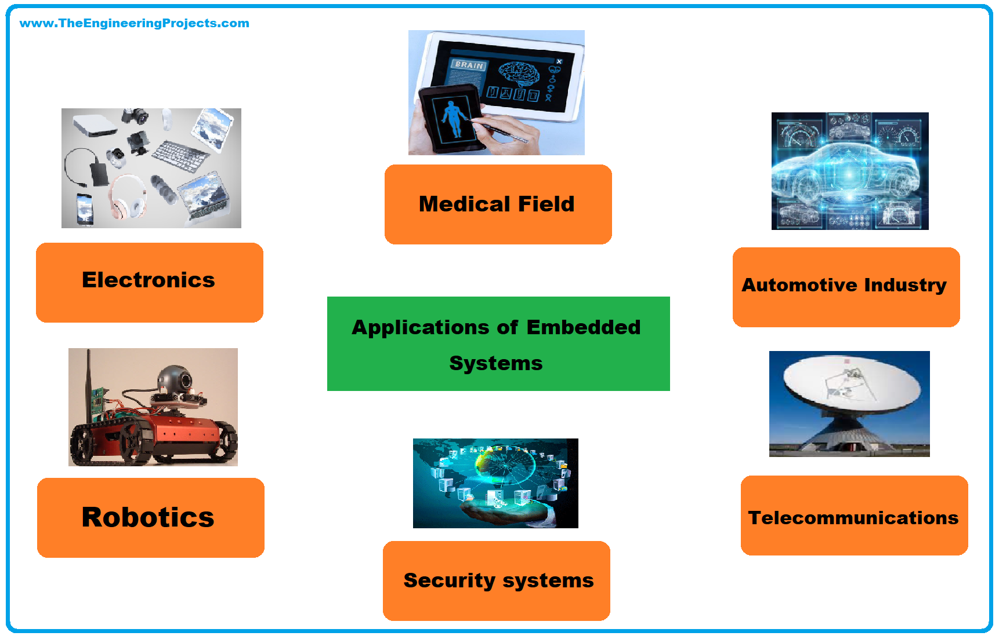
WHAT MAKES THIS AN EMBEDDED SYSTEM?
🖥️
⏱️
Not a general-purpose computer
Real-time constraints
🔌
📥
Interfaces directly with physical hardware
Responds to external inputs
⚙️
🔄
Processing in hardware, not software
Operates continuously without interruption
The FPGA acts as the embedded processor — all logic synthesized directly to hardware gates, not software instructions.
Dedicated Function
Real-Time Operation
Hardware I/O
Continuous Operation

Slide 4
COMPARED TO A REAL PACEMAKER
⚕ Real Pacemaker (ASIC)
🔬 Our FPGA Simulation
—
Run by Application Specific Integrated Circuits (ASIC)
✓
Simulates core pacing logic — not a replacement
—
Extremely miniaturized — fits inside the body
✓
Replicates sensing, detection & pacing in real time
—
Battery powered for years untouched
✓
Reprogrammable instantly — ideal for research & education
—
FDA approved & clinically validated
✓
No real heart needed — safe testing environment
—
Costs tens of thousands of dollars
✓
Costs tens of dollars
—
Fixed design — cannot be reprogrammed
✓
Vivado ILA allows live signal observation & modification

Slide 5
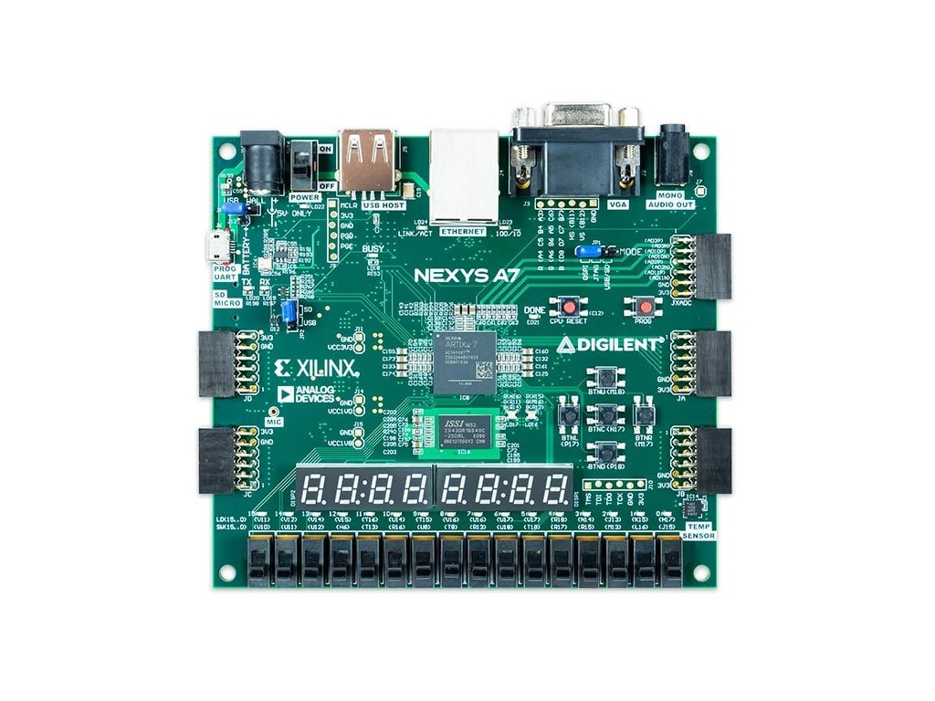
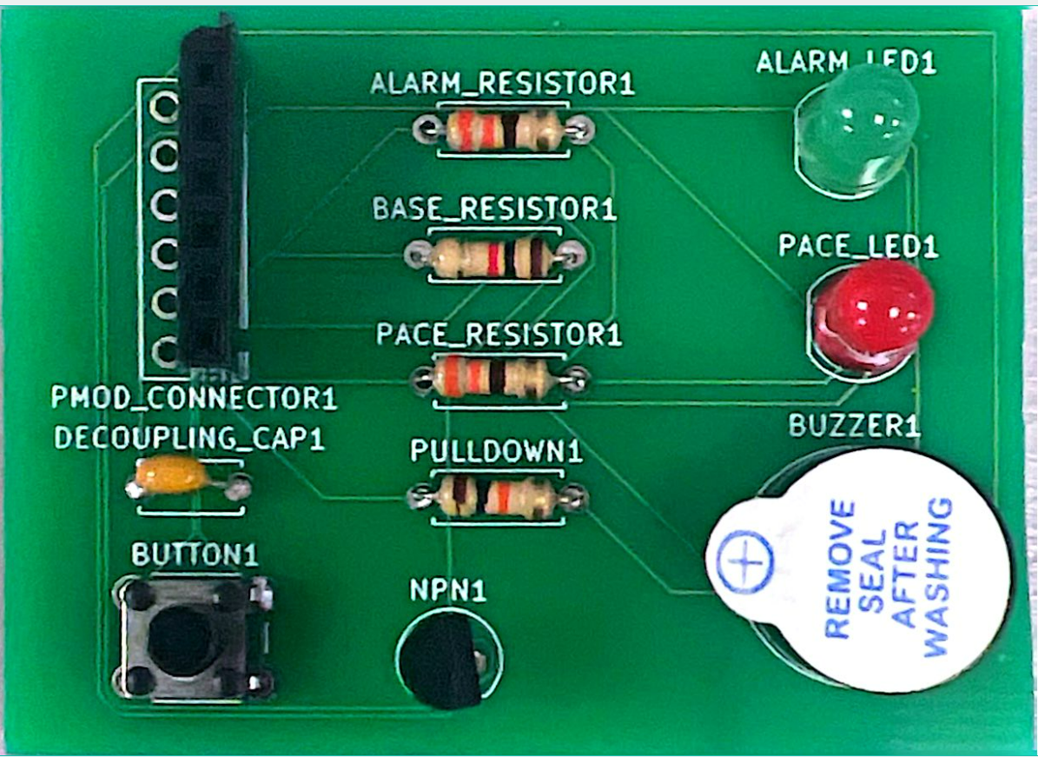
WHY WE CHOSE THE FPGA BOARD
⏱️
🎯
Time Precision
Deterministic Behavior
100 MHz clock = 10 ns resolution. Every heartbeat fires at the exact cycle.
No OS jitter. Hardware logic always executes in the same number of cycles.
💻
📡
Hardware vs Software
Real-Time I/O
Verilog runs on silicon — no software stack between decision and output.
PMOD pins drive LEDs and buzzer with zero latency from the FPGA.
📈
🔗
Scalability
Easy Interfacing
Add BPM detection, ECG sensing, or rate adaptation by reprogramming.
PMOD JA connector bridges FPGA directly to our custom PCB.

Slide 6
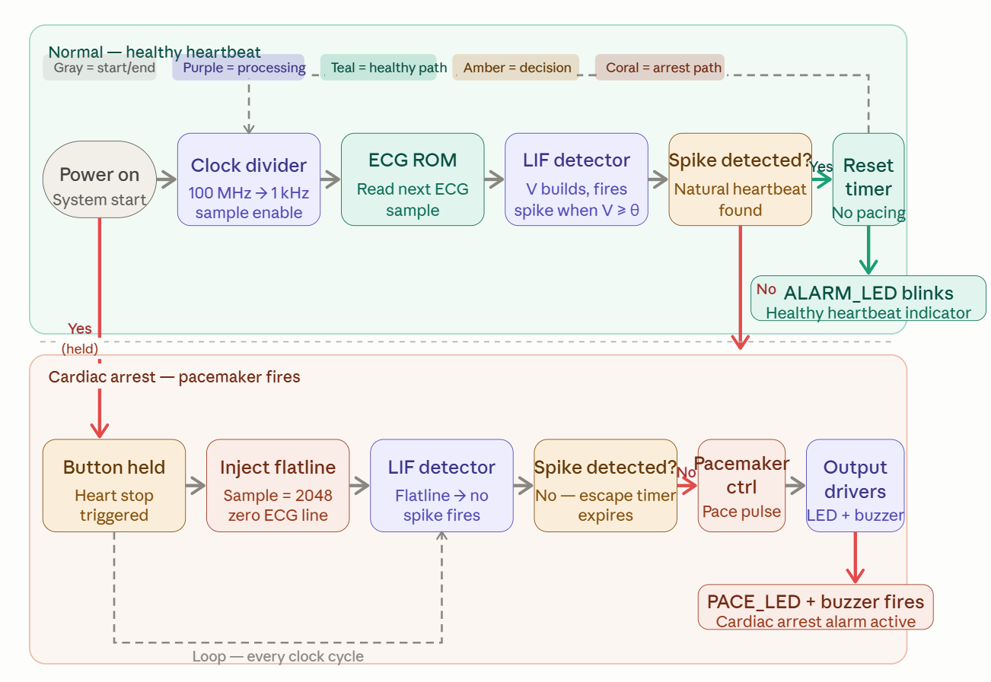
PACEMAKER LOGIC FLOWCHART
↑ Loops every clock cycle (10 ns @ 100 MHz)

Slide 7
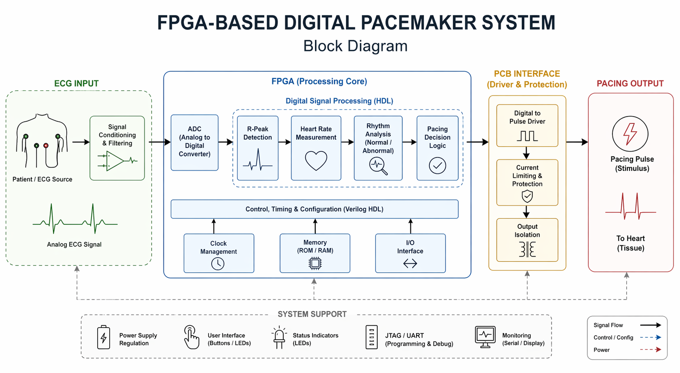
SYSTEM BLOCK DIAGRAM

Slide 8
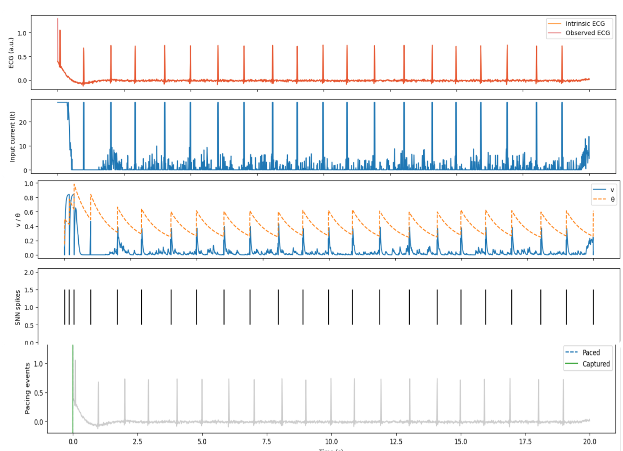
WAVEFORM RESULTS
ECG Sample Input
1
Input Current i(t)
2
Membrane Voltage vs Threshold
3
SNN Spikes
4
Refractory & Blanking Periods
5

Slide 9
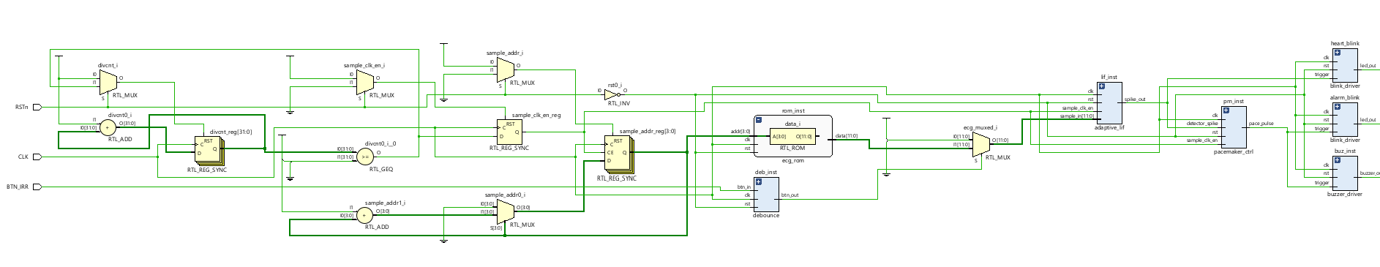
IMPLEMENTED DESIGN SCHEMATIC
Pacemaker Control
Drivers on PCB
Registers
MUX's
Adders
Vivado RTL schematic — synthesized Verilog mapped to Artix-7 silicon primitives (MUX, REG, ADD, ROM)

Slide 10
Questions?
✔
FPGA implements pacemaker logic in hardware — true embedded system
✔
27-bit counter drives ~70 BPM heartbeat with precise 10% duty pulse
✔
PWM at 90% duty cycle controls buzzer volume synced to heartbeat
✔
PMOD JA (C17/D18/E18) bridges FPGA to physical PCB peripherals
♥
✔
Vivado ILA provides live waveform capture for verification
✔
Justice Rebrovich & Tyler Olsen

