Slide 1

JUNIOR DESIGN — PCB DESIGN
FPGA Based Digital
Pacemaker
PCB Design & Hardware Integration
Justice Rebrovich & Tyler Olsen
KiCad · PCB Layout · PMOD Interface · Nexys A7-100T

Slide 2
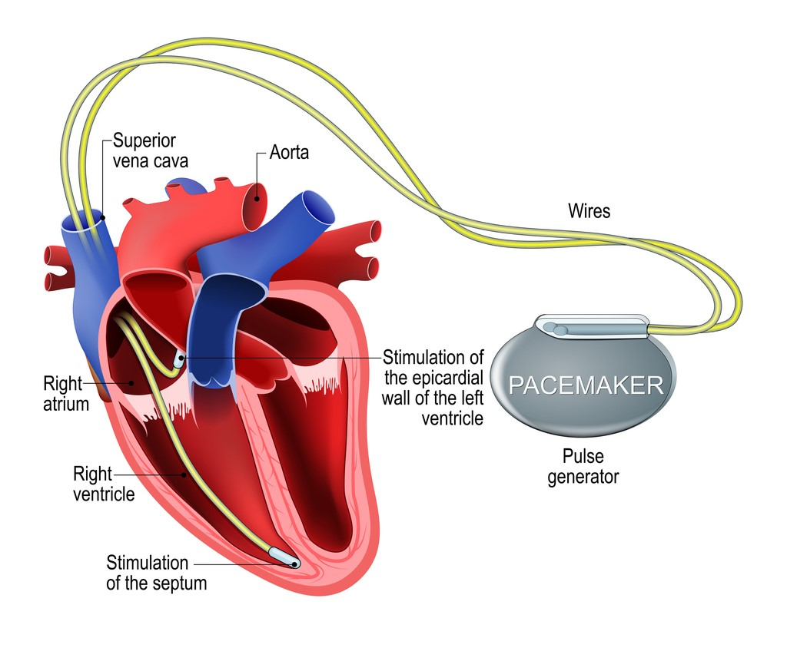
PROJECT OVERVIEW
🎯
Project Goal
Design and fabricate a custom PCB that interfaces with an FPGA to simulate pacemaker output — visible LEDs and audible buzzer.
🔌
Interface
PCB connects to the Nexys A7-100T via a standard PMOD connector. All signals routed through a 12-pin header.
🛠️
Tools Used
KiCad for schematic capture and PCB layout. Gerber files sent for physical fabrication.
⚡
Power
3.3V sourced directly from the FPGA PMOD VCC rail. No external power supply required.

Slide 3
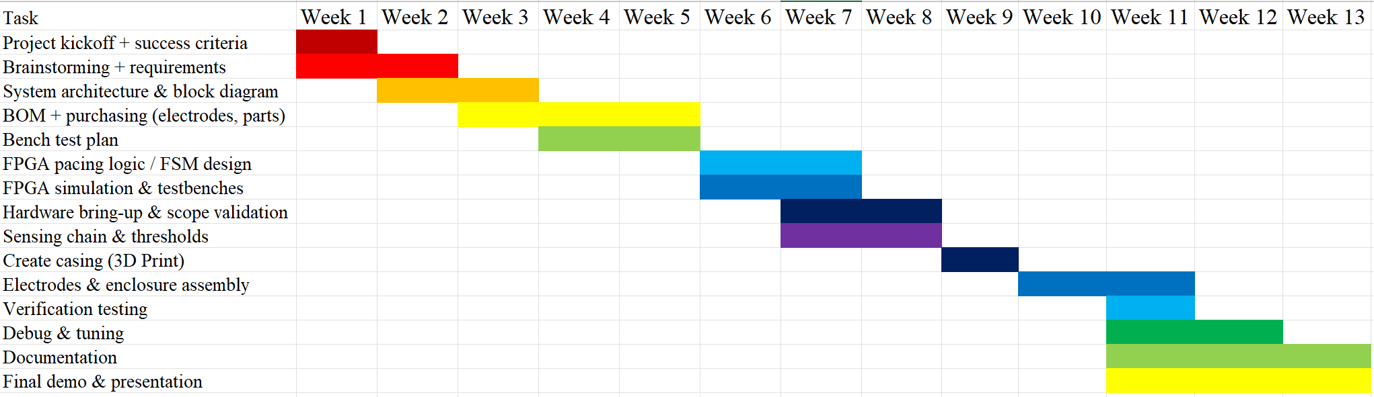
Gantt Chart

Slide 4
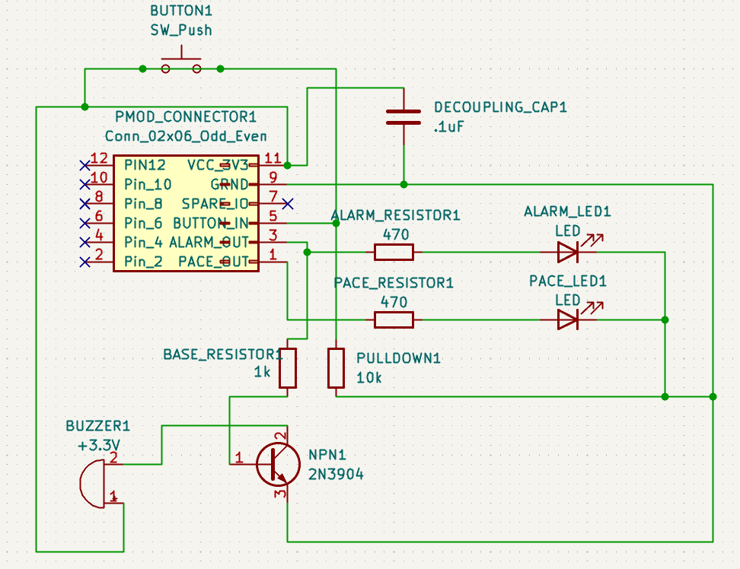
KICAD SCHEMATIC
Component list
PMOD_CONNECTOR1
Conn_D2x06_Odd_Even
12-pin FPGA interface
BUTTON1
SW_Push
Cardiac arrest trigger
ALARM_LED1
LED (green)
Healthy heartbeat indicator
PACE_LED1
LED (red)
Pacemaker firing indicator
ALARM_RESISTOR1
470 Ω
ALARM_LED current limit
PACE_RESISTOR1
470 Ω
PACE_LED current limit
BASE_RESISTOR1
1 kΩ
NPN transistor base drive
PULLDOWN1
10 kΩ
Button input pulldown
NPN1
2N3904
Buzzer drive transistor
BUZZER1
+3.3V passive
Cardiac arrest alarm
DECOUPLING_CAP1
0.1 µF
VCC noise decoupling

Slide 5
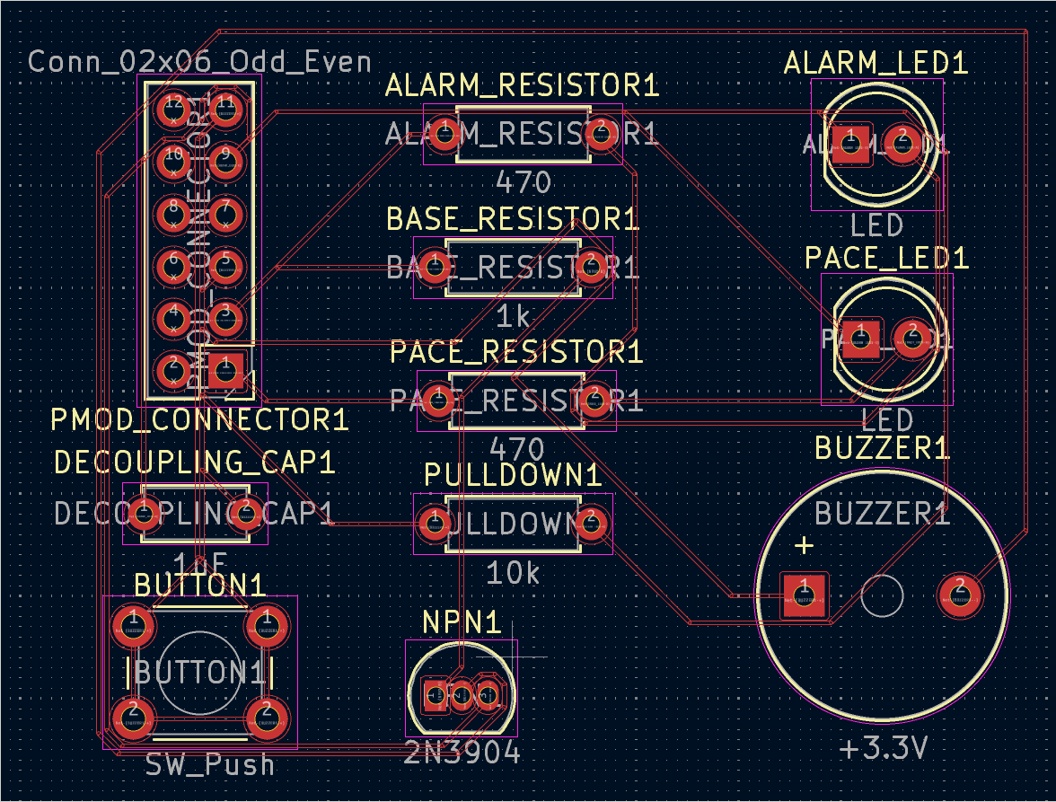
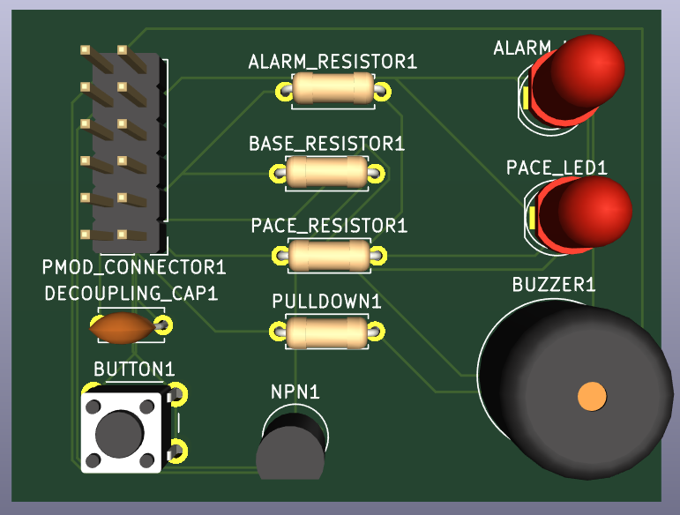
PCB LAYOUT & FABRICATED BOARD
Schematic from slide 3 routed in KiCad and fabricated as a 2-layer PMOD-compatible PCB
PCB LAYOUT
FABRICATED BOARD
KiCad top-copper view — components routed for short signal traces
Assembled board with PMOD header, LEDs, buzzer, NPN switch, and tactile button

Slide 6
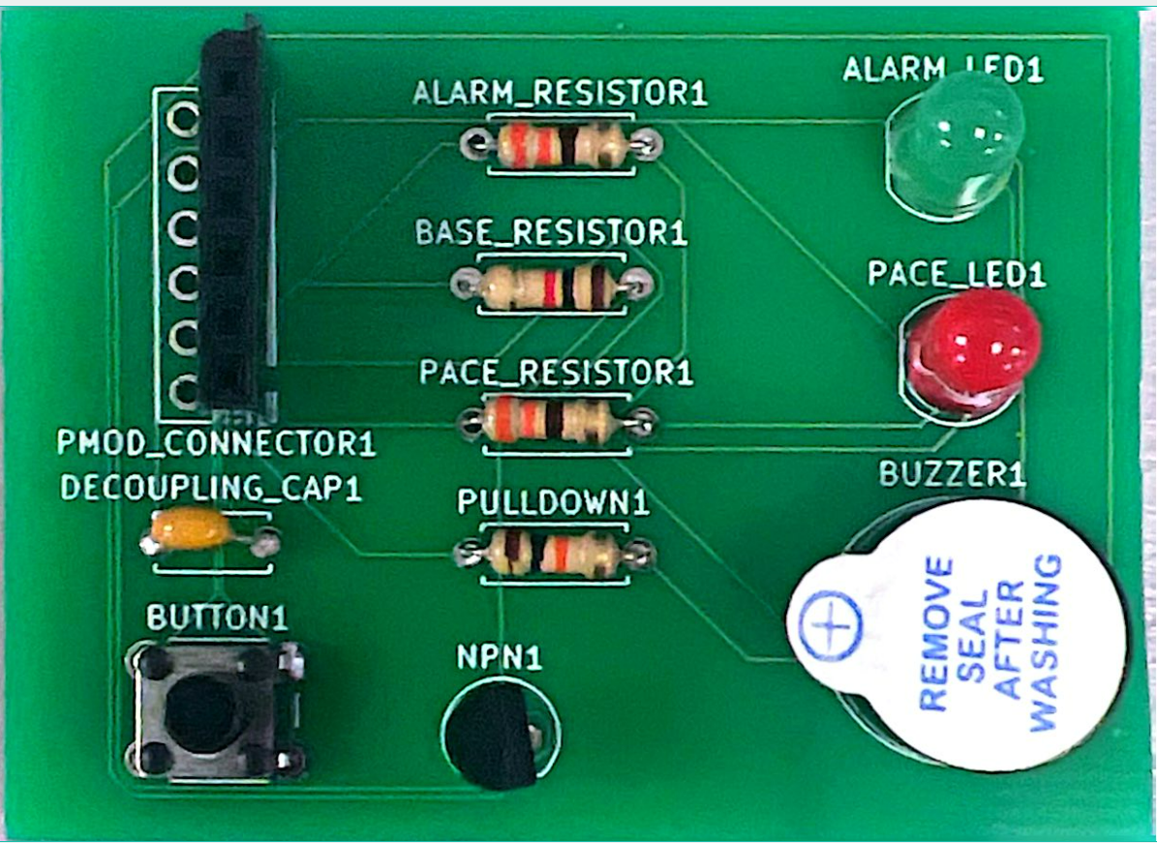
PCB LAYOUT & FABRICATED BOARD
PMOD_CONNECTOR1
12-pin FPGA interface
ALARM_LED1
Green — healthy heartbeat
PACE_LED1
Red — pacemaker firing
BUZZER1
Passive +3.3V buzzer
NPN1 (2N3904)
Buzzer drive transistor
BUTTON1
Cardiac arrest trigger
Resistors & Cap
470Ω, 1kΩ, 10kΩ, 0.1µF

Slide 7
CIRCUIT DESIGN BREAKDOWN
💡 LED Drive Circuit
🔊 Buzzer Drive Circuit
PACE_LED1 (red) — pacemaker firing
Passive +3.3 V buzzer, ~100 Ω → ~33 mA collector current
ALARM_LED1 (green) — healthy heartbeat
2N3904 NPN as low-side switch (GPIO can't source 33 mA)
470 Ω series resistor on each LED
1 kΩ base resistor: Rb = (3.3 − 0.7) ÷ 0.003 = 867 Ω → 1 kΩ
Sized from R = (3.3 − 2.0) ÷ 0.005 = 260 Ω → 470 Ω std
hFE ≥ 100 → Ib ≈ 0.33 mA needed; design supplies ~3 mA
Actual drive current ≈ 2.8 mA, well within GPIO limits
Transistor saturates: Vce(sat) ≈ 0.2 V
🔘 Button Input Circuit
⚡ Power & Decoupling
SW_Push momentary switch with 10 kΩ pulldown to GND
All power from PMOD VCC_3V3 (pin 11); GND on pins 5/9/11
Idle: pin LOW (1 µA leakage × 10 kΩ = 10 mV ≈ 0 V) ✓
0.1 µF (100 nF) ceramic decoupling cap on VCC rail
Pressed: pin pulled HIGH via VCC_3V3 → logic HIGH ✓
Placed as close as possible to PMOD VCC pin
10 kΩ chosen: clean logic levels, low static current draw
Filters FPGA switching transients above ~159 kHz
Routes through PMOD to FPGA pin E18 — simulates arrest
Prevents noise coupling back into the PCB

Slide 8
PCB DESIGN DECISIONS
Why 470 Ω for LED resistors?
Why a 2N3904 NPN for the buzzer?
Limits current to ~2.8 mA — safely below the 8 mA FPGA GPIO source limit. Keeps LEDs bright enough to see while protecting the FPGA output driver.
The FPGA GPIO cannot source the 30+ mA the buzzer needs. The 2N3904 acts as a switch — a small base current (~3 mA) controls the full buzzer current from VCC.
Why a 10 kΩ pulldown on the button?
Why a 0.1 µF decoupling capacitor?
Prevents the FPGA input from floating when the button is open. The high resistance minimises dormant current draw, important in a low-power medical simulation context.
FPGA switching activity creates fast transients on the VCC rail. A 0.1 µF ceramic cap placed close to the PMOD connector suppresses these before they affect PCB operation.
Why passive components through-hole?
Why route PMOD GND separately?
Through-hole components are easier to hand-solder for a prototype PCB. They also allow easy component swapping during testing without rework stations.
Using dedicated PMOD GND pins (5, 9) rather than a single point prevents ground loops and reduces noise coupling between digital signals and the buzzer drive circuit.

Slide 9
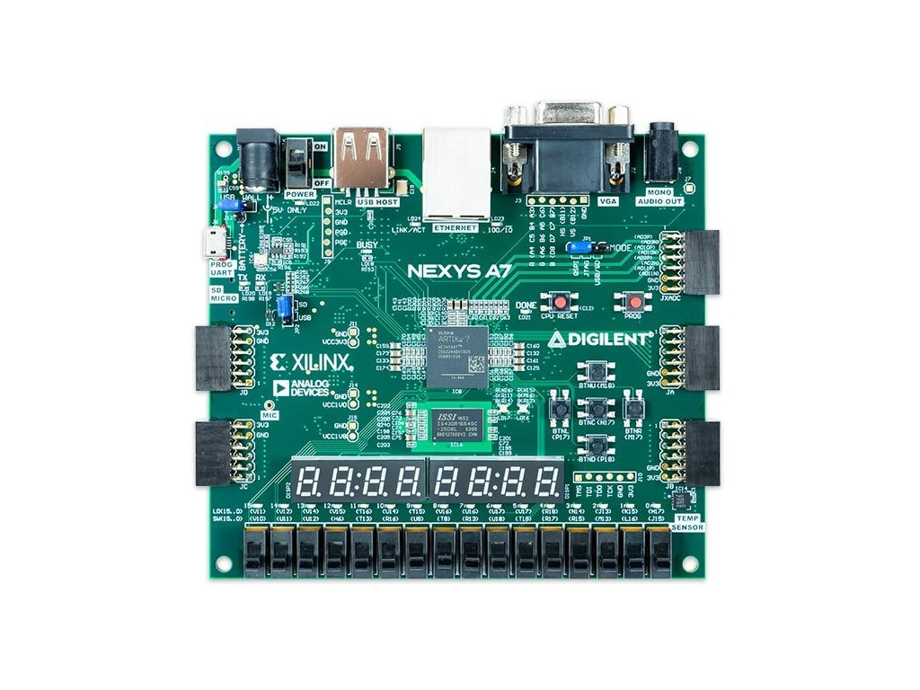
PMOD INTERFACE & PIN MAPPING
PMOD Connector (Conn_D2x06_Odd_Even)
Top row (signal pins)
Pin 1
Pin 2
Pin 3
Pin 4
PACE_OUT
ALARM_OUT
BTN_IN
SPARE
C17
D18
E18
—
Bottom row (power pins)
Pin 5
Pin 6
Pin 7
Pin 8
GND
VCC 3.3V
GND
VCC 3.3V
Physical wiring summary
FPGA PMOD JA → PCB PMOD header (plug directly)
Pin 1 (C17) PACE_OUT → 470Ω → PACE_LED1
PMOD JA — top row (left → right)
Pin 2 (D18) ALARM_OUT → 470Ω → ALARM_LED1
[ Pin 1 ] [ Pin 2 ] [ Pin 3 ] [ Pin 4 ] [ GND ] [ VCC ]
Pin 3 (E18) BTN_IN ← 10kΩ pulldown
[ C17 ] [ D18 ] [ E18 ] [ G17 ]
Pin 5 GND shared with PCB GND plane
Pin 6 VCC_3V3 → decoupling cap → rails
Plug PCB PMOD connector directly into JA — pin 1 to pin 1

Slide 10
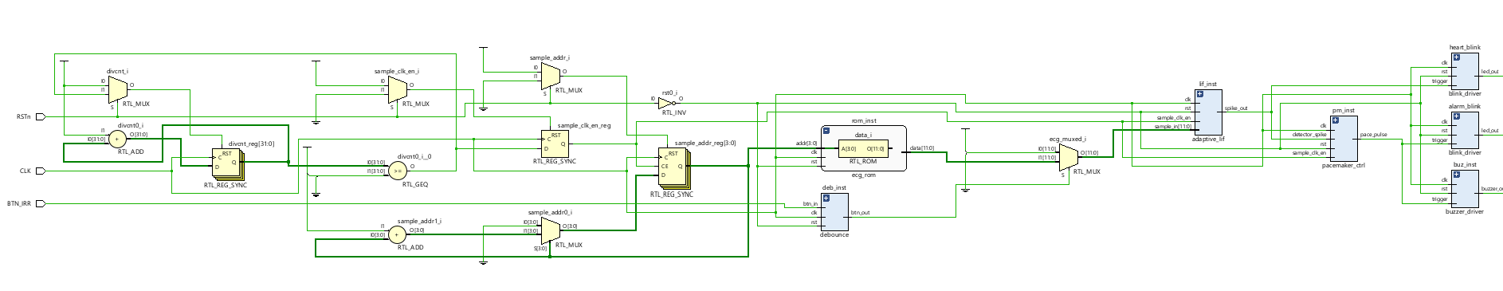
VIVADO RTL SCHEMATIC — FPGA SIDE
Pacemaker control
PCB output drivers
Registers
MUX's
Adders
The FPGA logic synthesized to these hardware primitives — all signals ultimately route through the PMOD pins to the PCB.
FPGA logic
→ PMOD JA pins (C17 / D18 / E18)
→ PCB traces
→ LEDs / buzzer

Slide 11
SYSTEM DEMO & RESULTS
Custom PCB — fabricated board
Nexys A7-100T — FPGA platform
✔ ALARM_LED blinks
✔ PACE_LED fires
✔ Buzzer sounds
✔ PMOD interface
~70 BPM — healthy heartbeat mode
On button hold — pacemaker mode
Synced to PACE_LED — audible alarm
Clean signals — no cross-talk

Slide 12
Questions?
✔
Custom PCB designed in KiCad — schematic, layout, Gerbers
✔
PMOD connector interfaces PCB directly to Nexys A7 JA header
✔
470 Ω resistors limit LED current to 2.8 mA — FPGA safe
✔
2N3904 NPN transistor drives buzzer — FPGA cannot source directly
♥
✔
10 kΩ pulldown ensures clean logic LOW on button input
✔
0.1 µF decoupling cap filters VCC switching noise from FPGA
★
Justice Rebrovich & Tyler Olsen

