Slide 1
1-Bit ALU Design:
ASIC Project
Created by: Brett & Justice

Slide 2
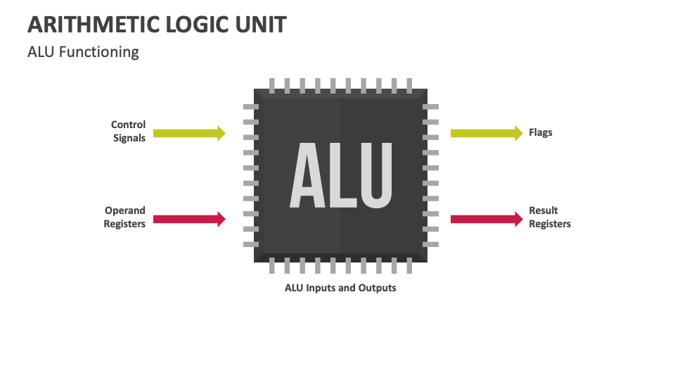
What is an ALU & How Does It Work?
What is an ALU?
The block inside a CPU that does math and logic.
Math: ADD, SUB
Logic: AND, OR, XOR
Compare & shift
Almost every instruction runs through it — its speed sets the CPU's clock.
How does it work?
Take 2 inputs + 1 control code → get 1 result, in one clock cycle.
A, B — the two operands
Op — which operation to run
Result — the answer
We design 1 bit-slice; stack N copies for an N-bit ALU.
Notes:
TIPS:
Check out the Layout Dropdown for more layout design options
It’s recommended not going below 24-point font size for presentations
If your text overflows a placement text box it’s recommended to edit/delete down text content instead of increasing size of text box to accommodate more text
Guides for textboxes are available under View tab > check Guides checkbox

Slide 3
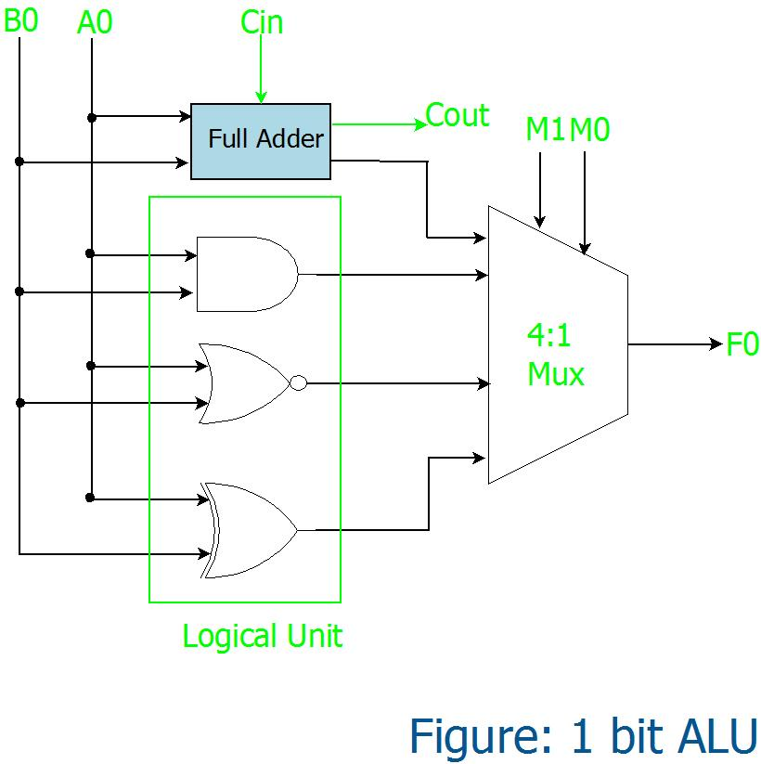
Architecture
Operations (S1 S0)
00 → ADD (A + B + Cin)
01 → AND (A · B)
10 → OR (A + B)
11 → XOR (A ⊕ B)
Gate inventory
4× NAND3 · 1× NOR4 · 7× INV
3× 2:1 MUX · 1× Full Adder
2µm CMOS · VDD = 5 V · IDn = IDp = 1386.8 µA · single metal
Notes:
TIPS:
Check out the Layout Dropdown for more layout design options
It’s recommended not going below 24-point font size for presentations
If your text overflows a placement text box it’s recommended to edit/delete down text content instead of increasing size of text box to accommodate more text
Guides for textboxes are available under View tab > check Guides checkbox

Slide 4
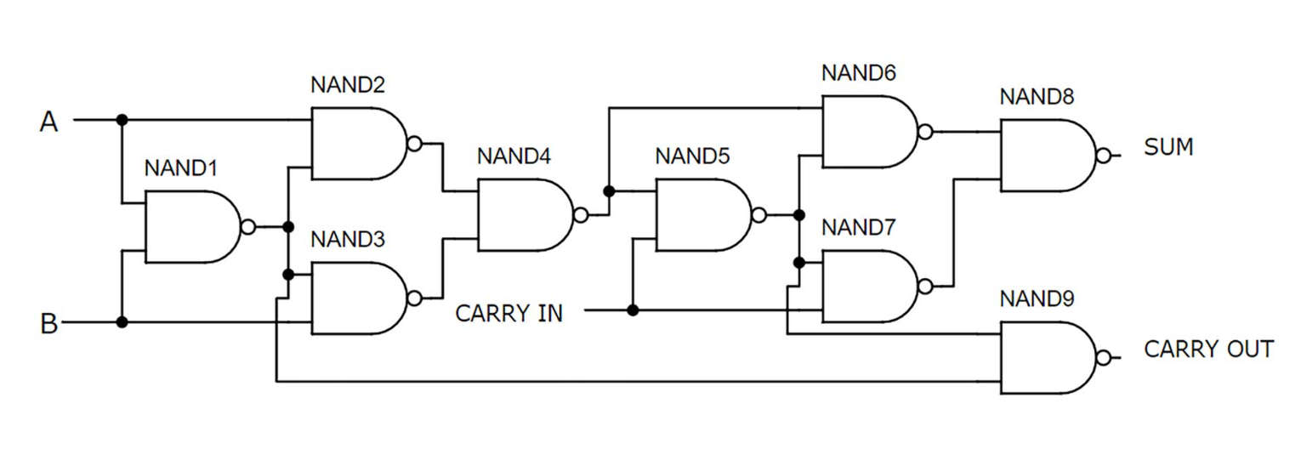
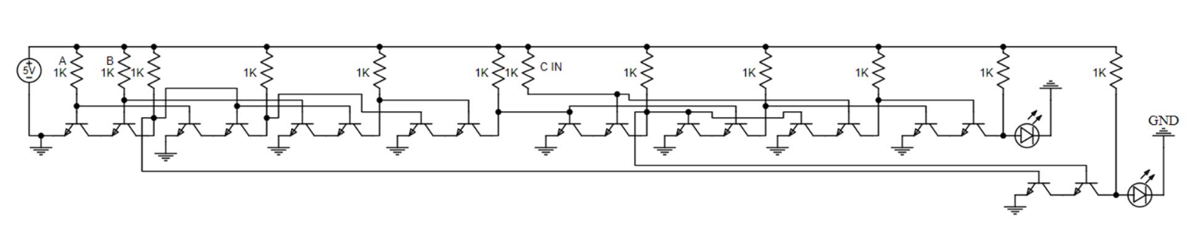
1-Bit Full Adder
What it does
Adds two bits A, B with a carry-in Cin → Sum and Carry-out (Cout).
Logic equations
Sum = A ⊕ B ⊕ Cin
Cout = AB + Cin(A ⊕ B)
At the transistors
Two CMOS XOR gates produce Sum.
An AOI (AND-OR-Invert) network forms Cout in one stage — fewer transistors than discrete gates.
PMOS pull-up to V_DD on top, NMOS pull-down to GND on bottom — exactly one path conducts at a time.
Logic-level: gate diagram of the full adder
Transistor-level: CMOS implementation
Notes:
TIPS:
Check out the Layout Dropdown for more layout design options
It’s recommended not going below 24-point font size for presentations
If your text overflows a placement text box it’s recommended to edit/delete down text content instead of increasing size of text box to accommodate more text
Guides for textboxes are available under View tab > check Guides checkbox

Slide 5
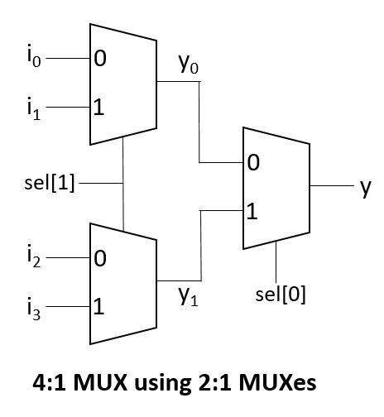
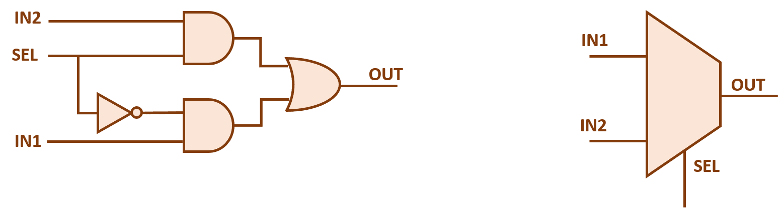
4-to-1 Multiplexer
What it does
Selects between two inputs A and B based on a select line S — the ALU uses it to pick which operation's result drives the output.
Logic equation
Y = S·B + S̄·A (when S=0 → Y=A, when S=1 → Y=B)
How to read the schematic
Built from two transmission gates — each is an NMOS+PMOS pair that opens or closes a path.
S and S̄ drive the gates so exactly one path (A or B) is connected to Y.
Transmission-gate style passes a full rail-to-rail signal — no logic-level degradation.
Notes:
TIPS:
Check out the Layout Dropdown for more layout design options
It’s recommended not going below 24-point font size for presentations
If your text overflows a placement text box it’s recommended to edit/delete down text content instead of increasing size of text box to accommodate more text
Guides for textboxes are available under View tab > check Guides checkbox

Slide 6
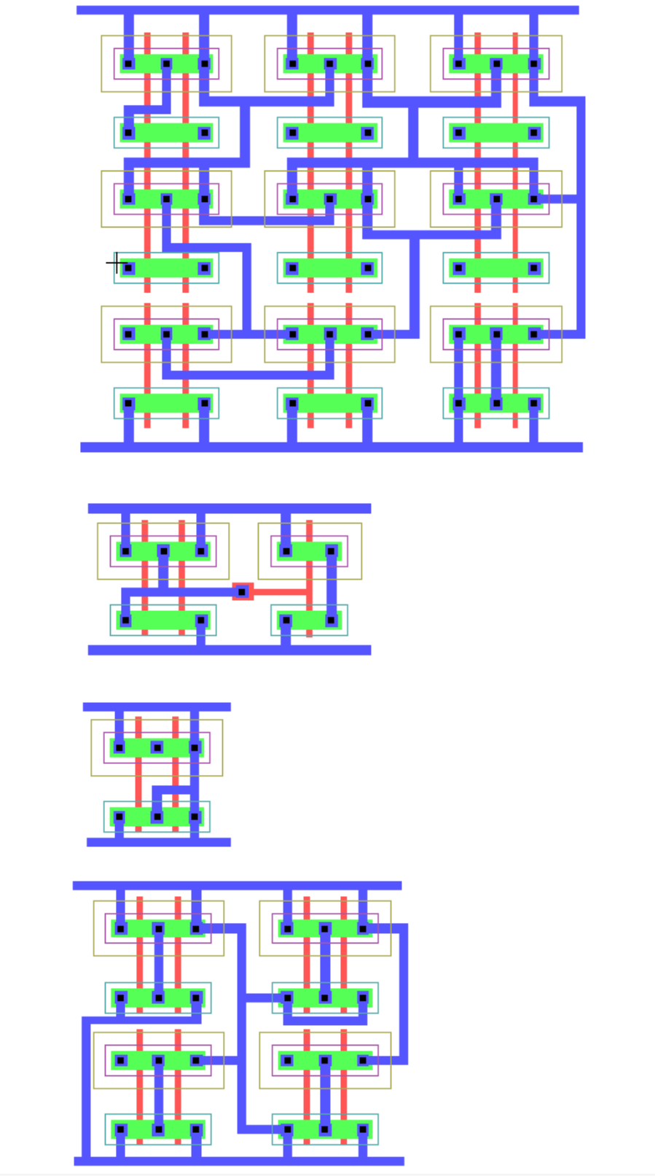
L-Edit Layout
Color Key
■ Metal1 ■ Poly ■ Active
■ N-Well ■ N-Sel ■ P-Sel
Cells Laid Out
Full Adder — outputs Sum & Cout
AND — NAND + inverter
NOR — series PMOS, parallel NMOS
XOR — from NAND/NOR; used 2× in Sum
PMOS & NMOS: W=6µm, L=2µm • DRC-clean

Slide 7
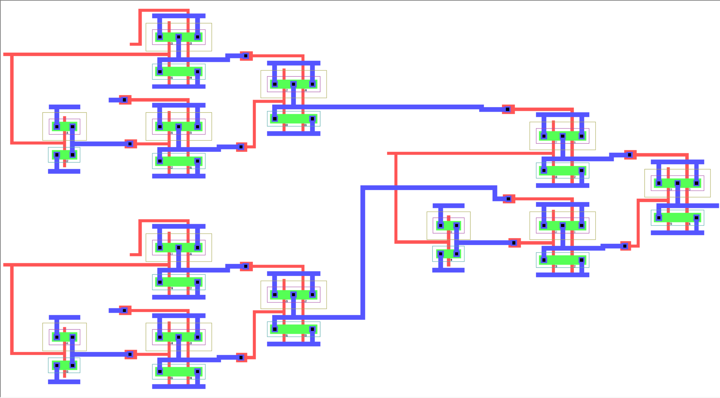
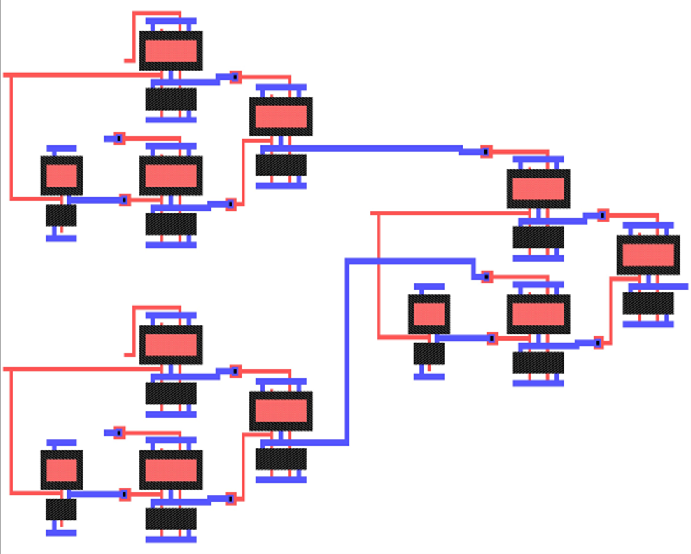
Parasitic Extraction & Capacitances
Subcircuits Built
AND: NAND2 + INV · OR: 2× INV + NAND2 + INV
XOR: 4× NAND2 · MUX21: INV + 2× NAND2
FULL_ADDER: 2× XOR + AND + OR
Extracted Capacitances & Significance
MUX avg node 24.07 fF · AND/NOR avg 40.72 fF
Full Adder max 364.3 fF — 17× ideal (21.6 fF)
Range: 6.54 fF (min) → 364.3 fF (max)
SUM path is most critical for ALU delay.
Extraction Process
L-Edit layout → DRC clean → parasitic extraction
Generates SPICE netlist with R/C parasitics
MOSFET LEVEL=1, VDD = 1.8 V (PMOS/NMOS: W=6µm, L=2µm)

Slide 8
LTSpice Netlist Structure
1-bit ALU — Top Level
Inputs: A, B, Cin, S0, S1 · Outputs: Result, Cout
Three cascaded 2:1 MUXes select between AND / OR / SUM
Function Selection
XAND A B AND_OUT AND_GATE
XOR1 A B OR_OUT OR_GATE
XSUM A B Cin SUM_OUT Cout FULL_ADDER
XMUX1 AND_OUT OR_OUT S0 MUX1_OUT MUX21
XMUX2 AND_OUT SUM_OUT S0 MUX2_OUT MUX21
XMUX3 MUX1_OUT MUX2_OUT S1 Result MUX21
Stimulus
PULSE sources on A, B, Cin, S0, S1 (binary counter pattern)
.tran 1n 640n · VDD = 1.8 V
Subcircuit Hierarchy
MUX21 = INV + 3× NAND2
AND_GATE = NAND2 + INV
OR_GATE = 2× INV + NAND2 + INV
XOR_GATE = 4× NAND2
FULL_ADDER = 2× XOR + 2× AND + OR
Primitives
.subckt NAND2 A B OUT
MP1/MP2 PMOS W=2u L=0.18u
MN1/MN2 NMOS W=1u L=0.18u
.subckt INV IN OUT
MP1 PMOS W=2u · MN1 NMOS W=1u
MOSFET Models
.model NMOS LEVEL=1 VT0= 0.5 KP=120µ
.model PMOS LEVEL=1 VT0=-0.5 KP= 60µ
* 1-bit ALU using three 2:1 MUX
* Inputs: A, B, Cin, S0, S1
* Outputs: Result, Cout
*-------------------------------
* Supply
*-------------------------------
VDD VDD 0 DC 1.8
VSS 0 0 DC 0
*-------------------------------
* Input sources
*-------------------------------
VA A 0 PULSE(0 1.8 0 1n 1n 20n 40n)
VB B 0 PULSE(0 1.8 0 1n 1n 40n 80n)
VCin Cin 0 PULSE(0 1.8 0 1n 1n 80n 160n)
VS0 S0 0 PULSE(0 1.8 0 1n 1n 160n 320n)
VS1 S1 0 PULSE(0 1.8 0 1n 1n 320n 640n)
*-------------------------------
* AND gate (A AND B)
*-------------------------------
XAND A B AND_OUT AND_GATE
*-------------------------------
* OR gate (A OR B)
*-------------------------------
XOR1 A B OR_OUT OR_GATE
*-------------------------------
* Full Adder
*-------------------------------
XSUM A B Cin SUM_OUT Cout FULL_ADDER
*-------------------------------
* MUX level 1
* S0=0 selects AND, S0=1 selects OR
*-------------------------------
XMUX1 AND_OUT OR_OUT S0 MUX1_OUT MUX21
*-------------------------------
* MUX level 2
* S0=0 selects AND, S0=1 selects SUM
*-------------------------------
XMUX2 AND_OUT SUM_OUT S0 MUX2_OUT MUX21
*-------------------------------
* MUX level 3 final output
* S1=0 selects MUX1, S1=1 selects MUX2
*-------------------------------
XMUX3 MUX1_OUT MUX2_OUT S1 Result MUX21
*-------------------------------
* 2:1 MUX subcircuit
* SEL=0 gives I0, SEL=1 gives I1
*-------------------------------
.subckt MUX21 I0 I1 SEL OUT
XINV_SEL SEL SELB INV
XN1 I0 SELB N1 NAND2
XN2 I1 SEL N2 NAND2
XN3 N1 N2 OUT NAND2
.ends MUX21
*-------------------------------
* AND gate subcircuit
*-------------------------------
.subckt AND_GATE A B OUT
XN1 A B N1 NAND2
XINV N1 OUT INV
.ends AND_GATE
*-------------------------------
* OR gate subcircuit
*-------------------------------
.subckt OR_GATE A B OUT
XINV_A A ABAR INV
XINV_B B BBAR INV
XN1 ABAR BBAR N1 NAND2
XINV_OUT N1 OUT INV
.ends OR_GATE
*-------------------------------
* Full Adder subcircuit
*-------------------------------
.subckt FULL_ADDER A B Cin SUM Cout
XXOR1 A B XAB XOR_GATE
XXOR2 XAB Cin SUM XOR_GATE
XAND1 A B AB AND_GATE
XAND2 Cin XAB CinXAB AND_GATE
XOR1 AB CinXAB Cout OR_GATE
.ends FULL_ADDER
*-------------------------------
* XOR gate subcircuit
*-------------------------------
.subckt XOR_GATE A B OUT
XN1 A B N1 NAND2
XN2 A N1 N2 NAND2
XN3 B N1 N3 NAND2
XN4 N2 N3 OUT NAND2
.ends XOR_GATE
*-------------------------------
* NAND2 subcircuit
*-------------------------------
.subckt NAND2 A B OUT
MP1 OUT A VDD VDD PMOS W=2u L=0.18u
MP2 OUT B VDD VDD PMOS W=2u L=0.18u
MN1 OUT A MID 0 NMOS W=1u L=0.18u
MN2 MID B 0 0 NMOS W=1u L=0.18u
.ends NAND2
*-------------------------------
* INV subcircuit
*-------------------------------
.subckt INV IN OUT
MP1 OUT IN VDD VDD PMOS W=2u L=0.18u
MN1 OUT IN 0 0 NMOS W=1u L=0.18u
.ends INV
*-------------------------------
* MOSFET models
*-------------------------------
.model NMOS NMOS LEVEL=1 VT0=0.5 KP=120u LAMBDA=0.01
.model PMOS PMOS LEVEL=1 VT0=-0.5 KP=60u LAMBDA=0.01
*-------------------------------
* Simulation command
*-------------------------------
.tran 1n 640n
.end

Slide 9
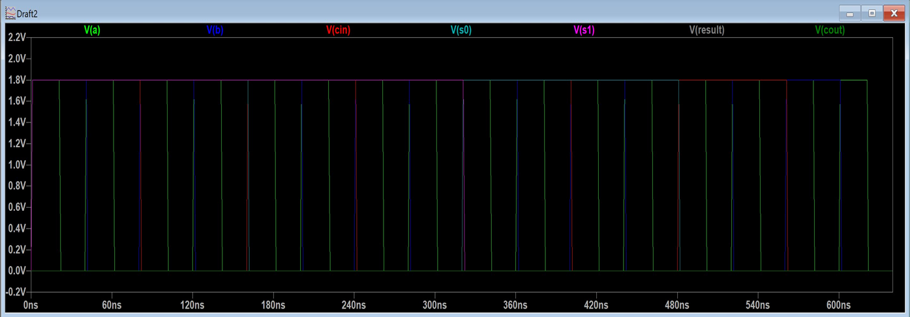
LTSpice Simulation — Ideal (No Parasitics)
Simulation waveforms verified
Signals
Inputs: V(A), V(B), V(Cin), V(S0), V(S1)
Outputs: V(Result), V(Cout)
Total simulation: .tran 1n 640n
All input combinations tested; Result and Cout respond correctly.
Signal | Period (ns high)
VA | 40 (20)
VB | 80 (40)
VCin | 160 (80)
VS0 | 320 (160)
VS1 | 640 (320)

Slide 10
Theoretical Calculations — 2µm Ideal
Process parameters (2µm CMOS)
VDD = 5V KPn = 50 µA/V² KPp = 25 µA/V²
VTn / VTp = 0.7V
W/L NMOS = 2µm / 2µm W/L PMOS = 4µm / 2µm
IDn = IDp = 462 µA CL (gate) = 21.6 fF
Rise time = Fall time = 102.9 ps
Ideal gate delays (no parasitics)
INV = 116.9 ps
NAND2 = 175.4 ps
AND = NAND2+INV = 292.3 ps
OR = NOR2+INV = 263.1 ps
XOR = 4×NAND2 = 701.6 ps
Full Adder SUM = 1958.6 ps
2:1 MUX = 643.1 ps
ALU total path delays (ideal)
ALU AND total = 2221.6 ps
ALU OR total = 2192.4 ps
ALU XOR total = 2630.9 ps
ALU SUM total = 3887.9 ps
Delay formula
tp = (tr + tf) / 2 where:
tr = CL / IDp tf = CL / IDn
SUM path most critical — cascades Full Adder
+ 3 MUX stages (3 × 643.1 ps = 1929.3 ps MUX)

Slide 11
Parasitic Delay Calculations — Extracted Values
Extracted device parameters
PMOS/NMOS W=6µm L=2µm
IDn (extracted) = 1386.8 µA IDp = 693.4 µA
Extracted capacitances
MUX avg node cap: 24.07 fF
MUX total cap: 288.8 fF
AND/NOR avg cap: 40.72 fF
AND/NOR total cap: 570.0 fF
Full Adder max cap: 364.3 fF
Full Adder total: 746.4 fF
Rise time (190fF load) = 603.0 ps
Fall time (190fF load) = 301.5 ps
Parasitic gate delays
INV (CL=190fF) = 514.0 ps
NAND3 (CL=29fF) = 131.4 ps
AND = NAND3+INV = 645.3 ps
OR = NOR4+INV = 750.4 ps
XOR = 4×NAND2 = 420.4 ps
Full Adder SUM = 985.2 ps
2:1 MUX total = 774.3 ps
ALU total delays (with parasitics)
ALU AND total = 2968.2 ps
ALU OR total = 3073.3 ps
ALU XOR total = 2743.3 ps
ALU SUM total = 5544.7 ps

Slide 12
Ideal (LTSpice) vs Parasitic (L-Edit)
Worst-case path: SUM
3,888 → 5,545 ps (+42.6%)
Full Adder drives ~364 fF; output cap dominates the critical path.
AND / NOR: ~35–40%
AND: 2,222 → 2,968 ps (+33.6%)
NOR: 2,192 → 3,073 ps (+40.2%)
MUX cascade carries most of the parasitic load.
XOR essentially flat
2,631 → 2,743 ps (+4.3%)
Larger drive transistors absorb the extracted RC, masking parasitic impact.
Notes:
Why Kp = 2.0?
Kp = 2.0 was chosen from the root locus because it places the closed-loop poles in a stable, well-damped region.
The selected poles are approximately:
s = −1 ± 0.75j
This gives a faster response with low overshoot and avoids unstable or jerky motor behavior.

Slide 13
Ideal vs Parasitic — Full Comparison
Measurement | LTSpice Ideal | L-Edit Parasitic | Δ Overhead | % Increase
tp AND | 2,221.6 ps | 2,968.2 ps | 746.6 ps | +33.6%
tp NOR | 2,192.4 ps | 3,073.3 ps | 880.9 ps | +40.2%
tp XOR | 2,630.9 ps | 2,743.3 ps | 112.4 ps | +4.3%
tp SUM | 3,887.9 ps | 5,544.7 ps | 1,656.8 ps | +42.6%
INV delay | 116.9 ps | 514.0 ps | 397.1 ps | +340%
MUX delay | 643.1 ps | 774.3 ps | 131.2 ps | +20.4%
Rise time | 102.9 ps | 603.0 ps | 500.1 ps | +490%
Fall time | 102.9 ps | 301.5 ps | 198.6 ps | +193%
XOR benefits from larger W=6µm transistors in extracted netlist (+4% vs +40% for SUM). Rise time most affected by large parasitic CL.
Notes:
Why does the speed response settle at 0.667?
Closed-loop DC gain:
Tω(0) = KOL / (1 + KOL)
With KOL ≈ 2:
Tω(0) = 2 / (1 + 2) = 0.667

Slide 14
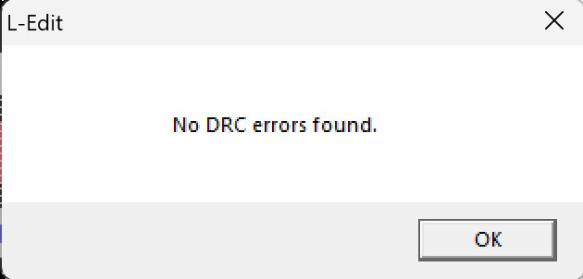

Conclusion
✓ 1-bit ALU designed in 2µm CMOS using L-Edit — zero DRC errors achieved
✓ All 4 operations (AND, OR, XOR, ADD) verified functionally in LTSpice
✓ Parasitic extraction shows real CL up to 364fF — 17× larger than ideal 21.6fF
✓ SUM path most critical: 5.54 ns with parasitics vs 3.89 ns ideal (+42.6%)
✓ XOR least affected (+4.3%) due to larger W=6µm transistors in extracted netlist
✓ Rise time increases from 102.9 ps to 603 ps — dominated by large output capacitance
1-Bit ALU • 2µm CMOS • L-Edit + LTSpice • Ideal vs Extracted Comparison
Mission accomplished.

Slide 15
The End

