Slide 1
Prediction/Analysis of booking cancellations using Online travel booking company data
Prepared by:
Justice Arthur (N01613631)
Luting Chiu (N01604196)
Sachindra (N01640062)
ITE 5201 Humber College

Slide 2
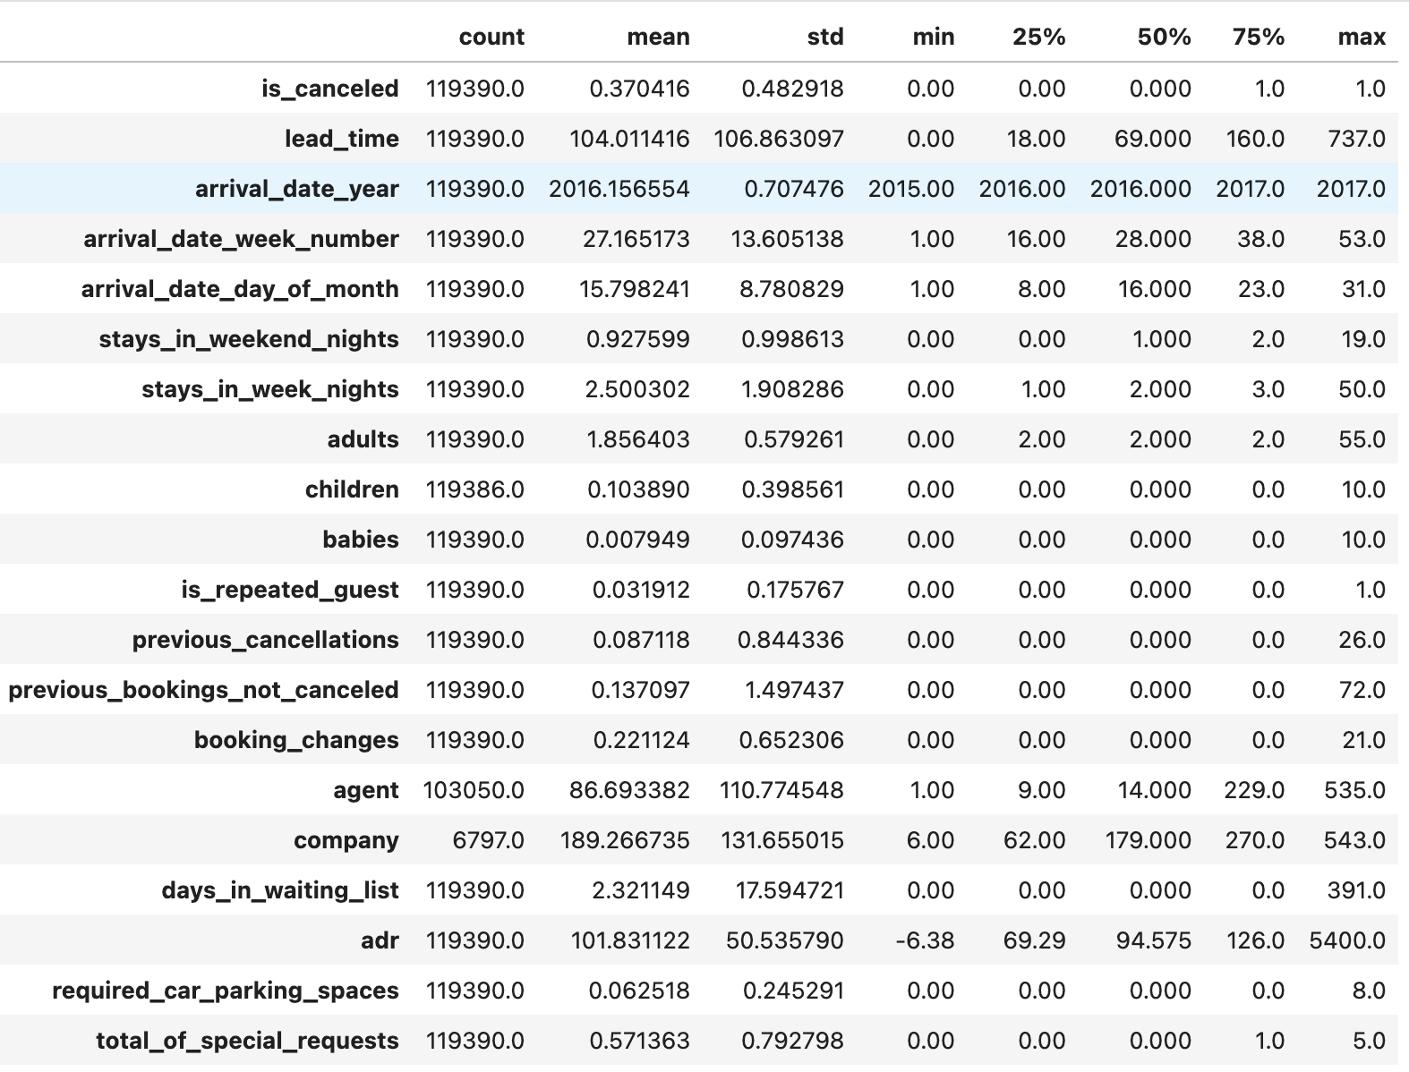
Problem Statement Prediction/Analysis of booking cancellations using Online travel booking company data
Dataset The determination of cancellation status (1 for canceled, 0 for not canceled) is shaped by a multitude of factors, encompassing customer behavior, temporal considerations, geographical location, and individual background.
We have 31 features and about 100K records.

Slide 3
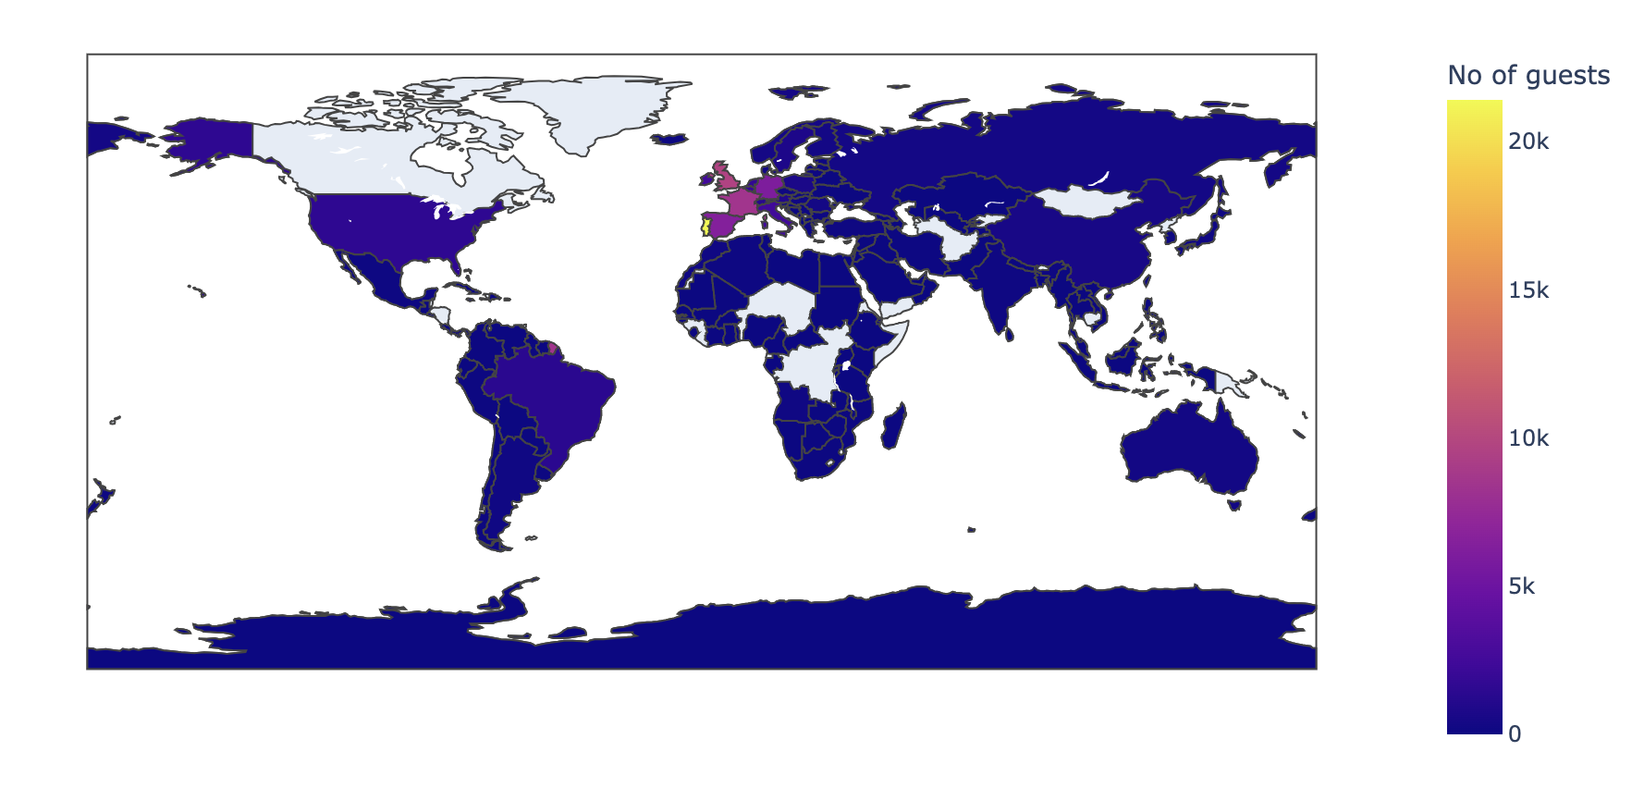
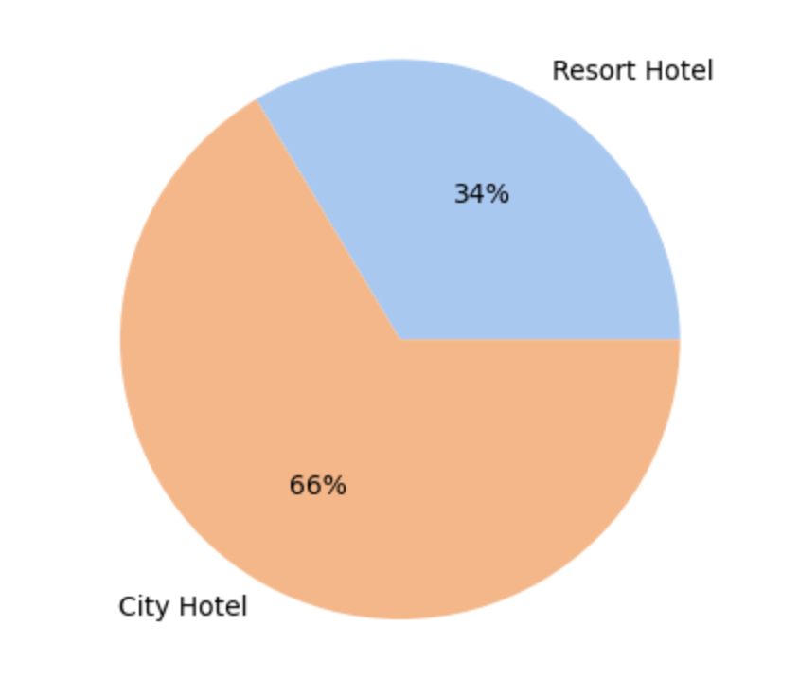
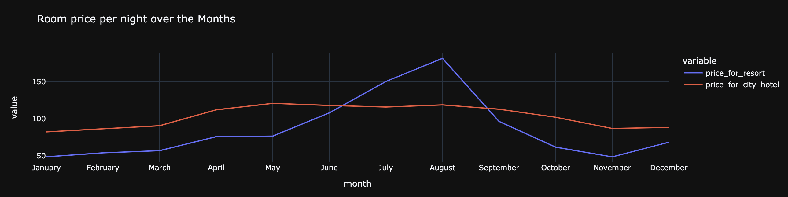
Statistical Plots

Slide 4
Proposed Analytical/ Predictive model Following data exploration and engineering, the model incorporates the variables: hotel, lead_time, arrival_date_year, arrival_date_month, arrival_date_week_number, arrival_date_day_of_month, meal, country, market_segment, distribution_channel, previous_cancellations, previous_booking_not_canceled, deposit_type, days_in_waiting_list, customer_type, and AverageDailyRate. The dataset is split into 75% training data and 25% testing data. With a categorical target variable (0 and 1), a logistic regression model (binomial) is applied for predictive analysis.

Slide 5
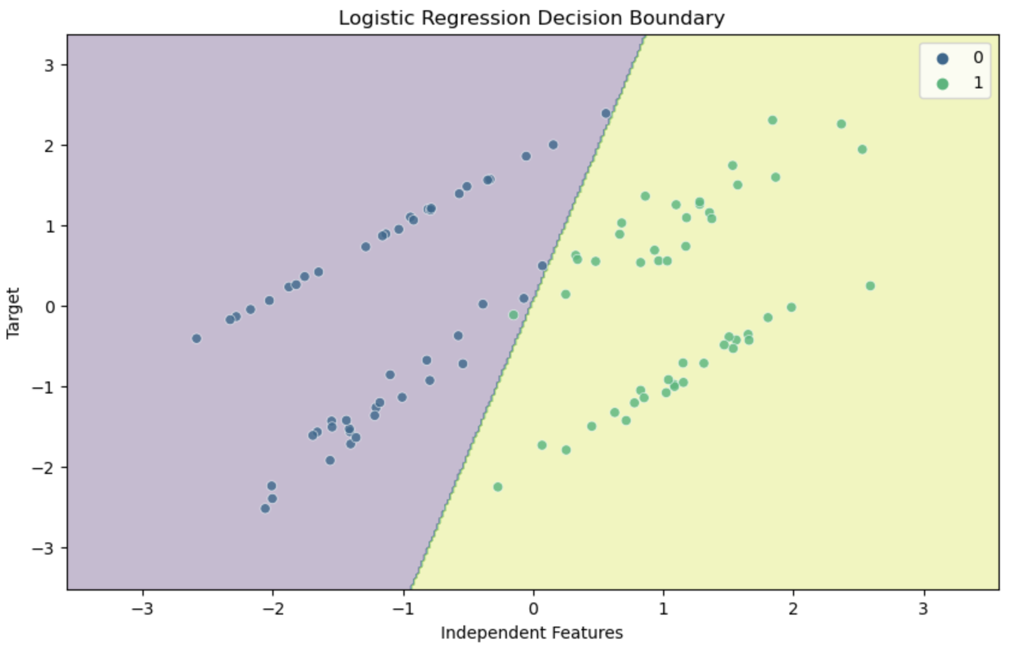
Proposed Predictive model… Logistic regression assumes a linear relationship between the independent features and the log-odds of the target. As a result, the decision boundary is a linear function of the features. The shape of the decision boundary reflects the linearity assumption of logistic regression.

Slide 6
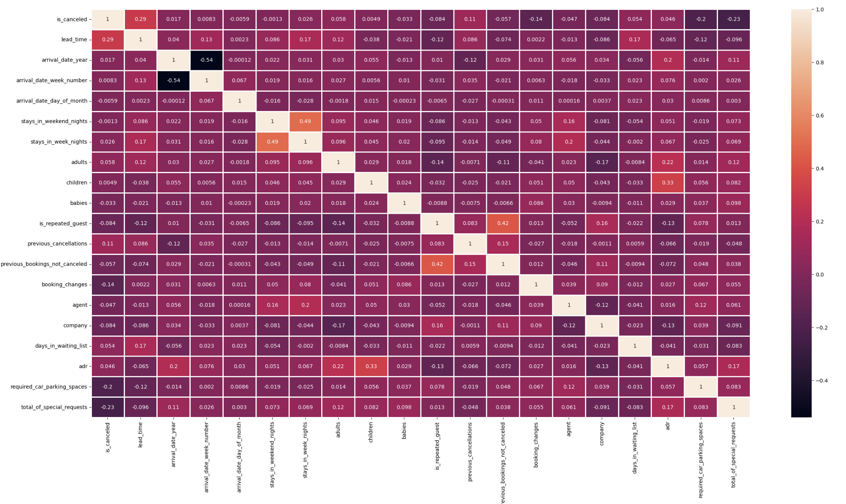
Analytical & Inference results Heatmap: Identifies the variables correlated with the cancellation status. Moreover, The linear progression here provides a visually intuitive way to understand the relative magnitudes of the values and their relationships within the dataset.

Slide 7
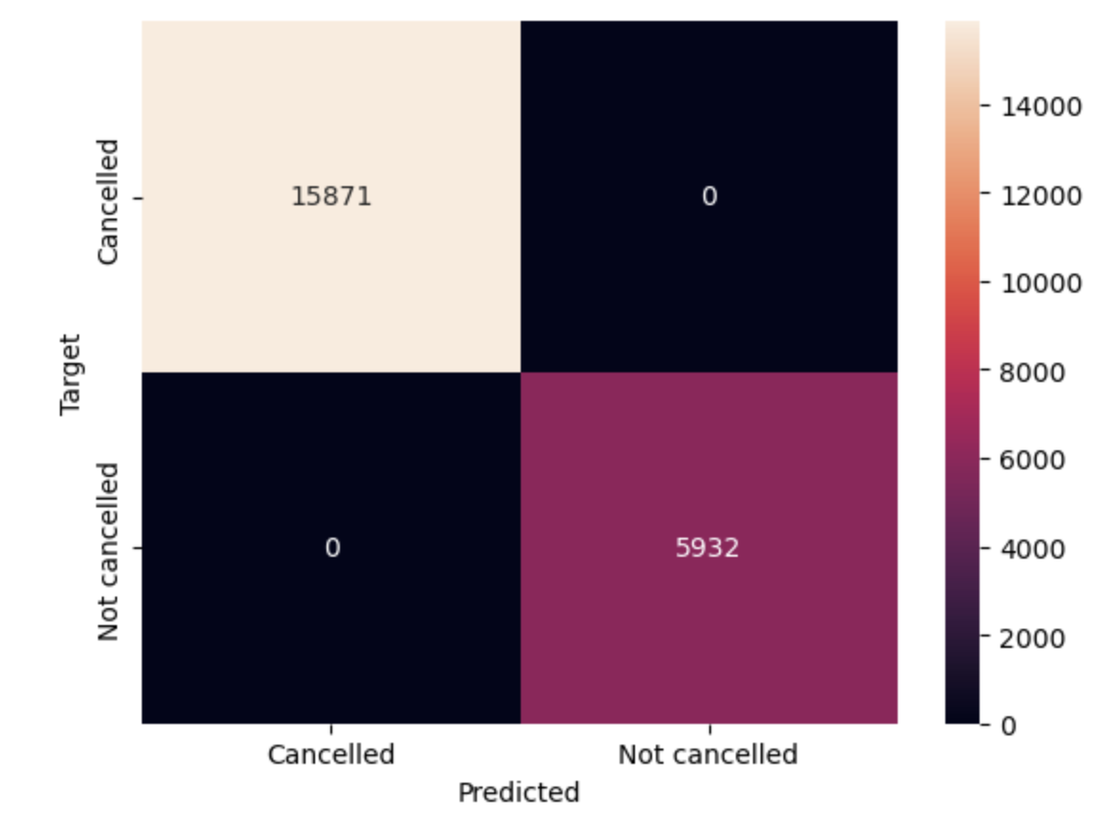
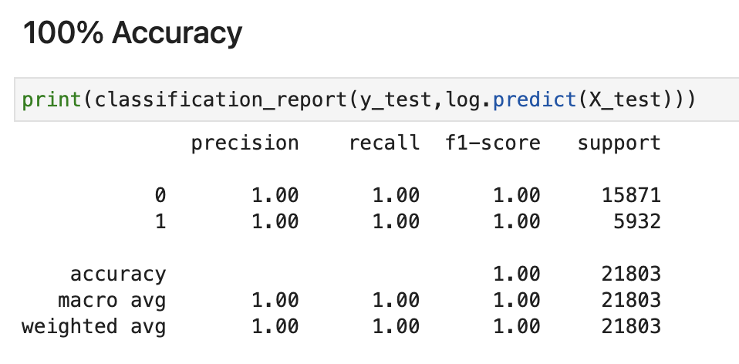
Analytical & Inference results

