Slide 1
Linear Regression

Slide 2
Problem Statement: Imagine you went to buy a house
location
# rooms
Dist from landmark
Human Brain
Price
Age of House
Target (Y)
Dist from graveyard

Slide 3
Problem Statement Continued...
Features (X)
Model
Target (Y)
Independent variable
Dependent variable

Slide 4
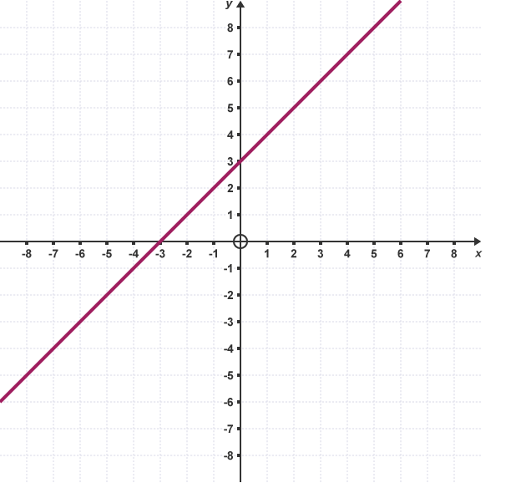
Linear Regression
Linear regression is a regression model which tries to predict the relationship between the dependent variable Y and independent variable X in a linear fashion.
Y = mx + c, m is the impact of an independent variable on the dependent variable.

Slide 5
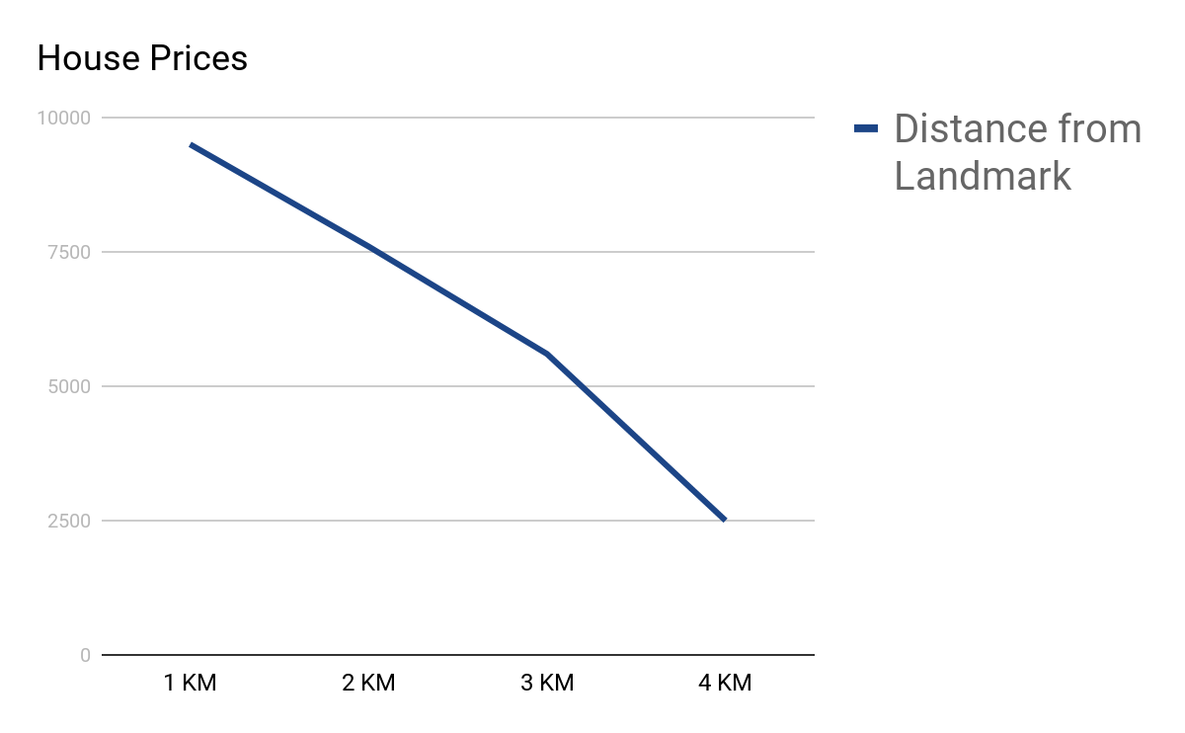
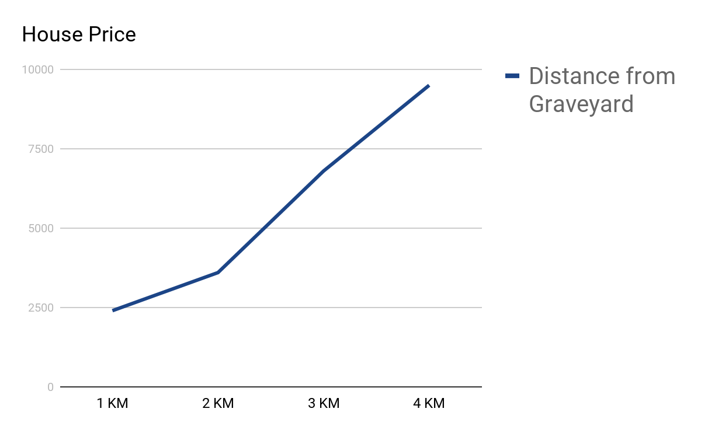
Example: House Prices vs Distance from Graveyard
The magnitude of this positive/negative impact is called ‘weight’

Slide 6
Re-creating Equation
House Price = w1*location + w2*No_of_rooms + w3*Distance_from_landmarks + w4*Age_of_house + w5*Distance_from_graveyard + c
(w1,...,w5 are the individual impacts of that feature to the house price)
Y = w1*x1 + w2*x2 + w3*x3 + w4*x4 + w5*x5 + c

Slide 7
Re-creating Equation
Consider the weights and features as vectors , apply a dot product
w1*x1 + w2*x2 + w3*x3 + w4*x4 + w5*x5 =
[w1 , w2 , w3 , w4 , w5].[x1 , x2 , x3 , x4 , x5]
Y = W.X + c
(weights vector)
(feature vector)

