Slide 1
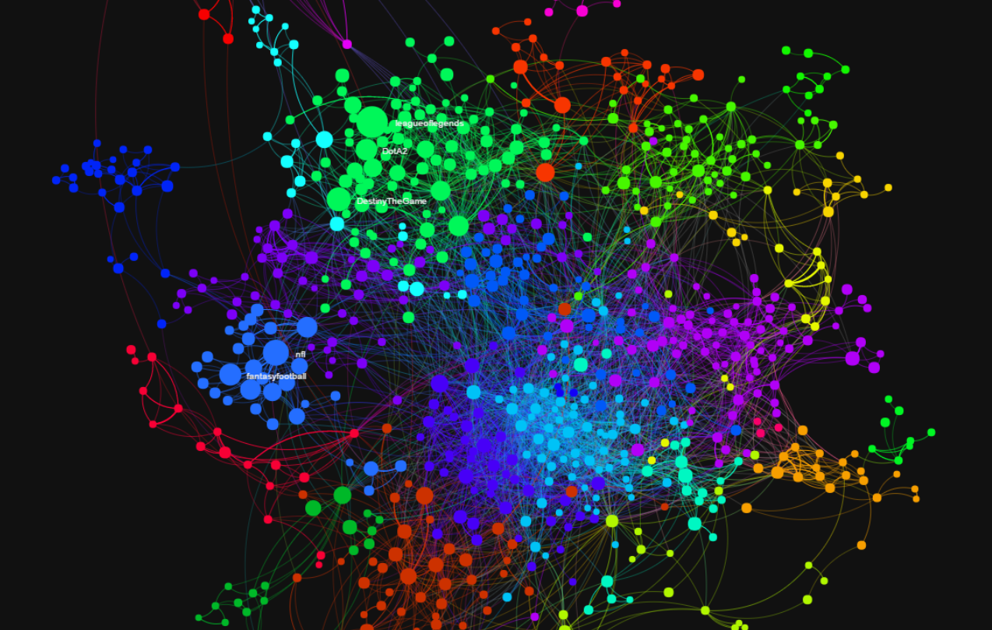

Data Visualization Framework:
Visualizing Relationships Between Different Categories
By: Justin Ahn (yongjina), Tianyu Gu (tianyug)

Slide 2



Our Framework’s Goals
⧫ Instead of one area of data (ex: social media, music, sports), a category of data.
⧫ Related nodes in one category of data -> strength of relationship.
⧫ Other methods of analysis as well -> Node Specific, Relationship Specific
⧫ Can be applied to various areas->
Reddit
Weather
Politics

Slide 3


What is a Relationship in terms of Data Categories?
⧫ Some discrete thinking involved…
⧫ Lets think about this in terms of Object A, Object B
⧫ The case of Reddit?
⧫ Thus -> Our framework’s data structure & role of data plug-ins.

Slide 4
Data structure design:
in Category package
Plugin design:
in Plugin package
⧫ Keep all the categories
⧫ plugin to
get input data
⧫ plugin to
Visualize data
⧫ one specific category
⧫ plugin to
Analyze data

Slide 5
Framework Architecture

Slide 6
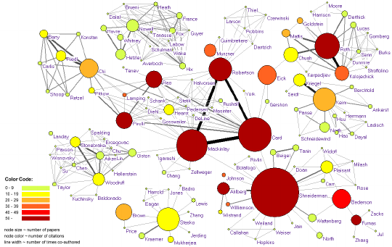
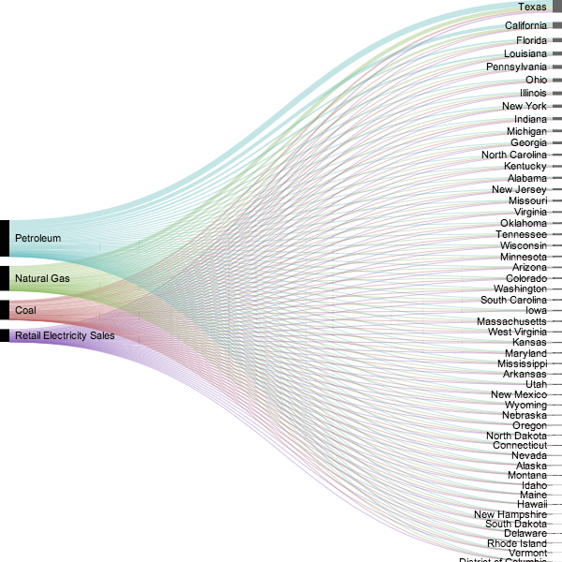
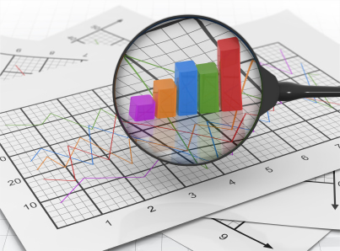
Examples of Framework Usage
⧫ Allows for extreme creativity in data, analysis, and visualization!

