Slide 1
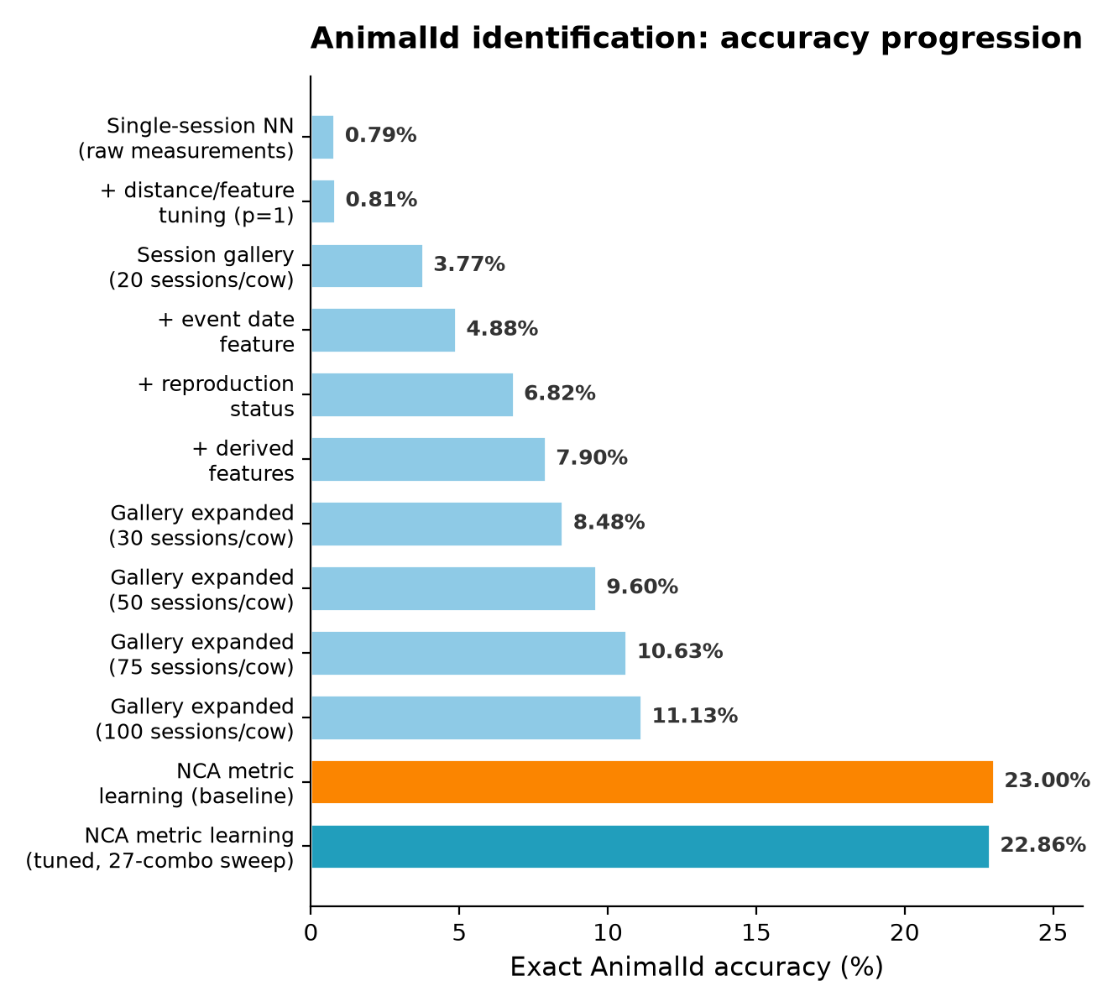
Tuning the NCA Metric-Learning Model
AnimalId Identification Pipeline | ANSCI 6040 Dairy Session Data | 8.5M rows
Standardized Nearest Neighbors (baseline)
18% exact | 39% top-5
NCA Metric Learning (tuned, best of 27)
23% exact | 52% top-5
Expanded NCA Hyperparameter Sweep (27 configurations)
Init strategy | Best config | Exact acc. | Top-5 cov.
auto | n=6, iter=100 | 23% | 52%
identity | n=6, iter=100 | 20% | 48%
pca | n=8, iter=100 | 19% | 48%
Key Takeaways
▸ NCA metric learning nearly doubles exact-match accuracy over the standardized-distance baseline (18% → 23%) and raises top-5 coverage from 39% to 52%.
▸ init="auto" dominates every configuration tested; "pca" and "identity" initializations underperform across the board.
▸ max_iter has little effect once init="auto" is used — 50 iterations already matches 300.
▸ Reducing n_components below 6 hurts accuracy (4-component configs drop to 15–19%).
▸ Re-validated the full 49-cell / 8.5M-row notebook end-to-end after each change — zero regressions.
project_1_ANSC_4040_analysis.ipynb • NearestNeighbors + NeighborhoodComponentsAnalysis (scikit-learn)

