Slide 1

Tata Cars Sales Performance Dashboard
Power BI Analysis of New & Used Car Sales
Submitted By: Justin Joji

Slide 2
INTRODUCTION
The project presents an interactive Power BI analysis of Tata Cars Sales, covering both new and pre-owned cars.
The purpose of the analysis is to identify sales trends, top performing models, segment performance, fuel preferences,
EV adoption levels and state wise demand patterns.
Using comprehensive sales data, the study includes data cleaning and correction to ensure accurate reporting.
The dashboards developed provide actionable insights to support market planning, inventory management and regional
Strategy development.

Slide 3
OBJECTIVE
Compare new and used car sales.
Identify best selling models and segments.
Analyze state wise sales performance.
Study fuel, transmission and EV trends.
Convert raw data into business insights using Power BI.

Slide 4
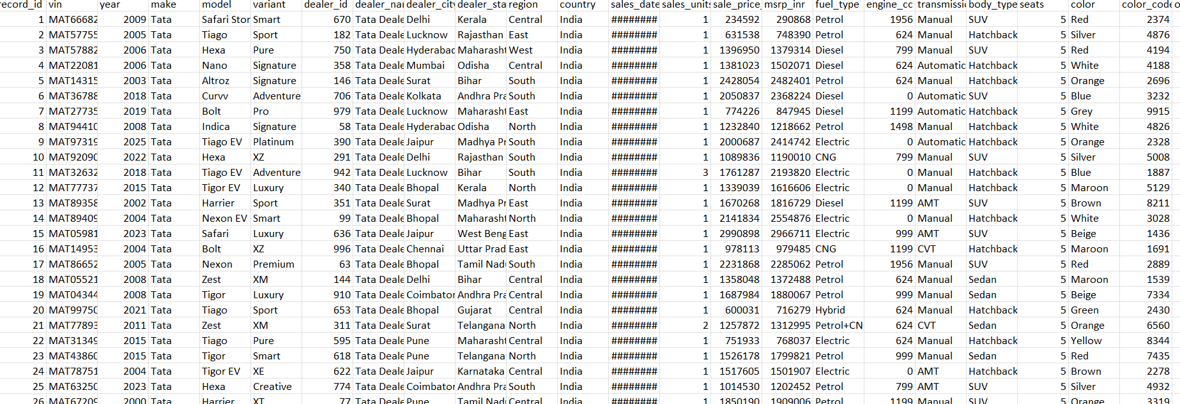
DATASET
Total Entries : 100000
Total Columns : 70

Slide 5
KEY DETAILS
Data Set: Tata Cars Sales 100k dataset
Markets Covered: New and Pre owned cars
Cars Model & Body type
Fuel type & Classifications
Transmission Type
State and Region
Sales Year
Sales Unit
MSRP and Sales Price
Average Mileage
Ev Units Count

Slide 6
CHARTS AND CARDS
Charts : 19
Used for trend analysis and comparisons
Cards : 24
Display key metrics
Tables : 2
Provide detailed, row level data for drill down analysis
All visuals are designed for quick insights and data driven decision making.

Slide 7
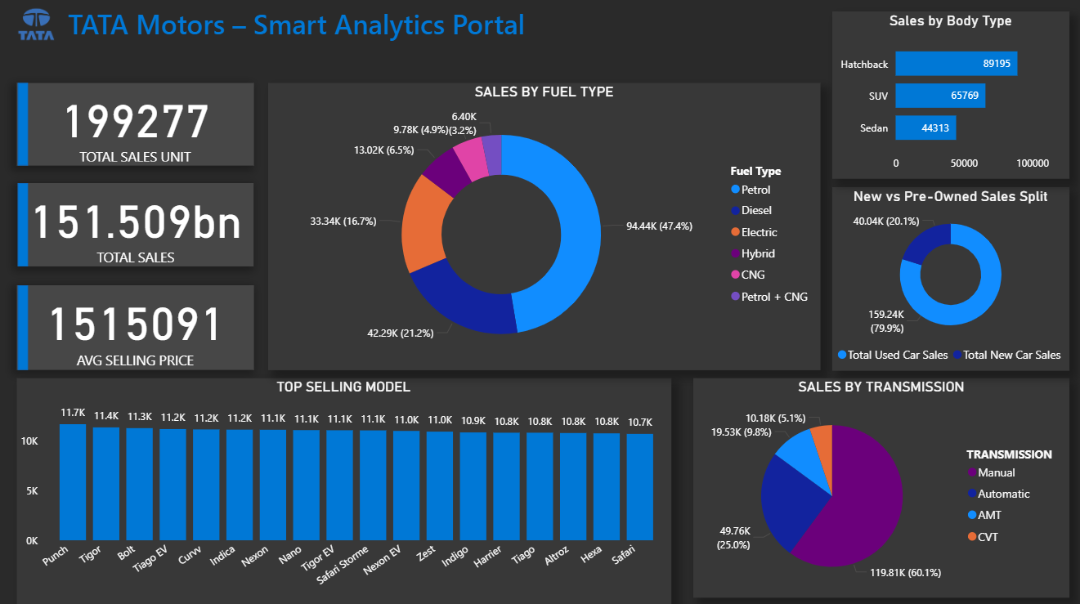
DASHBOARD

Slide 8
FINDINGS
Key Analysis Outcomes
Punch is the top selling model overall across both new and used markets.
New Car Segment
Sedans lead, with Tigor EV as the highest selling sedan.
Hatchback sales are increasing, driven mainly by Punch.
EV adoption remains limited, with only 6,576 EV units sold.
SUV sales are increasing due to growth in models like Nexon, Harrier, Safari and Curvv.
Used Car Segment
Hatchbacks dominate used car sales, showing higher resale demand than SUVs and sedans.
EV sales surpass new EV sales, with 26,765 used Ev units sold, indicating stronger activity in used market.
Punch is the leading top selling car in Used market.

Slide 9
FINDINGS
Fuel Type Trends
Petrol remains the most preferred fuel across both new and used cars.
Diesel and CNG steady demand.
Electric cars represent an emerging segment with increasing adoption, particularly in the pre owned market.
State Performance
Tamil Nadu records the highest sales volume.
Mileage Performer
Punch delivers the best mileage performance among leading models.
Yearly trend
Year 2000 recorded the highest total sales volume making a peak year.

Slide 10
FINDINGS
Segment Insight
Sedans show the lowest overall market share compared to SUVs and hatchbacks.
Hatchback is the leading Segment

Slide 11
IMPROVEMENTS
Increase production and promotion of Punch, as it is the highest-selling and best mileage model.
Focus marketing campaigns in Tamil Nadu, the top sales performing state.
Develop strategies to boost sedan sales, especially beyond Tigor.
Expand new EV offerings and incentives to improve EV sales, as new EV sales remain low.
Continue prioritizing petrol variants while continuing support for diesel and CNG segments.
Promote automatic transmissions to meet changing customer preferences or increase automatic
transmission offerings.
Strengthen availability of hatchback models in used car market where demand is highest.

Slide 12
CONCLUSION
Dashboard provides a clear view of Tata Car Sales (2000-2025).
The Dashboard providing a long term insights into market trends, customer preferences, and model performance
across new and used cars.
The Dashboard deliver actionable insights that can guide production planning and marketing focus for improved
business performance.

Slide 13
REFERENCE
Dataset : Kaggle
Visualization : Microsoft Power BI

Slide 14
Power BI Analysis of Tata New & Used Car Sales
THANK YOU
Submitted By: Justin Joji

