Slide 1
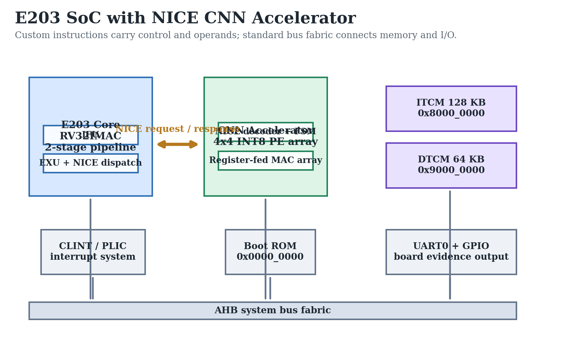
RISC-V Custom Instruction Based Lightweight CNN Accelerator
FPGA Prototype Validation on E203 + NICE
JU JIAXING | BEng Computer Engineering | May 2026
Notes:
Opening: this project demonstrates a RISC-V custom-instruction CNN accelerator and validates it from RTL simulation to FPGA board execution.

Slide 2
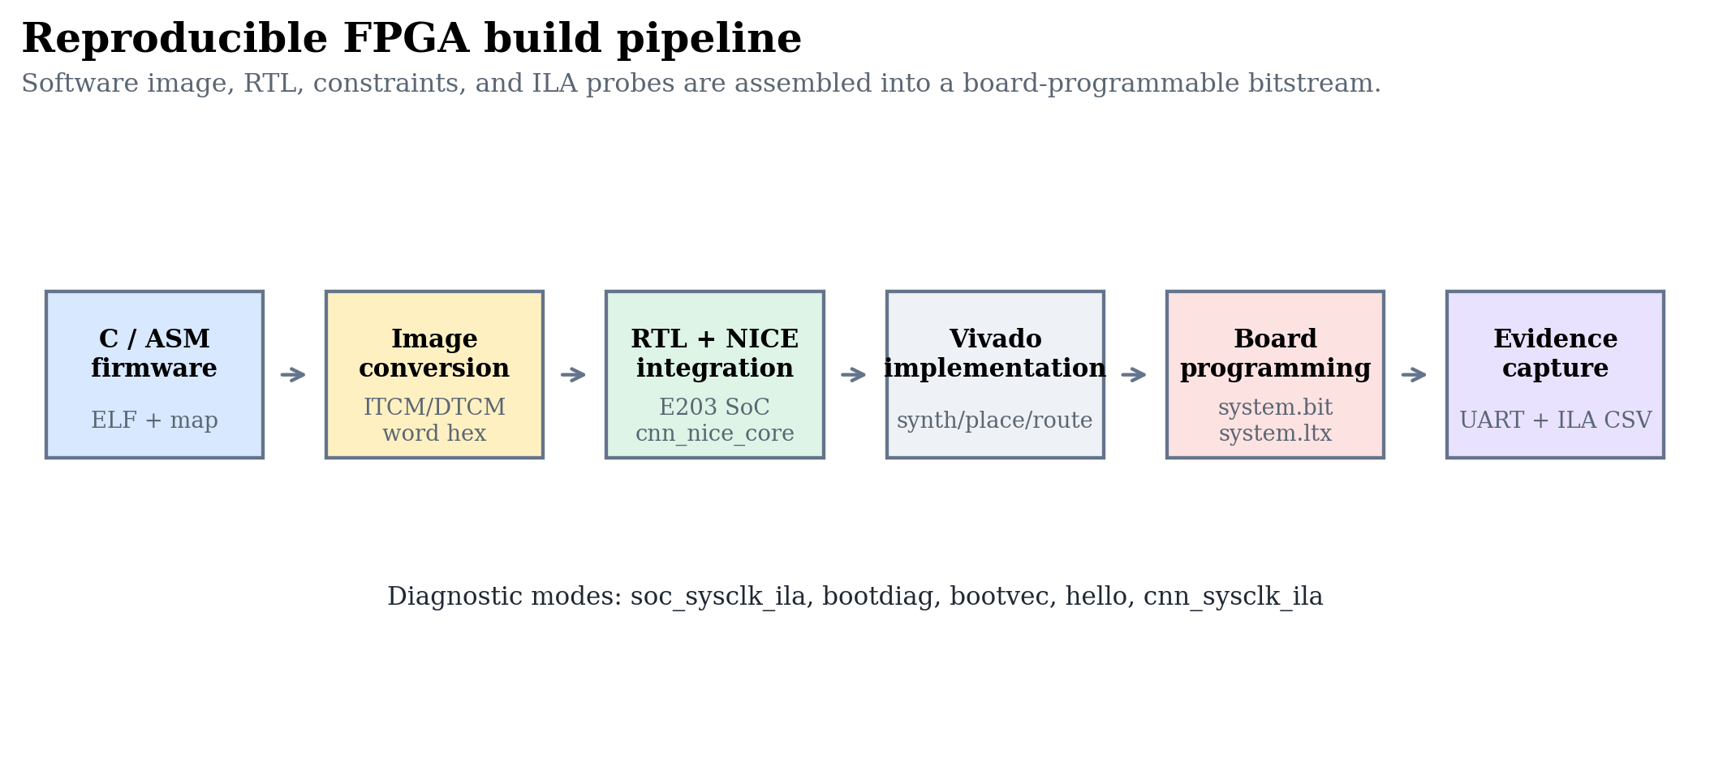
Why this project matters
Edge CNN inference needs more throughput than a small CPU can provide, but a full custom accelerator must still remain verifiable.
CNN convolution is MAC-heavy and expensive for a scalar CPU.
RISC-V custom instructions let the accelerator stay close to the execution pipeline.
The project target is not only speedup, but a reproducible FPGA validation chain.
Evidence: thesis_latex/figures + 04_Experiments board/simulation logs.
Final Year Project Defense | Evidence-backed FPGA validation
02
Notes:
Set motivation: the design is about acceleration and evidence, not just RTL implementation.

Slide 3
System architecture
The accelerator is attached through the NICE coprocessor interface rather than memory-mapped I/O.
Evidence: thesis_latex/figures + 04_Experiments board/simulation logs.
Final Year Project Defense | Evidence-backed FPGA validation
03
Notes:
Explain that NICE carries operands and control directly, while AHB remains responsible for memory and peripherals.

Slide 4
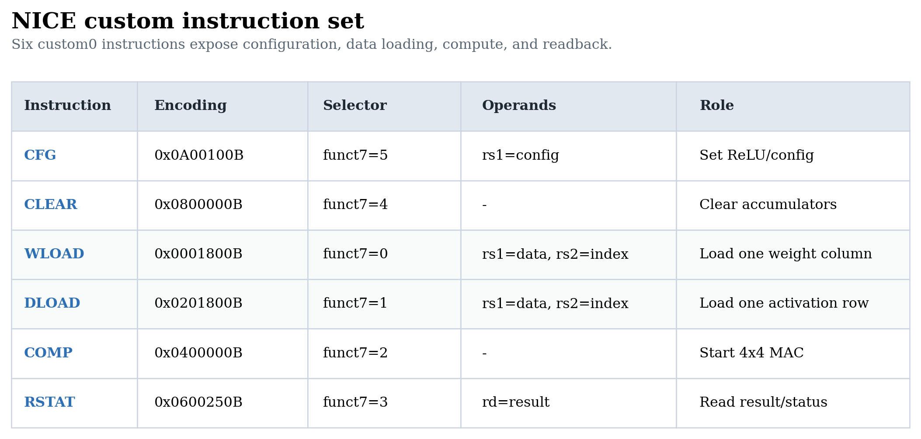
Custom instruction interface
Six custom0 instructions form a small software-visible ISA for convolution control.
CFG/CLEAR configure and reset the accelerator state.
WLOAD/DLOAD serialize 4x4 INT8 data into the PE array.
COMP/RSTAT trigger compute and read the accumulated result.
Evidence: thesis_latex/figures + 04_Experiments board/simulation logs.
Final Year Project Defense | Evidence-backed FPGA validation
04
Notes:
Walk through the six instructions and emphasize the rs2 index semantics.

Slide 5
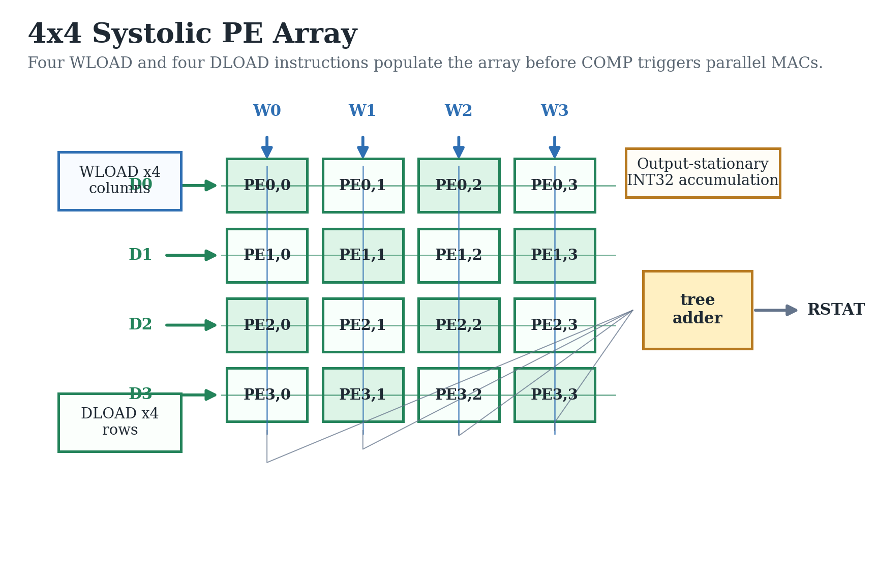
Accelerator datapath
A 4x4 INT8 PE array exposes parallel MAC throughput through register-fed custom instructions.
Evidence: thesis_latex/figures + 04_Experiments board/simulation logs.
Final Year Project Defense | Evidence-backed FPGA validation
05
Notes:
Explain WLOAD columns, DLOAD rows, output-stationary accumulation, and RSTAT readback.

Slide 6
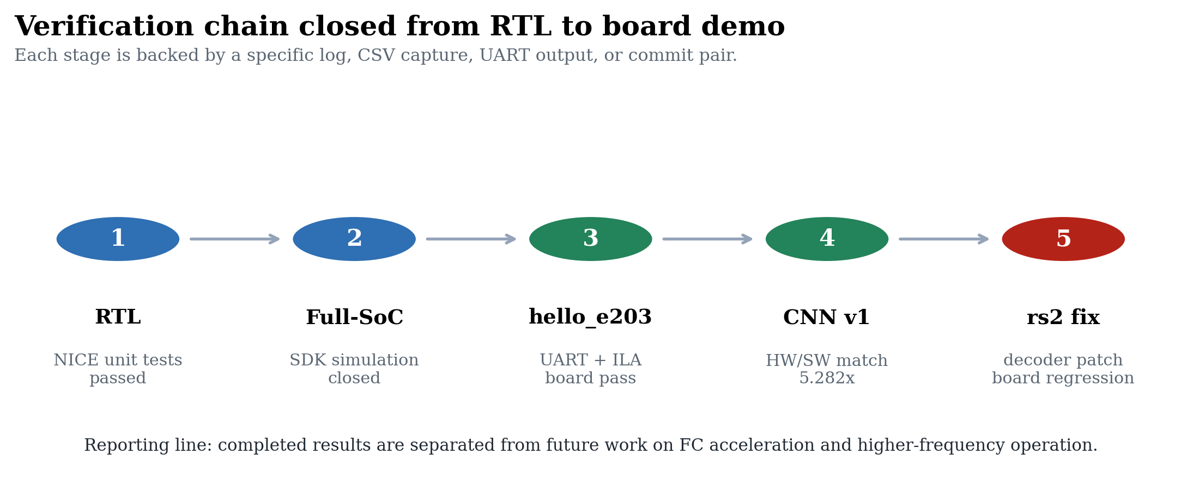
Verification strategy
The same evidence chain supports the thesis and the defense.
Evidence: thesis_latex/figures + 04_Experiments board/simulation logs.
Final Year Project Defense | Evidence-backed FPGA validation
06
Notes:
Emphasize the closed chain: RTL, full-SoC, hello board, CNN board, rs2 regression.

Slide 7
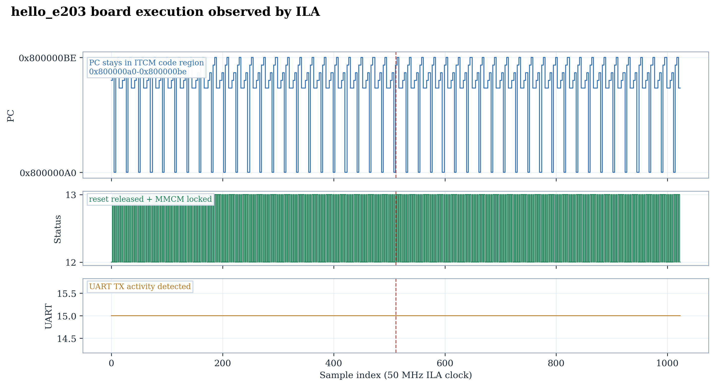
Board bring-up evidence
The hello_e203 run closed the CPU boot path with UART and ILA evidence.
MROM boot redirects execution to ITCM.
UART proves firmware-level execution.
ILA confirms PC activity and board-level reset/clock health.
Evidence: thesis_latex/figures + 04_Experiments board/simulation logs.
Final Year Project Defense | Evidence-backed FPGA validation
07
Notes:
Use this slide to explain how ILA made the board bring-up observable.

Slide 8
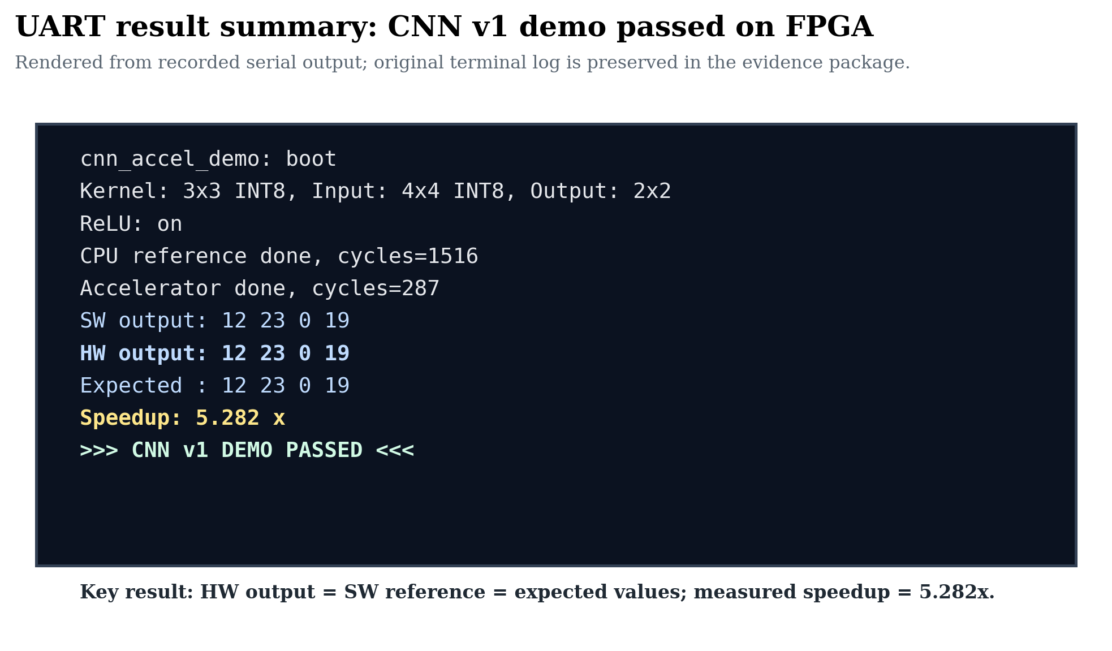
CNN board result
The CNN v1 demo passed on the FPGA: hardware output matched software and expected values.
Evidence: thesis_latex/figures + 04_Experiments board/simulation logs.
Final Year Project Defense | Evidence-backed FPGA validation
08
Notes:
State the board result plainly: SW output, HW output, expected output all match; speedup is 5.282x.

Slide 9
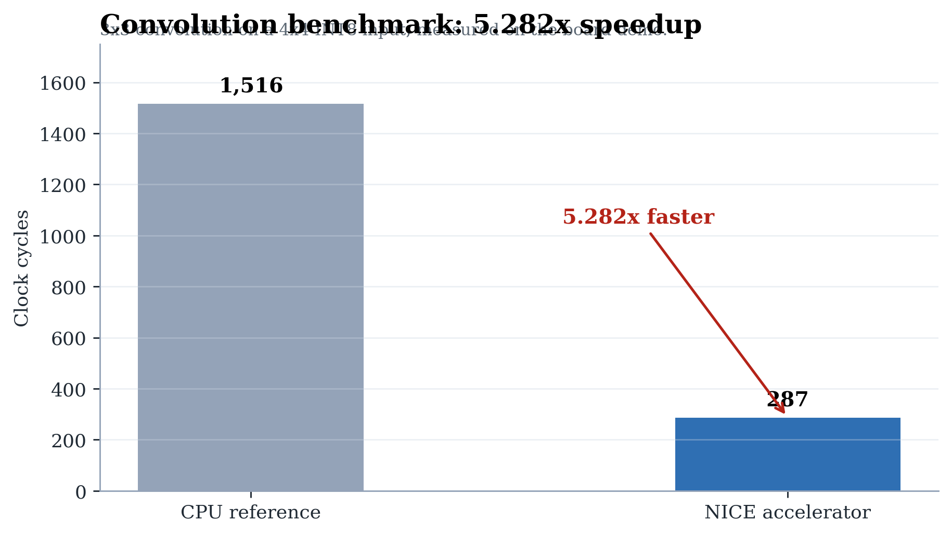
Performance and fit
The accelerator reaches the target convolution speedup while fitting comfortably in the A7-100T.
Evidence: thesis_latex/figures + 04_Experiments board/simulation logs.
Final Year Project Defense | Evidence-backed FPGA validation
09
Notes:
Start with speedup, then mention resource headroom and why end-to-end inference is still limited by software FC layers.

Slide 10
NICE rs2 bug case study
The key integration bug was not in the PE array: it was an E203 decoder optimization conflicting with NICE operand semantics.
Root cause
Fix
Board regression
The E203 decoder treated rs2=x0 as no operand needed. NICE WLOAD/DLOAD use rs2 as a vector-bank index, so index 0 was incorrectly gated.
For NICE instructions, rv32_need_rs2 follows nice_need_rs2 directly. Standard RISC-V x0 gating remains unchanged.
cnn_sysclk_ila rebuilt cleanly. UART confirmed HW/SW/Expected match and 5.282x speedup after the fix.
Evidence: thesis_latex/figures + 04_Experiments board/simulation logs.
Final Year Project Defense | Evidence-backed FPGA validation
10
Notes:
Explain this as the engineering insight: protocol integration details matter as much as datapath correctness.

Slide 11
Contributions and next work
The project closes a reproducible custom-instruction accelerator prototype and leaves clear expansion paths.
Implemented a 4x4 INT8 CNN accelerator with six NICE instructions.
Closed RTL, full-SoC, hello_e203 board, and CNN v1 board validation.
Future work: FC acceleration, higher SoC clock, larger benchmark coverage.
Evidence: thesis_latex/figures + 04_Experiments board/simulation logs.
Final Year Project Defense | Evidence-backed FPGA validation
11
Notes:
Close with what is achieved and what remains deliberately scoped as future work.

