Slide 1
Leaflet Package in R
Creating interactive maps with real-world locations
Justin McQuaite
DSS 445 - R Statistical Programming

Slide 2
What is Leaflet?
A package for interactive maps in R
Build maps that users can zoom and pan around
Add markers that display information when clicked
Visualize geographic data such as college campuses or sports arenas

Slide 3
Main functions
leaflet() - starts a Leaflet map
addTiles() - adds the background map
addMarkers() - adds clickable pins
addCircleMarkers() - adds customizable circles
Also use of %>% (pipe operator)

Slide 4
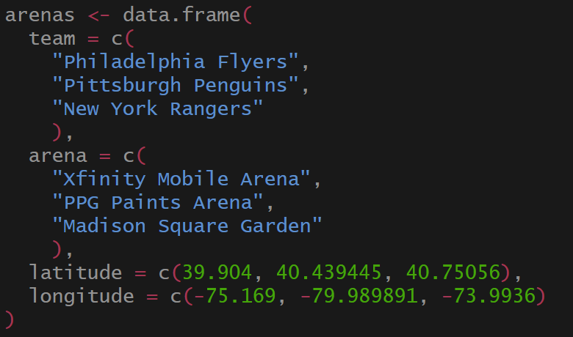
Data used for demonstration

Slide 5
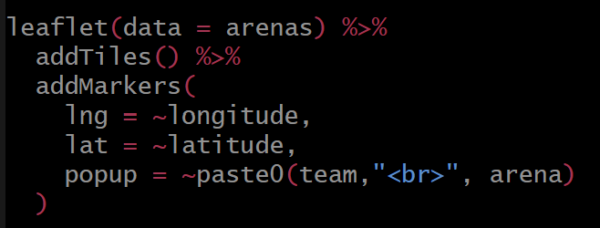
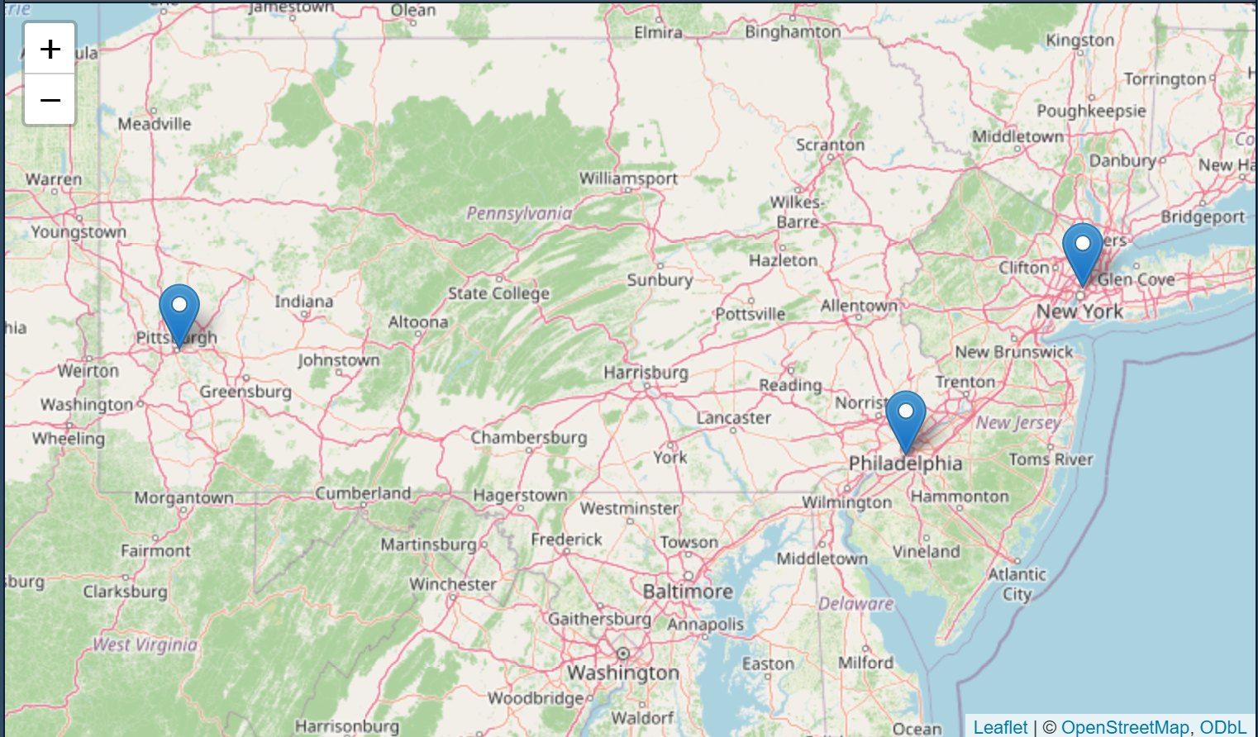
Creating the Map

Slide 6
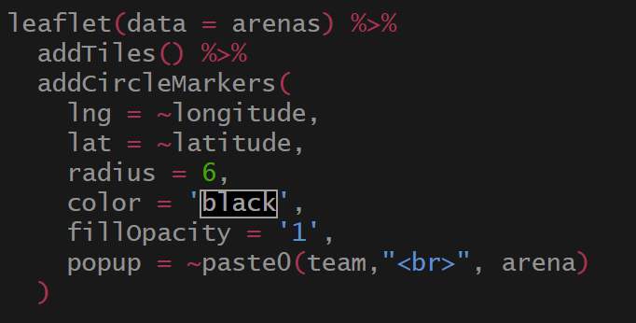
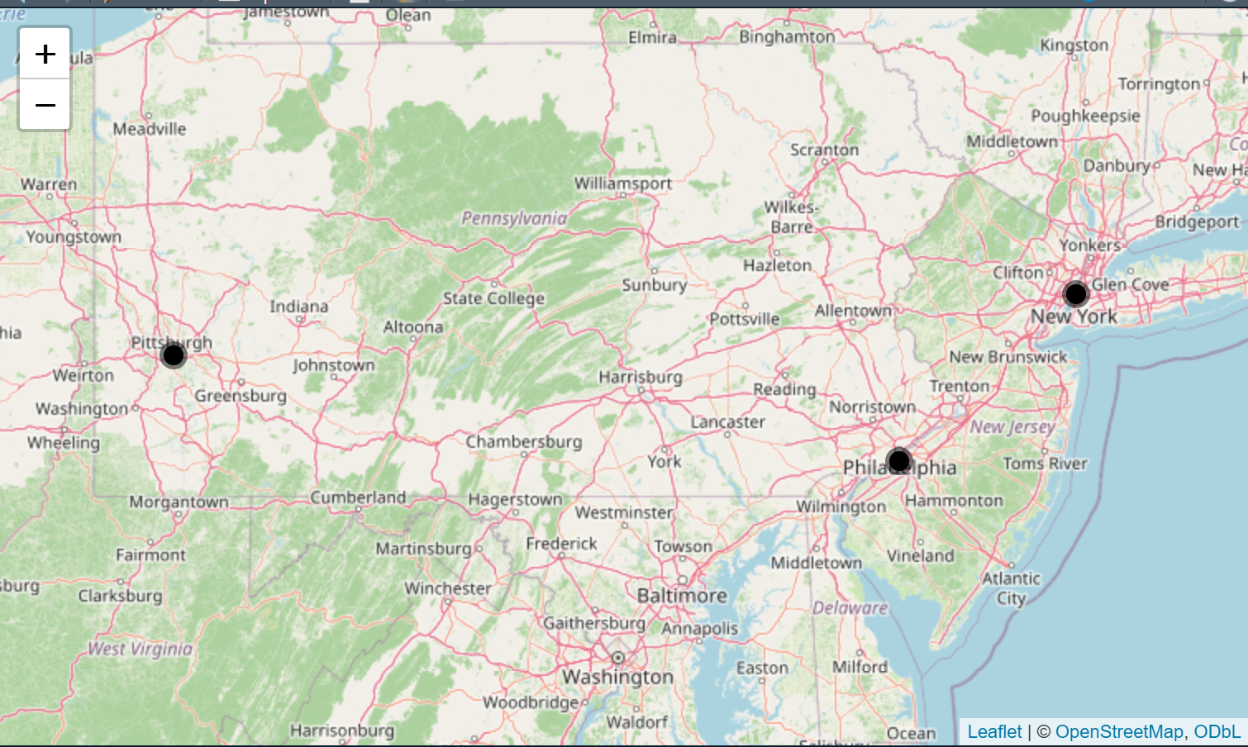
Creating the map with circle markers

