Slide 1
Forecasting Consumer Demand and the Pricing of Tickets

Slide 2
Outline and Summary
Part 1: Forecasting and understanding the underlying demand for tickets
A brief history of ticket pricing at the Braves
A summary of demand forecasting
An example of Time Series, Experimental, and Other forecasting techniques
Intro to our data
Project introduction: Using the data to forecast demand
Part 2: The mechanics and psychology of pricing
An introduction to some reading material
Technical concepts
Practical considerations
Fitting distributions: The price response function
The pricing workflow
Project outline

Slide 3
Forecasting Demand
Forecasting and understanding the underlying demand for tickets

Slide 4
2012-2024: A brief history of ticket pricing at the Braves
“In many cases, the prices charged to customers are the result of a large number of uncoordinate and arbitrary decisions.”
- Robert L. Phillips
2012: Flat Pricing discriminated by proximity to Home Plate
Ticket prices were determined by the perception of sight-line quality
2014: Variable Pricing
Events began to be discriminated. Higher prices charged for games considered more attractive
2017: Dynamic Pricing
More factors began to be considered. Prices were changed monolithically based on forecasts.
2021-2025: Dynamic Pricing with dynamic inventory control
Much more sophisticated models began to be deployed. Inventory distribution protocols became integrated into pricing tactics.

Slide 5
Determining Underlying Demand and Prices for Tickets
Determining Underlying Demand… Forecasts are always wrong
One metric isn’t enough to accurately estimate demand. A better approach is to use several independent metrics and to weigh them according to conditions.
How attractive is this product?... What combinations of features can we use and weight to estimate how attractive a future game might be?
Examples of features used to model demand:
Bottom-up Forecasting
Top-down Forecasting
Secondary market prices
Analysis of your purchase flow
Show rates
Revenue per inventory unit
Inventory availability
Inventory characteristics
Marketing and promotions
Seasonality
Market and opponent
Day of the week
Team performance
School schedules

Slide 6
Forecasting Demand
There are many technical methods to use for forecasting demand. Different conditions may make specific techniques more appropriate. Each has strengths and drawbacks, and each can be used to simulate demand. Some examples include:
Time Series approaches (exponential smoothing, moving averages, etc.)
Regression and its variants (mixed effects models, robust, etc.)
Machine Learning (XGBoost, A.I. methods, etc.)
Econometric approaches (Cross Price Elasticity of Demand, etc.)
Don’t ignore other methods…
Judgement Approaches: Somebody could give you a good approximation.
Experimental Approaches: Survey methods such as a Van Westendorp or Conjoint Analysis
Relational/Causal Approaches: People may want to purchase warm clothes if it is cold.

Slide 7
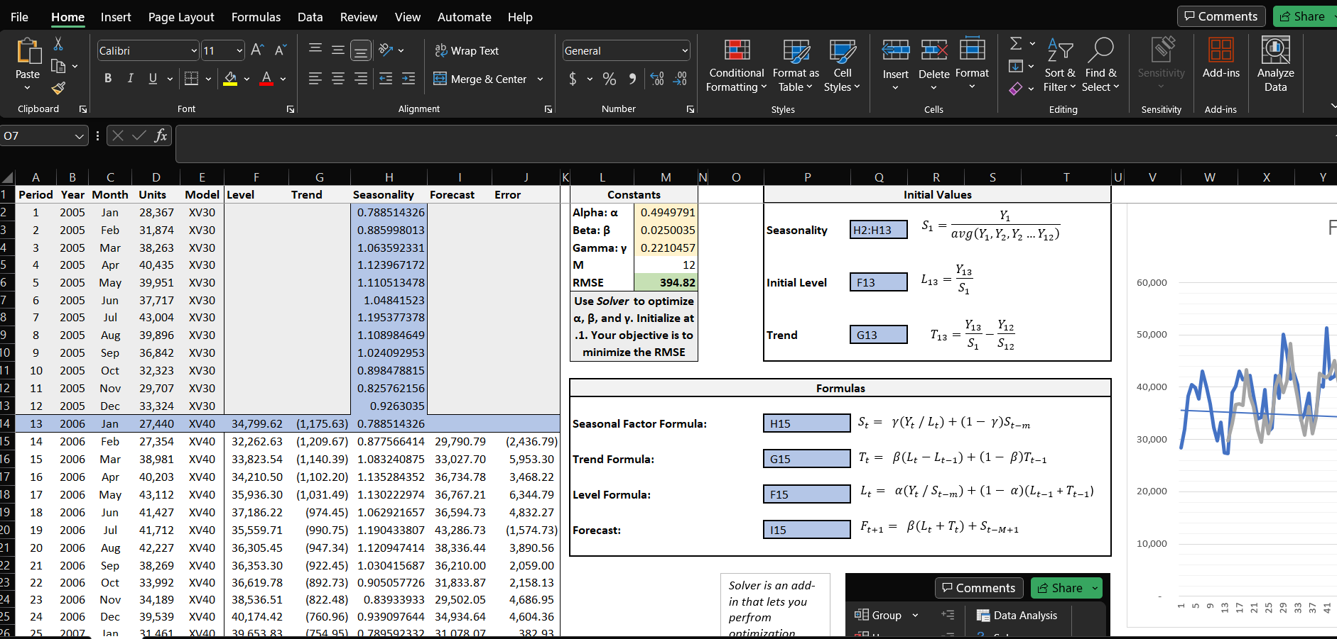
Forecasting Demand: Time Series
Good example of how to utilize Linear Optimization techniques that you might find in Network Management.
On data with obvious trends and seasonality, it can produce good results.
Easy to produce, interpret, and implement.
https://en.wikipedia.org/wiki/Exponential_smoothing
https://en.wikipedia.org/wiki/Linear_programming
https://github.com/Justin-Watkins/Emory/tree/main/exponential_smoothing

Slide 8
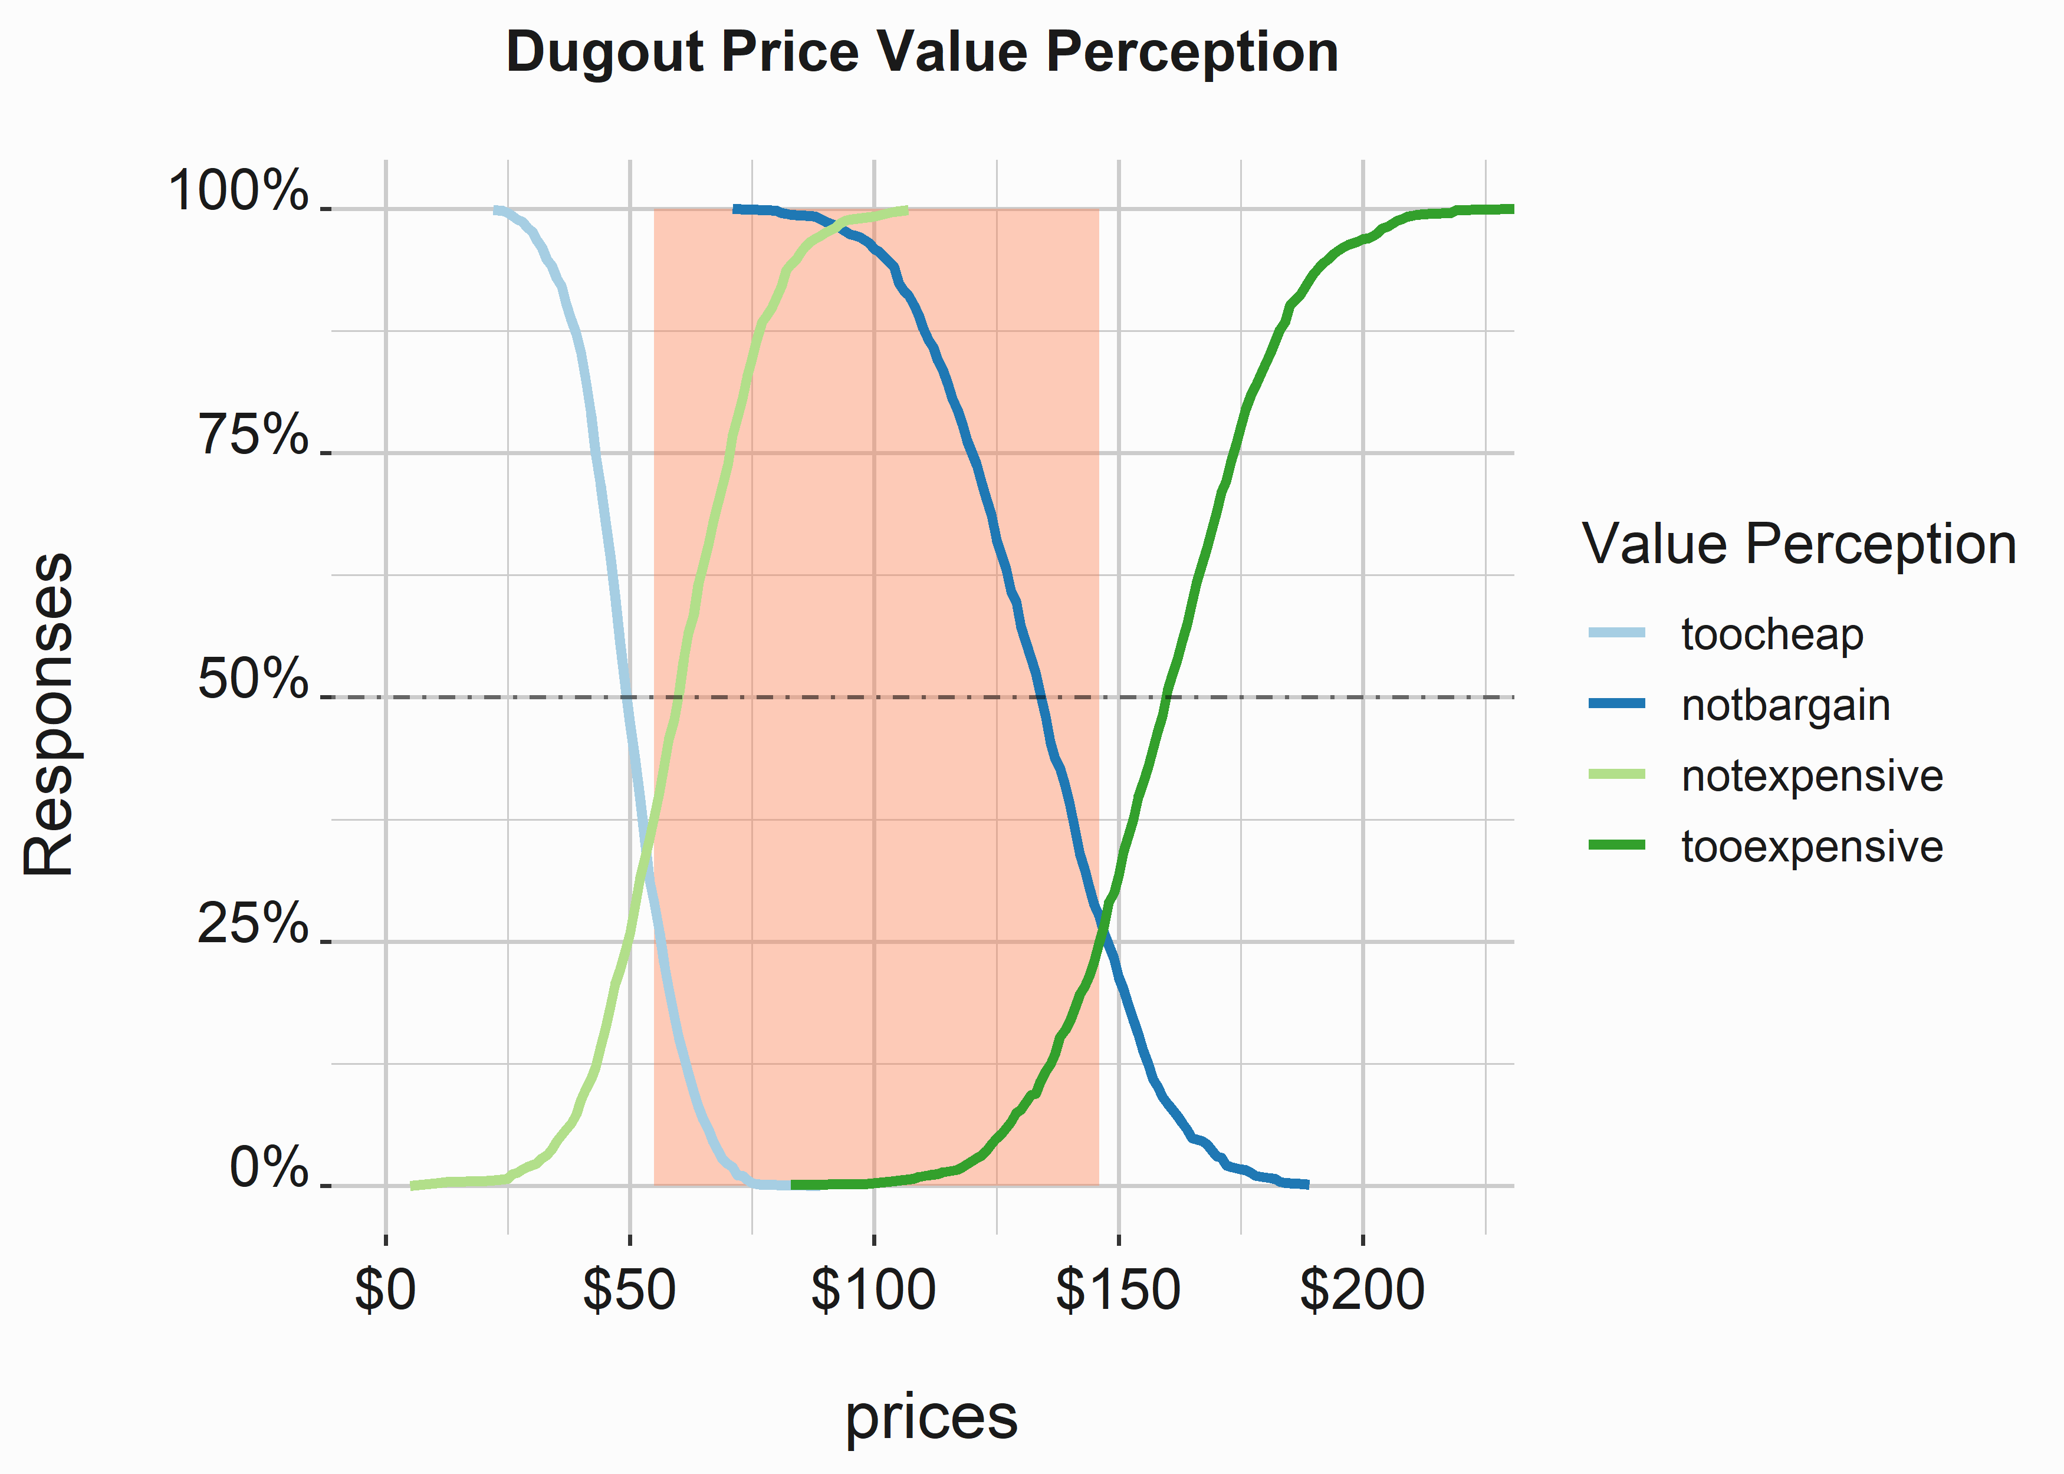
Forecasting Demand: Experimental Approaches
Van Westendorp’s Price Sensitivity Meter
Does not demonstrate Willingness to Pay
Survey based. One similarity to conjoint analysis is that it forces some level of tradeoff.
Is one of many experimental approaches to determining price.
Useful to help triangulate starting prices. It is always a good thing to ensemble methods.
Other Materials
Forbes on VW
Wikipedia

Slide 9
Forecasting Demand: Regression and Machine Learning
Mixed-Effects Models can be used to determine the importance of certain features to weight their importance to overall demand. This has many potential uses. These models can also be used in conjunction with clustering algorithms to simplify some forecasting exercises.
XGBoost is a machine learning technique that operates like a cheat code for getting good results under a variety of conditions and circumstances.
Other variants of OLS Regression such as Robust regression can sometimes help alleviate issues that manifest with modeling ticket demand and prices. They also have other advantages over some machine learning techniques. Regularization can help correct for the common problem of collinearity.
The rapidly changing world of Machine Learning, A.I., and LLMs forces me to mention a few expressions that you should always keep in mind when working in industry.
Law of the Instrument: “If all you have is a hammer, everything looks like a nail.”
Occam’s Razor: “The simplest explanation is usually the best one.”
Perfect is the enemy of good.

Slide 10
Forecasting Demand: Project Introduction
A simplified version of the data you will encounter in your project can be found on these two pages. The code can be used to help guide your analysis of the data for the project.
https://github.com/Justin-Watkins/Emory/tree/main/code
https://github.com/Justin-Watkins/Emory/tree/main/data
A full explanation of the project can be found in the README here:
https://github.com/Justin-Watkins/Emory/tree/main
The data that you will use to complete your project can be found here:
https://github.com/Justin-Watkins/Emory/tree/main/project
This project will be a competition. The team that produces the best results will win. We’ll cover the project in more detail during the next session.

Slide 11
Setting Prices
The Mechanics and Psychology of Pricing

Slide 12
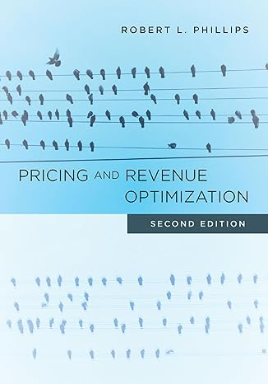
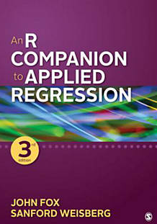
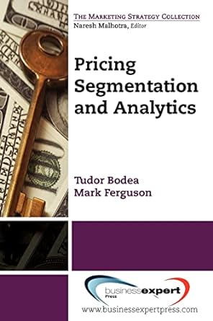

Reading Material
These books draw a good balance between interpretability and technicality. These are four that I have used, but there are lots of good options out there.

Slide 13
The Psychology of Pricing and Consumer Behavior
We can only cover a sliver of these topics… However, keep in mind that Consumer Segmentation is critical for price and product differentiation.
Given the breadth of this subject, you’ll have to look up the following concepts on your own. Let’s discuss a few of them:
Decoy effect
Charm Pricing
Compromise Effect
Anchoring Mechanisms
Prospect Theory
Fees and Discounts
Markdown Management
Fairness and Dual Entitlement
Consumer Search Costs
Competitive Response
Product Versioning
Regional Pricing
Couponing
Group and Season Pricing
Cannibalization
Constrained Supply
Newsvendor Problem
Multi-class Problem
Network Management
Bid Pricing
Overbooking
Custom products
Dynamic Pricing
Game Theory
B-to-B Pricing
Promotion Effects
Reference Pricing
Freemium Strategies
Elasticity
Arbitrage

Slide 14
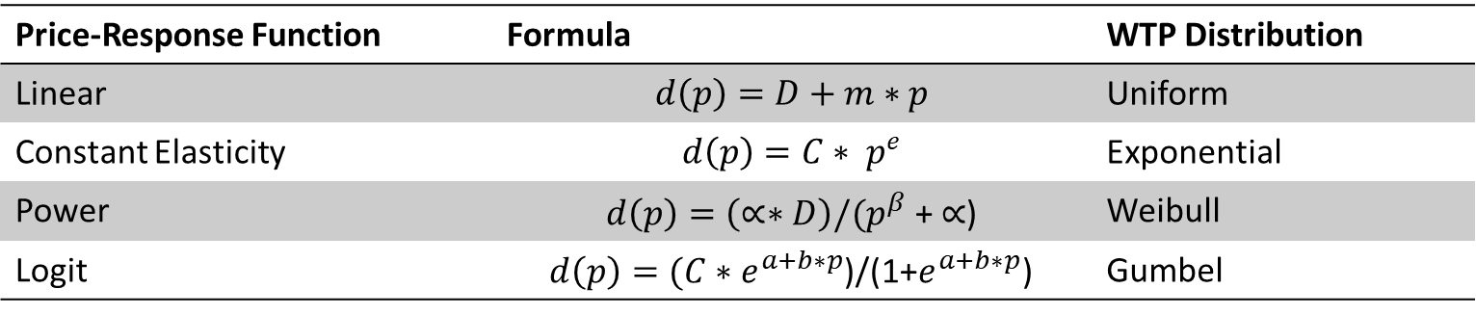
Fitting Distributions and Price Discrimination
Limits to Price Differentiation:
Imperfect Segmentation: It can be difficult to determine Willingness to Pay
Cannibalization: Customers are trained to look for ways to pay lower prices
Arbitrage: Third Parties can resell tickets
We will focus on Willingness-to-Pay. Common Price-Response Functions are listed in the following table
Price-Response Function | Formula | WTP Distribution
Linear | $$d\left(p\right)=D+m∗p$$ | Uniform
Constant Elasticity | $$d\left(p\right)=C∗ p^{e}$$ | Exponential
Power | $d\left(p\right)=\left(∝∗D\right)/{(p}^{β}$ + $∝$) | Weibull
Logit | $d\left(p\right)=(C∗e^{a+b∗p}$)/(1+$e^{a+b∗p}$) | Gumbel
Price response functions are outstanding tools that allow us to predict consumer responses at each price level. They are a heuristic used to adjust our pricing tactics and strategy continuously. The following sections will demonstrate constructing a price-response function.

Slide 15
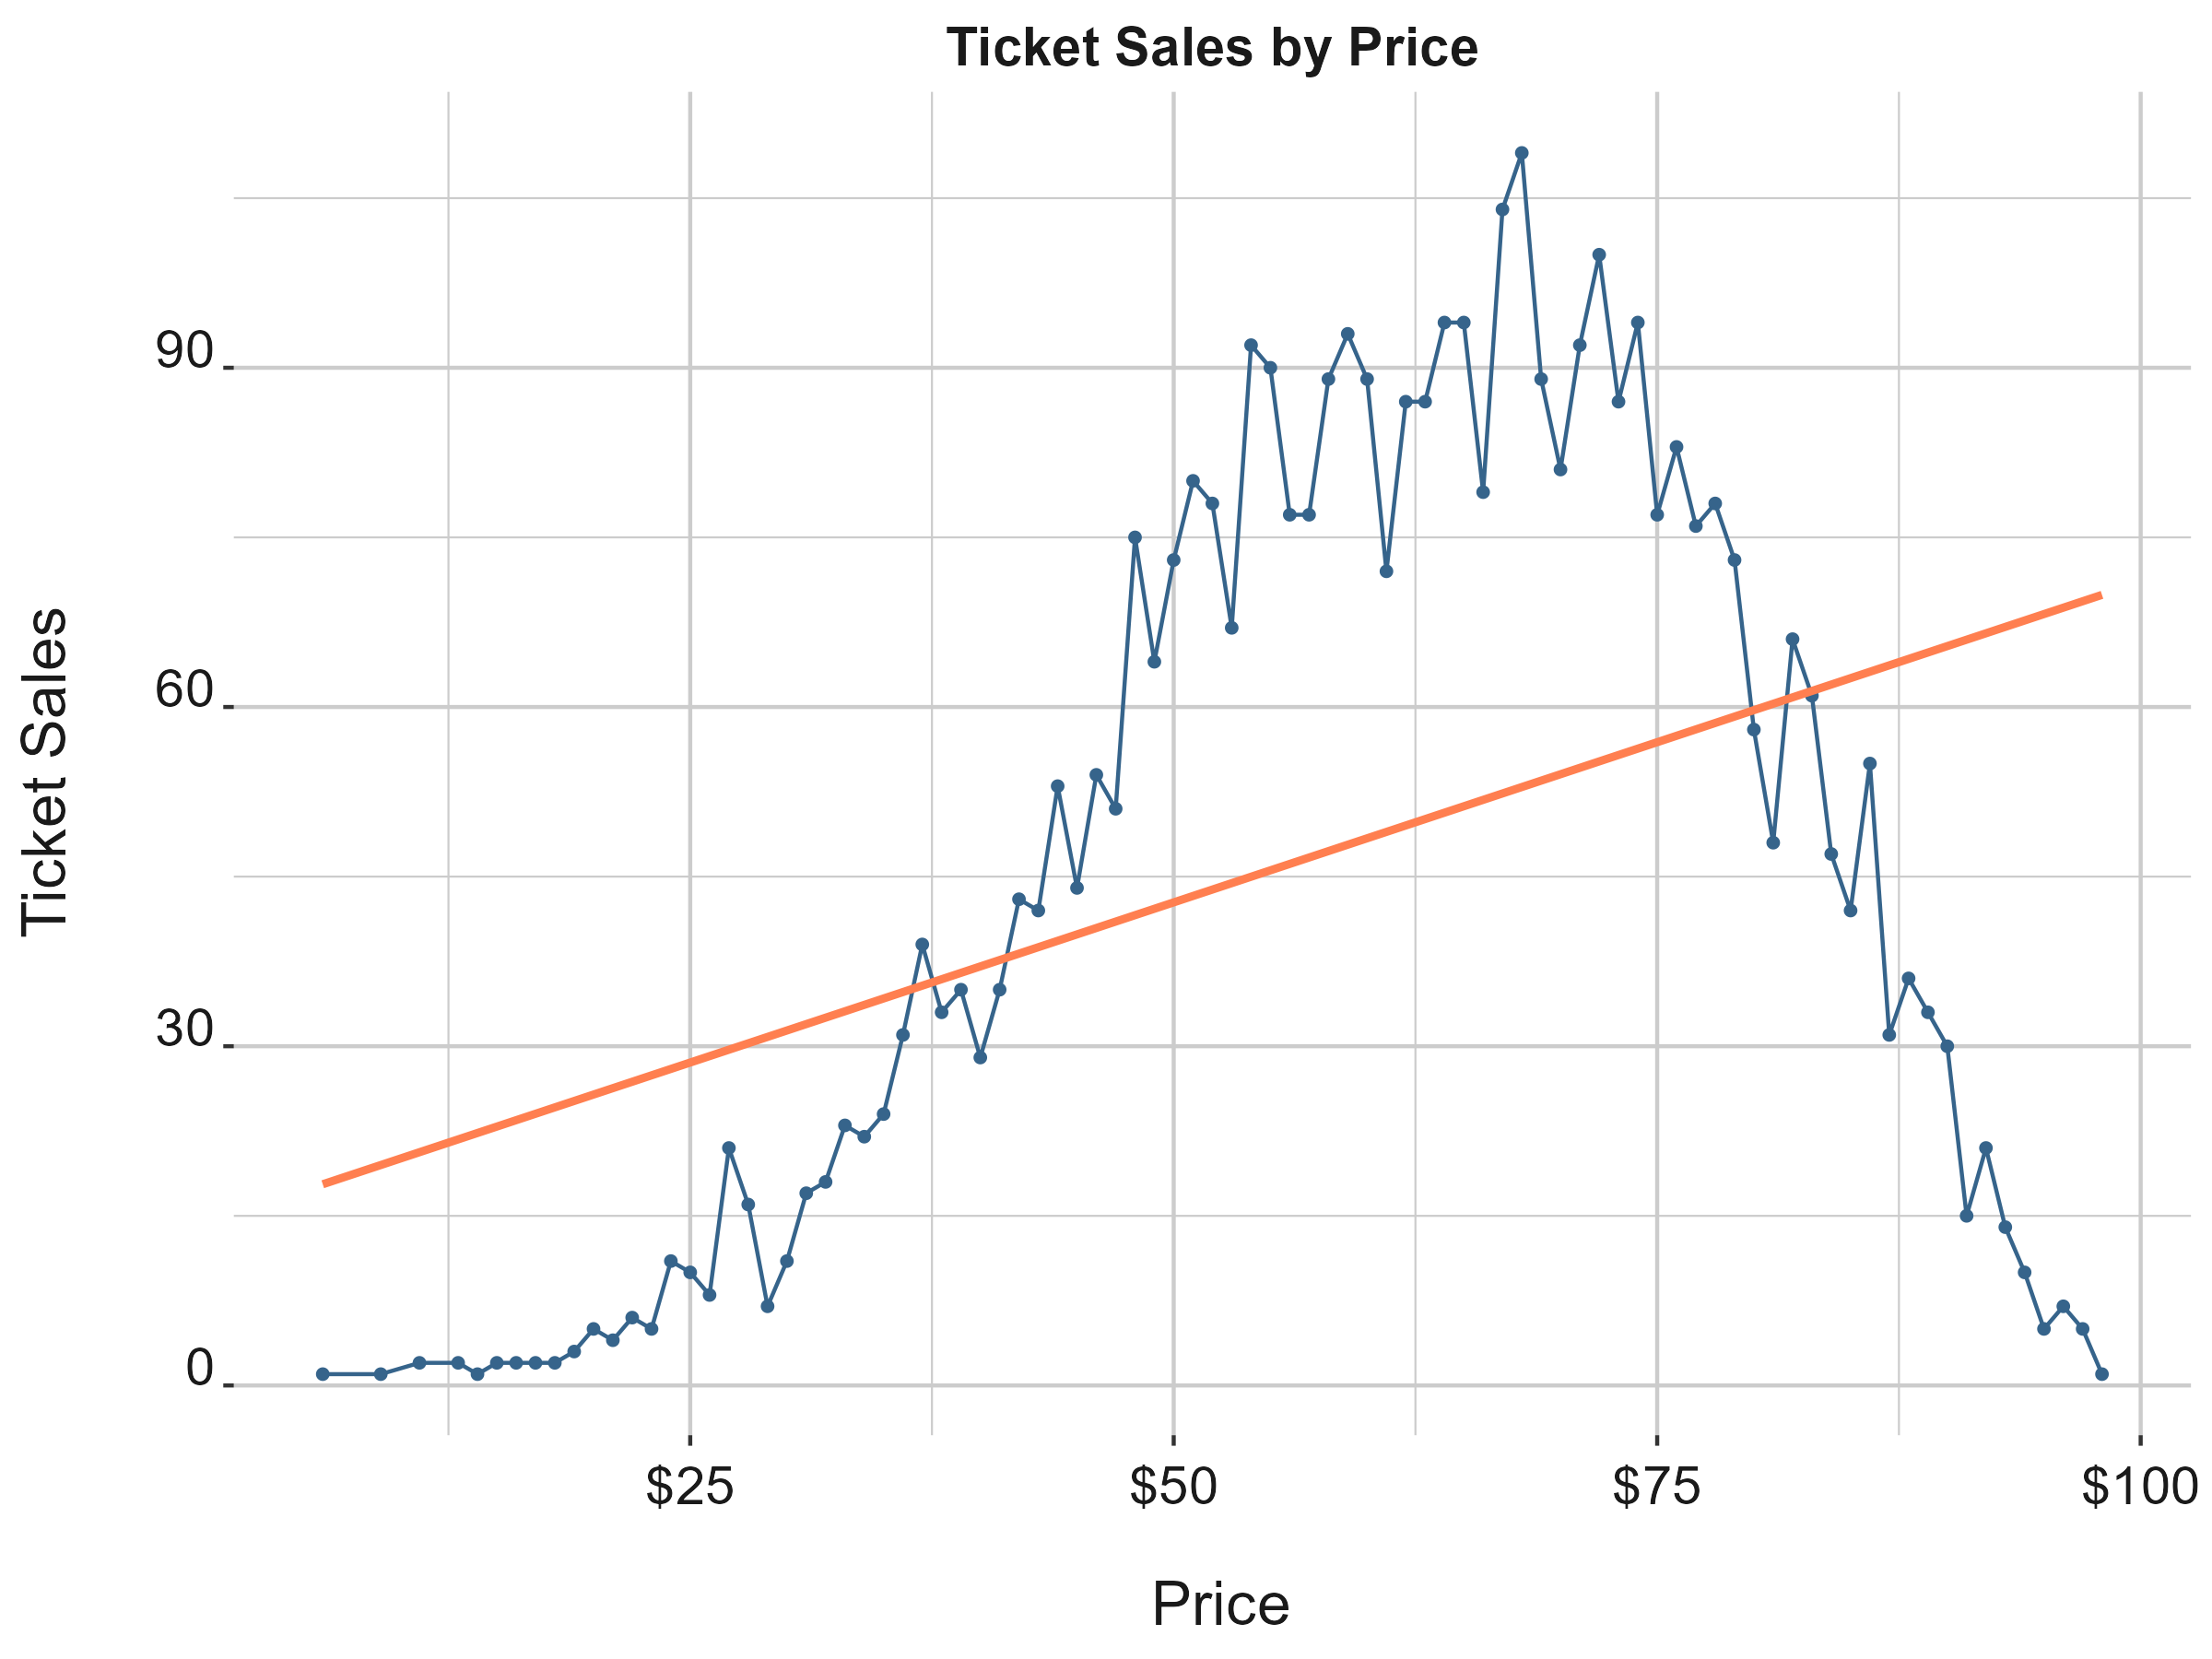
Pricing: Price Response Function
This data follows a beta distribution and simulates secondary market purchases for a particular section over time. Secondary market prices are interesting because they can float in an unconstrained way but may suffer from inventory availability problems.
This is also for illustration. Actual sales data is typically highly skewed but can follow many different distributions.

Slide 16
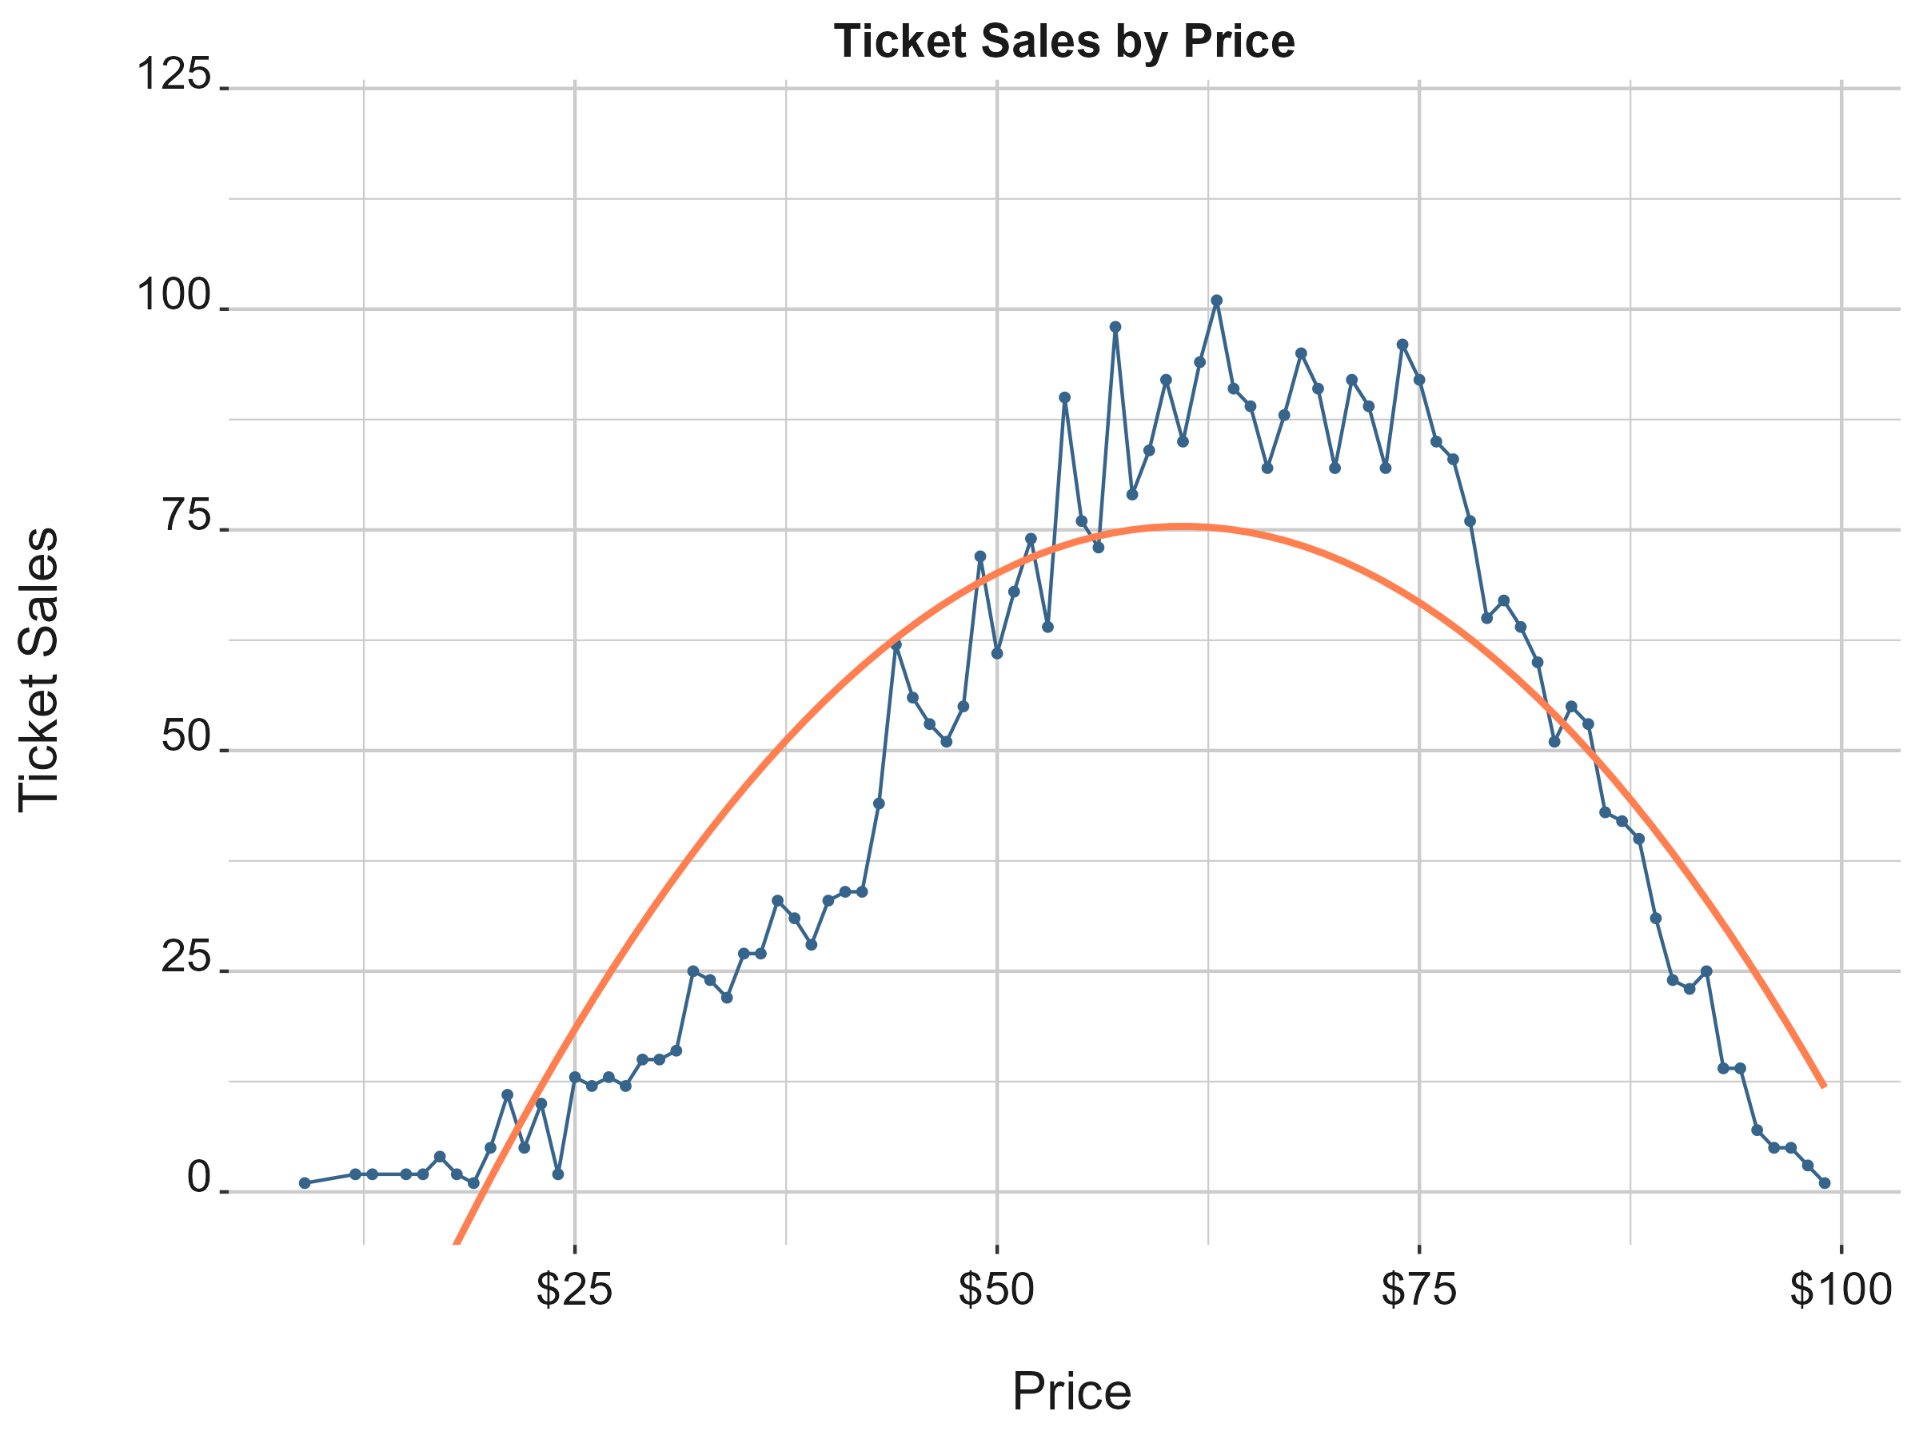
Pricing: Price Response Function
Fitting a polynomial function to the data works much better than a linear model. However, we can see that we could probably do better. (We know we could do better since we picked the distribution). We can see that the line over and underestimates tickets sold at each price level across the entire distribution.
How do we use this function to set prices? This depends on the circumstances…

Slide 17
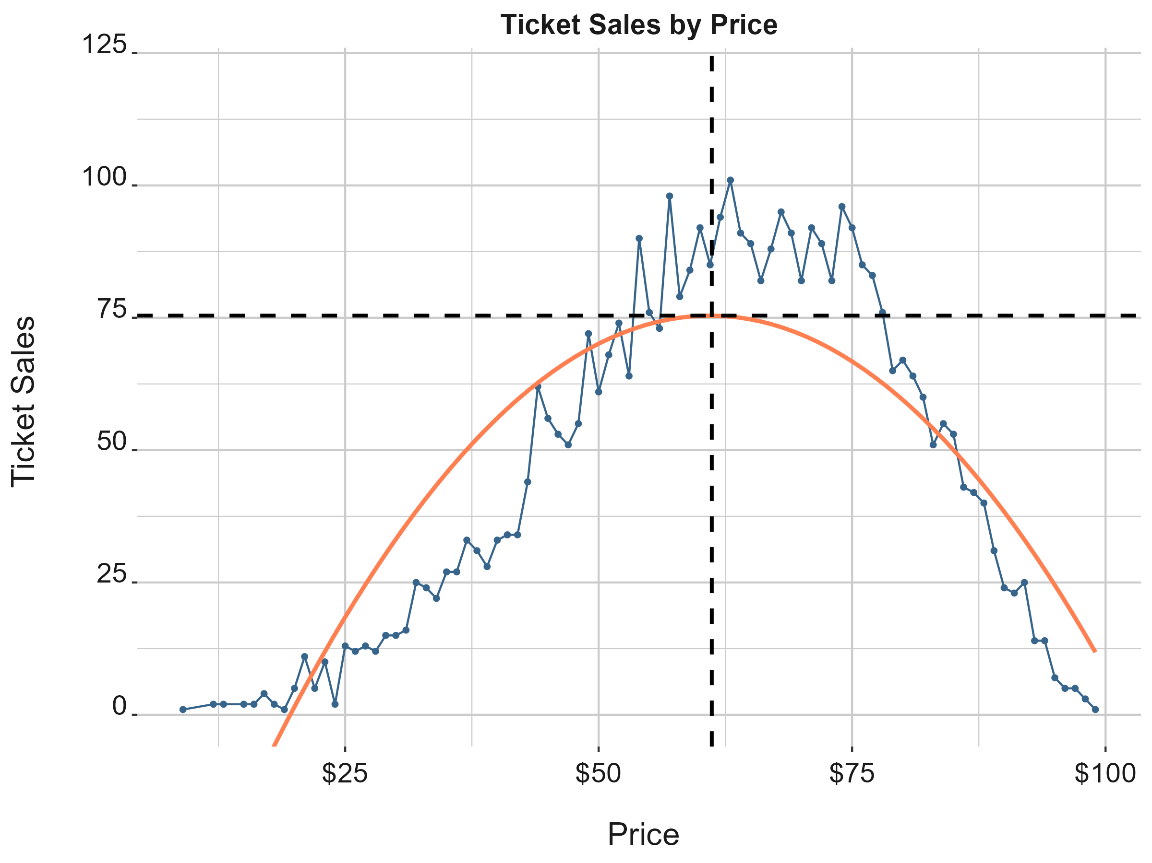

Pricing: Price Response Function
We can use the function from the polynomial fit to obtain the revenue-maximizing point on the curve.
$$Sales=\text{−88.16618}{+\text{5.35142}\text{x} \text{+ }\text{−0.04375}\text{x}}^{2}$$
Take the derivative and set it = 0
$\frac{d}{dx}={\text{(}\text{−0.04375}\text{x}}^{2}+$ $\text{5.35142}\text{x} \text{−88.16618}\text{)}$
$$0=5.35142 − \text{.0875}\text{x}$$
Solving the function gives us $61.16
Plugging $61.16 back into our sales equation gives us 75 or so tickets. If we could only set one price, this is where you might consider setting it.

Slide 18
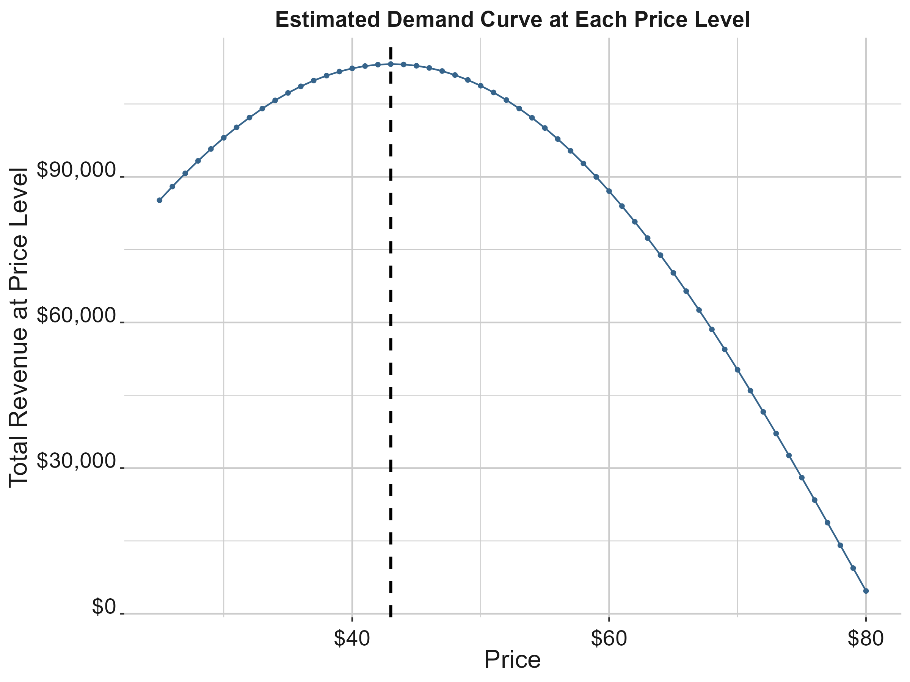
Pricing: Price Response Function
This gives us a reasonable model to use to estimate our revenue opportunity. This is where qualitative factors must be considered.
If we assume that for every price level, we sell every ticket that is more expensive, calculating overall revenue suggests that a ticket around $43 maximizes overall revenue. This is because we assume that we forego all sales below every price level.
This demonstrates the potential power of price discrimination and some of the practical considerations for setting prices.

Slide 19
The pricing workflow
This section outlines the steps in a typical pricing analysis scenario

Slide 20
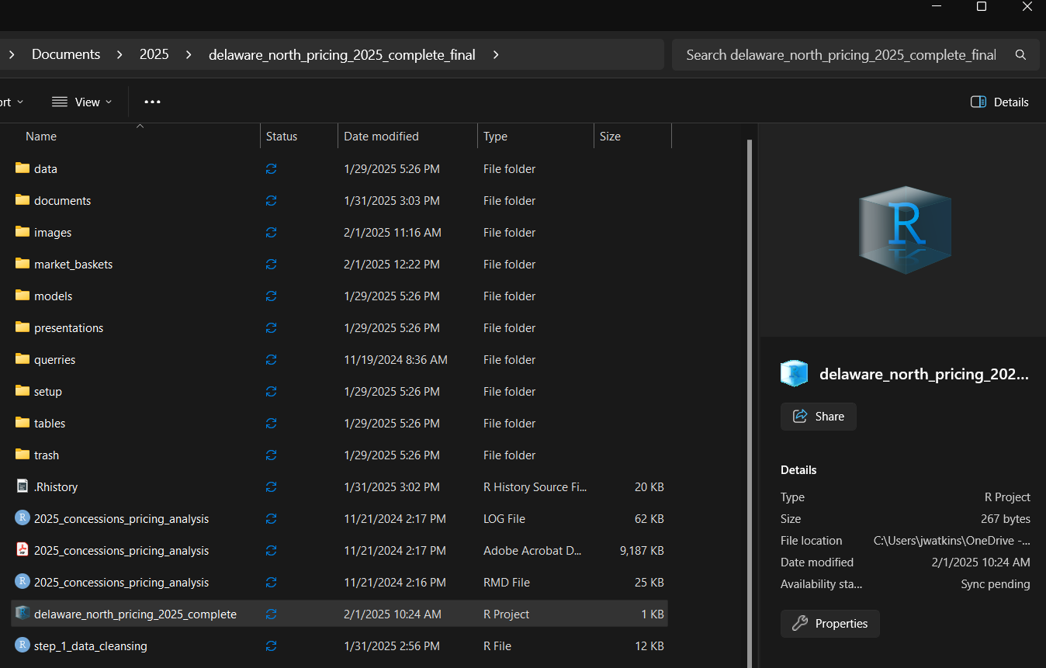
Setting up your environment
Try to keep a consistent folder structure. This will come in handy for you and your colleagues.
I tend to follow a structure that looks like a typical website backend.
I also tend to name files in steps:
Step_1_data_cleansing
Step_2_graphics
Step_3_modeling_demand
Step_4_optimization

Slide 21
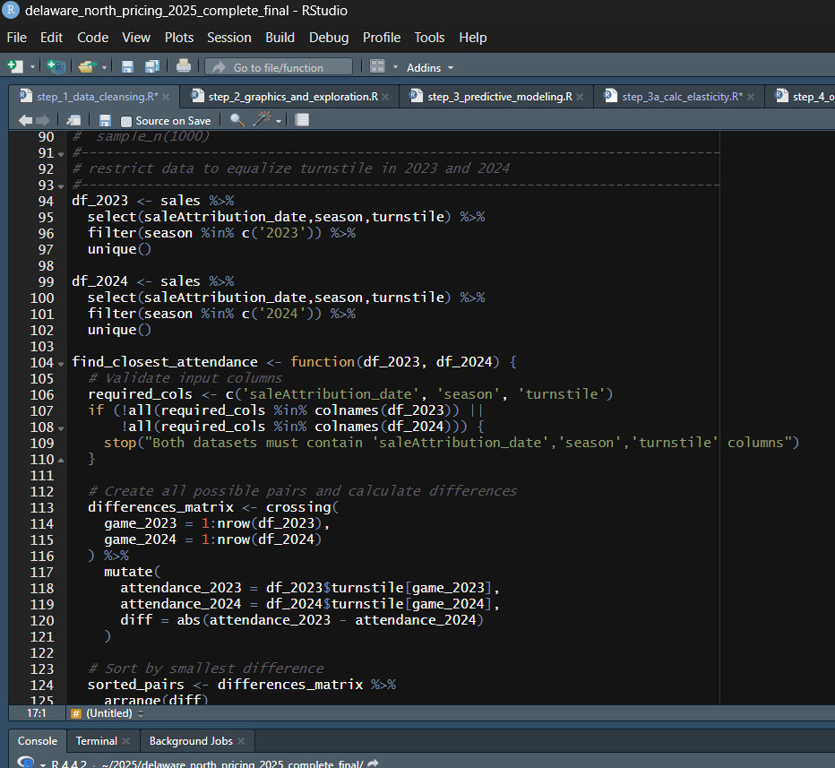
Step 1: Cleaning and understanding your data
!!! THIS IS THE MOST IMPORTANT STEP !!!
If you do not understand your data, your analysis will suffer.
Your analysis should be both:
Interpretable
Sensible
Remember that models are stupid and have been commoditized. The difference between a good model and a bad model is in how well you interpret the data. If you must explain your model to an operator, it had better make logical sense.

Slide 22
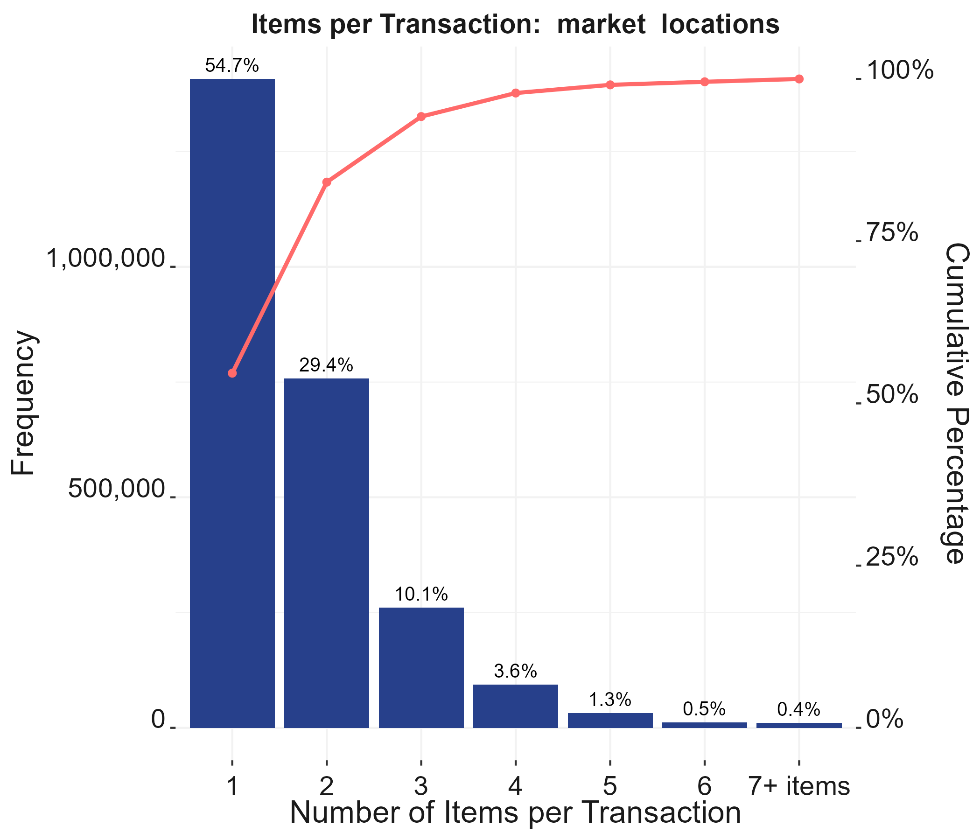
Step 2: Building your Graphics… Use simple graphs as much as you can
Get good at making attractive graphics
Do you know about the color wheel?
How many different types of charts can you name? (This is a Pareto Chart)
Try to use a consistent theme (colors, etc.)
I never use pie charts
I try not to utilize a secondary y axis (Pareto charts are my one exception)
Show the correct graphs to the correct people
Always interpret your graphs for the recipient
You’ll get the most effective use out of the simplest bar graphs. Always simplify
Build graphics around all basic features. They always come in handy

Slide 23
Step 3: Modeling Demand
#-------------------------------------------------------------------------------
# Residual diagnostics plots
#-------------------------------------------------------------------------------
#par(mfrow = c(2, 2))
plot(lm_fit)
#-------------------------------------------------------------------------------
# Histogram and density plot of residuals
#-------------------------------------------------------------------------------
hist(residuals(lm_fit), main = "Histogram of Residuals", xlab = "Residuals")
plot(density(residuals(lm_fit)), main = "Density Plot of Residuals")
#-------------------------------------------------------------------------------
# Shapiro-Wilk test for normality
#-------------------------------------------------------------------------------
shapiro.test(residuals(lm_fit))
set.seed(12345)
sampled_residuals <- sample(residuals(lm_fit), 10)
shapiro.test(sampled_residuals)
ks.test(residuals(lm_fit), "pnorm",
mean = mean(residuals(lm_fit)),
sd = sd(residuals(lm_fit)))
#-------------------------------------------------------------------------------
# Variance Inflation Factor (VIF)
#-------------------------------------------------------------------------------
car::vif(lm_fit)
#-------------------------------------------------------------------------------
# Durbin-Watson test for autocorrelation
#-------------------------------------------------------------------------------
lmtest::dwtest(lm_fit)
#-------------------------------------------------------------------------------
# Cook's Distance
#-------------------------------------------------------------------------------
plot(lm_fit, which = 4)cooksd <- cooks.distance(lm_fit)
plot(cooksd, type = "h", main = "Cook's Distance")
abline(h = 4/length(cooksd), col = "indianred1")
#-------------------------------------------------------------------------------
# Influence Plot
#-------------------------------------------------------------------------------
influencePlot(lm_fit)
#-------------------------------------------------------------------------------
# Breusch-Pagan test for homoscedasticity
#-------------------------------------------------------------------------------
bptest(lm_fit
)#-------------------------------------------------------------------------------
# Component + Residual plot
#-------------------------------------------------------------------------------
crPlots(lm_fit)
Take some time to really study regression
Many practitioners don’t pay enough attention to their models and have terrible results on validation data due to violating basic tenets of regression. Don’t get humiliated.
Follow a rubric. LLMs will sometimes do things incorrectly
Learn when to use special forms of regression such as RIDGE and LASSO.
Learn when and how to utilize factor analysis (PCA)
Understand Mixed Effects Models and how they can be used to improve your modeling
Always triangulate with various techniques. I typically utilize OLS regression, Ridge, xgboost, and occasionally Random Forests and Torch.
You’ll use your models to gauge price response

Slide 24
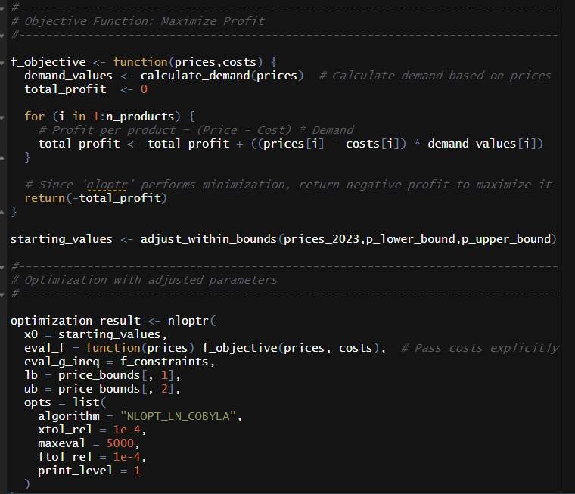
Step 4: Optimization: Solving for the best prices
Get familiar with Optimization methods
You can used mixed effects models to estimate elasticity
Cross-Price elasticity is utilized to build robust models that solve all prices at once
Optimization is also dumb…
Feature engineering is important here
A Model is only as good as its constraints
Gradient-based and non-gradient methods
Brute force methods (DeOptim)
What happens if you can’t get a model to converge?

Slide 25
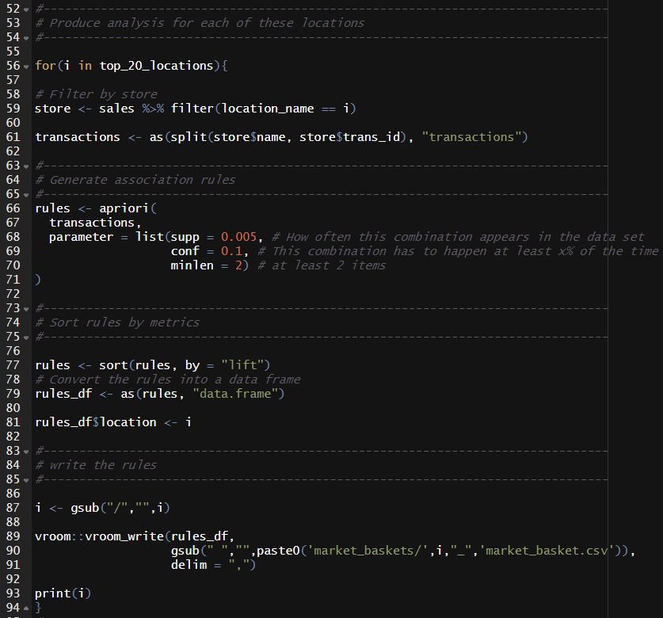
Step 5: Market baskets
Always extend your analysis
Market baskets help you understand underlying patterns in your data that are easy to explain.
For instance, you might see that customers routinely purchase the same items together which could indicate a bundling opportunity.
These sorts of analysis are utilized for our concessions business.

Slide 26
Step 6: Implementing pricing changes
Study all the dirty tricks!
Consider increasing the price of Cash Cows (high volume, low contribution).
Some ??? (High contribution, low volume) items may benefit from price decreases.
Price higher margin items to decrease purchases of Dogs.
Study decoy pricing and asymmetrical domination.
Take advantage of anchoring. Keep a very high-priced item on most menus.
Bundle items.
Consider altering descriptions of items. Longer descriptions have been effective in some cases.
Charm price all value items (end with a 9). Price premium items so that they end with a 0.
Omit currency symbols from prices. Only include numbers.
Highlight items we want to encourage more effectively.
Consider a Van Westendorp survey that can be administered internally to gauge pricing perception. Conjoint surveys may also be useful to help understand substitute preference.

Slide 27
Project Instructions and Discussion
The data that you will use to complete your project can be found here:
https://github.com/Justin-Watkins/Emory/tree/main/project
Project Instructions and Discussion

