Slide 1

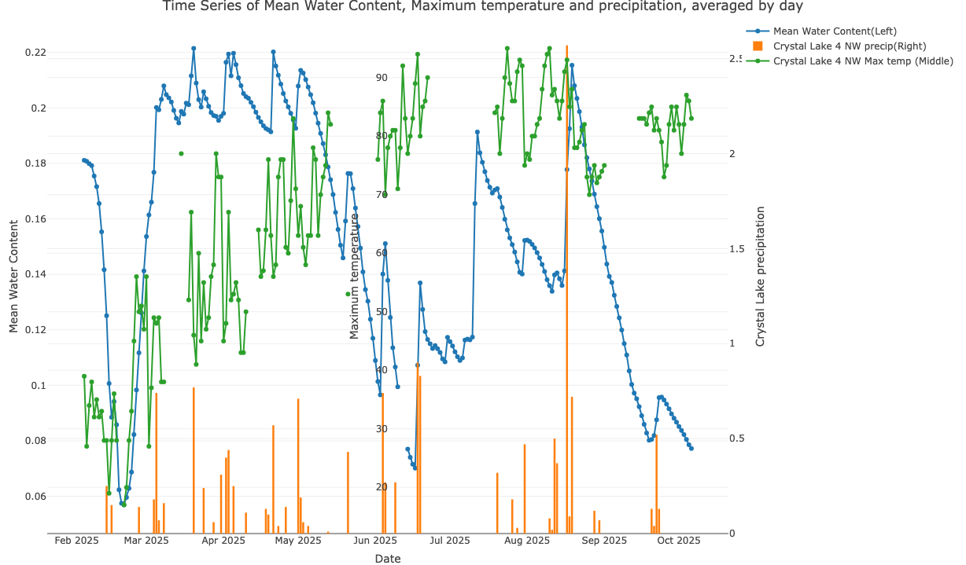
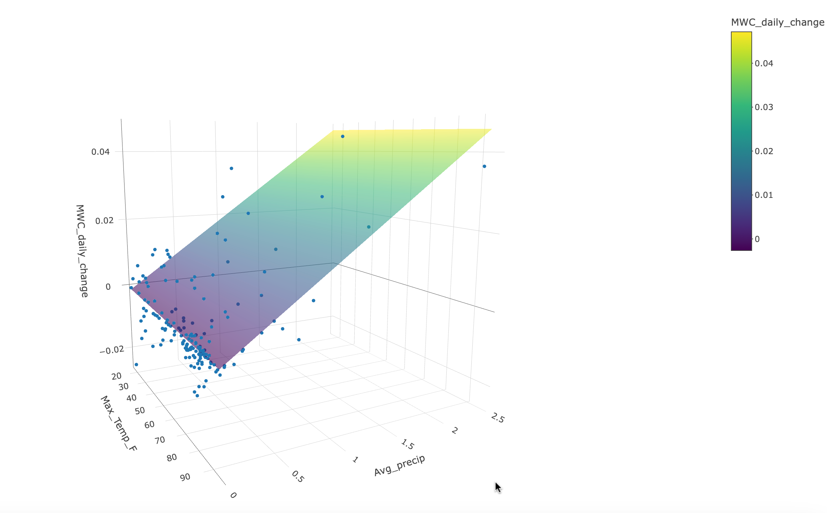
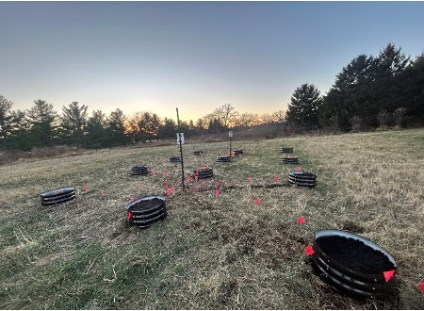
A Comparative Analysis of Soil Moisture Under Different Atmospheric Conditions
Justin Peabody, Dr. Debjani Ghatak, Tristan Peterson
School of Environmental Sustainability
Loyola University Chicago
Introduction
Methods
Model Results and Limitations
Existing literature shows that urbanization affects and alters surface hydrology. Urban areas frequently experience reduced soil water percolation due to the compression of land by overlying infrastructure. As a result of such compression, only about 20% of water that falls on urban soil is absorbed while 80% flows through drainage systems and into rivers, contributing to flooding and soil dehydration (Markovi, G. et al., 2014). Impervious soil cover in cities also result in increased collection of anthropogenic pollutants by the impervious surfaces and their subsequent release into river systems during heavy rainfall events (Chithra S.V. et al., 2015) as well as increases in land surface temperatures and urban heat island effects (Yuan, Fei, and Marvin E. Bauer, 2007).
Additional ecological damage can result from pollutants within the building materials themselves, such as carcinogenic coal tar pitch in asphalt (Frazer, 2005). Moreover, nitrogen and phosphorous from fertilizers and decaying organic matter can accumulate over the surfaces, which leaches into aquatic systems during storms and causes eutrophication (Obiakor et al., 2012). Loyola’s Lakeshore Campus, being in an urban area, provides sustainable solutions to water conservation and stormwater diversion. This campus currently utilizes permeable pavement on major walkways, which helps to absorb stormwater and reduce flooding and runoff during heavy precipitation events.
The research methodology includes (1) downloading volumetric water content readings collected by the sensors at the LUREC field site from February 4 to October 6, 2025, (2) analysis and visualization of data, and (3) generating preliminary statistical models of daily changes in mean water content as a function of daily maximum temperature at a nearby weather station and the average of daily precipitation at three nearby weather stations. Weather station data was scraped from NOAA’s National Centers for Environmental Information website (see References and External Data Sources section for URL). Models were generated using Ordinary Least Squares multiple linear regression using the R statistical software.
The current regression model contains several important limitations. Firstly, since average precipitation values are clustered heavily near zero (only a few extreme precipitation events per station), our estimates for daily change in mean water content are very uncertain for high daily average precipitation values (very little average precipitation data beyond 1 inch). Secondly, although average temperature of three stations is likely a better estimate of the LUREC site’s daily precipitation than one station’s temperature, it is still an estimate based on proxies, which introduces uncertainty due to the spatial variability of precipitation events. Using Crystal Lake’s maximum temperature as a proxy for the LUREC site’s maximum temperature also introduces uncertainty. Thirdly, while average precipitation is a statistically significant linear predictor of daily change in mean water content (p<2.2e^-16), maximum temperature is not significant (p=0.479), which counters intuition.
These uncertainties could be overcome if temperature sensors and precipitation gauges were installed on site. Once soil cover materials are installed, new models can be generated and compared against the current model. Another potential modeling goal is to determine whether the relationships between individual pots’ mean water content, daily maximum temperature, and precipitation significantly differ depending on the soil cover material.
Data visualization and modeling analymodeling
Relationship between Soil Water Content, Precipitation and Maximum Temperature
Feb-Oct 2025
Fig 2: A time series graph of averaged mean water content for all 12 pots and Crystal Lake 4 NW weather station daily precipitation and minimum temperature. Shows less than one day of time delay between precipitation (in inches) and increases in mean soil water content (in m^3 water/m^3 soil).
Fig 3: A multiple linear regression model of daily change in mean water content (across all 12 pots) Z vs Crystal Lake 4 NW maximum temperature (Y) and daily precipitation averaged across 3 nearby weather stations (X). The three stations used were Crystal Lake 4 NW, Woodstock 5 NW, and Woodstock 3.8 SW.
Objectives and Future Goals Goals
This multi-year project, which utilizes the field site set up in 2025 at the Loyola University Retreat and Ecology Campus (LUREC) by Dr. Debjani Ghatak and former undergraduate student Tristan Peterson (Fig 1), aims to quantify the efficiency of permeable surface cover compared to impermeable surface cover in influencing surface hydrology. Funding is being sought to obtain temperature sensors, precipitation gauges, and soil cover materials; including cement, vegetation, and permeable tile; via the Provost Fellowship and/or the School of Environmental Studies Fellowship. Future goals include installation of the aforementioned temperature sensors and precipitation gauges at the LUREC field site, covering the pots at the site with the cover materials, collecting on-site temperature and precipitation data, and statistically analyzing the data to examine differences in moisture content between the cover materials and to more accurately model the relationships between soil water content and ambient atmospheric conditions.
Fig 1: The LUREC field site, which consists of a 3 by 4 array of cylindrical pots with Meter Group TEROS 10 soil moisture sensors installed in each pot. These sensors generate hourly readings of volumetric soil water content and transmit them via cables to data loggers. Each data logger receives readings from 6 of the 12 pots.
References and External Data Sources
Markovi, G., et al. "Rainwater infiltration in the urban areas." WIT Transactions on Ecology and the Environment 181 (2014): 313-320.
Chithra, S. V., et al. "Impacts of impervious surfaces on the environment." International Journal of Engineering Science Invention 4.5 (2015): 27-31.
Yuan, Fei, and Marvin E. Bauer. "Comparison of impervious surface area and normalized difference vegetation index as indicators of surface urban heat island effects in Landsat imagery." Remote Sensing of environment 106.3 (2007): 375-386.
Frazer, Lance. "Paving paradise: the peril of impervious surfaces." Environmental health perspectives 113.7 (2005): A456.
Ramamurthy, Prathap, and Elie Bou‐Zeid. "Contribution of impervious surfaces to urban evaporation." Water Resources Research 50.4 (2014): 2889-2902.
Obiakor, M. O., C. D. Ezeonyejiaku, and T. C. Mogbo. "Effects of vegetated and synthetic (impervious) surfaces on the microclimate of urban area." Journal of Applied Sciences and Environmental Management 16.1 (2012): 85-94.
Ncei.Noaa.Gov. n.d. “Past Weather | National Centers for Environmental Information (NCEI).” Accessed April 4, 2026. https://www.ncei.noaa.gov/access/past-weather/Woodstock%2C%20Illinois.

