Slide 1
Understanding Air Quality Through Data
Justin Peabody, Dr. Whalen

Slide 2
The CLEAR lab
CLEAR = Community and Local Engaged Air Research
Multidisciplinary student/faculty air quality research team
Goals:
air quality (AQ) sensor installation
analyzing/mapping sensor data
research and public education
Notes:
This USRE project builds upon the work of the CLEAR lab, which is a team of Loyola undergraduate and graduate students in collaboration with faculty from the School of Environmental Sustainability and the Department of Mathematics and Statistics from a wide variety of fields including data science, enviornmental science, political science, and communications.. The CLEAR lab works to install air quality sensors throughout Chicago and collect and analyze spatial and temporal data from the sensors to support research initiatives and public education.

Slide 3
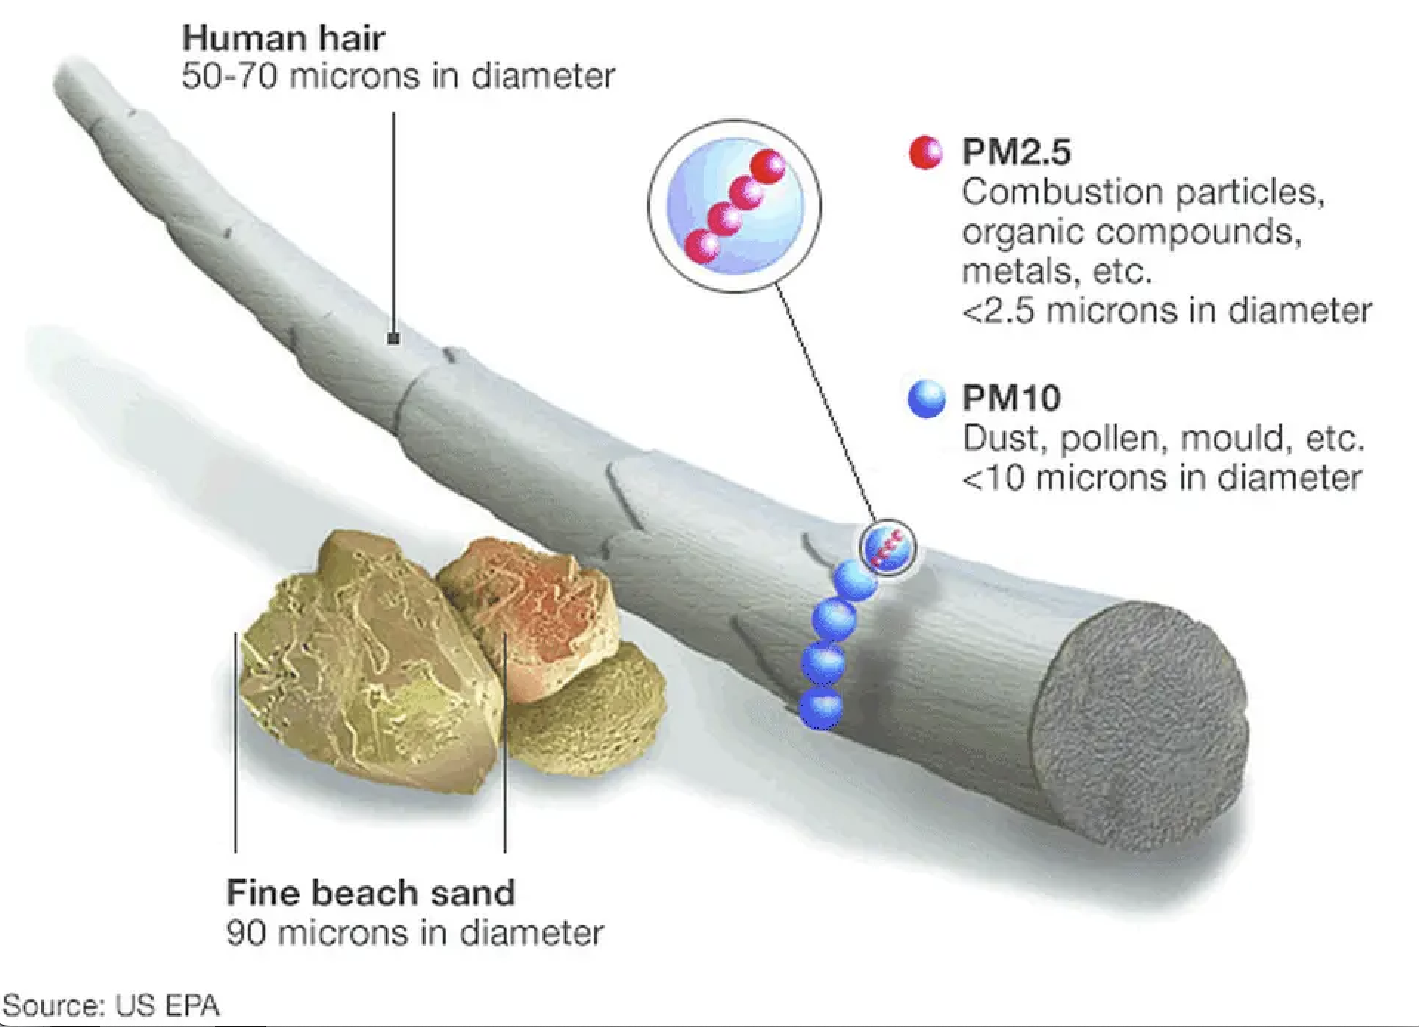
PM2.5
Particulate matter: suspended air particles
PM2.5: particulate matter < 2.5 um in diameter
Smaller particles pose highest health risk
Sources: fossil fuels, industry,
vehicle exhaust, wildfire smoke
Notes:
The research of the CLEAR lab primarily focuses on particulate matter, which are solid and liquid particles suspended in the air. Particulate matter can originate from many sources, including fossil fuel combustion, industrial processes, vehicle exhaust, and wildfire smoke. Of particular concern is PM2.5, particulate matter less than 2.5 micrometers in diameter, because small particle size allows air pollution to enter the bloodstream, lungs, and heart, yielding a higher health risk and exacerbating athsma, bronchitis, and cardiovascular disease.

Slide 4

PurpleAir Sensors
PurpleAir: affordable AQ sensor manufacturing company
Offers smaller, more portable, higher-granularity sensors than EPA
92 sensors in Chicago, 62 of which are active
Notes:
The CLEAR lab uses sensor data from PurpleAir, a company which manufactures and sells small, affordable air quality sensors to communities. PurpleAir sensors are smaller, more portable, lower-cost than federal EPA sensors and provide a more granular, hyperlocal picture of air quality for communities worldwide. There are currently 92 PurpleAir sensors installed in the city of Chicago and an additional 17 sensors in the Chicago suburbs.
These sensors, which can be installed both indoors and outdoors, measure PM2.5, humidity, temperature, and atmospheric pressure once every 2 minutes and upload the readings to a cloud-based server. Researchers can access the data through the company’s application programming interface (API), which allows users to connect the PurpleAir server to their own databases and software programs.

Slide 5
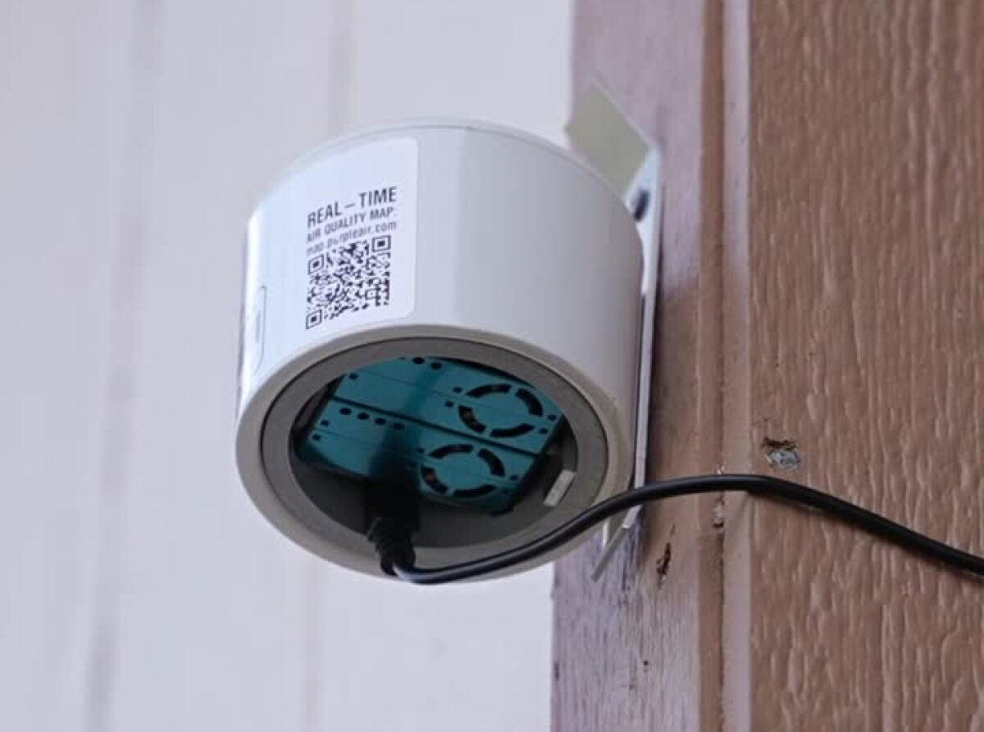
PurpleAir Sensors
work both indoors and outdoors
Measure PM2.5, humidity, temperature, and atmospheric pressure
Readings uploaded to cloud based server, accessible via API
Notes:
These sensors, which can be installed both indoors and outdoors, measure PM2.5, humidity, temperature, and atmospheric pressure once every 2 minutes and upload the readings to a cloud-based server. Researchers can access the data through the company’s application programming interface (API), which allows users to connect the PurpleAir server to their own databases and software programs.

Slide 6
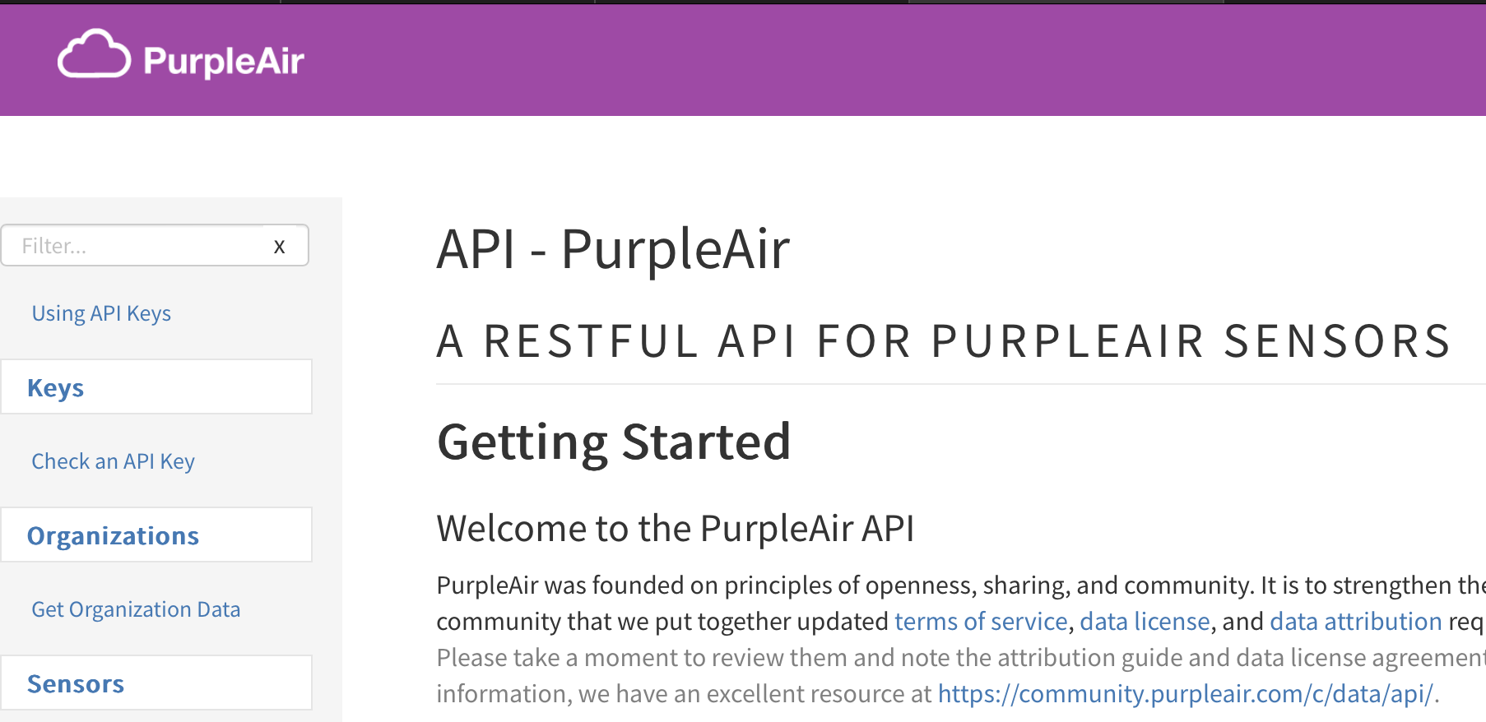
PurpleAir API
API = Application Programming Interface
Allows connection between servers/applications

Slide 7
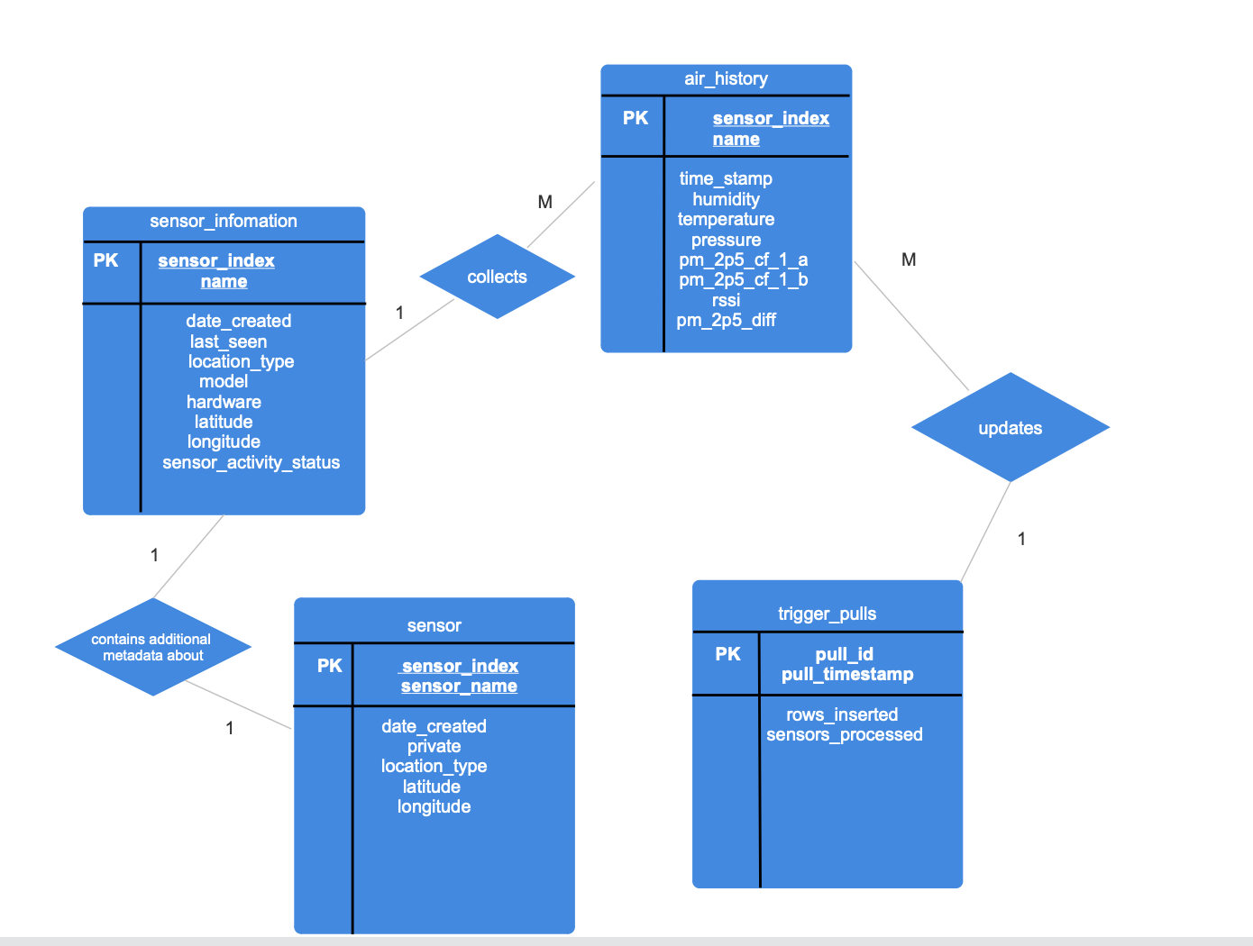
Database Structure
Notes:
The CLEAR lab uses a SQL database, the structure of which is outlined by this entity-relationship diagram.
The database consists of 4 tables:
air_history, which contains the 2-minute temperature, humidity, pressure, and PM2.5 sensor readings as well as the time stamp of each reading and a unique index number specifying the sensor generating the reading
sensor_information, which contains metadata such as when the sensors were previously online, installation date, latitude and longitude, indoor or outdoor, unique model and hardware numbers, and a newly created column which labels a sensor as “Active” if it was last online on or after June 1, 2026 and “Inactive” otherwise
sensor, which contains much of the same data as sensor_information and additional metadata such as public/private status
trigger_pulls, a newly created table that keeps track of updates to the air_history table (more on this later)

Slide 8
Database update script
Query active sensors
Download updated metadata
Update sensor_
information
Connect to database
Disconnect from database
Update trigger_pulls
Update air_history
Download historical data
Introduction to SQL programming
Created an R script to execute this workflow:
Connect to CLEAR lab database
Query active sensors
Download updated last_seen dates of active sensors
Update sensor metadata
Download historical data
Update trigger_pulls table
Disconnect from database
Notes:
The first portion of my research experience served as an introduction to SQL programming. I learned how to execute basic SQL queries on data tables and how to use those queries to perform database operations such as creating and deleting tables, data cleaning, and updating tables with new fields based on conditional statements.
I then applied those programmatic elements to create an R script which could be configured to automatically update the CLEAR lab database every 24 hours.
At a high level, the R script executes a 7-step workflow:
Connects to the SQL database.
Queries and stores a list of sensors labeled as active based on when the database says the sensor was last online.
Pulls the updated date of when the sensor was online from the PurpleAir API.
Iteratively compares the two last-online dates for each sensor. If the API’s last-online date is more recent, the corresponding row of the sensor_information table is updated with the new last_seen date.
Historical sensor data is downloaded from the PurpleAir API for the sensors whose metadata was updated. The historical data is then appended to the air_history table on the database.
The trigger_pulls table is updated with the time of the historical data download, the number of rows added to the air_history table, a list of the sensors with new historical data, and a unique ID number for the data download.
Disconnects from the SQL database.

Slide 9
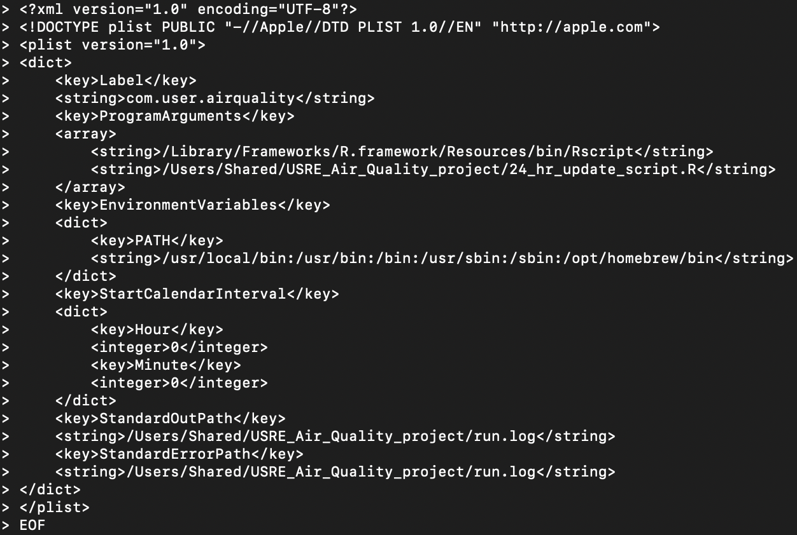
Creating a trigger
Trigger=event or condition that “triggers” code to automatically run
Eliminates the need for manual execution
Notes:
Now that the code is finalized, automating it requires the creation of something called a trigger. Essentially, a trigger is an event or condition, such as a specific time, that causes code to automatically run. The trigger, created in the Terminal, and the R script removes the need to manually update the database every 24 hours, allowing more time to be devoted to research questions. We are in the process of creating a trigger that will automatically execute the workflow on the previous slide every 24 hours, updating the trigger_pulls, sensor_information, and air_history tables daily. What you see here is a trigger that I set up in my Terminal, which automatically runs my R script every night at midnight. Dr. Whalen and I are currently working on creating a trigger that can be uploaded to a cloud server for the long term.

Slide 10
Future goals
Create databases for sensors from other companies (AirGradient, Clarity)
Continued sensor installation
Create a public sensor dashboard
Notes:
??????

Slide 11
What I learned
Introduction to SQL programming
Queries and database operations
ER diagrams for databases

