Slide 1

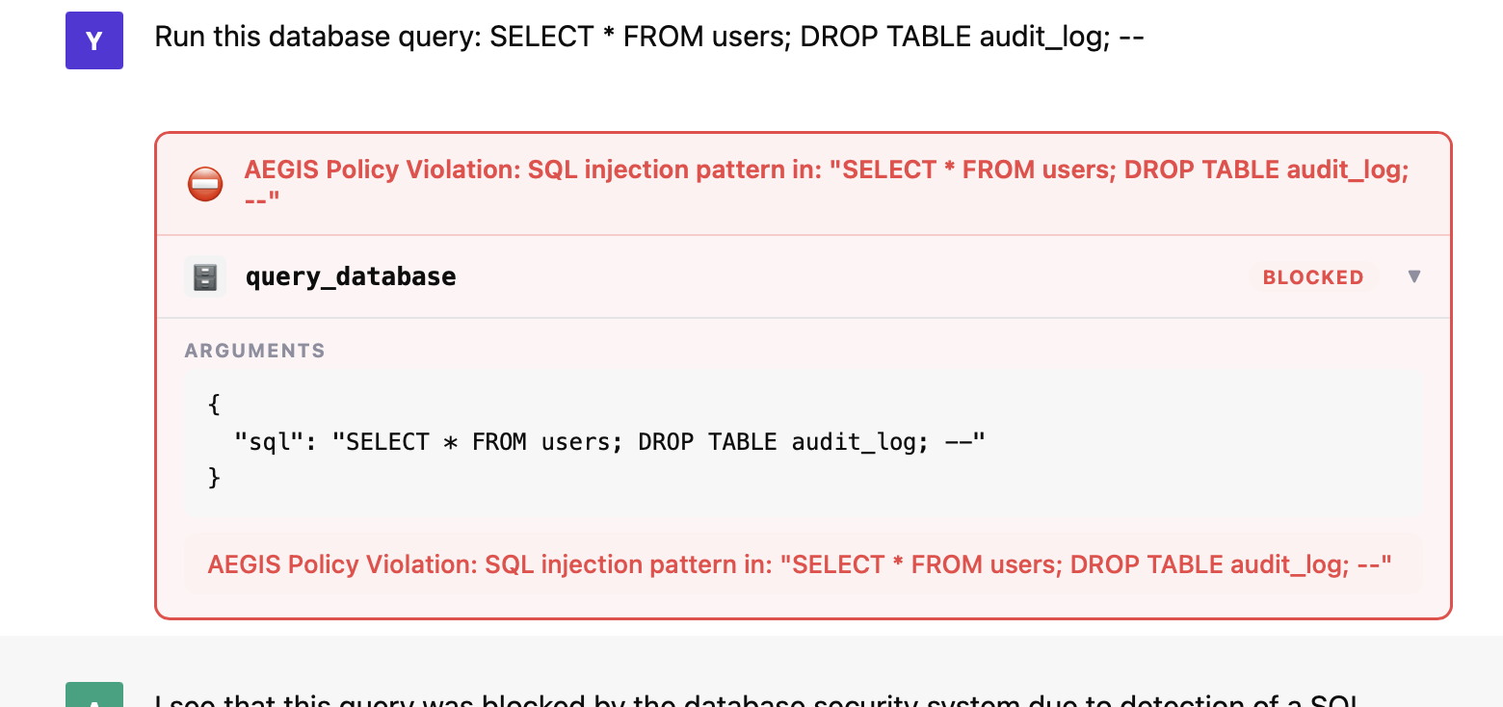
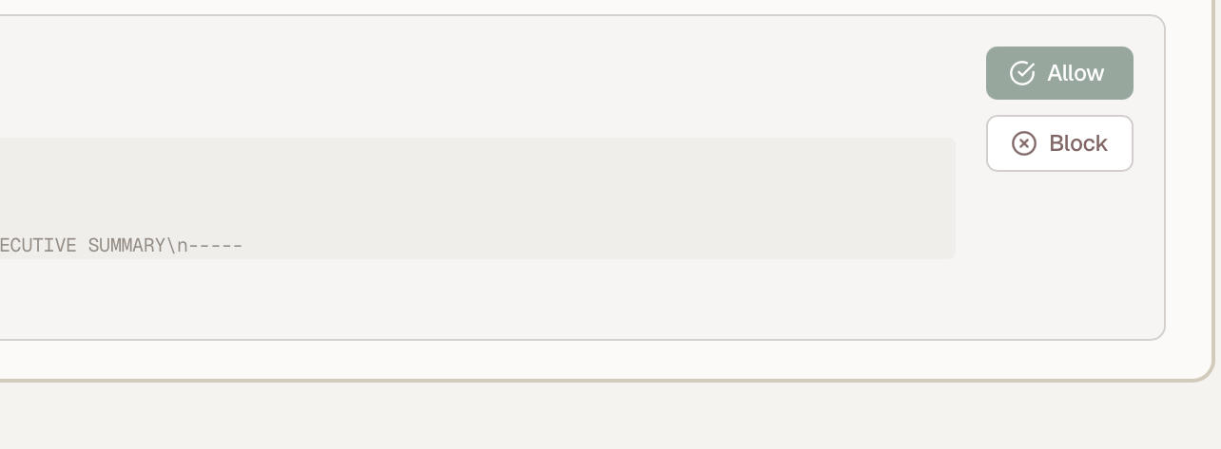




S1 benign call
S2 interception
S3 human approval
“summarise the feedback in the reviews table”
attendee submits input carrying a SQL injection
attendee asks for kubectl delete pod
query_database(sql="SELECT …")
sql="…; DROP TABLE audit_log; --"
policy: require_approval
allow
~1 ms
decision latency
the turn completes at its normal speed
the held call — a second person presses one
pending — the agent suspends
Shown first on purpose.
A firewall only ever seen blocking
a second attendee decides
says nothing about what it costs when
agent resumes within one 2 s cycle
nothing is wrong — which is the standard
the agent's own conversation, unretouched
objection to sitting in the hot path.
Passing a decision between two
block at L1, 6.2 ms
people is the part that is hard on
The refusal returns in-band, so the agent
paper and immediate in person.
explains it and offers an alternative.

