Slide 1

-Sai Alekya Prathi
-Justin Little
-Navyanjali Kondapaneni
-Sujal Patel
-Kalam Syed

Slide 2
What does the application do?
Our application is useful for roommates who struggle to manage all the things happening like paying bills, managing chores, and keeping up with groceries in their household. Our goal is to ease the process for everyone involved.

Slide 3
How does it work?
All the roommates will create an account and login to the app. After this, the admin can create a household or with a unique 5-digit house pin to set up their house. Other roommates can enter the unique 5 digit PIN to enter the house.
Once the user is logged in they will be directed to the home page with options to add any bills, chores, or groceries for that given day. They are also able to view the list of existing bills, chores, and groceries.
Users can also edit their own profile or view a list of all roommates in the house.

Slide 4
How did we implement the app?
React Native to implement the application because it can be used both in iOS and also android devices.
ATOM as our code editor.
Firebase as our NOSQL database & user authentication.
Windows users in our group tested on Android using an Android emulator and Mac users tested on iOS via X-Code iOS Simulator and Android via Android emulator.
Used the MobX solution for project scalability and organization. Used the React-Navigation package to navigate between pages within the app.
Link to our github: https://github.com/Justin5197/roommate-reminders-react-native

Slide 5
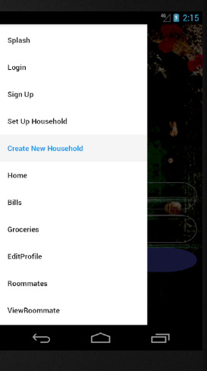
Navigation
We implemented a DrawerNavigator with react-navigation for easy navigation for users, and for us when developing the app. Ideally, the app would have more seamless clickthrough navigation, however this made it simple for us to be able to go from page to page when testing and using the app ourselves.

Slide 6
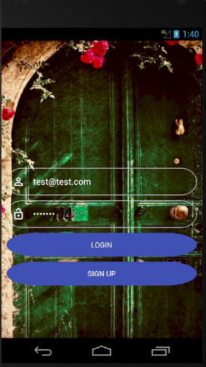
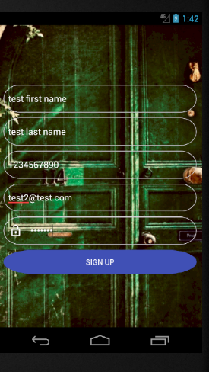
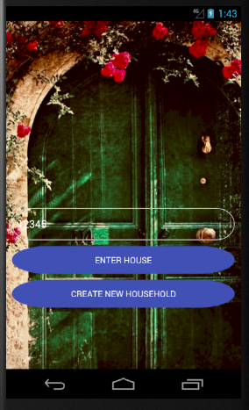
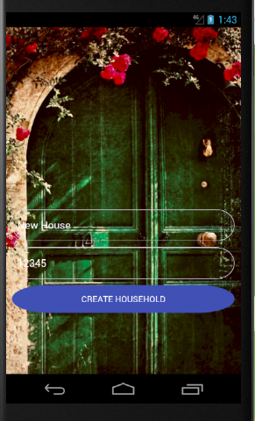
Login Page
Sign Up Page
Set Up Household Page
Create New Household Page

Slide 7
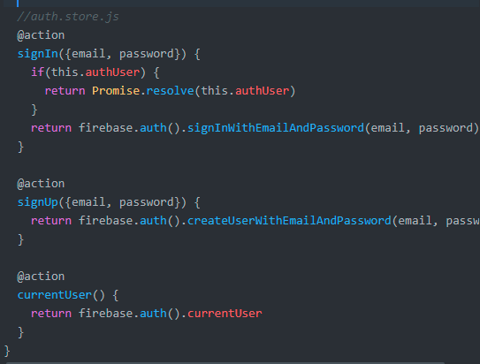
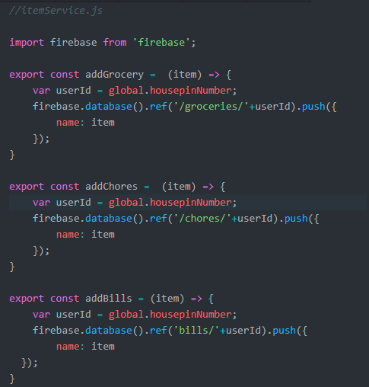
Functionality
We wanted to make sure that the app is time-efficient and only calls on functions when it needs them, so we tried to incorporate functional programming with these database calls in our authentication store and item service. We believe this greatly contributes to the time efficiency of the application.

Slide 8
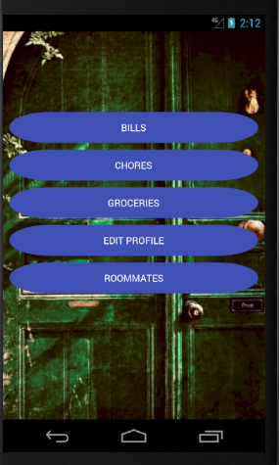
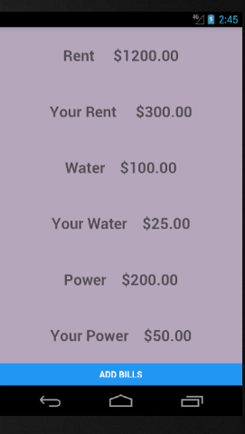
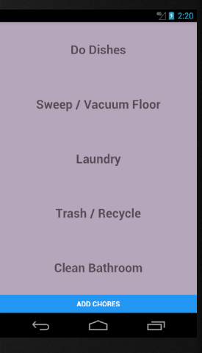
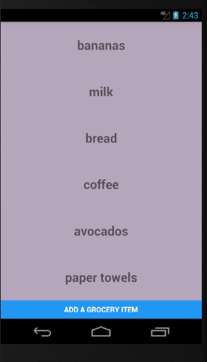
Home Page
Bills Page
Chores Page
Groceries Page

Slide 9
Work Distribution
Alekya
Project Manager – divided up tasks
Organized Firebase data
Created item service for populating bills, chores, grocery lists.
Justin
Created React native project, Firebase, source control
Set up navigation for app between screens
Set up login system for users and households
Kalam
Created all Add/View bills, chores, groceries pages
Created the EditProfile functionality
Navyanjali
Design, created presentation
Sujal
Worked on design/colors as well

Slide 10

ANY QUESTIONS????

Slide 11

THANK YOU!!

