Slide 1
Lab1
Platform introduction & MPI
Parallel Programming
2022/09/29

Slide 2
Outline
Platform introduction - Apollo
Login to Apollo
Linux command
MPI hello world
Compile and job submission
Time measurement
Lab1 - Pixels in circle

Slide 3
Platform instruction - Apollo
19 nodes for this course (apollo31 - 48, 50)
Intel X5670 2x6 cores @ 2.93GHz (Hyper threading disabled)
96GB RAM (each node)
5.5TB shared RAID5 disk
QDR Infiniband (40 Gb/s)

Slide 4
Software
OS: Arch Linux
Compilers: GCC 10.2.0, Clang 11.0.1
MPI: Intel MPI Library, Version 2019 Update 8
Scheduler: Slurm 20.02.5

Slide 5
Available resources
1 login node (apollo31) (200%CPU max)
18 compute nodes (1200% CPU max)
Use squeue to view SLURM usage
Cluster monitor: http://apollo.cs.nthu.edu.tw/monitor
48GB disk space per user
Use quota -s to view disk quota

Slide 6
Outline
Platform introduction - Apollo
Login to Apollo
Linux command
MPI hello world
Compile and job submission
Time measurement
Lab1 - Pixels in circle

Slide 7
Login to Apollo
Address: apollo.cs.nthu.edu.tw
Username: check email
Password: check email
MINING IS PROHIBITED. Also, do not attack the server.

Slide 8
SSH - Linux and Mac
Open terminal
ssh pp22sXX@apollo.cs.nthu.edu.tw
Enter password
You'll be ask to change your password on first login

Slide 9
SSH - Windows
Tools
MobaXterm
Putty
Cmd or Powershell (Windows 10)
Windows Terminal (Windows 11)
ssh pp22sXX@apollo.cs.nthu.edu.tw
Enter password
You'll be ask to change your password on first login

Slide 10
Outline
Platform instruction - Apollo
Login to Apollo
Linux command
MPI hello world
Compile and job submission
Time measurement
Lab1 - Pixels in circle

Slide 11
Some useful command
Login: ssh pp22sXX@apollo.cs.nthu.edu.tw
File transfer:
rsync -avhP filename pp22sXX@apollo.cs.nthu.edu.tw:filename
Editors: vim emacs nano
SLURM usage: squeue
Disk quota: quota -s
Change password: passwd
Download file: wget aria2c
Code syntax highlighting: pygmentize

Slide 12
Outline
Platform introduction - Apollo
Login to Apollo
Linux command
MPI hello world
Compile and job submission
Time measurement
Lab1 - Pixels in circle

Slide 13
MPI hello world
#include <mpi.h>
#include <stdio.h>
int main(int argc, char *argv[]) {
int rank, size;
MPI_Init(&argc, &argv);
MPI_Comm_rank(MPI_COMM_WORLD, &rank); // the total number of process
MPI_Comm_size(MPI_COMM_WORLD, &size); // the rank (id) of the calling process
printf("Hello, World. I am %d of %d\n", rank, size);
MPI_Finalize();
return 0;
}
You can download this code directly on apollo.
wget https://www.open-mpi.org/papers/workshop-2006/hello.c
Notes:
Note: Why does MPI_Init take argc and argc as argument?
https://stackoverflow.com/questions/2642996/why-does-mpi-init-accept-pointers-to-argc-and-argv

Slide 14
MPI_Send
int MPI_Send(const void *buf,
int count,
MPI_Datatype datatype,
int dest,
int tag,
MPI_Comm comm)

Slide 15
MPI_Recv
int MPI_Recv(void *buf,
int count,
MPI_Datatype datatype,
int source,
int tag,
MPI_Comm comm,
MPI_Status *status)

Slide 16
MPI_Reduce
int MPI_Reduce(const void *sendbuf,
void *recvbuf,
int count,
MPI_Datatype datatype,
MPI_Op op,
int root,
MPI_Comm comm)

Slide 17
Outline
Platform instruction - Apollo
Login to Apollo
Linux command
MPI hello world
Compile and job submission
Time measurement
Lab1 - Pixels in circle

Slide 18
Compilation
gcc - C compiler
g++ - C++ compiler
mpicc - MPI C compiler wrapper
mpicxx - MPI C++ compiler wrapper
mpicc and mpicxx actually invoke gcc and g++
You can use clang instead by adding the flags -cc=clang for c and -cxx=clang++ for c++
Compile the hello world program:
mpicc -O3 hello.c -o hello

Slide 19
Run the hello world program
$ srun -n4 ./hello
Output:
Hello, World. I am 3 of 4
Hello, World. I am 1 of 4
Hello, World. I am 2 of 4
Hello, World. I am 0 of 4

Slide 20
Job submission
SLURM workload scheduler: On a cluster system, there are multiple users and multiple nodes. SLURM schedules jobs submitted by users across different nodes, so that the same resource is not used by two jobs at the same time (to ensure accuracy of performance-critical experiments), and also increases the utilization of the cluster.
SLURM prefer the following jobs:
short jobs (you can set time limit)
less resource demanding jobs
jobs queued for a long time
users that haven't run a lot of jobs recently

Slide 21
Job submission using srun
srun [options] ./executable [args]
Options:
-N NODES: NODES is the number of nodes to run the job
-n PROCESSES: PROCESSES is the number of total process to launch
-c CPUS: CPUS is the number of cpus available to each process
-t TIME: The time limit in "minutes" or "minutes:seconds"
-J NAME: The name of the job. Will be displayed on squeue

Slide 22
Job submission using sbatch
Using sbatch command to submit jobs in the background
You can write a simple script to do that
$ sbatch script.sh
#!/bin/bash
#SBATCH -n 4
#SBATCH -N 2
srun ./hello

Slide 23
Job control
sinfo: view status of nodes
squeue: view submitted jobs in queue
scancel JOBID: cancel a job with its JOBID

Slide 24
Practices
Compile and run the hello world program.

Slide 25
Outline
Platform introduction - Apollo
Login to Apollo
Linux command
MPI hello world
Compile and job submission
Time measurement
Lab1 - Pixels in circle

Slide 26
Correct measurement method
srun -n4 time ./hello
sbatch + time srun
MPI_Wtime()
omp_get_wtime()
clock_gettime(CLOCK_MONOTONIC, ...)
std::chrono::steady_clock
#!/bin/bash
#SBATCH -n 4
#SBATCH -N 2
time srun ./hello

Slide 27
Example: MPI_Wtime()
double starttime, endtime;
starttime = MPI_Wtime();
.... stuff to be timed ...
endtime = MPI_Wtime();
printf("That took %f seconds\n",endtime-starttime);

Slide 28
Example: clock_gettime(CLOCK_MONOTONIC, ...)
int main() {
struct timespec start, end, temp;
double time_used;
clock_gettime(CLOCK_MONOTONIC, &start);
.... stuff to be timed ...
clock_gettime(CLOCK_MONOTONIC, &end);
if ((end.tv_nsec - start.tv_nsec) < 0) {
temp.tv_sec = end.tv_sec-start.tv_sec-1;
temp.tv_nsec = 1000000000 + end.tv_nsec - start.tv_nsec;
} else {
temp.tv_sec = end.tv_sec - start.tv_sec;
temp.tv_nsec = end.tv_nsec - start.tv_nsec;
}
time_used = temp.tv_sec + (double) temp.tv_nsec / 1000000000.0;
printf("%f second\n", time_used);
}

Slide 29
Wrong measurement method
time srun -n4 ./hello: this time include queuing time
time(NULL): the resolution is too low (1-second)
clock(): it will count 2x time when using two threads and will not include I/O time.
clock_gettime(CLOCK_REALTIME, ...): it will be affected by NTP adjustments and DST changes.
std::high_resolution_clock::now(): it may be affected by NTP adjustments and DST changes.

Slide 30
Outline
Platform introduction - Apollo
Login to Apollo
Linux command
MPI hello world
Compile and job submission
Time measurement
Lab1 - Pixels in circle

Slide 31

Pixels in circle
Suppose we want to draw a filled circle of radius r on a 2D monitor, how many pixels will be filled?
We fill a pixel when any part of the circle overlaps with the pixel. We also assume that the circle center is at the boundary of 4 pixels.
For example, 88 pixels are filled when r=5.

Slide 32
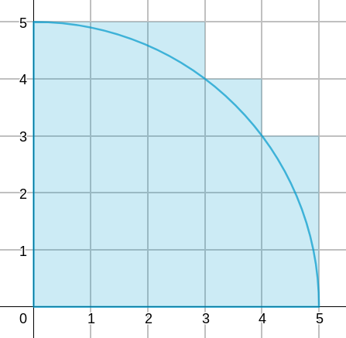
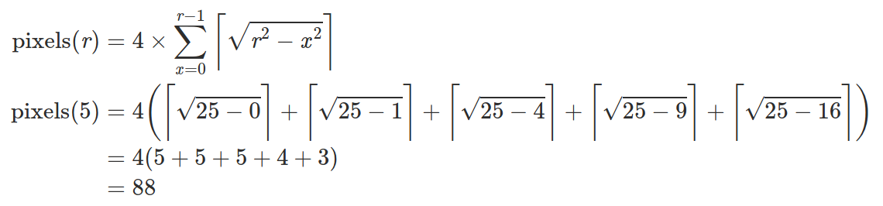
Pixels in circle
Equation:
Example: r = 5

Slide 33
Lab Spec
Parallelize the calculation using MPI.
Program input format: srun -Nnode -nproc ./lab1 r k
node: number of nodes
proc: number of MPI processes
r: the radius of circle, integer
k: integer
Program output: pixels % k (Since the output pixels may be very large, we output the remainder instead.)
Your program should be at least (n/2) times faster than the sequential version when running with n processes. For example, when running with 12 processes, your execution time should not exceed 1/6 of the sequential code.

Slide 34
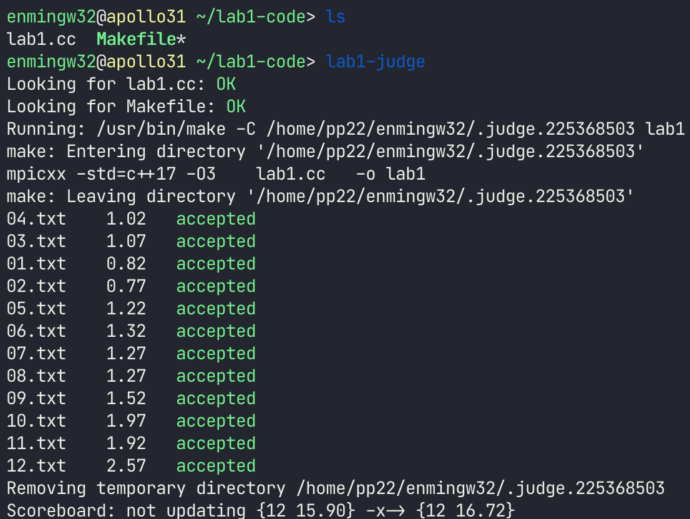
Lab Spec
The sequential code lab1.cc and a build file Makefile can be found at /home/pp22/share/lab1/sample, copy these files to your home directory.
All of the test cases can be found in /home/pp22/share/lab1/testcases
Within the same directory of lab1.cc and Makefile, run lab1-judge to check.
Scoreboard
Submit your code to eeclass:
lab1.cc
Makefile (optional, if you change any compile flags)
Due: 10/06 (Thu.) 23:59
Full score for AC of all 12 test cases; otherwise, zero.

