Slide 1
Advanced SUSE Linux Enterprise Server Administration (Course 3038)
Chapter 3
Configure Network Services

Slide 2
Objectives
Configure a DNS Server Using BIND
Configure an Apache Web Server
Configure a Samba Server as a File Server
Advanced SUSE Linux Enterprise Server Administration (Course 3038)

Slide 3
Configure a DNS Server Using BIND
Objectives
  Understand the Domain Name System
  Install and Configure the BIND Server Software
  Configure a Caching-Only DNS server
  Configure a Master Server for Your Domain
  Configure One or More Slave Servers
  Configure the Client Computers to Use the DNS Server
  Use Command-Line Tools to Query DNS Servers
  Find More Information About DNS
Advanced SUSE Linux Enterprise Server Administration (Course 3038)

Slide 4
Understand the Domain Name System
How name resolution worked in the early days of the Internet
  Computers communicate using IP addresses
  For humans it is simpler to use a computer name
    Requires some kind of conversion
  File at the Network Information Centre (NIC) of the Stanford Research Institute in California
    Provided exactly this conversion
  In 1984, Paul Mockapetris created the Domain Name System (DNS)
    Guarantees unique computer names worldwide
Advanced SUSE Linux Enterprise Server Administration (Course 3038)

Slide 5
Understand the Domain Name System (continued)
The Internet Domain Concept
  DNS consists of several domains that can be divided into subdomains
  Top level of this structure is the root domain
  There are over 13 computers worldwide
    That act as root name servers
  First layer beneath root domain contains the top level domains (TLDs)
  Fully qualified domain name (FQDN)
    Made from the actual computer name, the domain name, and the name of the TLD
Advanced SUSE Linux Enterprise Server Administration (Course 3038)

Slide 6
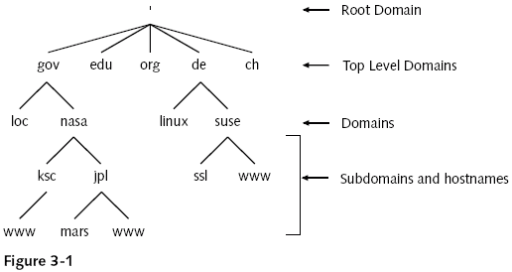
Understand the Domain Name System (continued)
Advanced SUSE Linux Enterprise Server Administration (Course 3038)

Slide 7
Understand the Domain Name System (continued)
How Name Servers work
  Domains are administered locally
    Instead of using a global authority
  For each domain there is one DNS server
    Known as the master server
  Slave servers
    Distribute the load and serve as backups
    Keep a copy of the information on the master server
    Update this information at regular intervals
      This update is called zone transfer
Advanced SUSE Linux Enterprise Server Administration (Course 3038)

Slide 8
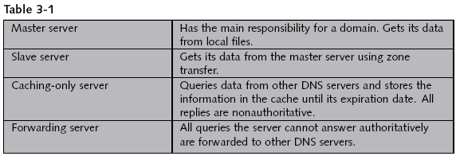
Understand the Domain Name System (continued)
Advanced SUSE Linux Enterprise Server Administration (Course 3038)

Slide 9
Understand the Domain Name System (continued)
How to query DNS
  Resolver
    Makes a request to a DNS server
    Interprets the answer
    Sends back this information to the program that called it up
  DNS server receives a request from a resolver
    DNS server provides the required information to the resolver
    DNS server queries the responsible authority
      The data is stored in the cache of the DNS server
Advanced SUSE Linux Enterprise Server Administration (Course 3038)

Slide 10
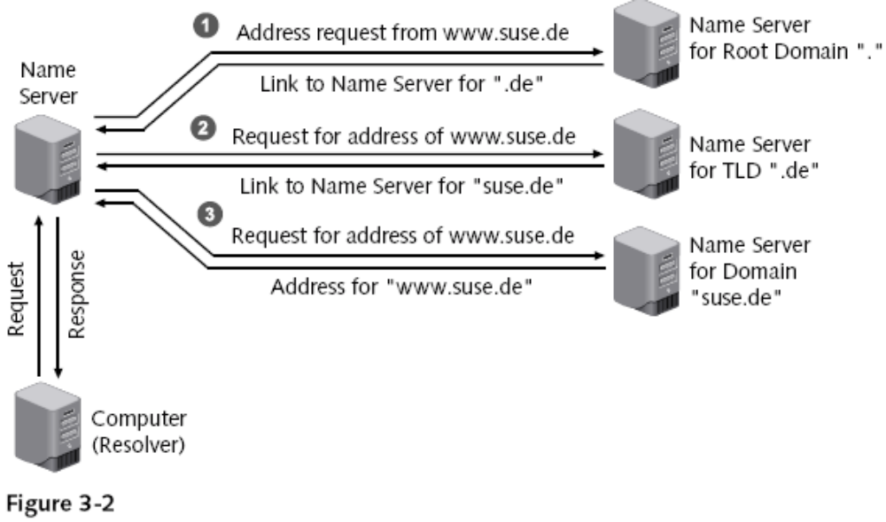
Understand the Domain Name System (continued)
Advanced SUSE Linux Enterprise Server Administration (Course 3038)

Slide 11
Install and Configure the BIND Server Software
Install the following packages:
  bind
  bind-utils
Start the server
  rcnamed start
Stop a running server
  rcnamed stop
Have DNS server start automatically
  insserv named
Advanced SUSE Linux Enterprise Server Administration (Course 3038)

Slide 12
Configure a Caching-Only DNS Server
Caching-only DNS server
  Does not manage its own databases
  Accepts queries and forwards them to other servers
DNS server configuration is defined in the file /etc/named.conf
  Directory /var/lib/named/ contains database files
  Entries needed for every DNS server
    Entry for root DNS servers
    Forward resolution for localhost
    Reverse resolution for network 127.0.0.0
  Define up to three DNS servers in the options block
Advanced SUSE Linux Enterprise Server Administration (Course 3038)

Slide 13
Configure a Master Server for Your Domain
Adapt the main server configuration file
  Adapt configuration for the caching-only DNS server
    Global options are followed by definitions for the database files
  At least two files are necessary for each domain
    Forward resolution
    Reverse resolution
  One file for each subnet must be created for reverse resolution
  Each definition begins with the instruction zone
  Zone name is always followed by an “in” for Internet
Advanced SUSE Linux Enterprise Server Administration (Course 3038)

Slide 14
Configure a Master Server for Your Domain (continued)
Create the zone files
  Structure of the files
    reference [TTL] class type value
  The file /var/lib/named/master/digitalairlines.com.zone
    BIND 9 requires you to specify a default TTL
    Structure
      TTL entry
      SOA entry
      Entry for the name server
      Allocation of IP addresses to host names
  The file /var/lib/named/master/10.0.0.zone
    Structure similar to previous file
Advanced SUSE Linux Enterprise Server Administration (Course 3038)

Slide 15
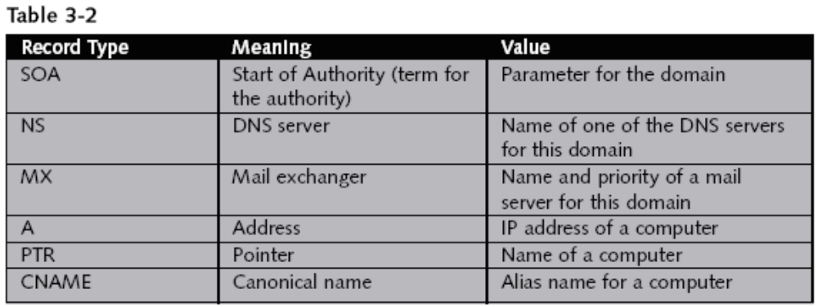
Configure a Master Server for Your Domain (continued)
Advanced SUSE Linux Enterprise Server Administration (Course 3038)

Slide 16
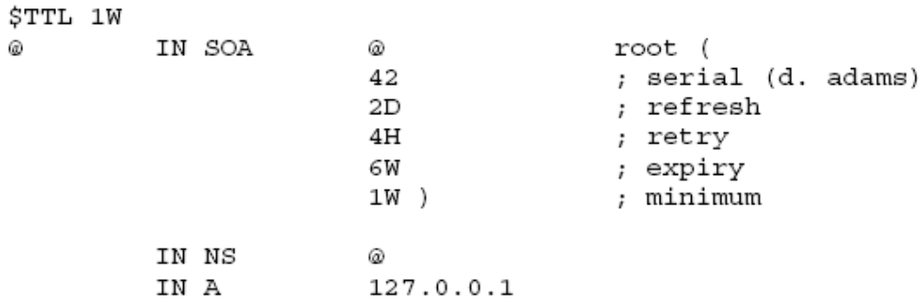
Configure a Master Server for Your Domain (continued)
Create the zone files
  The file /var/lib/named/master/localhost.zone
Advanced SUSE Linux Enterprise Server Administration (Course 3038)

Slide 17
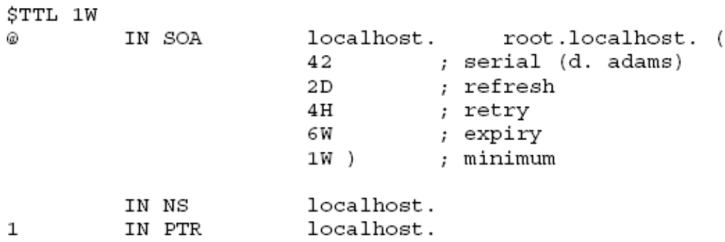
Configure a Master Server for Your Domain (continued)
Create the zone files
  The file /var/lib/named/master/127.0.0.zone
Advanced SUSE Linux Enterprise Server Administration (Course 3038)

Slide 18
Configure a Master Server for Your Domain (continued)
Create additional resource records
  Define mail servers for the domain
    MX (Mail Exchange) entry must be made in the database file for forward resolution
    Several mail servers can be given
  Assign aliases for computers
    Define CNAME (canonical name) entries in the database file for forward resolution
Advanced SUSE Linux Enterprise Server Administration (Course 3038)

Slide 19
Configure One or More Slave Servers
Configure at least one more DNS server
  Besides the master server
Slave server
  Receives copies of the zone files from the master server (called a zone transfer)
  Queries the master server at regular intervals
  Master server sends a message to all listed slave servers (called notify)
Advanced SUSE Linux Enterprise Server Administration (Course 3038)

Slide 20
Configure One or More Slave Servers (continued)
Configuration file /etc/named.conf
  Contains at least two entries that define it as the master server
  They are two zone definitions for loopback network
  There may also be a zone definition for the root DNS server
Instruct master server to inform slave servers about modifications
Slave servers must be entered as DNS servers in the database files
Advanced SUSE Linux Enterprise Server Administration (Course 3038)

Slide 21
Configure The Client Computers to Use the DNS Server
Use YaST to configure a client computer
  Enter the IP address of the DNS server
  Add some information about your domain
Information is written to the file /etc/resolv.conf
  Types of entries
    search
    nameserver
Another important file for the clients: /etc/nsswitch.conf
  Configures the name service switch
Advanced SUSE Linux Enterprise Server Administration (Course 3038)

Slide 22
Use Command-Line Tools to Query DNS Servers
host command
  Syntax: host computer nameserver
  host contacts the servers listed in /etc/resolv.conf
  By default, host returns the IP address or the host name
    For additional information use option –t
dig command
  Syntax: dig @nameserver computer type query_options
  Dig does not use the domain list from /etc/resolv.conf
Advanced SUSE Linux Enterprise Server Administration (Course 3038)

Slide 23
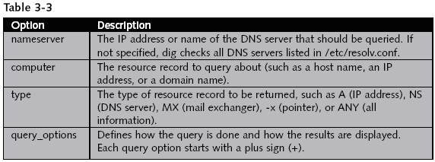
Use Command-Line Tools to Query DNS Servers (continued)
Advanced SUSE Linux Enterprise Server Administration (Course 3038)

Slide 24
Find More Information About DNS
BIND writes verbose messages to the file /var/log/messages
  Messages contain information on the filename and the line in which this error occurs
Advanced SUSE Linux Enterprise Server Administration (Course 3038)

Slide 25
Exercise 3-1 Configure a DNS Server
In this exercise, you will do the following:
  Part I: Install BIND
  Part II: Configure a DNS Master Server
  Part III: Configure the DNS Slave Server
Advanced SUSE Linux Enterprise Server Administration (Course 3038)

Slide 26
Configure an Apache Web Server
Objectives
  The Basic Functionality of a Web Server
  How to Install and Set Up a Basic Apache Web Server
  The Structure and the Basic Elements of the Apache Configuration Files
  The Basic Apache Configuration
  How to Configure Virtual Hosts
  How to Limit Access to the Web Server
  How to Configure OpenSSL for Connection Encryption
Advanced SUSE Linux Enterprise Server Administration (Course 3038)

Slide 27
The Basic Functionality of a Web Server
Delivers data that is requested by a Web browser
Data can have different formats such as
  HTML files, image files, Flash animations, or sound files
Web browsers and Web servers communicate using HTTP (Hyper Text Transfer Protocol)
Web server can perform tasks such as
  Limiting access to specific Web sites
  Logging access to a file
  Encrypting connection between a server and browser
Advanced SUSE Linux Enterprise Server Administration (Course 3038)

Slide 28
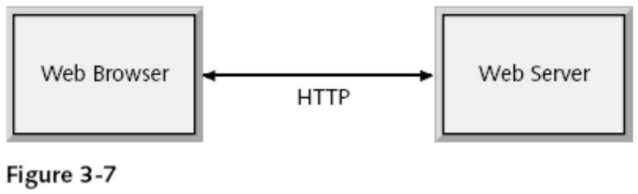
The Basic Functionality of a Web Server (continued)
Advanced SUSE Linux Enterprise Server Administration (Course 3038)

Slide 29
How to Install and Set Up a Basic Apache Web Server
Install the required software packages
  Packages
    apache2
    apache2-prefork
    apache2-example-pages
  SLES 9 ships with Apache versions series 1 and 2
Start and test the Web server
  Start the Web server
    rcapache2 start
  Stop the Web server
    rcapache2 stop
Advanced SUSE Linux Enterprise Server Administration (Course 3038)

Slide 30
How to Install and Set Up a Basic Apache Web Server (continued)
Start and test the Web server (continued)
  Automatically start the Web server
    insserv apache2
  Test the Web server
    Open a Web browser and connect to http://localhost
  Remotely connect to your Web server
    Open a Web browser and enter http://your_system_IP_address
Advanced SUSE Linux Enterprise Server Administration (Course 3038)

Slide 31
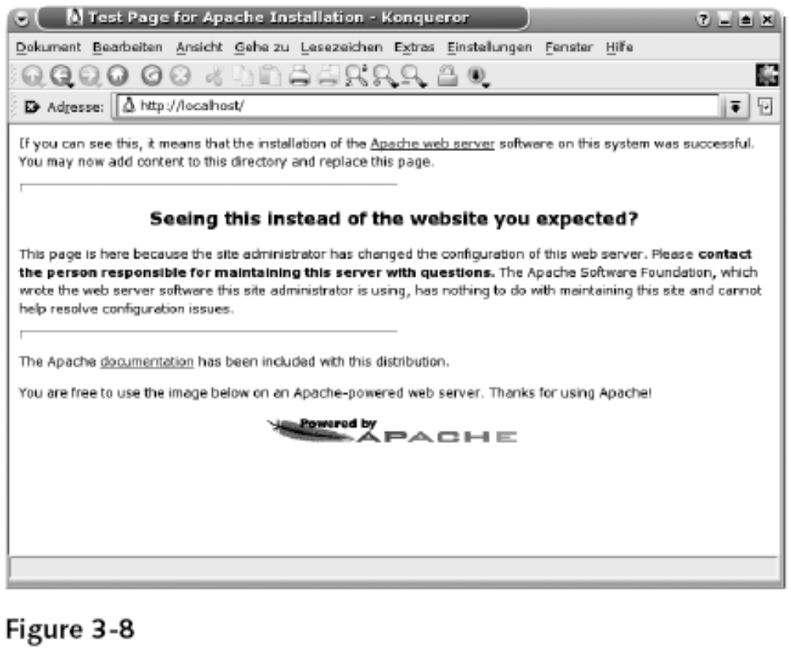
How to Install and Set Up a Basic Apache Web Server (continued)
Advanced SUSE Linux Enterprise Server Administration (Course 3038)

Slide 32
How to Install and Set Up a Basic Apache Web Server (continued)
Locate the DocumentRoot of the Web server
  Default directory of the data provided by Apache is /srv/www/htdocs
    Called the DocumentRoot
  Replace data in DocumentRoot directory
    To display your own Web server content
  Access subdirectories in DocumentRoot
    http://your_server/name_of_subdirectory
  If no specific file is requested in the address
    Apache looks for a file with the name index.html
Advanced SUSE Linux Enterprise Server Administration (Course 3038)

Slide 33
The Structure and the Basic Elements of the Apache Configuration Files
Locate the Apache Configuration files
  Directory /etc/apache2
  Files
    httpd.conf
    default-server.conf
    vhost.d
    uid.conf
    listen.conf
    server-tuning.conf
    error.conf
    ssl-global.conf
Advanced SUSE Linux Enterprise Server Administration (Course 3038)

Slide 34
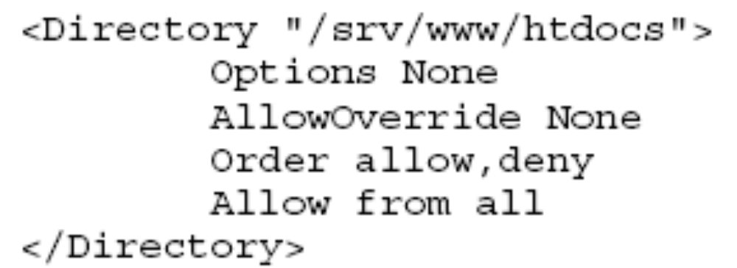
The Structure and the Basic Elements of the Apache Configuration Files (continued)
Understand the basic rules of the configuration files
  Directives
    Options of the Apache configuration files
    Directives are case sensitive
    Can be grouped so that they do not apply to the global server configuration
  Example
Advanced SUSE Linux Enterprise Server Administration (Course 3038)

Slide 35
The Structure and the Basic Elements of the Apache Configuration Files (continued)
Understand the basic rules of the configuration files (continued)
  Reload the Web server
    rcapache2 reload
  Stop and restart the Web server
    rcapache2 restart
  Verify the syntax of the configuration files
    apache2ctl configtest
Advanced SUSE Linux Enterprise Server Administration (Course 3038)

Slide 36
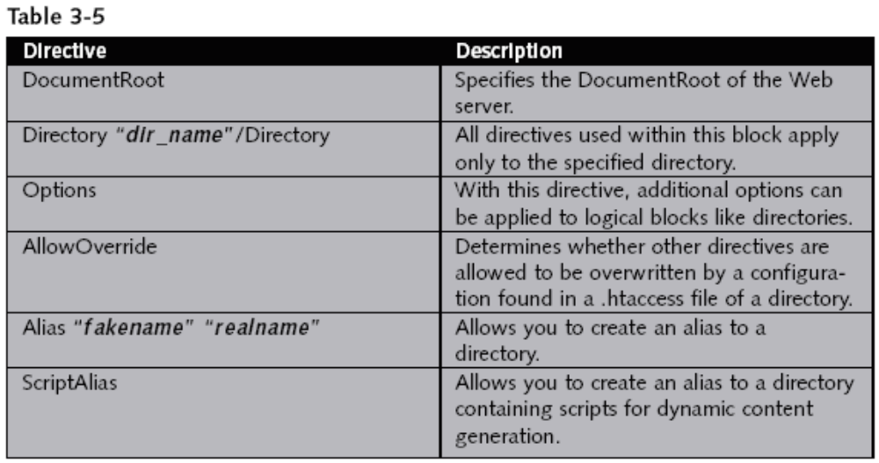
The Basic Apache Configuration
Main Apache Web server configuration file
  /etc/apache2/default-server.conf
Advanced SUSE Linux Enterprise Server Administration (Course 3038)

Slide 37
How to Configure Virtual Hosts
The concept of virtual hosts
  Apache server can be reached using:
    http://localhost
    http://web_server_IP_address
    http://web_server_hostname
  Apache serves the same files located in the DocumentRoot directory
  Apache lets you set up multiple virtual Web servers
    On one physical system
    Needs to have an entry in the DNS for every virtual host
Advanced SUSE Linux Enterprise Server Administration (Course 3038)

Slide 38
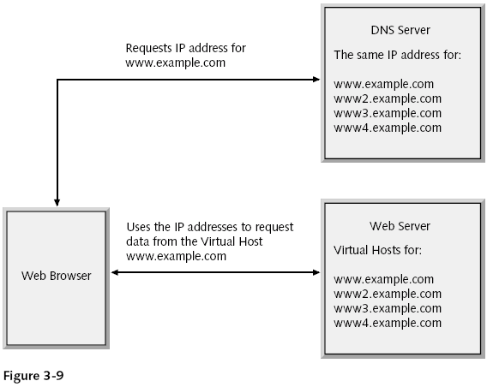
How to Configure Virtual Hosts (continued)
Advanced SUSE Linux Enterprise Server Administration (Course 3038)

Slide 39
How to Configure Virtual Hosts (continued)
How to configure a virtual host
  Create a configuration file in the directory /etc/apache2/vhosts.d/
    Name of the configuration file must end with .conf
  You can find a template file vhost.template
    In the directory /etc/apache2/vhosts.d/
Advanced SUSE Linux Enterprise Server Administration (Course 3038)

Slide 40
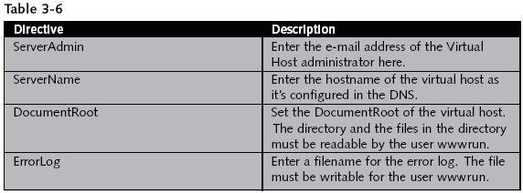
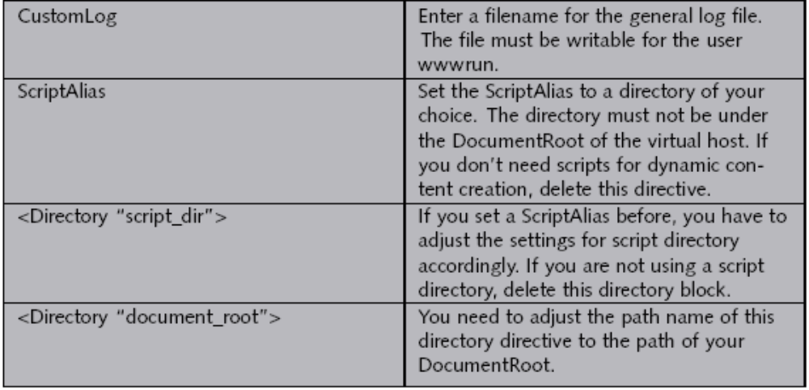
How to Configure Virtual Hosts (continued)
Advanced SUSE Linux Enterprise Server Administration (Course 3038)

Slide 41
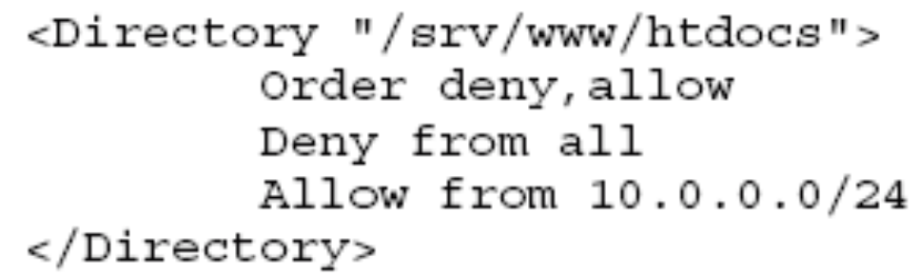
How to Limit Access to the Web Server
Limit access on an IP address basis
  Apache directives
    See Table 3-7
  Example
Advanced SUSE Linux Enterprise Server Administration (Course 3038)

Slide 42
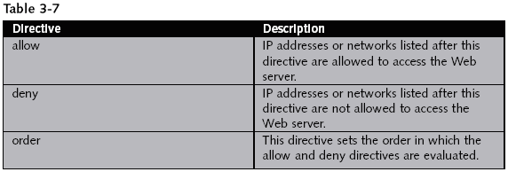
How to Limit Access to the Web Server (continued)
Advanced SUSE Linux Enterprise Server Administration (Course 3038)

Slide 43
How to Limit Access to the Web Server (continued)
Limit access with user authentication
  Users are required to log in before they can access the data
  Create password file and an account for the user tux
    htpasswd2 -c /etc/apache2/htpasswd tux
  Add more users
    htpasswd2 /etc/apache2/htpasswd username
  Delete a user from the password file
    htpasswd2 -D /etc/apache2/htpasswd username
Advanced SUSE Linux Enterprise Server Administration (Course 3038)

Slide 44
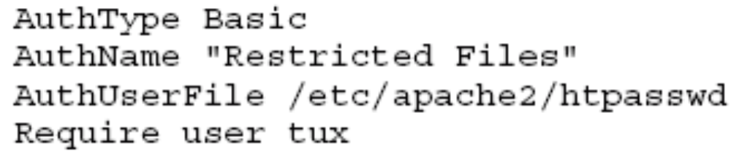
How to Limit Access to the Web Server (continued)
Limit access with user authentication (continued)
  Add following lines to the directory block
    Of the directory that should be restricted
Advanced SUSE Linux Enterprise Server Administration (Course 3038)

Slide 45
How to Configure OpenSSL for Connection Encryption
The basics of SSL encryption
  Often data is transmitted across a network in encrypted form by using RSA keys
  Encryption is based on a private key and a public key
  Public and private keys can also be used to sign data
  Problem with the encryption procedure
    Determine who the owner of a public key is
  Certificate Authority (CA)
    Signs the public keys with its own private keys
  Certificate
    Public key signed by a CA
Advanced SUSE Linux Enterprise Server Administration (Course 3038)

Slide 46
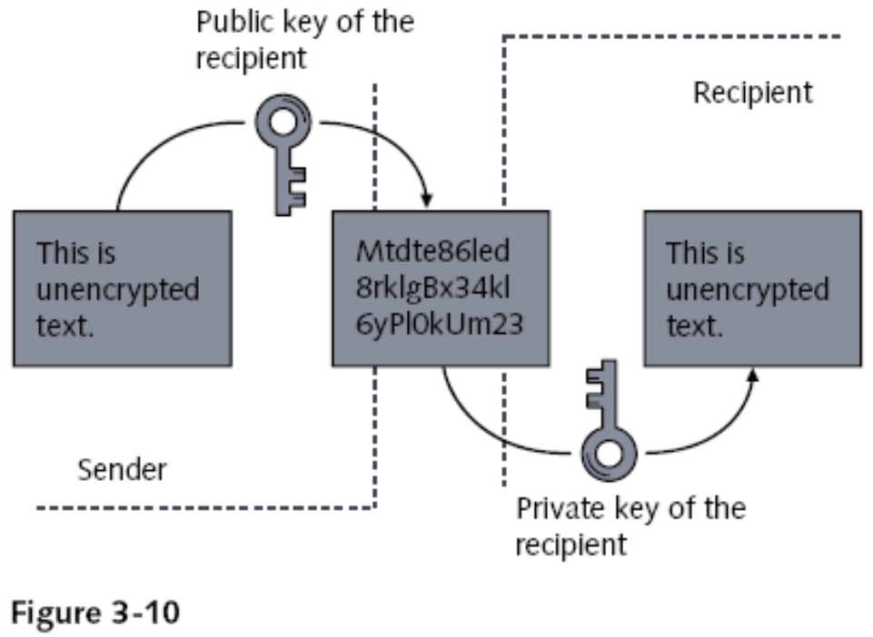
How to Configure OpenSSL for Connection Encryption (continued)
Advanced SUSE Linux Enterprise Server Administration (Course 3038)

Slide 47
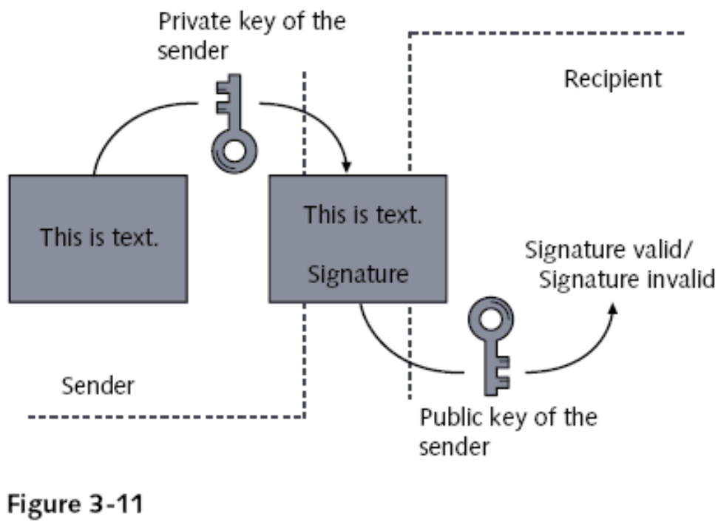
How to Configure OpenSSL for Connection Encryption (continued)
Advanced SUSE Linux Enterprise Server Administration (Course 3038)

Slide 48
How to Configure OpenSSL for Connection Encryption (continued)
The basics of SSL encryption (continued)
  Process of using a CA with SSL encryption:
    Browser recognizes Web address starting with https://
    Web browser asks the server for its public RSA key
    Web server sends the public key to the Web browser
    Web browser verifies the key of the server with the public key of the CA that signed the key
    If the key is valid, Web browser and Web server establish a secure connection
Advanced SUSE Linux Enterprise Server Administration (Course 3038)

Slide 49
How to Configure OpenSSL for Connection Encryption (continued)
How to create a test certificate
  Create an RSA key pair
    You need a file with as many random numbers as possible
    Generate the key pair by entering
      opensslgenrsa -des3 -out server.key -rand /tmp/random 1024
    You are prompted to enter a password
  Sign the public key to create a certificate
    Enter the following command
      openssl req -new -x509 -key server.key -out server.crt
Advanced SUSE Linux Enterprise Server Administration (Course 3038)

Slide 50
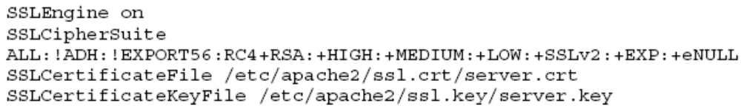
How to Configure OpenSSL for Connection Encryption (continued)
How to configure Apache to use SSL
  Change two settings in the file /etc/sysconfig/apache2
    APACHE_START_TIMEOUT=“10”
    APACHE_SERVER_FLAGS=“SSL”
  Configure the main server to use SSL encryption
    Add directives to /etc/apache2/default-server.conf
  Configure a virtual host to use SSL encryption
    Define virtual host with a directive such as:
      <VirtualHost your_hostname:443>
Advanced SUSE Linux Enterprise Server Administration (Course 3038)

Slide 51
How to Configure OpenSSL for Connection Encryption (continued)
The limitations of the SSL configuration
  SSL setup as described in this section is a very basic configuration
  For more information go to http://httpd.apache.org/docs-2.0/
Advanced SUSE Linux Enterprise Server Administration (Course 3038)

Slide 52
Exercise 3-3 Configure an Apache Web Server
In this exercise, you will do the following:
  Part I: Install Apache
  Part II: Test the Installation
  Part III: Configure a Virtual Host for the Accounting Department
  Part IV: Configure User Authentication
  Part V: Configure SSL
Advanced SUSE Linux Enterprise Server Administration (Course 3038)

Slide 53
Configure a Samba Server as a File Server
Objectives
  The Purpose and the Possibilities of Samba
  How to Install and Set Up a Basic Samba Server
  The Structure and Elements of the Samba Configuration File
  How to Use the Samba Tools to Access SMB Shares from a Linux Computer
  How to Configure a File Server With User Authentication
  Additional Possibilities with Samba
Advanced SUSE Linux Enterprise Server Administration (Course 3038)

Slide 54
The Purpose and the Possibilities of Samba
Server Message Block (SMB) protocol
  Network protocol that provides file and print services in a Windows network
Samba enables Linux to use SMB
  Use Samba server to provide file and print services for Windows clients
  Use Samba tools to access SMB file and print services on a Linux system
  Use Samba as a domain controller for Windows clients
SMB services are provided by the NetBIOS protocol
Advanced SUSE Linux Enterprise Server Administration (Course 3038)

Slide 55
The Purpose and the Possibilities of Samba (continued)
The server side of Samba consists of two parts:
  nmbd
  smbd
Samba tools to integrate Linux as client in a Windows environment
  nmblookup
  smbclient
Advanced SUSE Linux Enterprise Server Administration (Course 3038)

Slide 56
How to Install and Set Up a Basic Samba Server
Install following packages using YaST
  samba
  samba-client
  samba-doc
Start Samba daemons
  rcnmb start
  rcsmb start
Automatically start Samba daemons
  insserv nmb
  insserv smb
Advanced SUSE Linux Enterprise Server Administration (Course 3038)

Slide 57
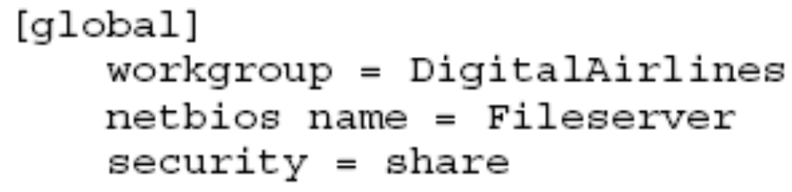
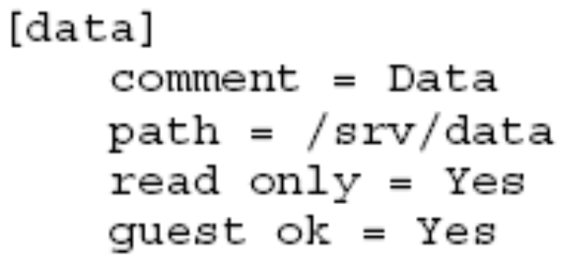
The Structure and Elements of the Samba Configuration Files
Configuration file /etc/samba/smb.conf
Create a Section for the General Server Configuration
Create a Section for the Files to be Shared
Test syntax of configuration file with testparm
Advanced SUSE Linux Enterprise Server Administration (Course 3038)

Slide 58
How to Use the Samba Tools to Access SMB Shares from a Linux Computer
Use nmblookup for name resolution in a NetBIOS network
  nmblookup Fileserver
Use smbclient to access SMB shares
  Browse the shares provided by a server
    smbclient –L //Fileserver
    smbclient –L //Fileserver –U tux (if authentication is required)
  Access files provided by an SMB server
    smbclient //Fileserver/data
    Smbclient can be used as a command-line FTP client
Advanced SUSE Linux Enterprise Server Administration (Course 3038)

Slide 59
How to Use the Samba Tools to Access SMB Shares from a Linux Computer (continued)
Use smbclient to access SMB shares (continued)
  Print on printers provided by an SMB server
    smbclient //Printserver/laser –c ‘print letter.ps’
Mount SMB shares into the Linux File system
  mount -t smbfs //Fileserver/data /mnt
  mount -t smbfs -o username=tux,password=novell //Fileserver/data /mnt
Advanced SUSE Linux Enterprise Server Administration (Course 3038)

Slide 60
How to Configure a File Server with User Authentication
Prepare the server for user authentication
  Change the security option in the smb.conf file
    security = user
  User Level Security
    Windows-compatible encrypted password file is stored in the file /etc/samba/smbpasswd
  Sets an SMB password for the user tux
    smbpasswd -a tux
Advanced SUSE Linux Enterprise Server Administration (Course 3038)

Slide 61
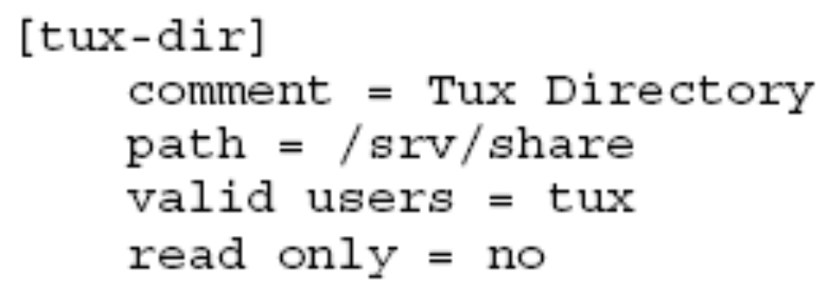
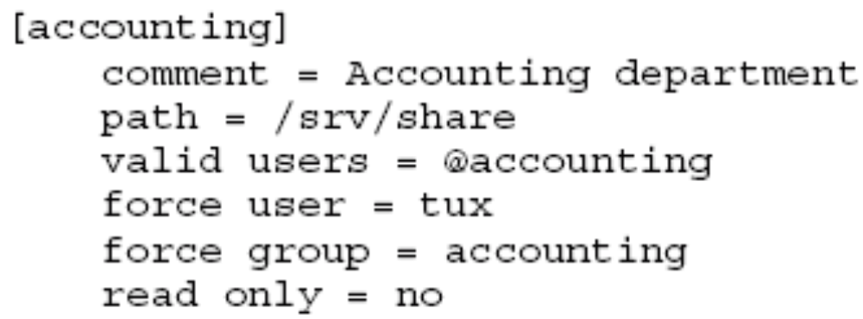
How to Configure a File Server with User Authentication (continued)
Configure a share that is accessible to only one user
Configure shared access for a group of users
Advanced SUSE Linux Enterprise Server Administration (Course 3038)

Slide 62
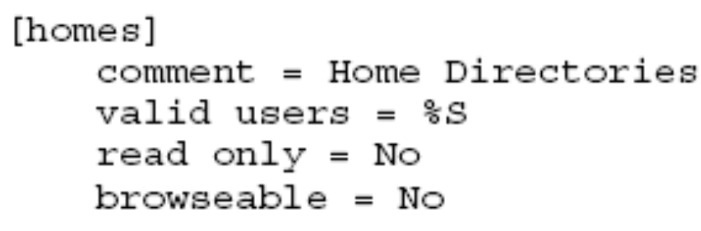
How to Configure a File Server with User Authentication (continued)
Configure the export of home directories
Advanced SUSE Linux Enterprise Server Administration (Course 3038)

Slide 63
Additional Possibilities with Samba
You could:
  Use Samba as member server of a Windows domain
  Use Samba as domain controller
Find more information about Samba at
  The samba-doc package in the directory
    /usr/share/doc/packages/samba/
  The man page of smb.conf
  The Samba project site at www.samba.org/
Advanced SUSE Linux Enterprise Server Administration (Course 3038)

Slide 64
Exercise 3-4 Configure a File Server with Samba
In this exercise, you will do the following:
  Part I: Install Samba
  Part II: Configure a Share for the User Geeko
  Part III: Access the Share of the User Geeko With smbclient
  Part IV: Mount Geeko’s Share
Advanced SUSE Linux Enterprise Server Administration (Course 3038)

Slide 65
Summary
DNS comprises a hierarchical namespace
FQDNs and their associated IP addresses
  Are stored on authoritative DNS servers in a zone file
Query a DNS server
  Forward lookup
  Reverse lookup
DNS server uses BIND server software
The host and dig commands may be used to test DNS name resolution
Advanced SUSE Linux Enterprise Server Administration (Course 3038)

Slide 66
Summary (continued)
LDAP directory service
  Allows network users to query information for a wide range of uses
LDAP resources are organized into a hierarchical tree structure
Edit /etc/openldap/slapd.conf or use YaST
  To configure LDAP server
GQ LDAP browser allows you to query an LDAP database
Apache Web server is the most common Web server on Linux systems
Advanced SUSE Linux Enterprise Server Administration (Course 3038)

Slide 67
Summary (continued)
Apache may be used to host several Web sites on a single computer (virtual hosts)
OpenSSL may be used with Apache
  To provide encryption for Web content
Become a Samba server
  Start the Samba and NetBIOS daemons
testparm command
  Detects syntax errors in Samba configuration file
Connect to a Windows or Samba file server
  Using the mount and smbclient commands
Advanced SUSE Linux Enterprise Server Administration (Course 3038)

