Slide 1
COMP 2144
Web Server Administration
Ben Blanc

Slide 2
Week 1
Introduction
LAMP

Slide 3
Lab Exercise
Navigate to Course Homepage
Click Lab Manuals Tab
Click the Download link under
“Week 1 Lab Manual – Fundamentals”

Slide 4
Begin With
Go to C drive and go to XAMMP .
Ensure the following path is present: comp2144/practice/wk1
  If not, create the neccesary folders
Create a file in ‘wk1’ folder and call it “f1.html”
Add necessary html 5 tags to f1.html

Slide 5
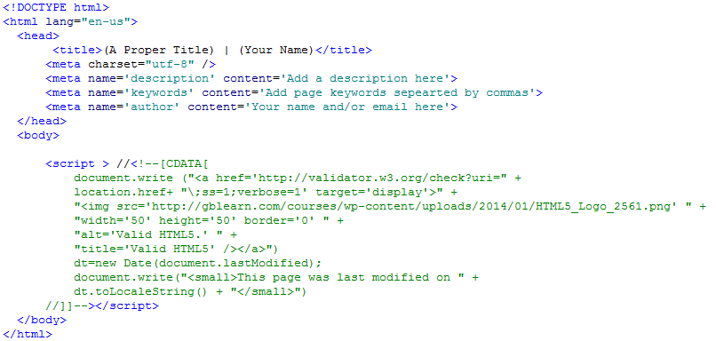

Slide 6
Task 1: f1.html
Find 5 Linux distros, each must include:
Logo of the distribution
Name of the distribution
Download link
A link to installation tutorial on the web (Optional)
Save in XAMPP

Slide 7
Task 2: f2.html
Find 5 Database Engines
EXCLUDING MySQL, each must have:
Logo of the Database Engines
Name of the Database Engines
Download link
A link to installation tutorial on the web (Optional)
Save in XAMPP

Slide 8
Task 3: f3.html
Find 5 server scripting languages, each must have:
Logo of the language if it exists
Name of language
Download link
Sample if statement code
Save in XAMPP

